Slide 1
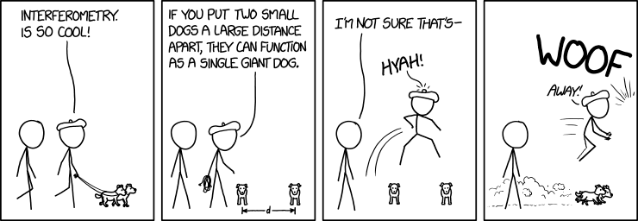
P8: Exploring the Fourier Transform for Compressed Sensing Reconstructions in the MeerKAT era

Slide 2
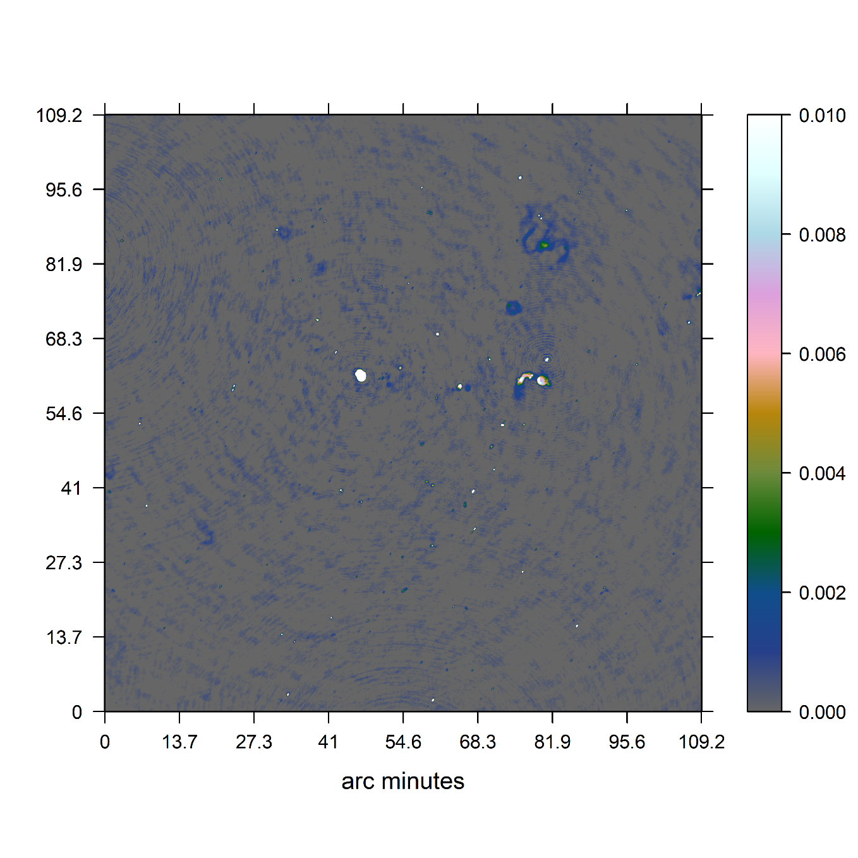
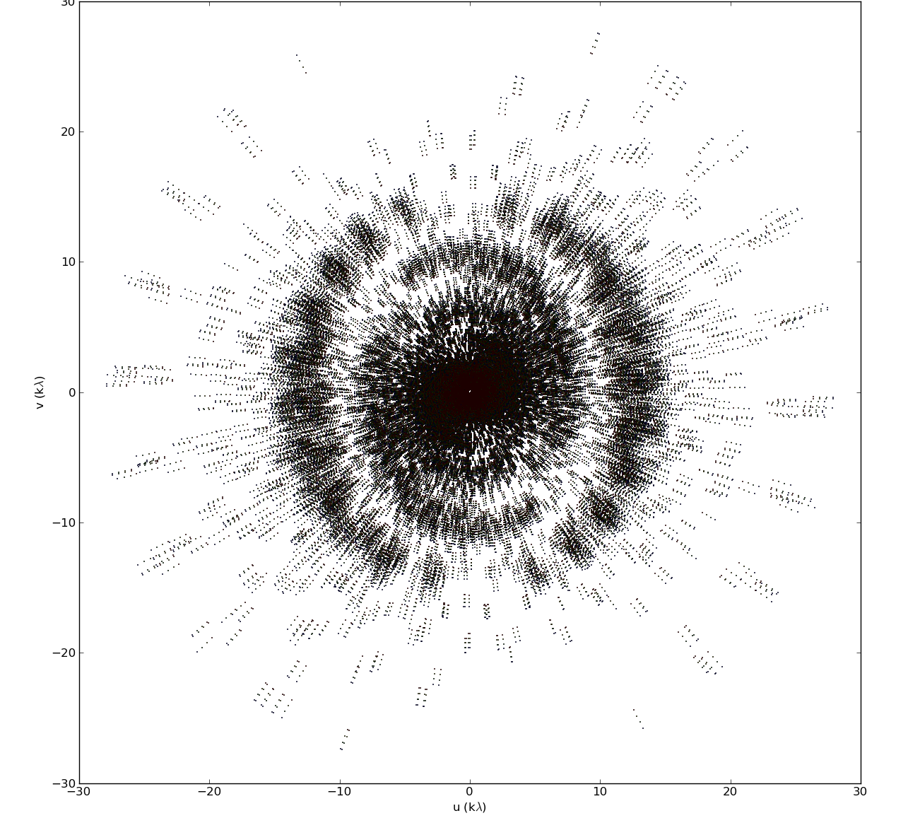
MeerKAT Radio Interferometer

Slide 3
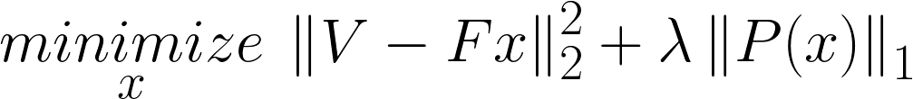
Reconstruction Problem
Image
Measurements

Slide 4
Reconstruction Problem
Image
Measurements

Slide 5
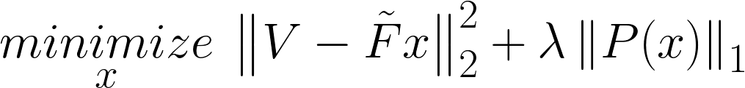
Reconstruction Problem
Non-uniform FFT
approximation

Slide 6




Non-uniform FFT Cycle

Slide 7

CLEAN and the non-uniform FFT

Slide 8
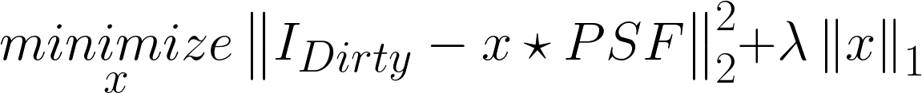
CLEAN and the non-uniform FFT

Slide 9
CLEAN and the non-uniform FFT

Slide 10

CLEAN and the non-uniform FFT

Slide 11
Redundancy and Noise

Slide 12
Replacing the non-uniform FFT
Direct Fourier Transform
Projection on a uniform grid
Spherical Wave Harmonics
…

Slide 13
My Solution
FT: Direct Fourier Transform
Optimization Algorithm: Coordinate Descent
Regularization: Starlet Transform

Slide 14
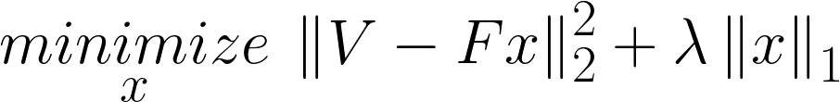
Coordinate Descent

Slide 15
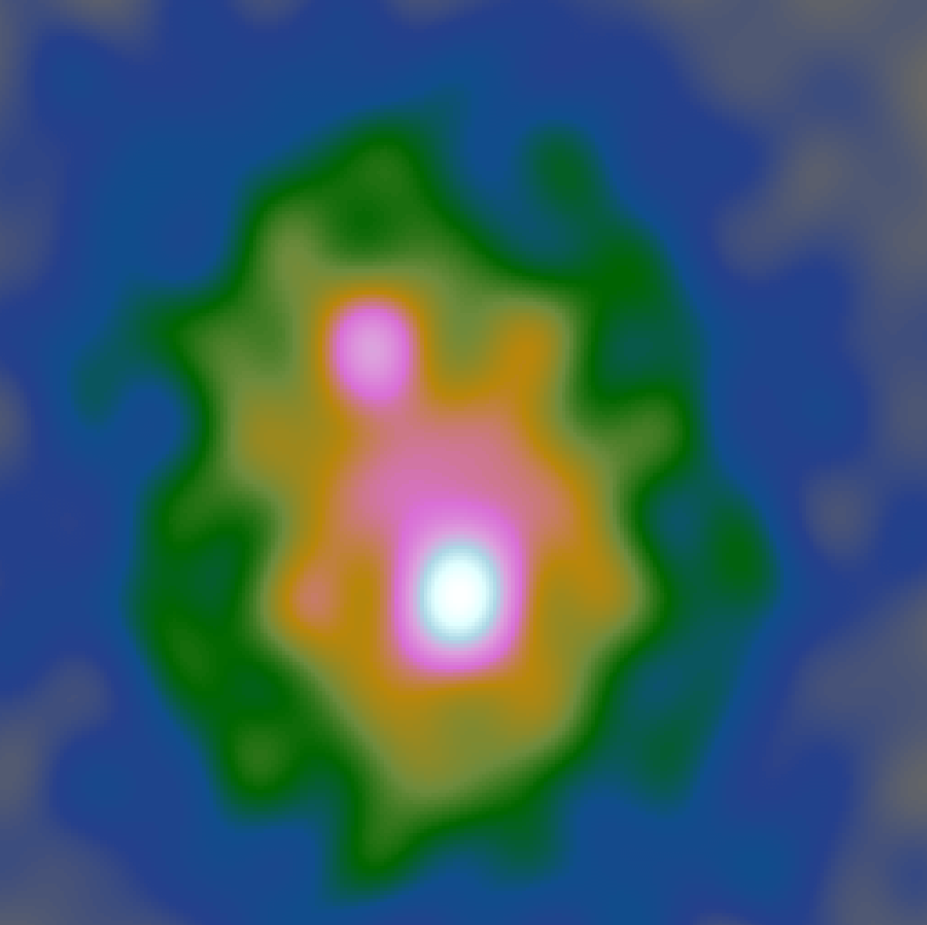
Coordinate Descent
Dirty Image

Slide 16
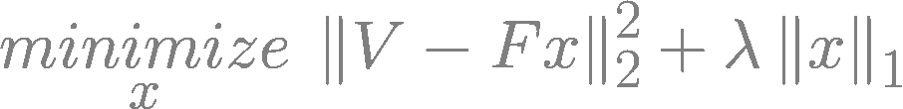
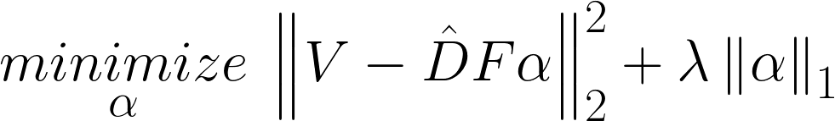


Coordinate Descent + Starlets

Slide 17
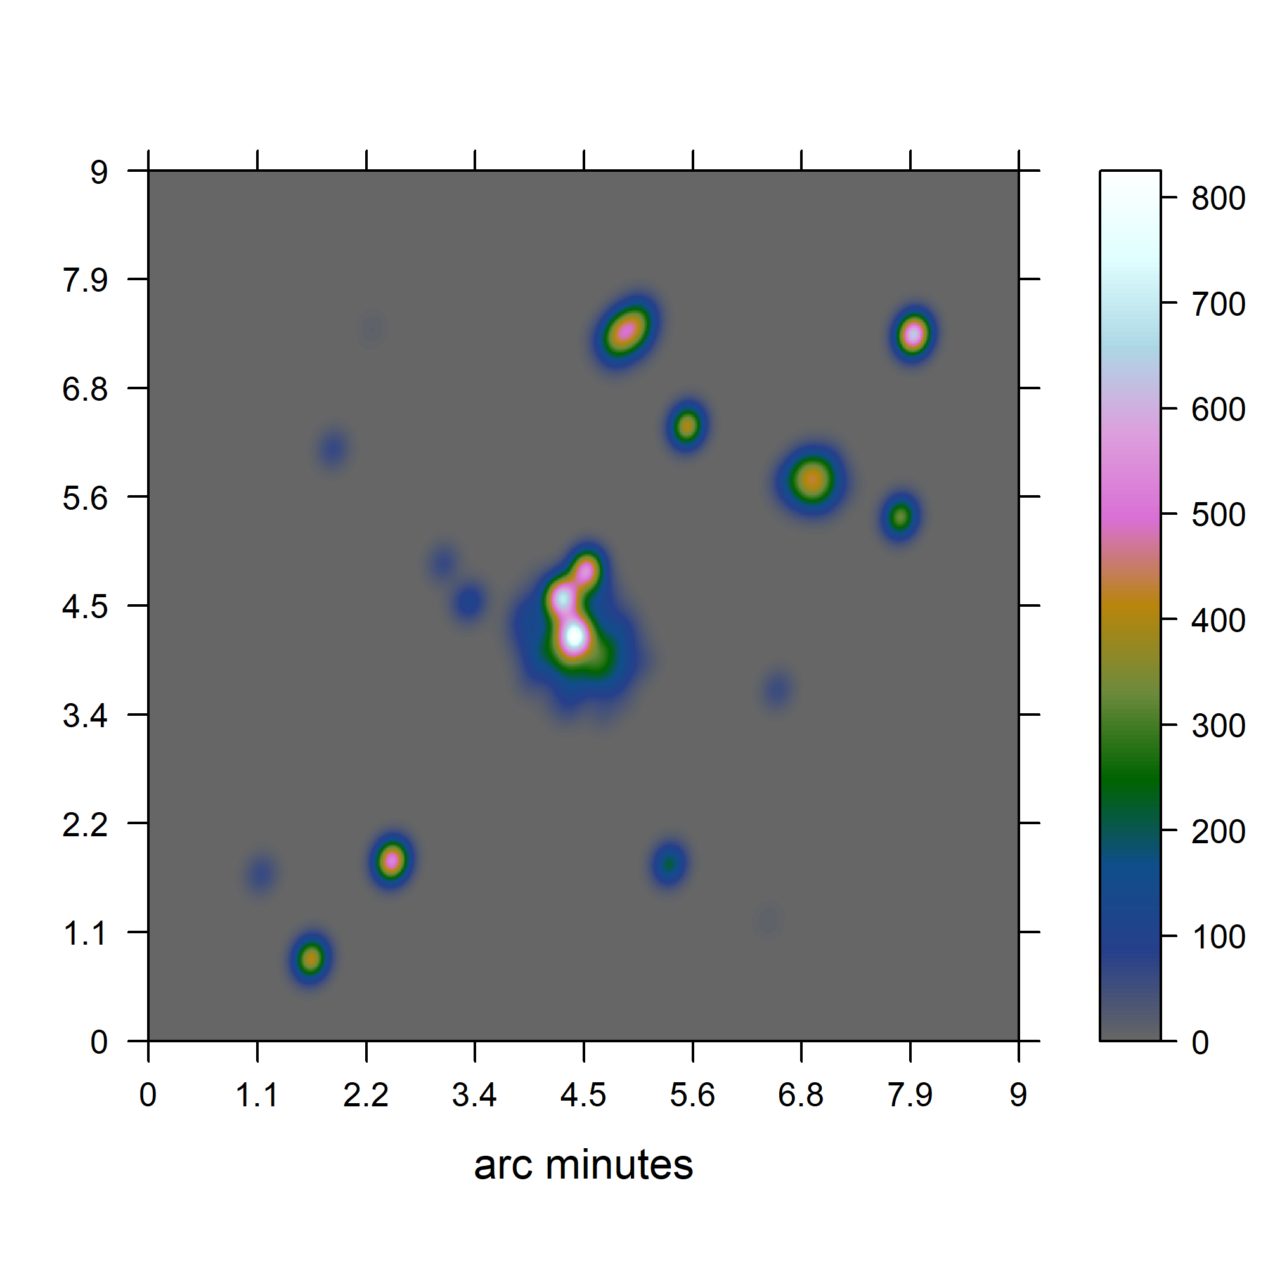
Test on simulated data

Slide 18
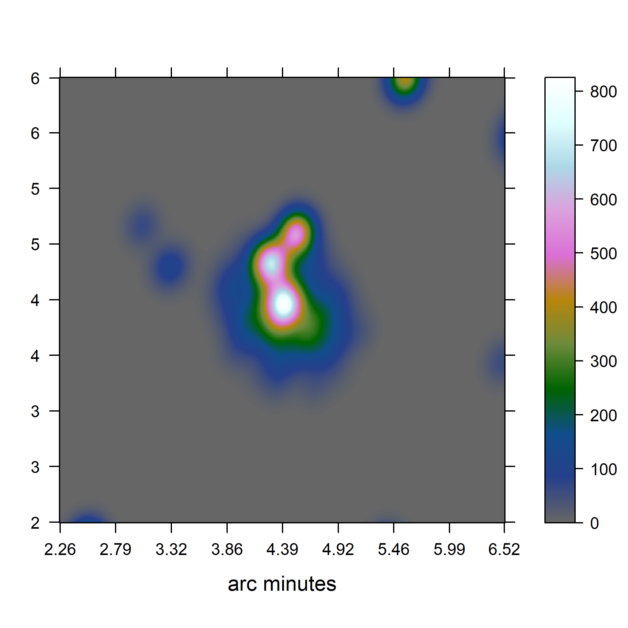
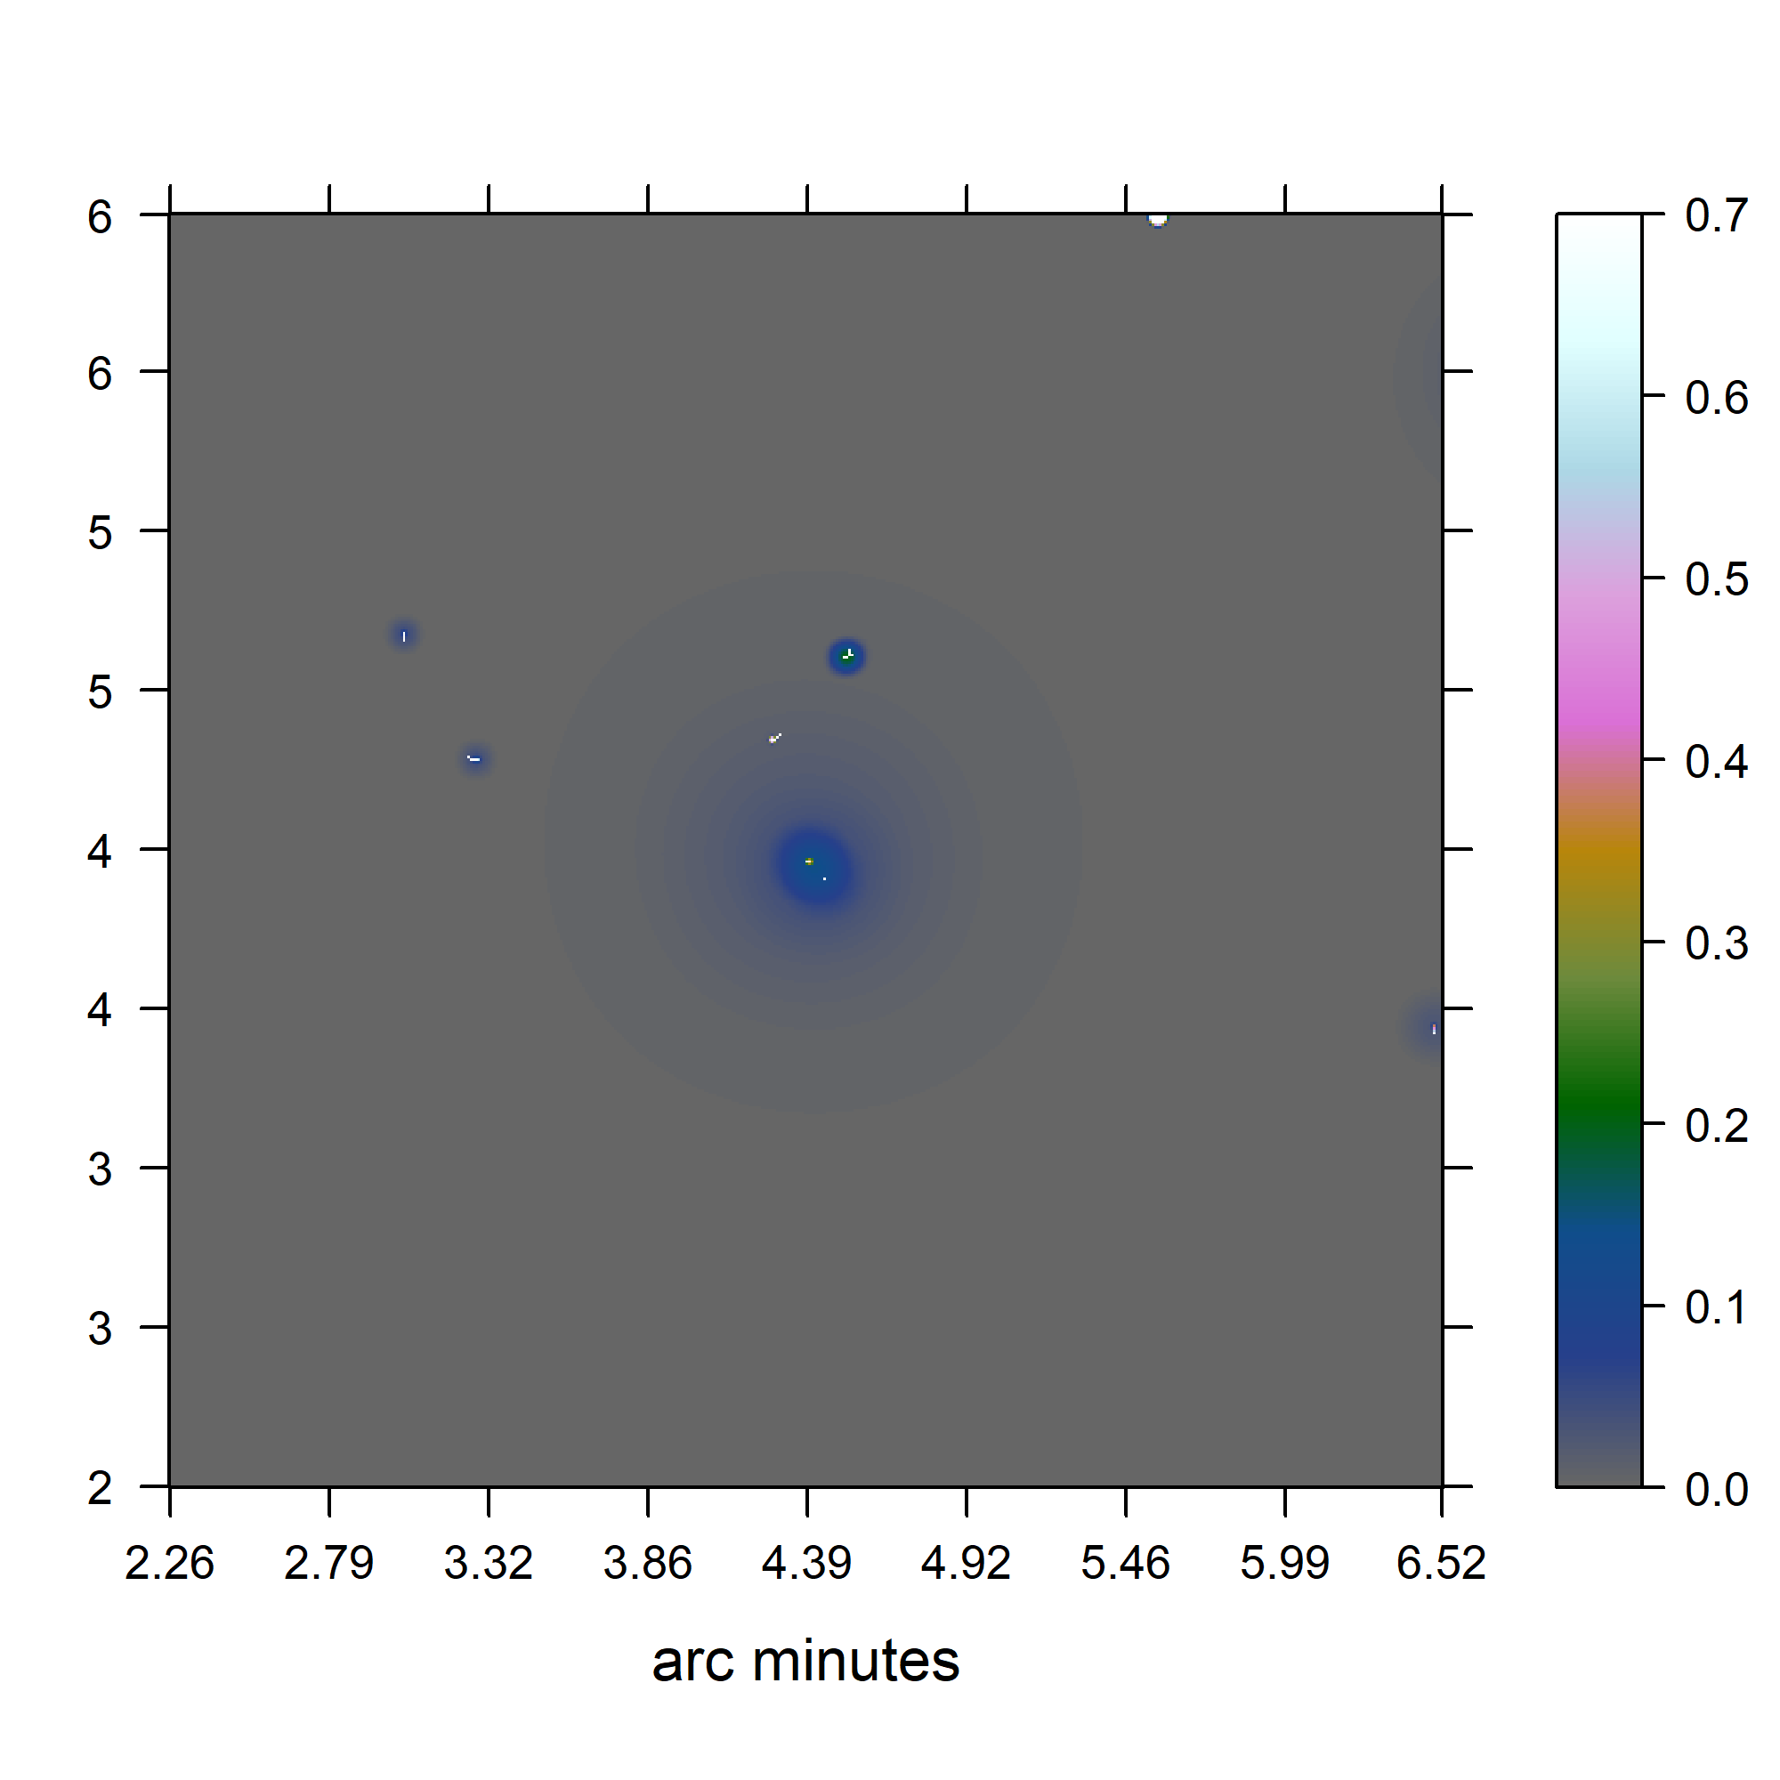
Test on simulated data
CLEAN
Coordinate Descent
Jansky/Beam

Slide 19
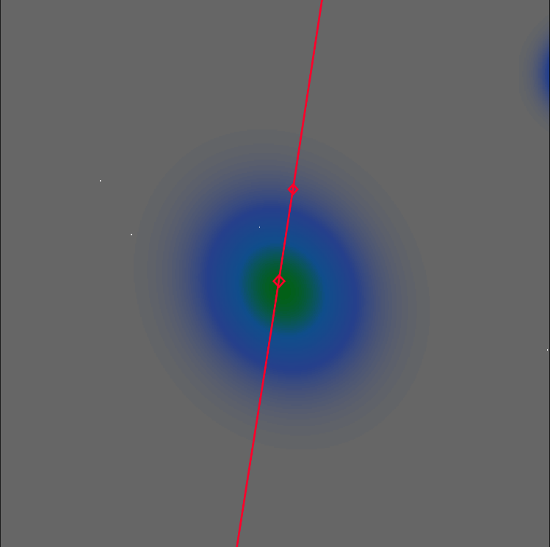
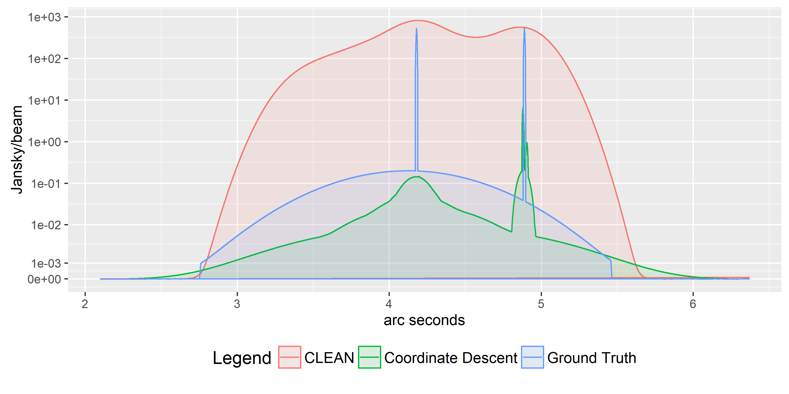
Test on simulated data

Slide 20
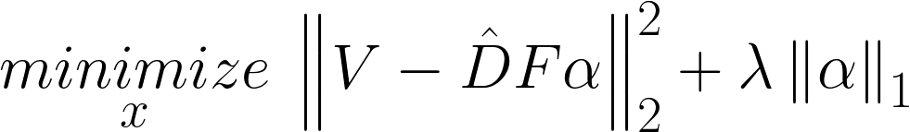
Test on simulated data
3300/1’100’000
~0.3%

Slide 21
Test on simulated data
3300/1’100’000
~0.3%
~250

Slide 22
Coordinate Descent for MeerKAT?

Slide 23

Coordinate Descent for MeerKAT?

Slide 24
Coordinate Descent for MeerKAT?
4000 Million Visibilities → M
60 Million Pixels → N
250+ non-zero entries → s

Slide 25


Coordinate Descent for MeerKAT?
4000 Million Visibilities → M
60 Million Pixels → N
250+ non-zero entries → s

Slide 26
Coordinate Descent for MeerKAT?

Slide 27
Future of MeerKAT

Slide 28
Future of MeerKAT
Direct Fourier Transform
Projection on a uniform grid
Spherical Wave Harmonics
…

Slide 29
Future of MeerKAT
10 tb/s

Slide 30
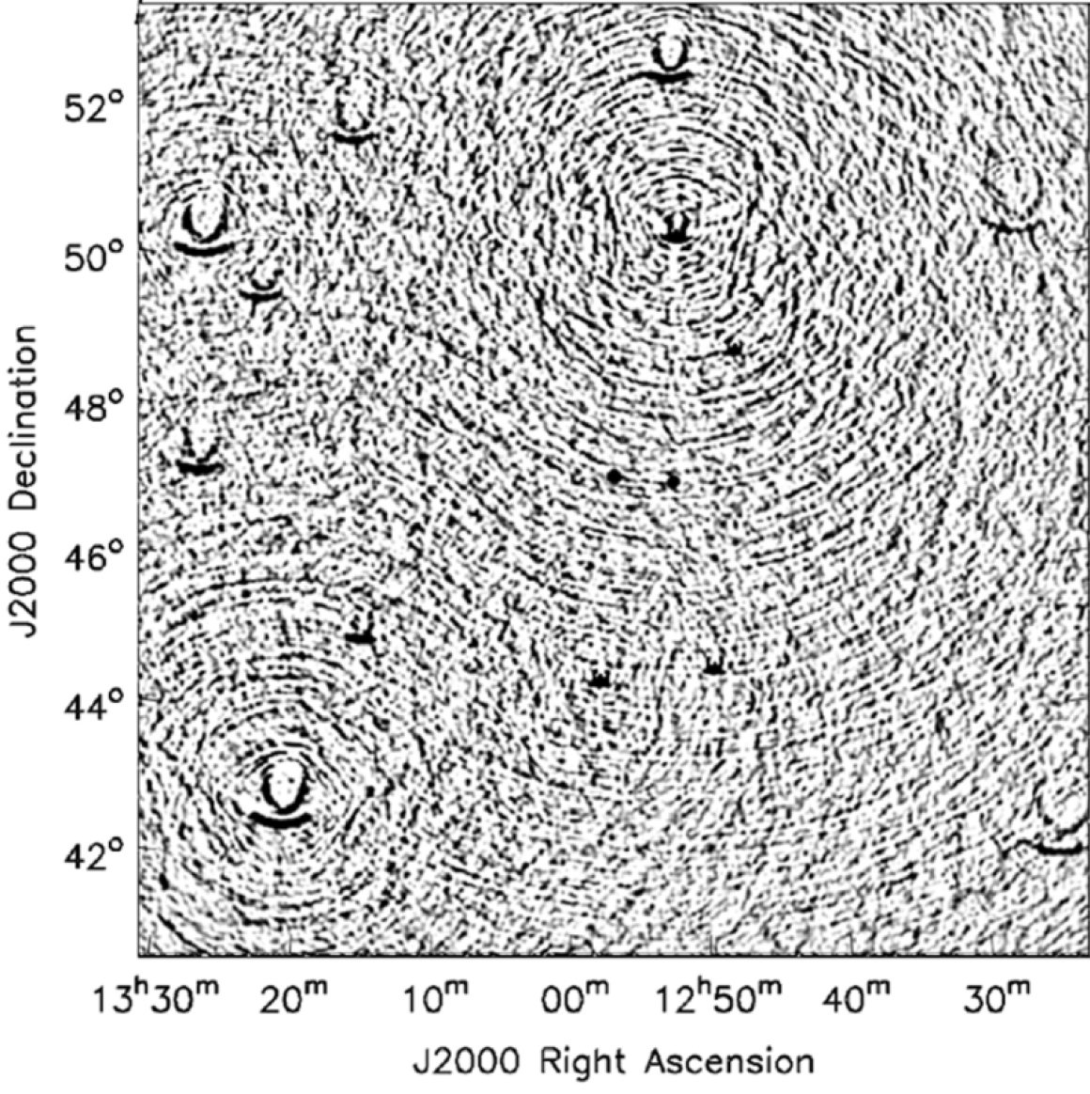
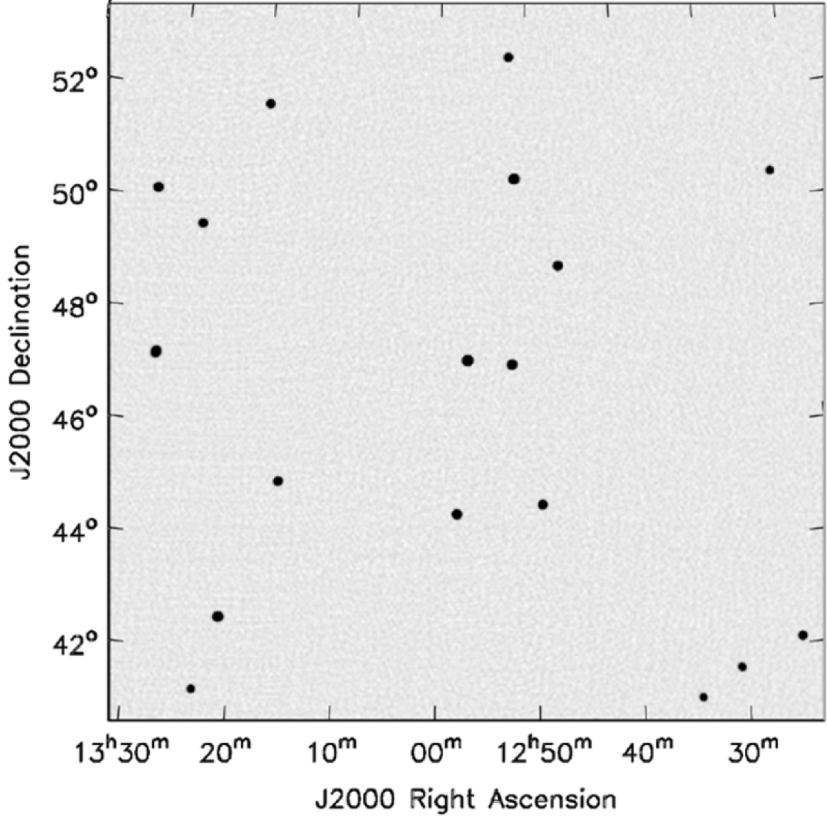
Wide Field of View
2D Fourier Transform
With w-correction

Slide 31
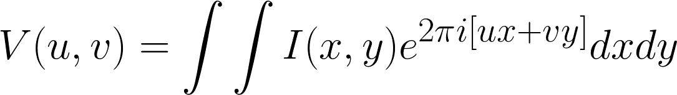
Wide Field of View

Slide 32
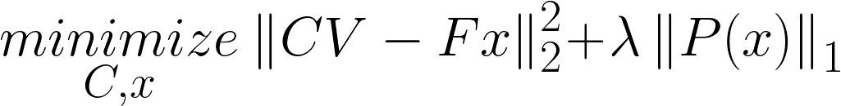
Calibration

Slide 33
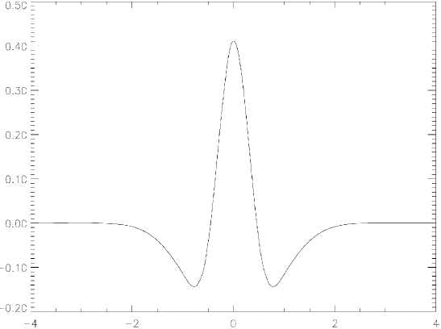
Starlet

Slide 34




Super Resolution (but)

Slide 35
Compressed Sensing

Slide 36




Compressed Sensing (approx.)

Slide 37
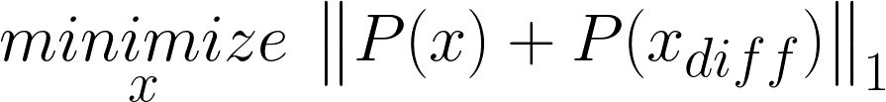
Compressed Sensing (approx.)

Slide 38
Compressed Sensing (approx.)

