Slide 1
Exploring the Fourier Transform for Compressed Sensing Reconstructions in the MeerKAT era

Slide 2
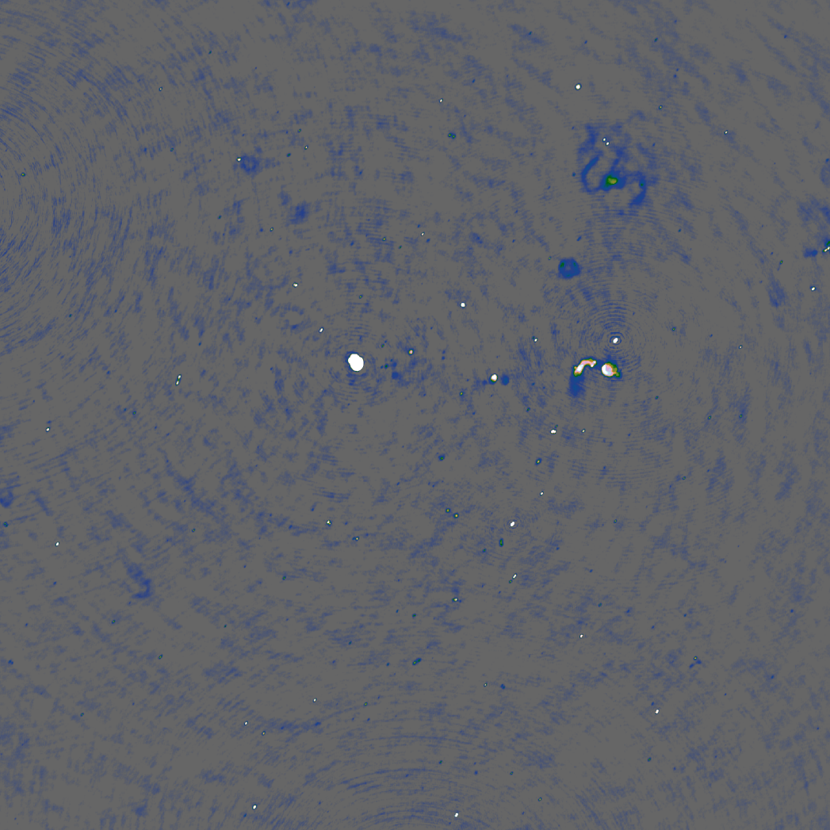
Fourier Transform

Slide 3
Compressed Sensing

Slide 4
MeerKAT era
4000 Million+ Visibility Measurements
60 Million+ Pixels

Slide 5
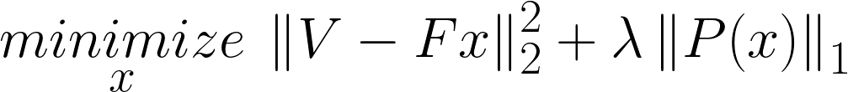
(Constrained) Optimization Problem

Slide 6
(Constrained) Optimization Problem
Image
Measurements

Slide 7
(Constrained) Optimization Problem
Image
Measurements

Slide 8
CLEAN

Slide 9
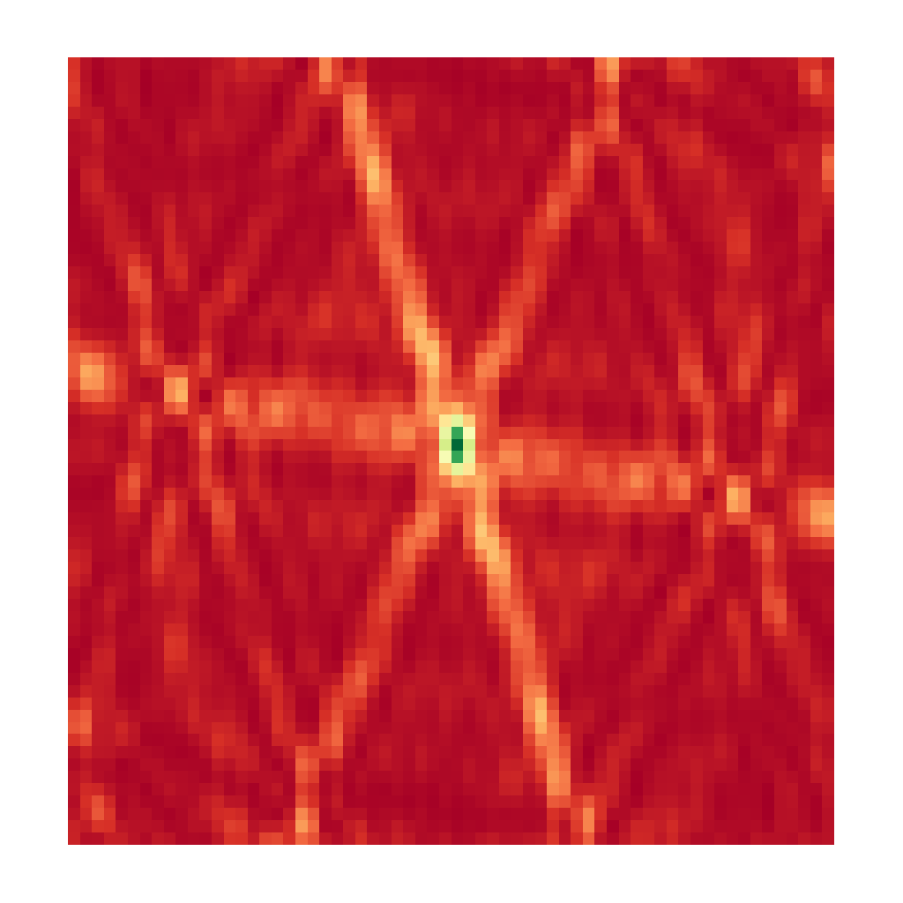
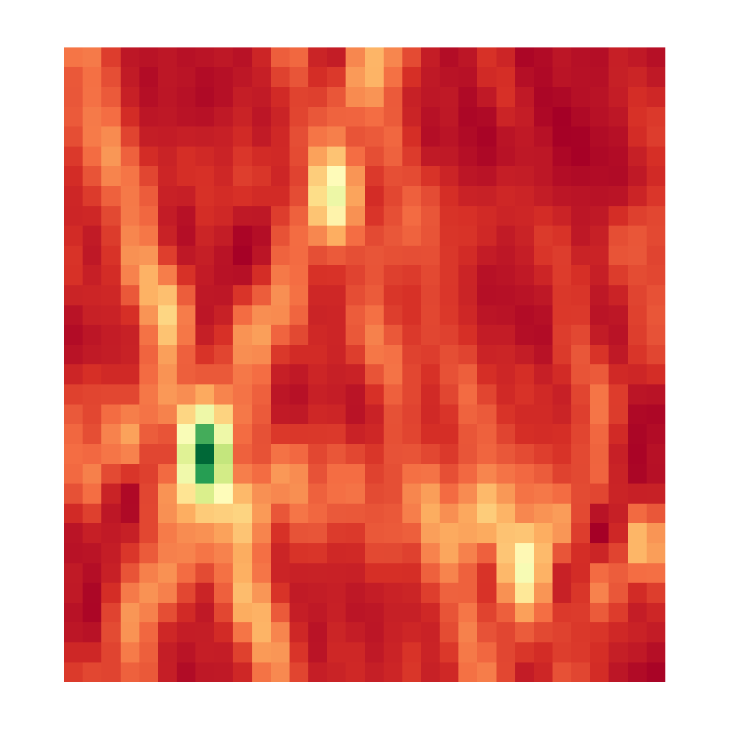

CLEAN
Point Spread Function
Dirty Image
Output

Slide 10

CLEAN

Slide 11
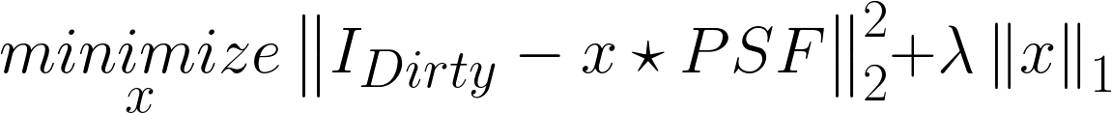
CLEAN

Slide 12
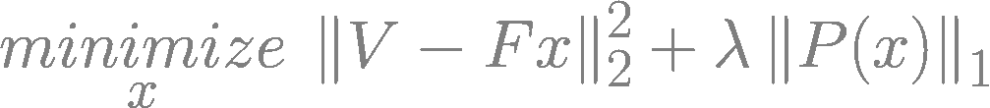
CLEAN

Slide 13
CLEAN

Slide 14
CLEAN

Slide 15

CLEAN

Slide 16
CLEAN

Slide 17
Compressed Sensing

Slide 18



Compressed Sensing (approx.)

Slide 19
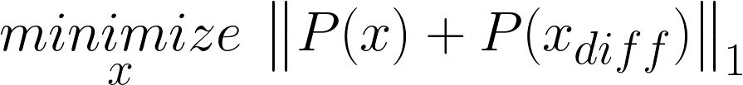
Compressed Sensing (approx.)

Slide 20
Compressed Sensing (approx.)

Slide 21
Replacing the non-uniform FFT

Slide 22
Replacing the non-uniform FFT
Projection on a uniform Grid
Spherical Wave Harmonics
Direct Fourier Transform

Slide 23
Projection on a uniform Grid

Slide 24
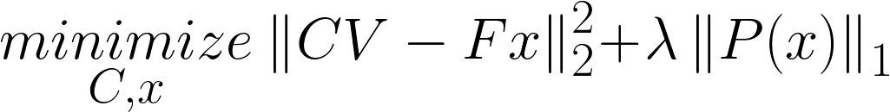
Projection on a uniform Grid

Slide 25
Spherical Wave Harmonics
?

Slide 26
Direct Fourier Transform

Slide 27
Direct Fourier Transform and Coordinate Descent

Slide 28
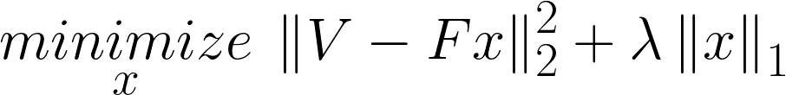
Direct Fourier Transform and Coordinate Descent

Slide 29
Direct Fourier Transform and Coordinate Descent
Dirty Image

Slide 30
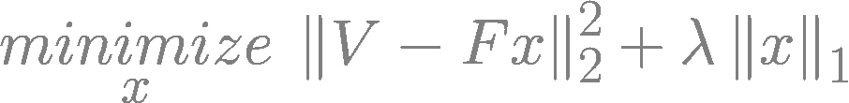
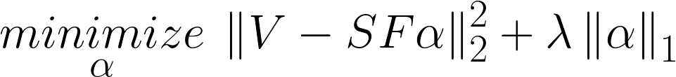
Direct Fourier Transform and Coordinate Descent

Slide 31

Direct Fourier Transform and Coordinate Descent

Slide 32
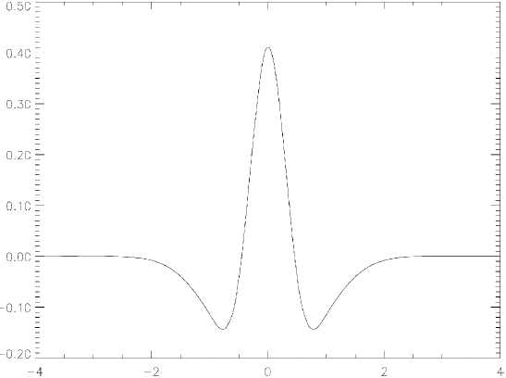
Starlet transform

Slide 33
Starlet transform

Slide 34
Simulated results

Slide 35
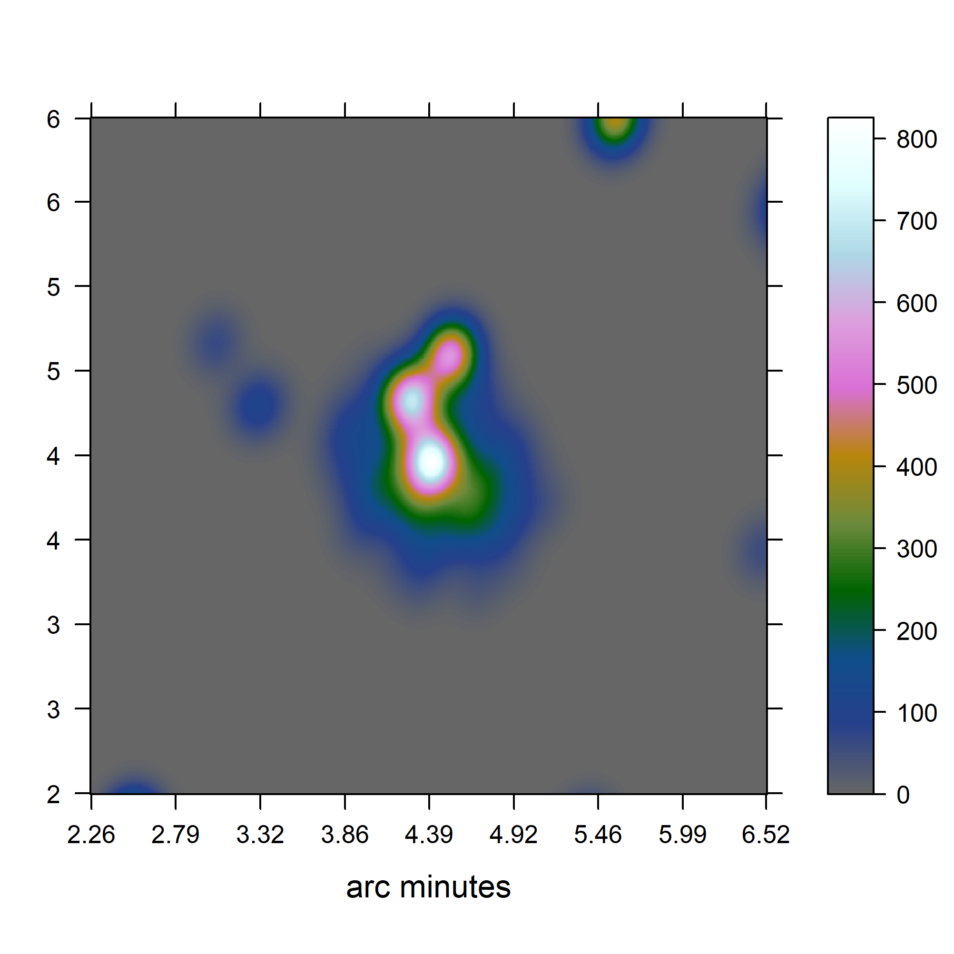
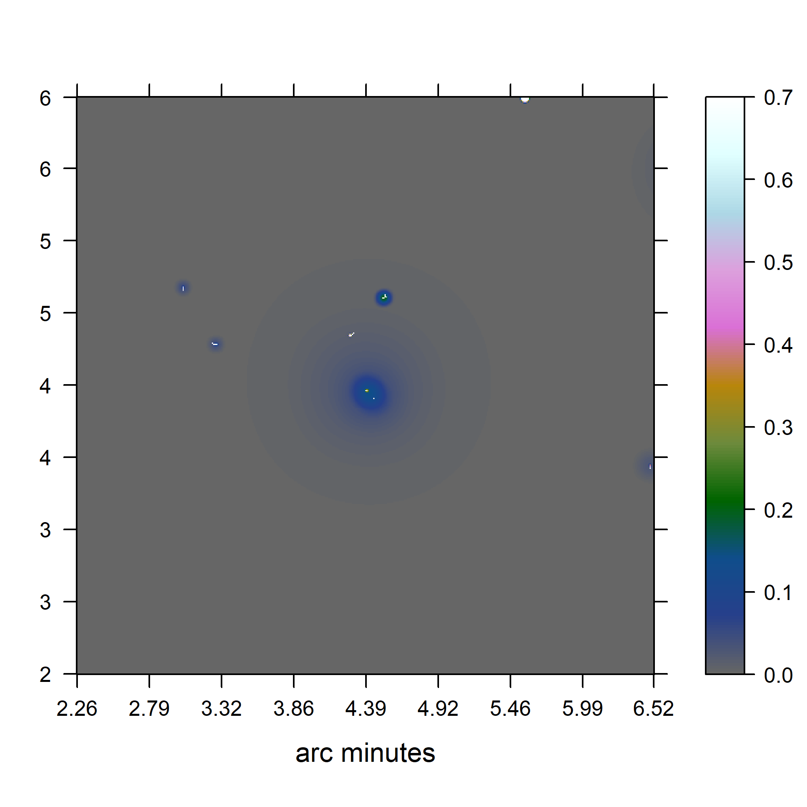
Simulated results

Slide 36
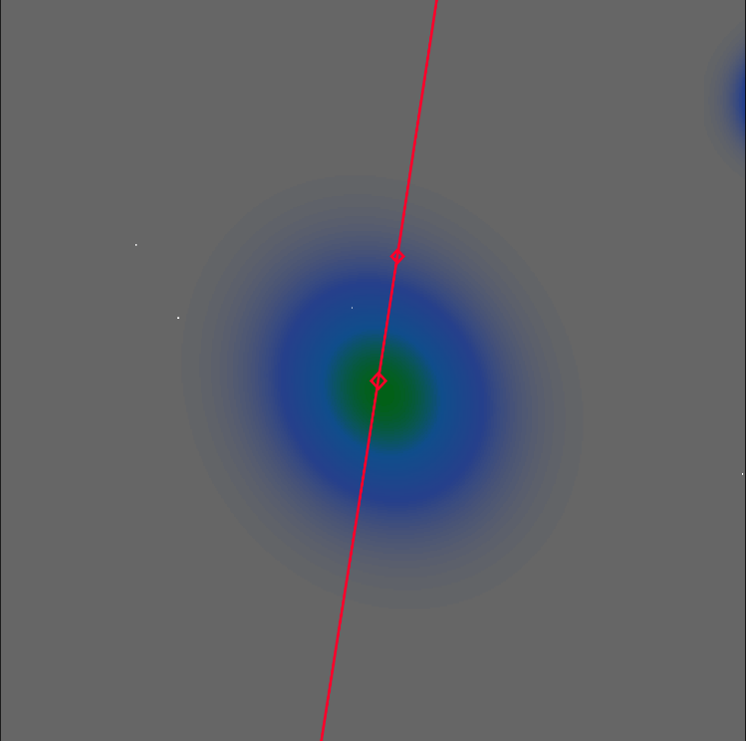
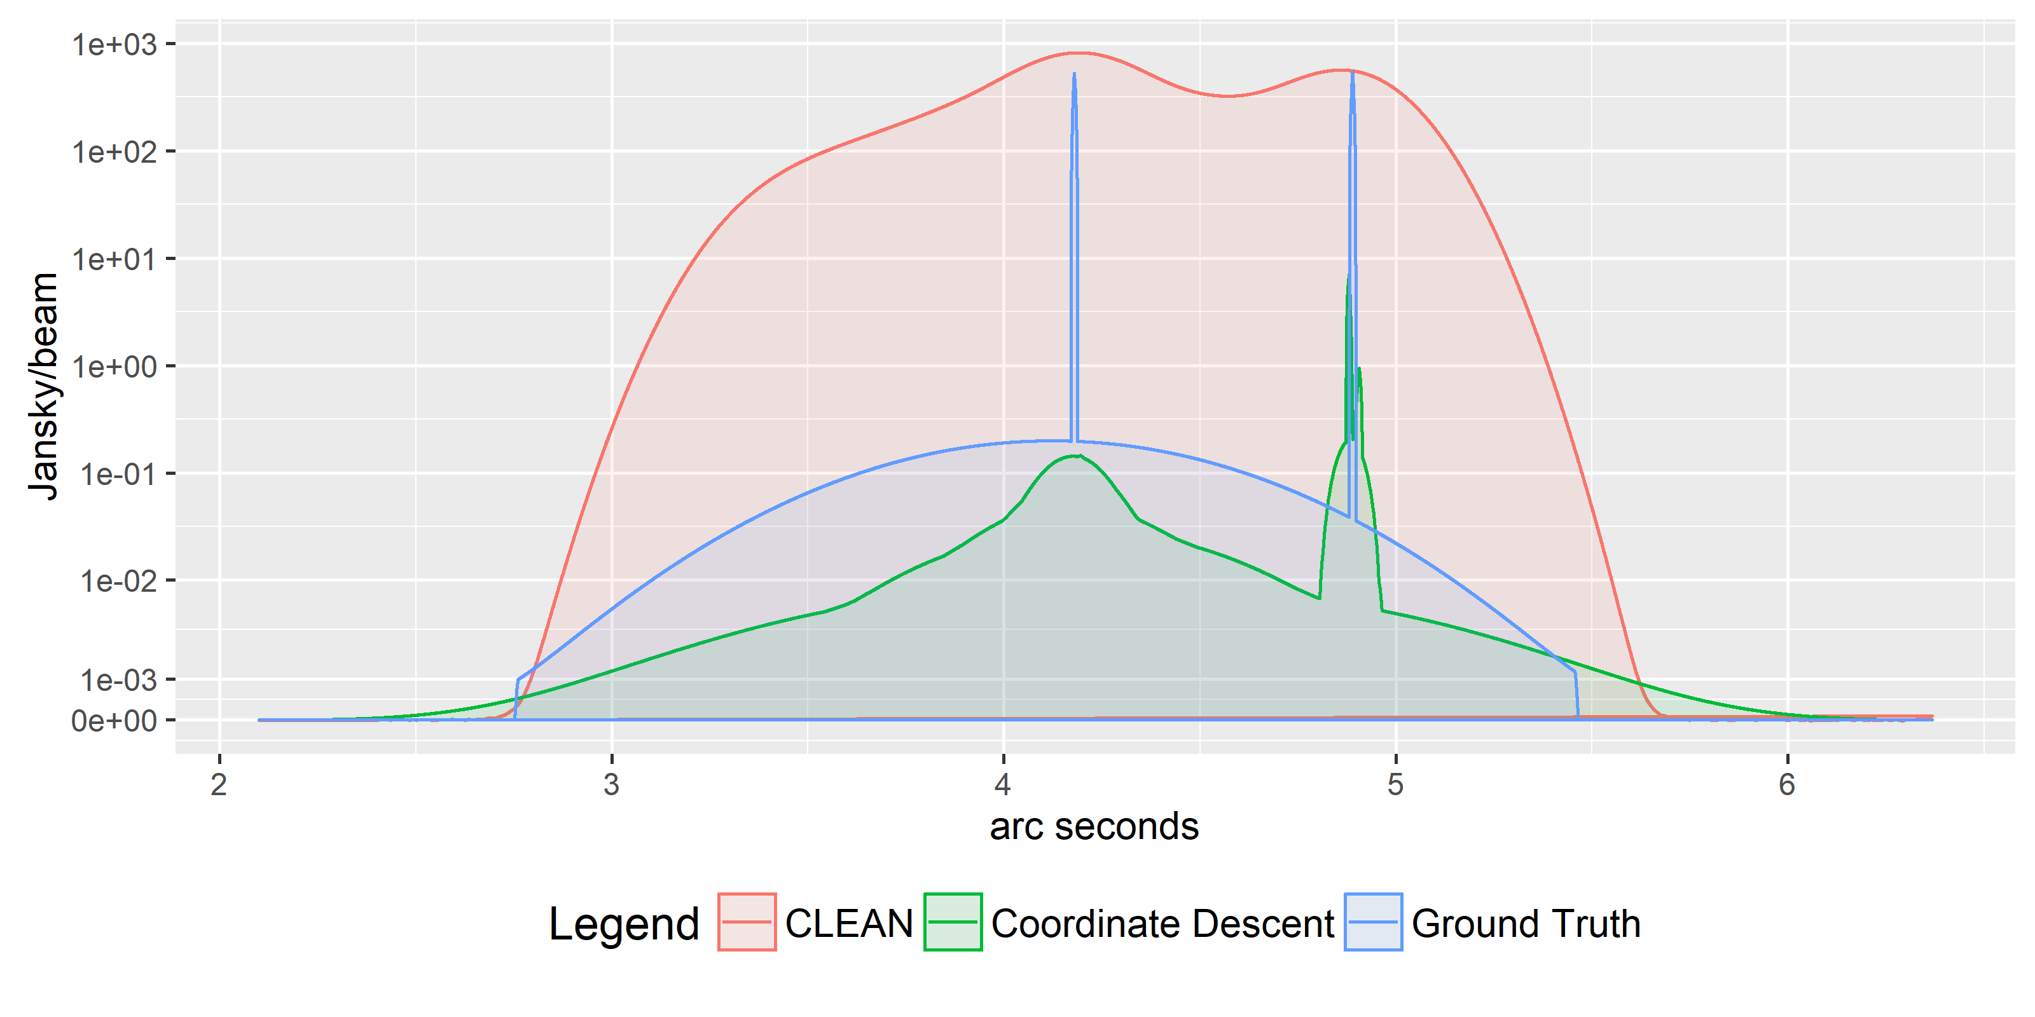
Simulated results

Slide 37




Super Resolution (but)

Slide 38
Scalability
??

Slide 39
Redundancy

Slide 40
Future

Slide 41
Future

Slide 42
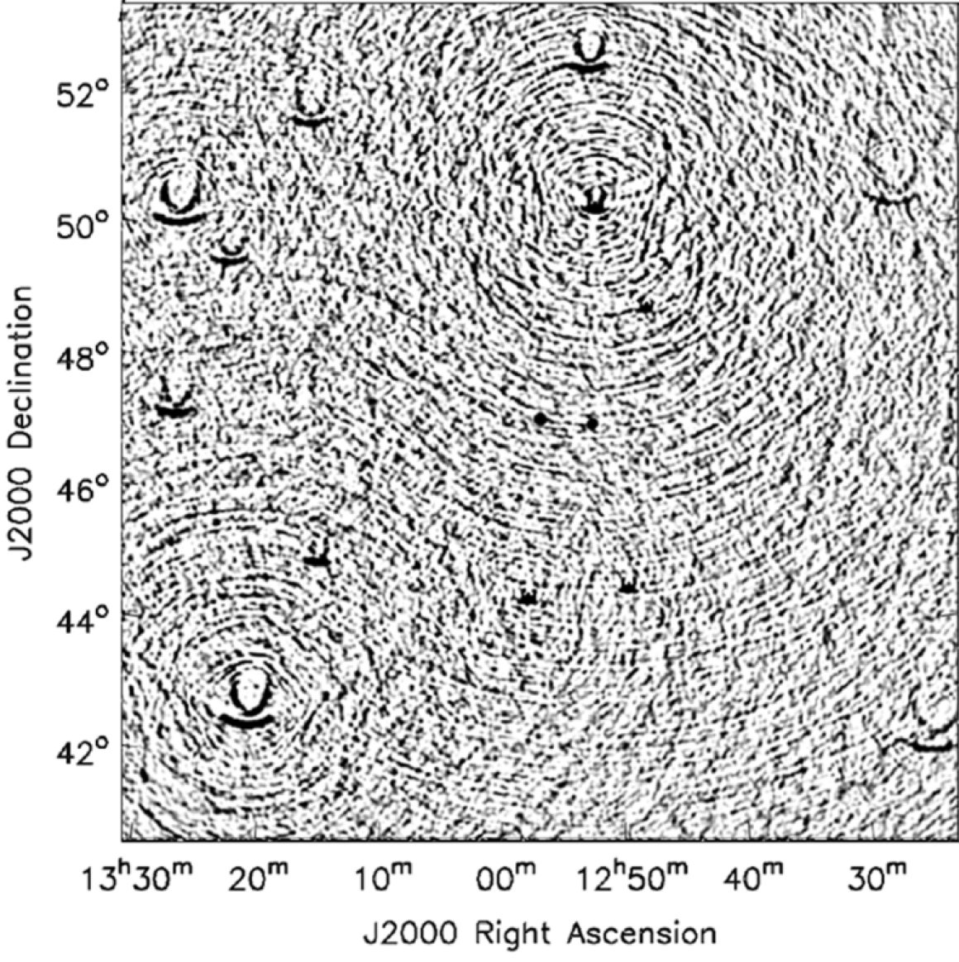
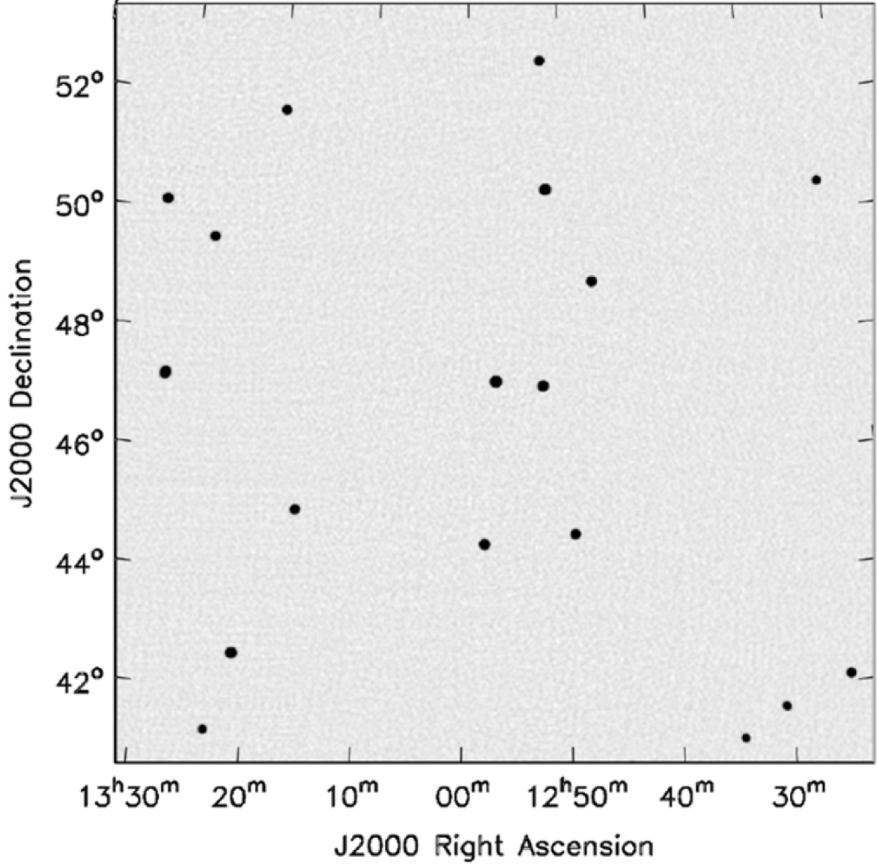
Wide Field of View
2D Fourier Transform
With w-correction

Slide 43
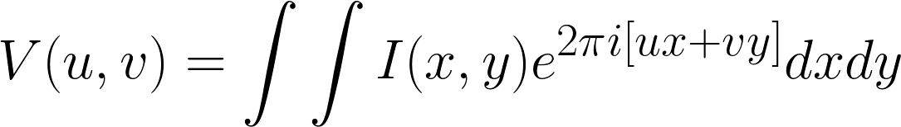
Wide Field of View

