Slide 1
Exploring the Fourier Transform for Compressed Sensing Reconstructions in the MeerKAT era

Slide 2
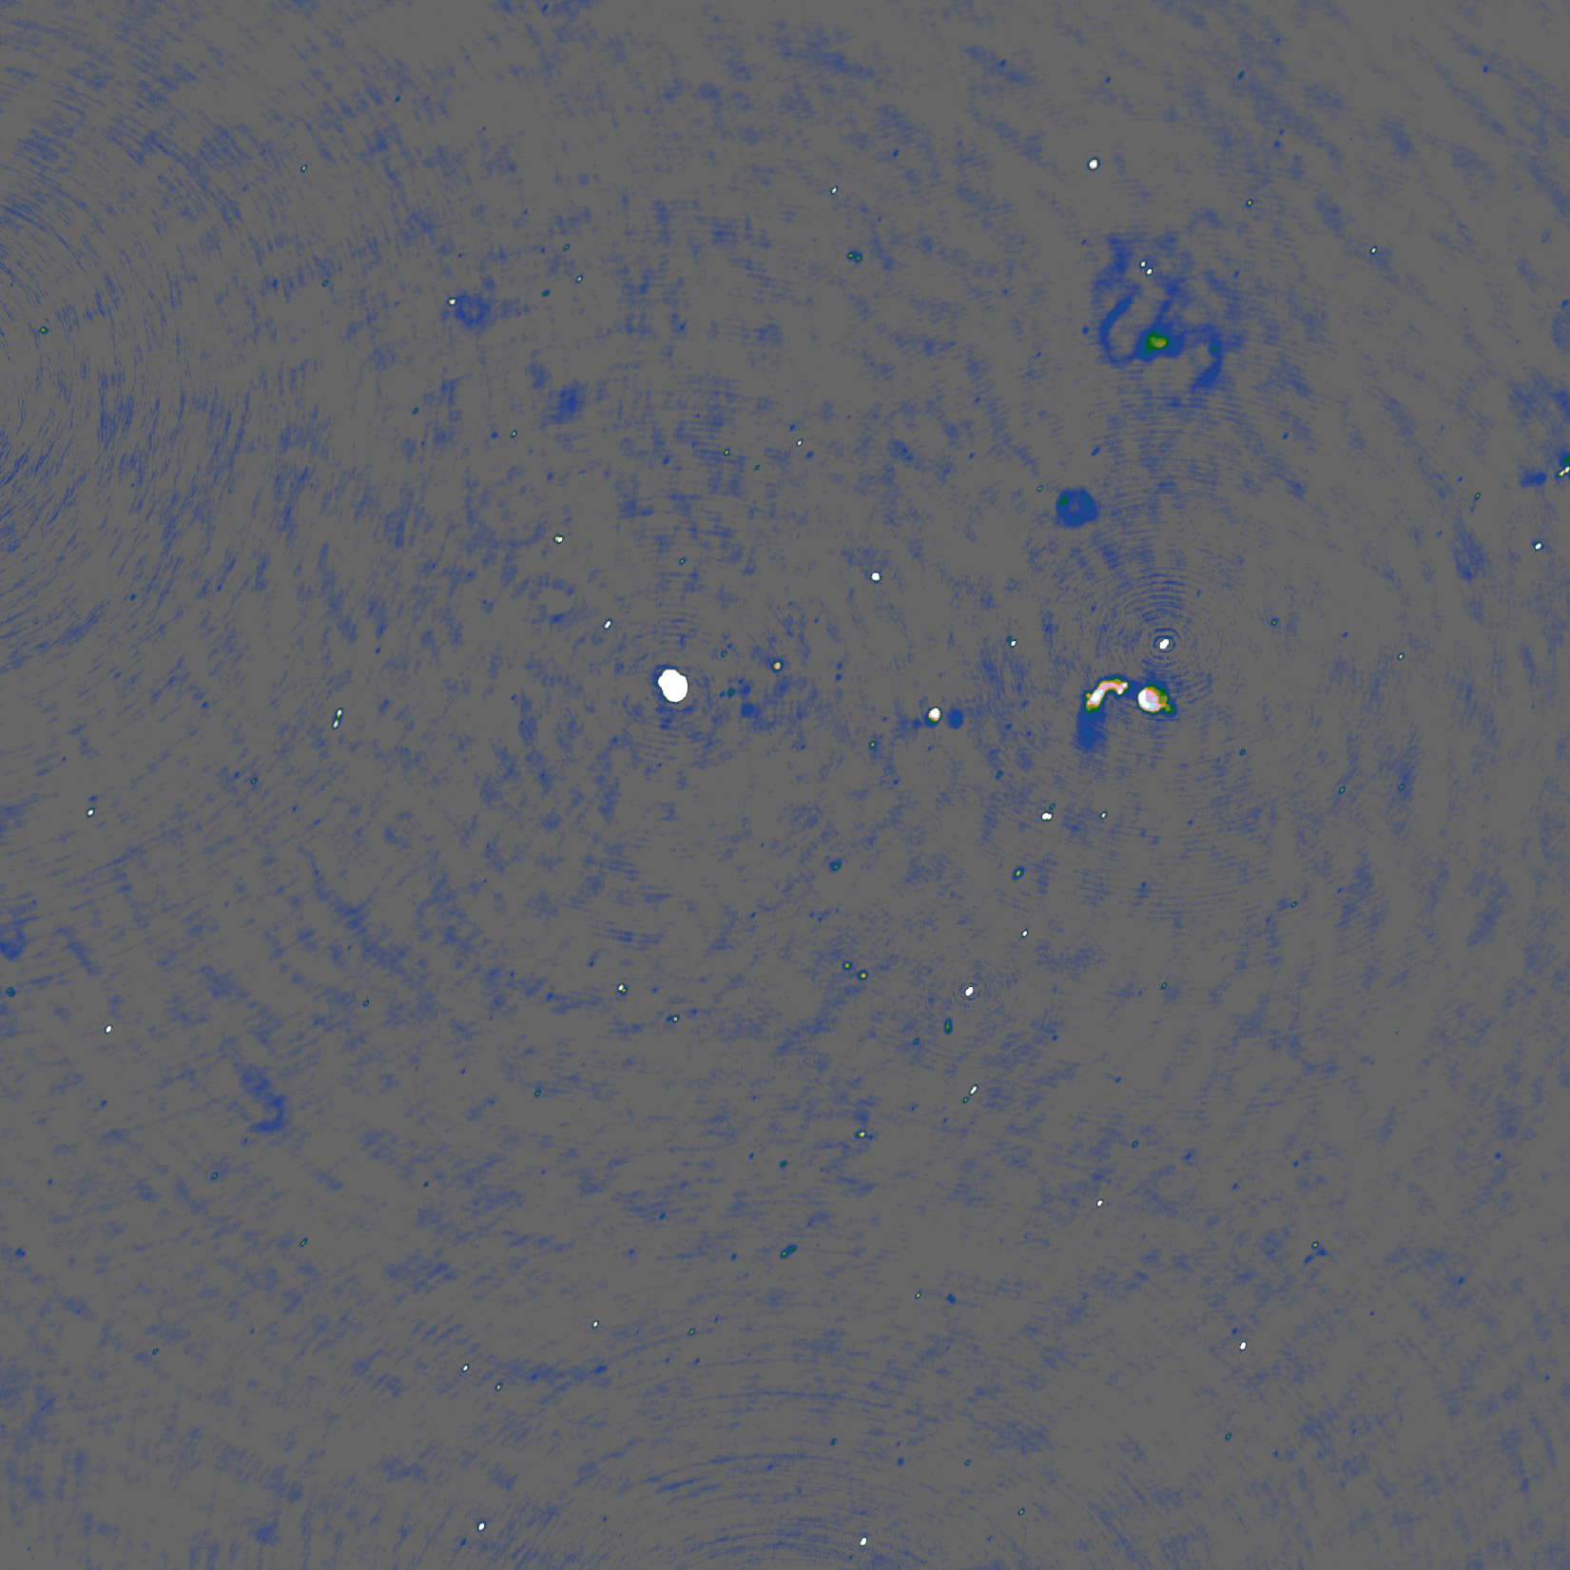
CLEAN

Slide 3
Why Compressed Sensing

Slide 4
MeerKAT scale
4000 Million+ Visibility Measurements
60 Million+ Pixels

Slide 5
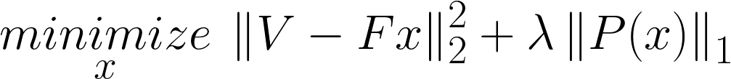
Constrained Optimization Problem

Slide 6
Constrained Optimization Problem
Image
Measurements

Slide 7
Constrained Optimization Problem
Image
Measurements

Slide 8
Deconvolution

Slide 9

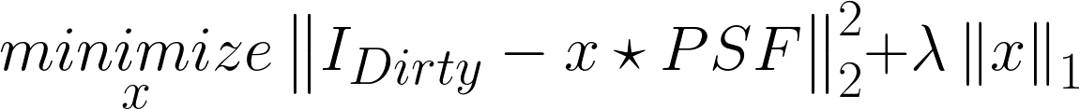
CLEAN

Slide 10
CLEAN

Slide 11

CLEAN

Slide 12

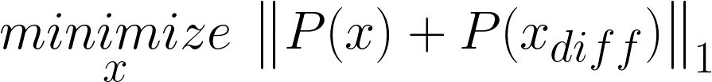
Compressed Sensing (approx.)

Slide 13
Replacing the non-uniform FFT
Projection on a uniform Grid
Spherical Wave Harmonics
Direct Fourier Transform

Slide 14
Projection on a uniform grid

Slide 15
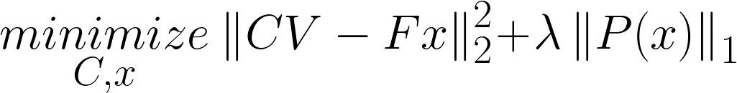
Calibration

Slide 16
Spherical Wave Harmonics
?

Slide 17
Direct Fourier Transform

Slide 18
Coordinate Descent

Slide 19
Starlet transform

Slide 20
Simulated results

Slide 21
Simulated results, mixed

Slide 22
Scalability
??

Slide 23
Redundancy

Slide 24
Future

Slide 25
Future

Slide 26
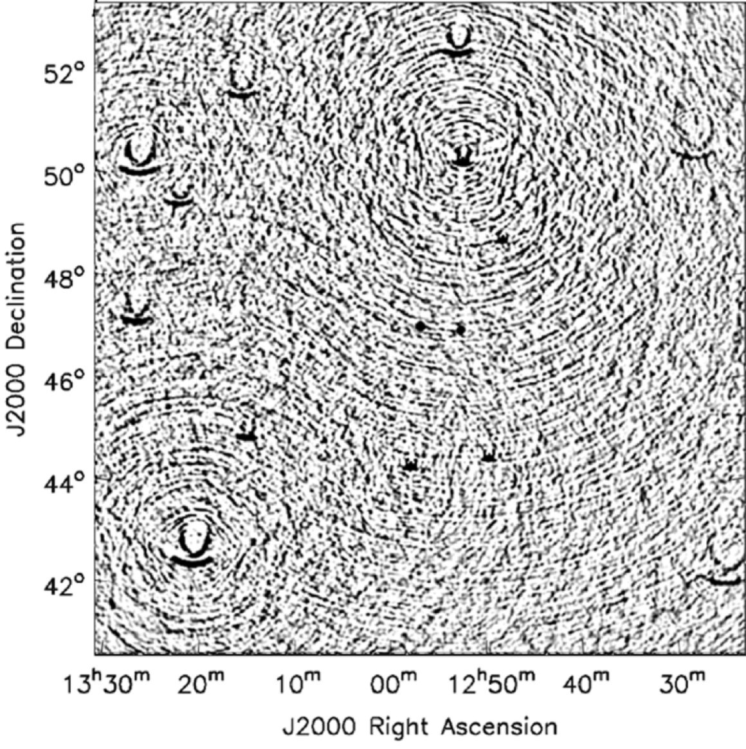
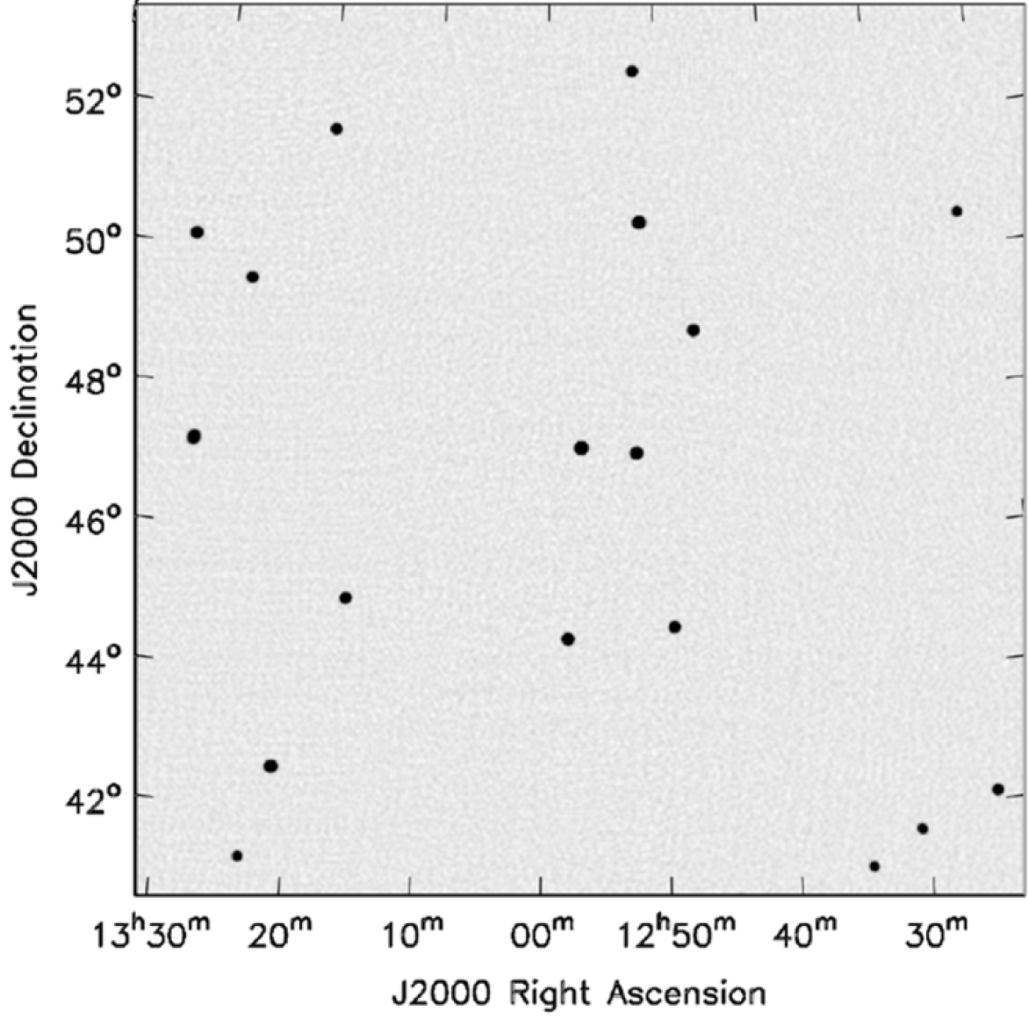
Wide Field of View
2D Fourier Transform
With w-correction

Slide 27
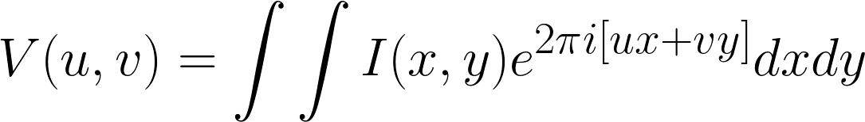
Wide Field of View

