Slide 1
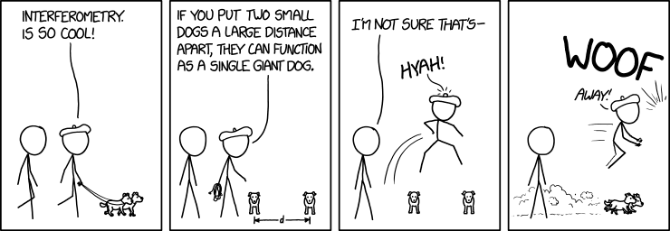
P8: Exploring the Fourier Transform for Compressed Sensing Reconstructions in the MeerKAT era

Slide 2
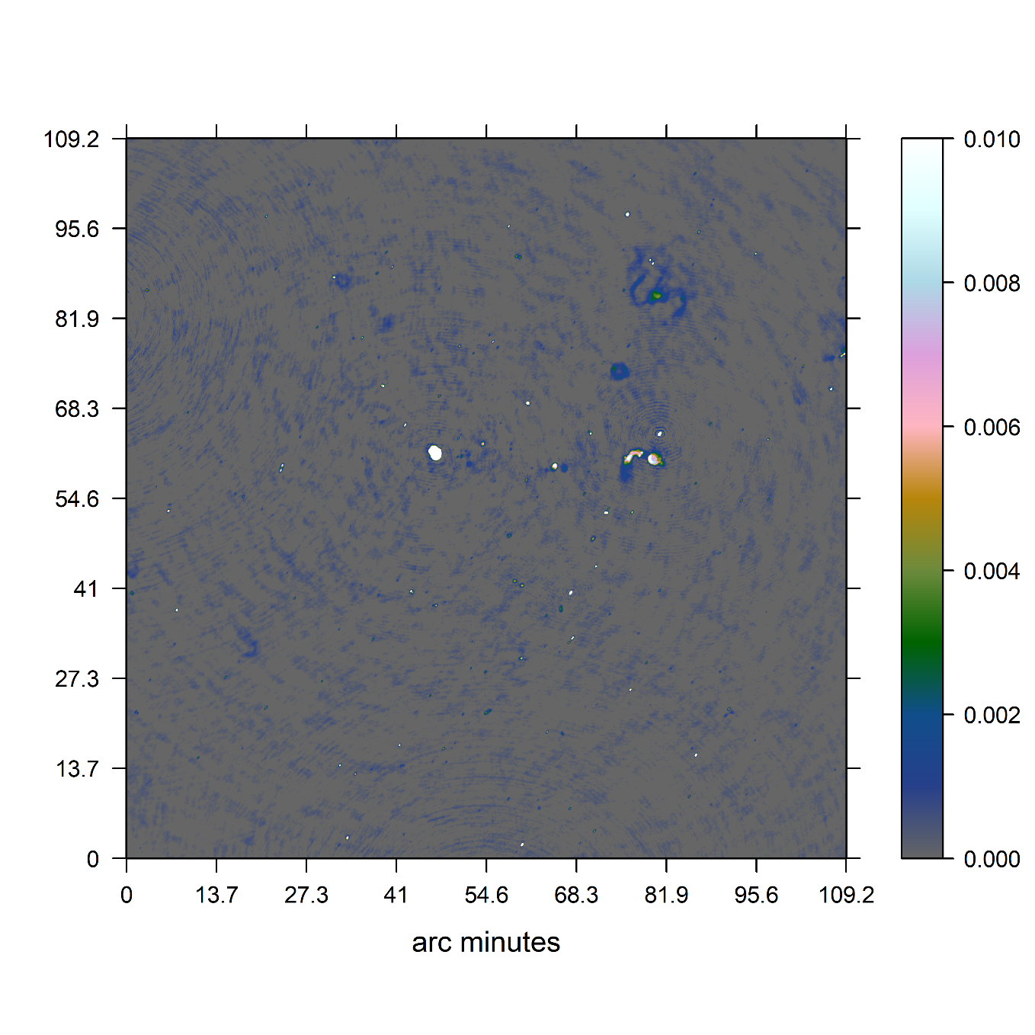
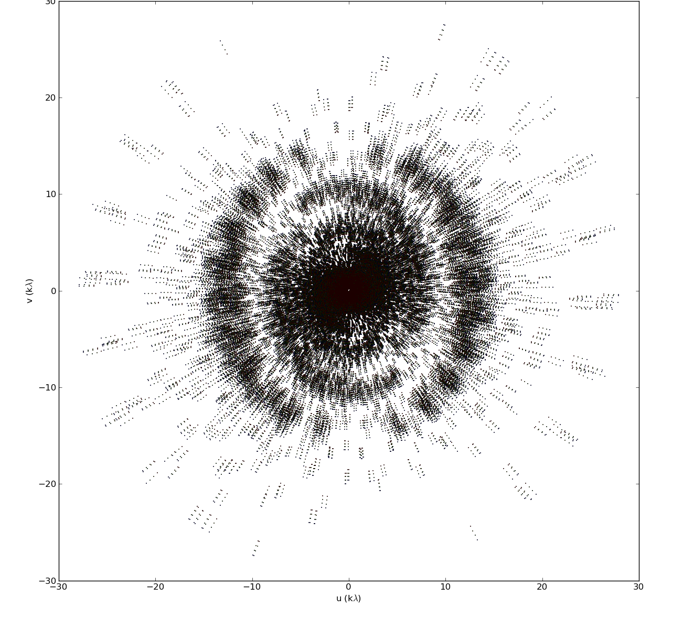
MeerKAT Radio Interferometer

Slide 3
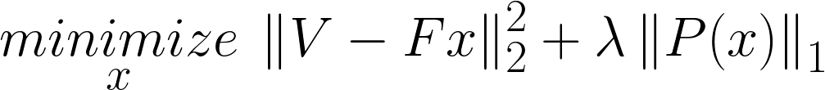
Reconstruction Problem
Image
Measurements

Slide 4
Reconstruction Problem
Image
Measurements

Slide 5
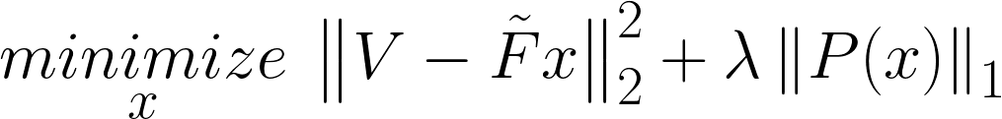
Reconstruction Problem
Non-uniform FFT
approximation

Slide 6




Non-uniform FFT Cycle

Slide 7
Redundancy and Noise

Slide 8
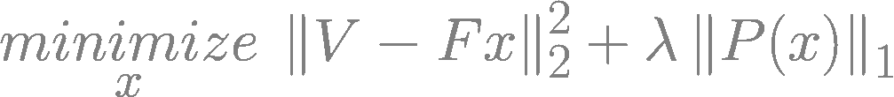
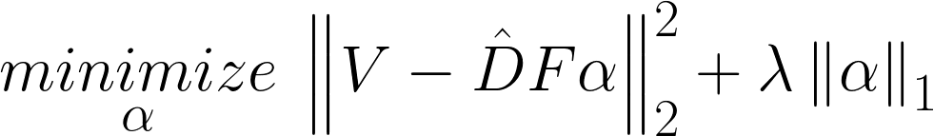
My Solution
Direct Fourier Transform
Starlet Transform

Slide 9
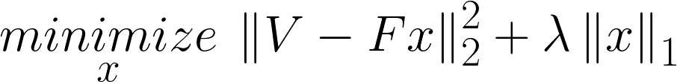
Coordinate Descent

Slide 10
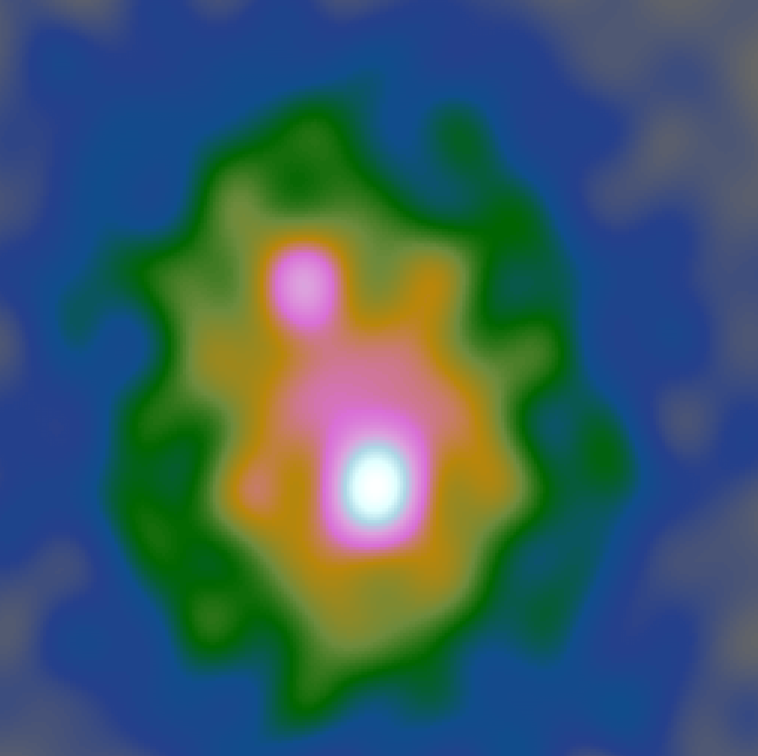
Coordinate Descent
Dirty Image

Slide 11
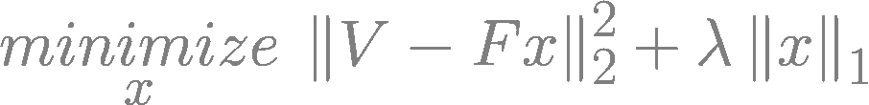


Coordinate Descent + Starlets

Slide 12
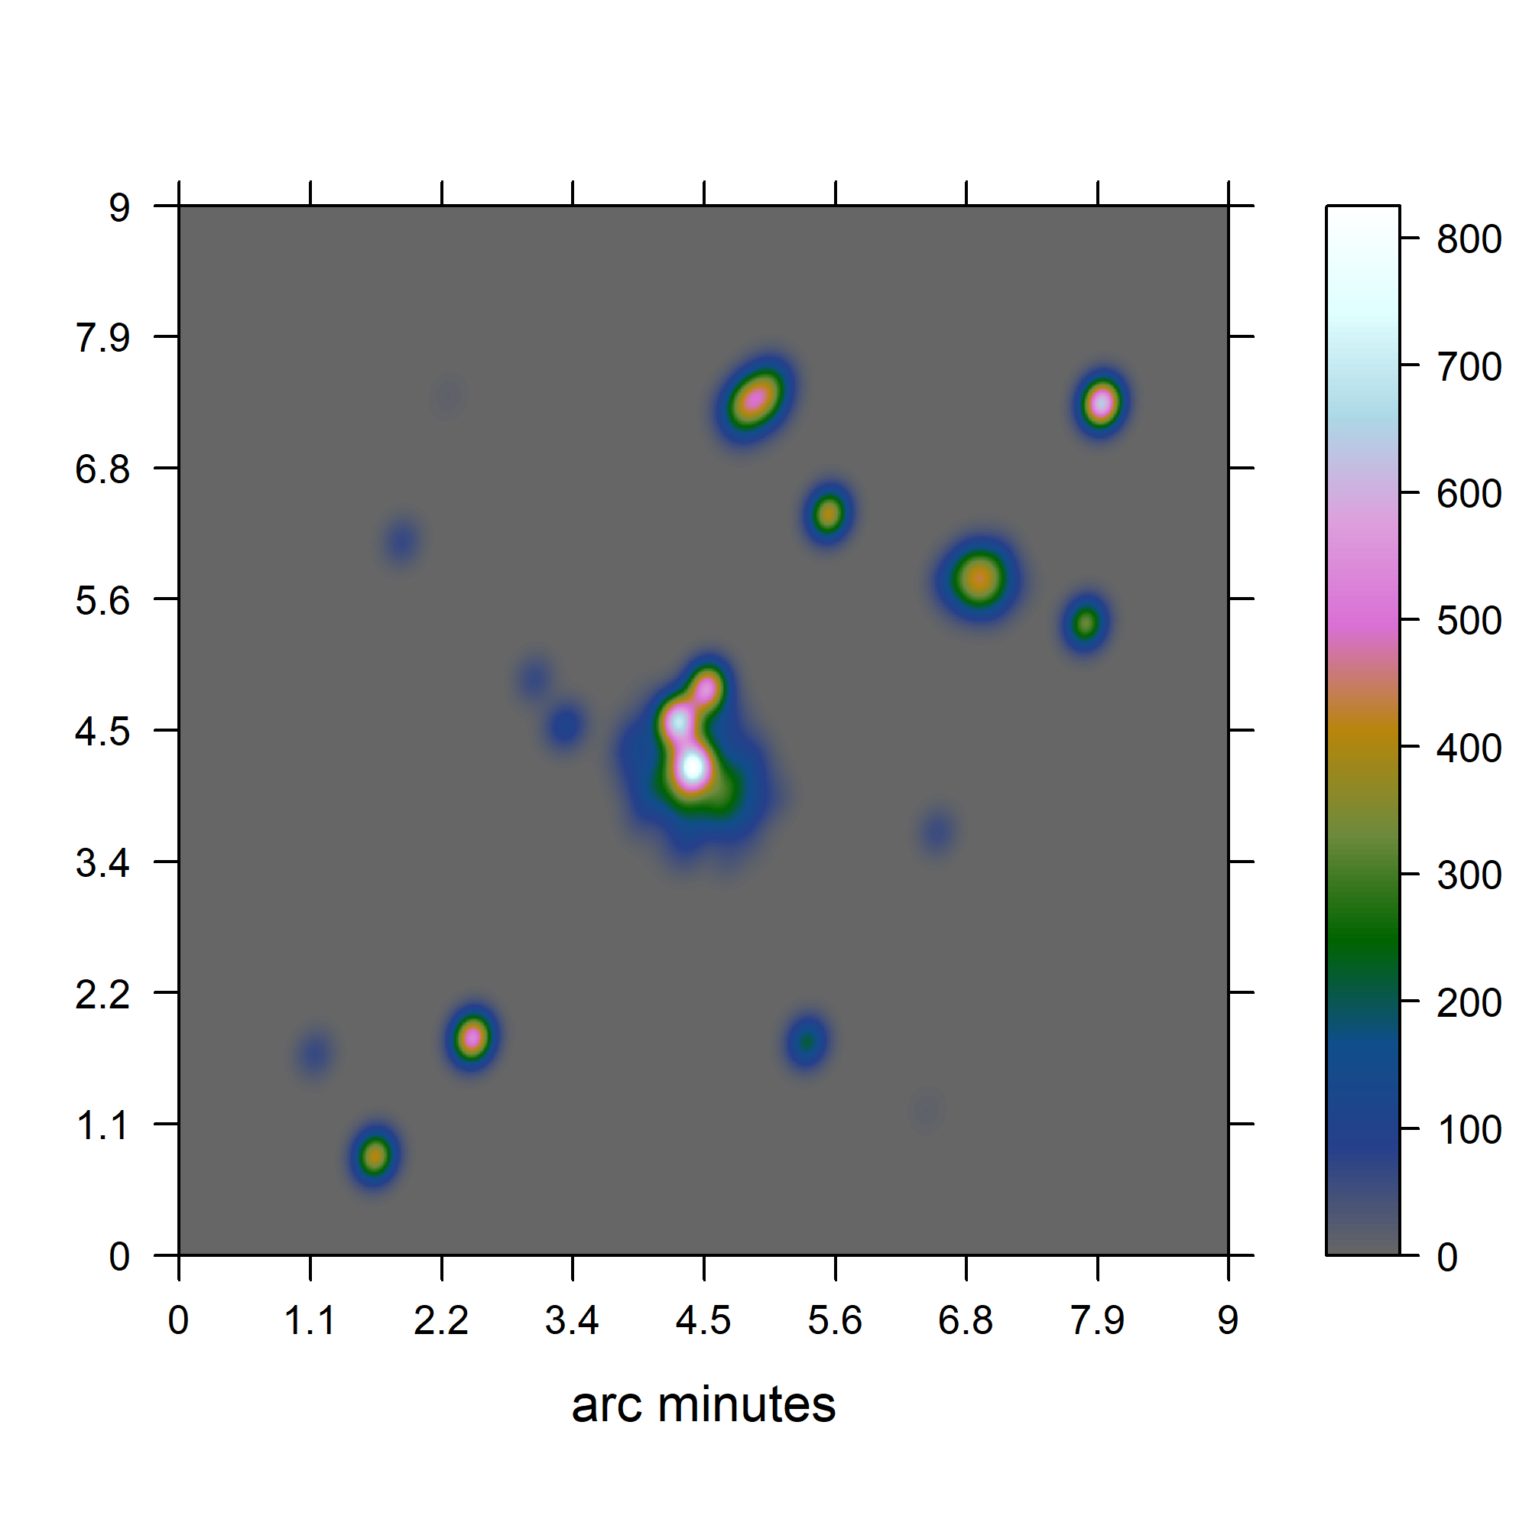
Test on simulated data

Slide 13
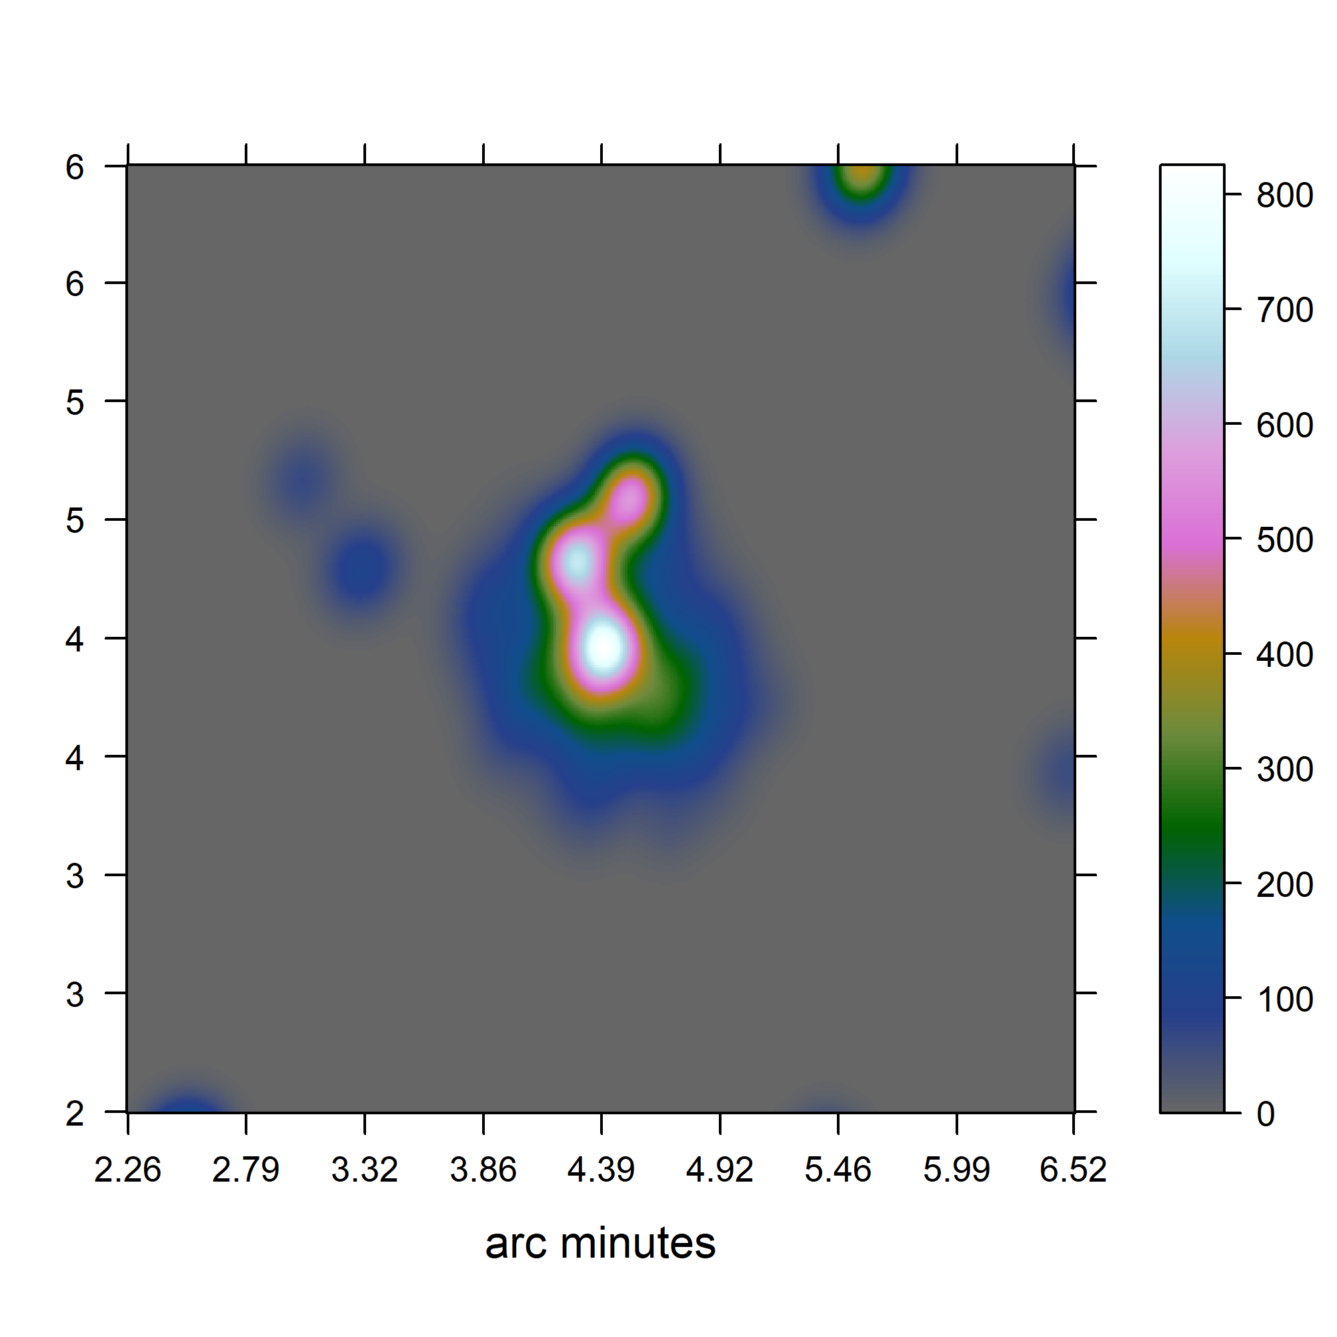
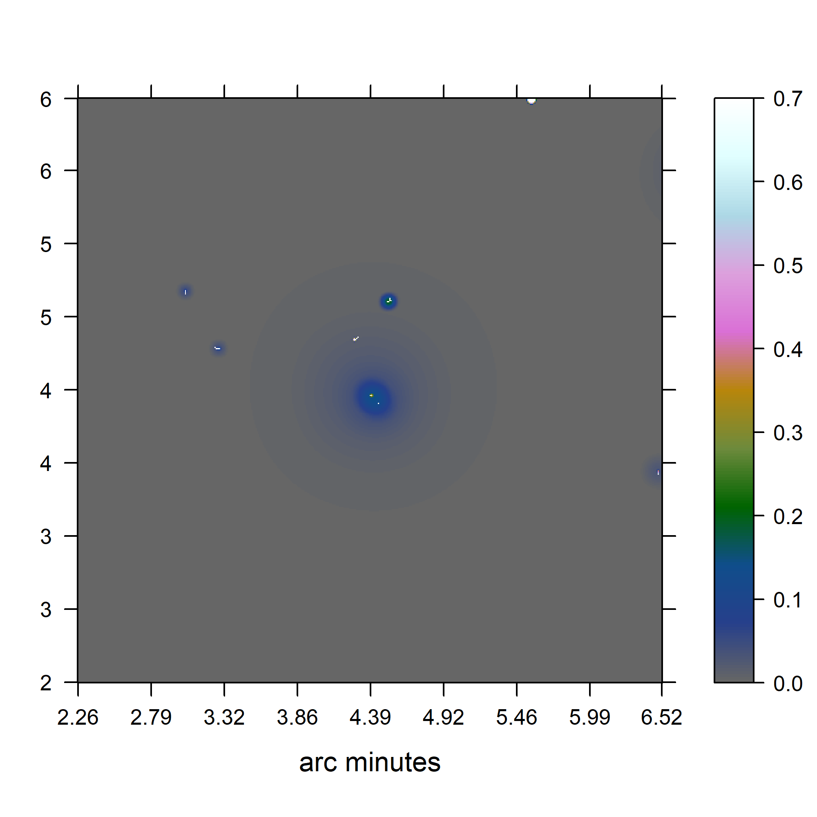
Test on simulated data
CLEAN
Coordinate Descent
Jansky/Beam

Slide 14
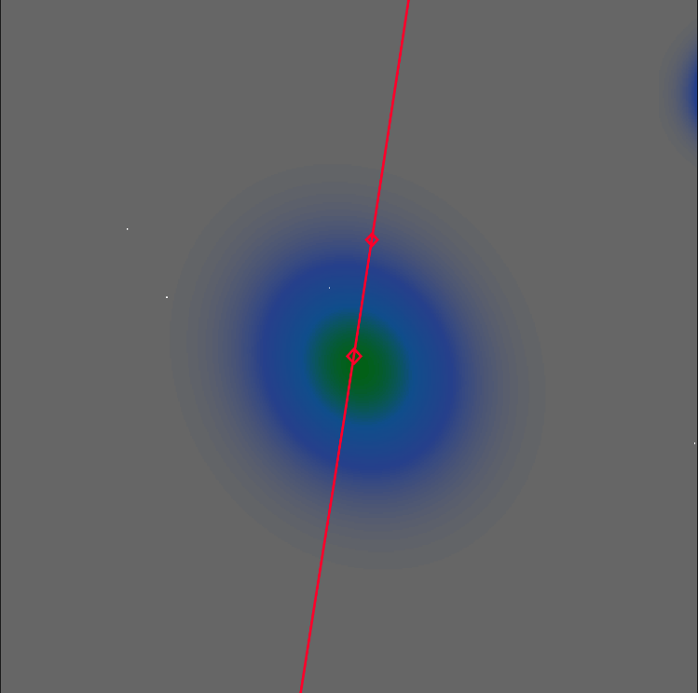
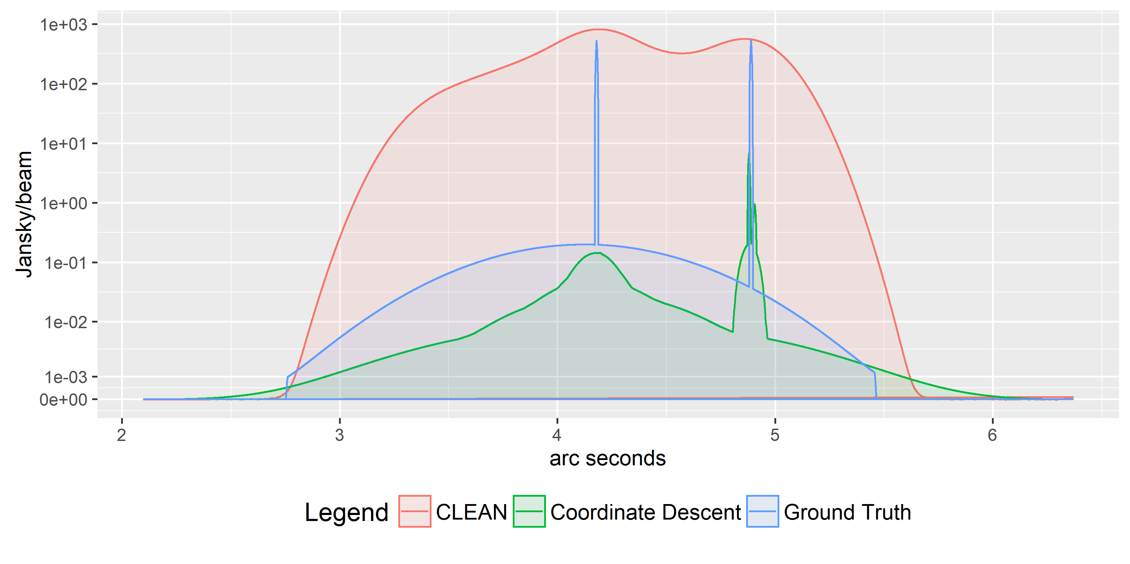
Test on simulated data

Slide 15
Test on simulated data
3300/1’100’000
~0.3%
~250

Slide 16
Coordinate Descent for MeerKAT?

Slide 17
Coordinate Descent for MeerKAT?
“small” Dataset 88gb
4000 Million Visibilities
60 Million Pixels

Slide 18

Coordinate Descent for MeerKAT?
4000 Million Visibilities → M
60 Million Pixels → N
250+ non-zero entries → s

Slide 19


Coordinate Descent for MeerKAT?
4000 Million Visibilities → M
60 Million Pixels → N
250+ non-zero entries → s

Slide 20
Coordinate Descent for MeerKAT?

Slide 21
Future of MeerKAT

Slide 22
Future of MeerKAT
Direct Fourier Transform
Projection on a uniform grid
Spherical Wave Harmonics
…

Slide 23
Future of MeerKAT
~10 Terabytes/s

Slide 24
Questions?

Slide 25
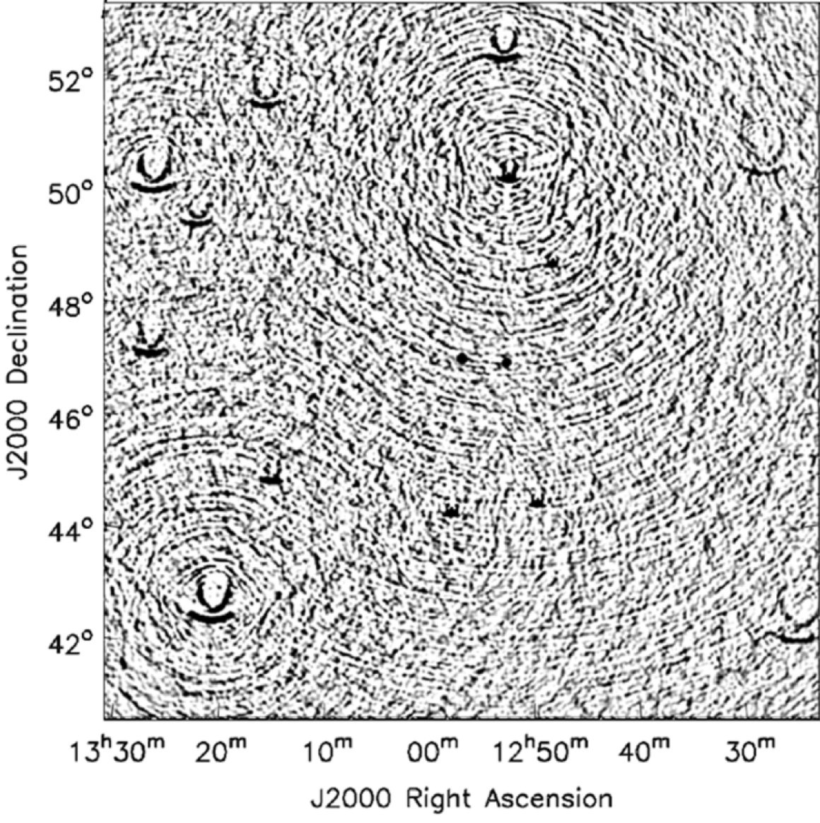
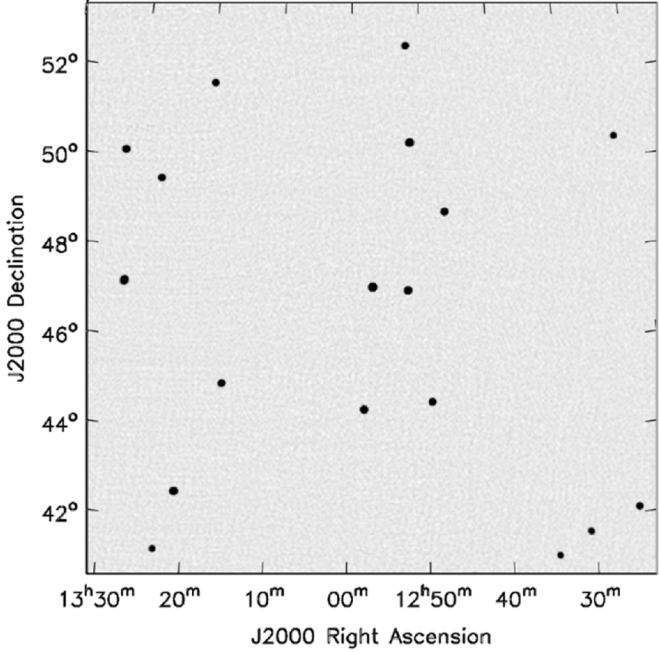
Wide Field of View
2D Fourier Transform
With w-correction

Slide 26
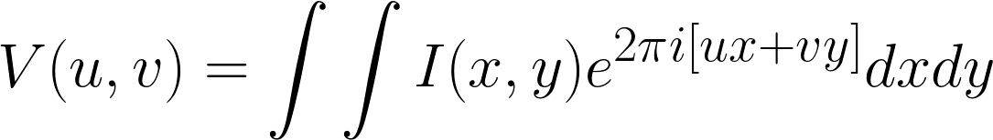
Wide Field of View

Slide 27
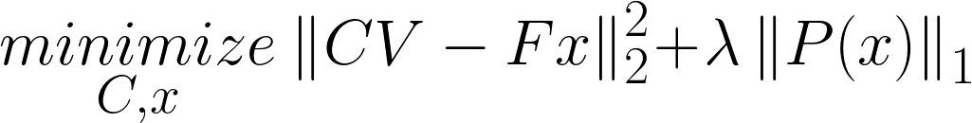
Calibration

Slide 28
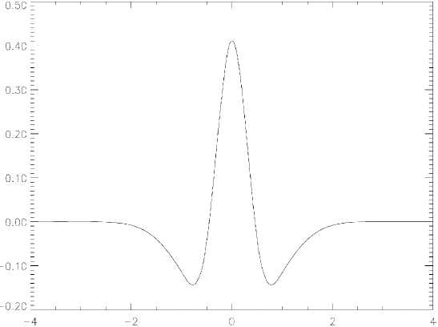
Starlet

Slide 29




Super Resolution (but)

Slide 30

CLEAN and the non-uniform FFT

Slide 31
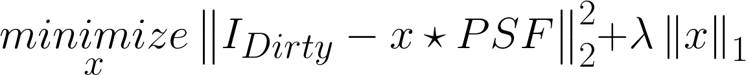
CLEAN and the non-uniform FFT

Slide 32
CLEAN and the non-uniform FFT

Slide 33

CLEAN and the non-uniform FFT

Slide 34
Compressed Sensing

Slide 35




Compressed Sensing (approx.)

Slide 36
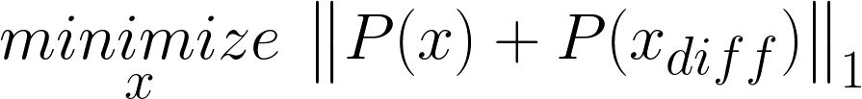
Compressed Sensing (approx.)

Slide 37
Compressed Sensing (approx.)

