Slide 1
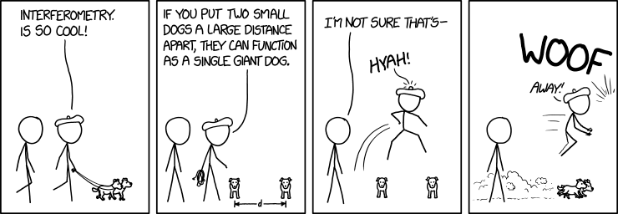
P8: Exploring the Fourier Transform for Compressed Sensing Reconstructions in the MeerKAT era

Slide 2
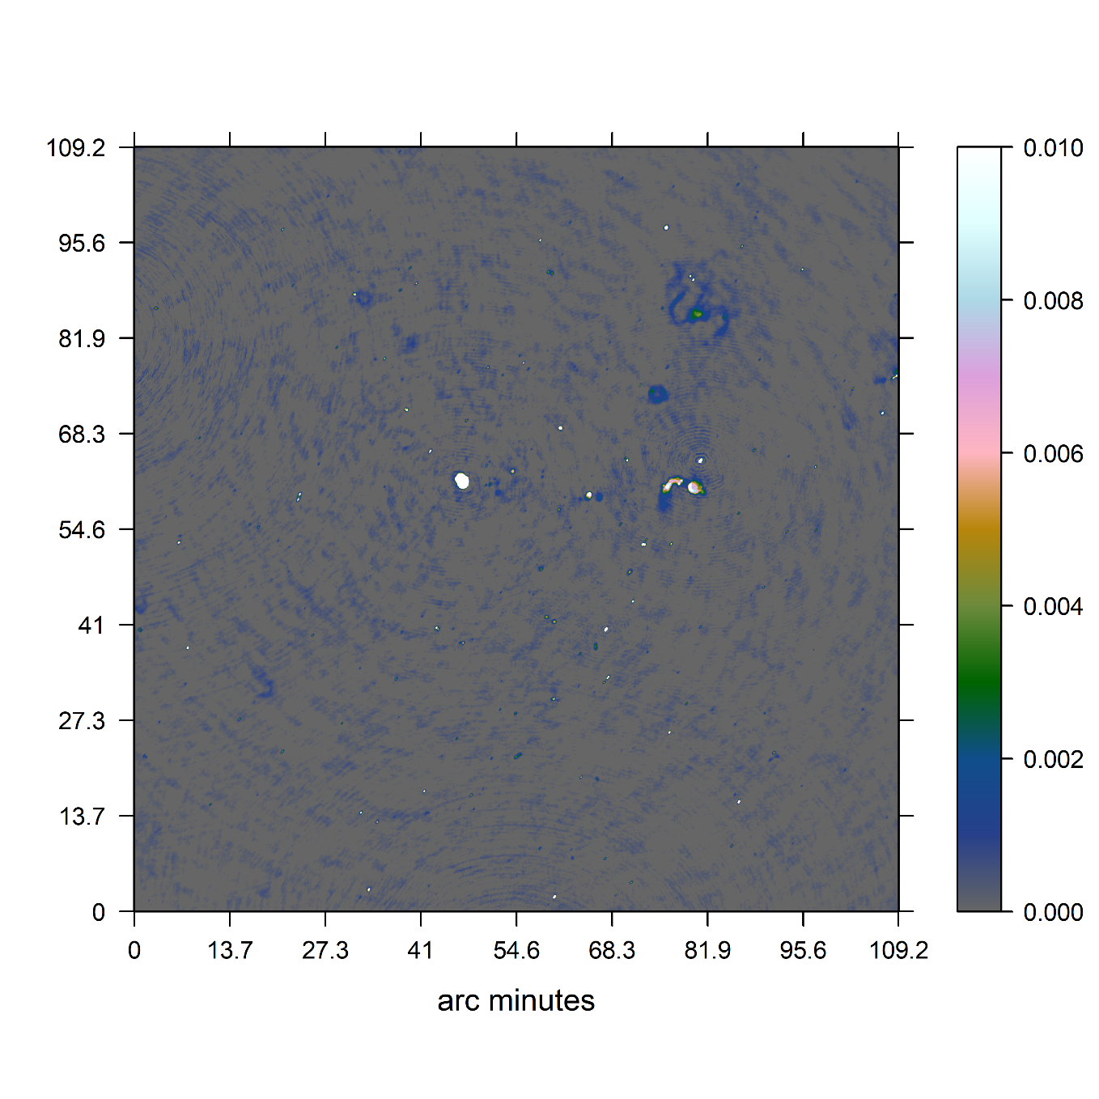
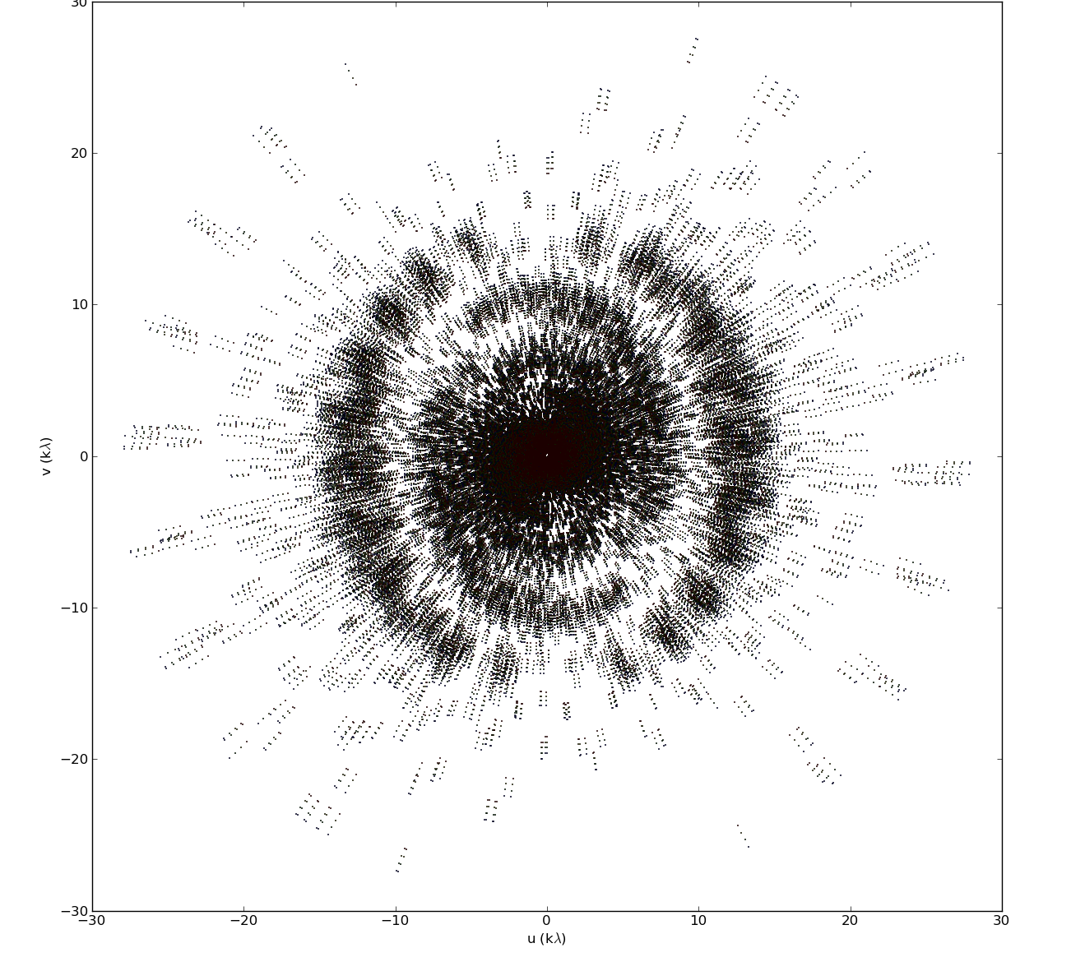
MeerKAT Radio Interferometer

Slide 3
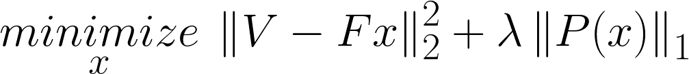
Reconstruction Problem
Image
Measurements

Slide 4
Reconstruction Problem
Image
Measurements

Slide 5
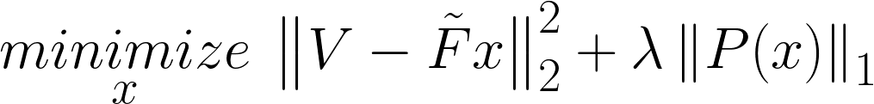
Reconstruction Problem
Non-uniform FFT
approximation

Slide 6
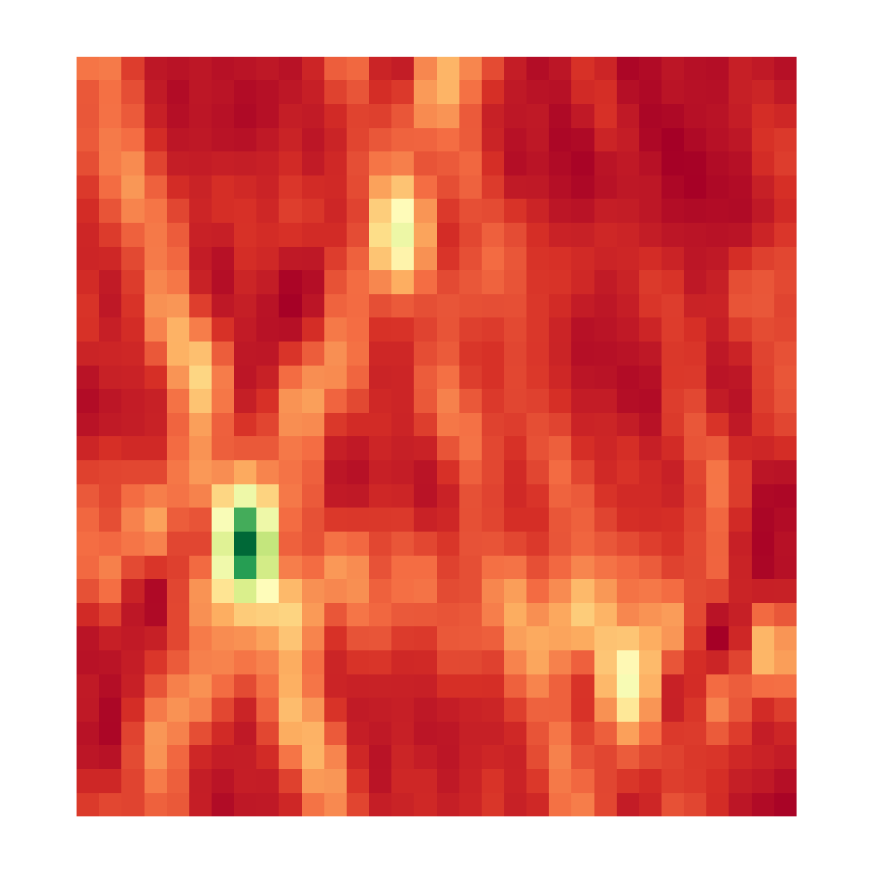
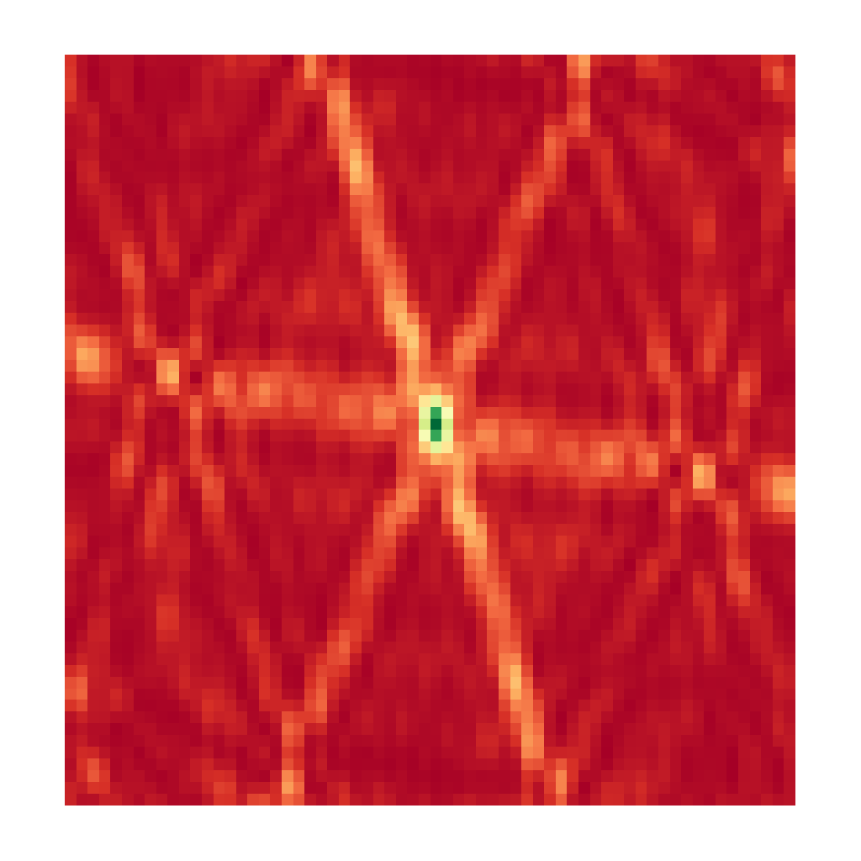
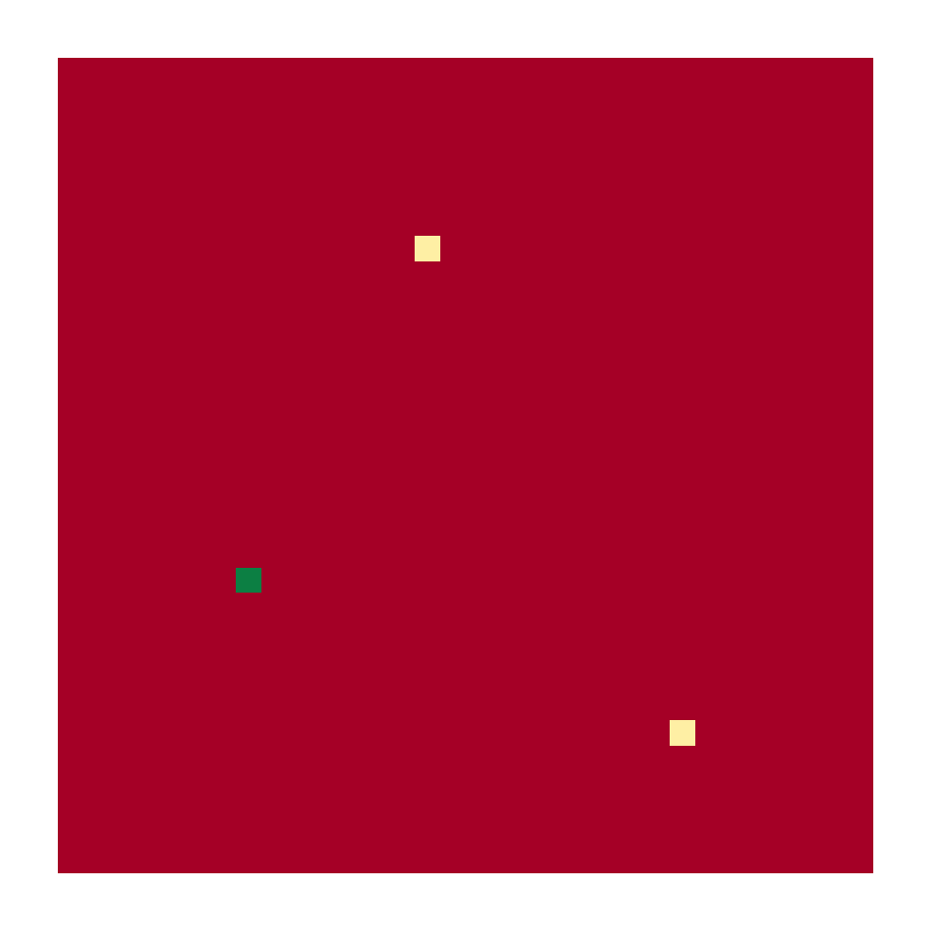
CLEAN and the non-uniform FFT
Dirty Image
Point Spread Function
Reconstruction

Slide 7

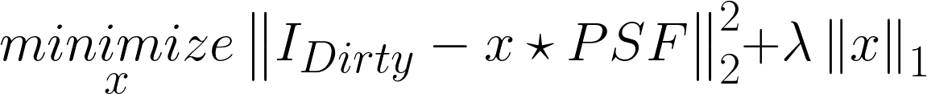
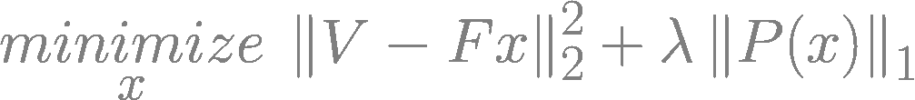
CLEAN and the non-uniform FFT

Slide 8
CLEAN and the non-uniform FFT

Slide 9

CLEAN and the non-uniform FFT

Slide 10
Redundancy and Noise

Slide 11
Replacing the non-uniform FFT
Direct Fourier Transform
Projection on a uniform grid
Spherical Wave Harmonics
…

Slide 12
My Solution
FT: Direct Fourier Transform
Optimization Algorithm: Coordinate Descent
Regularization: Starlet Transform

Slide 13
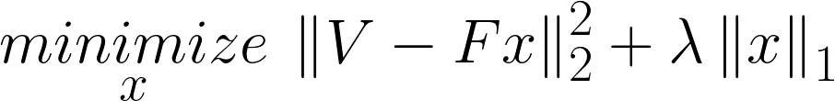
Coordinate Descent

Slide 14
Coordinate Descent
Dirty Image

Slide 15
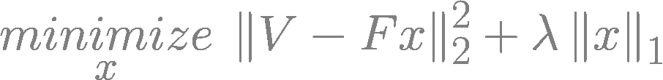
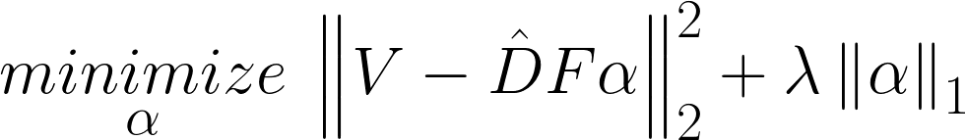


Coordinate Descent + Starlets

Slide 16
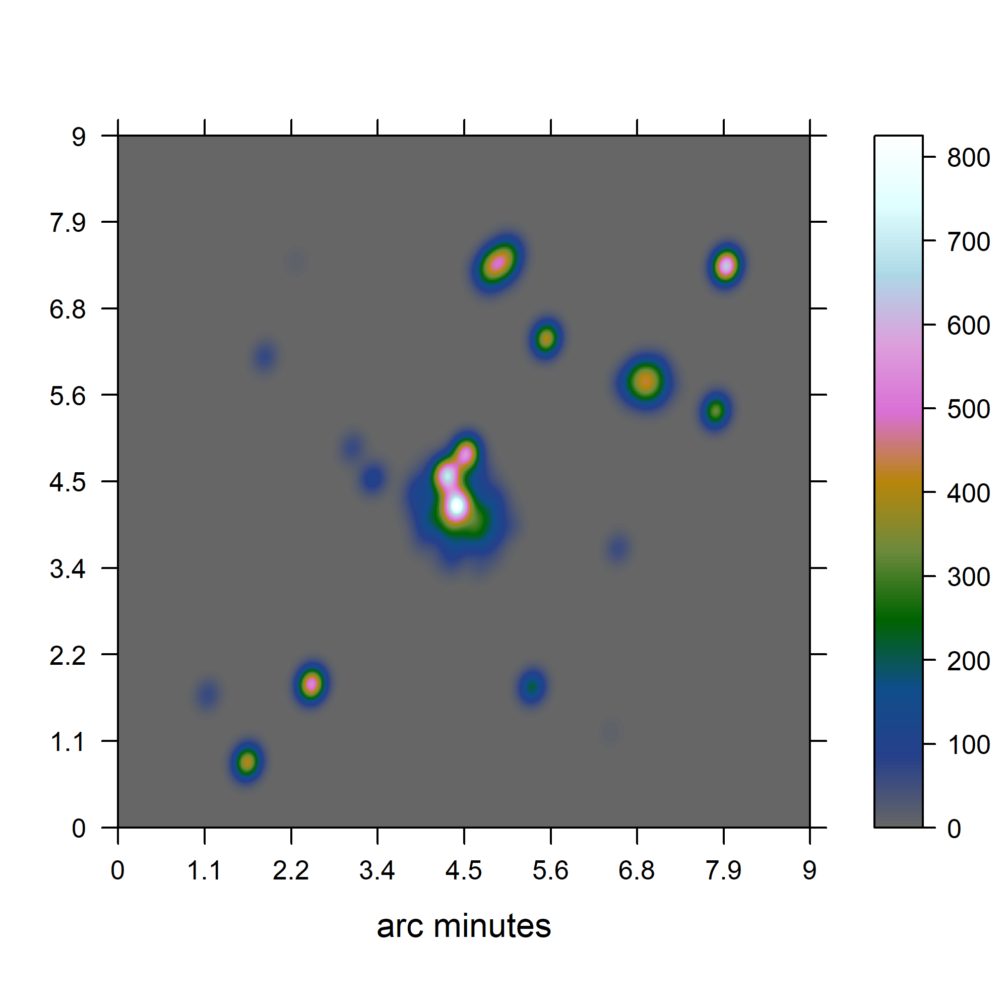
Test on simulated data

Slide 17
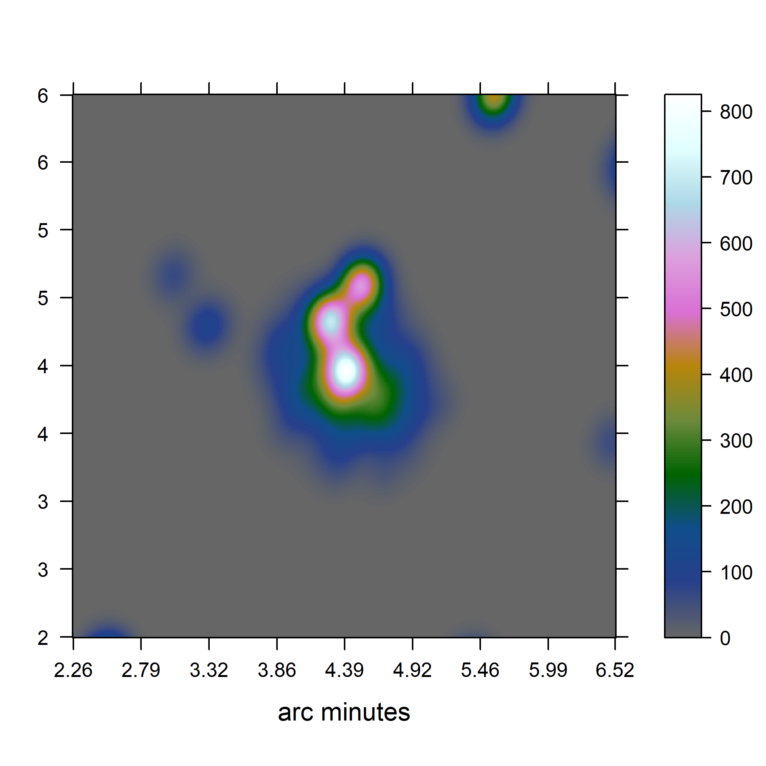
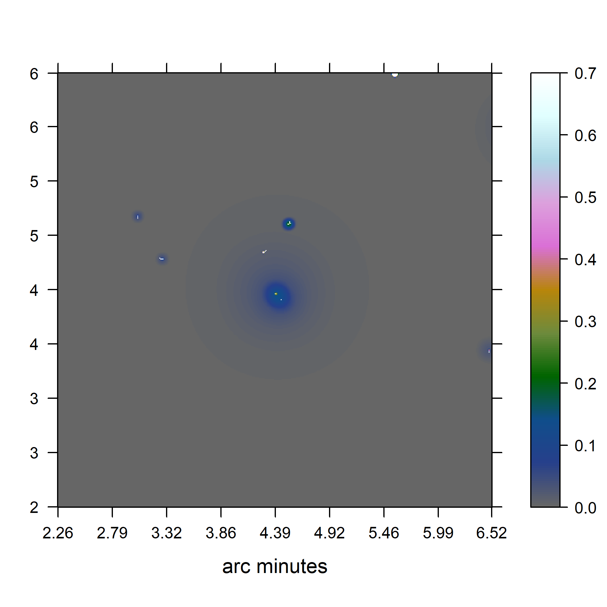
Test on simulated data
CLEAN
Coordinate Descent
Jansky/Beam

Slide 18
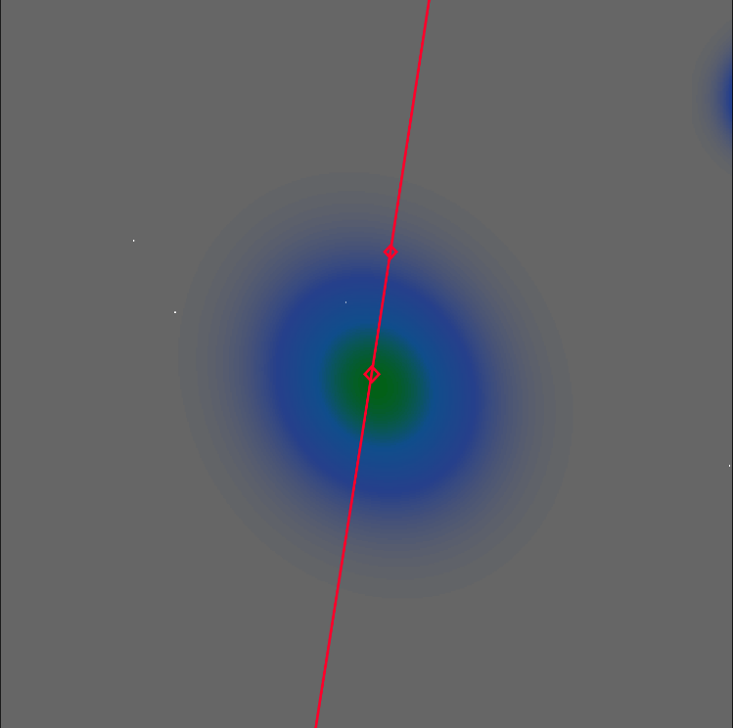
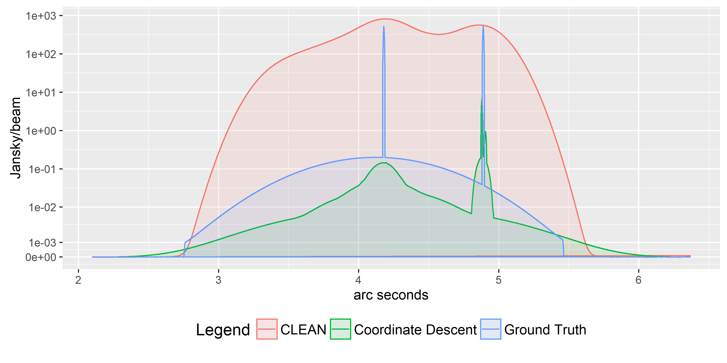
Test on simulated data

Slide 19
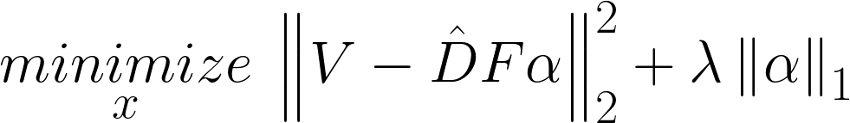
Test on simulated data
3300/1’100’000
~0.3%

Slide 20
Test on simulated data
3300/1’100’000
~0.3%
~250

Slide 21
Coordinate Descent for MeerKAT?

Slide 22



Coordinate Descent for MeerKAT?

Slide 23
Coordinate Descent for MeerKAT?
4000 Million Visibilities → M
60 Million Pixels → N
250+ non-zero entries → s

Slide 24


Coordinate Descent for MeerKAT?
4000 Million Visibilities → M
60 Million Pixels → N
250+ non-zero entries → s

Slide 25
Coordinate Descent for MeerKAT?
No
but…

Slide 26
Redundancy and Noise

Slide 27
Replacing the non-uniform FFT
Direct Fourier Transform
Projection on a uniform grid
Spherical Wave Harmonics
…

Slide 28
Future of MeerKAT
10 tb/s

Slide 29
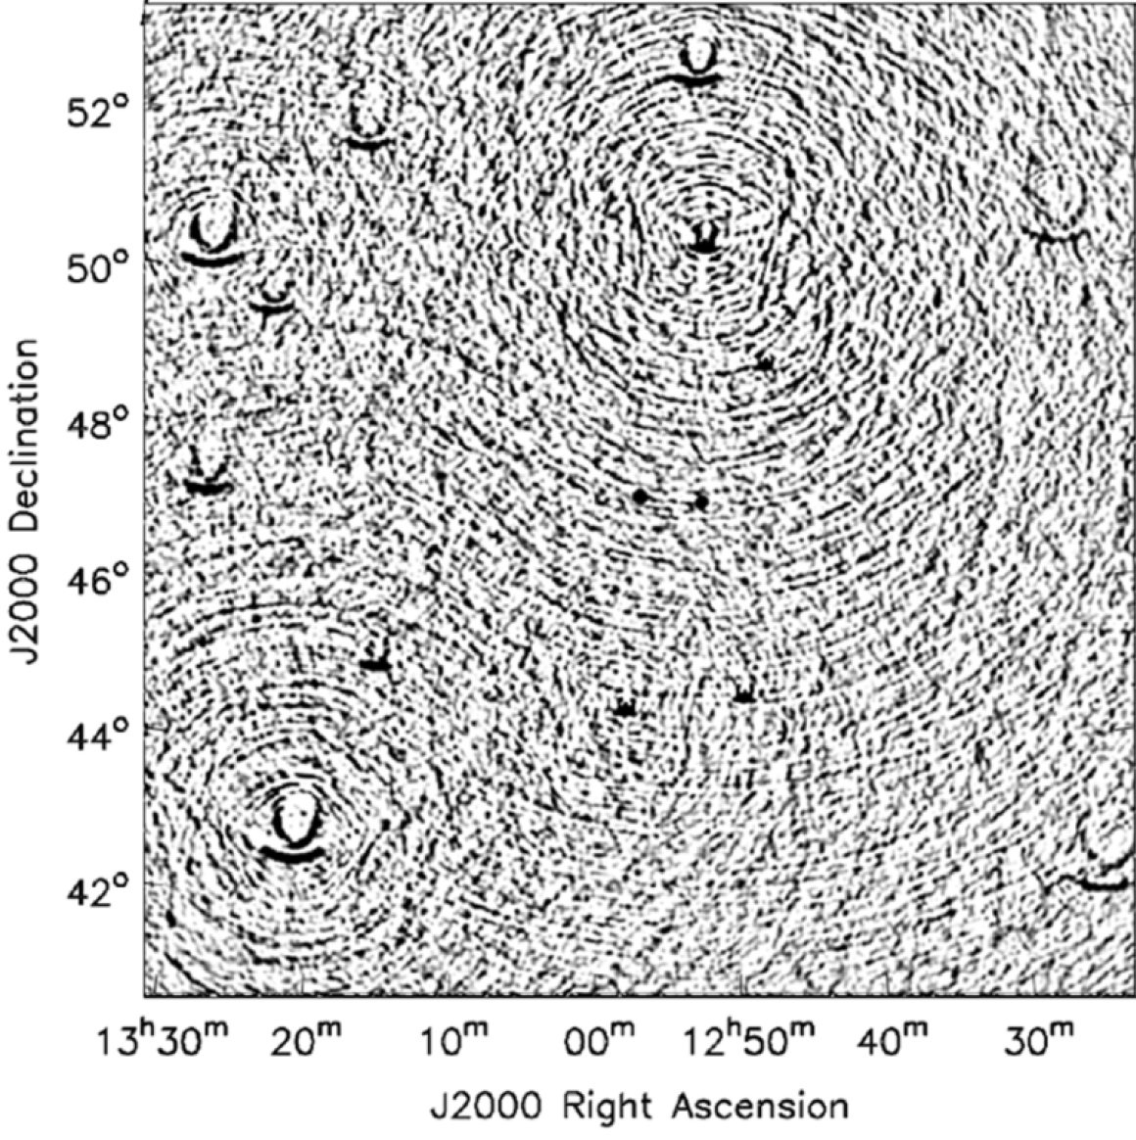
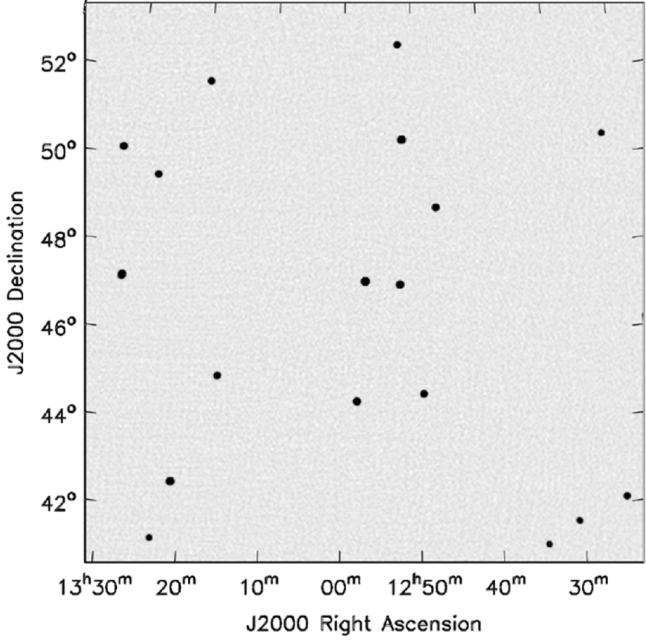
Wide Field of View
2D Fourier Transform
With w-correction

Slide 30
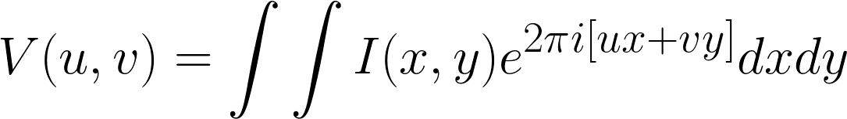
Wide Field of View

Slide 31
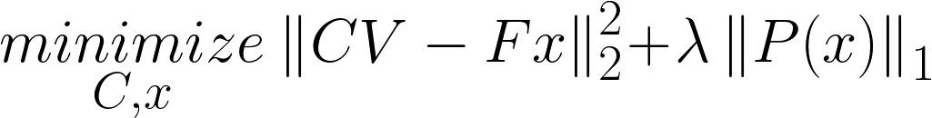
Calibration

Slide 32
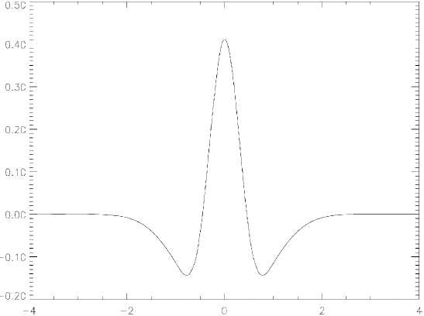
Starlet

Slide 33




Super Resolution (but)

Slide 34
Compressed Sensing

Slide 35



Compressed Sensing (approx.)

Slide 36
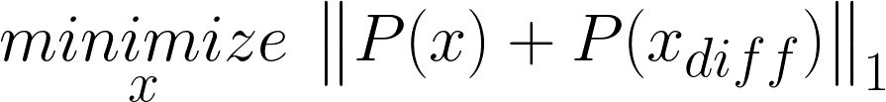
Compressed Sensing (approx.)

Slide 37
Compressed Sensing (approx.)

