Slide 1
P8: Exploring the Fourier Transform for Compressed Sensing Reconstructions in the MeerKAT era

Slide 2
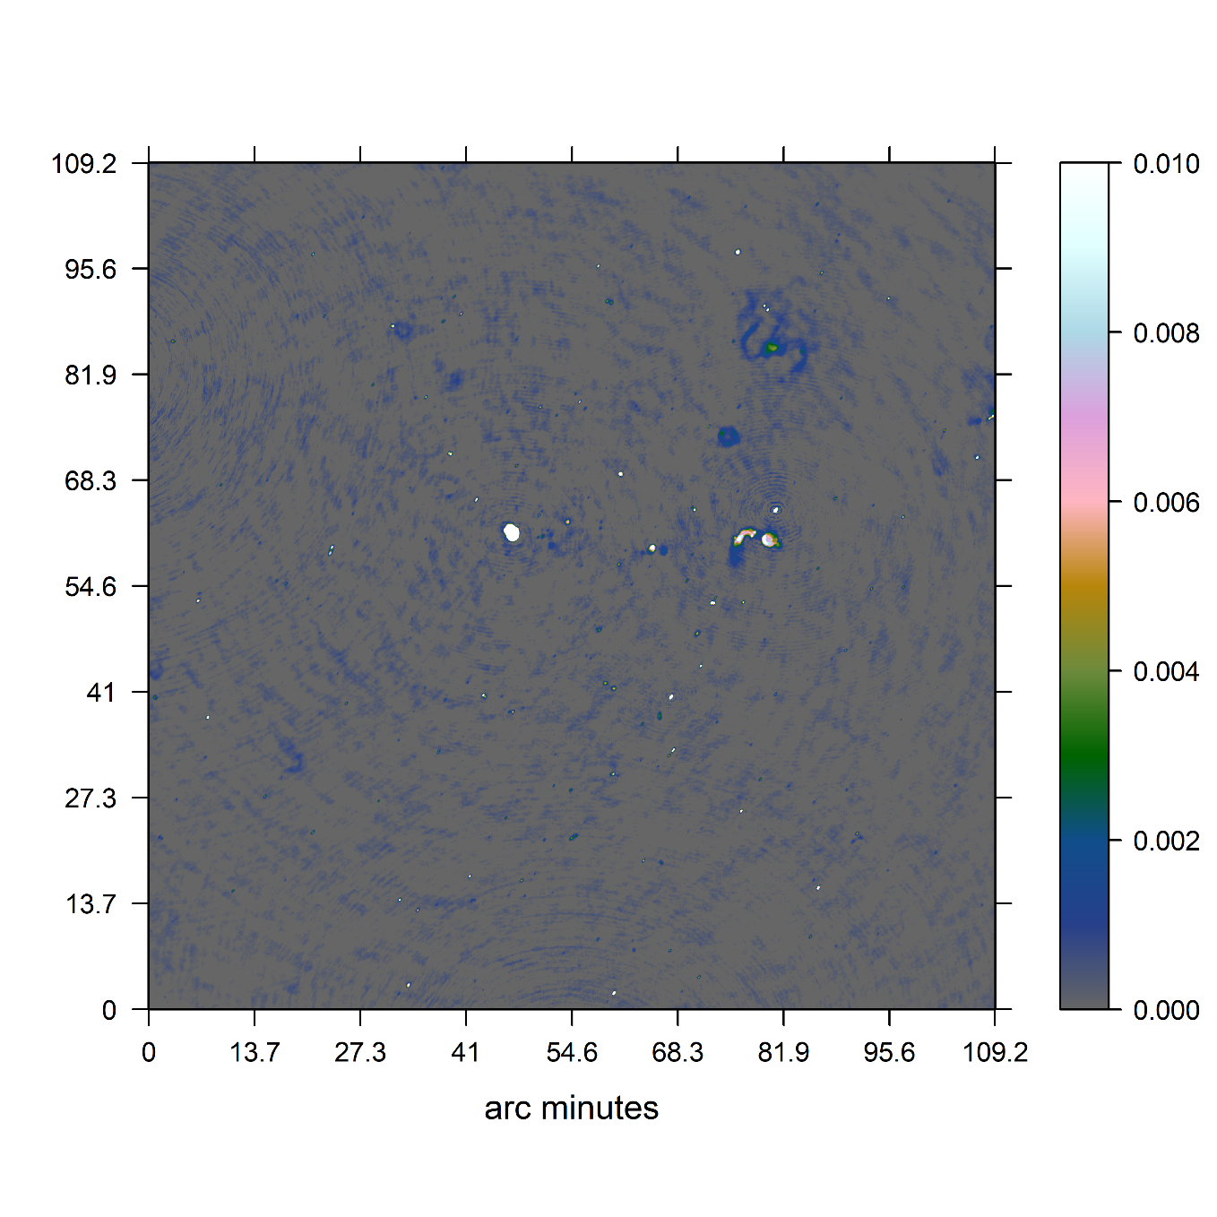
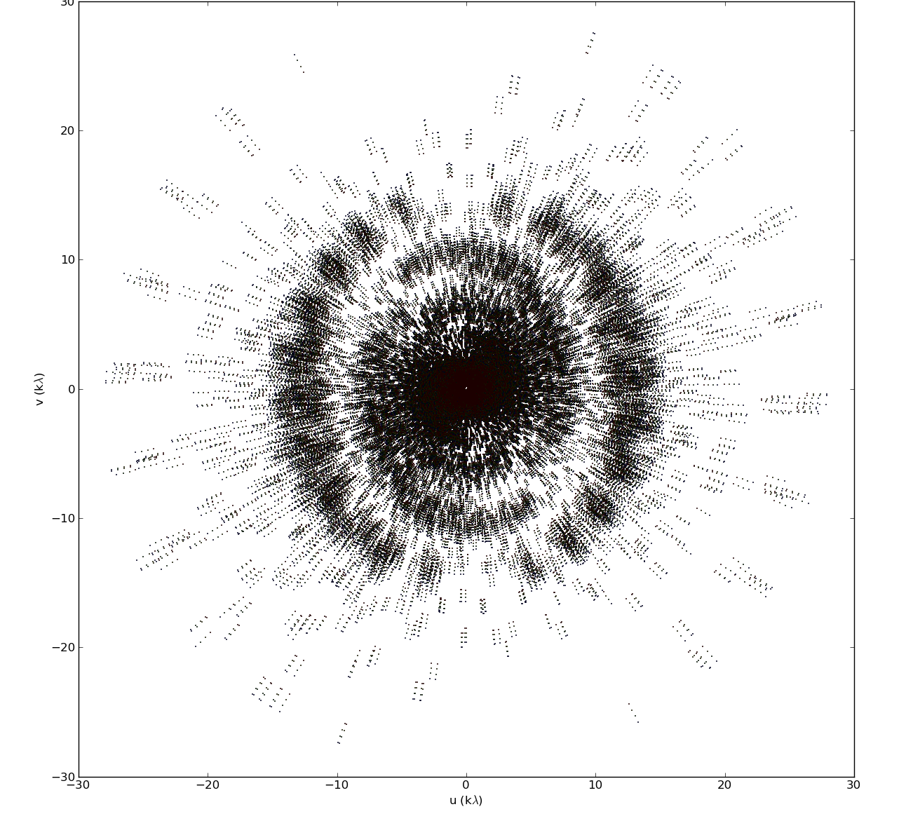
Radio Interferometers

Slide 3
The MeerKAT era
4000 Million+ Visibility Measurements
60 Million+ Pixels

Slide 4
Why Compressed Sensing

Slide 5
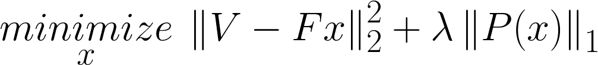
Reconstruction Problem
Image
Measurements

Slide 6
Reconstruction Problem
Image
Measurements

Slide 7
Redundancy and Noise

Slide 8
Reconstruction Problem

Slide 9
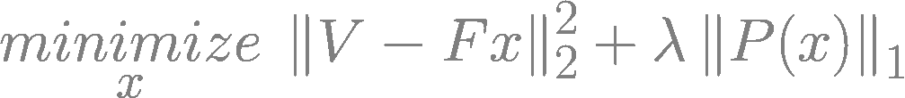
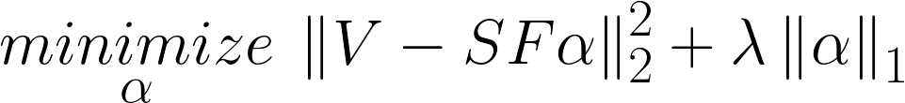

Reconstruction Problem and my Solution
Sparse Starlet
Space

Slide 10
CLEAN and the non-uniform FFT

Slide 11

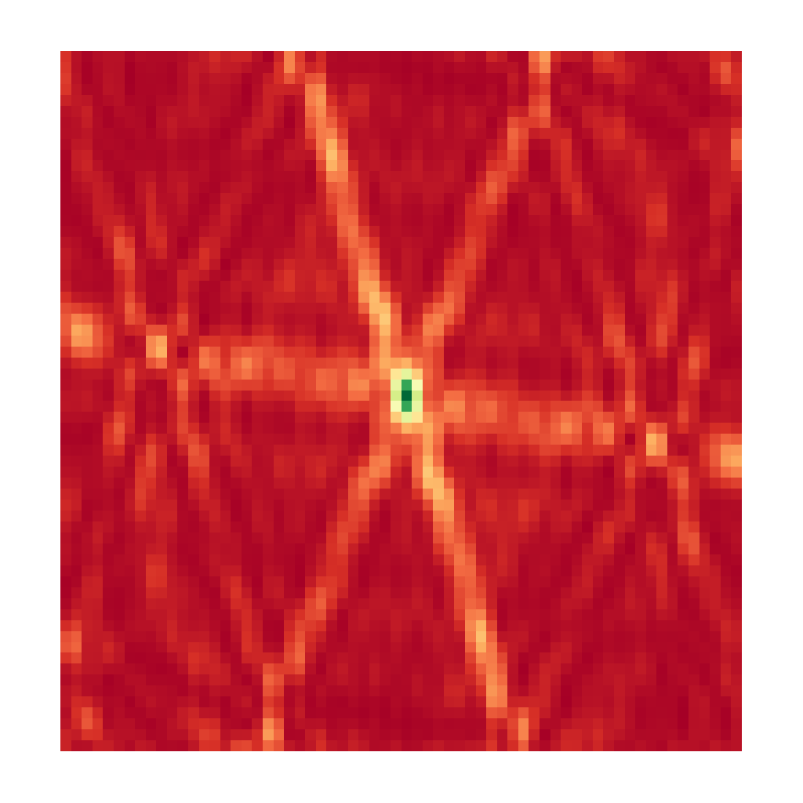
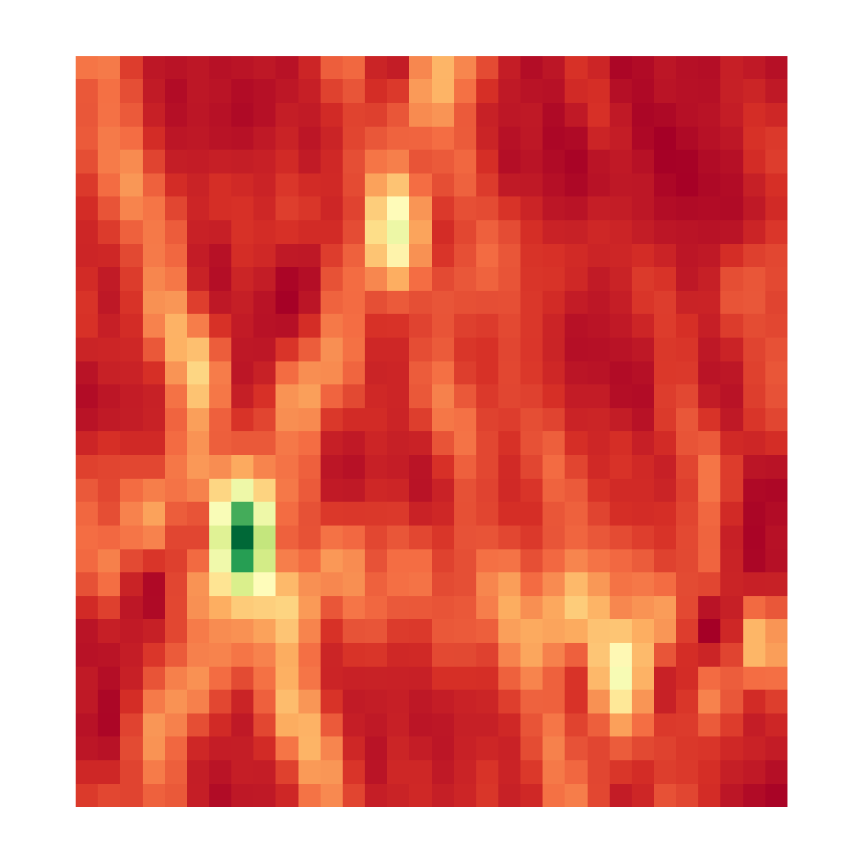
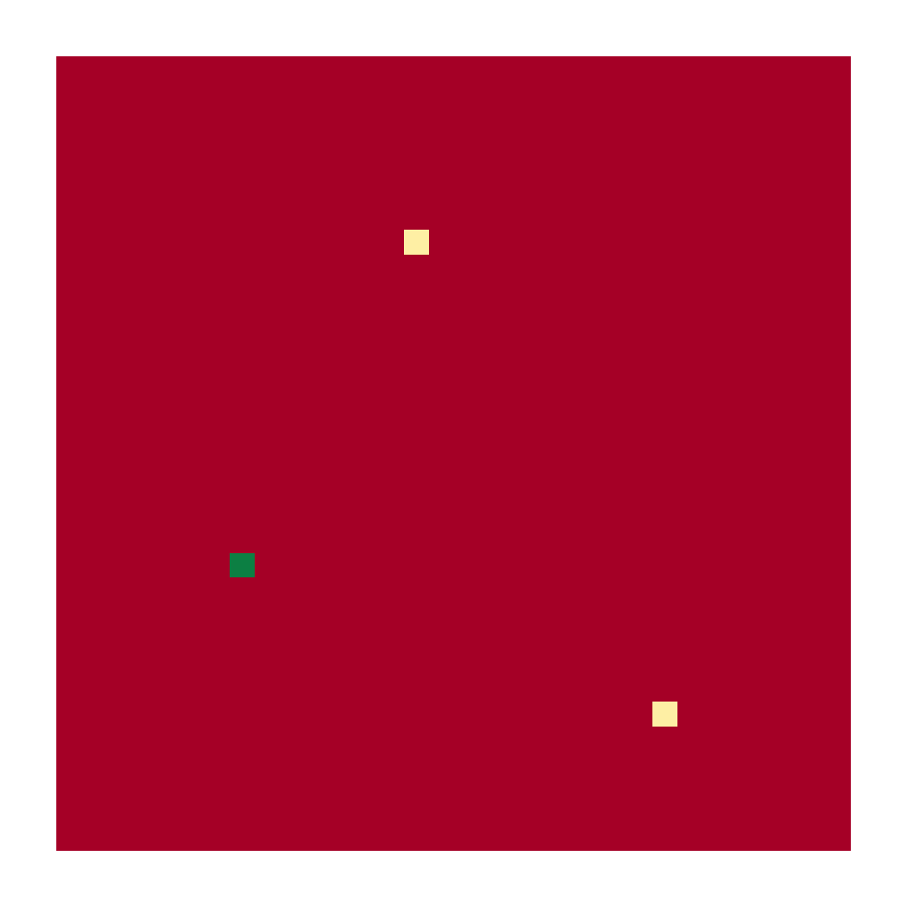
CLEAN and the non-uniform FFT
Point Spread Function
Dirty Image
Reconstruction

Slide 12
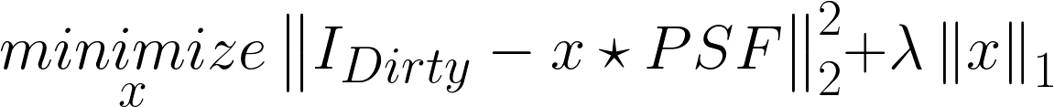
CLEAN and the non-uniform FFT

Slide 13
CLEAN and the non-uniform FFT

Slide 14
Compressed Sensing

Slide 15




Compressed Sensing (approx.)

Slide 16
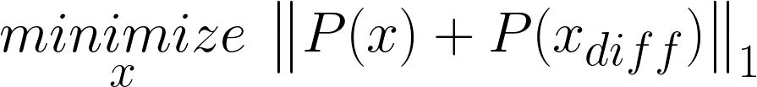
Compressed Sensing (approx.)

Slide 17
Compressed Sensing (approx.)

Slide 18
Replacing the non-uniform FFT
Projection on a uniform Grid
Direct Fourier Transform

Slide 19
Projection on a uniform Grid

Slide 20
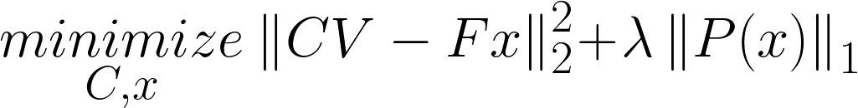
Projection on a uniform Grid

Slide 21
Direct Fourier Transform

Slide 22
Direct Fourier Transform and Coordinate Descent

Slide 23
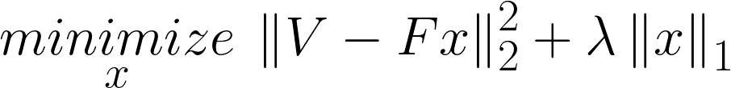
Direct Fourier Transform and Coordinate Descent

Slide 24
Direct Fourier Transform and Coordinate Descent
Dirty Image

Slide 25
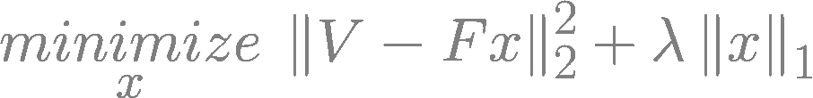
Direct Fourier Transform and Coordinate Descent

Slide 26
Simulated results

Slide 27
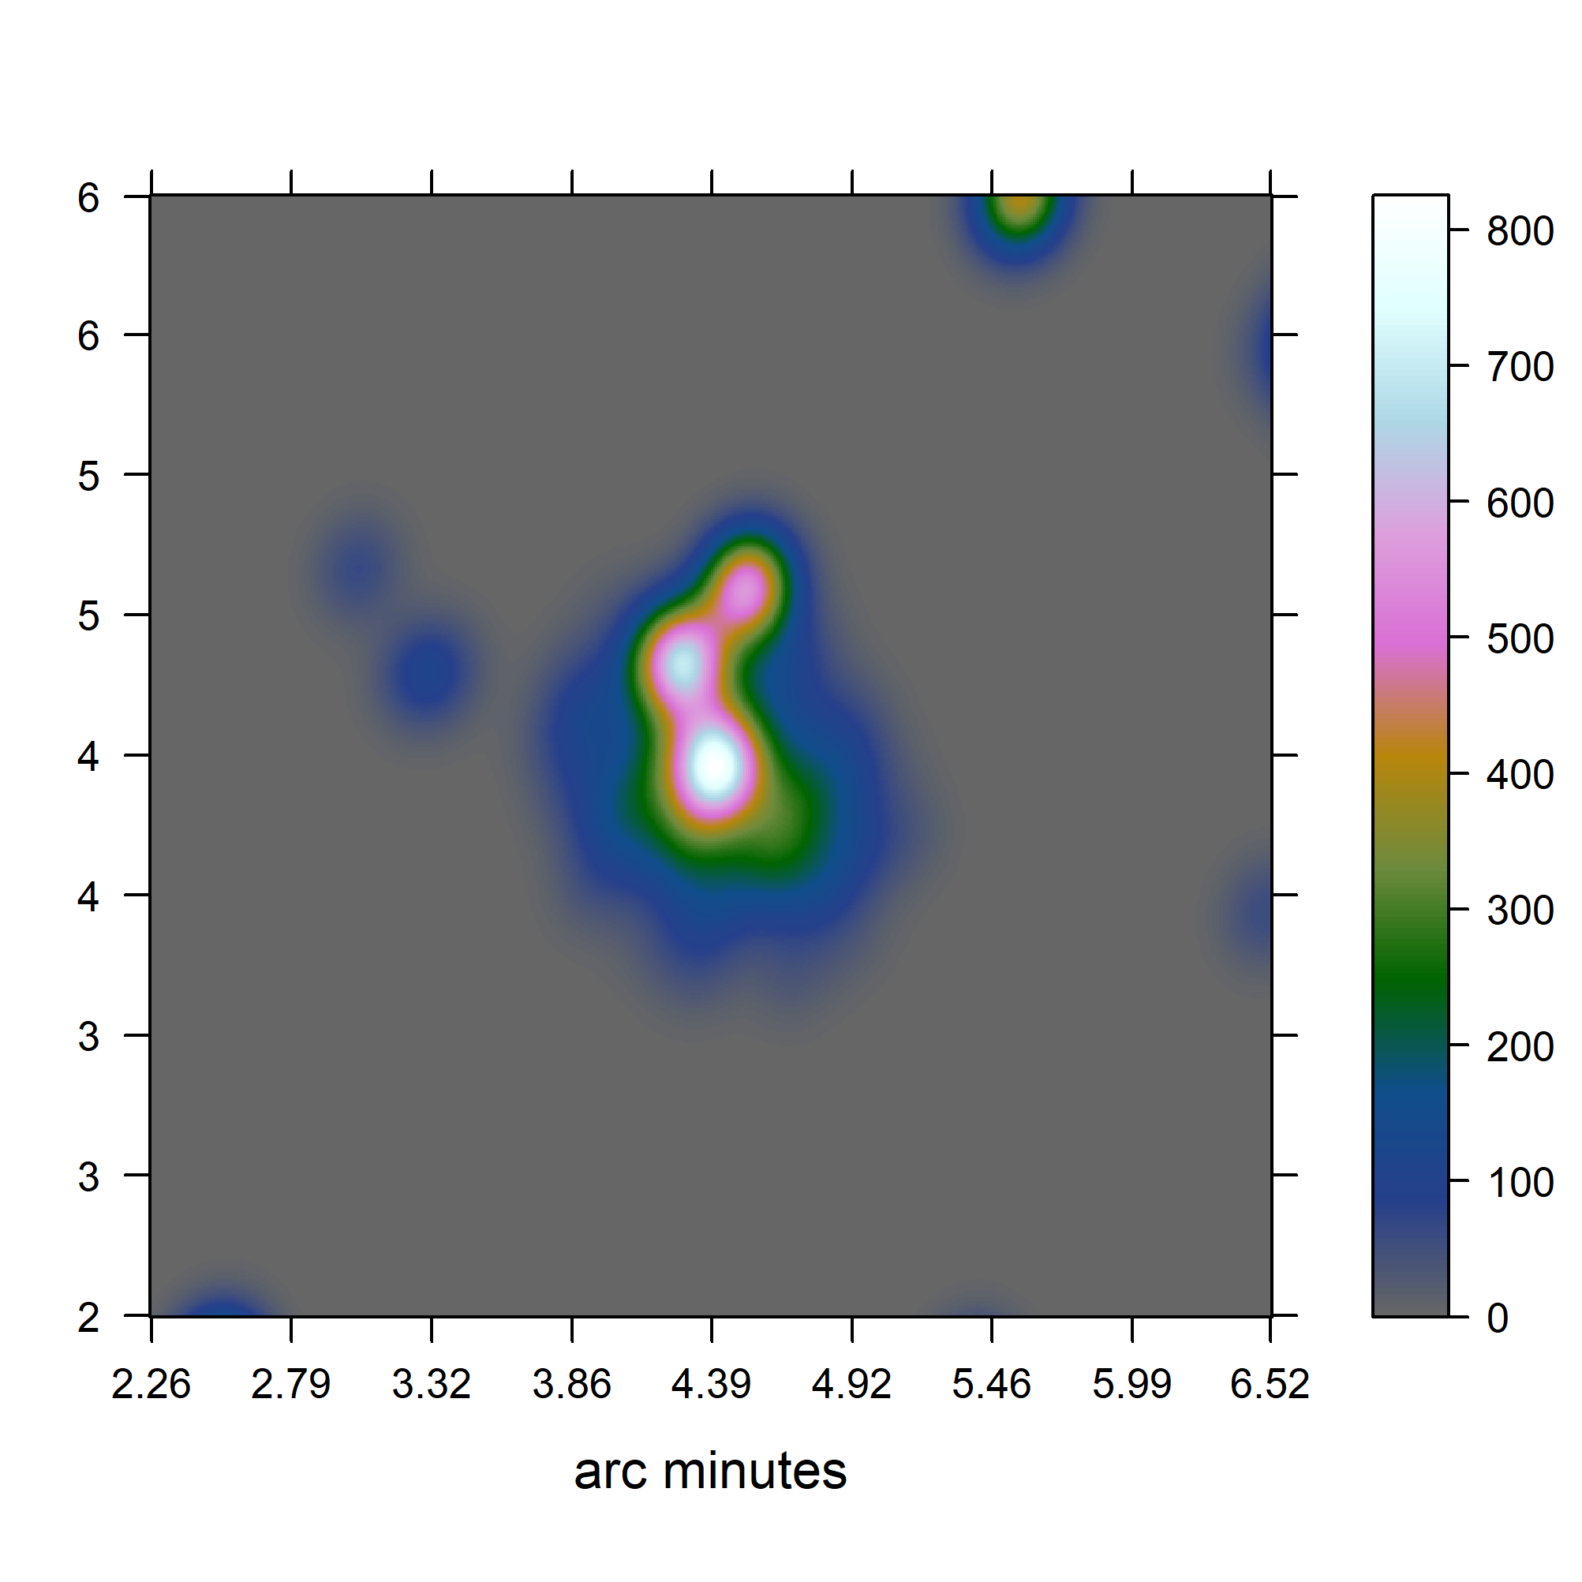
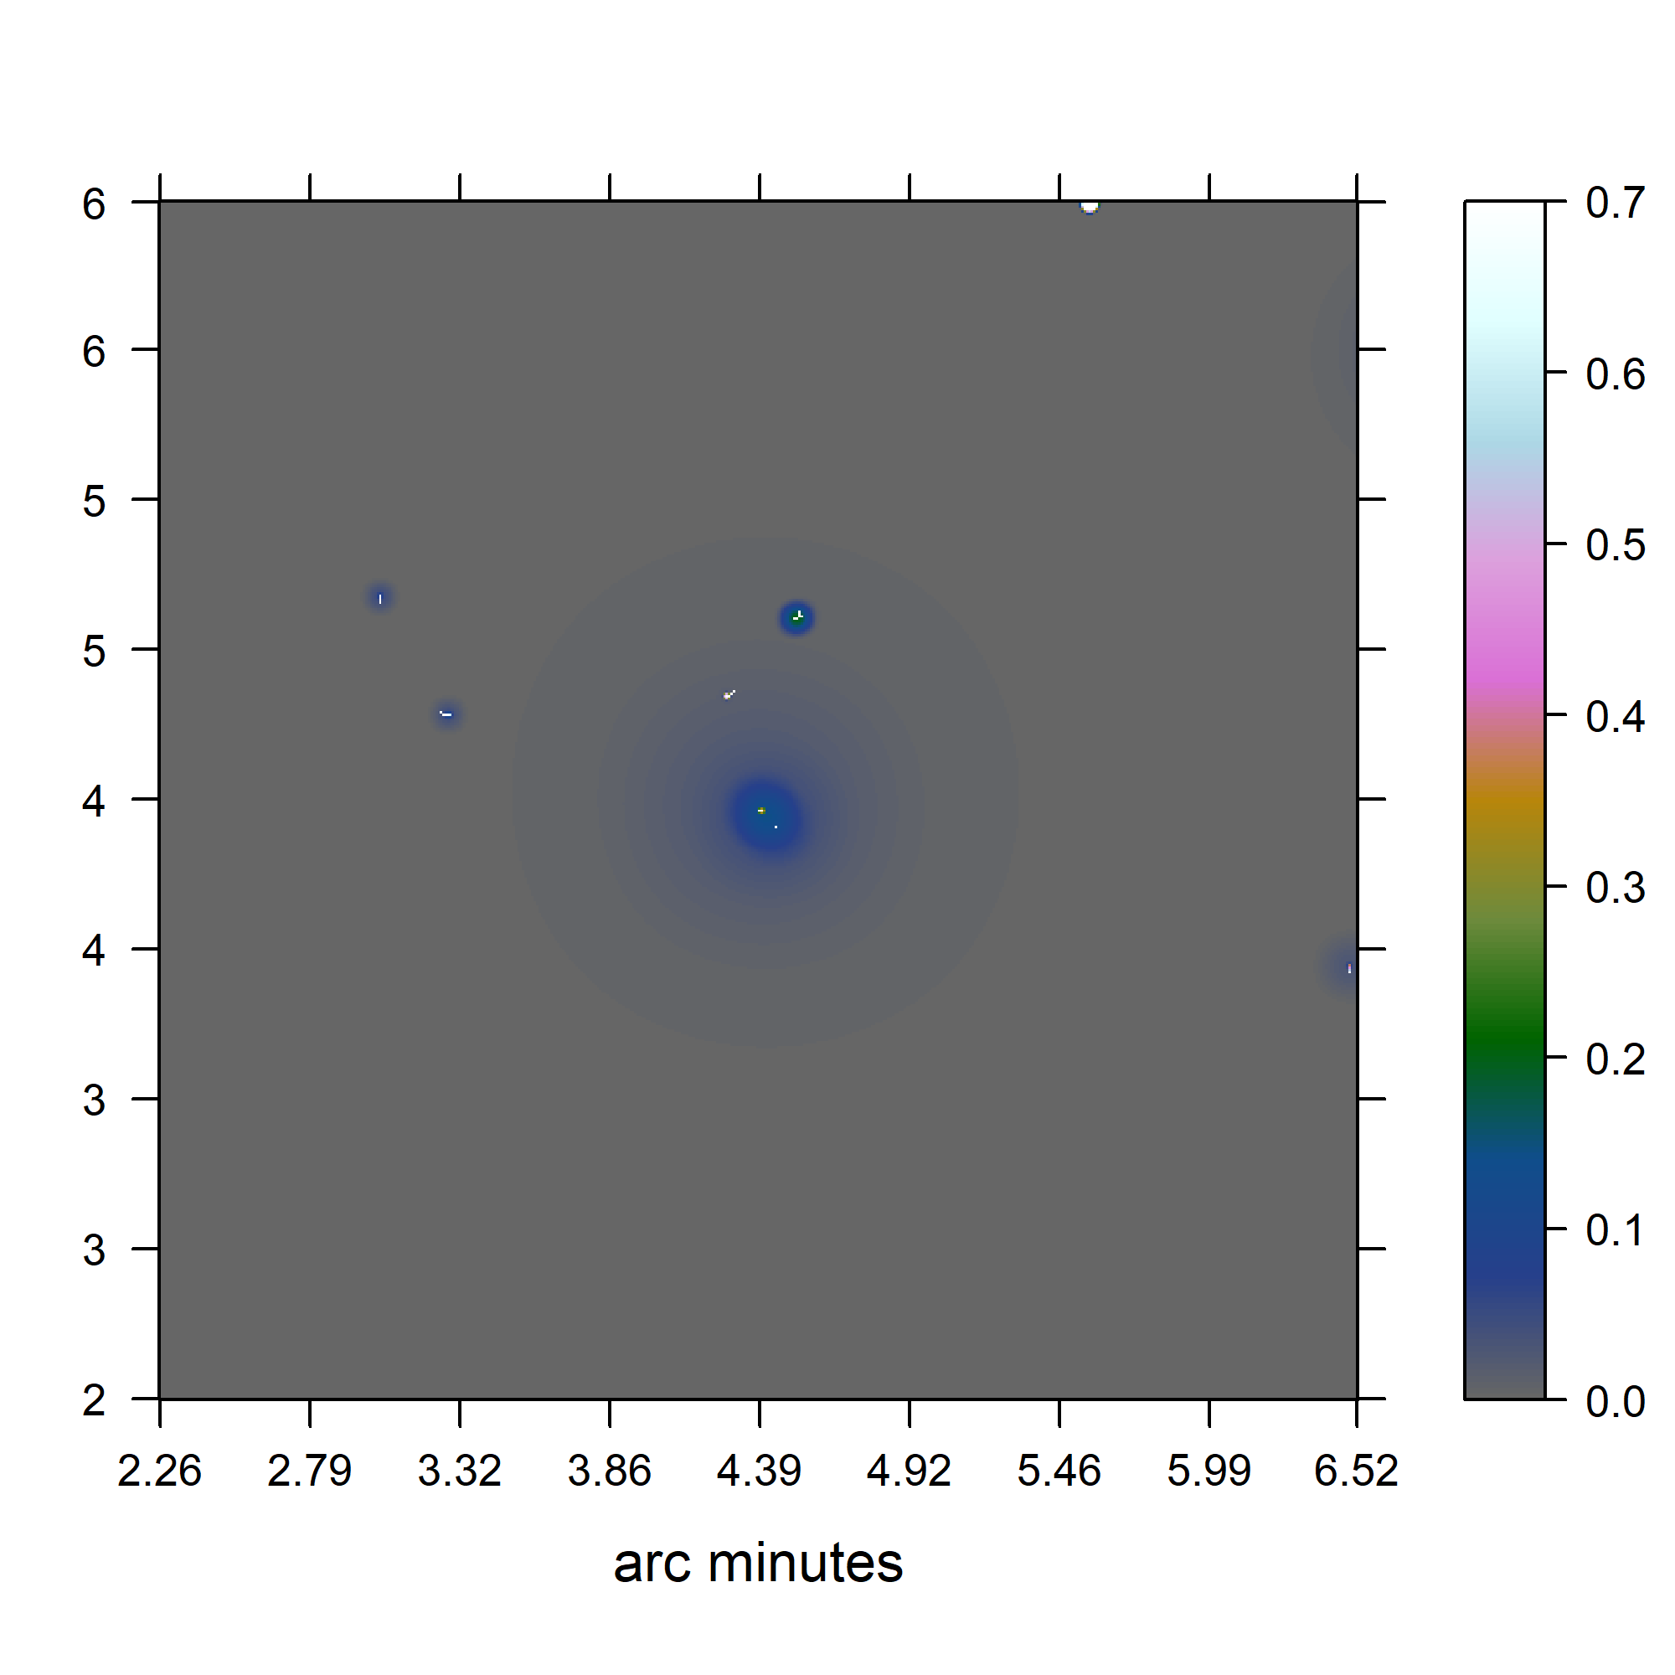
Simulated results

Slide 28
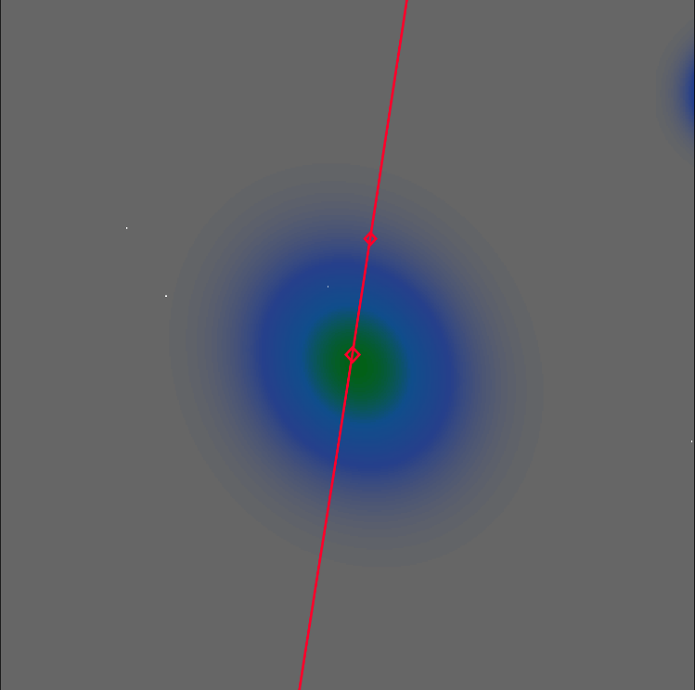
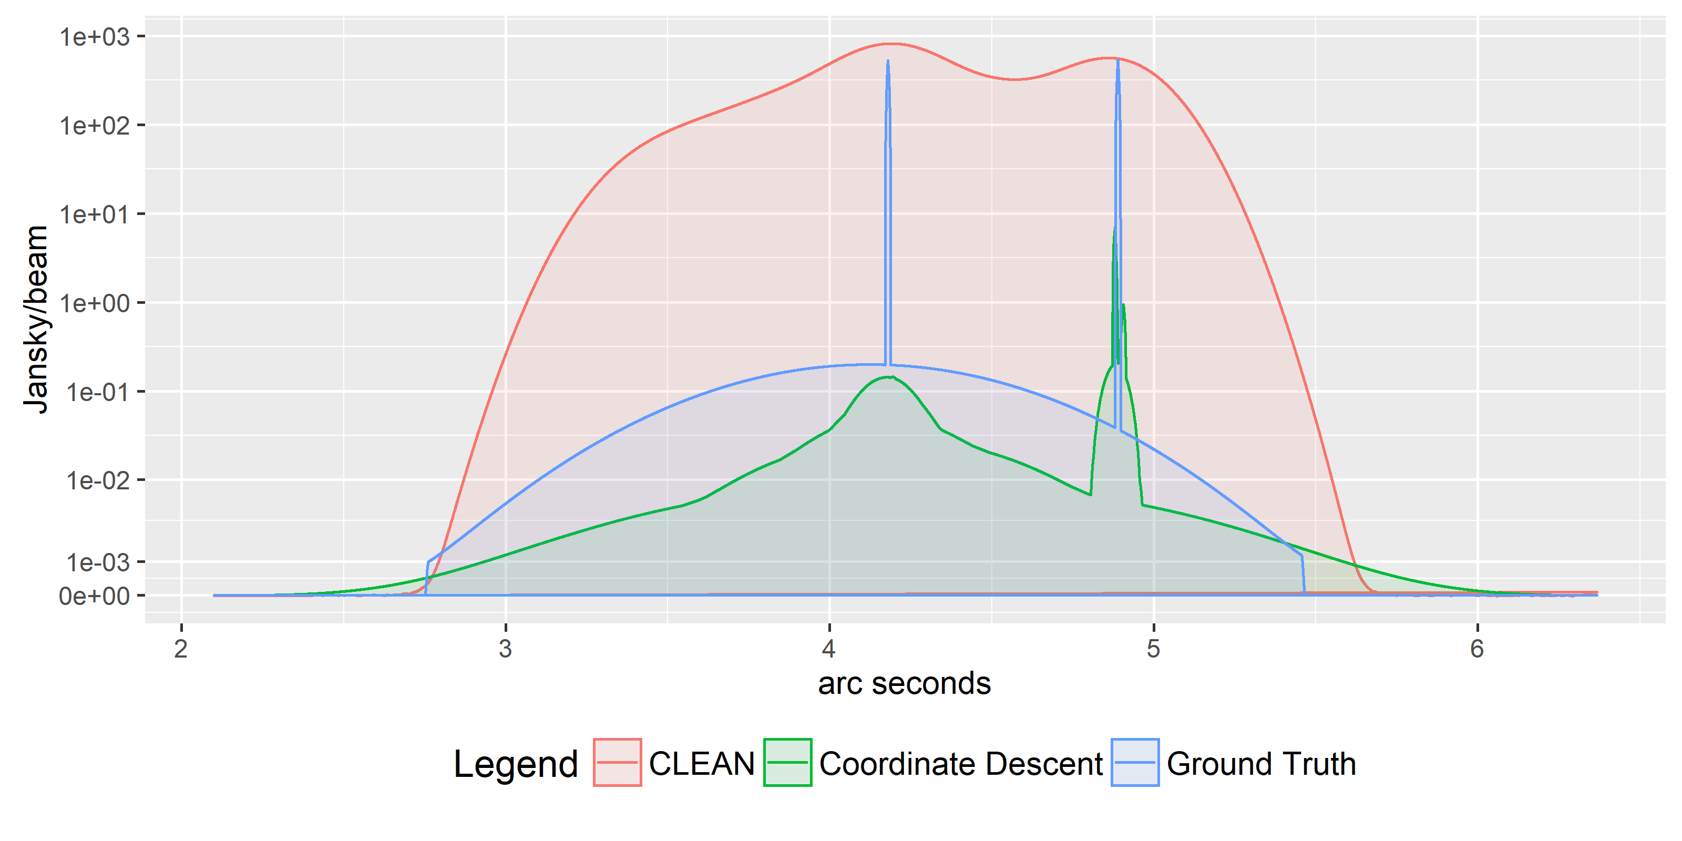
Simulated results

Slide 29




Super Resolution (but)

Slide 30
Coordinate Descent for MeerKAT?

Slide 31
Coordinate Descent for MeerKAT?
Sparse
Coordinate Descent: Columns * sparse * iterations

Slide 32
Coordinate Descent for MeerKAT?
Sparse
Coordinate Descent: nr rows * sparse * iterations

Slide 33
Redundancy and Noise

Slide 34
Future

Slide 35
Future

Slide 36
Future

Slide 37
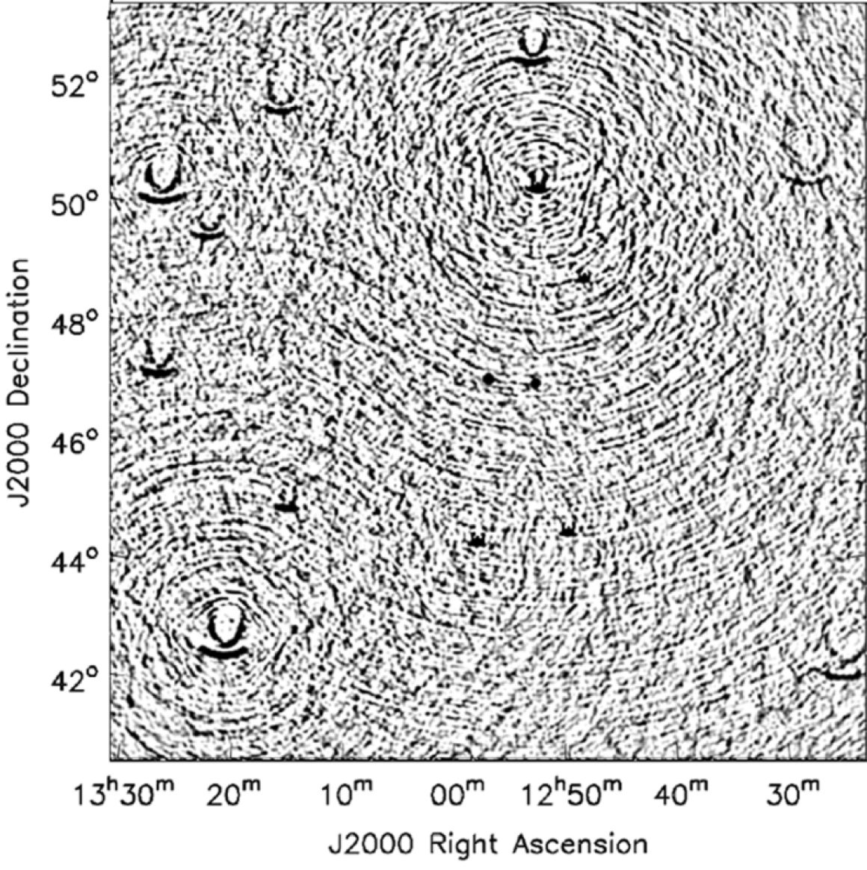
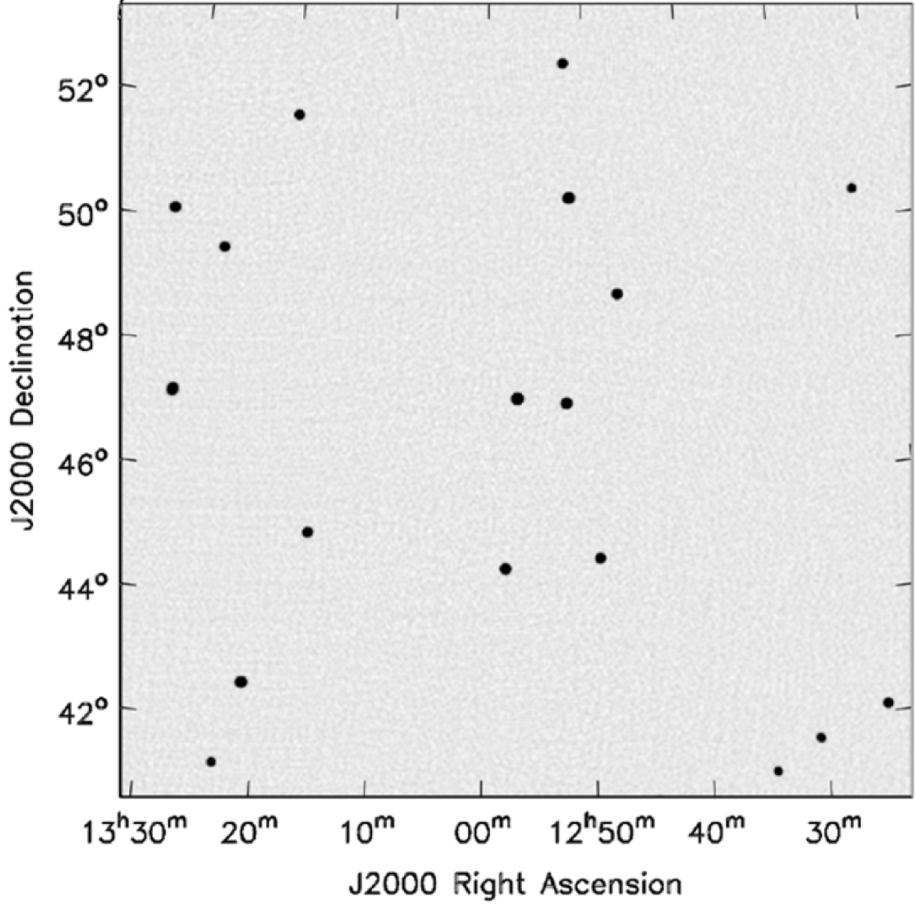
Wide Field of View
2D Fourier Transform
With w-correction

Slide 38
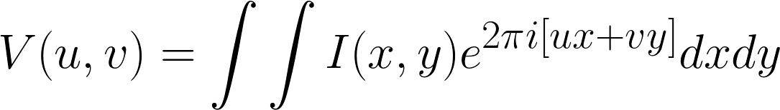
Wide Field of View

Slide 39
Calibration

Slide 40
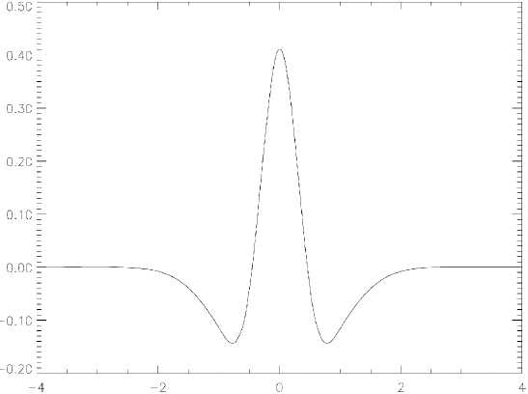
Starlet

Slide 41
CLEAN and the non-uniform FFT

