Slide 1
Towards distributed image reconstruction
Jonas Schwammberger
Master student @ Institute for Data Science, FHNW

Slide 2
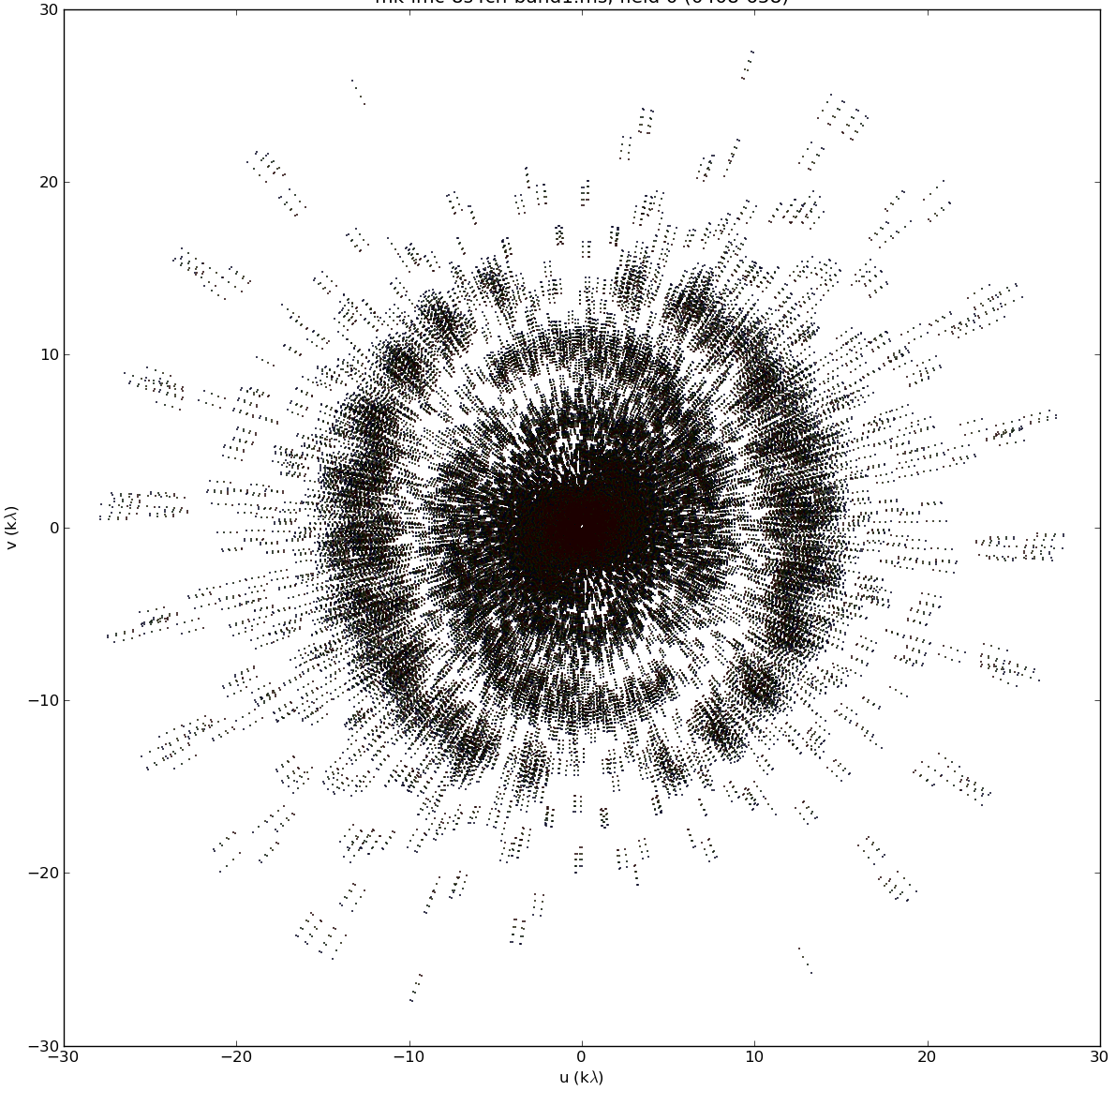
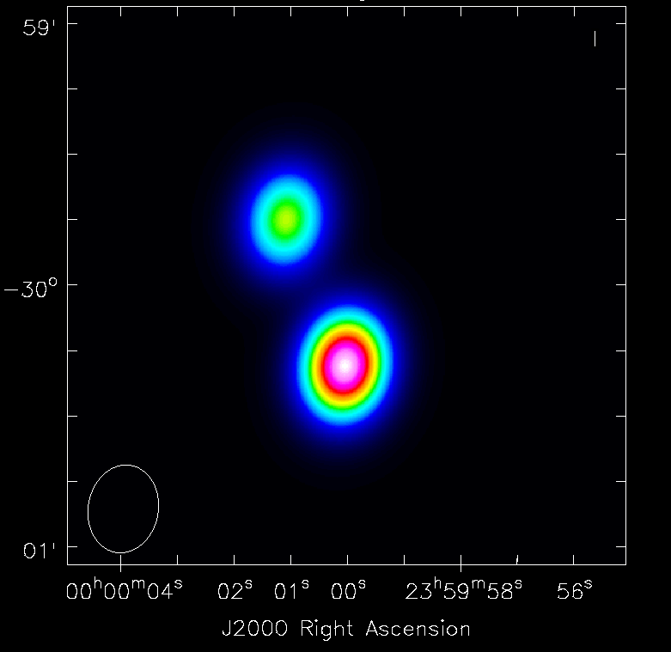
Image reconstruction problem
Image space
Fourier space

Slide 3
Why do we need distribution?

Slide 4
Distributed gridding and deconvolution
Implementation: .netcore (C#)
MPI for node communication
Hardware: 4 Linux nodes, 1 CPU each
Speedup on 1GB LMC MeerKAT observation
Preliminary results and algorithms

Slide 5
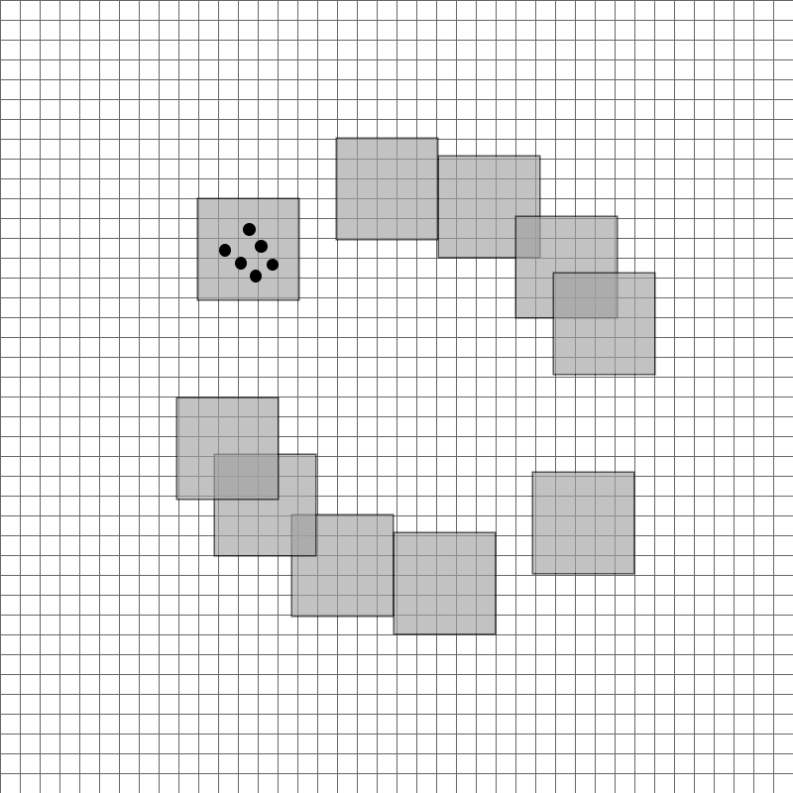
Image Domain Gridding (IDG)
uniform grid
Veenboer, Bram, Matthias Petschow, and John W. Romein. "Image-Domain gridding on graphics processors." 2017 IEEE International Parallel and Distributed Processing Symposium (IPDPS). IEEE, 2017.
visibilities
subgrids

Slide 6
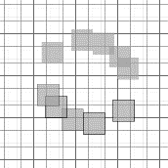
Distributed gridding
MPI_Reduce
Grid 1024 *1024
~8 MB
~1000 MB

Slide 7
Distributed gridding

Slide 8
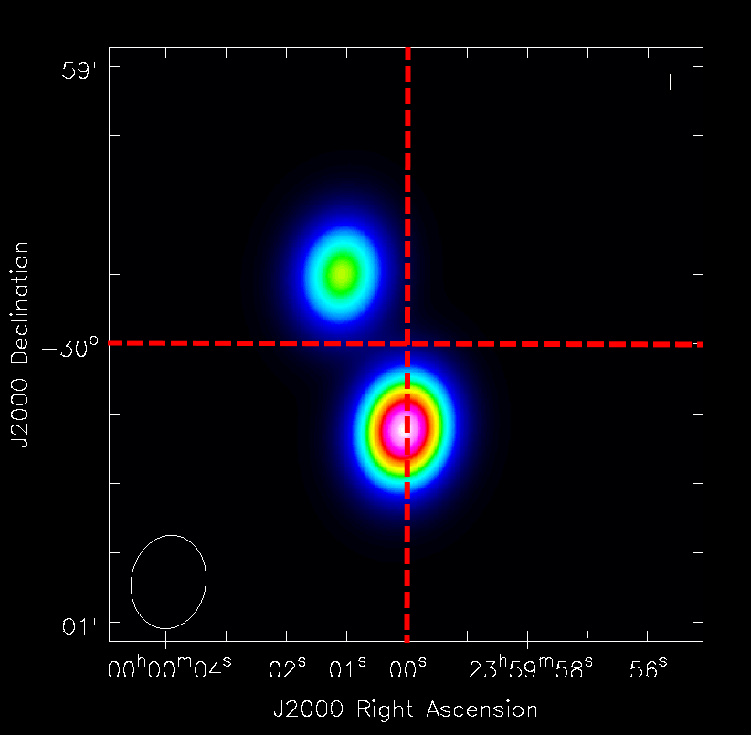
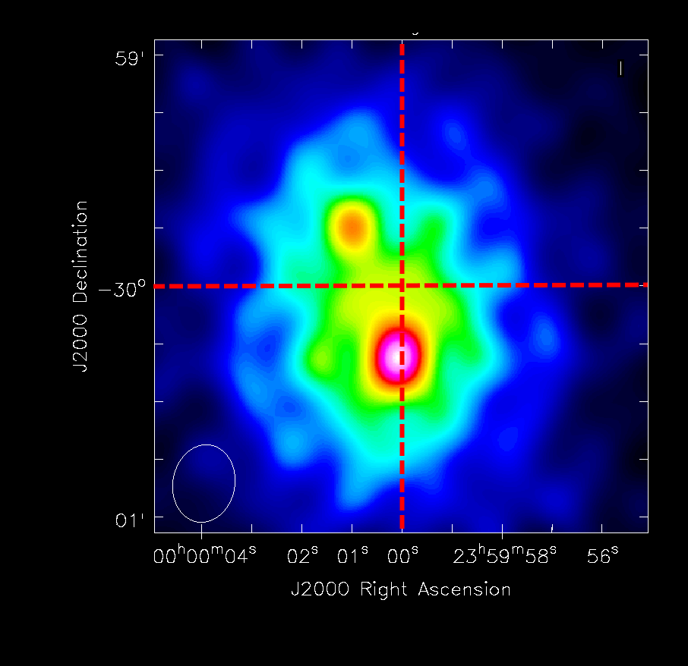
Distributed deconvolution

Slide 9
Methods for distributed deconvolution
ADMM methods in Radio Astronomy
Ferrari, André, et al. "Distributed image reconstruction for very large arrays in radio astronomy." 2014 IEEE 8th Sensor Array and Multichannel Signal Processing Workshop (SAM). IEEE, 2014.
Carrillo, Rafael E., Jason D. McEwen, and Yves Wiaux. "PURIFY: a new approach to radio-interferometric imaging." Monthly Notices of the Royal Astronomical Society 439.4 (2014): 3591-3604.
…
Coordinate Descent methods in Signal Processing
Fercoq, Olivier, et al. "Fast distributed coordinate descent for non-strongly convex losses." 2014 IEEE International Workshop on Machine Learning for Signal Processing (MLSP). IEEE, 2014.
Felix, Simon, Roman Bolzern, and Marina Battaglia. "A compressed sensing-based image reconstruction algorithm for solar flare X-ray observations." The Astrophysical Journal849.1 (2017): 10.
…

Slide 10
Coordinate Descent deconvolution
residuals = dirty image
Search pixel with the value that can be modified the most
Calculate the optimum value for this pixel independently of all other pixels (optimum of a parabola)
Update residuals
Repeat until residuals are small
More sophisticated CD methods, but that is the core algorithm

Slide 11
Distributed Coordinate Descent deconvolution
Distributed CD:
Search local pixel with the value that can be modified the most
Find best global pixel (MPI_ReduceAll)
Update local residuals
Repeat

Slide 12
Distributed Coordinate Descent

Slide 13
Baseline distributed gridding + deconvolution
Distributed gridding: More effective with a lot of input data
Distributed deconvolution:
We have more communication efficient CD methods to explore:
Shotgun
PCDM
Hydra
…
CD on the GPU: McGaffin, Madison Gray, and Jeffrey A. Fessler. "Edge-preserving image denoising via group coordinate descent on the GPU." IEEE Transactions on Image Processing 24.4 (2015): 1273-1281.

Slide 14
Questions

Slide 15


Comparison CLEAN with CD+ElasticNet
Noise Regularization: ElasticNET
L1 Norm
L2 Norm
+

Slide 16
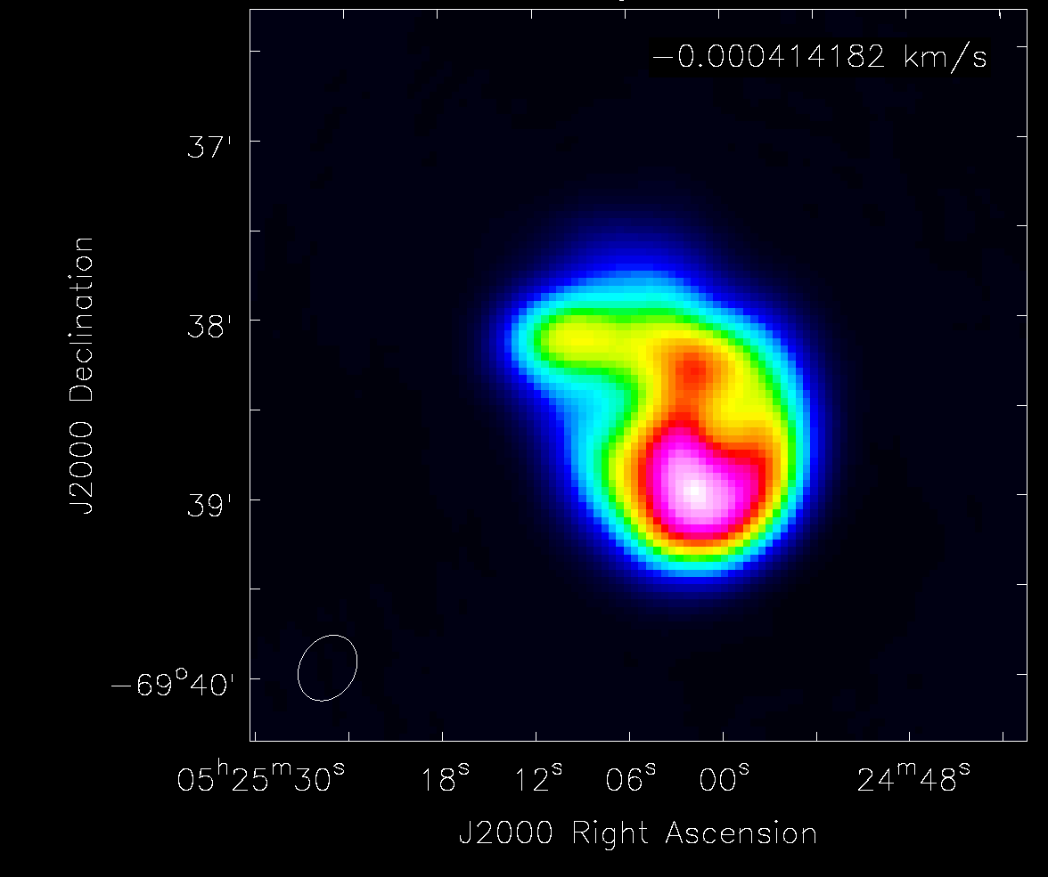
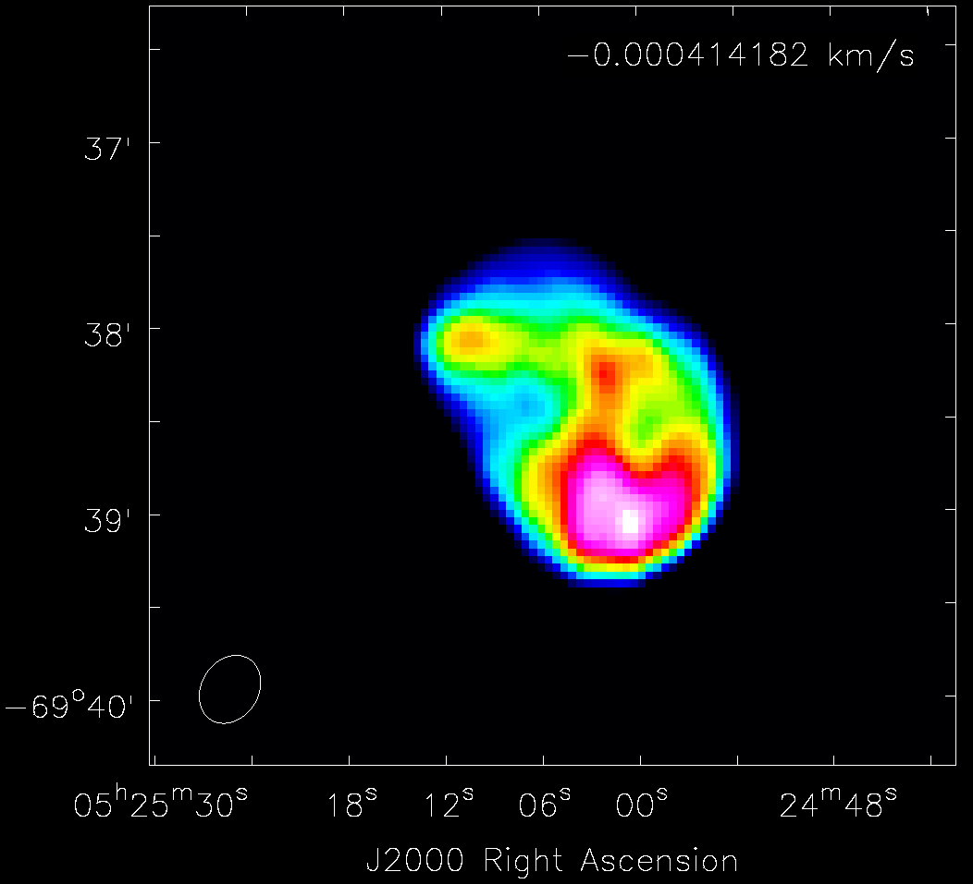
Comparison
CLEAN
CD + ElasticNET

