Slide 1
Towards distributed image reconstruction
Jonas Schwammberger
Master student @ Institute for Data Science, FHNW

Slide 2
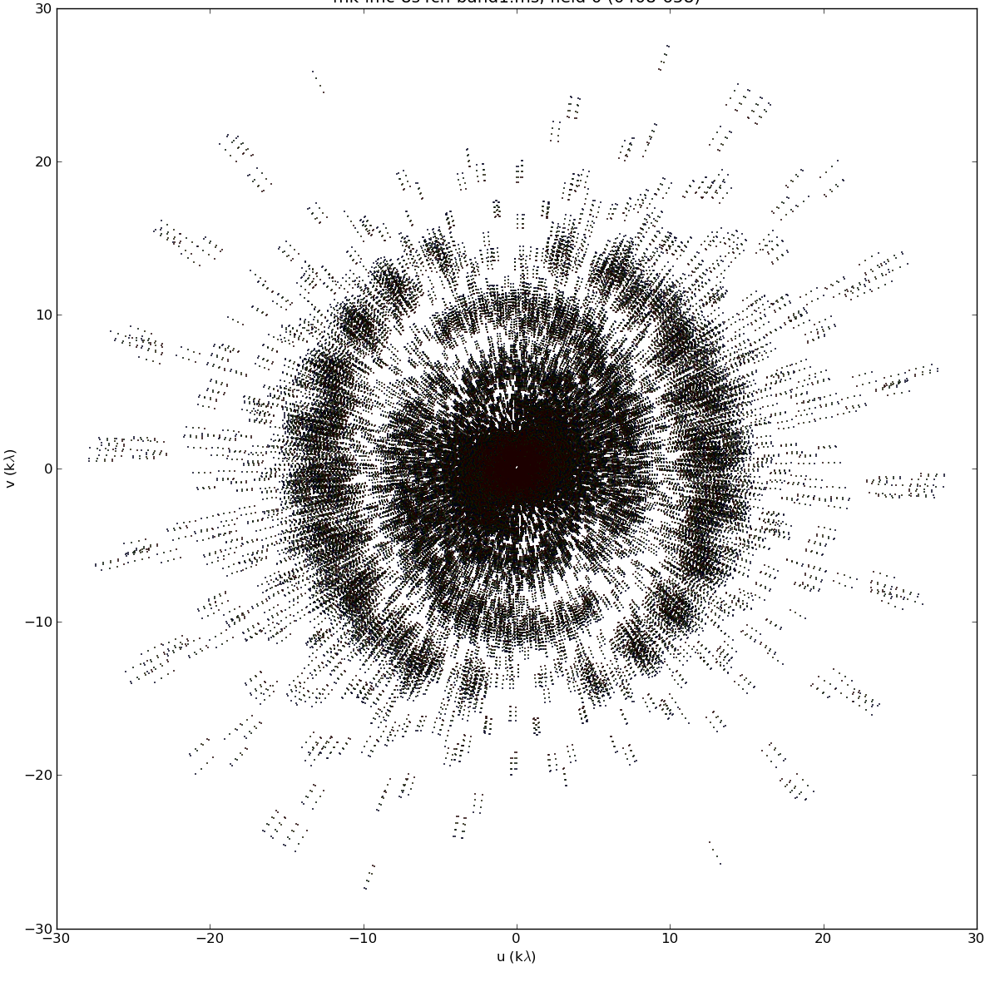
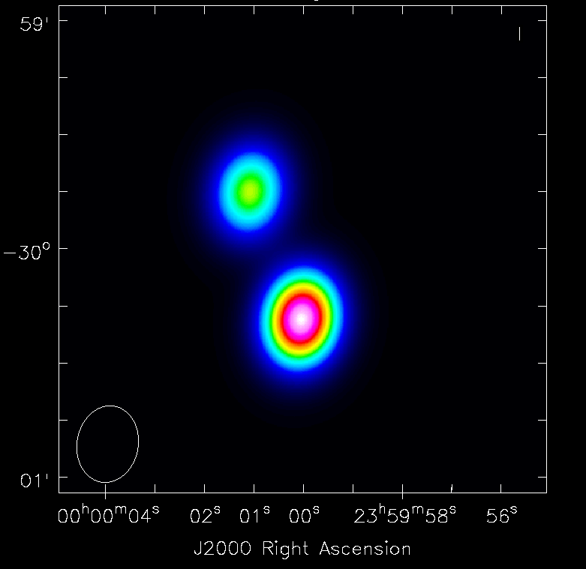
Image reconstruction problem
Image space
Fourier space

Slide 3
Why do we need distribution?

Slide 4
Distributed gridding and deconvolution
Hardware: 4 Linux nodes, 1 CPU each
Implementation: .netcore (C#)
MPI for node communication
Tested speedup on 1GB real-world MeerKAT observation
Preliminary results and algorithms

Slide 5
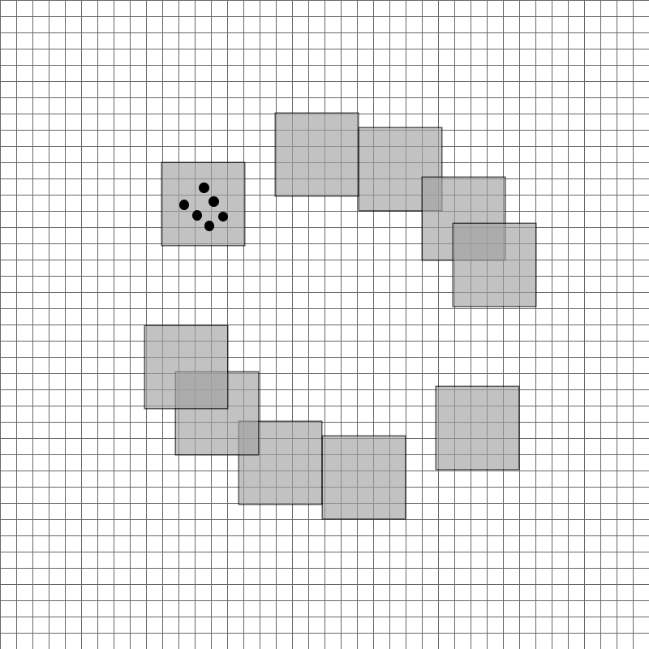
Image Domain Gridding (IDG)
uniform grid
Veenboer, Bram, Matthias Petschow, and John W. Romein. "Image-Domain gridding on graphics processors." 2017 IEEE International Parallel and Distributed Processing Symposium (IPDPS). IEEE, 2017.
GPU implementations exist
.netcore so far uses the CPU
visibilities
subgrids

Slide 6
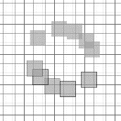
Distributed gridding
MPI_Reduce
Grid 1024 *1024
~8 MB
~1000 MB

Slide 7
Distributed gridding

Slide 8
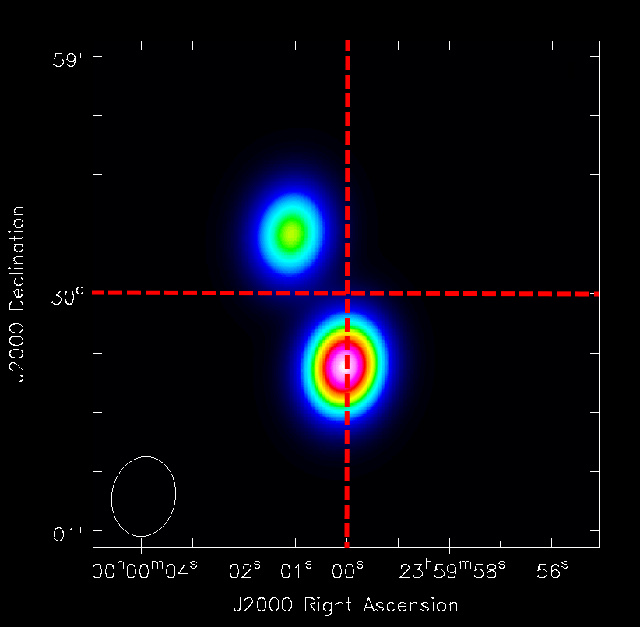
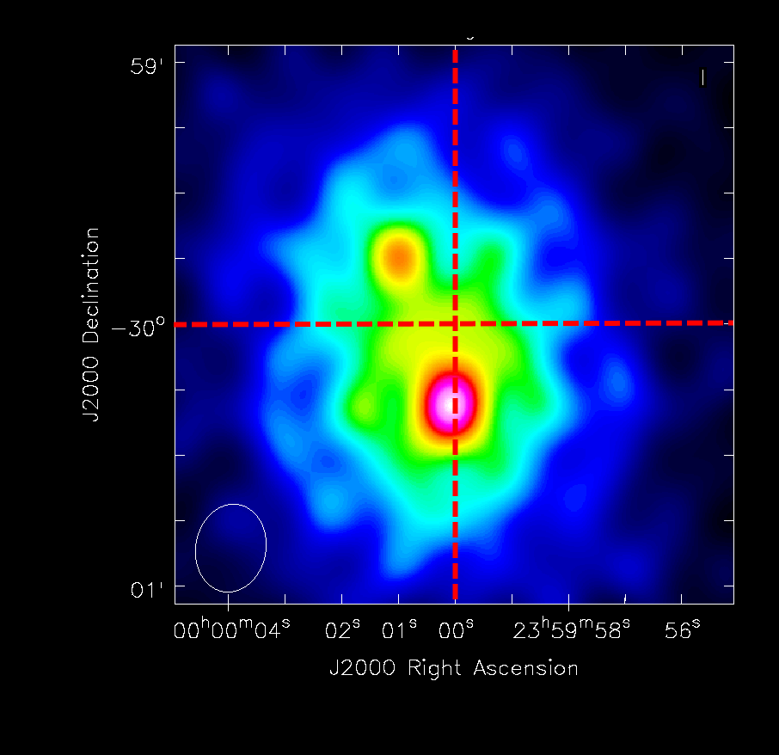
Distributed deconvolution

Slide 9
Distributed algorithms
ADMM variants in Radio Astronomy
Ferrari, André, et al. "Distributed image reconstruction for very large arrays in radio astronomy." 2014 IEEE 8th Sensor Array and Multichannel Signal Processing Workshop (SAM). IEEE, 2014.
Carrillo, Rafael E., Jason D. McEwen, and Yves Wiaux. "PURIFY: a new approach to radio-interferometric imaging." Monthly Notices of the Royal Astronomical Society 439.4 (2014): 3591-3604.
…
Coordinate Descent variants
Bradley, Joseph K., et al. "Parallel coordinate descent for l1-regularized loss minimization." arXiv preprint arXiv:1105.5379(2011).
Fercoq, Olivier, et al. "Fast distributed coordinate descent for non-strongly convex losses." 2014 IEEE International Workshop on Machine Learning for Signal Processing (MLSP). IEEE, 2014.
…

Slide 10
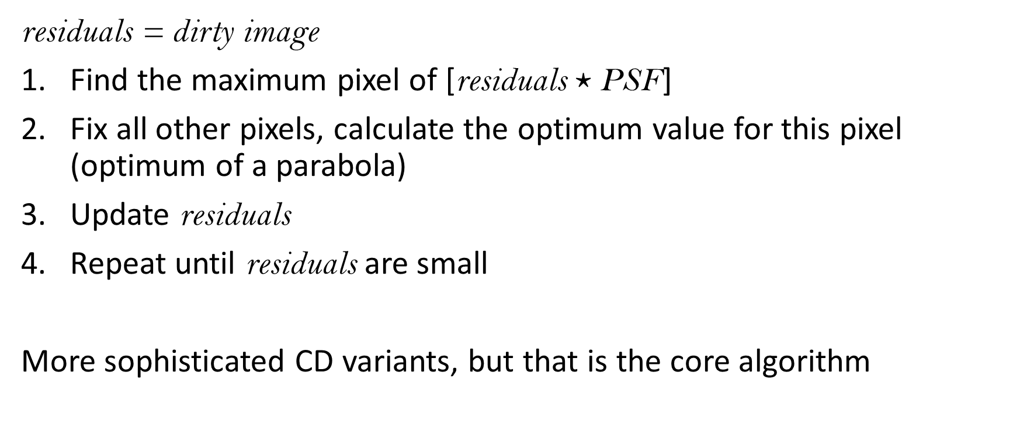
Coordinate Descent deconvolution
residuals = dirty image
Find the maximum pixel of [residuals $⋆$ PSF]
Fix all other pixels, calculate the optimum value for this pixel (optimum of a parabola)
Update residuals
Repeat until residuals are small
More sophisticated CD variants, but that is the core algorithm

Slide 11
Distributed Coordinate Descent deconvolution
Distributed CD:
Find maximum local pixel
Find maximum global pixel (MPI_ReduceAll)
Update dirty image patch
Repeat

Slide 12
Distributed Coordinate Descent

Slide 13
Distributed gridding + deconvolution
Distributed gridding: More effective with more input data
Distributed deconvolution: Communication is difficult
But we have more communication efficient CD algorithms to explore:
Shotgun
PCDM
Hydra
…
GPU accelerated IDG and CD exist

Slide 14
Questions

Slide 16
(Alternative zu Folie 13) Distributed gridding + deconvolution
Distributed gridding:
More effective with more input data
Bandwidth limited, well-suited for super computers
Distributed deconvolution:
Latency limited, not well-suited for super computers
We have more communication efficient CD algorithms to explore:
Shotgun
PCDM
Hydra
…
GPU accelerated CD variants exist

Slide 17

(Alternative zu Folie 2) Image reconstruction problem
Image space
Fourier space

Slide 18


Comparison CLEAN with CD+ElasticNet
Noise Regularization:
ElasticNet
L1 Norm
L2 Norm
+

Slide 19
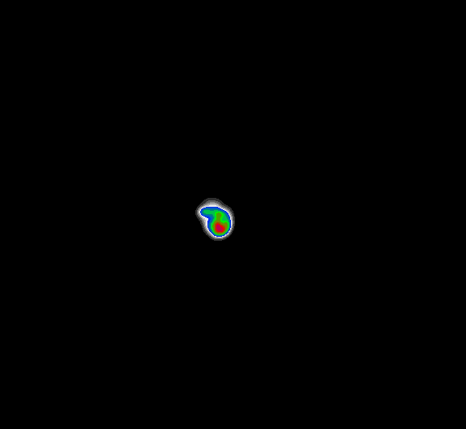

Comparison
Distributed CD + ElasticNET
CLEAN

