Slide 1
Towards distributed image reconstruction
Jonas Schwammberger
Institute for Data Science @FHNW

Slide 2
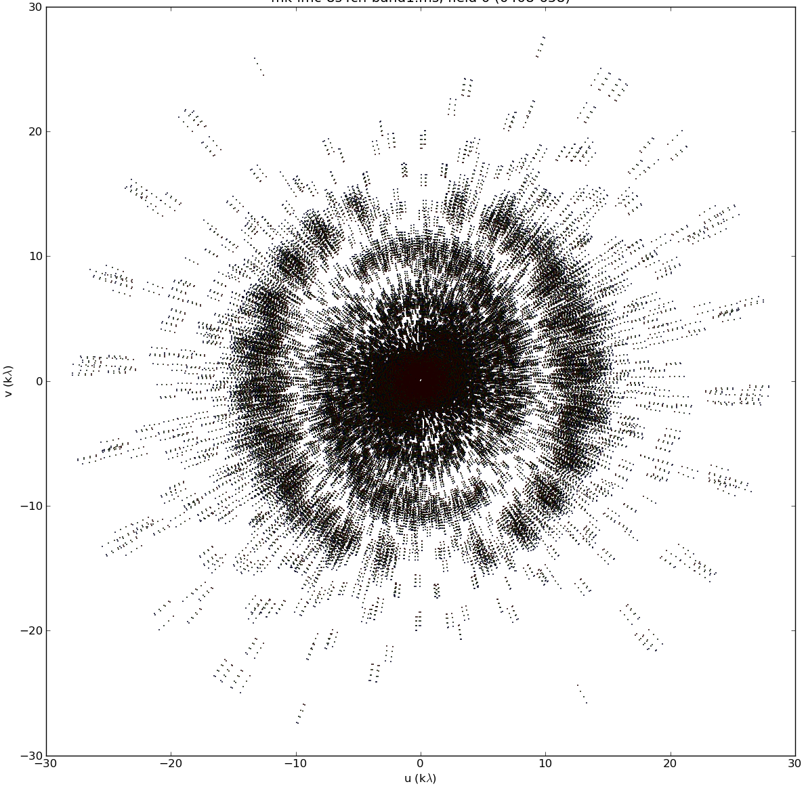
Radio interferometric image reconstruction

Slide 3
Why do we need distribution?

Slide 4
Distributed Gridding and Deconvolution
Simple distributed gridding and distributed deconvolution
Implementation: .netcore(C#) and MPI for communication
Test on 1GB real-world MeerKAT observation
Preliminary results

Slide 5
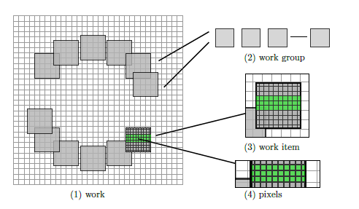
Image Domain Gridding

Slide 6
Distributed Gridding
MPI_Reduce
Grid 1024 *1024
~8 MB
~1000 MB

Slide 7
Distributed gridding

Slide 8
Distributed deconvolution
Difficult to separate
Always noisy, we require

Slide 9
ElasticNet Regularization

Slide 10
Coordinate Descent
Algorithm:
Minimize a pixel
Repeat until converged

Slide 11
Distributed Coordinate Descent

Slide 12
Distributed deconvolution

Slide 13
Distributed gridding:
Distributed deconvolution:

