Slide 1
Towards distributed image reconstruction

Slide 2
The problem

Slide 3
Solution

Slide 4
Deconvolution

Slide 5
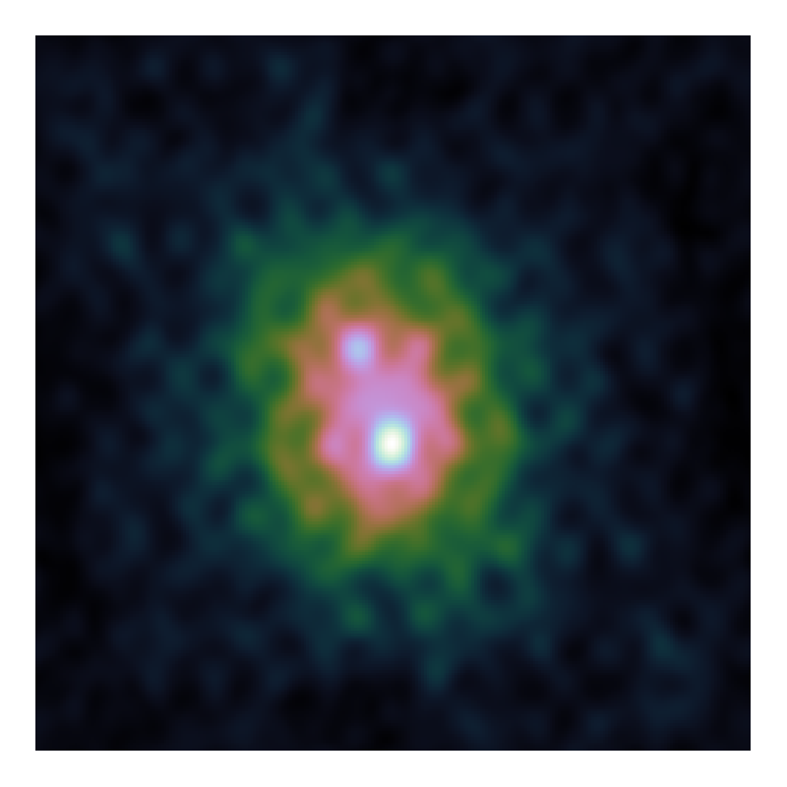
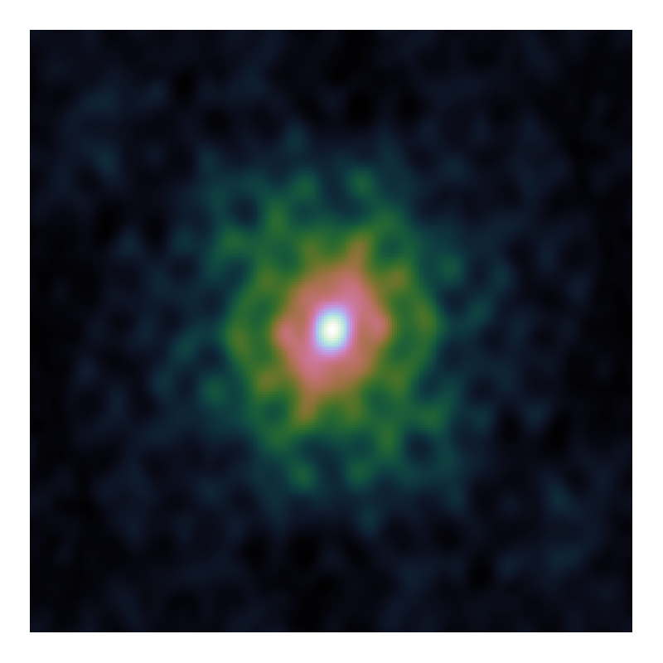
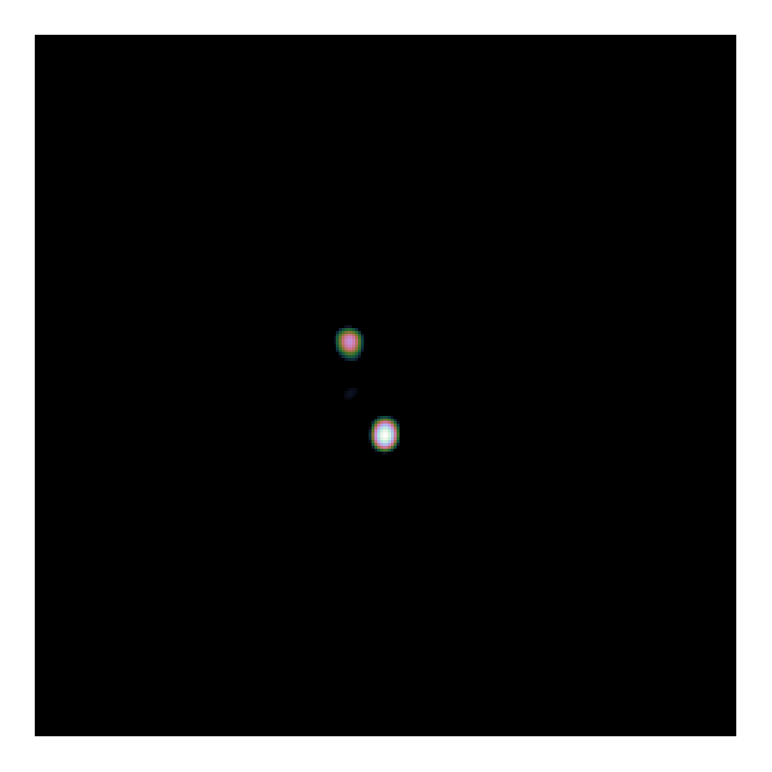
CLEAN

Slide 6
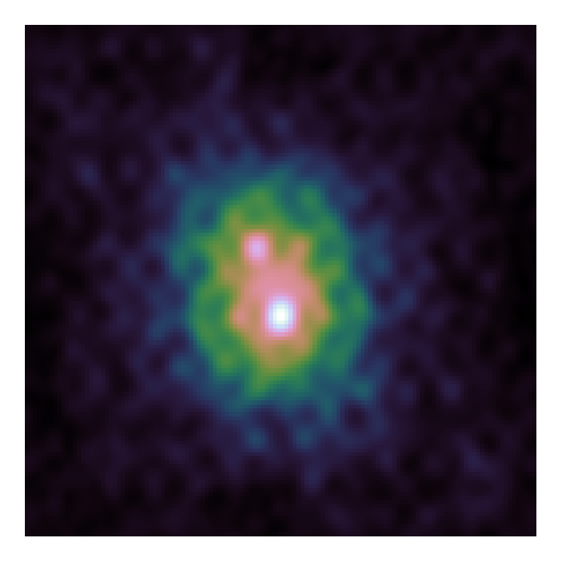

CLEAN

Slide 7
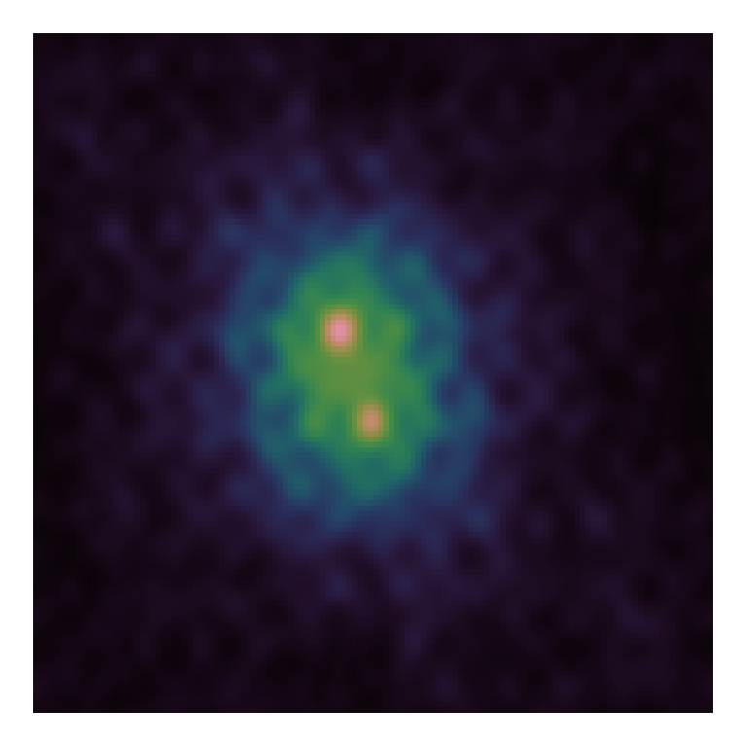

CLEAN

Slide 8
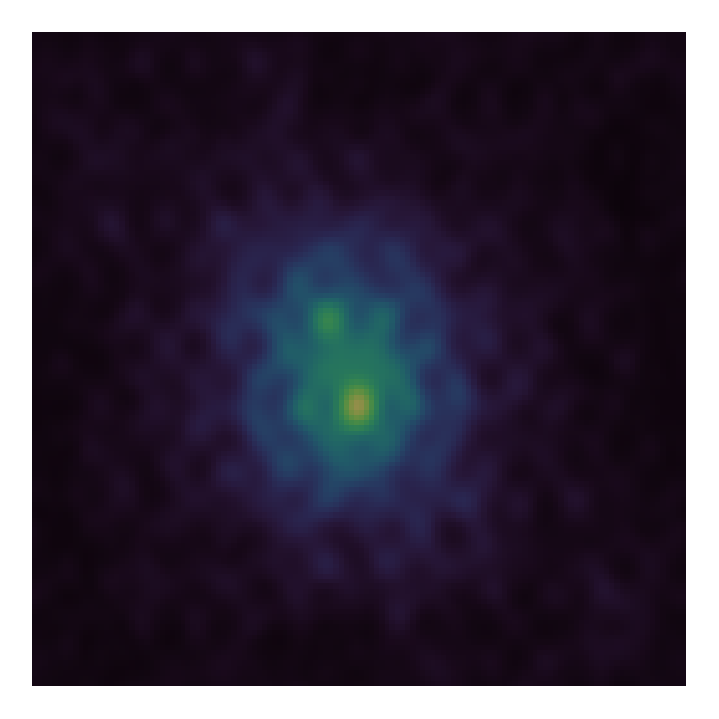
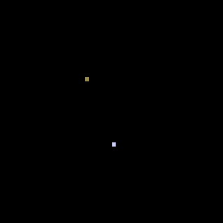
CLEAN

Slide 9
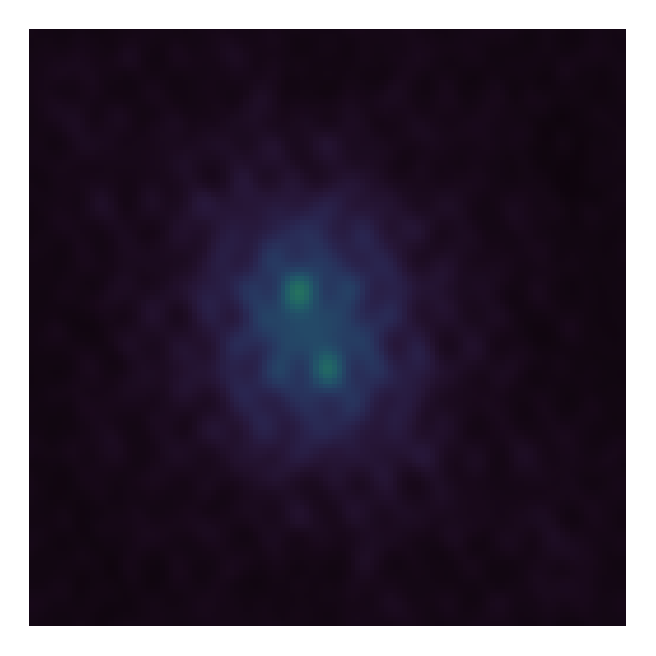
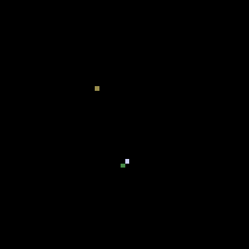
CLEAN

Slide 10
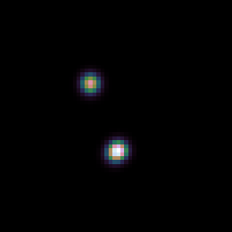
CLEAN

Slide 11
Multi-scale CLEAN

Slide 12
Elastic Net Regularization

Slide 13
Serial Coordinate Descent

Slide 14
Gradient calculation

Slide 15
PSF Approximation

Slide 16
PSF approximation Method 1

Slide 17
PSF Approximation Method 2

Slide 18
Parallel Coordinate Descent

Slide 19
ESO

Slide 20
Problems on the deconvolution

Slide 21
Search Factor

Slide 23
LMC Observation

Slide 24
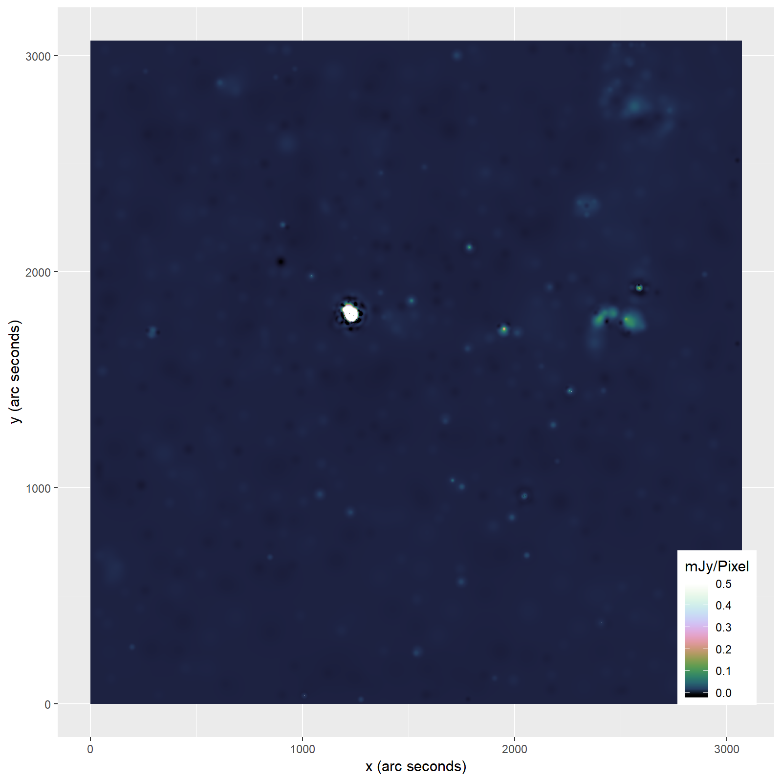

Slide 25
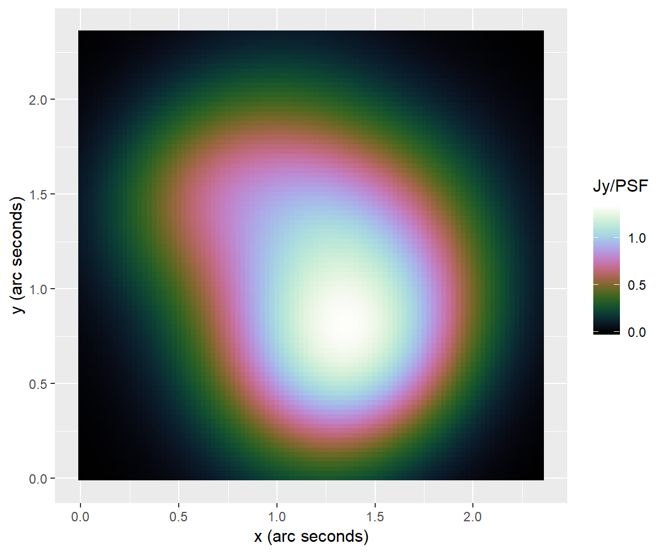
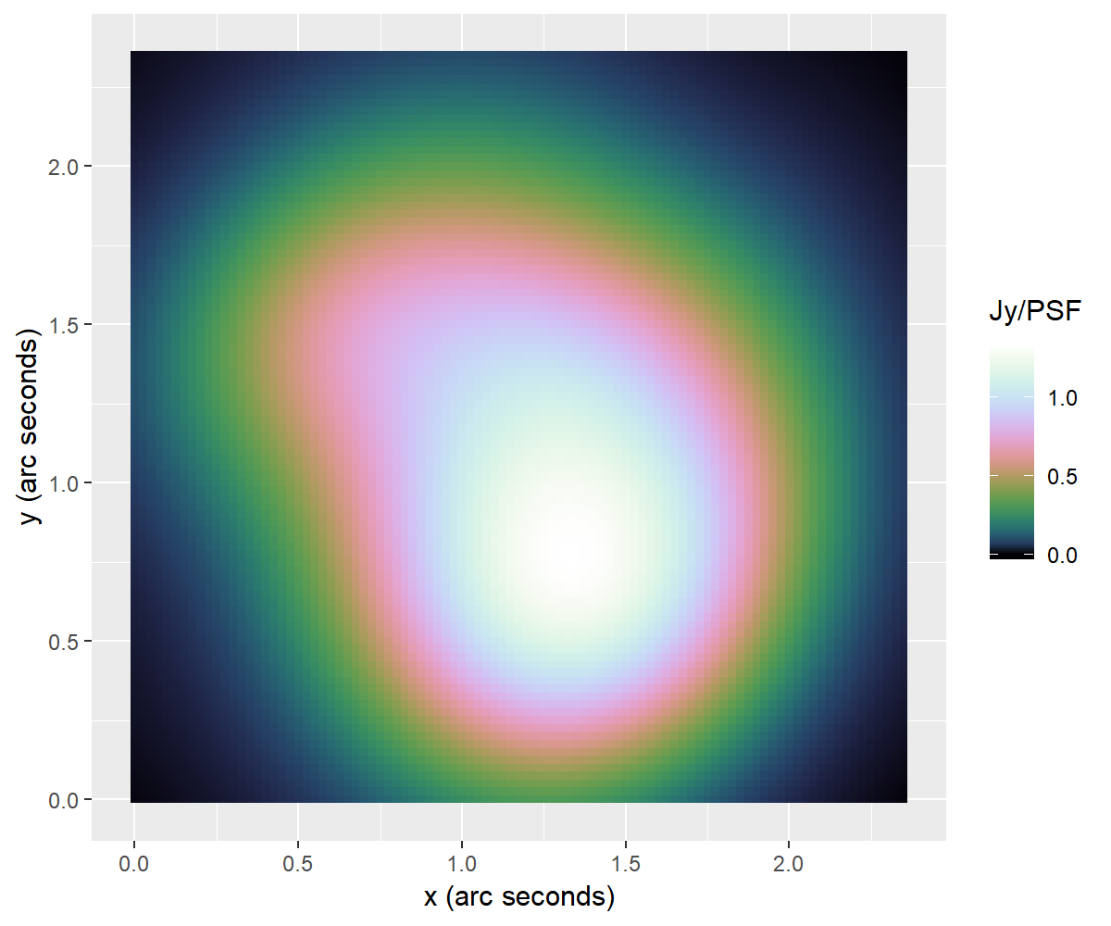
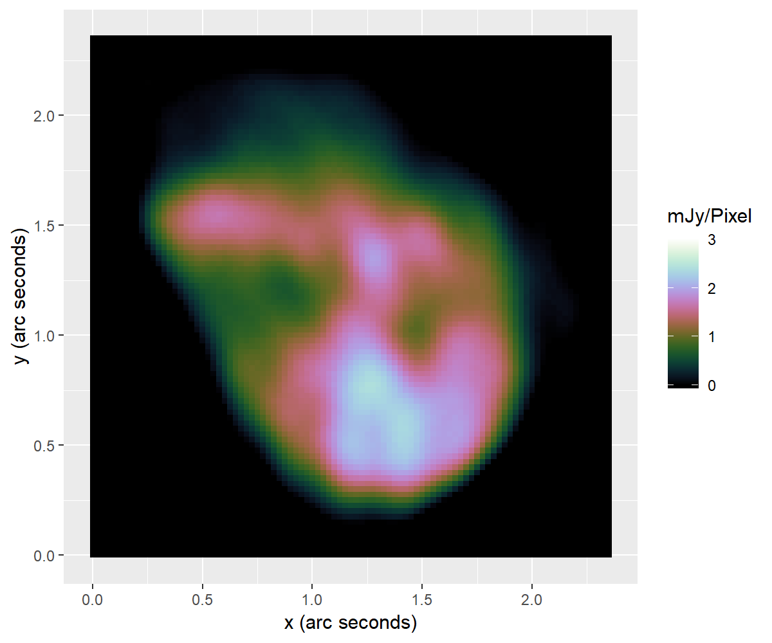
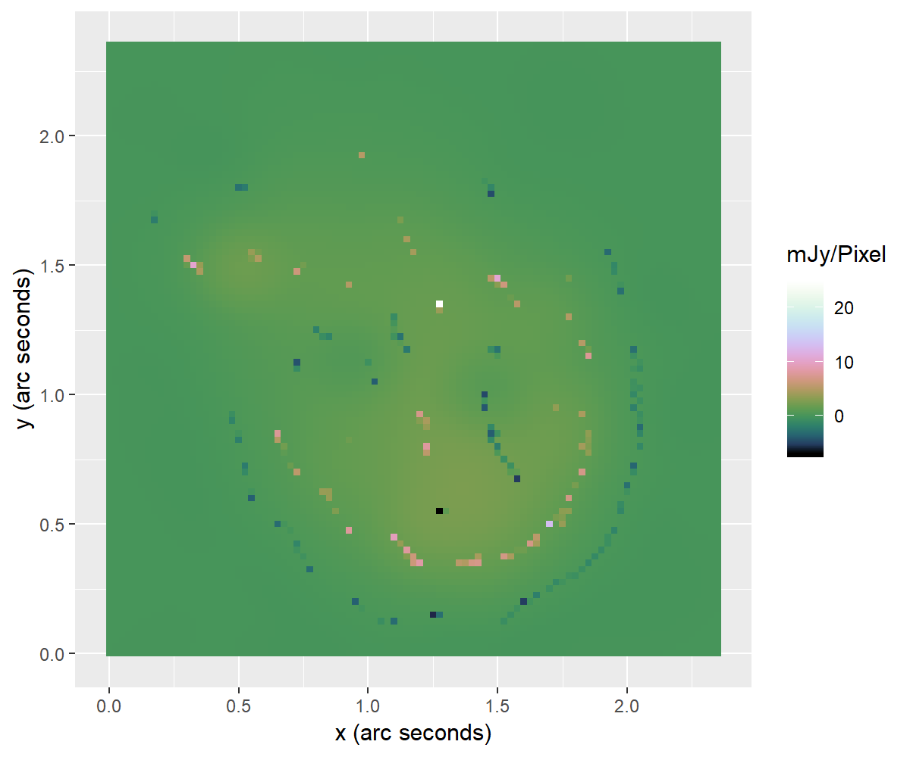

Slide 26
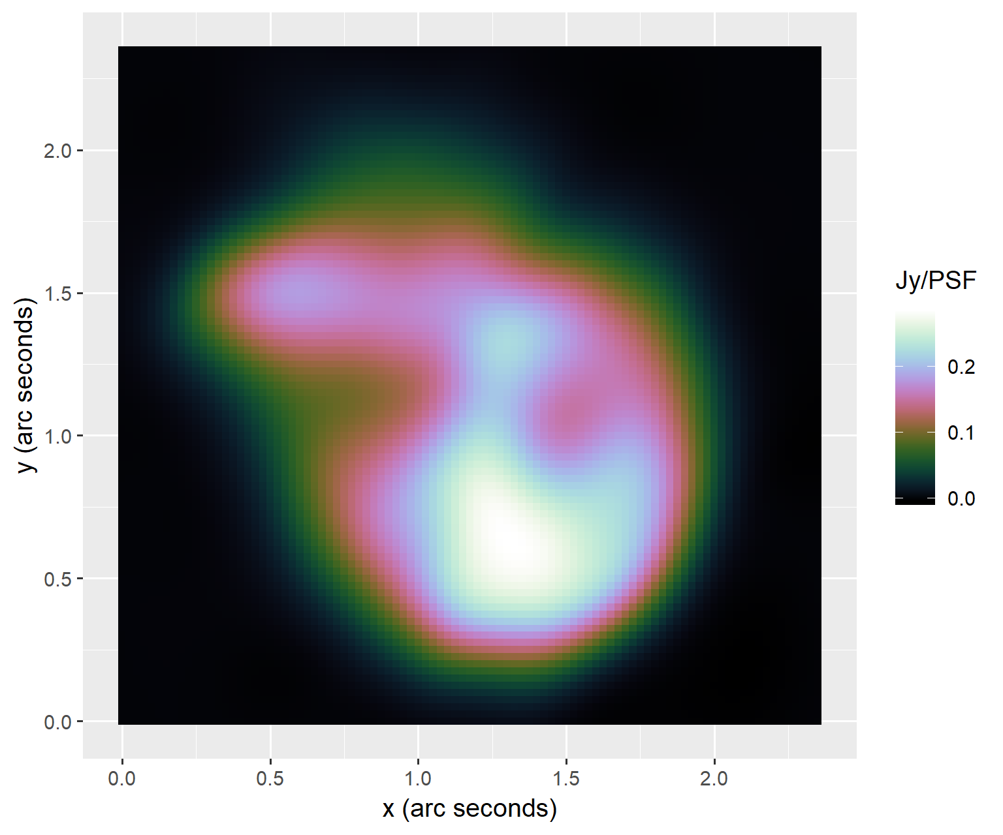

Slide 27
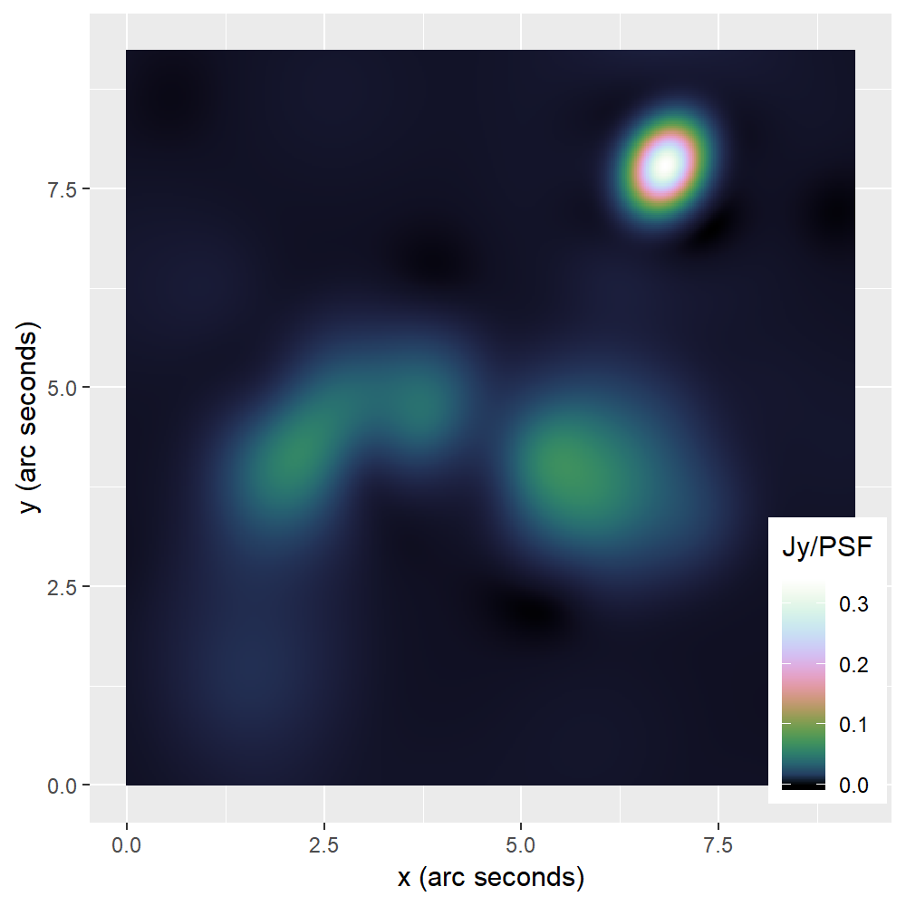
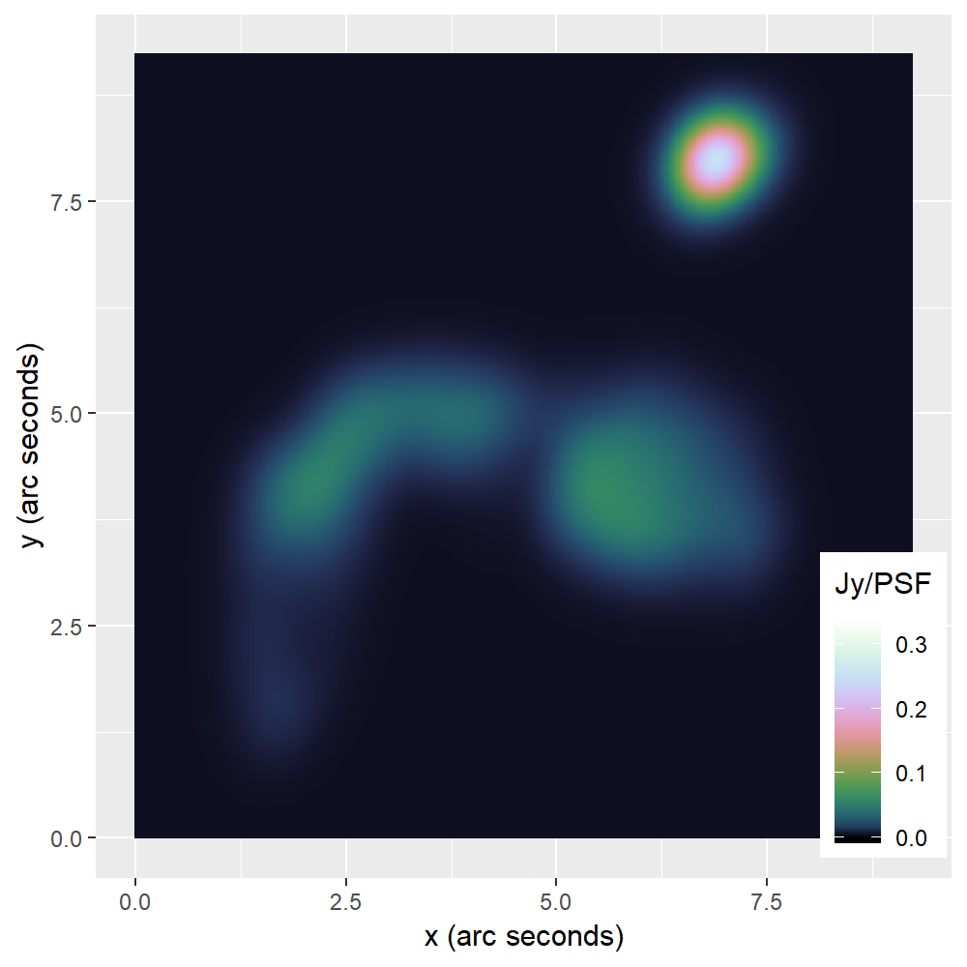
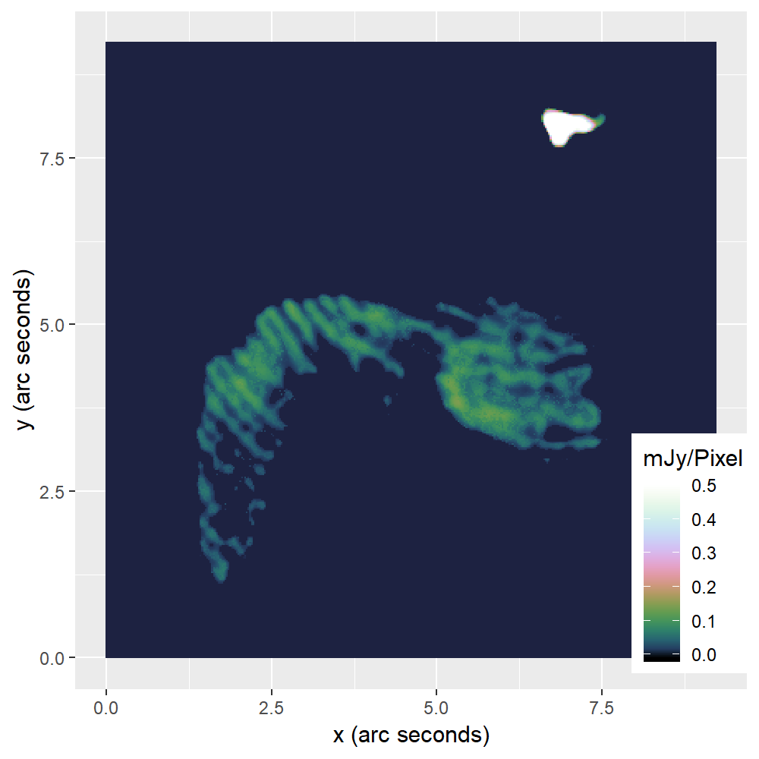
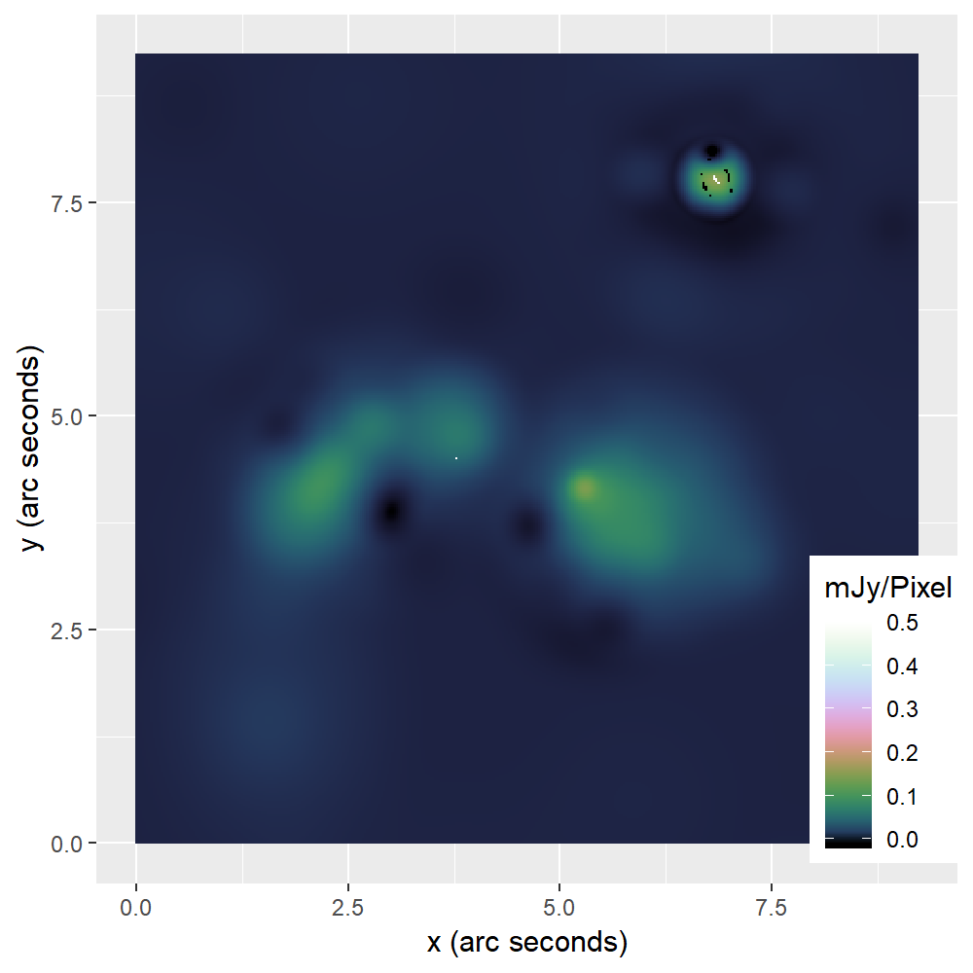

Slide 28
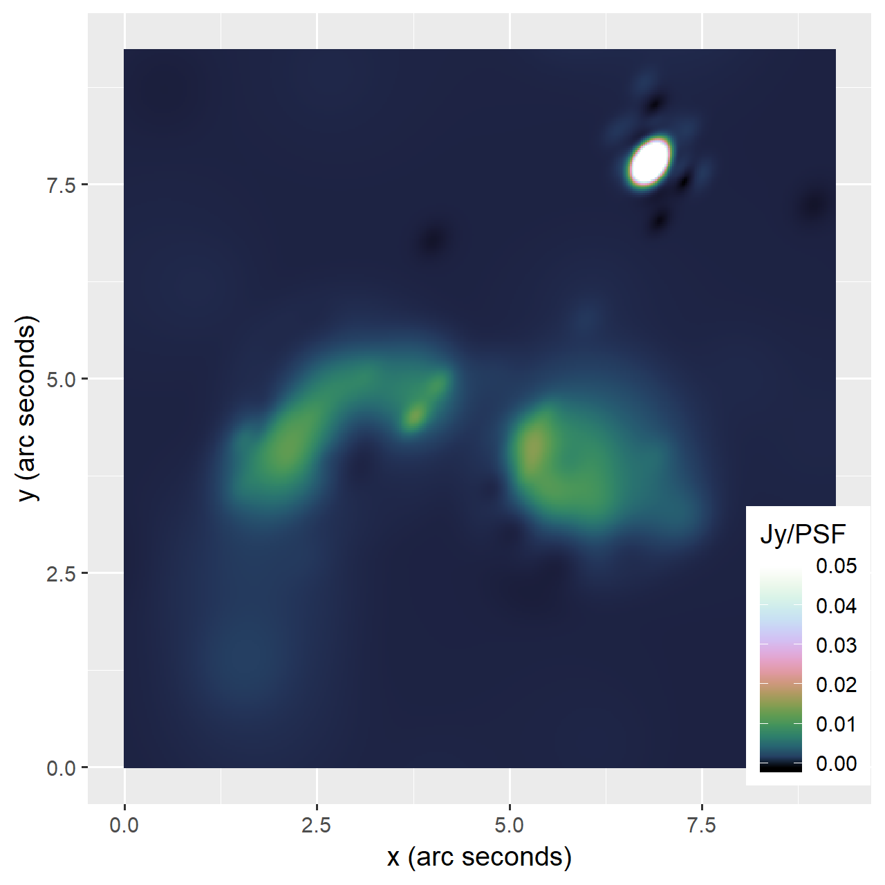

Slide 29
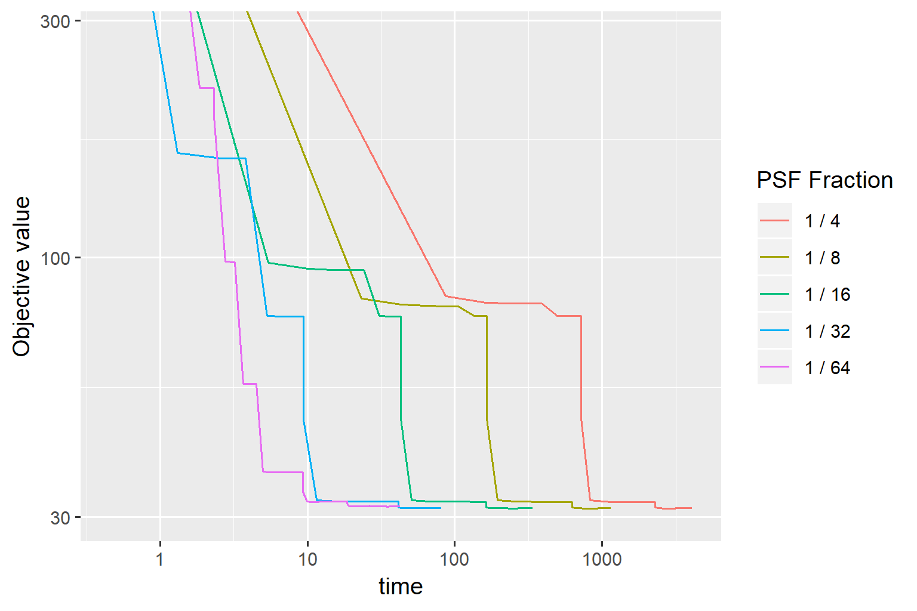
Speedup PCDM

Slide 30
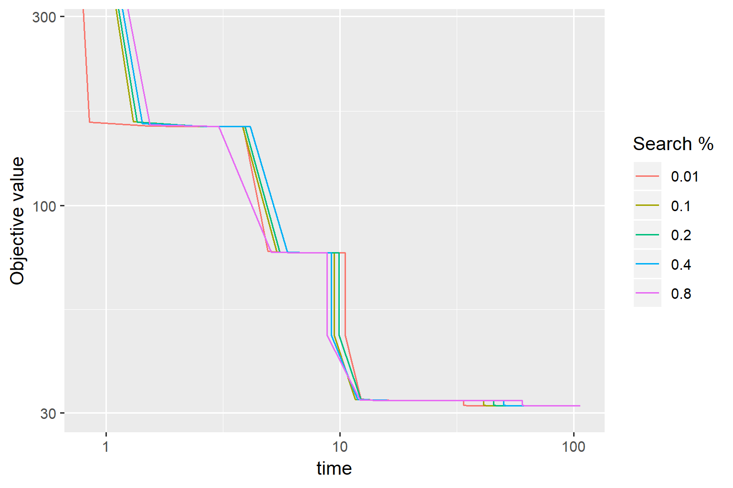

Slide 31
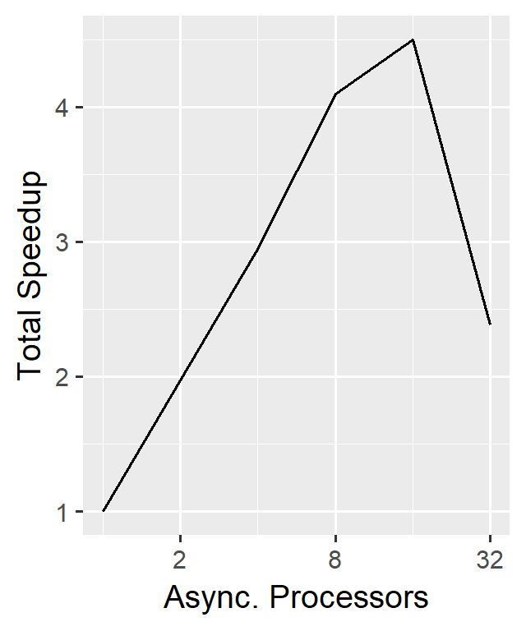
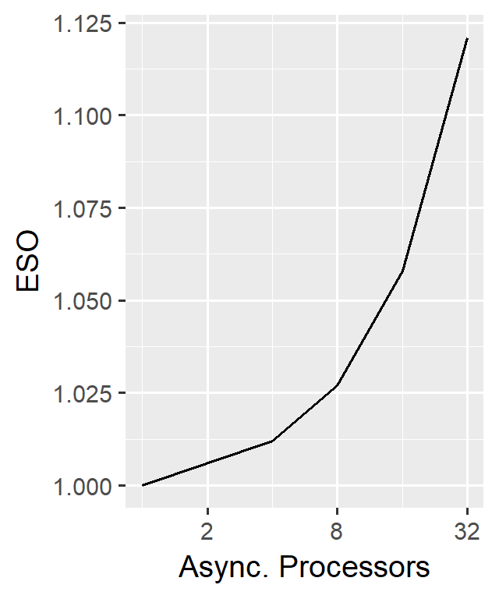
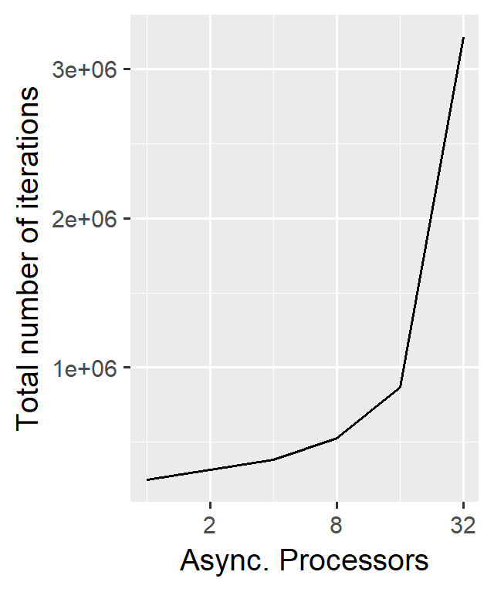
Scalability

Slide 32
Test
Table

Slide 33
Speed comparison to CLEAN

Slide 34
Conclusion

