Slide 1
Towards distributed image reconstruction

Slide 2
The problem

Slide 3
Solution

Slide 4
Deconvolution

Slide 5
CLEAN

Slide 6
CLEAN BEAM

Slide 7
Multi-scale CLEAN

Slide 8
Super Resolution

Slide 9
Elastic Net Regularization

Slide 10
Serial Coordinate Descent

Slide 11
Gradient calculation

Slide 12
PSF Approximation

Slide 13
PSF approximation Method 1

Slide 14
PSF Approximation Method 2

Slide 15
Parallel Coordinate Descent

Slide 16
ESO

Slide 17
Problems on the deconvolution

Slide 18
Search Factor

Slide 20
LMC Observation

Slide 21
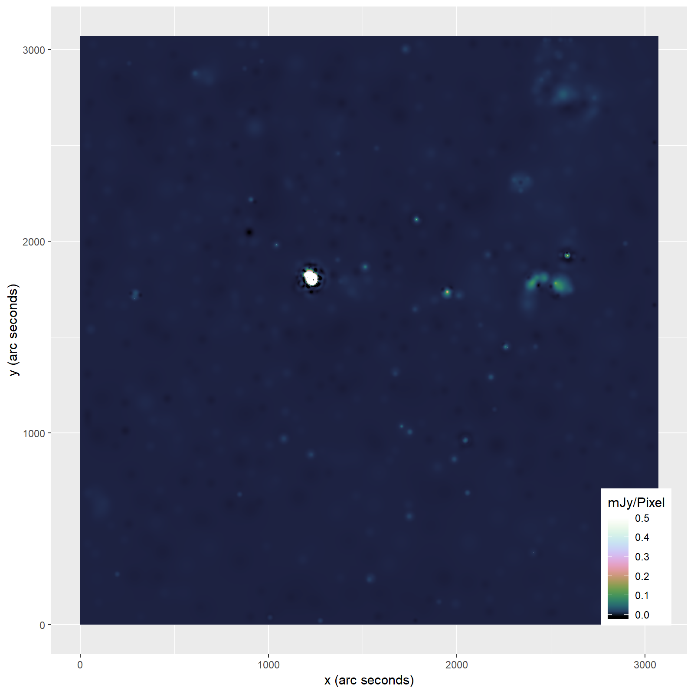

Slide 22
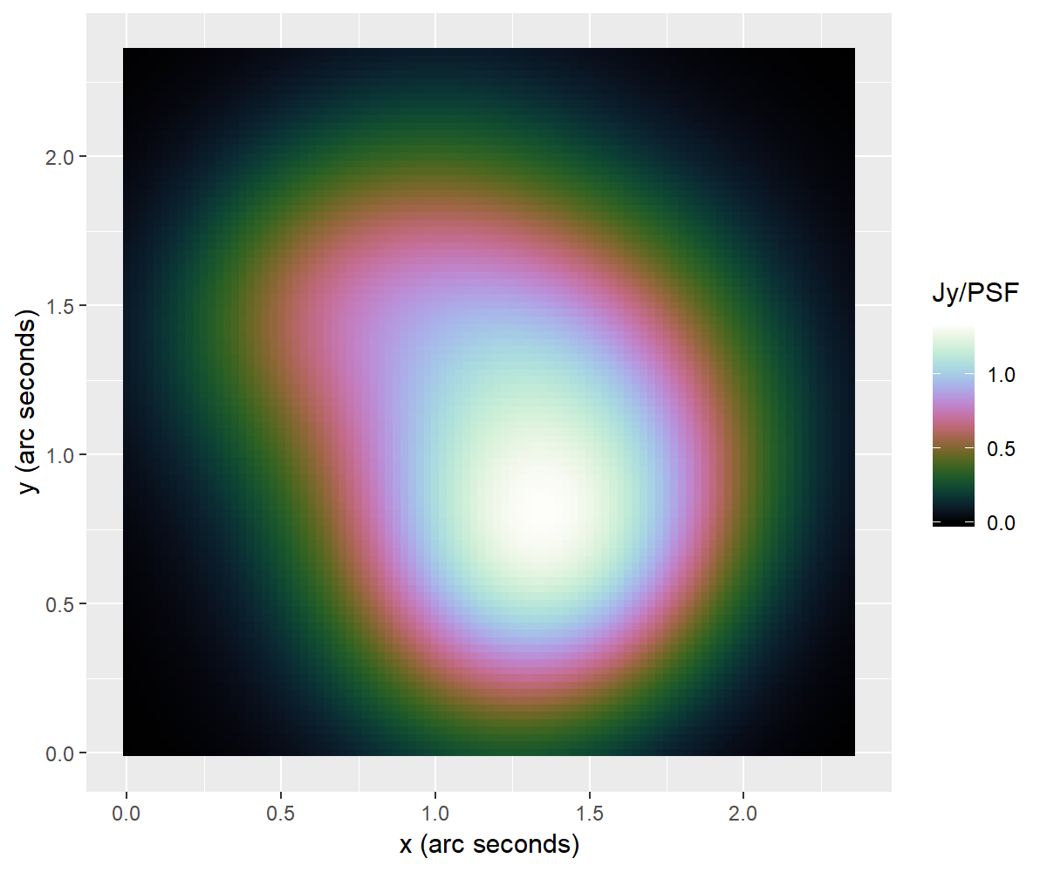
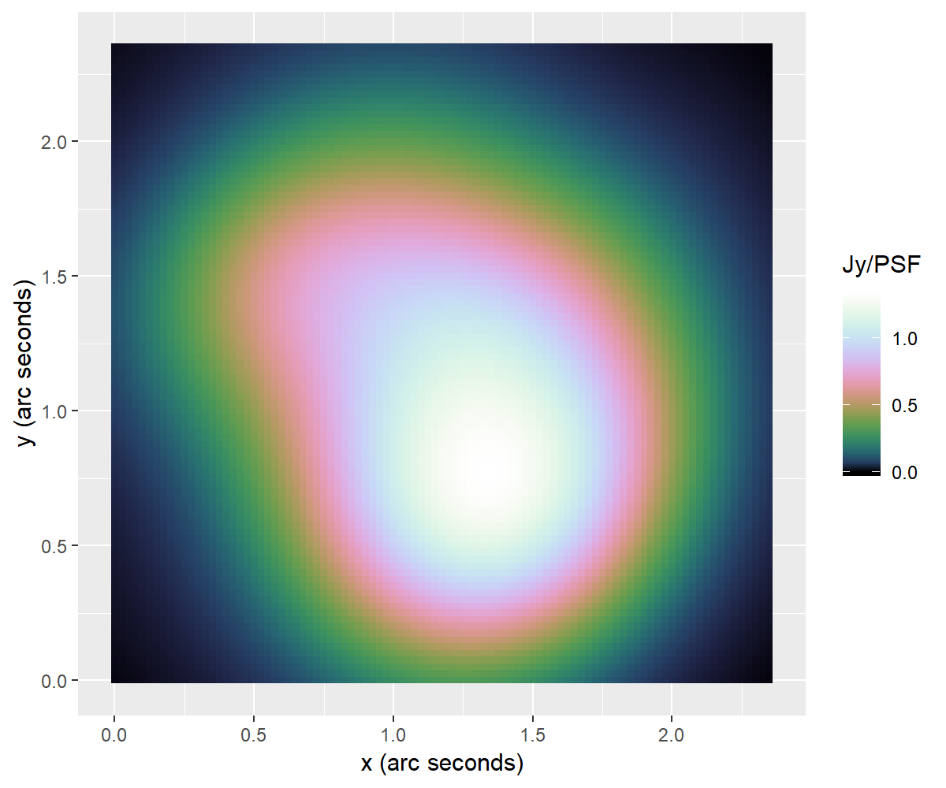
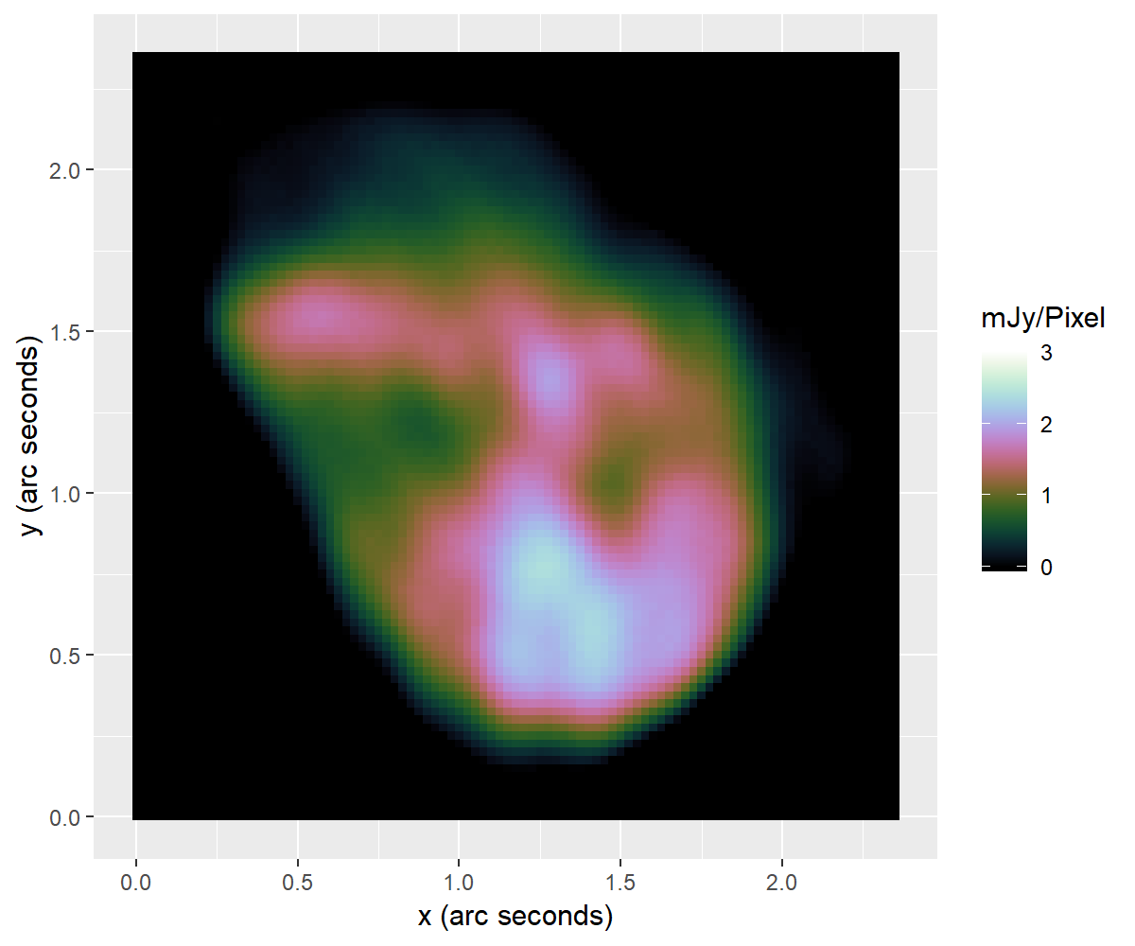
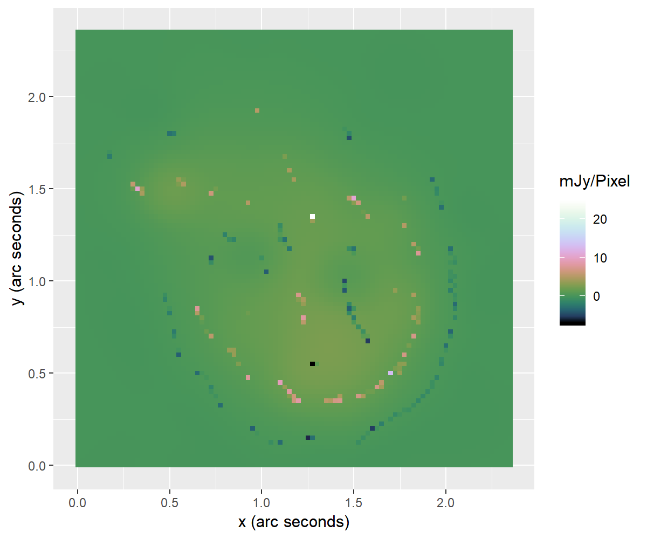

Slide 23
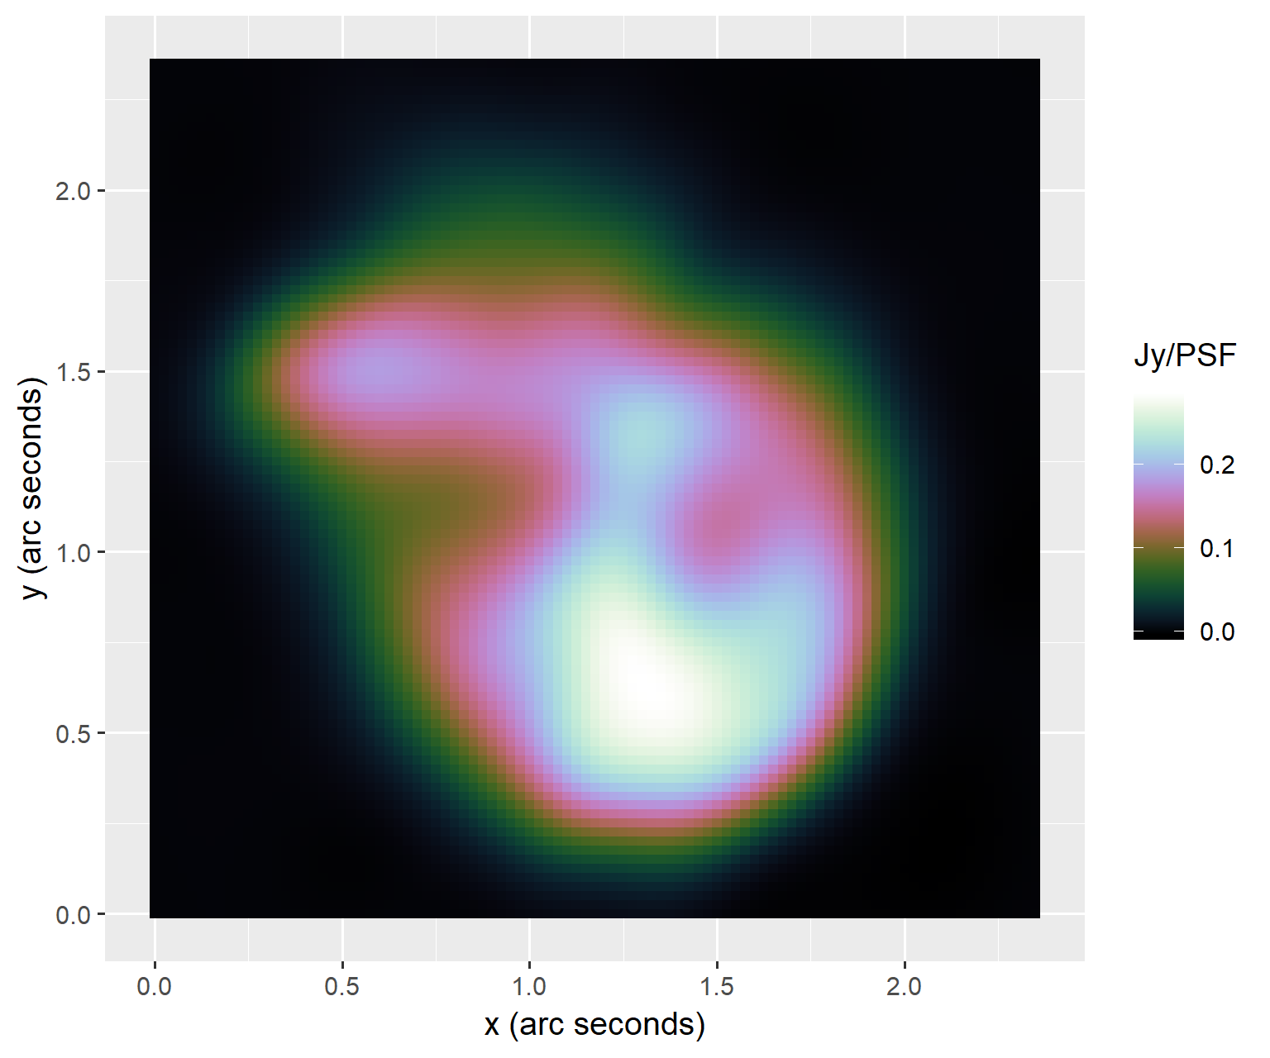

Slide 24
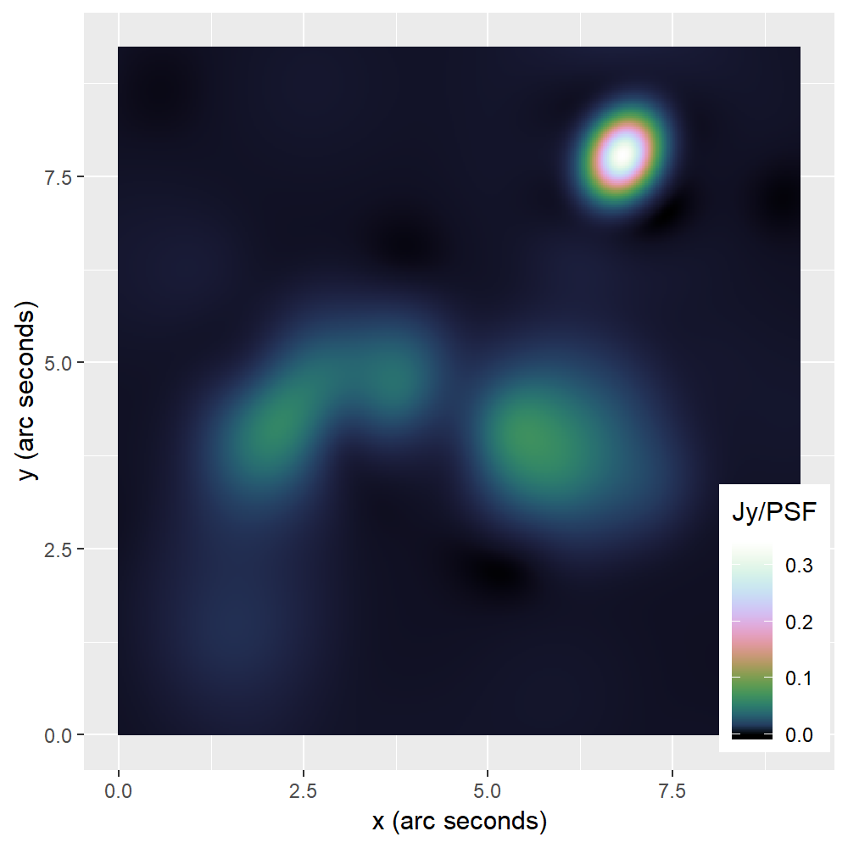
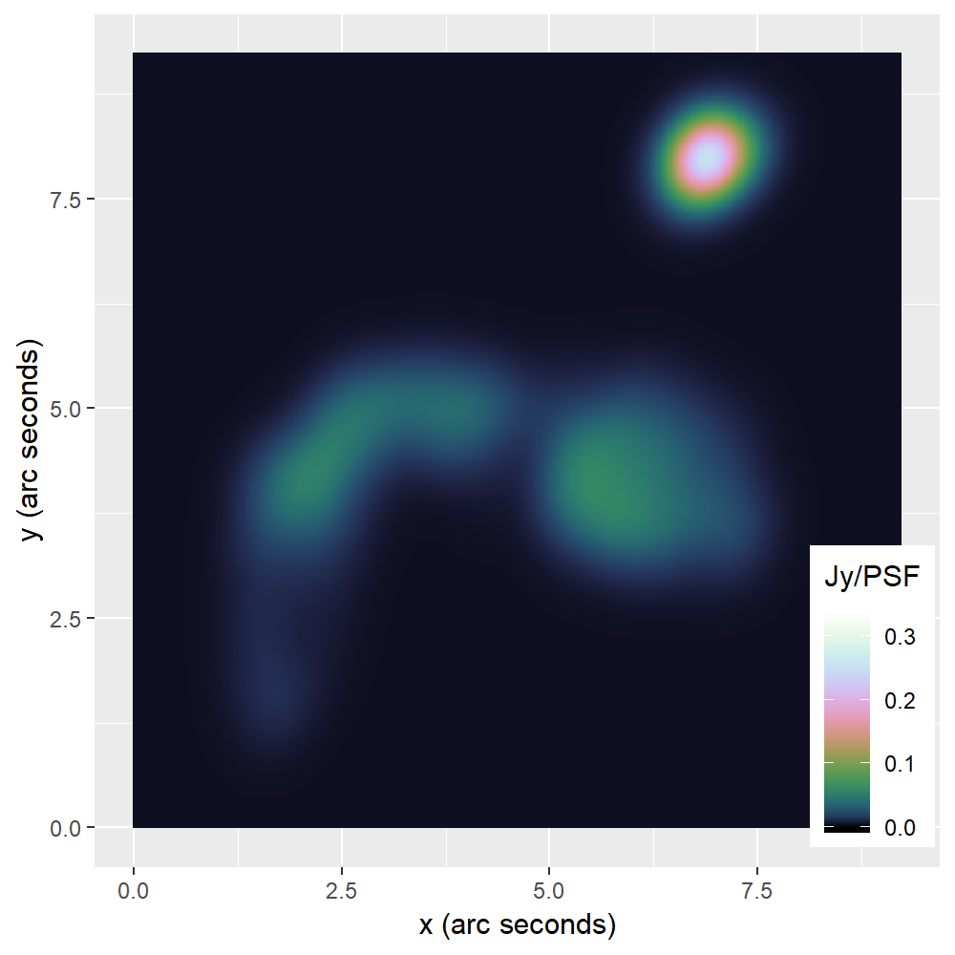
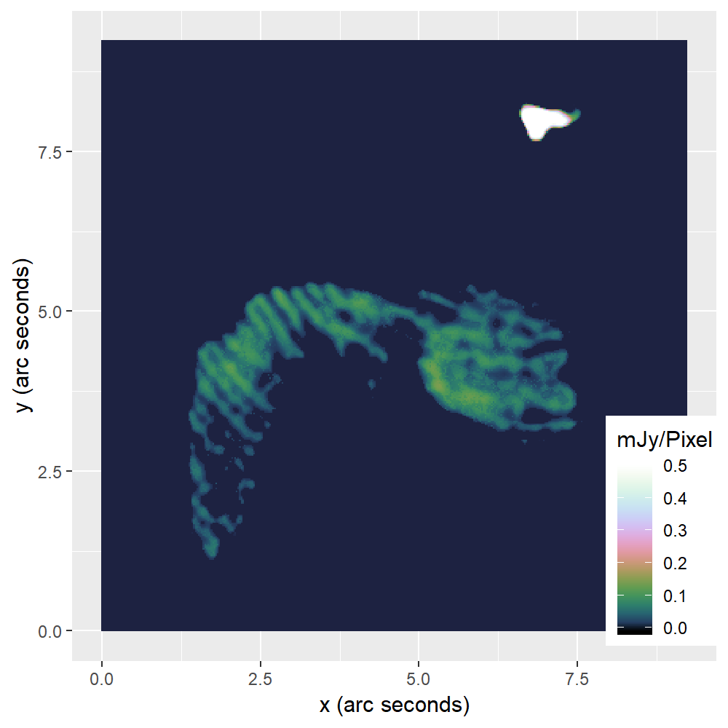
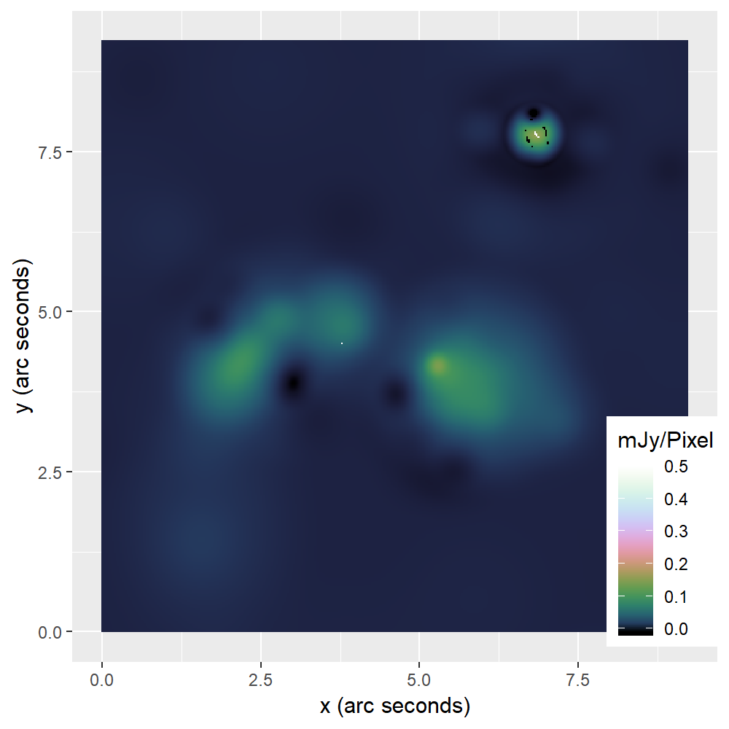

Slide 25
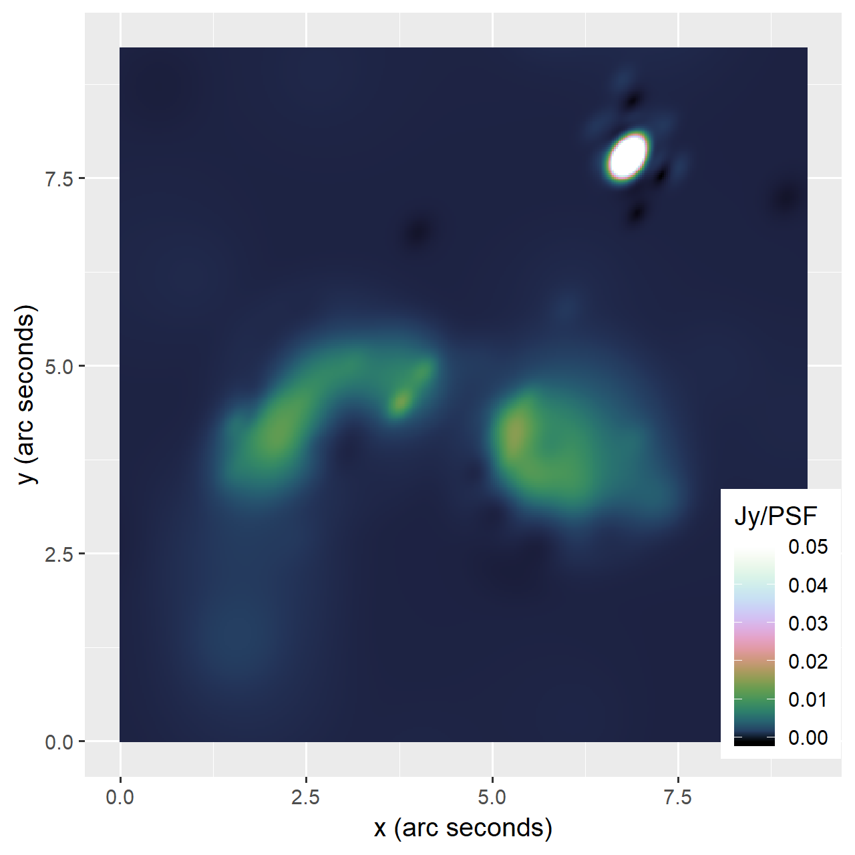

Slide 26
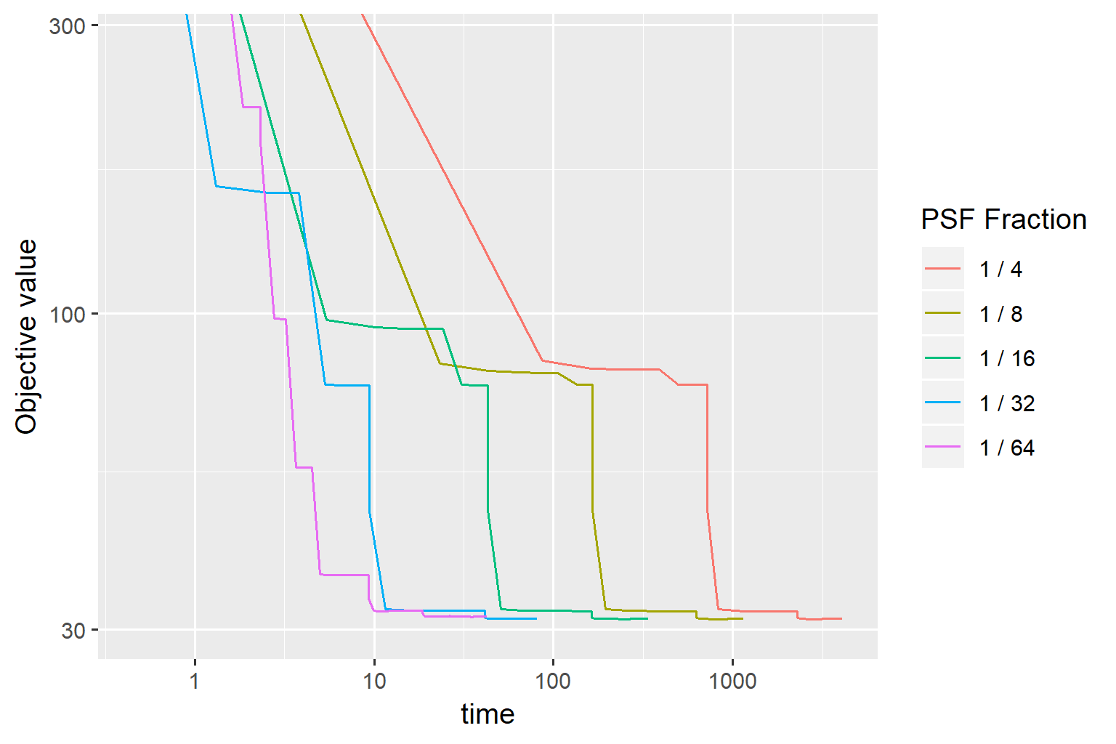
Speedup PCDM

Slide 27
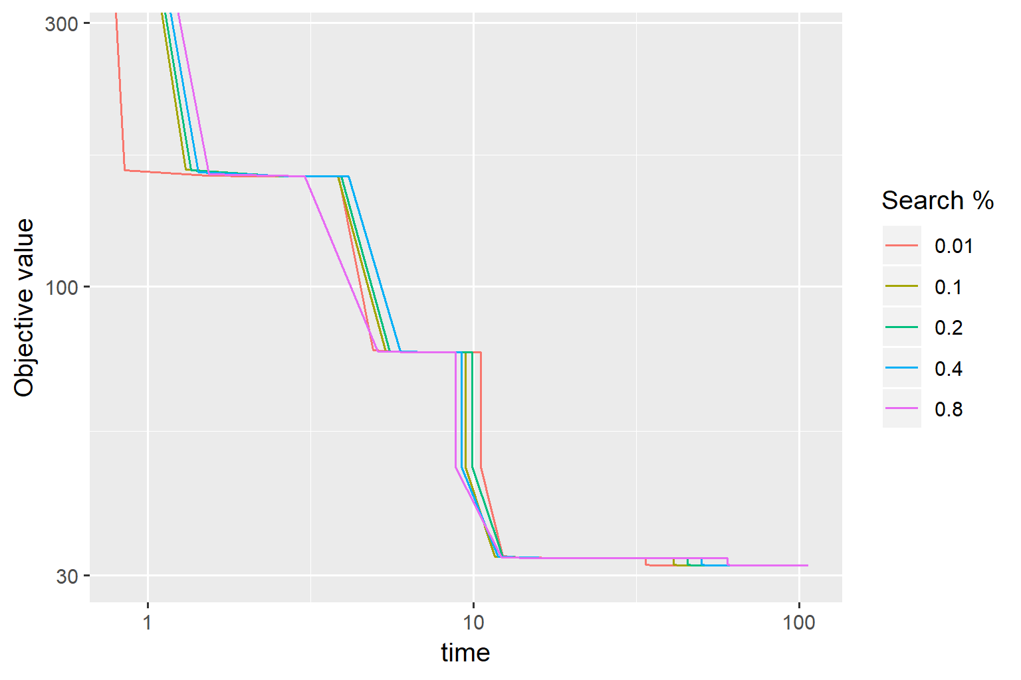

Slide 28
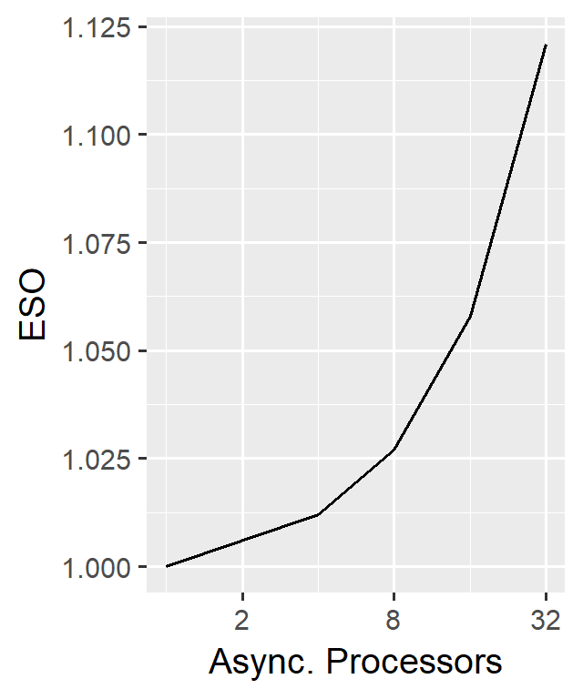
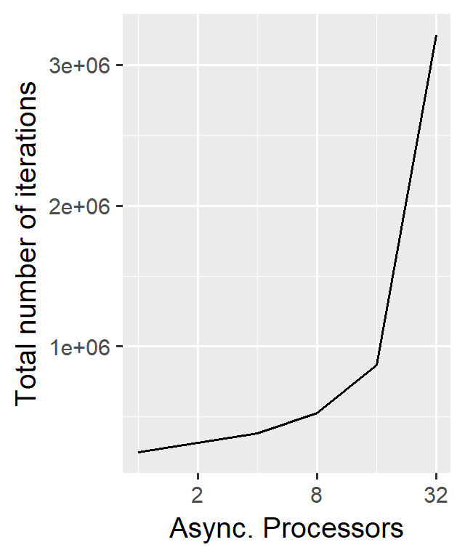
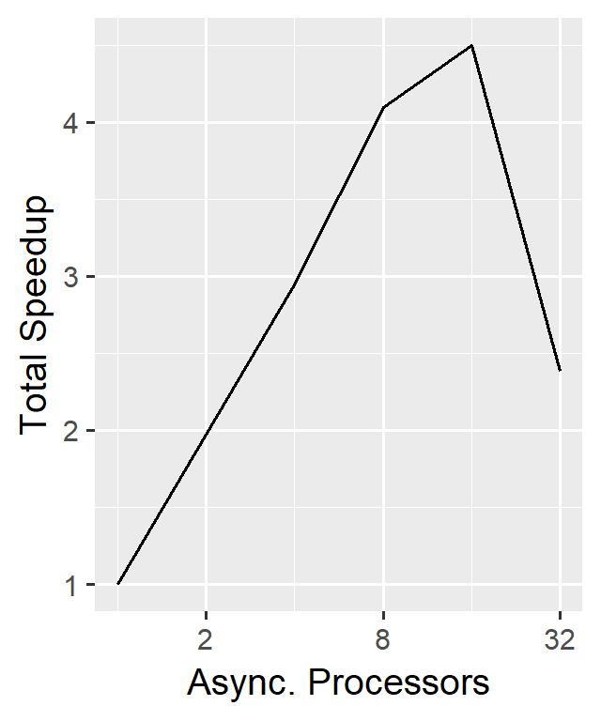
Scalability

Slide 29
Test
Table

Slide 30
Speed comparison to CLEAN

Slide 31
Conclusion

