Slide 1
Towards distributed image reconstruction
Jonas Schwammberger
Master student @ Institute for Data Science, FHNW

Slide 2
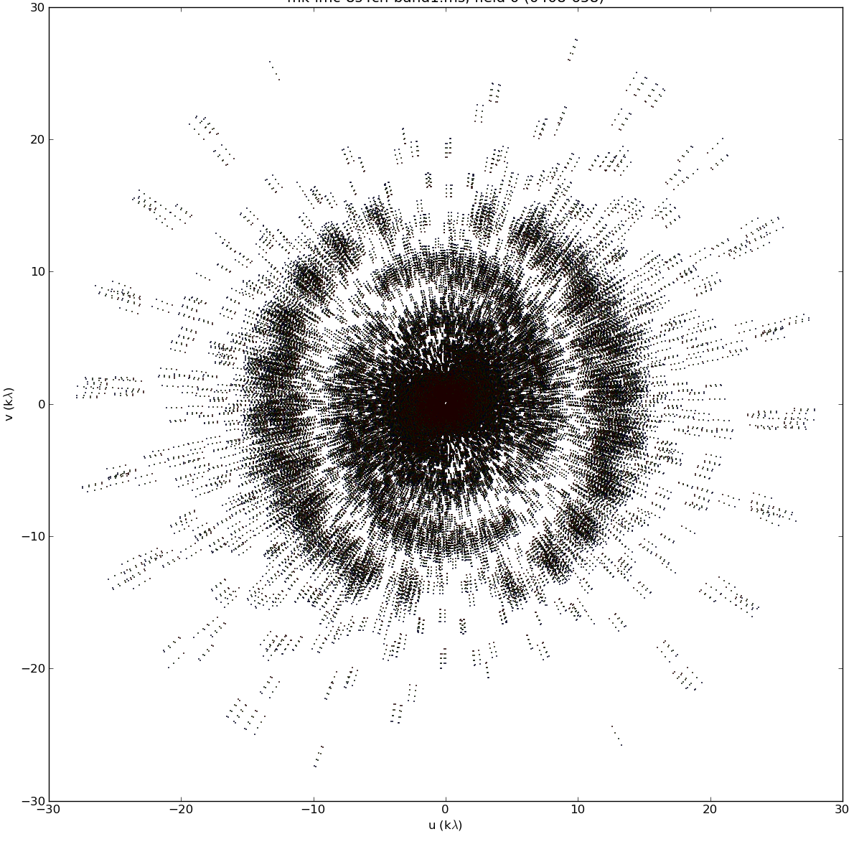
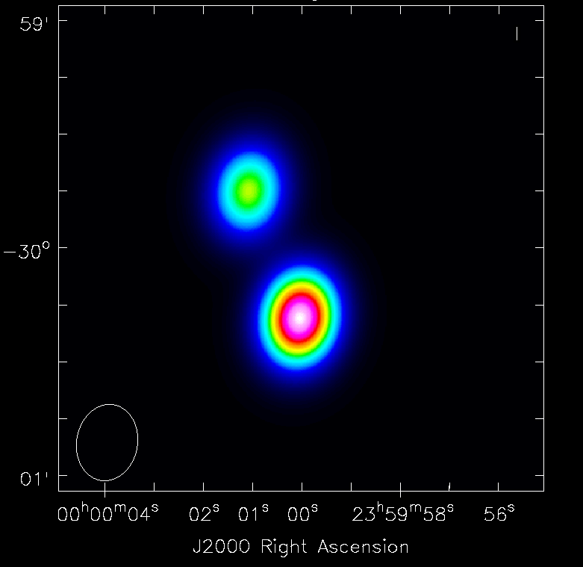
Image reconstruction problem

Slide 3
Why do we need distribution?

Slide 4
Distributed Gridding and Deconvolution
Implementation: .netcore (C#)
MPI for node-communication
Tested speedup on 1GB real-world MeerKAT observation
Preliminary results and algorithms

Slide 5
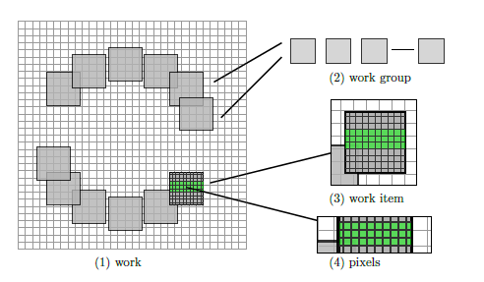
Image Domain Gridding (IDG)

Slide 6
Distributed gridding
MPI_Reduce
~1000 MB
Grid 1024 *1024
~8 MB

Slide 7
Distributed gridding

Slide 8
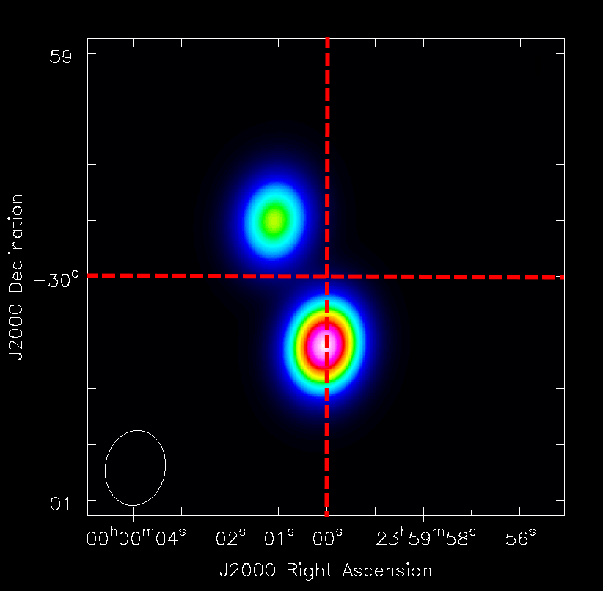
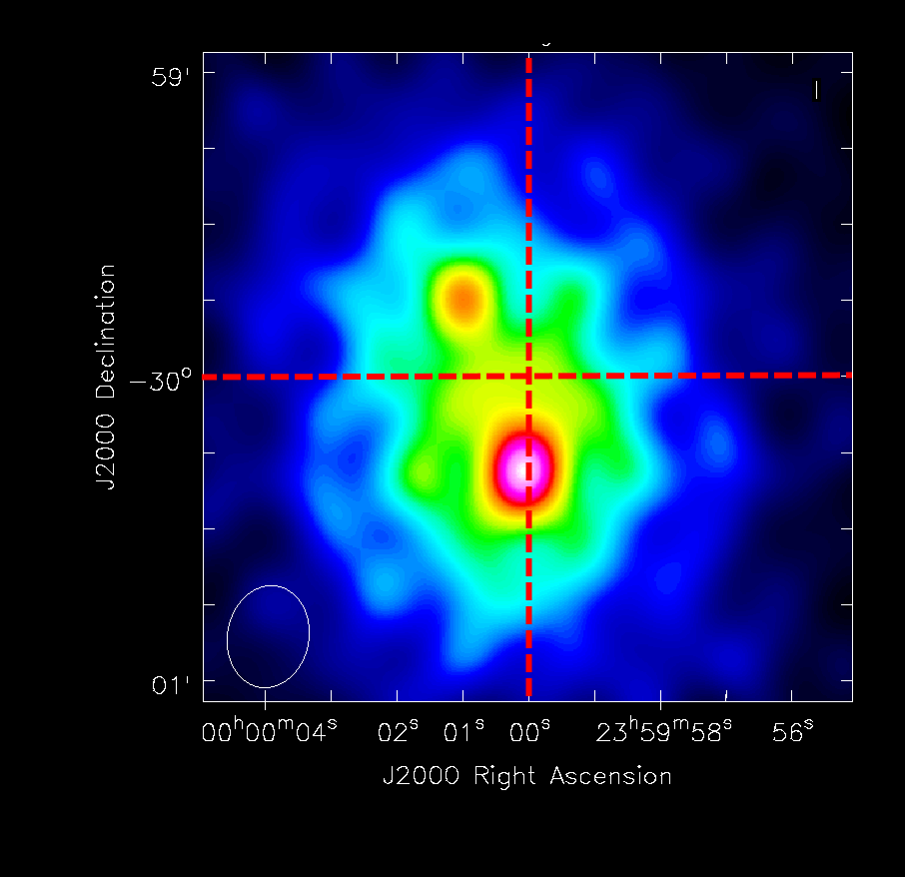
Distributed deconvolution

Slide 9
Coordinate Descent deconvolution
Search the best pixel to deconvolve
Calculate the optimum for the pixel(reduces to parabola fitting –b/2a)
Repeat until converged

Slide 10
Distributed Coordinate Descent deconvolution
Distributed CD:
Search best local pixel
Decide on the best global pixel (MPI_ReduceAll)
All nodes update local residuals

Slide 11
Distributed Coordinate Descent

Slide 12
Distributed gridding + deconvolution
Distributed gridding: More effective with more input data
Distributed deconvolution: Communication is difficult
But we have many unexplored CD variants:
Shotgun
PCDM
Hydra
…
IDG and CD benefit from GPU acceleration

Slide 15


Comparison CLEAN with CD+ElasticNet
Noise Regularization:
ElasticNet
L1 Norm
L2 Norm
+

Slide 16
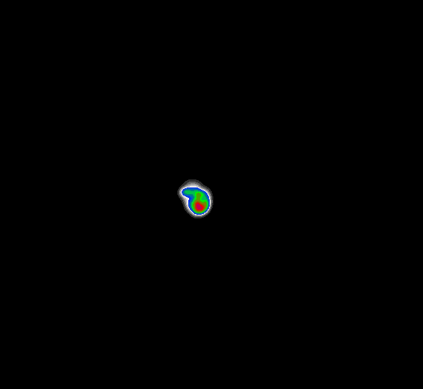

Comparison
Distributed CD + ElasticNET
CLEAN

