Slide 1

The SDG Adventure
Meet the KALKI team, dedicated to creating an engaging platform for students to learn about the Sustainable Development Goals (SDGs).

Slide 2
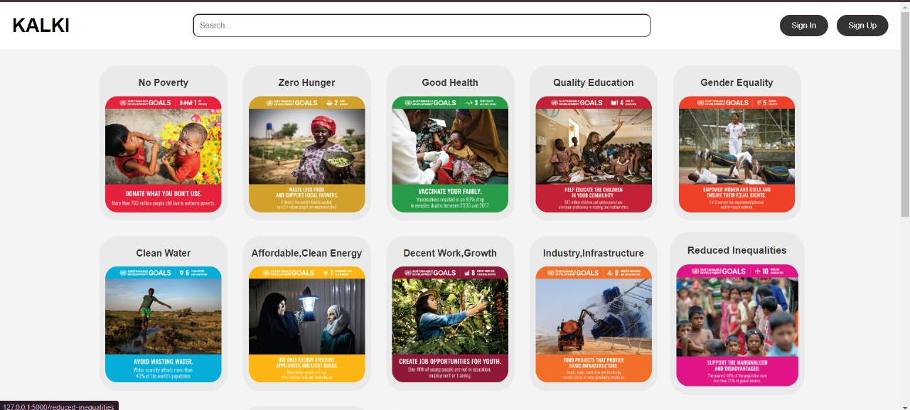
Educating for a Sustainable
Sign in
Sign up

Slide 3
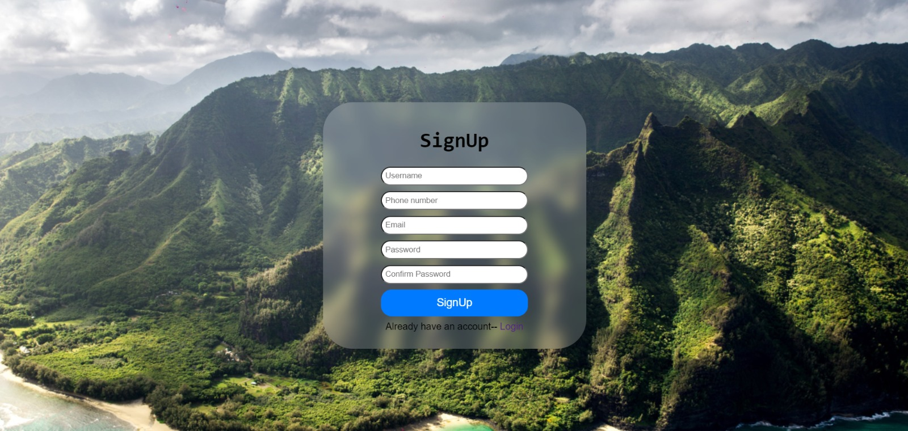
Enter Information
here to sign up

Slide 4
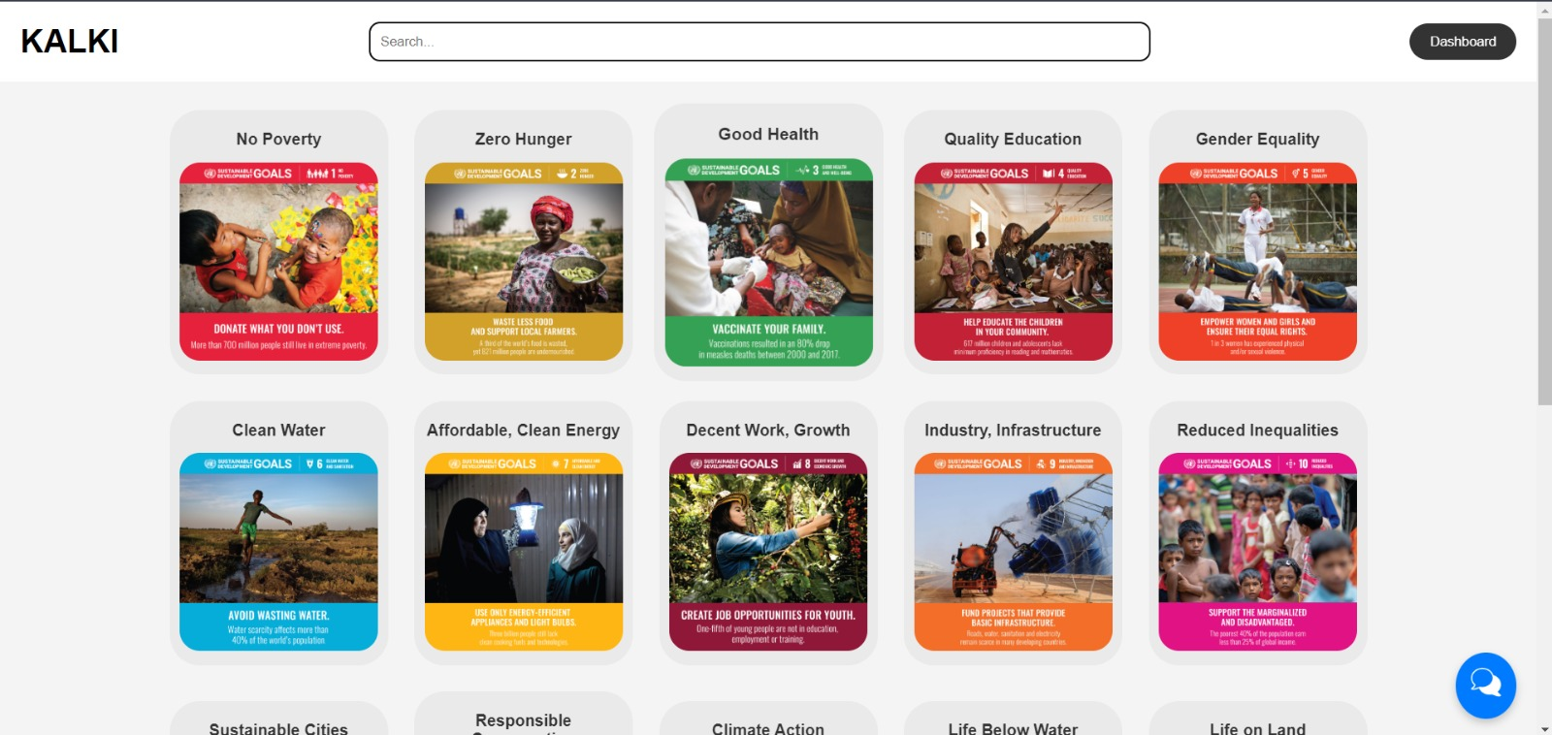
Visit the page to learn more about each SDG
AI Chatbot

Slide 5
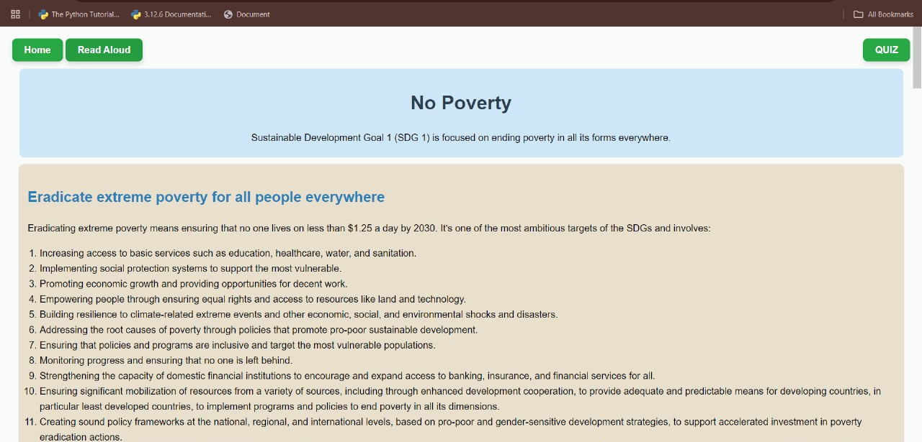
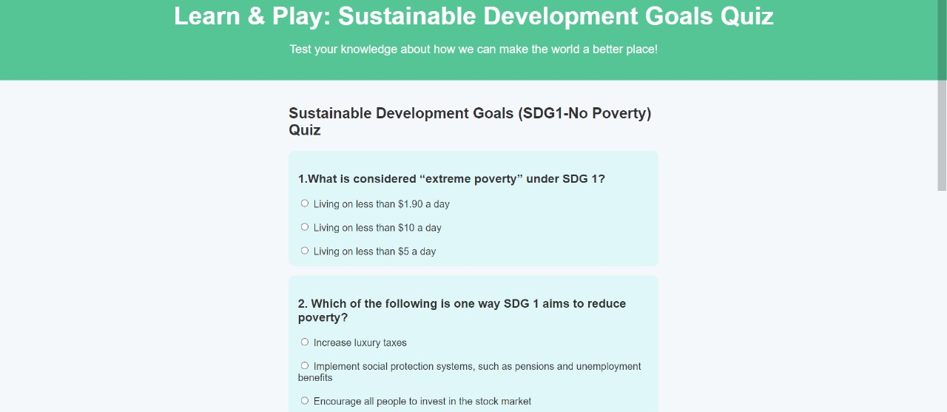
Open Quiz Page
Page of information about the chosen SDG
Page of take a quiz about the chosen SDG

Slide 6
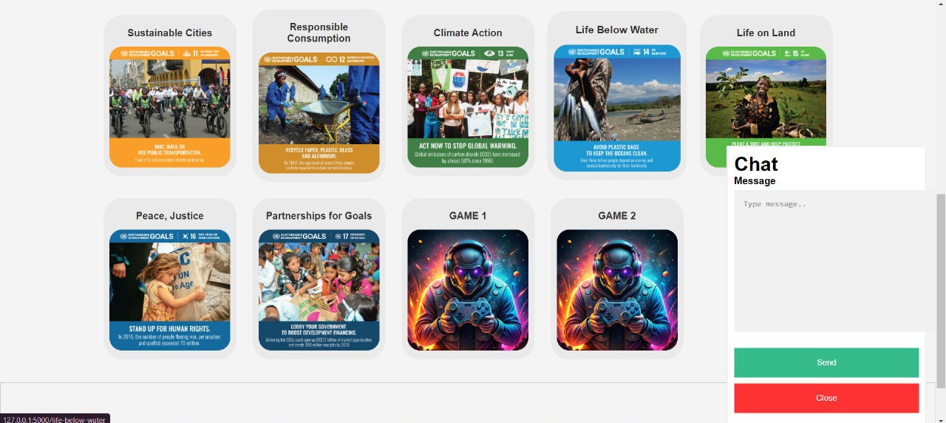
Games
AI Chatbot

Slide 7
