Slide 1
ENVIRONMENTAL MANAGEMENT · 22ENV231
MOSAIC-Air
Wind-aware urban air
pollution forecasting
A spatiotemporal deep-learning pilot for short-term PM₂.₅ forecasts, emerging hotspots, and forecast uncertainty.
Aakash · Shaik Mohammed Atif · Shivadev
Amrita Vishwa Vidyapeetham · Amritapuri Campus
MOSAIC-AIR · ENVIRONMENTAL MANAGEMENT
01

Slide 2
01 / MOTIVATION
Air risk changes across both time and place
A single citywide number can hide where the next local episode is forming.
01
02
03
Uneven monitoring
Moving conditions
Action needs context
Sparse station coverage leaves gaps between measured locations.
Wind and weather change how pollution builds and moves through a city.
Managers need forecasts with uncertainty and a clear location, not a score alone.
PROJECT QUESTION
Can wind-conditioned station relationships improve multi-horizon PM₂.₅ forecasts and help flag emerging high-pollution episodes?
MOSAIC-AIR · ENVIRONMENTAL MANAGEMENT
02

Slide 3
02 / PROJECT
From monitoring records to decision support
One reproducible pilot links modelling, evaluation, and a location-focused interface.
01
02
03
Prepare
Forecast
Communicate
Hourly PM₂.₅ + weather
12 station panel
WAGTF-Net
+1 · +6 · +24 hours
Hotspots · event probability
P10–P90 uncertainty
Research focus
Benchmark short-horizon forecasts · detect episode risk · test missing-input sensitivity
MOSAIC-AIR · ENVIRONMENTAL MANAGEMENT
03

Slide 4
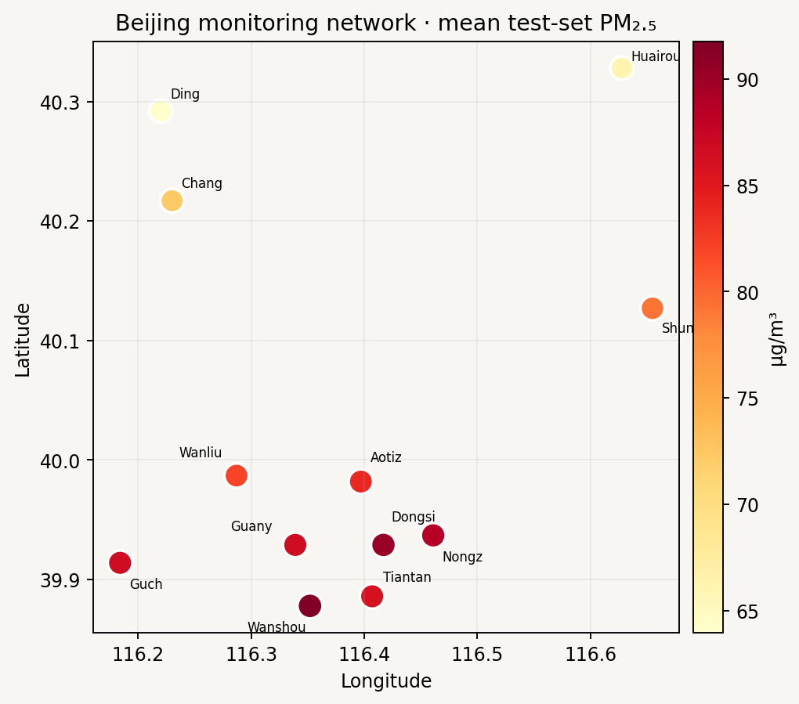
03 / DATA
A documented multi-station benchmark
UCI Beijing Multi-Site Air Quality · historical hourly observations · public CC BY 4.0 dataset
12
monitoring sites
PILOT SCOPE
Beijing
35,064
hourly timestamps
Public benchmark makes the method reproducible. It does not represent air quality in Kerala or Amritapuri.
420,768
site-hour records
2013–2017
benchmark period
PM₂.₅ · PM₁₀ · SO₂ · NO₂ · CO · O₃
Temperature · pressure · dew point
Precipitation · wind direction · speed
Site coordinates are approximate values added from published station tables.
MOSAIC-AIR · ENVIRONMENTAL MANAGEMENT
04

Slide 5
04 / FRAMEWORK
MOSAIC-Air connects prediction to a readable map
The pilot is implemented end to end: historical panel → model → API → browser dashboard.
INPUT WINDOW
WAGTF-NET
FORECAST
INTERFACE
24 h of pollution
weather · time
station locations
temporal convolution
wind-biased graph attention
adaptive fusion
PM₂.₅ median
P10 / P90 range
episode probability
station map
hotspots · weather
REST API
Historical replay only
Current pollution observations and forecast weather are needed before this pipeline can be used live.
MOSAIC-AIR · ENVIRONMENTAL MANAGEMENT
05

Slide 6
05 / MODEL
Wind changes how station information is shared
Attention combines learned similarity with direction, speed, and distance.
B
WAGTF-Net
• 24 h temporal convolution per station
• Graph attention across nearby sites
• Wind alignment biases source → destination influence
• Three horizons × P10 / P50 / P90 + episode probability
A
D
C
Approximate wind-informed attention is a learned influence prior, not a physical transport simulator.
DOWNWIND
MOSAIC-AIR · ENVIRONMENTAL MANAGEMENT
06

Slide 7
06 / EVALUATION
Chronological holdout tests time-forward forecasting
Inputs use the previous 24 hours; issue times are spaced every six hours.
TRAIN
VALIDATE
TEST
Mar 2013 – Dec 2015
Jan – Jun 2016
Jul 2016 – Feb 2017
FORECAST HORIZONS
+1 h
+6 h
+24 h
BASELINES
EVALUATION
Persistence · HistGradientBoosting
MAE · RMSE · R² · episode F1 / Brier · P10–P90 coverage
MOSAIC-AIR · ENVIRONMENTAL MANAGEMENT
07

Slide 8
07 / RESULTS
WAGTF-Net is strongest at six hours in this pilot
Held-out MAE (µg/m³) · all event cutoffs selected on validation data
62.8
60
AT +6 HOURS
54.5
53.0
28.80
µg/m³ MAE
40
34.1
31.2
28.8
vs 31.19 for Gradient Boosting
≈ 7.7% lower MAE
20
10.4
10.1
10.9
At +1 h, Gradient Boosting has lower MAE (10.07 vs 10.92).
0
+1 h
+6 h
+24 h
Persistence
HistGradientBoosting
WAGTF-Net
MOSAIC-AIR · ENVIRONMENTAL MANAGEMENT
08

Slide 9
08 / RELIABILITY
Uncertainty helps—but missing inputs still matter
Nominal 80% P10–P90 coverage is close overall; the long-horizon interval is broad.
+1 h
+6 h
+24 h
82.5% coverage
84.1% coverage
80.4% coverage
36.7 µg/m³ mean width
95.8 µg/m³ mean width
155.4 µg/m³ mean width
ADDITIONAL 20% PM₂.₅ INPUT MISSING · CHANGE IN TEST MAE
+1 h
+6 h
+24 h
+63.6%
+13.6%
+0.8%
10.9 → 17.9 MAE
28.8 → 32.7 MAE
53.0 → 53.5 MAE
Randomly masking extra input cells without retraining. One-hour forecasts degrade most; add missing-data augmentation before deployment.
MOSAIC-AIR · ENVIRONMENTAL MANAGEMENT
09

Slide 10
09 / PROTOTYPE
The dashboard makes forecasts location-specific
A local REST API serves the selected historical issue time to the browser interface.
STATION MAP · GEOGRAPHIC CONTEXT
INCLUDED
• Interactive station map
• 1 / 6 / 24 h horizon selector
• P10–P90 uncertainty range
• Episode probability + hotspot ranking
• FastAPI JSON endpoints
SELECTED SITE
Station detail
PM₂.₅ median
P50
P10–P90 range
Episode probability
Wind · temperature
Historical replay · not live · not a health advisory
MOSAIC-AIR · ENVIRONMENTAL MANAGEMENT
10

Slide 11
10 / INTERPRETATION
What this pilot can—and cannot—say
The result is promising at the medium horizon and bounded by its benchmark design.
WHAT WE FOUND
NEXT VALIDATION
• 6 h MAE improves about 7.7% over HistGradientBoosting
• 24 h improvement is modest; intervals are wide
• One-hour forecasts depend on recent PM₂.₅ inputs
• Forecasts and hotspot views work end to end
• Use a local dataset; test held-out stations and cities
• Join live observations to forecast weather
• Stress-test outages, drift, and systematic missingness
• Calibrate by station/horizon; review thresholds locally
The 75 µg/m³ label is a project benchmark—not a health or regulatory threshold.
MOSAIC-AIR · ENVIRONMENTAL MANAGEMENT
11

Slide 12
MOSAIC-AIR · PILOT CONCLUSION
A reproducible path from
station data to spatial forecasts.
WAGTF-Net shows value at 6 hours in this Beijing case study. The next step is validation with local data, weather forecasts, and environmental stakeholders.
Thank you
MOSAIC-AIR · ENVIRONMENTAL MANAGEMENT
12

