Slide 1

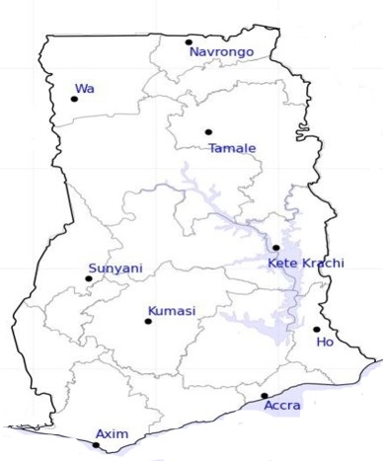




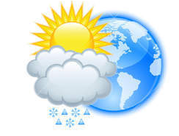




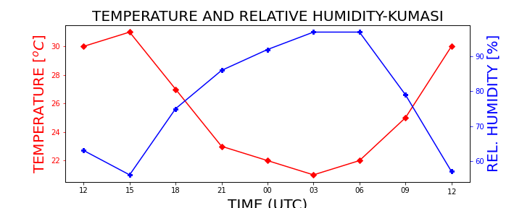


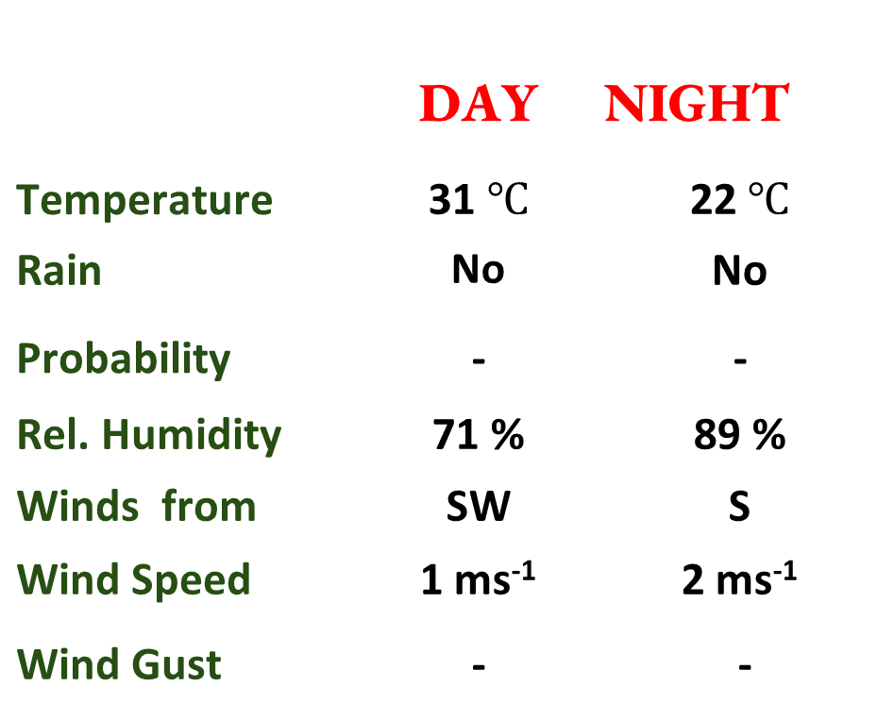
KNUST WEATHER FORECAST
24-HOUR FORECAST
24-11-2022 @ 1200 UTC
Rain
Wind
Dust
.
Forecast Summary (KUMASI)
 | DAY | NIGHT
Temperature | 31 $℃$ | 22$℃$
Rain | No | No
Probability | - | -
Rel. Humidity | 71 % | 89 %
Winds from | SW | S
Wind Speed | 1 ms⁻¹ | 2 ms⁻¹
Wind Gust | - | -
Low risk
Be aware
Be Prepared
Take Action
Department of Meteorology and Climate Science, CoS
SUNSET: 05:46 PM SUNRISE: 5:59 AM
POWERED BY:

