Slide 1

Foster Care and High School Dropouts
An exploration into the correlation between kids in foster care and high school drop out rates.

Slide 2
Table of Contents:
Overview
Hypothesis
Method
Method-Gathering the Data
Median Household Income
Children in Foster Care
Dropouts
Analysis
Conclusion
Sources

Slide 3

A story about a boy…
Clayton Graves aged out of the foster care system in 1991.
During his early years, Clayton was a bright student who was inquisitive and engaging.
Starting his first year of high school, Clayton quickly fell behind the rest of his class.
Moving from home to home made it difficult for him to keep up with his peers as he changed schools.
By the time he turned he turned 18, Clayton was homeless and had dropped out of high school. He would remain homeless for the next 10 years.

Slide 4
“In Colorado, only one in four students who experience foster care during high school graduate with their class.” -Colorado Department of Human Services
It is no secret that foster kids struggle in school.
In an annual report to the Colorado Legislature, students in out-of-home placement noted significantly higher truancy rates than students in more conventional households.
We decided to take a look at the problem from a national perspective in order to determine how wide-spread the problem is.

Slide 5
Hypothesis
Based on Clayton’s experience, we believe that there is a direct correlation between poverty level, number of children in foster care, and the number of high school dropouts.
The lower the median household income, the higher the number of children in foster care and thus the higher the number of children who do not finish high school

Slide 6
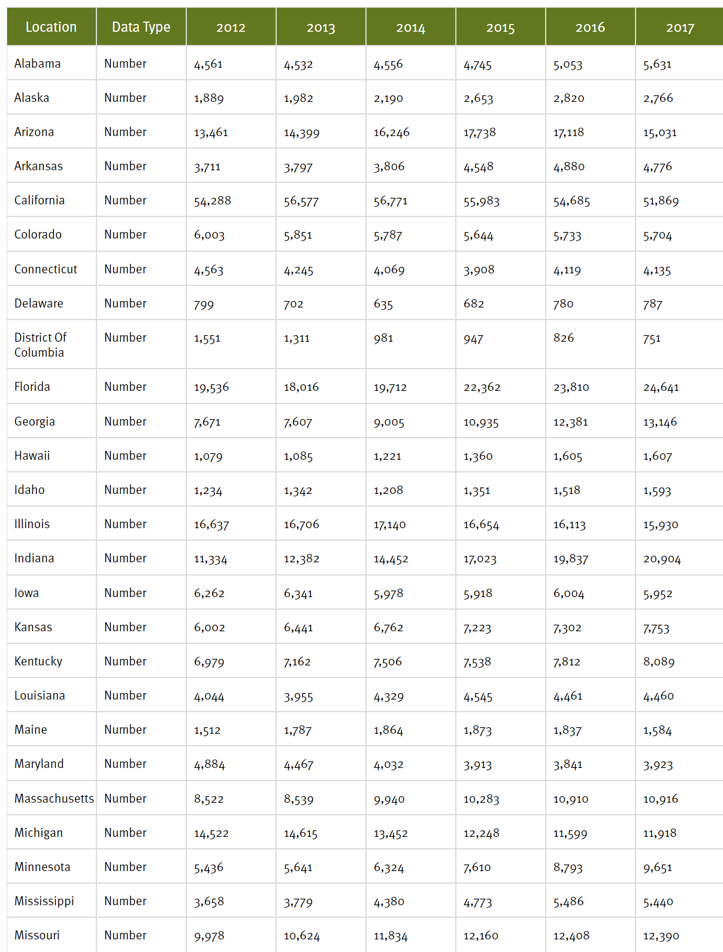
Method
In order to properly test our hypothesis, we needed to gather 3 data sets on a national level:
Median household income by state
Number of children in foster care by state
Number of foster children who successfully graduated high school and/or completed post secondary degrees
The third data set was not formatted in a way we could use so we had to find a substitute.
The number of high school drop-outs was available by state and could still potentially show a correlation. We will explore this more in later slides.

Slide 7
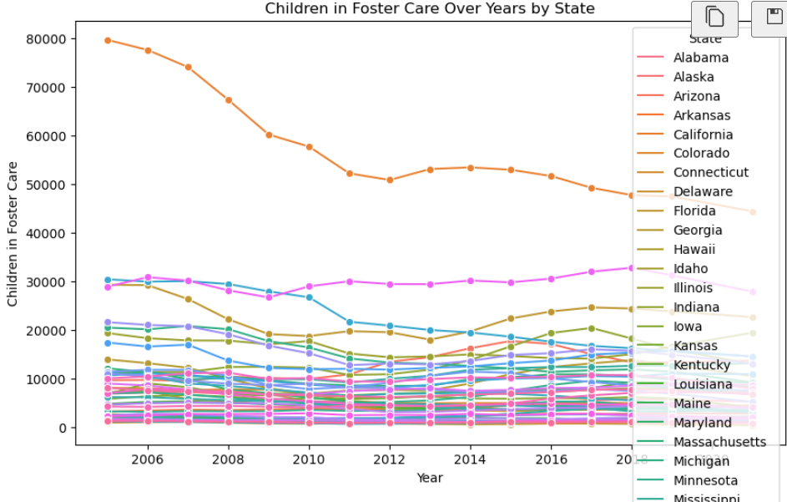
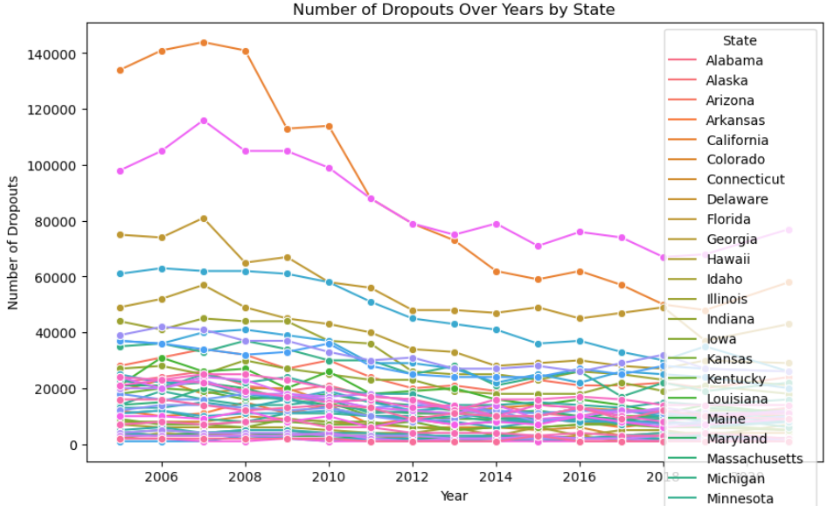
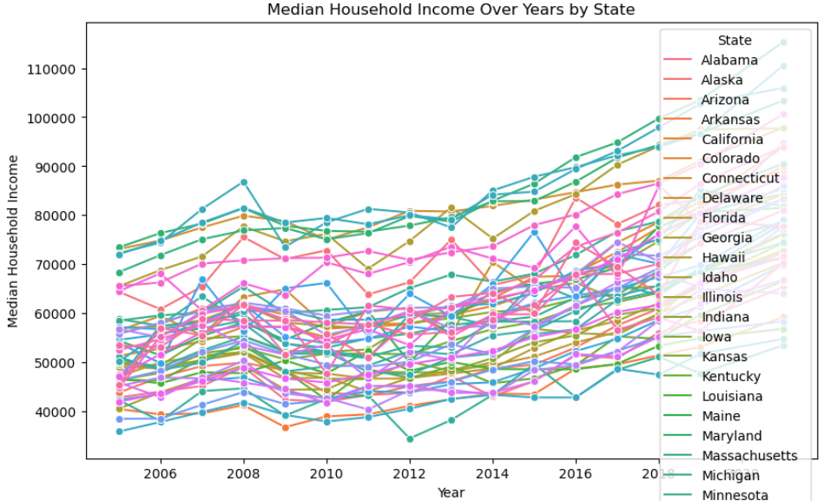
Method-Gathering the Data
Initial data by state was too hard to read with 52 states represented.

Slide 8
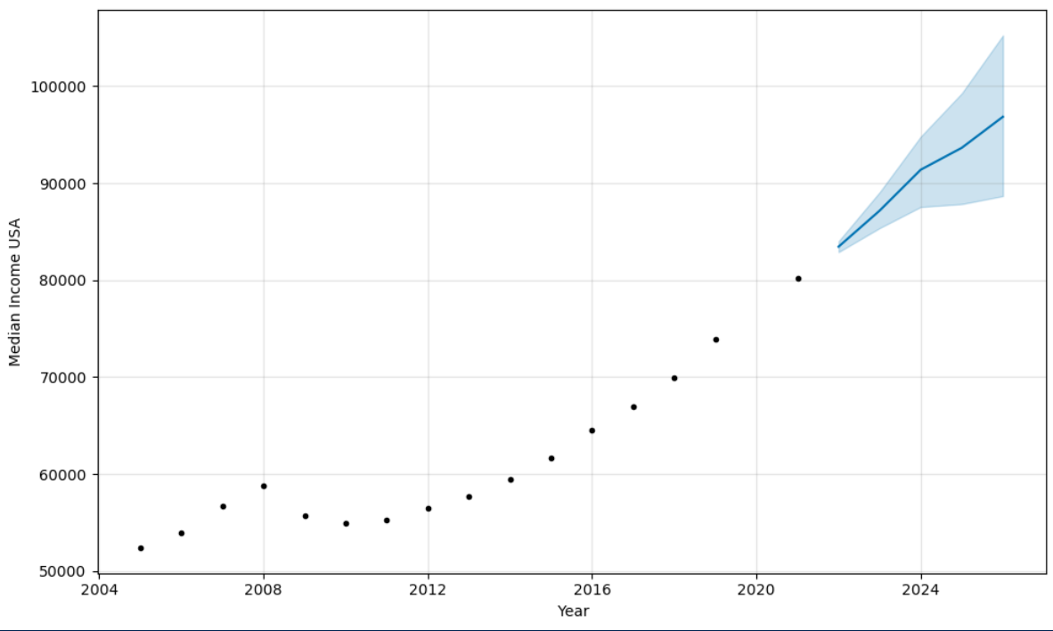
Median Household Income
We pulled the data from datacenter.aef.org.
Data was presented by state and year.
Despite the impact of the 2008 housing crises, initial graph data showed a steady increase in household income from 2005 to 2021

Slide 9
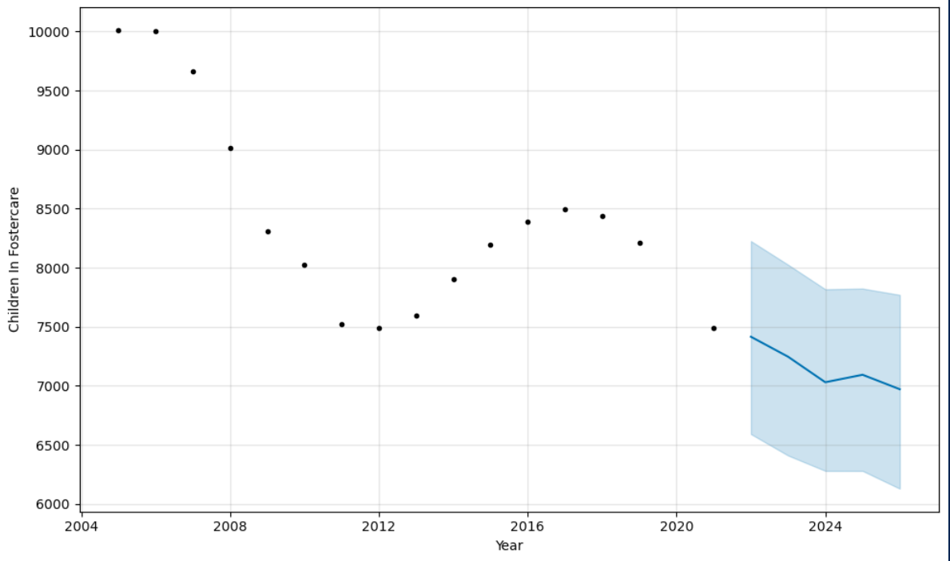
Children In Foster Care
We pulled the data from datacenter.aef.org.
Data was presented by state and year.
Overall numbers showed a sharp drop, followed by an increase in 2016.
The over all trend is expected to continue to decrease and is already at its lowest level in our recorded data.

Slide 10
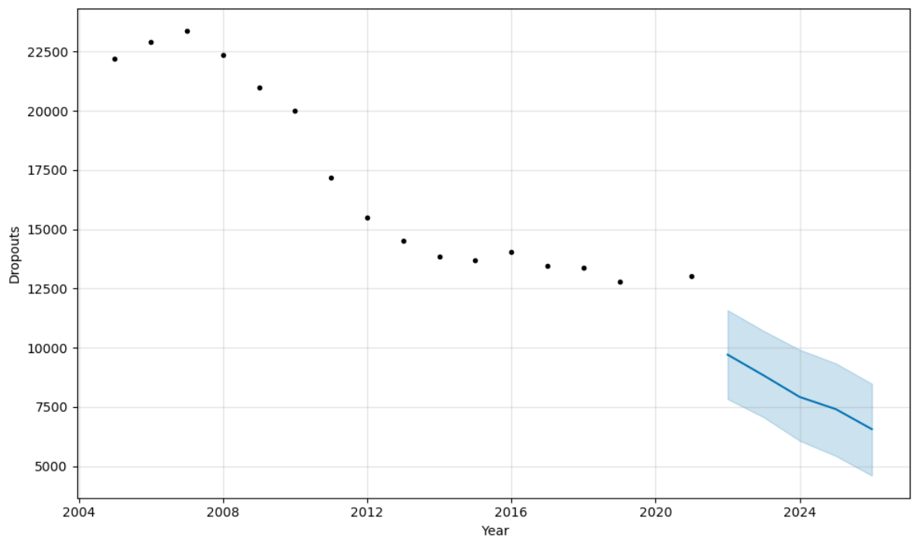
Dropouts
We pulled the data from datacenter.aef.org.
Data was presented by state and year.
Dropout rates appear to be trending downward over the last 16 years and are expected to continue to do so throughout 2024.

Slide 11
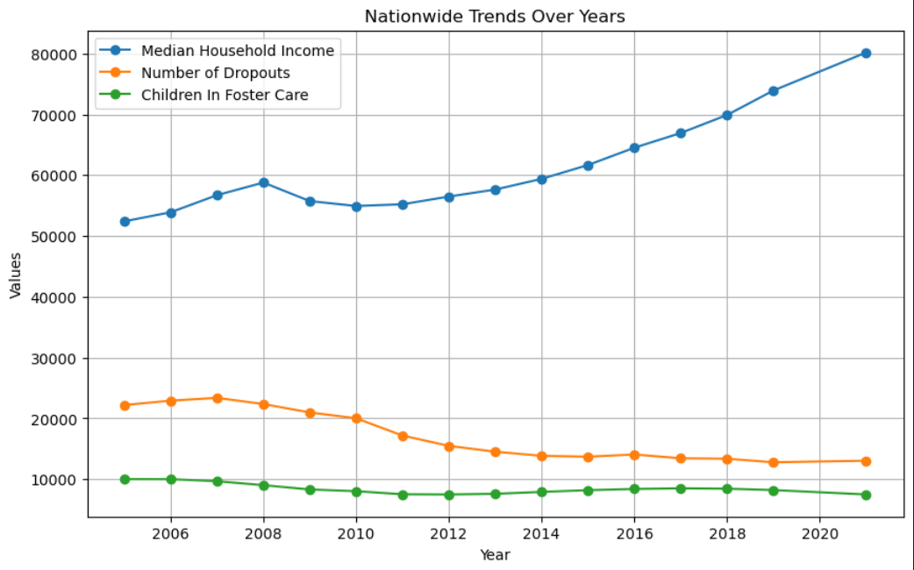
Analysis
Initial comparison of data shows no correlation at all between median household income and they other datasets.

Slide 12
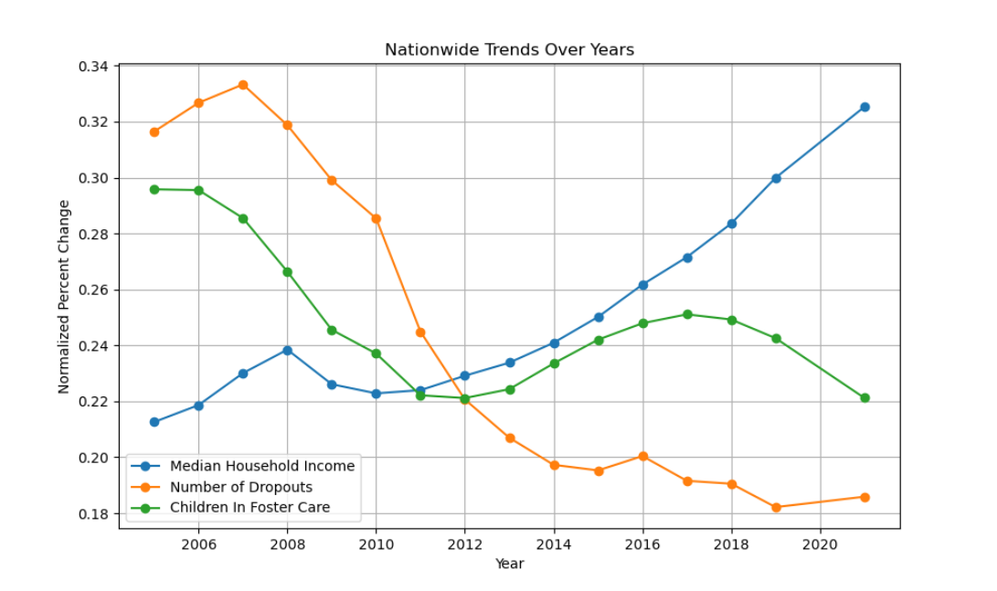
Analysis
However, when viewing the data in a normalized format, a relationship does begin to materialize.
We are able to see an inverse correlation where the household income increased, and the number of children in foster care and dropouts decreased.

Slide 13
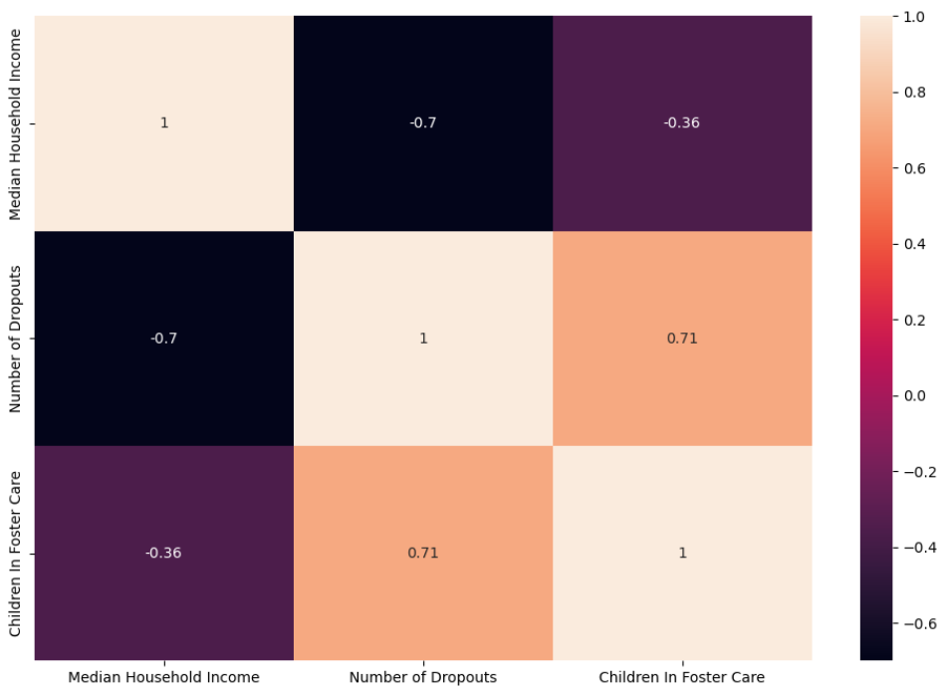
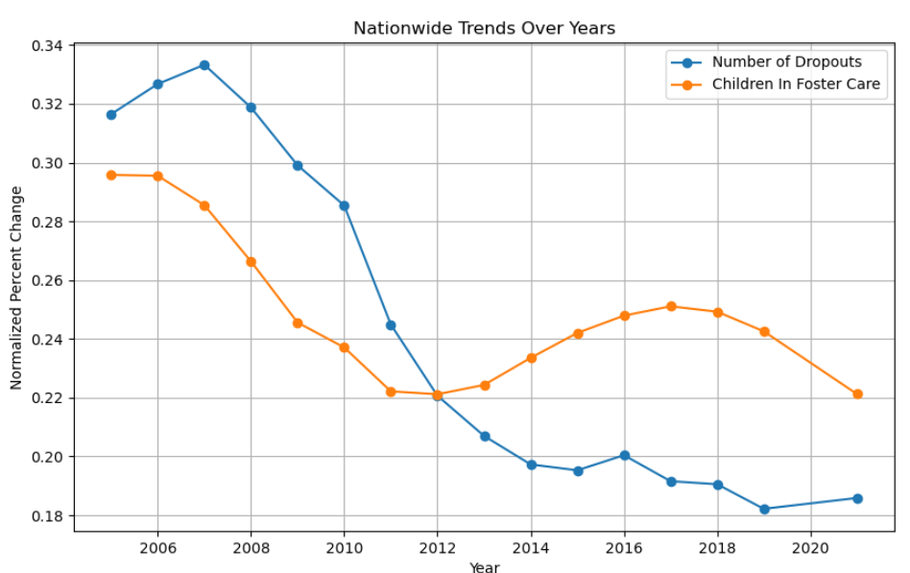
Analysis
When we dive deeper into the analysis of the number of children in foster care and the number of dropouts for the same time period, we do see evidence of a relationship.

Slide 14

Conclusion
Median household income is reported to be increasing overtime, although our data doesn’t account for inflation.
There appears to be an inverse correlation between median household incomes and children in foster care/high school dropouts
The appearance of a correlation between the rates of children in foster care and dropouts presents an opportunity to directly focus on the dropout rates of children in foster care. There is also an opportunity to look into how best to allocate federal funds for maximum impact.

Slide 15
Sources
Project Github
Project Github README
Quote from Colorado Department of Health
Median Household Income Data
Children in Foster Care Data Source
Dropouts Data

