Slide 1
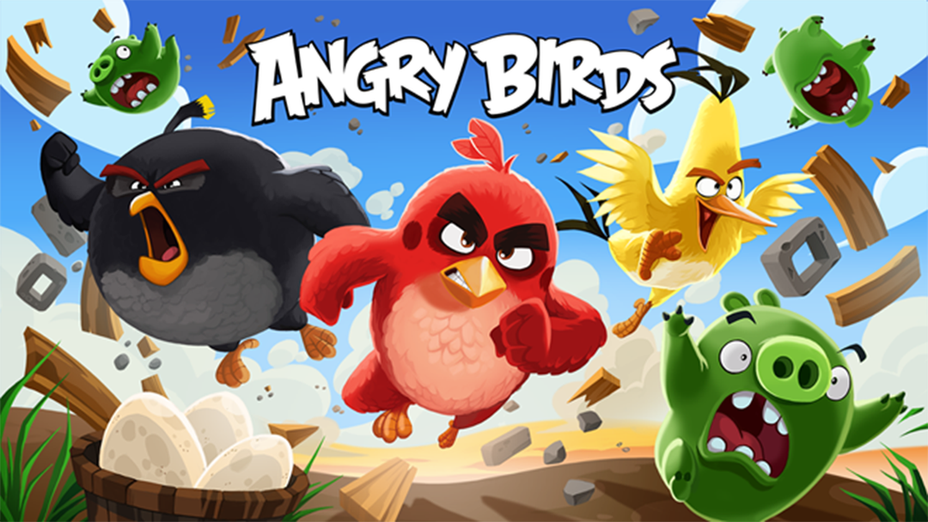

Slide 2
Group Members
Nguyễn Hà Văn ITITUN17030
Nguyễn Quốc Ngọc Long ITITUN18029
Khưu Khôn Lâm ITITIU18303

Slide 3
Content
Overview Project
Game Logic
Class Diagram
Demo Game

Slide 4
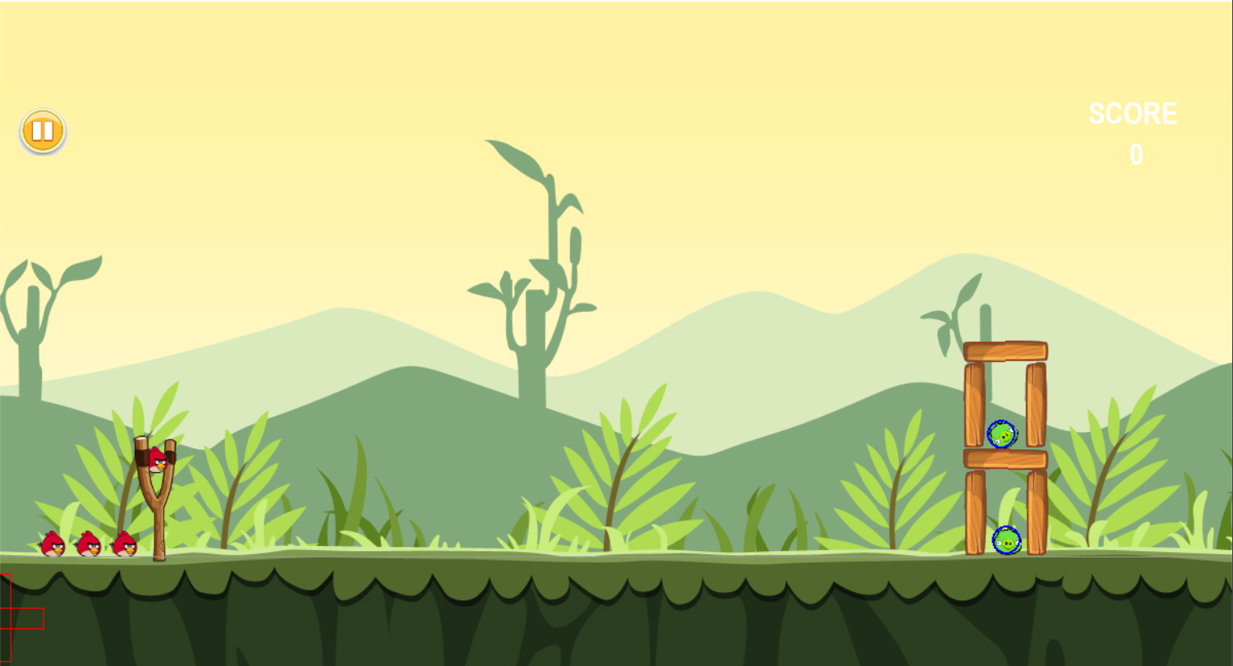
Overview Project
Remake famous game Angry Birds with Python and Object-Oriented Programing knowledge

Slide 5
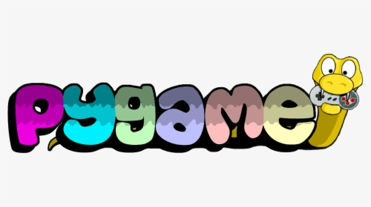

Overview Project
Support Libraries : Pygame and Pymunk
Pygame: a cross-platform set of Python modules designed for writing video games.
Pymunk: a easy-to-use pythonic 2d physics library that can be used whenever you need 2d rigid body physics from Python.

Slide 6
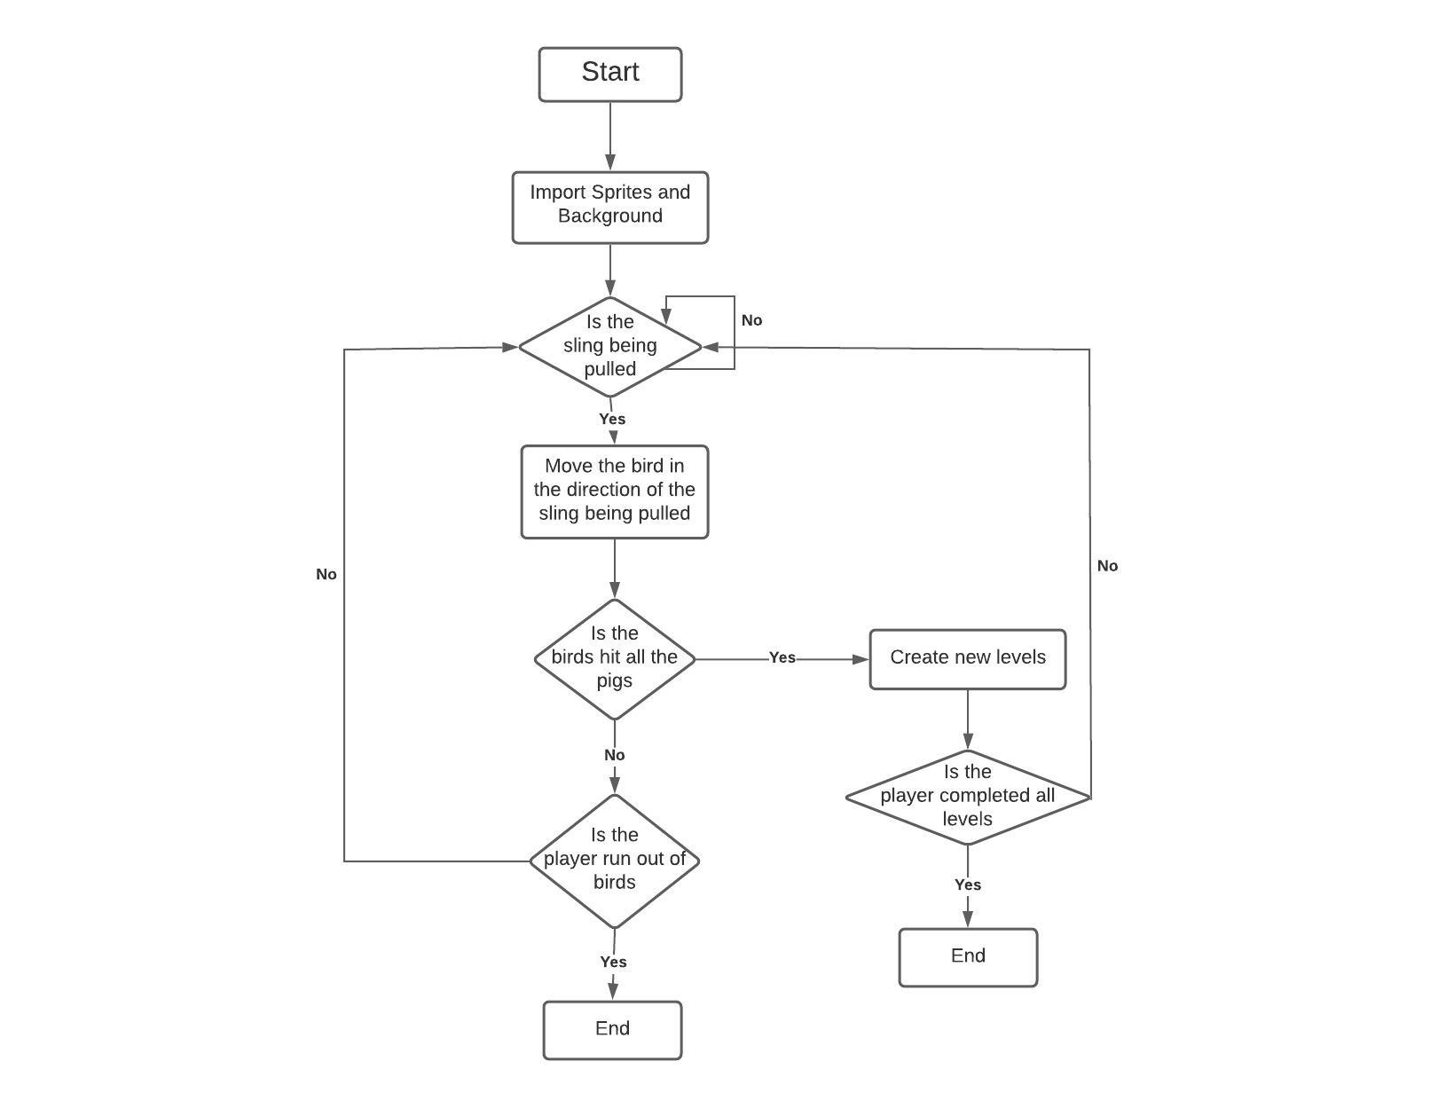
Game Logic
Flow chart

Slide 7
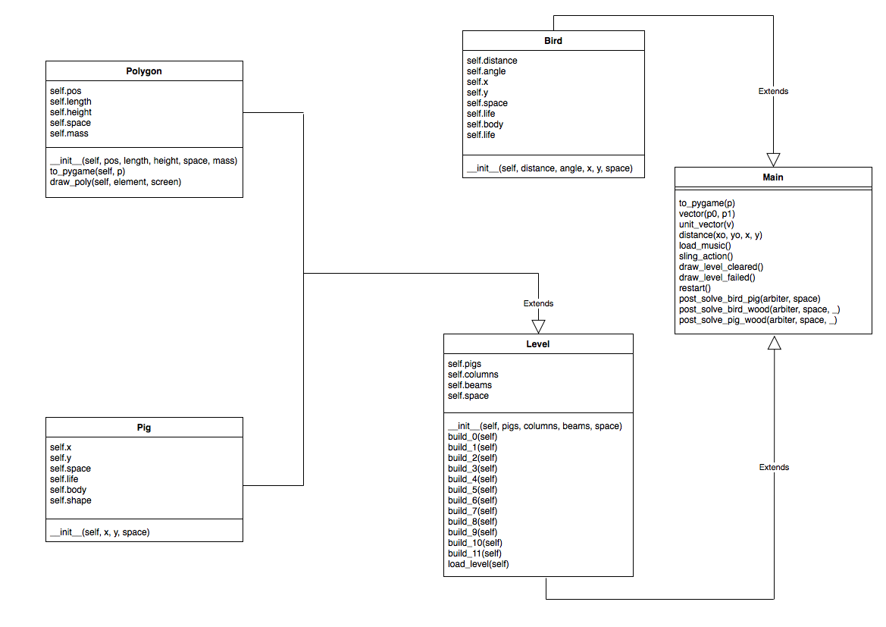
Class Diagam

Slide 8
Demo Game

