Slide 1
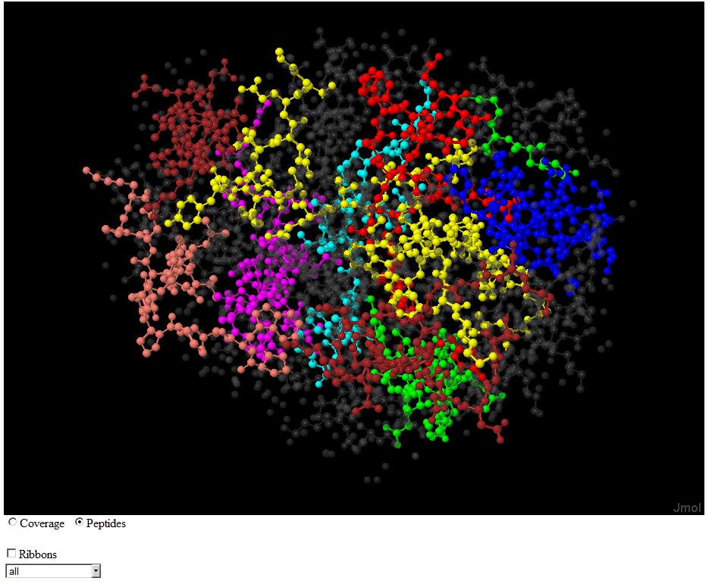
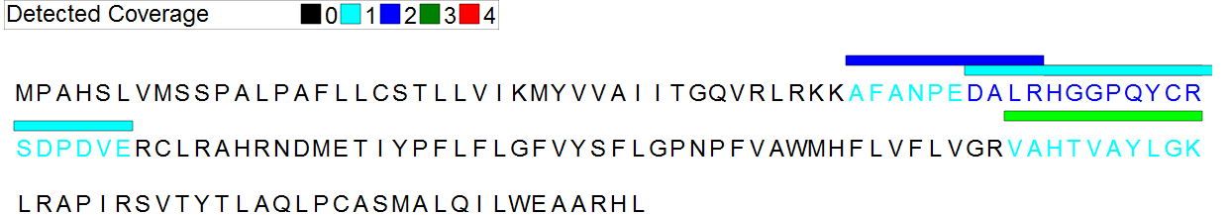
Spaghetti: Visualization of Observed Peptides in Tandem Mass Spectrometry
Steven M. Lewis PhD
20-July-2012

Slide 2
Correlating Detected Peptides and 3D Structure
Why?
  Most spectra cannot be matched to peptides
  Many amino acids do not appear in detected peptides
  Missed Cleavages are common in detected peptides
Why Not?
  Proteins are denatured before digestion destroying 3D Structure

Slide 3
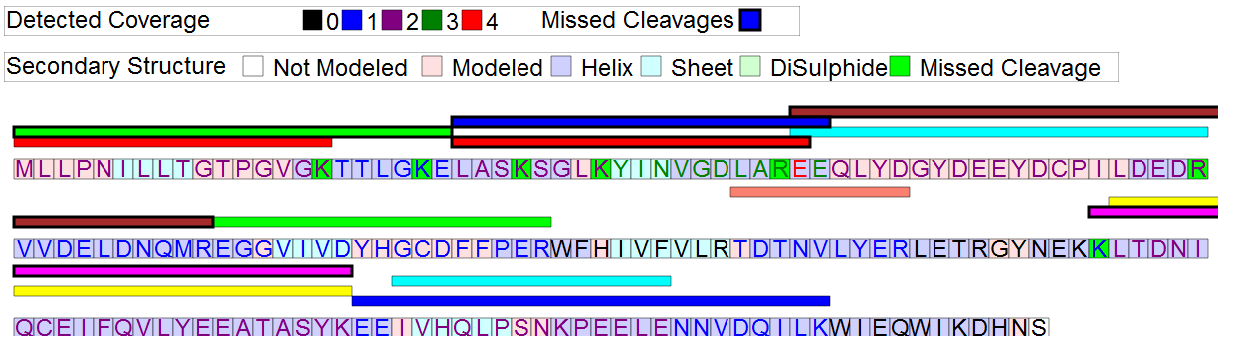
Sequence View
Q9Y3D8.html
Adenylate kinase isoenzyme 6

Slide 4
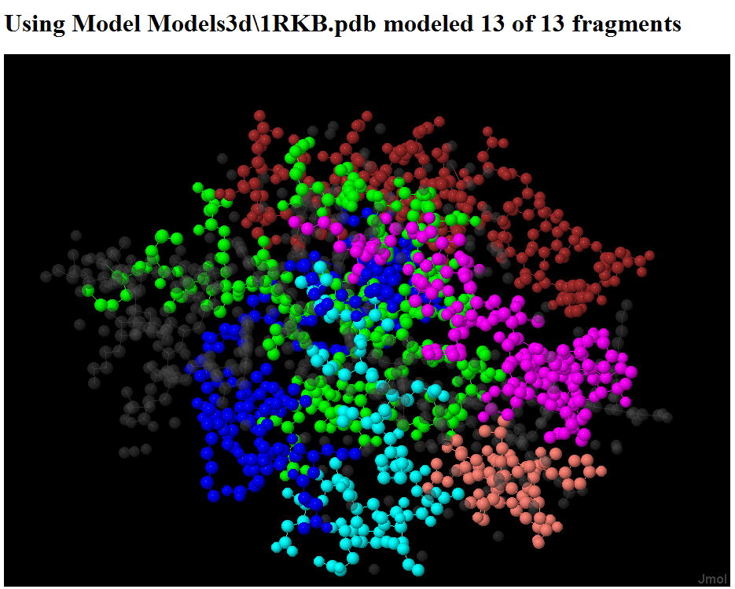
Three Dimensional View

Slide 5

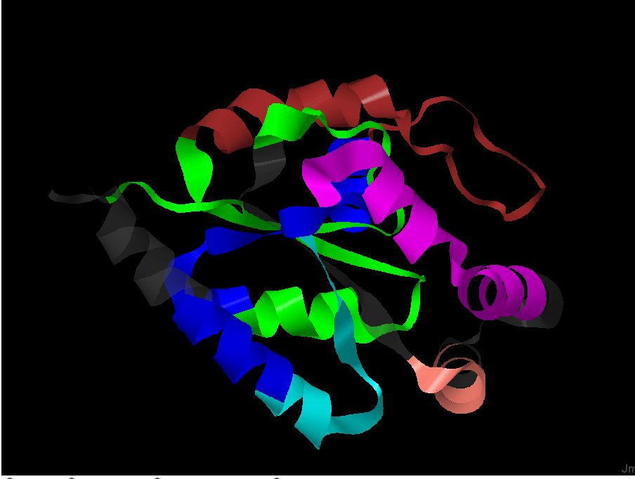
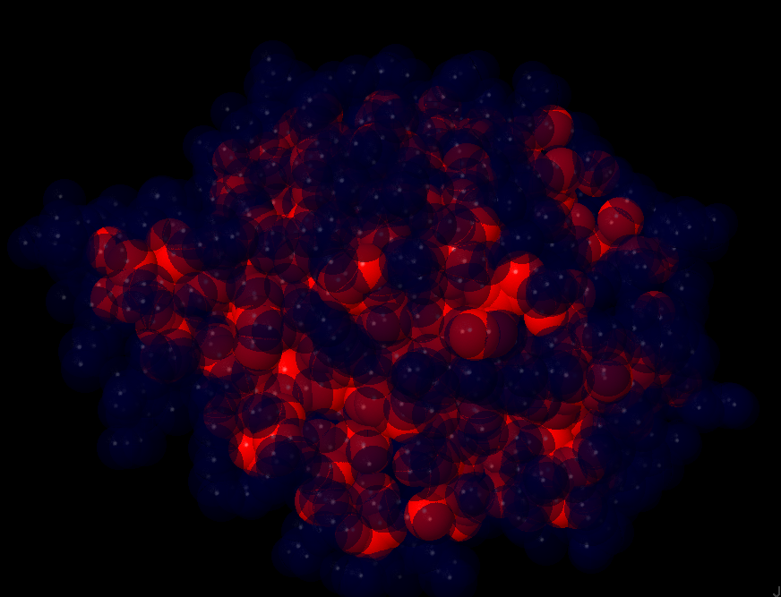
Controls
Ribbons
Solvent Atomic Access

Slide 6
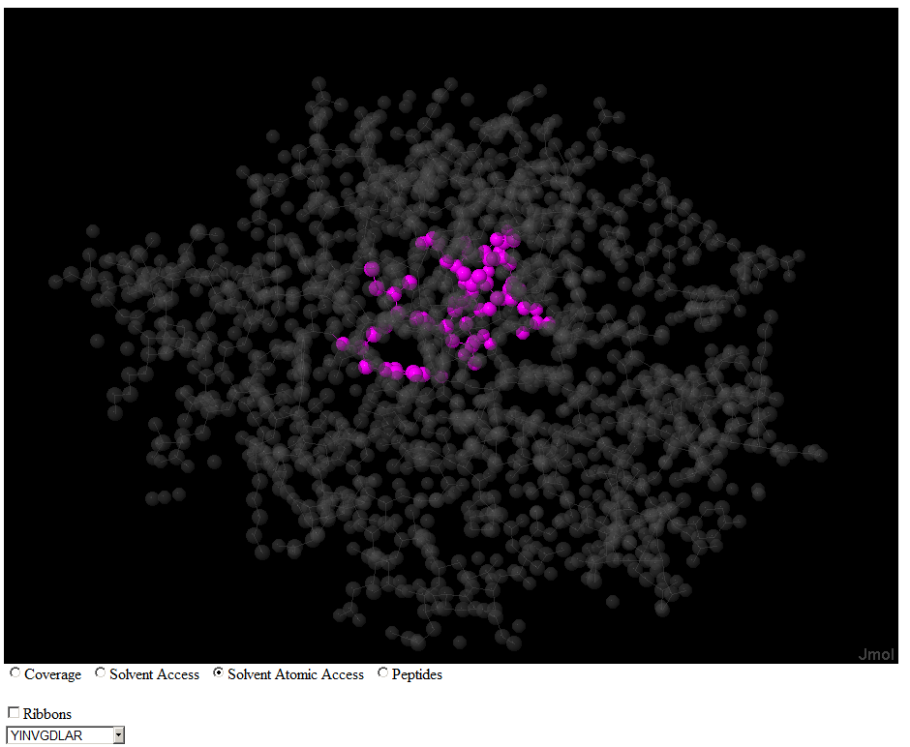
One Peptide View
Solvent Atomic Access

Slide 7
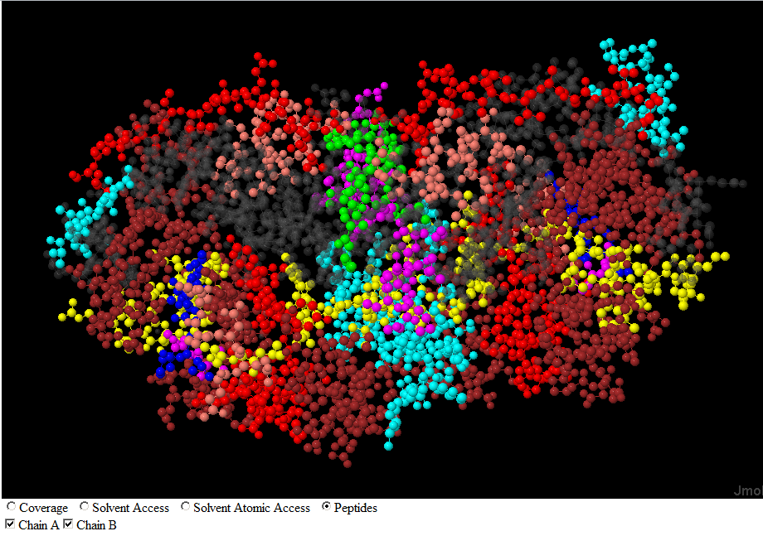
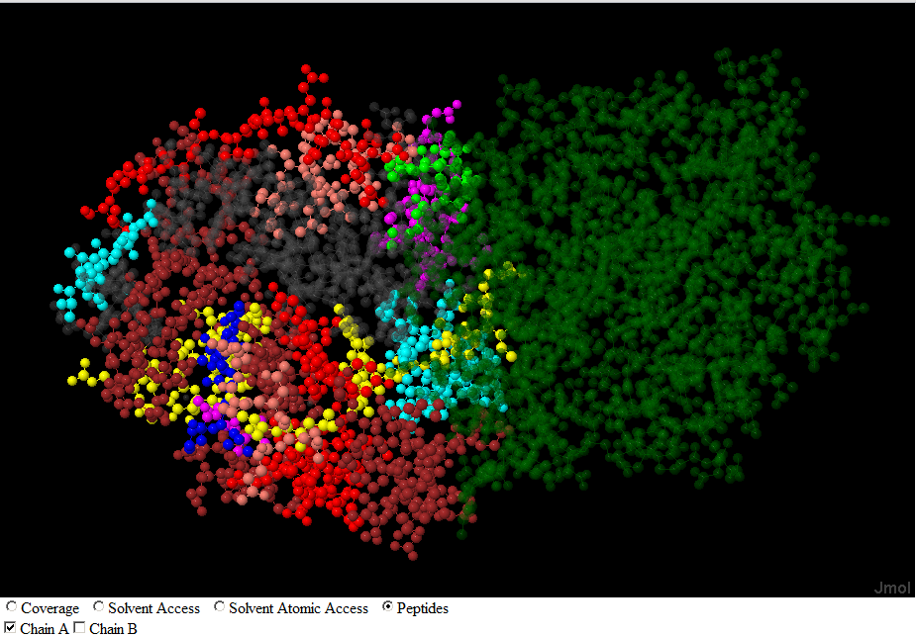
Multiple Chain View
Chains A and B
Chain A Only

Slide 8
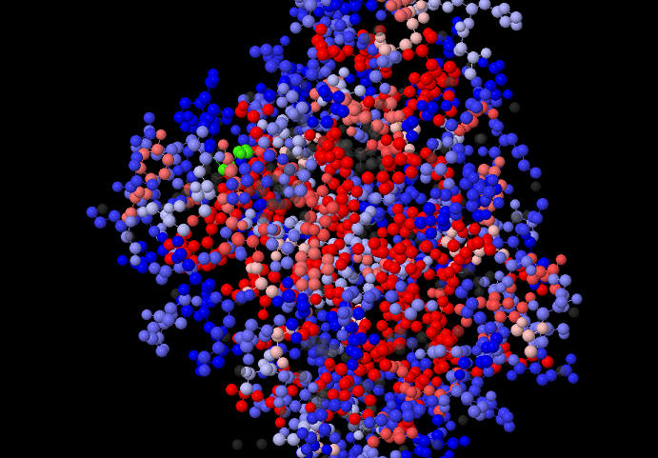
Hydrophobicity View
Blue is hydrophilic Red is Hydrophobic

Slide 9
The Software
Data acquisition
  Gather data from multiple on-line sites
2. Compute Accessible Surface Area
3. Display
  Add JMol – a capable 3D molecular viewer.
  Insert scripts to show features
  Web pages may be generated statically or dynamically

Slide 10
Data Acquisition
Problems
  Start with a protein identifier
  Read sequence and 3d Models from http://www.uniprot.org
  Read fragments from http://www.peptideatlas.org.
  Download 3D models from http://www.pdb.org
  Determine which 3d model best represents your protein.

Slide 11
The Best 3D Model
Criteria
  Fit to the protein
    Many models have multiple chains
    You are interested in one chain or multiple if multiple copies of the protein are present.
    Find the longest sequence of amino acids in the protein available in the model
    Sometimes Smith-Waterman helps
  .Model Criteria
    Technique
    Resolution

Slide 12
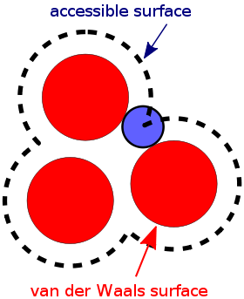
Accessible Surface Area
Which atoms in the model are accessible to solvent
Shrake-Rupley algorithm
  A. Shrake, J. A. Rupley, Environment and exposure to solvent of protein atoms. Lysozyme and insulin, Journal of Molecular Biology, Volume 79, Issue 2, 15 September 1973, Pages 351-364
  Adopted from code by Bosco Ho
Why?
  Solvent access can determine missed Trypsin cleavages
  More generally solvent Accessible implies active sites

Slide 13
Testing Accessible Surface Area Algorithm
Did the algorithm do the right thing?
Turn all atoms red
Turn accessible atoms transparent blue
Rotate

Slide 14
JMol Scripting
Jmol is an applet
  Jmol.js has javascript for the applet
  <script src="../Jmol.js" type="text/javascript">
  </script>
  Jmol.js has javascript for the applet
  Load a predefined script
  window.defaultloadscript = showAminoAcids;
  Initialize the applet - ../.. Is code base
  jmolInitialize("../../");
  Create applet
  jmolApplet(["924","678"], <!– size →
  loadText + window.defaultloadscript, <!– script →
  jmol_id <!– id →
  );

Slide 15
What can be Scripted
select all – Next command applies to all objects
color translucent[80,80,80] white – Make translucent
ribbon off; – Turn off ribbon display
Color a fragment on chain B blue
select GLU138:B;color Blue;\
select GLU139:B;color Blue;\
select ILE140:B;color Blue;\
…
Running a script
jmolScript(
script, // what to do
jmol_id // which jmol instance
)

Slide 16
Set all Exposed Atoms
Color solvent exposed atoms transparent blue
wireframe off;
spacefill 100%;
Select all;color red; , <!– others red →
select water;color translucent[0,0,50];
select atomno = 1083 ;color translucent[0,0,50];
select atomno = 1084 ;color translucent[0,0,50]; select atomno = 1085 ;color translucent[0,0,50];
…

Slide 17
Color Atoms not solvent
Color solvent exposed atoms transparent blue
wireframe off;
spacefill 100%;
Select all;color red; , <!– others red →
select water;color translucent[0,0,50];
select atomno = 1083 ;color translucent[0,0,50];
select atomno = 1084 ;color translucent[0,0,50]; select atomno = 1085 ;color translucent[0,0,50];
…

Slide 18
Showing the Sequence
Build SVG Graphics representation
<g id="Item4" >
<rect style="fill:#ffe0e0;" width="20" height="20" transform="translate(10,62)" transform="translate(20,80)" />
<text id="Item6" style="fill:Purple;background- color:#ffe0e0;" text-anchor="middle" transform="translate(20,80)" >M
</text>
<rect style="fill:#ffe0e0;" width="20" height="20" transform="translate(30,62)" transform="translate(40,80)" />
<text id="Item7" style="fill:Purple;background- color:#ffe0e0;" text-anchor="middle" transform="translate(40,80)" >L
</text>

Slide 19
How to View
Amazon Hosted
Local
Ilya Lab
slewis/LabTalk-6-Sep 2012/IndexGood.html
The code is at
  http://code.google.com/p/hydra-proteomics/
  main
  org.systemsbiology.xtandem.fragmentation. ProteinCollection

Slide 20
Where to View
Criteria
  Fit to the protein
    Many models have multiple chains
    You are interested in one chain or multiple if multiple copies of the protein are present.
    Find the longest sequence of amino acids in the protein available in the model
    Sometimes Smith-Waterman helps
  .Model Criteria
    Technique
    Resolution

Slide 21

Special Thanks to
The Developers of Jmol
Rob Moritz
Terry Farrah
Eric Deutsch
Mike Hoopman
Grants
R01GM087221 from NIGMS
and R01CA137442 from NCI

