Slide 1





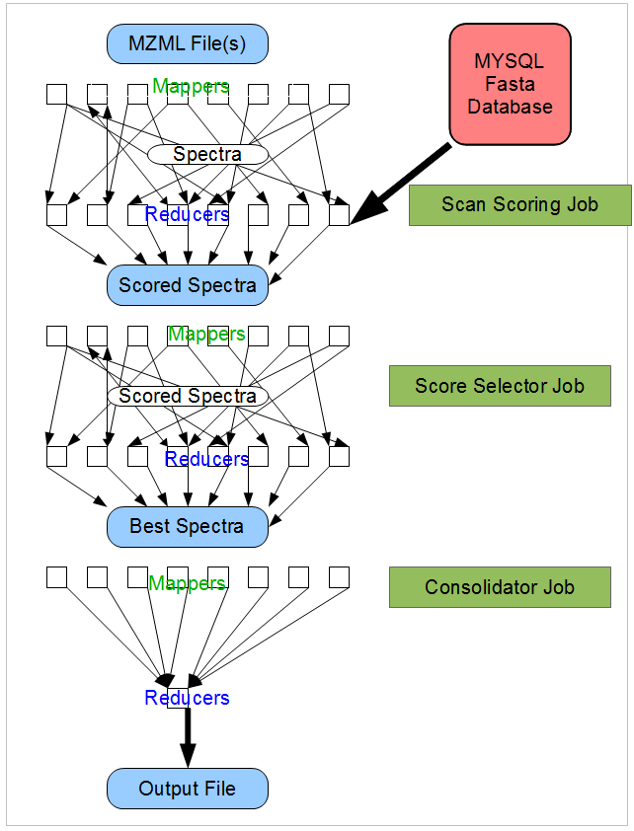
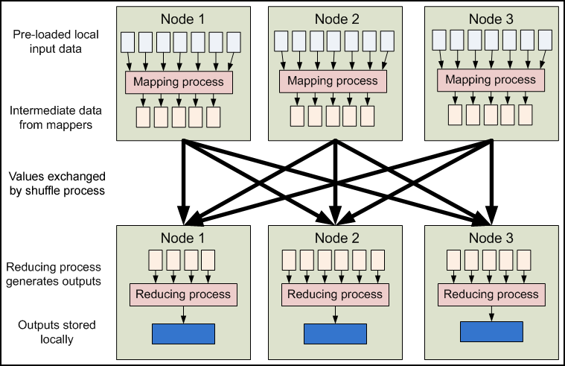
Application of Hadoop to Proteomic Searches
Steven Lewis ¹, Attila Csordas ², Sarah Killcoyne¹, Henning Hermjakob ², John Boyle¹
¹Institute for Systems Biology, Seattle, Washington, USA. ²PRIDE Group Proteomics Services Team EMBL European Bioinformatics Institute.
SQL Database Population
Shotgun Proteomics involves large search problems comparing many spectra with possible peptides. As researchers apply modifications and consider alternate cleavages, the search space grows by a few orders of magnitude. Modern searches strain the resources of a single machine. We have an implementation which uses the Hadoop version of Google's Map-Reduce algorithm to search Proteomics databases.
Fasta files are converted into tables in a SQL database. Peptides possibly with modifications are stored with the MZ ratio as an integer as a key. Separate tables hold tryptic, semitryptic and modified peptides.
Normally databases need to be generated infrequently since they can be reused in a pipeline.
Running on a 10 node, 80 CPU cluster, the Hadoop job (15,000 proteins, 12 million semitryptic peptides) took 26 minutes scoring 400 million times compared to the same job running on X!Tandem over 24 hours on a 4 CPU single processor machine. We are in the process of testing against multiprocessor and alternate Hadoop streaming implementations of X!Tandem.
Map-Reduce Algorithm
Architecture
Future Directions
Map-Reduce is an algorithm developed by Google for processing large data sets on massive clusters. The algorithm has been implemented by apache.
Data processing proceeds in two steps: Map and Reduce. In the map step a series of values are read and sent out as key/value pairs. After all maps complete processing, the keys are sorted and sent to a reduce step. In many cases including this one multiple Map-Reduce jobs are chained.
Dynamically Generate In Silico Spectra
A static database is good for standard peptides. When isotopic labeling, posttranslational modifications and unconstrained searches are added, the maintenance of this database becomes expensive. We are working on adding another Hadoop job to generate theoretical spectra or allow scoring against a SpectracaST style database of measure spectra.
Multiple Scoring Algorithms
Most of the infrastructure brings peptides and spectra together in the scoring reducer. The scoring algorithm is a small and interchangeable portion of that code. The architecture allows multiple algorithms – say Sequest, K_Score and XTandem to be run in this step and combined in the output.
  The advantages of using the Hadoop framework are: the infrastructure is widely used and well tested, mechanisms for dealing with failures and retries are built into the framework, and resources may be expanded by simply expanding the size of the cluster. Two other advantages of the specific algorithms are the ability to handle multiple algorithms in a single run and the use of databases and other caching. In addition the performance scales with the size of the cluster allowing scaling as the complexity of the fit and the size of the data scales.
Mapper Contract
There is no guarantee of the order in which keys will be received or which map process will handle them..
Reducer Contract
All items tagged with a specific key will be sent to a single reducer in a single step.
All keys sent to a specific reducer will be received in a known sort order.
Hadoop infrastructure Contract
Tasks will be distributed to processors in a ‘fair’ fashion.
Tasks which fail or run slowly will be restarted on another machine
Failed tasks will be retried before failing the entire job.
Hardware failures will be handled.
This project is supported by Award Number R01GM087221 from NIGMS
and R01CA137442 from NCI

