Slide 1
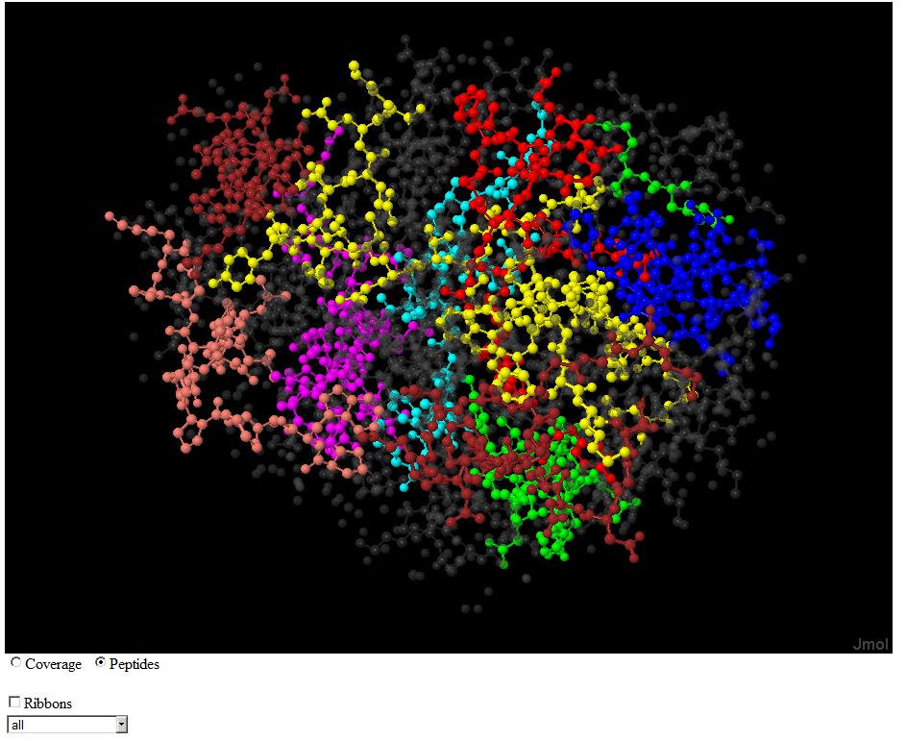
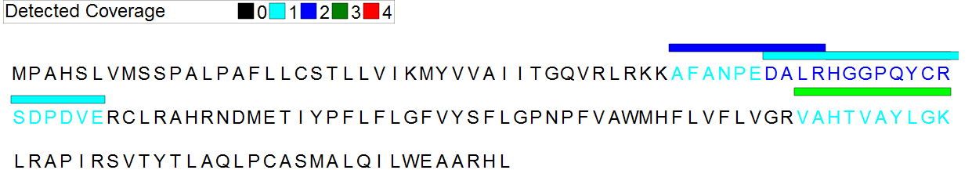
Spaghetti: Visualization of Observed Peptides in Tandem Mass Spectrometry
Steven M. Lewis PhD
20-July-2012

Slide 2
Correlating Detected Peptides and 3D Structure
Why?
  Most spectra cannot be matched to peptides
  Many amino acids do not appear in detected peptides
  Missed Cleavages are common in detected peptides
Why Not?
  Proteins are denatured before digestion destroying 3D Structure

Slide 3
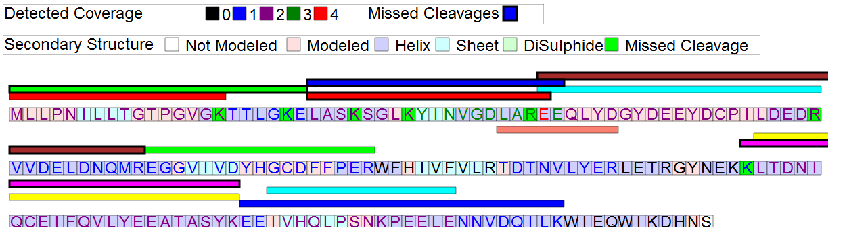
Sequence View
Q9Y3D8.html
Adenylate kinase isoenzyme 6

Slide 4
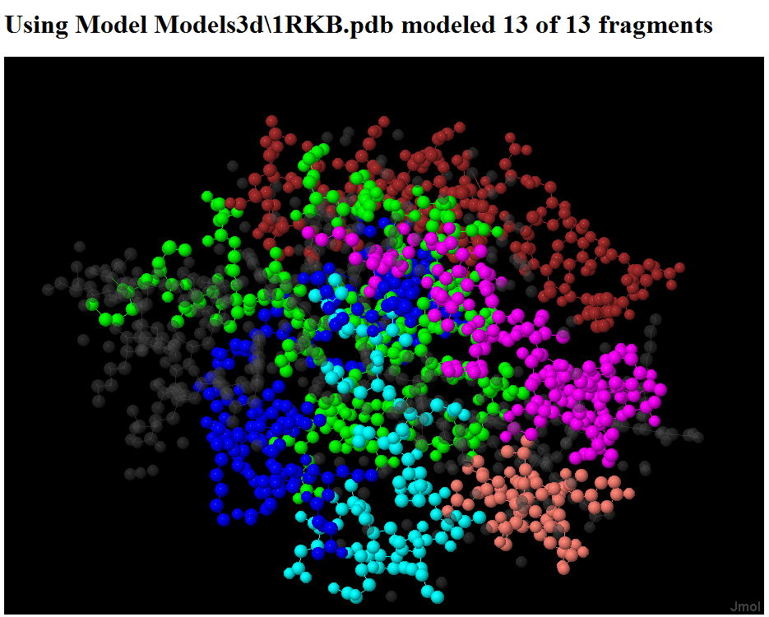
Three Dimensional View

Slide 5

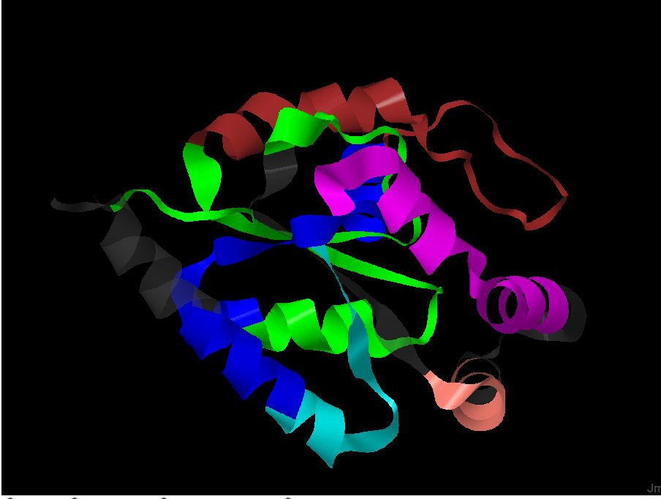
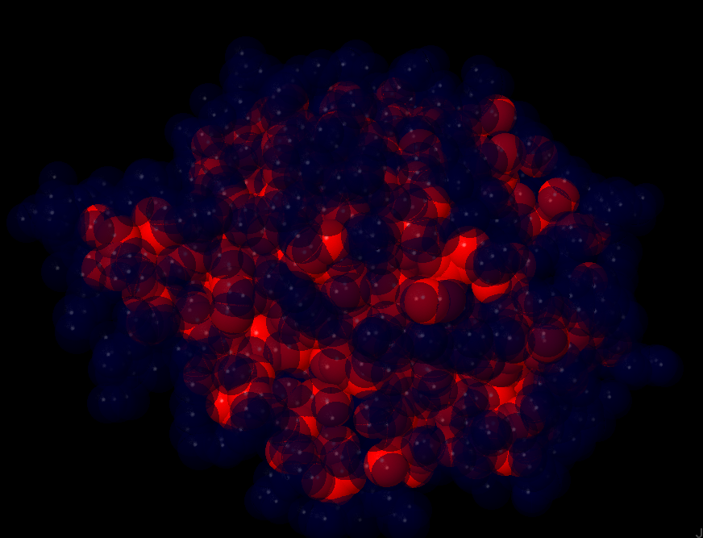
Controls
Ribbons
Solvent Atomic Access

Slide 6
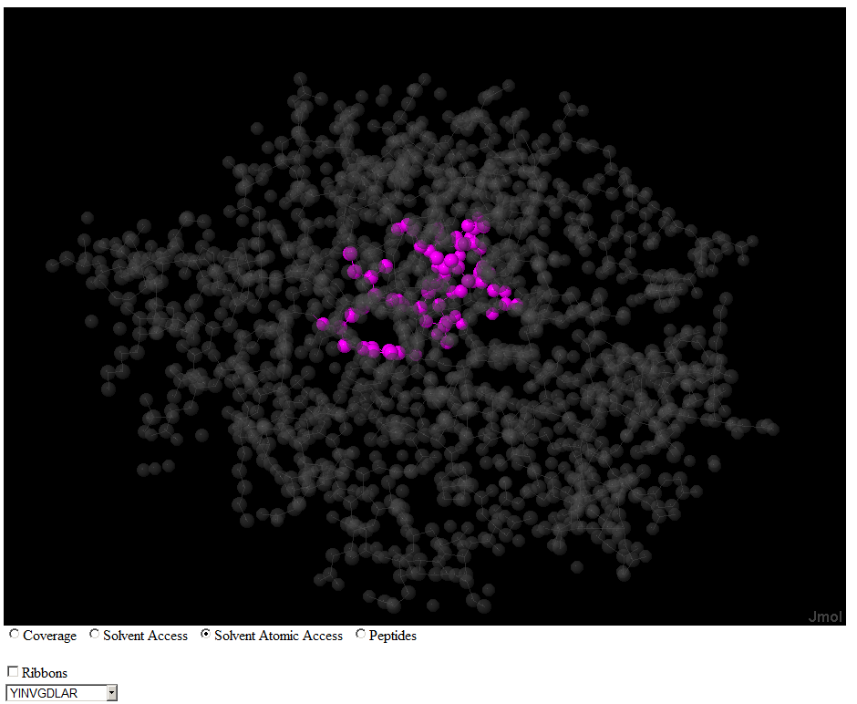
One Peptide View
Solvent Atomic Access

Slide 7
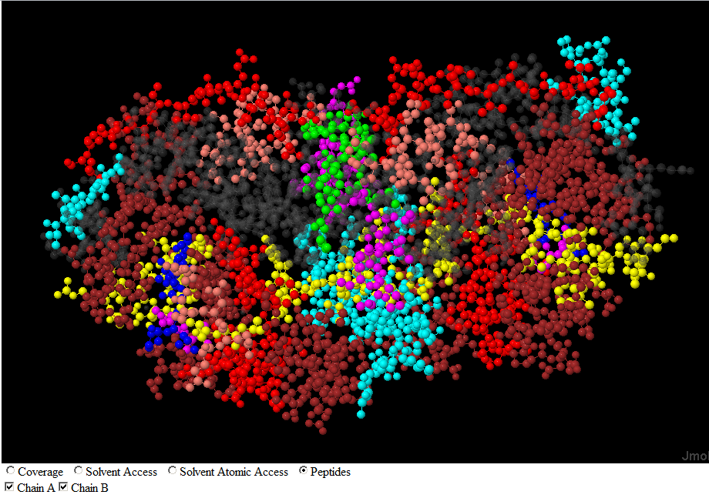
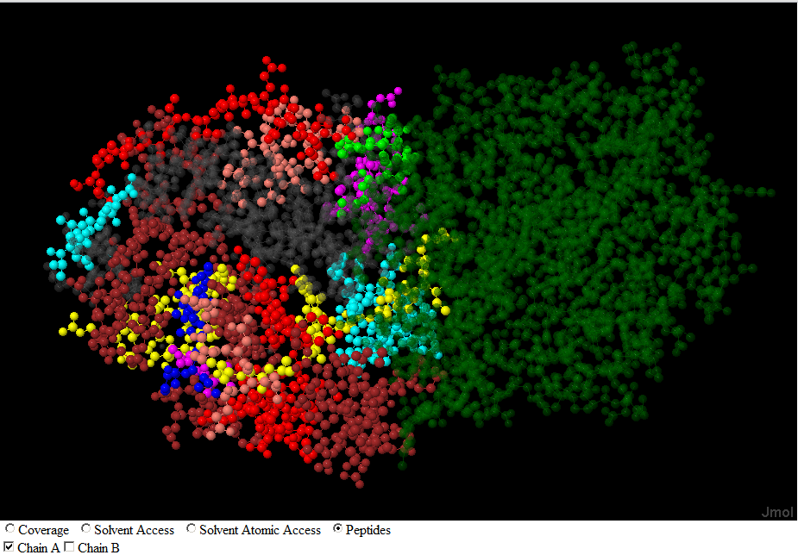
Multiple Chain View
Chains A and B
Chain A Only

Slide 8

Special Thanks to
The Developers of Jmol
Rob Moritz
Grants
R01GM087221 from NIGMS
and R01CA137442 from NCI

