Slide 1



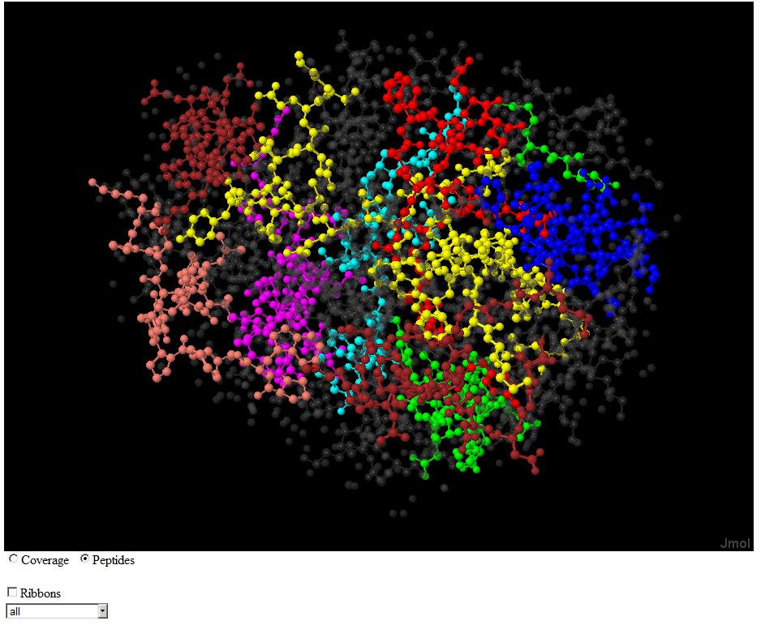
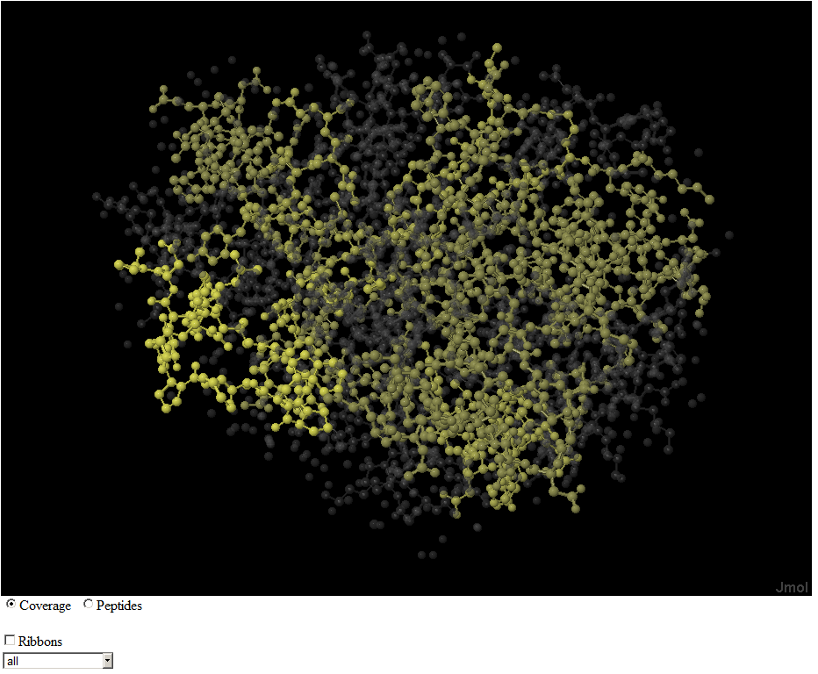
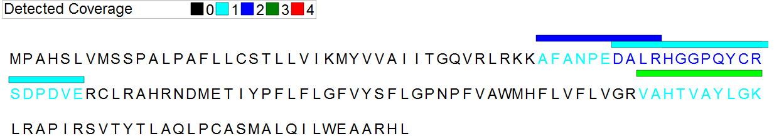
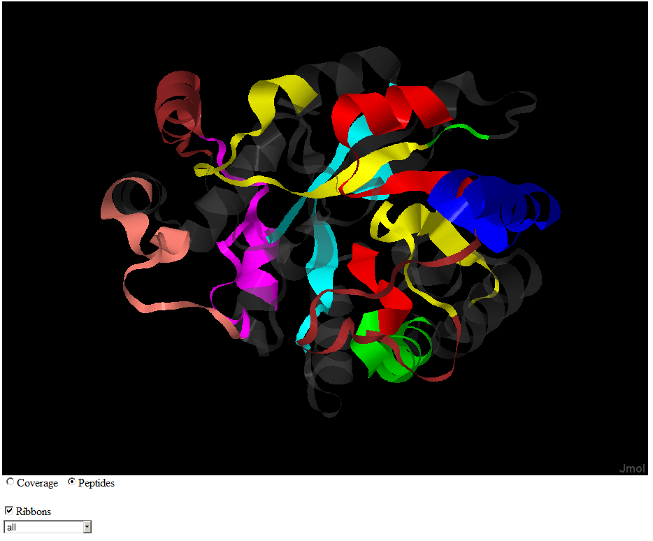
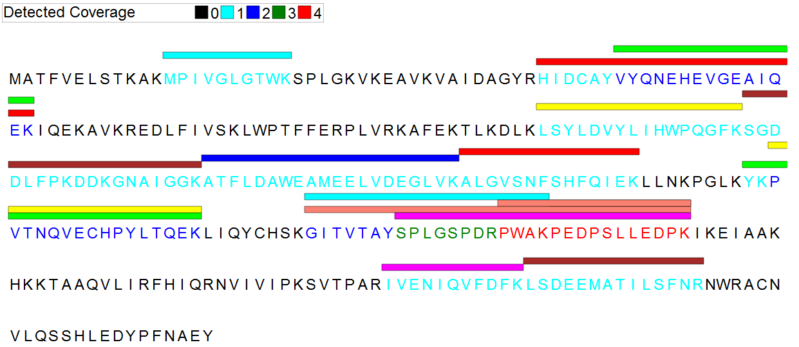
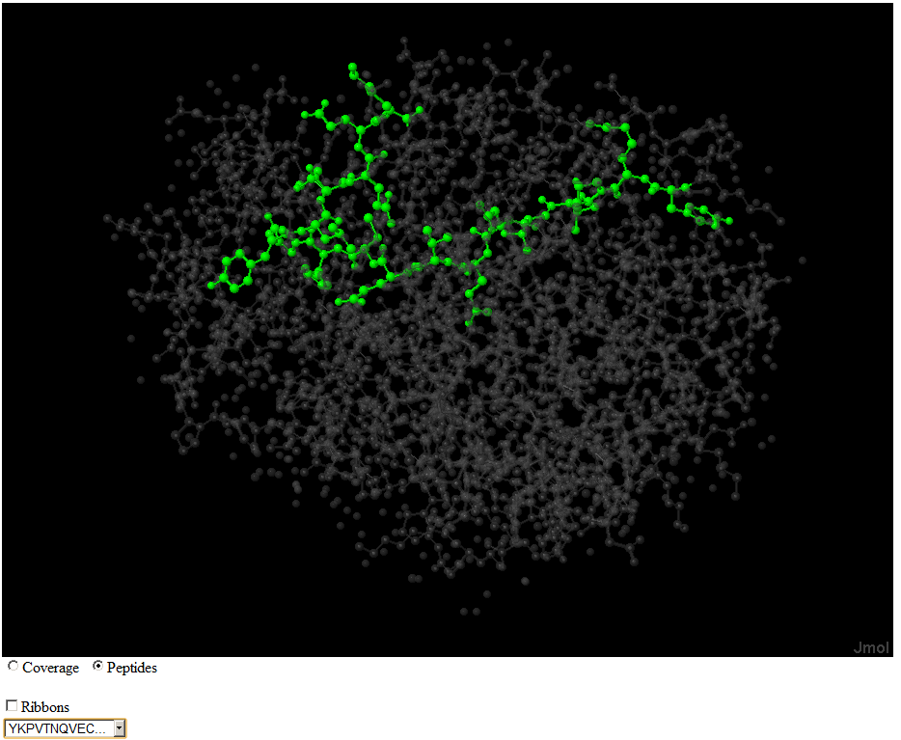

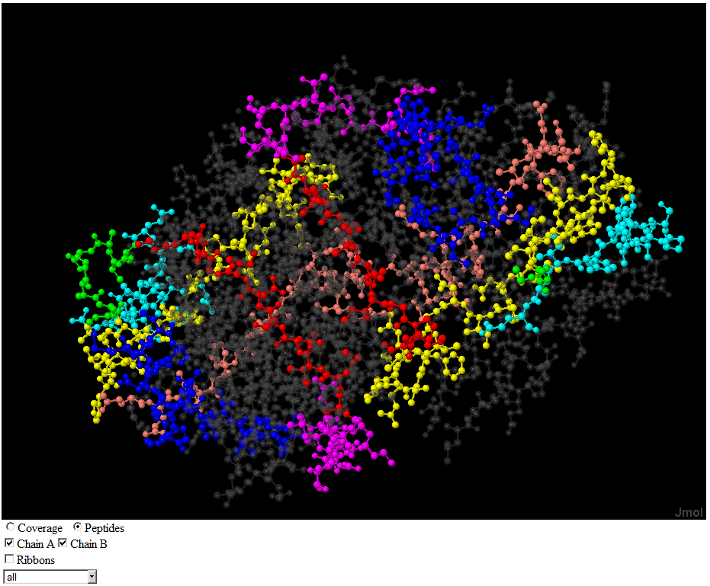
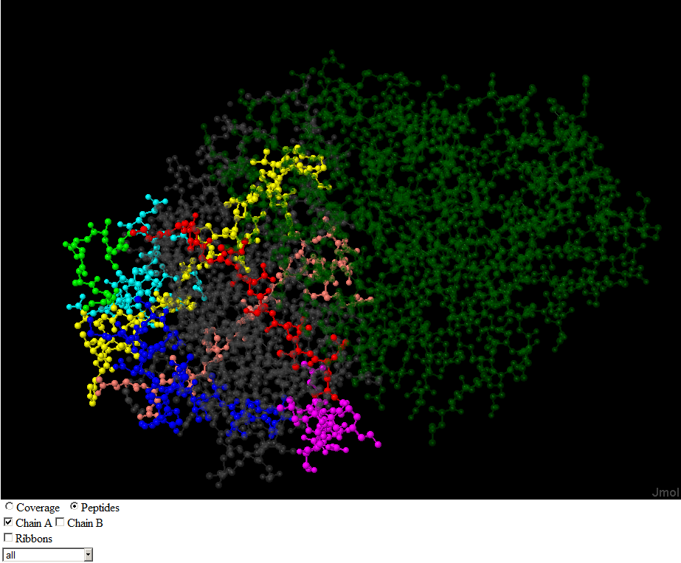
Spaghetti: Visualization of Observed Peptides in Tandem Mass Spectrometry
Steven Lewis ¹, Terry Farrah¹, Eric W Deutsch¹, John Boyle¹
¹Institute for Systems Biology, Seattle, Washington, USA
Visualization Options Demo
We present a visualization and analysis tool, called Spaghetti, for the exploration of mass spectrometry detected peptides and their structural locations. Studying patterns of peptide location across a protein can be used for many purposes: exploring PTM (post translational modification) locations with respect to putative protein active sites and protein-protein interaction sites; verifying the reliability of a protein inference by exploring peptide coverage and biases to specific regions; and studying biases in the distribution of detected peptides across protein secondary structure elements, structural domains, and protein chains.
Spaghetti produces two dimensional and three dimensional views of the relationship between observed peptides and protein structure including visualization of the locations of the peptides. Coverage statistics and analysis are provided. This tool has been coupled with the Peptide Atlas, a compendium of millions of peptide observations from experiments conducted in dozens of diverse laboratories, to allow the inclusion of as large a collection of data as possible..
Coverage
Color intensity is proportional to the number of detected peptides containing an amino acid
  This view shows detected peptides in the context of the protein sequence. In many cases a single amino acid will be contained in multiple detected peptides. The amino acids are colored to show this level of coverage.
014684 Prostaglandin E synthase
Ribbon
Toggle the view between atoms and ribbons.
060218 Aldo-keto reductase
Integration of Detected Peptides and
3D Structure
  Tandem Mass spectrometry has proven to be a powerful tool for identifying and quantifying proteins . Peptide Atlas is a high quality repository of proteins and known detected peptides. An important issue in proteomics is the fact that most spectra currently detected cannot map to a specific peptide. Also a significant fraction of the amino acids in known proteins are not in any detected fragment.
  The function of this work is to integrate knowledge of detected peptides with existing knowledge of the three dimensional structure of proteins to aid in understanding of the factors responsible for certain portions of the protein structure being strongly detected in tandem mass spectrometry while others are detected weakly or not at all.
Peptide
Use Colors to highlight one specific peptide
Future Directions
  Integrate with Peptide Atlas
  Incorporate Structure Features – solvent exposure
  Mark missed cleavages
  Relate Structure to peptide detection
Chain Showing 014732 Inositol monophosphatase Dimer
Dim unselected Chains when a structure has more than one chain
Chain A and B Chain A only
Visualization Options
  Spaghetti is a tool to integrate the information in Peptide Atlas on peptide detection in proteins to existing 3D structure of those proteins. In addition to providing a tool for visualization, the tool can be used to help determine why certain peptides are detected and certain region of protein molecules are found in many detected peptides and others are not.
This project is supported by Award Number R01GM087221 from NIGMS
and R01CA137442 from NCI

