Slide 1
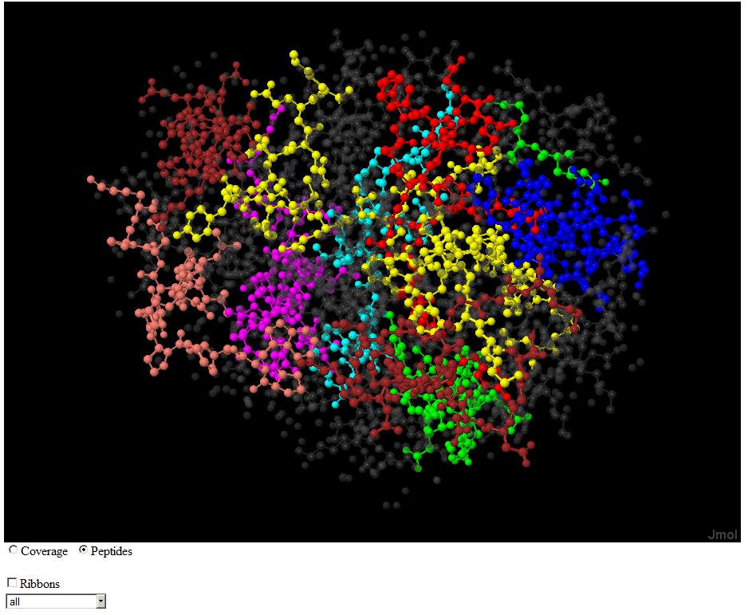
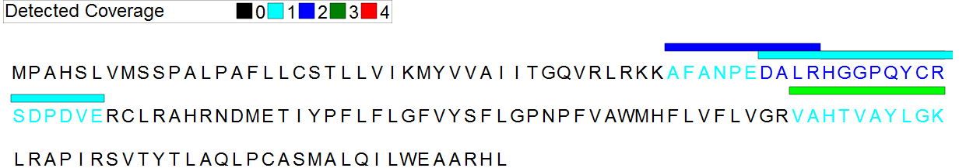
Spaghetti: Visualization of Observed Peptides in Tandem Mass Spectrometry
Steven M. Lewis PhD
20-July-2012

Slide 2
Correlating Detected Peptides and 3D Structure
Why?
  Most spectra cannot be matched to peptides
  Many amino acids do not appear in detected peptides
  Missed Cleavages are common in detected peptides
Why Not?
  Proteins are denatured before digestion destroying 3D Structure

Slide 3
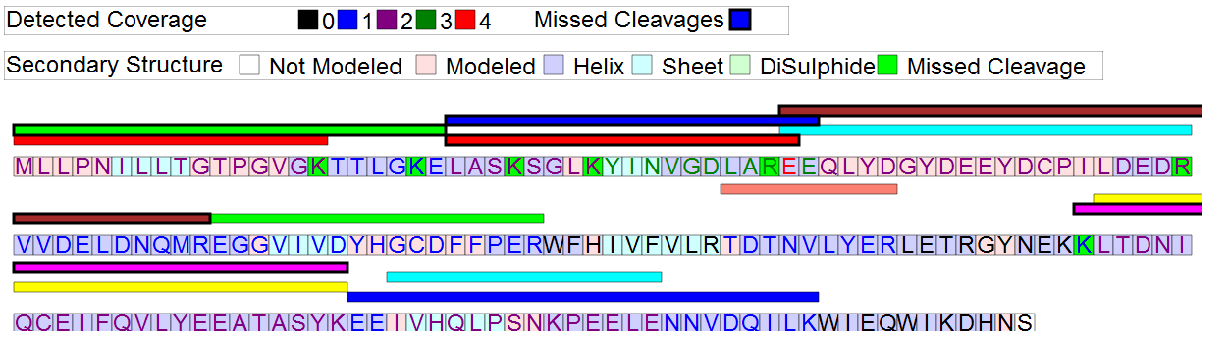
Sequence View
Q9Y3D8.html
Adenylate kinase isoenzyme 6

Slide 4
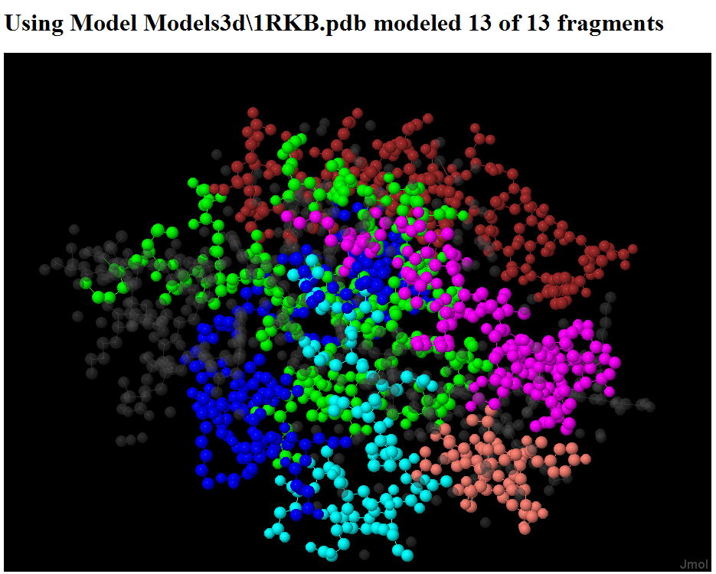
Three Dimensional View

Slide 5

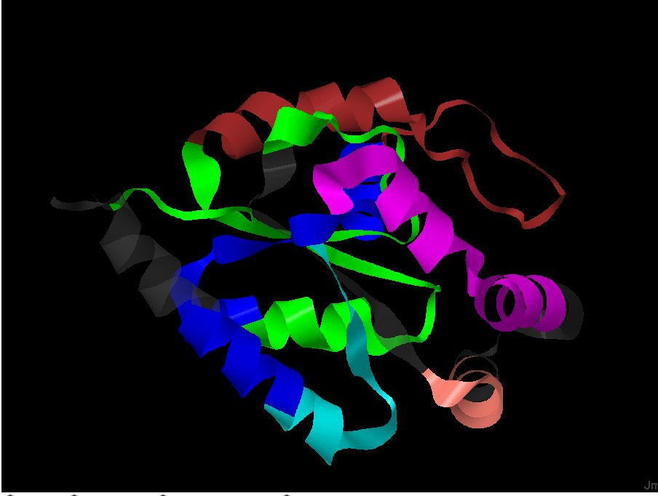
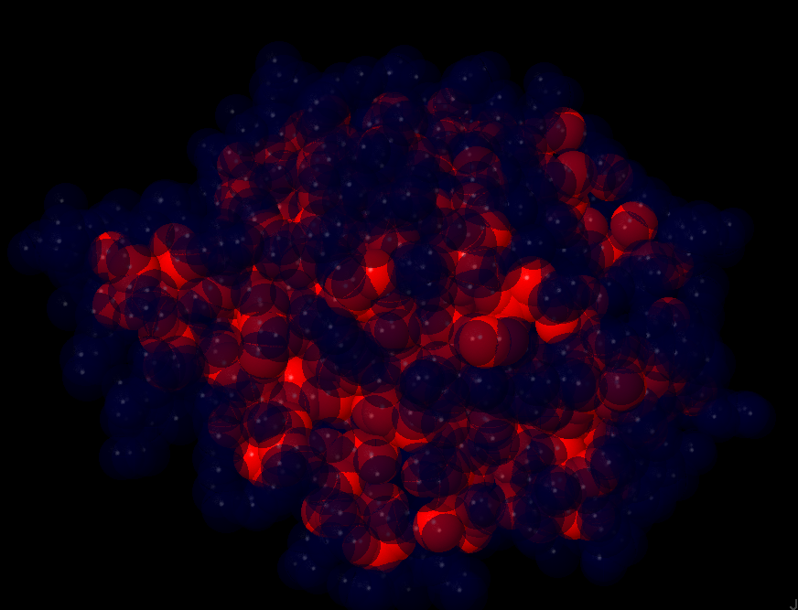
Controls
Ribbons
Solvent Atomic Access

Slide 6
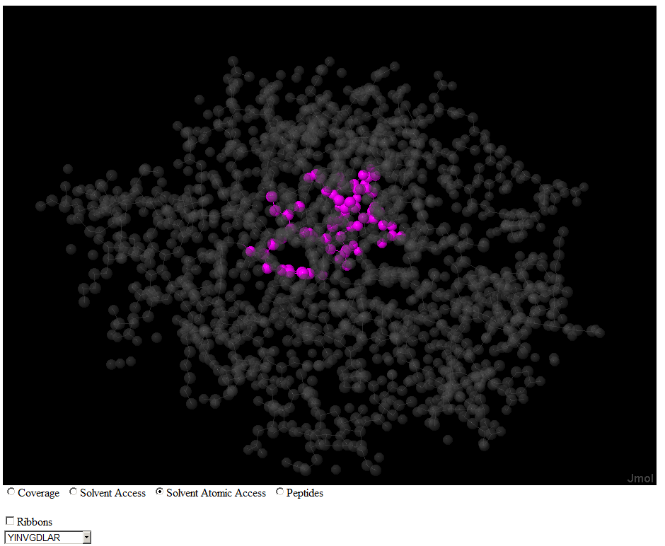
One Peptide View
Solvent Atomic Access

Slide 7
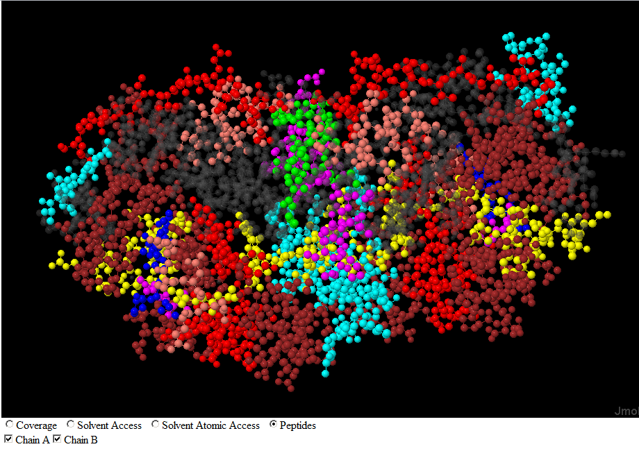
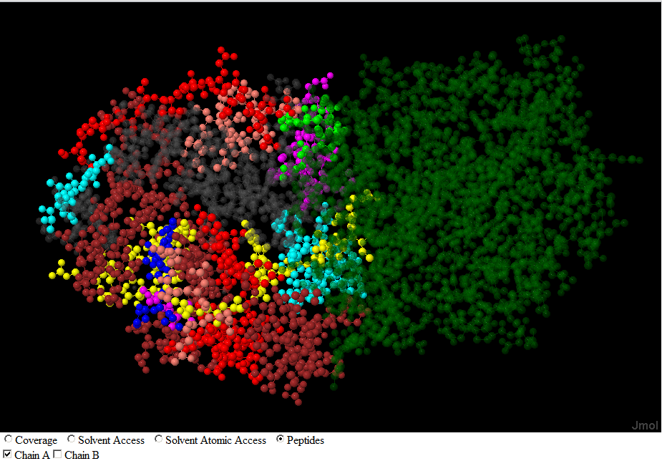
Multiple Chain View
Chains A and B
Chain A Only

Slide 8
The Software
Data acquisition
  Gather data from multiple on-line sites
Display
  Add JMol – a capable 3D molecular viewer.
  Insert scripts to show features
  Web pages may be generated statically or dynamically

Slide 9
Data Acquisition
Problems
  Start with a protein identifier
  Read sequence and 3d Models from http://www.uniprot.org
  Read fragments from http://www.peptideatlas.org.
  Download 3D models from http://www.pdb.org
  Determine which 3d model best represents your protein.

Slide 10
The Best 3D Model
Criteria
  Fit to the protein
    Many models have multiple chains
    You are interested in one chain or multiple if multiple copies of the protein are present.
    Find the longest sequence of amino acids in the protein available in the model
    Sometimes Smith-Waterman helps
  .Model Criteria
    Technique
    Resolution

Slide 11
JMol Scripting
Jmol is an applet
  Jmol.js has javascript for the applet
  <script src="../Jmol.js" type="text/javascript">
  </script>
  Jmol.js has javascript for the applet
  Load a predefined script
  window.defaultloadscript = showAminoAcids;
  Initialize the applet - ../.. Is code base
  jmolInitialize("../../");
  Create applet
  jmolApplet(["924","678"], <!– size →
  loadText + window.defaultloadscript, <!– script →
  jmol_id <!– id →
  );

Slide 12
What can be Scripted
select all – Next command applies to all objects
color translucent[80,80,80] white – Make translucent
ribbon off; – Turn off ribbon display
Color a fragment on chain B blue
select GLU138:B;color Blue;\
select GLU139:B;color Blue;\
select ILE140:B;color Blue;\
…
Running a script
jmolScript(
script, // what to do
jmol_id // which jmol instance
)

Slide 13
Set all Exposed Atoms
Color solvent exposed atoms transparent blue
wireframe off;
spacefill 100%;
Select all;color red; , <!– others red →
select water;color translucent[0,0,50];
select atomno = 1083 ;color translucent[0,0,50];
select atomno = 1084 ;color translucent[0,0,50]; select atomno = 1085 ;color translucent[0,0,50];
…

Slide 14
Showing the Sequence
Color solvent exposed atoms transparent blue
wireframe off;
spacefill 100%;
Select all;color red; , <!– others red →
select water;color translucent[0,0,50];
select atomno = 1083 ;color translucent[0,0,50];
select atomno = 1084 ;color translucent[0,0,50]; select atomno = 1085 ;color translucent[0,0,50];
…

Slide 15
Color Atoms not solvent
Color solvent exposed atoms transparent blue
wireframe off;
spacefill 100%;
Select all;color red; , <!– others red →
select water;color translucent[0,0,50];
select atomno = 1083 ;color translucent[0,0,50];
select atomno = 1084 ;color translucent[0,0,50]; select atomno = 1085 ;color translucent[0,0,50];
…

Slide 16
The Best 3D Model
Amazon Hosted

Slide 17
Where to View
Criteria
  Fit to the protein
    Many models have multiple chains
    You are interested in one chain or multiple if multiple copies of the protein are present.
    Find the longest sequence of amino acids in the protein available in the model
    Sometimes Smith-Waterman helps
  .Model Criteria
    Technique
    Resolution

Slide 18

Special Thanks to
The Developers of Jmol
Rob Moritz
Grants
R01GM087221 from NIGMS
and R01CA137442 from NCI

