Slide 1
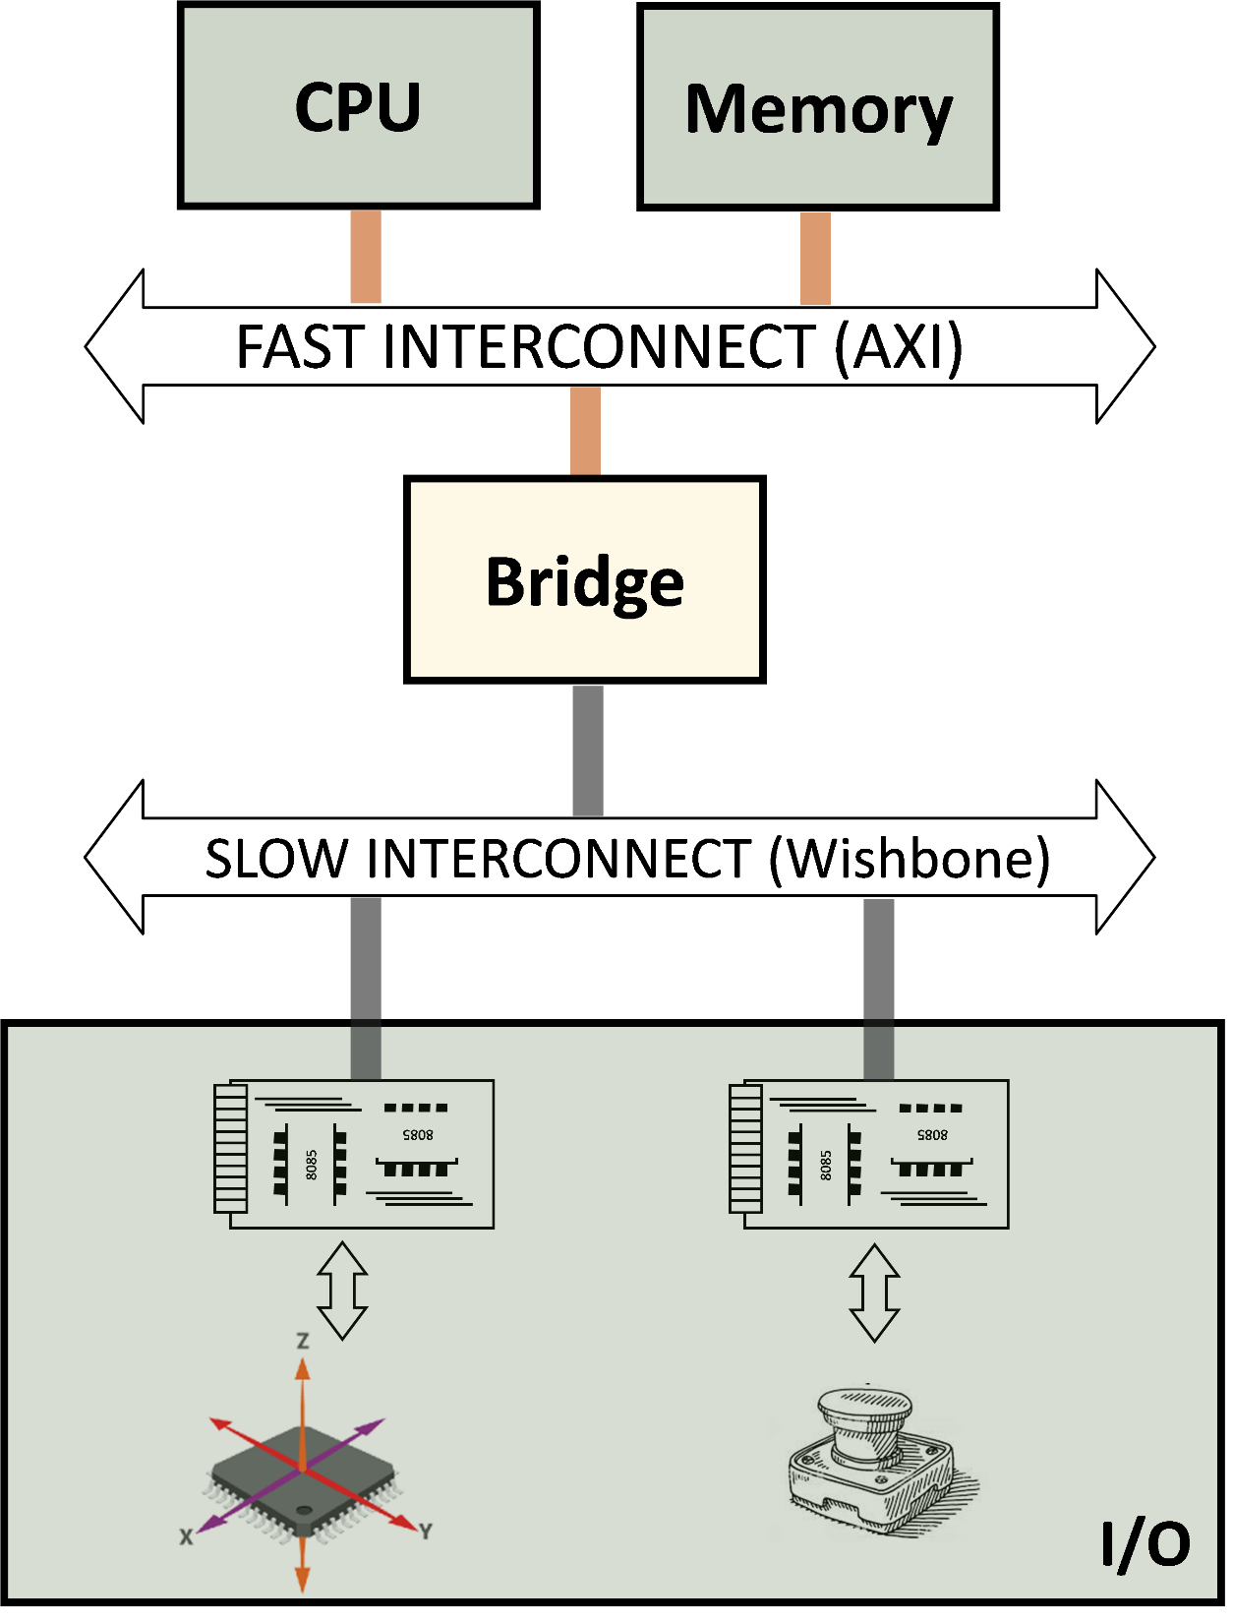
Device
Controller
(includes a
series of
registers)

