Slide 1
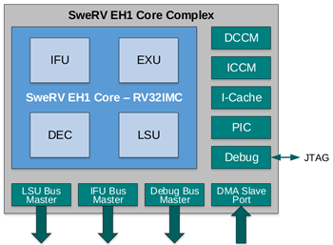
GPIO interrupt (gpio_irq)
GPIO
Timer interrupt (ptc_irq)
Timer

