Slide 1
PCB Review
Smoke Detector
Yougourthene Abbar & Zac Lynn
EGR 536
Instructor: Dr. Brakora
4/21/2024

Slide 2
Component Review
For each IC, connector, or other significant component in the design, check pinout against datasheet. Append images of the following
Schematic pinout from datasheet and design
Footprint from datasheet and designs showing pin number and dimensions
BOM entry showing part number corresponding correct part and package
List components here:
(U1) STM32L476RGT6
(U2) BME688
(U3) W25X40CL
(U4) CP2102N-A02-GQFN20R
(U5) DA14531MOD-00F01002
(X1) ABS25-32.768KHZ-6-T
(S1) TL3301NF160QG
(LED1) IN-P32TATRGB
(J1) 1725656
(J2) 1725656
(J3) 1725656
(J4) ZX62R-B-5P30
(J5) 1725656
P1
P2
P3
P4
P5
P6
(LS1) CST-931AP

Slide 3
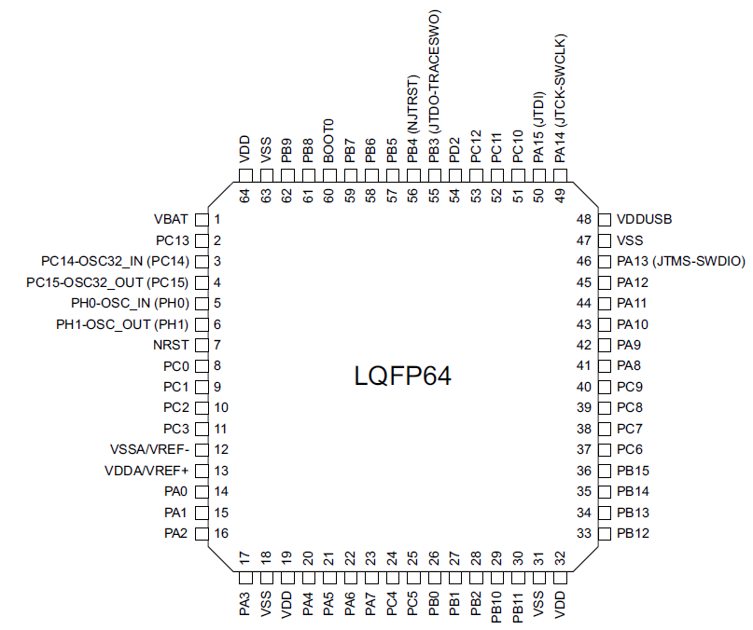
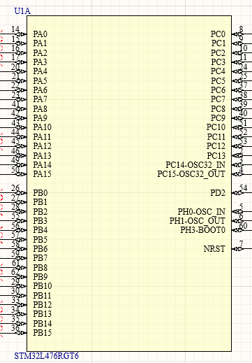
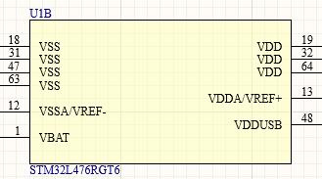
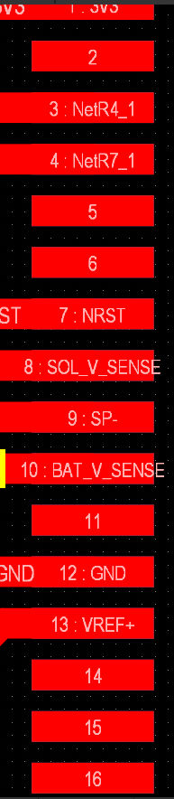
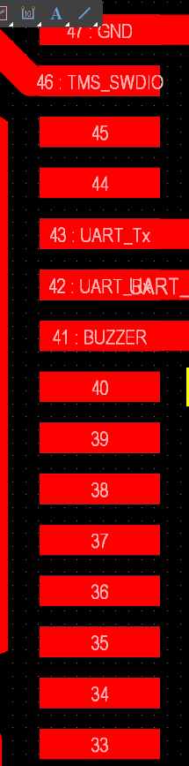
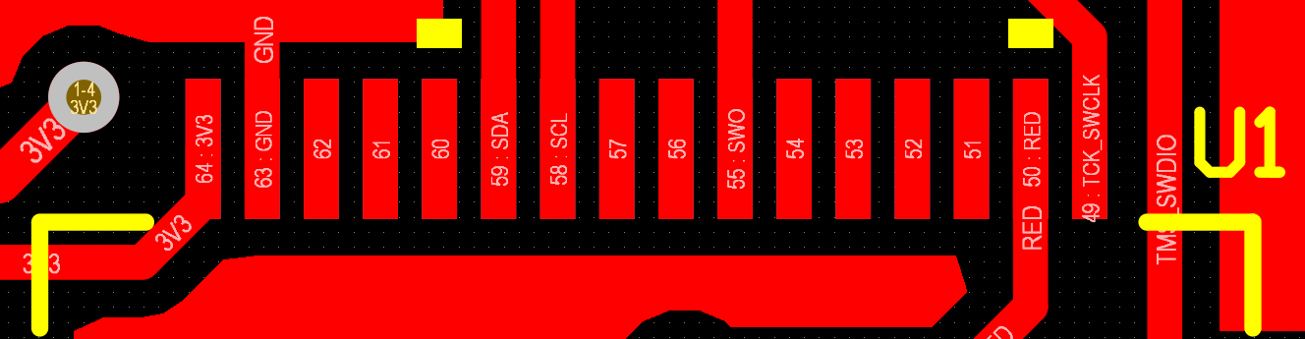
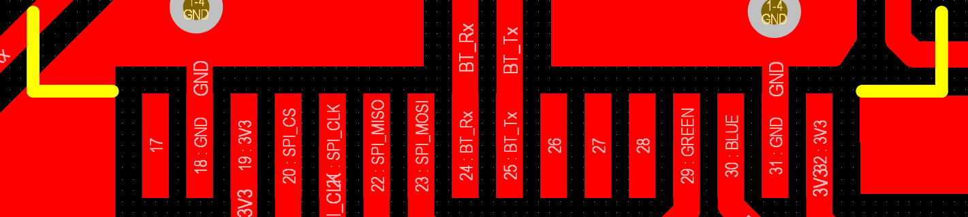
Component Review (U1) STM32L476RGT6

Slide 4
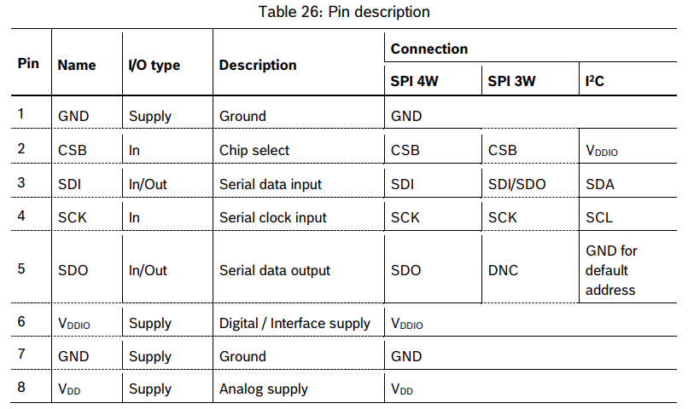
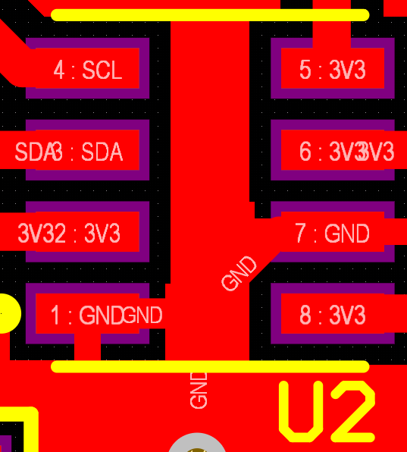
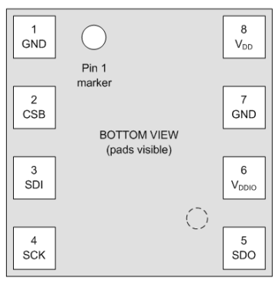
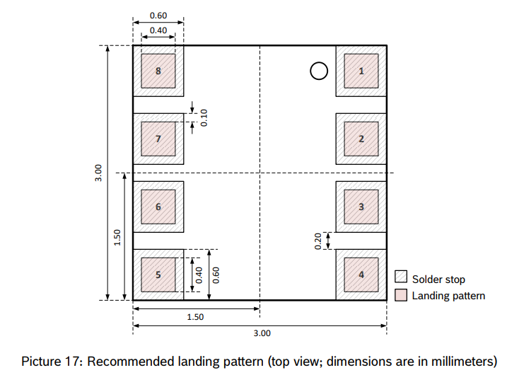
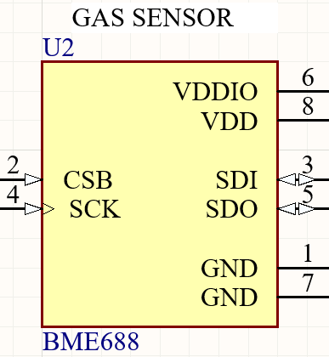
Component Review (U2) BME688

Slide 5
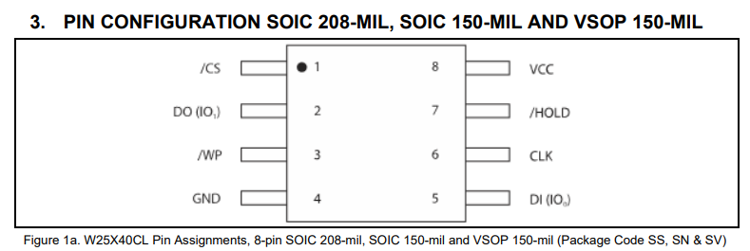
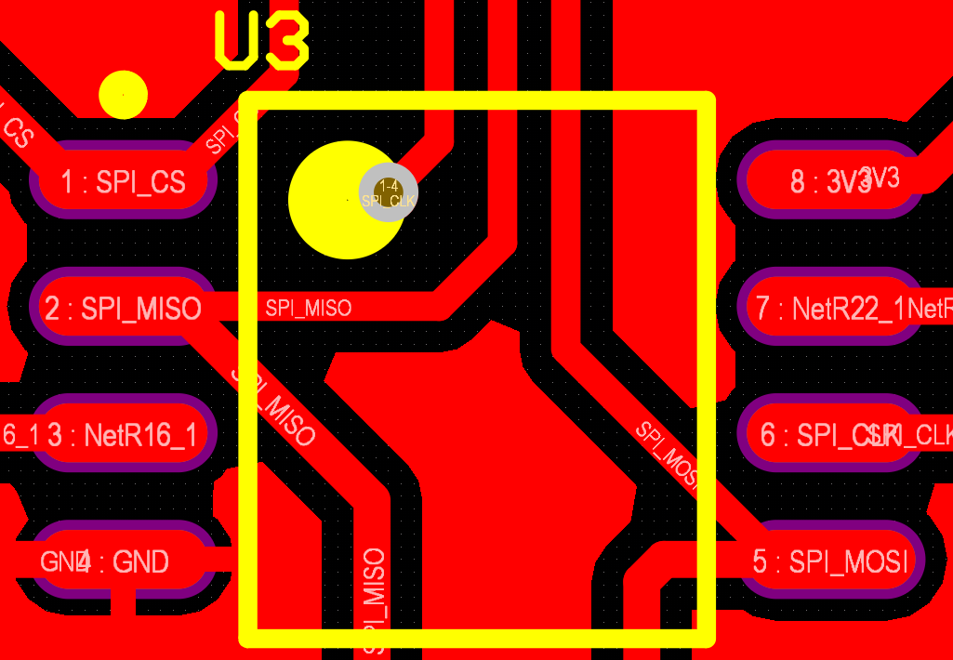
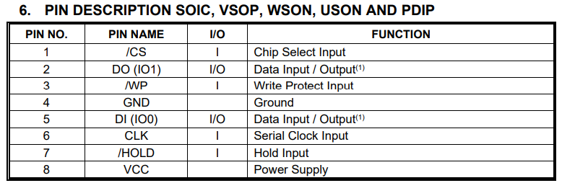
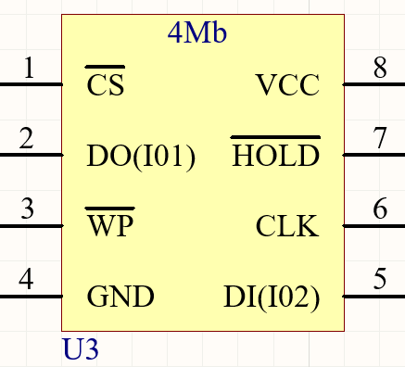
Component Review (U3) W25X40CL

Slide 6
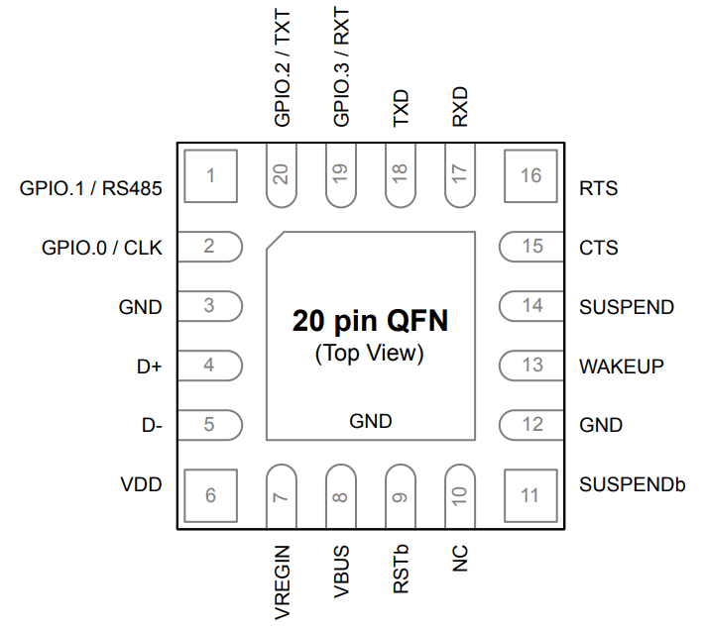
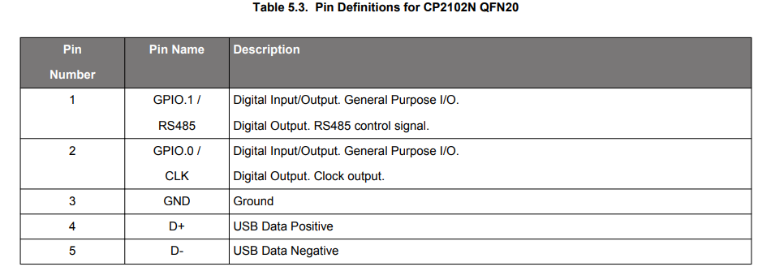
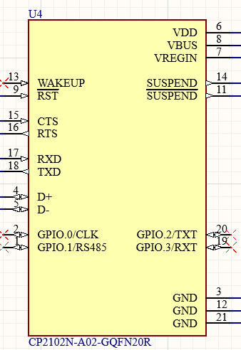
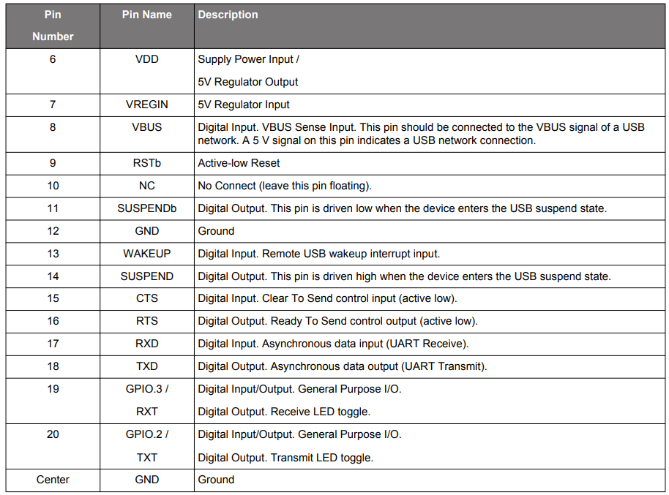
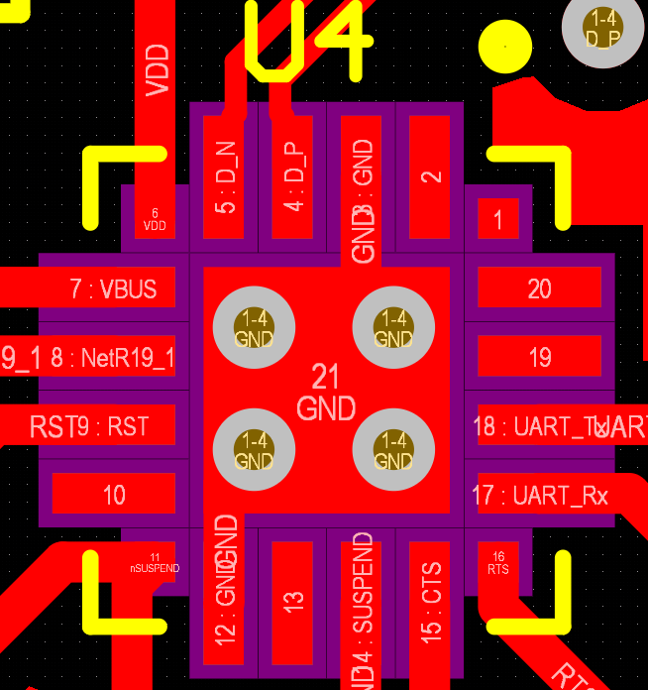
Component Review (U4) CP2102N-A02-GQFN20R

Slide 7
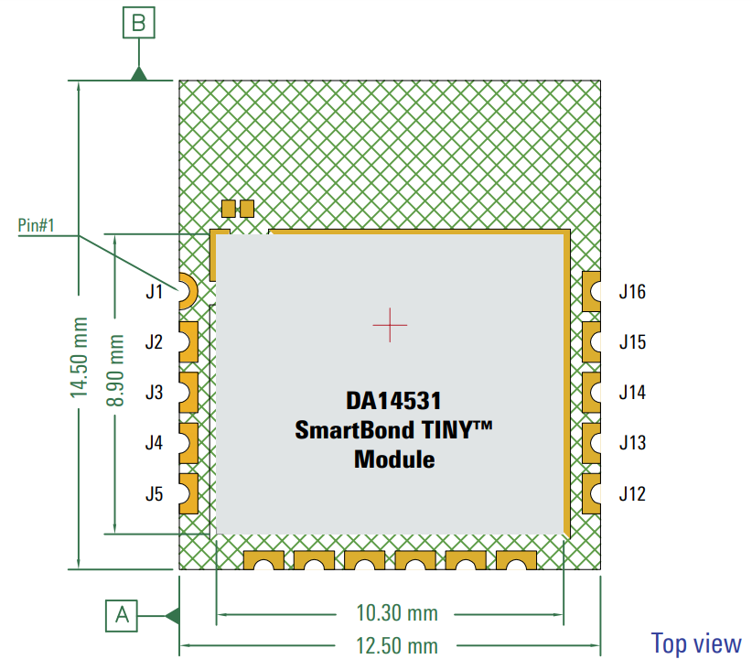
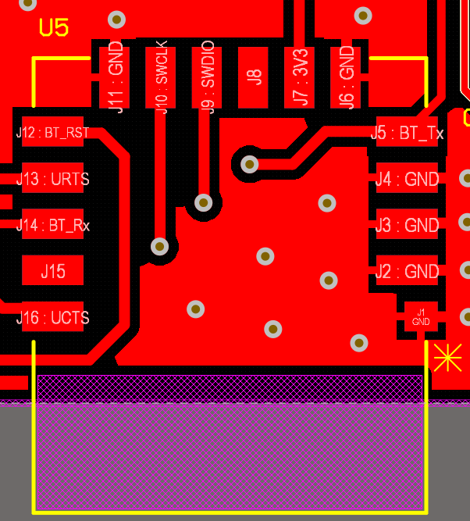
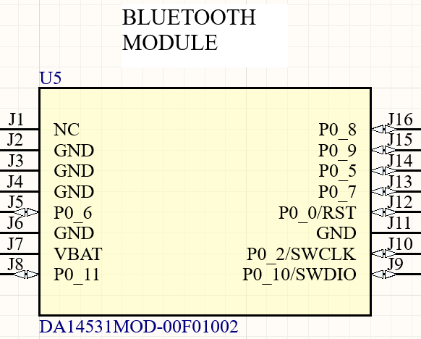
Component Review (U5) DA14531MOD-00F01002

Slide 8
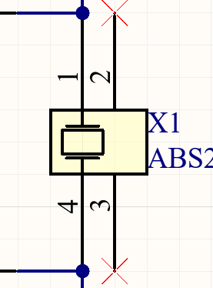
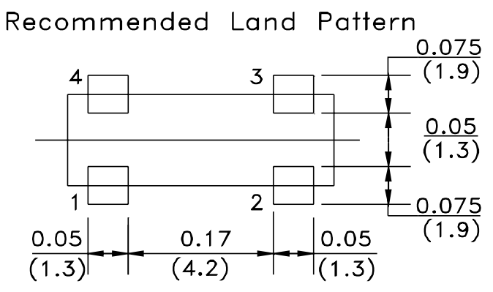
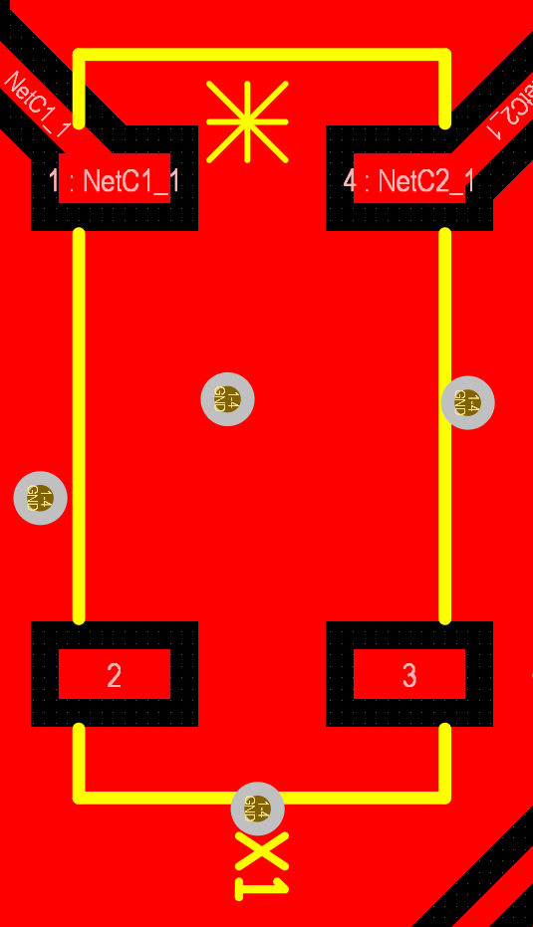
Component Review (X1) ABS25-32.768KHZ-6-T

Slide 9
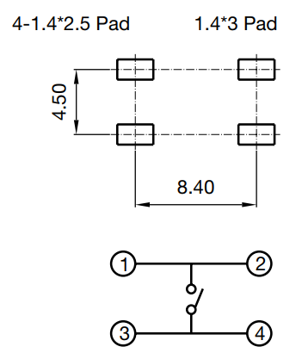
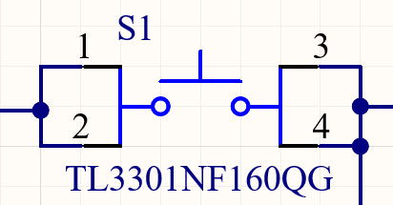
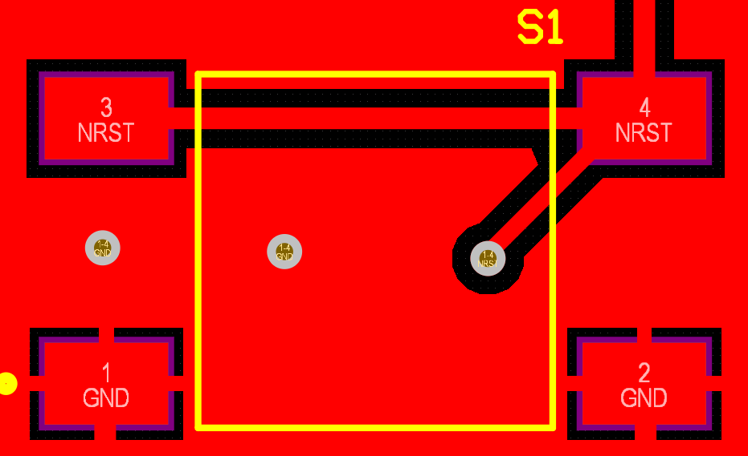
Component Review (S1) TL3301NF160QG

Slide 10
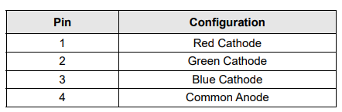
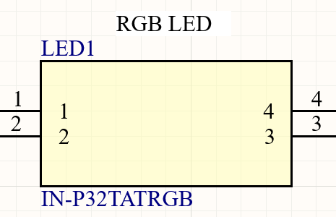
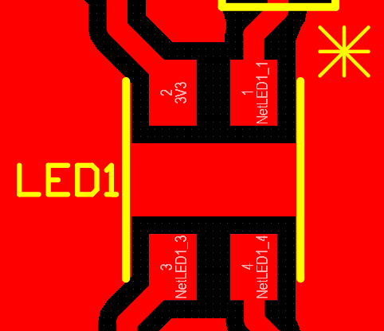
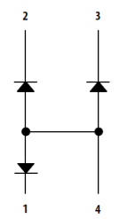
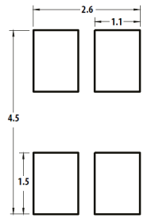
Component Review (LED1) IN-P32TATRGB

Slide 11
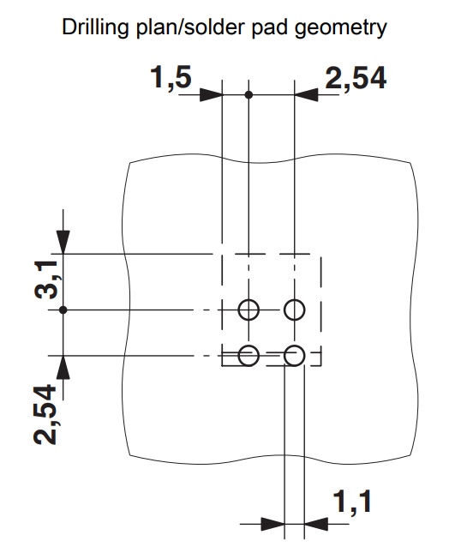
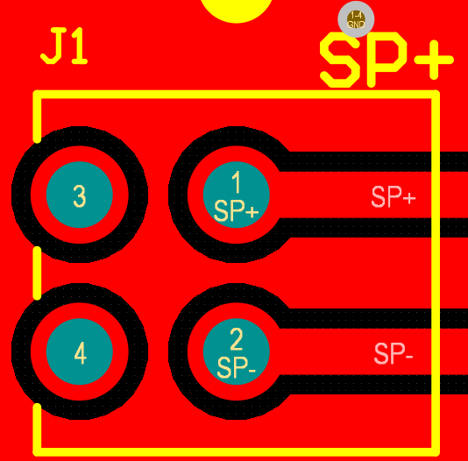
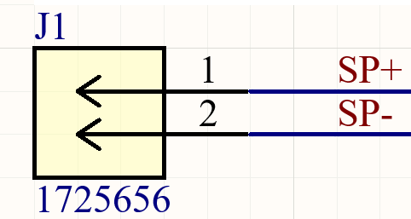
Component Review (J1) 1725656

Slide 12
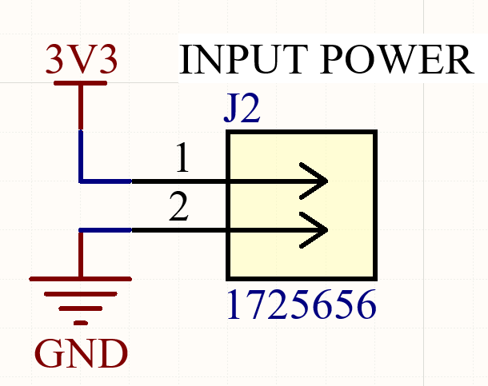
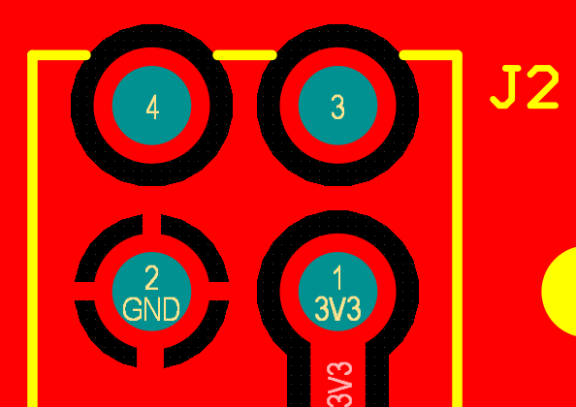
Component Review (J2) 1725656

Slide 13
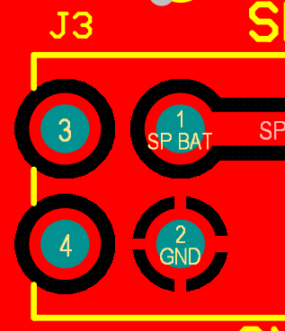
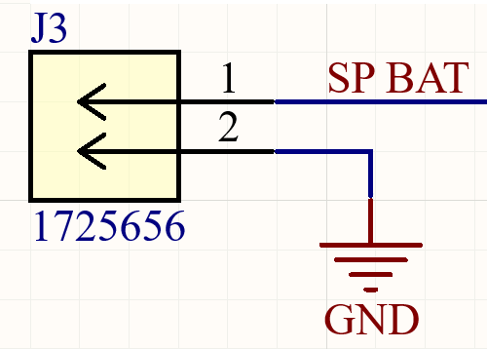
Component Review (J3) 1725656

Slide 14

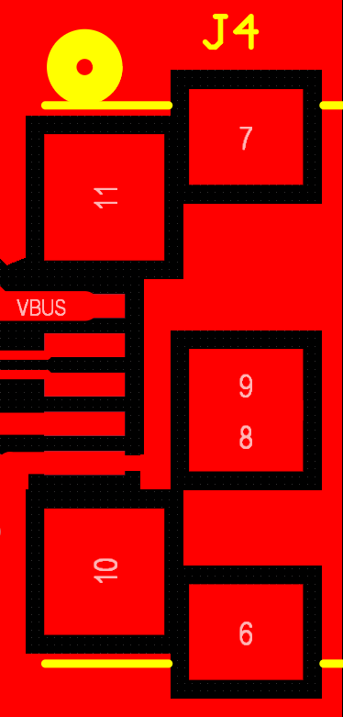
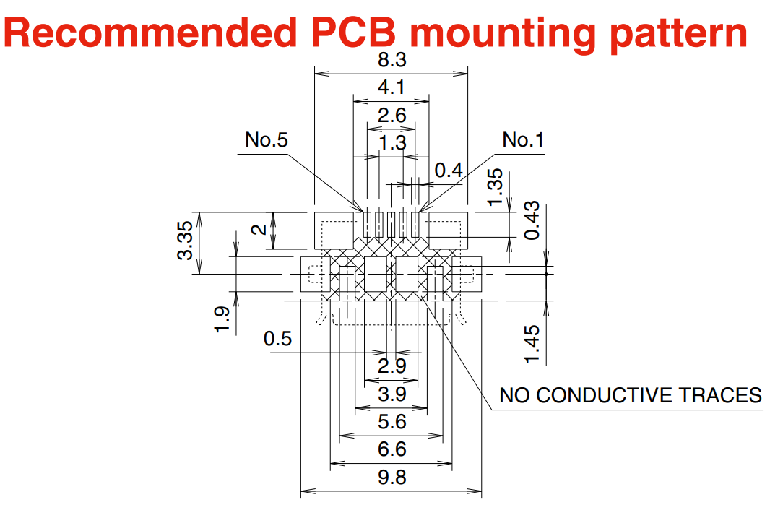
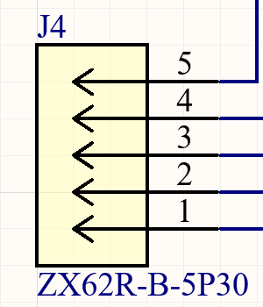
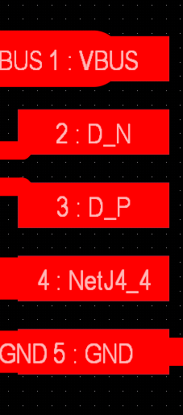
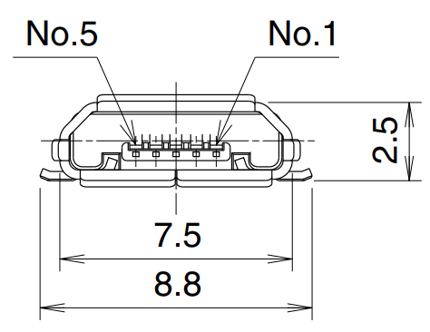
Component Review (J4) ZX62R-B-5P30

Slide 15
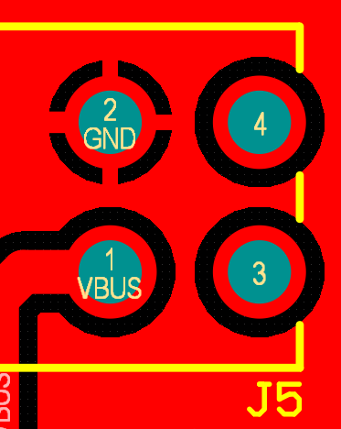
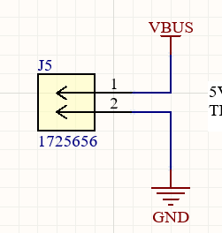
Component Review (J5) 1725656

Slide 16
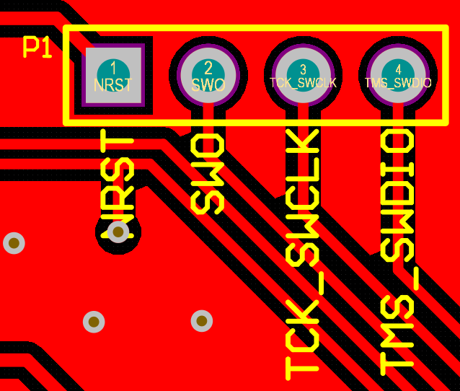

Component Review P1

Slide 17


Component Review P2

Slide 18


Component Review P3

Slide 19


Component Review P4

Slide 20


Component Review P5

Slide 21


Component Review P6

Slide 22



Component Review (LS1) CST-931AP

Slide 23
Schematic Review 1 (Reference Designs)
For each significant IC or other significant component, check the reference design and identify, and explain differences in this design.
List components sub-assemblies here:
(u2) BME688 - Gas Sensor
(u3) W25X40CLSNIG - Flash Memory
(u4) CP2102N-A02-GQFN20R - USB/UART Bridge
(u5) DA14531MOD-00F01002 - BLE Module

Slide 24


Schematic Check 1 (u2 - BME688 - Gas Sensor)

Slide 25

Schematic Check 1 (u3 - W25X40CLSNIG - Flash Memory)
No real reference design just connect SPI pins to MCU and pull Write protect and HOLD high so they are always true.

Slide 26


Schematic Check 1 (u4 - CP2102N-A02-GQFN20R - USB/UART Bridge)
Did not use external battery chagrin IC in the same way. Instead we Connected VBUS directly to battery charging circuit

Slide 27


Schematic Check 1 (u5 - DA14531MOD-00F01002 - BLE Module)
Broke out programming pins to a header.
Added CTS and RTS to debug header but not MCU. Don’t really need this in future.

Slide 28
Schematic Review 2 (Level Check)
For each significant IC or other significant component, check that the levels are within operating parameters.
Check maximum and minimum V_{DD}, V_{SS}. Within operating conditions?
Check maximum and minimum logic levels. Within V_{IH}, V_{IL}, etc.
Check drive types are compatible (push-pull, open-drain, differential, etc.)
List components sub-assemblies here:
(u1) STM32L476RGT6 - MCU
(u2,u1) BME688 - Gas Sensor
(u3,u1) W25X40CLSNIG - Flash Memory
(u4,u1) CP2102N-A02-GQFN20R - USB/UART Bridge

Slide 29

Schematic Check 2 (u1 - STM32L476RGT6 - MCU)
VDD comes from battery circuit with 3.3v regulator.
VIL/VIH and VOL/VOH here for reference since all other ICs interface with u1.

Slide 30

Schematic Check 2 (u2 - BME688 - Gas Sensor)

Slide 31

Schematic Check 2 (u3 - W25X40CLSNIG - Flash Memory)
3.3v * 0.3 = 0.99 V = Input low
3.3v * 0.7 = 2.31 V = input high
3.3v - 0.2 = 3.1 V = output high

Slide 32


Schematic Check 2 (u4 - CP2102N-A02-GQFN20R - USB/UART Bridge)
VIO = 3.3 V

Slide 33
Schematic Review 3 (Serial COMMs)
Check that there are no conflicts on the communication buses, polarities are correct, and signals appropriately marked
MCU pins associated with comm peripheral?
I2C
Pull-up resistors, sized appropriately for bus speed? Show resistors.
Unique address for peripherals on bus? Give addresses.
SPI
Unique CS line for each peripheral? Identify lines and pins.
Are matching resistors recommended? Show datasheet.
UART
RX, TX polarity correct? Double check and verify in datasheet.
LVDS
Marked differential and impendence controlled.
Are external terminations required? Show termination in datasheet.
USB2.0
D+, D-, marked differential and impedance controlled
Vbus decoupled
USB3.0/USB-C
Follows reference design
List comm buses here:
(u2) BME688 - Gas Sensor
(u3) W25X40CLSNIG - Flash Memory
(u4) CP2102N-A02-GQFN20R - USB/UART Bridge
(u5) DA14531MOD-00F01002 - BLE Module

Slide 34

Schematic Check 3 (u2 - BME688 - Gas Sensor)
Addr 0x76

Slide 35
Schematic Check 3 (u3 - W25X40CLSNIG - Flash Memory)

Slide 36
Schematic Check 3 (u4 - CP2102N-A02-GQFN20R - USB/UART Bridge)

Slide 37
Schematic Check 3 (u5 - DA14531MOD-00F01002 - BLE Module)

Slide 38
Schematic Review 4 (Connectors)
Check that pins on the connector are correct, within connector specifications, and signals
Connector signals aligns pin-for-pin with mating connector. Show connector, and mating connector.
Power
Voltages carried on pins do not exceed maximum? (For voltages above 9V)
Currents carried on pins near maximum rating? Show pins with significant current.
Decoupling available? Show capacitors on power lines.
Connectors to external interfaces
TVS Diodes on signal lines? Show
Other ESD suppression available? Show
Shielding connectors
Shielding grounded, otherwise? Show.
List connectors here:
(u4) CP2102N-A02-GQFN20R - USB/UART Bridge

Slide 39
Schematic Check 4 (u4 - CP2102N-A02-GQFN20R - USB/UART Bridge)
USB connector for USB/UART Bridge
VBUS and GND to a screw terminal to connect to battery charger board.

Slide 40
Schematic Review 5 (Power Supplies)
Check all switching power ICs for the following:
Are inductors recommended by manufacturer? Note differences.
Input and output capacitance sufficient? Note differences from reference design.
Kelvin Connections are marked?
List power supply ICs here:
(u1) STM32L476RGT6 - MCU

Slide 41



Schematic Check 1 (u1 - STM32L476RGT6 - MCU)
Analog ground not needed in this case so connected to ground.
No 8MHz oscillator in this case

Slide 42

Schematic Review 6 (MCUs)
Check all microcontroller Ics for the following:
Crystals
Check crystal part numbers in BOM.
Crystal has accuracy, voltage rating, impedance, and capacitance recommended by manufacturer.
Verify board capacitor calculation.
Programming Interface
Show that the programming interface (JTAG, SWD, etc.) is available, accessible, and consistent with reference design.
Voltage domains.
Verify core voltage conditioning is consistent with reference design whether V_{CORE} = V_{IO} or not.
Power-down behavior
Will pins receive signals when device is powered-down? Are pins rated for this?
List power supply ICs here:
(u1) STM32L476RGT6 - MCU
Always ON
N/A

Slide 43

Schematic Check 1 (u1 - STM32L476RGT6 - MCU)
Same programming port and RTC crystal circuit. Other pins are use specific

Slide 44
Schematic Review 7 (Passives)
Check that the passives are correct in BOM and are rated correctly.
Capacitor voltage
Verify all capacitor part numbers are correct in BOM.
Identify all capacitors whose maximum voltage is more that 50% of the voltage rating. Compare maximum voltage to voltage rating for those parts. If available, include the voltage characteristics from the manufacturer
Inductor Current
Verify the inductor part numbers are correct in BOM.
Identify all switching inductors or power filter inductors and maximum current in design. Compare maximum current to I_{SAT} and maximum I_{DC} for those inductor. If available, include the current characteristic from the manufacturer.
Resistor Power
Verify all resistor part numbers are correct in BOM.
Identify all resistors which have any significant current or high voltage. Compare maximum power dissipated to P_{MAX} for those components.
N/A
N/A

Slide 45
Schematic Review 8 (Semicondutors)
Check that the passives are correct in BOM and are rated correctly.
FETs
Verify all transistor part numbers are correct in BOM.
Check polarity of transistor, and check against datasheet and footprint.
Identify maximum V_{DS}, V_{GS}, I_{DS}, and ensure maximum ratings not exceeded.
Identify threshold V_{GS}. Will it turn on?
BJTs
Verify all transistor part numbers are correct in BOM.
Check polarity of transistor, and check against datasheet and footprint.
Identify maximum V_{CE}, V_{BE}, I_{CE}, and I_{BE}.
Diodes
Verify all diode part numbers are correct in BOM.
Check polarity of the diode, and check against datasheet and footprint.
Identify maximum current, reverse breakdown voltage, and forward voltage.
N/A

Slide 46
Layout Review 1 (Mechanical)
Check that is mechanically correct in outline, connector position, mounting holes, etc.
Board outline
Verify that board shape is consistent requirement or packaging
Mounting points
Verify that mounting holes, mounting hole keep-outs, or other attachment points are consistent with requirement or packaging.
Component clearances
Verify that components are vertically clear in the assembly.
Verify that components are 0.030” from routed edges and at least 0.0120” from scored edges.
Connectors
Verify that the pins of mating connectors correspond. Show footprints, connector drawings, and assembly diagram to illustrate.
If users can handle, what happens if connector is placed backwards?

Slide 47
Layout Review 2 (Stackup)
Check board stack and signal impedances are set correctly.
Board stackup confirmed by manufacturer or is standard stackup.
Dielectric and copper thicknesses correct
Dielectric materials named
Dielectric constants correct
Signal impedances are correct and applied in design.
Reference layers correctly assigned.
Differential pairs are tightly-coupled, (gap < substrate thickness).
Drill layers are manufacturable
No skew vias unless using stacked micro-vias.

Slide 48

Layout Review 2 (Stackup)

Slide 49
Layout Review 3 (Placement)
Check for best placement
Components placed in locations and orientations to minimize routing length and complexity?
Small decoupling capacitors are placed between feed and pin with proximal ground?

Slide 50
Layout Review 4 (Minimum Sizes)
Makes sure design rules consistent with manufacturer requirements
Vias
Through-hole and buried vias have <10:1 length-to-diameter ratio.
Blind vias have <1:1 length-to-diameter ratio.
Stacked micro-vias follow manufacturer recommendation
(Rigid) Via diameter >0.012” with 0.024” pad unless consulted with manufacturer
(Rigid-Flex) Larger capture pad on flex layers? Include consultation with manufacturer.
(Flex) Via diameter and capture pad consistent with manufacturer capabilities.
Line-and-space
Line-and-space >0.006” unless consulted with manufacturer. Minimum line and trace is: <list here>
N/A

Slide 51
Layout Review 5 (Power)
Component
DC high-current nets
Prefer regions instead of traces
Redundant vias sticking layers on different regions
DC high-voltage nets
0.0005”/volt clearance to other nets. Note exceptions in component footprints, etc.
Line-and-space
Line-and-space >0.006” unless consulted with manufacturer. Minimum line and trace is: <list here>
N/A

Slide 52
Layout Review 6 (Planes and Pours)
Look at planes and pours
Planes and pours not overly obstructed by vias (Swiss cheese)
No dead copper.
Fingers, spikes, small islands removed from reference voltage are suppressed.
>0.20” from routed edge and >0.060” from score center line.
(Flex regions) Planes and pours are hatched.
N/A

Slide 53
Layout Review 7 (Signal Integrity)
What’s making noise and what is susceptible to it?
List of high-speed or high-current switching nets:
List of analog, high-speed, or otherwise sensitive nets:
Are these signals kept apart?
Avoid unnecessarily long parallel routing.
N/A

Slide 54
Layout Review 8 (High-speed routing)
High-speed lines are isolated and delay-matched
High-speed routing matching
Verify traces width consistent with impedance design rules on layer and region found.
Electrical lengths match (xSignals, spreadsheet, etc.) and compare with requirement.
Coupling and signal integrity
Differential traces remain tightly coupled. Uncoupled length matching added near source of line mismatch.
Avoid parallel runs with other signal lines.
Identify all high-speed buses here:
N/A

Slide 55
Layout Review 8 (Assembly)
High-speed lines are isolated and delay-matched
Solder-paste venting
Large thermal pads have 50% to 60% area coverage.
Contiguous solder footprint no to exceed 0.080”x0.080”
Solder-thieving pads
Thermal relieve, solder-mask-defined pads, selective connection.
Solder mask slivers >0.004” (or other manufacturer spec)
Silk screen legible, not over solder mask openings.
(Two-sided assembly) Heavy components all on one side of board
SMD electrolytic caps
Large inductors
Motors, buzzers
Metalized SMD connectors (coax and similar)
N/A
N/A

