Slide 1
Autoencoder

Slide 2
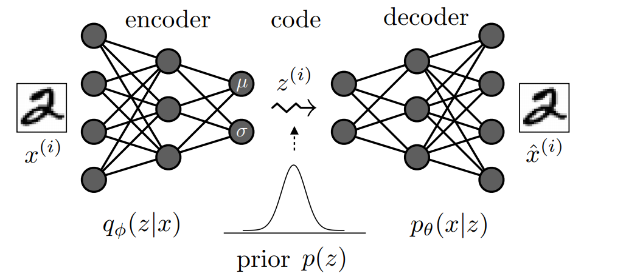
Autoencoder

Slide 3
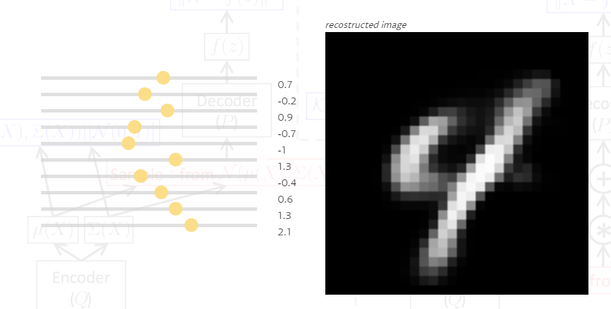
Demo
https://www.siarez.com/projects/variational-autoencoder

Slide 4
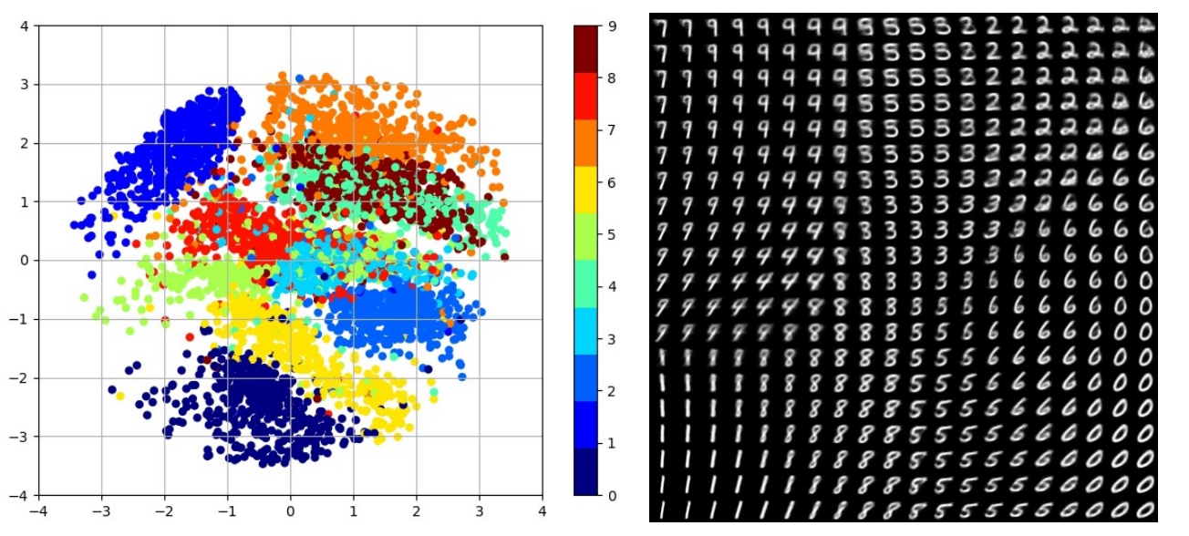
Visualization

Slide 5
1 Neuron

Slide 6
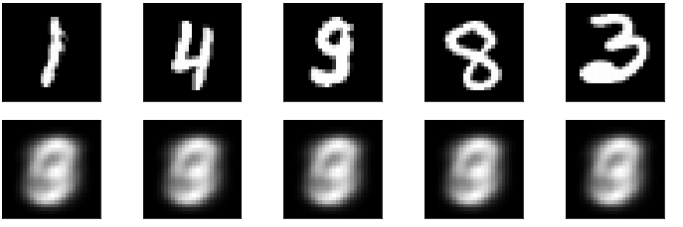
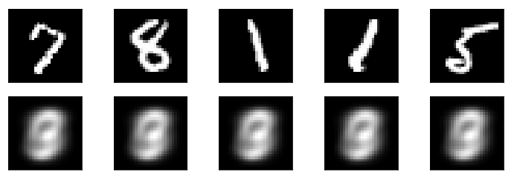
1 Neuron
1. Epoch
500. Epoch

Slide 7
3 Neurons

Slide 8
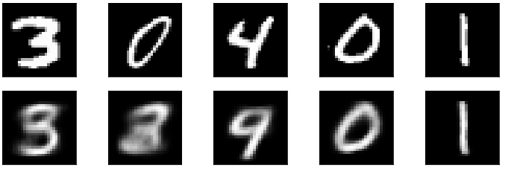
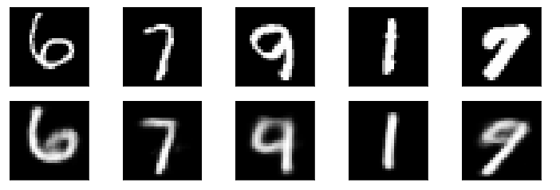
3 Neurons
1. Epoch
500. Epoch

Slide 9
10 Neurons

Slide 10
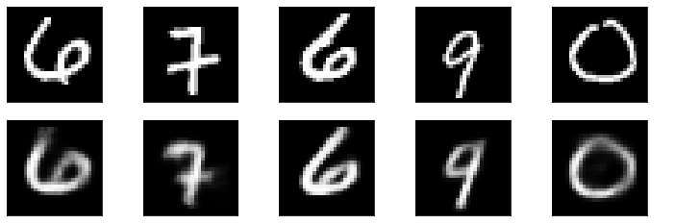
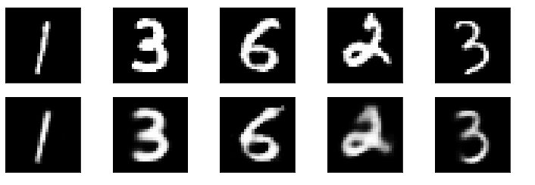
10 Neurons
1. Epoch
￼
500. Epoch

Slide 11
100 Neurons

Slide 12
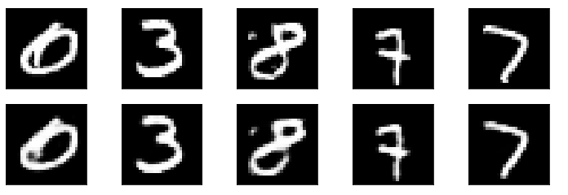
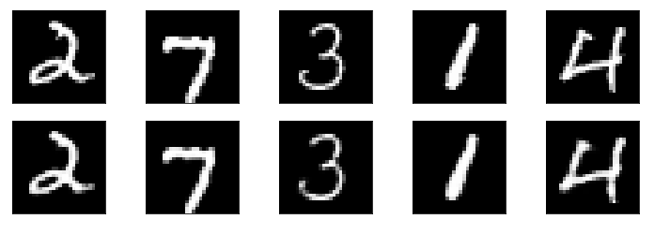
100 Neurons
1. Epoch
500. Epoch

Slide 13
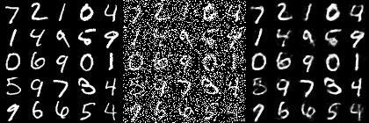
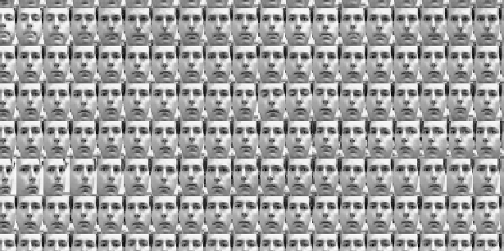
Applications

Slide 14
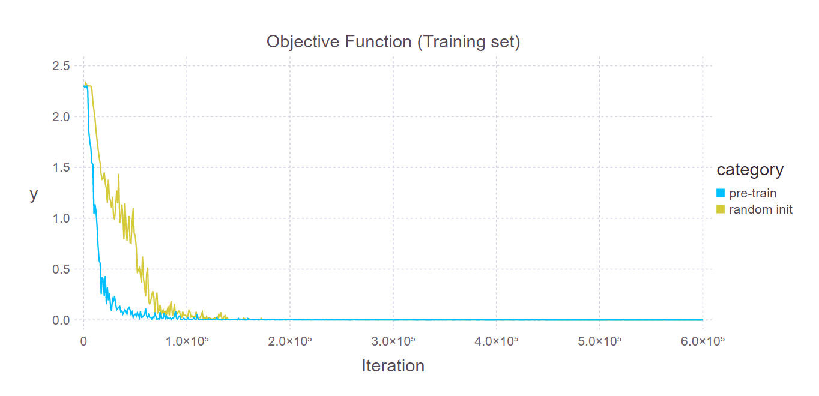
Applications

Slide 15
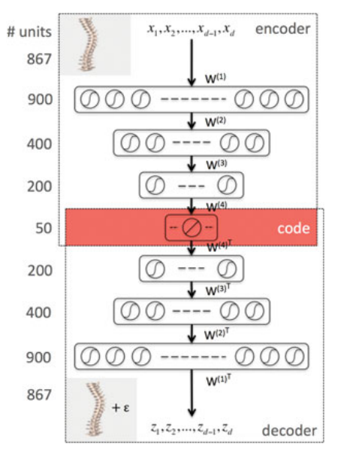
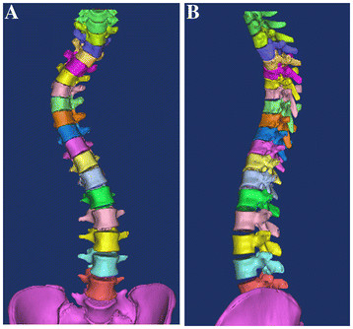
Applications
https://www.researchgate.net/figure/Segmented-3D-spine-modelA-Frontal-view-B-Lateral-view-A-segmented-3D-model-of-the_fig1_225300542
https://rd.springer.com/chapter/10.1007%2F978-3-319-14148-0_2
3D Spine Models in Adolescent Idiopathic Scoliosis

Slide 16
Autoencoder

Slide 17
Sources
„Tutorial on Variational Autoencoders“ https://arxiv.org/pdf/1606.05908.pdf
„Auto-Encoding Variational Bayes“ https://arxiv.org/pdf/1312.6114.pdf
http://www.opendeep.org/v0.0.5/docs/tutorial-your-first-model
https://mochajl.readthedocs.io/en/latest/tutorial/mnist-sDA.html
Additional sources: See Related links

Slide 18
Related links
https://www.siarez.com/projects/variational-autoencoder
https://dbs.uni-leipzig.de/file/Saalmann_Ausarbeitung.pdf
https://arxiv.org/pdf/1606.05908.pdf
https://github.com/manureini/Autoencoder

