Slide 1

Redshift DBA Commands
Version 1.0
8 July 2015

Slide 2
Resources
Redshift Documentation
http://docs.aws.amazon.com/redshift/latest/mgmt/welcome.html
http://docs.aws.amazon.com/redshift/latest/dg/welcome.html
Amazon Redshift Utils on github
https://github.com/awslabs/amazon-redshift-utils
Using version from July 3, 2015

Slide 3
Agenda
System Tables & Views
DBA Scripts
DBA Views
DBA Tools
Encoding Utility
Best Practice – work together with your DBA and execute Scripts and Views directly on your Redshift cluster
Warning: Encoding utility can change your data structure!

Slide 4
System Tables & Views
Overview about system tables & views

Slide 5
System Tables & Views
Contain information about how the system is functioning
Can be queried as any other table / view
Are not included in snapshots
There are two classes of visibility for data in system tables and views:
user visible
super user visible

Slide 6
Two types of System Tables
STL
generated from logs that have been persisted to disk to provide a history of the system
contain only 2-5 day of log history
to keep log history copy to other table or export to S3
Example:
STL_ERROR
records all errors that occur while running queries

Slide 7
Two types of System Tables
STV
virtual tables that contain snapshots of the current system data
Example:
STV_SESSIONS
views information about the active user sessions for Amazon Redshift

Slide 8
System Views
System views contain a subset of data found in several of the STL and STV system tables
These views provide quicker and easier access to commonly queried data
Example:
SVV_TABLE_INFO
shows summary information for tables in the database

Slide 9
System Catalog Tables
The system catalogs store schema metadata, such as information about tables and columns
System catalog tables have a PG prefix
Example:
PG_TABLE_DEF
stores information about table columns

Slide 10
DBA Scripts
SQL for running diagnostics

Slide 11
top_queries.sql
Return the top 50 most time consuming statements in the last 7 days
Only “select” queries
Change comments in SQL for more
Output
n_qry: Number of Queries with same SQL text
qrytext: First 80 Characters of the query SQL
min/max/avg: Min/Max/Avg Execution time

Slide 12
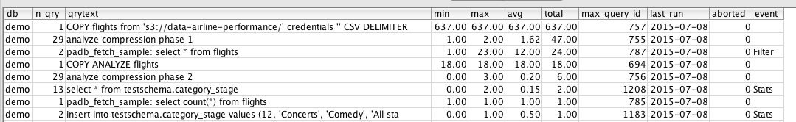
top_queries.sql

Slide 13
top_queries.sql
Insides:
Check if “analyze compression” takes a lot of time

Slide 14
perf_alerts.sql
Return top occurrences of alerts (join with table scans)
Output
Table: Name of the table where the alert happened, when applicable
minutes: Number of minutes spent doing the action. Not available for all alerts
rows: Number for rows of the scan/dist/bcast
Event: What is the Alerted Event
Solution: Proposed Solution to avoid the alert (and performance issue) in the future
Count: Number of occurrences of the alert

Slide 15
perf_alerts.sql

Slide 16
filter_used.sql
Return filter applied to tables on scans.
To aid on choosing sort key
Use the perm_table_name filter to narrow the results
Output
Table: Table Name
Filter: Text of the filter from explain plan
Secs: Number of seconds spend scanning the table
Num: Number of times that filter occurred
Query: Latest query id of a query that used that filter on that table

Slide 17
commit_stats.sql
Shows information on consumption of cluster resources through COMMIT statements from last 2 days == Commit queue statistics
showing largest queue length and queue time first
Output
startqueue: Time when the queueing started
node: Node where the queue started.
A number between 0 and # nodes might indicate a issue with a node. Usually -1 (leader).
queue_time: Queue time in miliseconds
commit_time: Commit time in miliseconds
Queuelen: Number of transactions in the queue

Slide 18
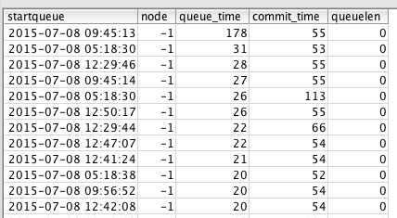
commit_stats.sql

Slide 19
current_session_info.sql
Query showing information about sessions with currently running queries
Output:
User
pid
DB name
s_start: Session start time
q_start: start time of query
Query: query Id

Slide 20

current_session_info.sql

Slide 21
missing_table_stats.sql
Query shows EXPLAIN plans which flagged "missing statistics" on the underlying tables
Indicator for running analyze
Output:
Node
count

Slide 22
queuing_queries.sql
Query showing queries which are waiting on a WLM Query Slot
Output:
Query id
querytxt
#slots
Query start time
Queue time in s
Execution time in s

Slide 23
queuing_queries.sql

Slide 24
table_info.sql
Return Table storage information (size, skew, etc)
Compare with this: http://docs.aws.amazon.com/redshift/latest/dg/c_analyzing-table-design.html
Output:
schema: Schema name
Table: Table name
tableid: Table id
DistKey: Distribution Key
Skew: Table Skew. Proportion between largest slice and smallest slice (null for diststyle ALL)
Sortkey: First column of Sortkey
#SKs: Number of columns in the compound sortkey
Rows: Number of rows
mbytes: Size of the table in Megabytes
Enc: Y if the table has at least one compressed column, N otherwise
pct_of_total: Size of the table in proportion to the cluster size
pct_stats_off: Measure of staleness of table statistics (real size versus size recorded in stats)
pct_unsorted: Proportion of unsorted rows compared to total rows

Slide 25
table_info.sql

Slide 26
DBA views
SQL views for daily admin work

Slide 27
v_check_data_distribution.sql
View to get data distribution across slices
More detailed view for table_info.sql
Output
rowcount_on_slice
total_rowcount
distrib_pct

Slide 28
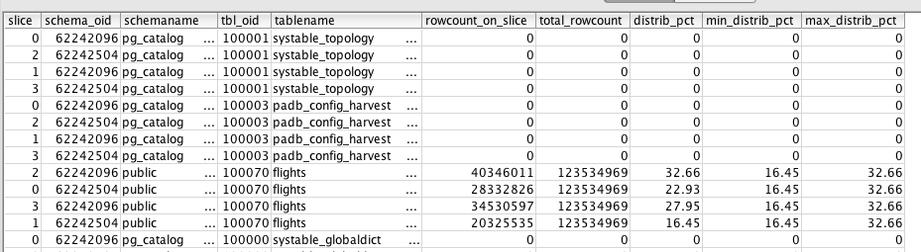
v_view_dependency.sql

Slide 29
v_space_used_per_tbl.sql
View to get pull space used per table
This tells you if you should run a “vacuum”
Output:
Tablename
Size
#rows
#unsorted_rows
Pct_unsorted: >20% -> run vacuum
recommendations

Slide 30
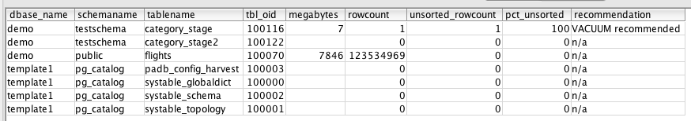
v_space_used_per_tbl.sql

Slide 31
v_constraint_dependency.sql
View to get the the foreign key constraints between tables
Outptut:
src_objectname
dependent_objectname
constraint_name: foreign / primary

Slide 32
v_view_dependency.sql
View to get the names of the views that are dependent other tables/views
Outptut:
src_objectname
dependent_objectname

Slide 33
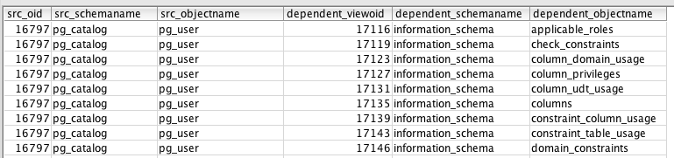
v_view_dependency.sql

Slide 34
v_object_dependency.sql
A view to merge the different dependency views together
Depends on admin.v_view_dependency and v_constraint_dependency.sql view

Slide 35
DBA views – Create DDLs

Slide 36
v_generate_schema_ddl.sql
View to get the DDL for schemas.

Slide 37
v_generate_tbl_ddl.sql
View to get the DDL for a table. This will contain the distkey, sortkey, constraints, not null and defaults.

Slide 38
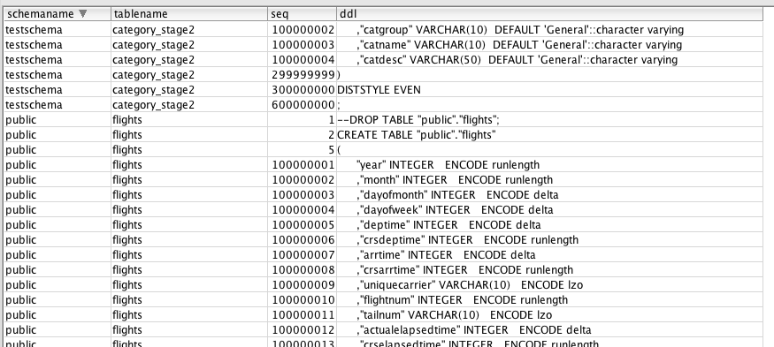
v_generate_tbl_ddl.sql

Slide 39
v_generate_unload_copy_cmd.sql
View to get that will generate unload and copy commands for an object (all tables).
After running the view the user will need to fill in what filter to use in the UNLOAD query if any (--WHERE audit_id > ___auditid___), the bucket location (__bucketname__) and the AWS credentials (__creds_here__).

Slide 40
v_generate_view_ddl.sql
View to get the DDL for a view.

Slide 41
DBA views For User Management

Slide 42
v_generate_group_ddl.sql
View to get the DDL for a group.

Slide 43
v_get_obj_priv_by_user.sql
View to get the table/views that a user has access to
Useful to audit your permissions!
Tables / views without permission will not be listed
Output:
Username
Table / View name
Sel / Ins / upd / del / ref: true / false

Slide 44
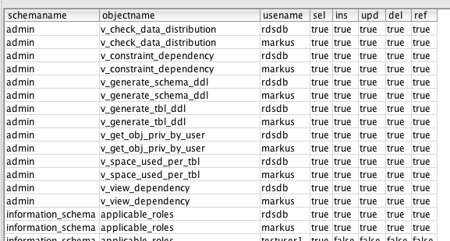
v_get_obj_priv_by_user.sql

Slide 45
v_get_tbl_priv_by_user.sql
View to get the tables that a user has access to
Useful to audit your permissions!
Same as v_get_obj_priv_by_user.sql
Only for tables

Slide 46
v_get_view_priv_by_user.sql
View to get the views that a user has access to
Useful to audit your permissions!
Same as v_get_obj_priv_by_user.sql
Only for views

Slide 47
v_get_schema_priv_by_user.sql
View to get the schema that a user has access to
Useful to audit your permissions!
Output:
User
Schema name
Cre / usg: true / false

Slide 48
v_generate_user_object_permissions.sql
View to get the DDL for a users permissions to tables and views.

Slide 49
v_get_users_in_group.sql
View to get all users in a group
Output:
Group name
users

Slide 50

v_get_users_in_group.sql

Slide 51
DBA Tools
Tools & code for optimizing DBA’s Redshift work

Slide 52
Column Encoding Utility
Analyze and optimize encoding structure

Slide 53
Redshift Column Encoding
Column Encoding specifies which algorithm is used to compress data within a column
http://docs.aws.amazon.com/redshift/latest/dg/t_Compressing_data_on_disk.html
many aspects influence best choice: data type, # discrete values, …
correct Column Encoding improves performance
COPY automatically chooses Column Encoding

Slide 54
Redshift Column Encoding Utility
Analyzes already loaded data
Uses ANALYZE COMPRESSION command
Can convert your Column Encoding structure
Will copy data into new Column Encoding optimized table
Based on Python

Slide 55
Redshift Column Encoding Utility - Arguments
--db - The Database to Use
--db-user - The Database User to connect to
--db-host - The Cluster endpoint
--db-port - The Cluster endpoint port (default 5439)
--analyze-schema - The Schema to be Analyzed (default public)
--analyze-table - A specific table to be Analyzed, if --analyze-schema is not desired
--target-schema - Name of a Schema into which the newly optimised tables and data should be created, rather than in place
--threads - The number of concurrent connections to use during analysis (default 2)
--output-file - The full path to the output file to be generated
--debug - Generate Debug Output including SQL Statements being run
--do-execute - Run the compression encoding optimisation
--slot-count - Modify the wlm_query_slot_count from the default of 1
--ignore-errors - Ignore errors raised in threads when running and continue processing
--force - Force table migration even if the table already has Column Encoding applied
--drop-old-data - Drop the old version of the data table, rather than renaming
--comprows - Set the number of rows to use for Compression Encoding Analysis

Slide 56
Redshift Column Encoding Utility - Example
python analyze-schema-compression.py --db demo --db-user markus --db-host demo.XXX.eu-west-1.redshift.amazonaws.com --analyze-table flights --output-file out.txt

Slide 57
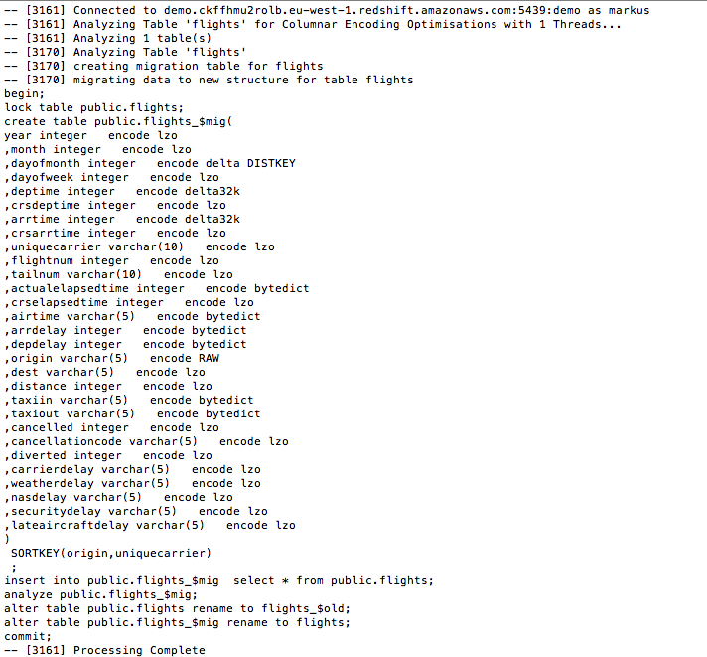

Slide 58
Redshift Column Encoding Utility – Install Notes
sudo easy_install pip
sudo yum install postgresql postgresql-devel gcc python-devel
sudo pip install PyGreSQL

Slide 59
FAQ

