Slide 1
Executive Summary
Expectations
  $500 component cost
  250 K samples/sec data rate @ 20 MHz
    Theoretical maximum
  9 weeks to design
Realities
  $200.00 component cost
  100 K samples/sec data rate @ 8MHz
  14 weeks to design

Slide 2
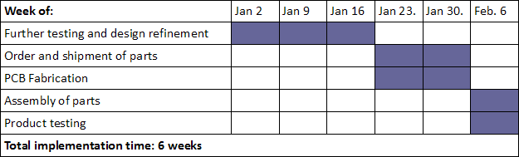
Executive Summary

