Slide 1
Analog Input Subsystem
Conditions input analog signals to be readable by analog to digital converter
Accepts signals within -12.7 to +12.7 V, scales them to a 0 to 5 V range.
Shifting and amplification is configurable by PC Software via Data-path Control Hardware

Slide 2
Analog Input Design Options
Op-amps chosen over transistors for amplification; inexpensive and simplifies design
Multiplexed resistors provide configurable scaling of input signals

Slide 3
Data-path Control Subsystem
Regulates the flow of data from input modules to PC
Serializes data for acquisition by PC Software
Allows PC Software to manage control of input data

Slide 4
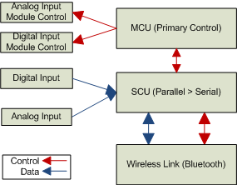
Data-path Control Diagram

Slide 5
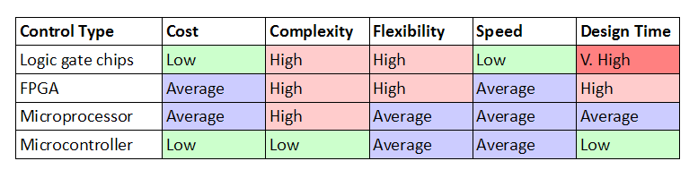
Data-path Control Design Options
Microcontroller chosen as best control method:

Slide 6
Power Subsystem
Provides power for hardware subsystems
DC-DC converter provides power for:
  Analog Input Subsystem
  Data-path Control Subsystem
Lithium-Ion battery powers Wireless Subsystem directly

Slide 7
Power Subsystem Design Options
Lithium-Ion battery powers wireless chip:
  WT32 has built-in Li-Ion charging capability
  Battery can power this directly, simplifies design

Slide 8
Wireless Link Subsystem
Enables wireless transmission of acquired signals to PC
Wireless eliminates need for PC to be physically connected to diagnostic tool

Slide 9
Wireless Link Design Options
WT32 Bluegiga chosen for wireless communication chip:
  More expensive than other options but more functionality
  Allows operation via programmable commands

Slide 10
PC Software Subsystem
Acquires data from data acquisition hardware
Provides a graphical user interface
Allows control over data acquisition process
Enables display of saved data

Slide 11
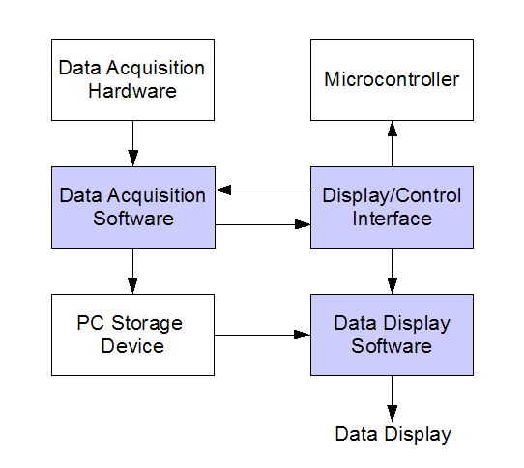
PC Software Diagram

Slide 12
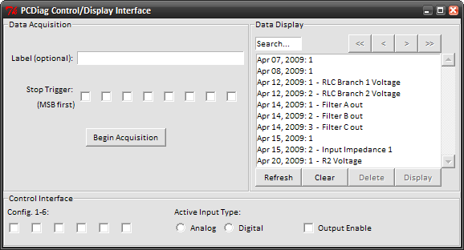
PC Software Interface

