Slide 1
ROCKBUSTER STEALTH DATABASE ANALYSIS

Slide 2
CONCESSIONS 2
PROJECT OVERVIEW
Rockbuster Stealth LLC is a movie rental company that used to have stores around the world.
Facing stiff competition from streaming services such as Netflix and Amazon Prime, the Rockbuster Stealth management team is planning to use its existing movie licenses to launch an online video rental service in order to stay competitive.

Slide 3
Objectives & Key Questions
1. Genre Analysis
Which genre contributed the most/least to revenue gain?
2. Rental Analysis
What are average rental statistics?
3. Location Analysis
Which countries are Rockbuster customers based in?
4. Customer Analysis
Who and Where are the customers with the highest lifetime value?
5. Spatial Analysis
How do sales compare across regions/countries?

Slide 4
CONCESSIONS 3
Company Overview
Total Customers: 599
Films For Rent: 1000
Average Rental Duration: 5 Days
Average Rental Cost: $2.98
Average Replacement Cost: $19.99

Slide 5
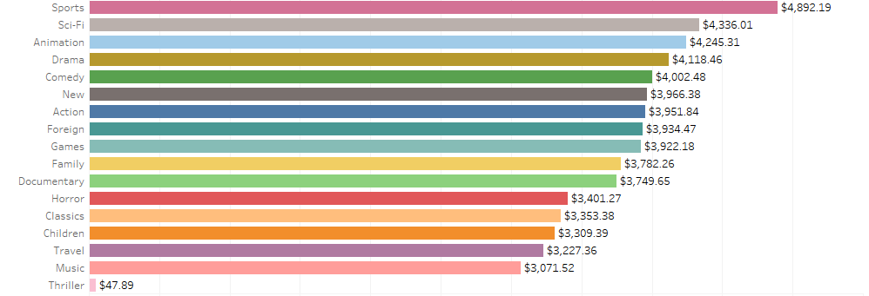
CONCESSIONS 2
Genre Analysis
Total Revenue & Films by Genre
The Highest Grossing Genres are:
Sports, Sci-FI, Animation, Drama and Comedy

Slide 6
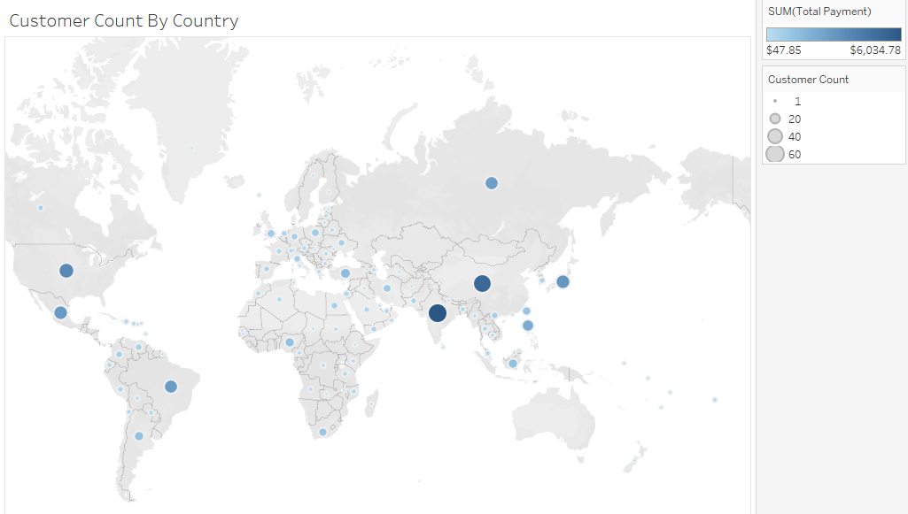
Location Analysis
Which Countries Have the Most Customers:
India: 60
China: 53:
Unites States: 36
Japan: 31
Mexico: 30

Slide 7
CONCESSIONS 3
Customer Analysis
First Name | Last Name | City | Country | Total Amount Paid
Sara | Perry | Atlixco | Mexico | $ 128.70
Eddie | Tomlin | Ozamis | Philippines | $ 122.74
Clinton | Buford | Aurora | United States | $ 98.76
Adam | Gooch | Adoni | India | $ 97.80
Francisco | Skidmore | So Leopoldo | Brazil | $ 93.79
The top customers come from Mexico, Philippines, United States, India and Brazil.
Interestingly Mexico, India and the United States are in the top 5 countries for revenue

Slide 8
CONCESSIONS 3
Recommendations
Sports, Sci-FI, Animation, Drama and Comedy
Sports, Sci-FI, Animation, Drama and Comedy films create the most revenue so continue to fill Inventory with those types of films.
India, China, Unites States, Japan Mexico create the most revenue of any countries focus marketing and sales efforts there.
The top customers come From Mexico, Philippines, United States, India and Brazil.
Which makes it clear that the most effort should be spent in India, Untied States, and Mexico as that’s where both revenue and customer loyalty are highest.

