Slide 1

ROCK BUSTER DATA DICTIONARY

Slide 2
Table Of Contents
Table of Contents
Entity Relationship Diagram …………………………………………………………………………………………….………….1
Facts Table
Rental ………………………………………………………………………………………………………………….….……..2
Dimension Tables
Actor ……………………………………………………………………………………………………………….…….…. 3
Address………………………………………………………………………………………………………………….….. 4
Category ……………………………………………………………………………………………………………………….. 5
City………………………………………………………………………………………………………………….. 6
Country ………………………………………………………………………………………………………………………. 7
Customer ………………………………………………………………………………………………………….………………….. 8
Film……………………………………………………………………………………………………………………..….……9
Film Actor ……………………………………………………………………………………………………………………………..10
Film Category ……………………………………………………………………………………………………………………………..11
Inventory ………………………………………………………………………………………………………………………..12
Language ………………………………………………………………………………………………………………………...13
Payment ………………………………………………………………………………………………………………………14
Staff ……………………………………………………………………………………………………………………………...15
Store…………………………………………………………………………………………………………………………16

Slide 3
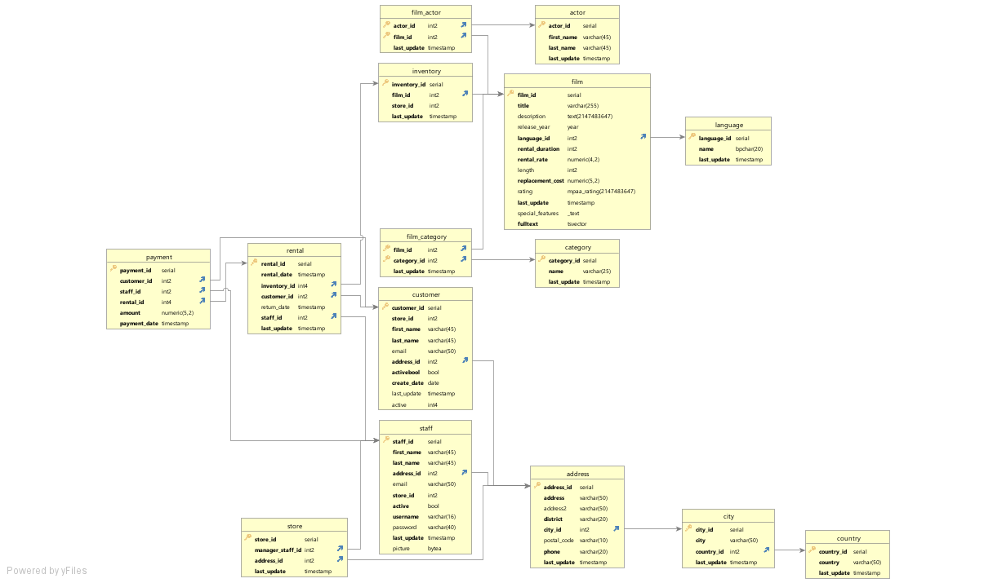
Entity Relationship Diagram

Slide 4
Fact Table: Rental

Slide 5
Dimension Table: Actor

Slide 6
Dimension Table: Address

Slide 7
Dimension Table: Category

Slide 8
Dimension Table: City

Slide 9
Dimension Table: Country

Slide 10
Dimension Table: Customer

Slide 11
Dimension Table: Film

Slide 12
Dimension Table: Film Actor

Slide 13
Dimension Table: Film Category

Slide 14
Dimension Table: Inventory

Slide 15
Dimension Table: Language

Slide 16
Dimension Table: Payment

Slide 17
Dimension Table: Staff

Slide 18
Dimension Table: Store

