Slide 1


A Symbolic Analysis of ECC-based Direct Anonymous Attestation
Jorden Whitefield, Liqun Chen, Ralf Sasse, Steve Schneider, Helen Treharne, Stephan Wesemeyer
Surrey Centre for Cyber Security, University of Surrey Department of Computer Science, ETH Zurich
17 June 2019

Slide 2

Outline
Direct Anonymous Attestation
Contributions
Formal Analysis of ECC DAA
Summary

Slide 3


Direct Anonymous Attestation (DAA)
Anonymous Digital Group Signature scheme
Strong but privacy-preserving authentication
ISO/IEC 20008 2013
Hardware-backed attestation using TPMs
Properties of DAA
User-controlled Anonymity
User-controlled Traceability
Host controls whether signatures can be linked.
Notes:
Direct Anonymous Attestation, or DAA, is an anonymous digital signature scheme that has strong privacy features and authentication.
In particular the properties are User-controlled anonymity where the user decides if they want to be anonymous, and user-controlled traceability where the user again can choose if message signatures can be linked.
DAA was originally designed for the TPM providing strong hardware backed attestation.

Slide 4



DAA Schemes
Valid measurement?
TPM 1.2 (RSA-based)
ISO/IEC 20008-2 mechanism 2
TPM 2.0 (pairing-based)
ISO/IEC 20008-2 mechanism 4 & ISO/IEC 11889
Smaller keys & signatures!
Proposed for FIDO 2
Enhanced Privacy ID (EPID)
Used by Intel SGX
Improved revocation
ABC

Slide 5









Overview of DAA operations
Issuer
Platform
Platform or TPM manufacturer
Non-anonymous attestation
Host
Issues credentials
JOIN
SIGN
Valid signature from a certified TPM?
TPM
TPM
Anonymous attestation
Verifier
Data collector, Bank...?
* Slide inspired from Anja Lehmann https://goo.gl/srqeQk

Slide 6

Is ECC DAA secure?
Need proof that ECC DAA is secure
Challenge: Can we formally verify the security and privacy of ECC DAA?
The Tamarin Prover
State-of-the-art symbolic security protocol analysis tool
Successfully applied to TLS 1.3, 5G, eVoting, V2X, etc

Slide 7
Contributions
Formalization of ISO/IEC 20008-2
First faithful automatable models of all ECC DAA operations
Propose authentication goals for the JOIN operation and find a flaw
Encode symbolic variants of goals from game-based security (secrecy, privacy)
Security Evaluation of ECC DAA
Security goals
Authentication: does not hold when a single TPM is compromised
Secrecy: does not hold when a single TPM is compromised
Privacy: holds in the presence of an adversary
Recommend and provably secure fix for the JOIN operation

Slide 8
What did we model?
Analysed ISO/IEC 20008 mechanism 4
“a secure and authentic channel between the principal signer and Issuer”
The standard does not provide a way to establish the channel
Two additions
Message Authentication Codes (MAC)
Chen, Page, Smart “On the design and implementation of an efficient DAA scheme”.
TPM Endorsement Keys
TPM Library – Part 1: Architecture
Restriction: Only consider a single Issuer

Slide 9
Challenges
Separation of Host and TPM
Communicate over secure I/O in practice
Restricted analysis to only consider unique 1:1 pairing
Zero Knowledge Proofs
Defined functions and equations to represent ZKPs symbolically
Proof Strategies
Guided proof required for unlinkability, codified and automated in an Oracle
All other lemmas automated using default heuristics
Notes:
There are a number of other proofs for DAA that show the mathematical correctness of ZKP.

Slide 10
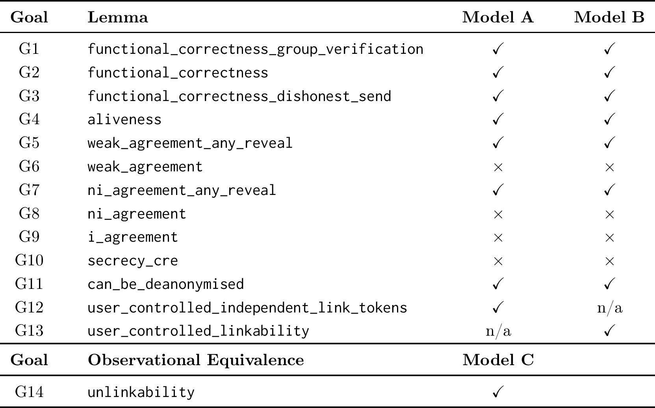
Security and Privacy Properties

Slide 11

{| n_{I}, km |}PK_{EKps}
{| n_{I}, km |}PK_{EKps}
(tsk, Q2) DAA key-pair
v,w
Γ = MAC(Q2,v,w)_{km}
Q2, v, w, Γ
Q2, v, w, Γ
Verify MAC
Compute v’ = v
Generate DAA credential
{| A, B, C |}PK_{EKps}
Compute D
[tsk]B
{| A, B, C |}PK_{EKps}
A, B, C, D

Slide 12

Platform B
Platform A
SK_{EKpsA}
SK_{EKpsA}
{| n_{I}, km |}PK_{EKpsB}
{| n_{I}, km |}PK_{EKpsB}
{| n_{I}, km |}PK_{EKpsA}
Q2, v, w, Γ
Q2, v, w, Γ
Q2, v, w, Γ
{| A_{A}, B_{A}, C_{A} |}PK_{EKpsB}
Compute D_{B}
[tsk]B_{A}
{| A_{A}, B_{A}, C_{A} |}PK_{EKpsB}
{| A_{A}, B_{A}, C_{A} |}PK_{EKpsA}
I Joined Platform A
A_{A}, B_{A}, C_{A}, D_{B}

Slide 13

Platform B
Platform A
SK_{EKpsA}
SK_{EKpsA}
{| n_{I}, km |}PK_{EKpsB}
{| n_{I}, km |}PK_{EKpsB}
{| n_{I}, km |}PK_{EKpsA}
Q2, v, w, Γ
Q2, v, w, Γ
Q2, v, w, Γ
v = H(PK_{EKpsB}||P1||Q2||U||PK_{I}||n_{I})
v = H(P1||Q2||U||PK_{I}||n_{I})
v’ = H(PK_{EKpsA}||P1||Q2||U||PK_{I}||n_{I})
v’ ≠ v

Slide 14
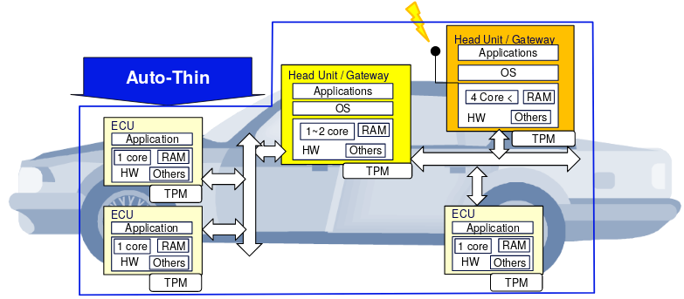

A DAA Scheme for V2X
Use-case targeting V2X communication using DAA
V2X requires authentication and privacy
State-of-the-art: Public Key Infrastructure
TCG Automotive-thin profile for TPMs in vehicles
Vehicle credentials (pseudonyms) can be created, signed, and verified using DAA
“Privacy-Enhanced Capabilities for VANETS Using Direct Anonymous Attestation.” In 2017 IEEE Vehicular Networking Conference,
VNC 2017

Slide 15

Summary
Discovered a flaw in the JOIN operation + proposed a fix
The security of a DAA should not rely on integrity of all TPMs
Fine-grained analysis of ECC DAA
Capture implementation detail including TPM command calls
Allow adversary control over secure I/O between TPM and Host
@sudo_jorden

