Slide 1
Formal Analysis of V2X Revocation Protocols
Jorden Whitefield, Liqun Chen, Frank Kargl, Andrew Paverd, Steve Schneider, Helen Treharne and Stephan Wesemeyer
University of Surrey, UK
Ulm University, Germany
Aalto University, Finland
STM 2017, Oslo, Norway
13/11/2018
1

Slide 2
Outline
Security challenges of Intelligent Transportation Systems
Revocation in Vehicle-to-Anything (V2X) communication
Formal Verification of REWIRE Protocols: PLAIN and R-TOKEN
O-TOKEN: Addressing the issues found
13/11/2018
2

Slide 3

Intelligent Transport Systems (ITS)
What are they?
ITS’s are the combination of transport and ICT Systems to enable safer, coordinated, environmentally friendly, and smarter transportation networks.
ITS's use Pseudonyms (short-lived certificates) for authenticated message exchange. Pseudonyms change frequently to protect privacy of vehicles. Standards
ISO15408-2
ETSI 102-941 and;
IEEE WAVE
Notes:
1 Minute
Features of an Intelligent Transportation are Traffic control systems, cruise control, Navigation, parking guidance and Fleet management.
But the application area goes so much further beyond the Automotive use case, techniques here could be applied to Rail, Aviation, Water, Connected Smart Cities, etc...
There already exists a few standards which focus on the security and privacy of such systems ISO, ETSI and WAVE .
ISO = Information technology -- Security techniques -- Evaluation criteria for IT security -- Part 2: Security functional components
3

Slide 4

Overview of V2X Security
Trust
Architecture
Attestation
Assurance
Privacy
Anonymity
Pseudonymity
Unlinkability
Unobservability
Authentication
Authorisation
Revocation
Software
Safety / Run time Verification
Assurance
Notes:
There are four key areas for V2X security:
Privacy: How can we defend against mass surveillance in V2X?
Authentication: How can I authenticate to others in a timely manner? Where time is essential to safety and preserve privacy.
What assurance do I have that the messages received are genuine?
How can a member of the network participate without exposing their identity?
Trust: Which parts of my system need to be secured to maintain system security? How can I be sure neighbour systems are in a trustable state? Are the other vehicles on the road actually vehicles? How can I be sure?
Software: Software is eating the world, being written by unskilled people resulting in errors. Need to verify the design and runtime of system, both in and outside the car. Software is everywhere. How confident am I in my software system? I.E Doesn’t fail. Can I detect problems at run time and fix them?
4

Slide 5


Pseudonyms in V2X
Pseudonyms can enable:
Anonymity
Pseudonymity
Unlinkability
Unobserveability
13/11/2018
5
Notes:
Pseudonym certificates (pseudonyms) are the most commonly applied way to address privacy concerns and
are also foreseen in emerging standards. Anonymity is a requirement in a V2X network as various privacy
issues arise from the frequent and real-time broadcasting of the position of vehicles.
5

Slide 6
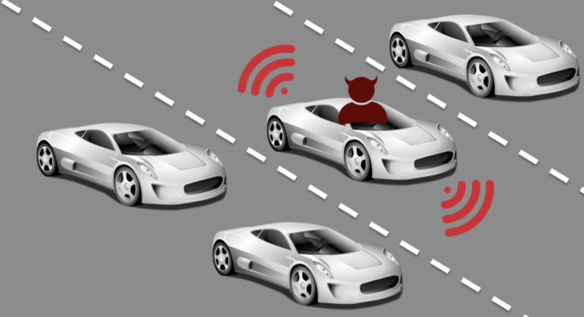
How do you remove a rogue vehicle?
1. Using Pseudonym Certificate Revocation Lists (does not scale)
2. Prevent vehicle from broadcasting network messages, by deleting its issued pseudonyms
13/11/2018
6
Notes:
In this example here we see the car-in-the-middle broadcasting bad messages to the surrounding vehicles. Bad messages could be the result of a faulty sensor or compromised vehicle. What needs to happen is this bad vehicle has to be removed from the network as to not cause harm to the other vehicles, this is known as 'Revocation'. Revocation needs to be timely, as state-of-the-art currently relies on CRLs being distributed, and privacy-preserving: removing vehicle without revealing its true identity.
6

Slide 7
How do you remove a rogue vehicle?
1. Using Pseudonym Certificate Revocation Lists (does not scale)
2. Prevent vehicle from broadcasting network messages, by deleting its issued pseudonyms
13/11/2018
7
Notes:
In this example here we see the car-in-the-middle broadcasting bad messages to the surrounding vehicles. Bad messages could be the result of a faulty sensor or compromised vehicle. What needs to happen is this bad vehicle has to be removed from the network as to not cause harm to the other vehicles, this is known as 'Revocation'. Revocation needs to be timely, as state-of-the-art currently relies on CRLs being distributed, and privacy-preserving: removing vehicle without revealing its true identity.
7

Slide 8
Pseudonym Lifecycle
13/11/2018
8
Notes:
For revocation to happen let us look at the typical lifecycle of pseudonyms. Abstractly a Intelligent Transportation System has three trusted third parties: - CA: issues long-term credentials to vehicle. - PP: responsible for handing out shorter-lived pseudonym certificates.
- RA: collects reports on misbehaviour, and takes decisions to revoke a misbehaving entities from the ITS.
V1 authenticates itself with the CA to obtain a long-term credential, that it uses to get fresh pseudonyms from the PP. It presents the credential to download a set of pseudonyms which V1 then uses to have authenticated communication with another vehicle, V2. During the V2X communication V1 detects some strange behaviour from V2 and issues a report against the pseudonym V2 is currently using. Over time as other vehicles in the system also report V2, the RA creates a revocation request and broadcasts it onto the network that V2 will receive. Once received V2 deletes its pseudonyms and confirms the revocation with the RA.
8

Slide 9
Existing REWIRE Protocols
By D. Förster, H. Löhr, J. Zibuschka, F. Kargl at TRUST 2015
Use of Trusted Components (TC) to support revocation
TC = no Certificate Revocation Lists
Two schemes identified in paper
PLAIN: Uses pseudonyms to sign "confirm revocation" messages
R-TOKEN: Link token scheme. Uses Long-term key pair for "confirm revocation" message signing
13/11/2018
9

Slide 10
Formal Analysis of REWIRE Protocols
Goals
Authentication: Completion of the protocol confirms the intended vehicle has been revoked
Functional Correctness: revocation happens even in presence of a change of pseudonym
Analysis performed using the TAMARIN Prover
Symbolic protocol analysis
Behavior defined as Multiset Rewrite rules
Properties expressed on traces using logic
13/11/2018
10

Slide 11
Summary of Results
PLAIN: is not functionally correct
Revocation can only occur when there is no change of pseudonym
R-TOKEN: has an authentication flaw
Revocation confirmation cannot be verified by the RA
O-TOKEN:
Improvement to the REWIRE protocols that ensures correct revocation
13/11/2018
11

Slide 12
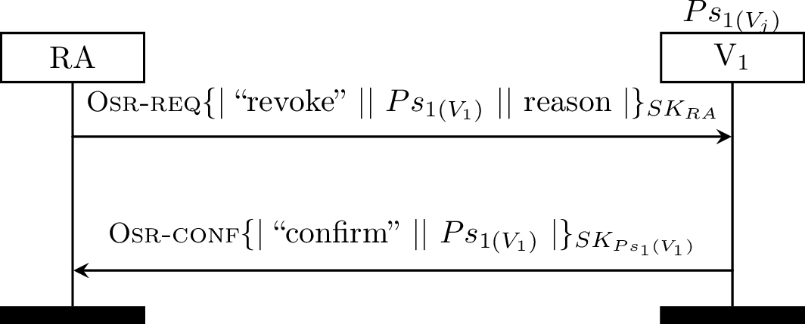
PLAIN
13/11/2018
12

Slide 13
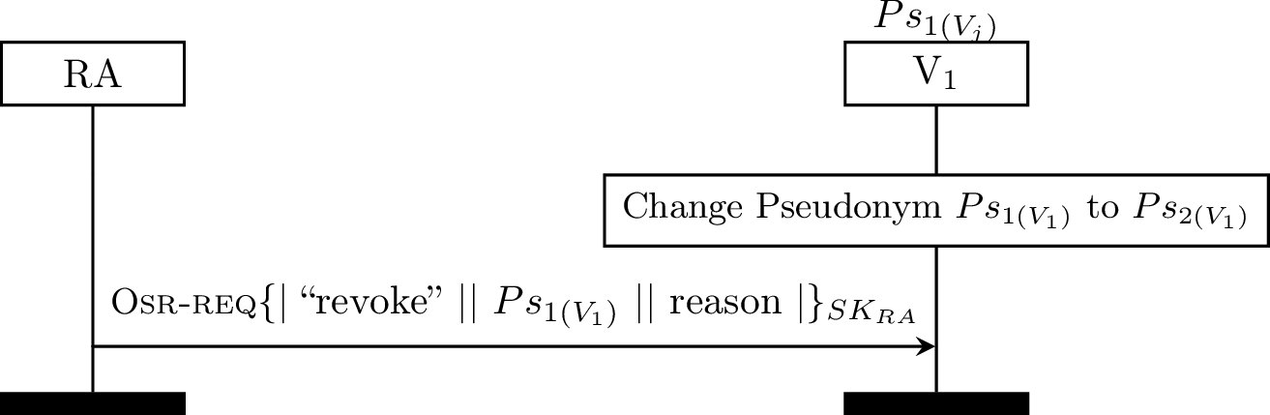
PLAIN
13/11/2018
13

Slide 14
R-TOKEN
Creates pseudo-linkability between pseudonyms
Vehicles in this scheme have long term key-pair PKVj / SKVj
Introduces extra field 'R-TOKEN' in pseudonyms
Pseudonym now consists of a key-pair and R-TOKEN.
13/11/2018
14

Slide 15
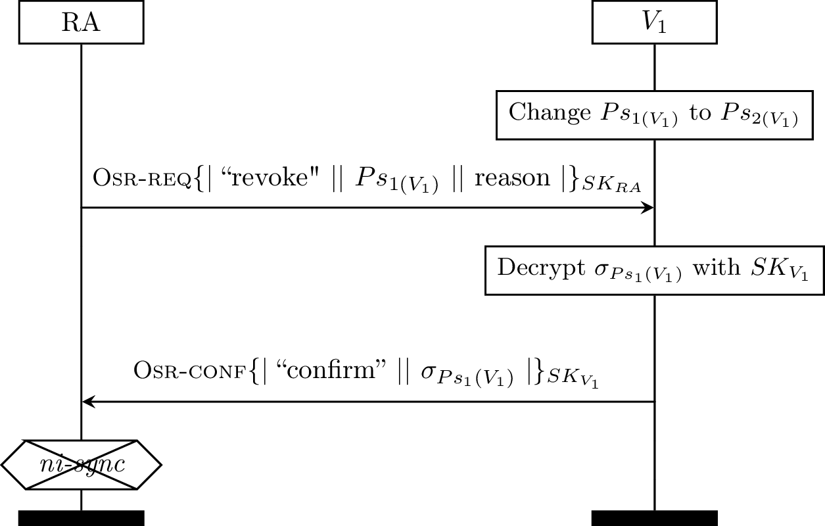
R-TOKEN
Includes R-TOKEN
Auth
13/11/2018
15

Slide 16

OBSCURE-TOKEN (O-TOKEN)
New key-pair "O keys" SKO / PKO
O-TOKEN is an encryption of SKO under vehicle long-term symmetric key:
Pseudonyms contain O-TOKEN and PKO
13/11/2018
16

Slide 17
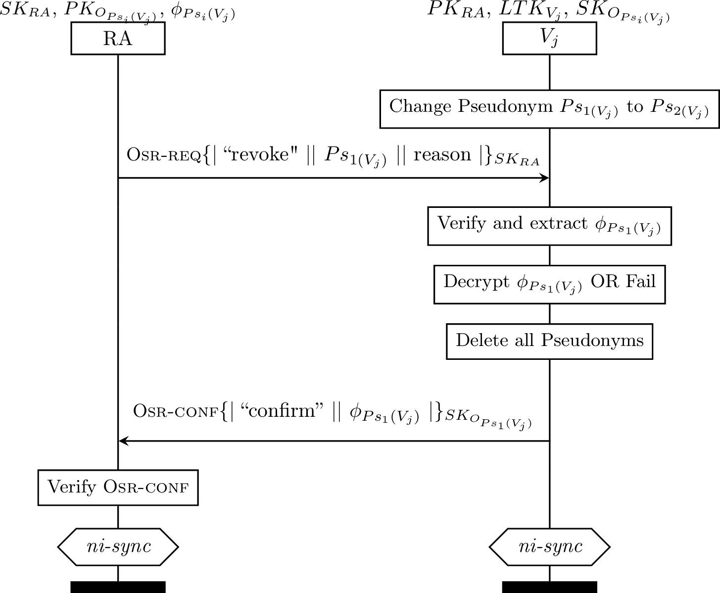
O-TOKEN
Auth
Auth
13/11/2018
17

Slide 18
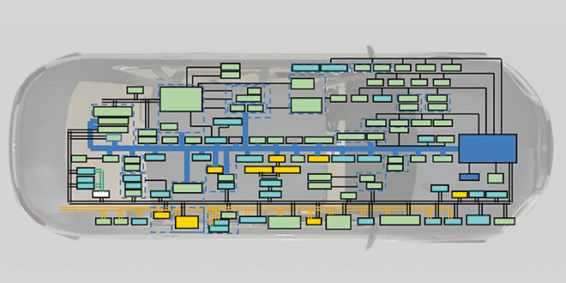
Future research directions
Finer grained model capture privacy
Use DAA to explore alternate architectures

Slide 19
Questions?
Thank you
13/11/2018
19

Slide 20


13/11/2018
20

