Slide 1
Syntapse:
An Autonomous Multi-agent Software Engineering Platform
Memory-first AI agents collaborating through a shared Cognee memory graph
Ideation Specialist
Team Members
Implementation Strategist
Cognee
PRD Architect
T Mohamed Yaser (160923733104)
Mohammed Sabeehuddin (160923733065)
Abdul Rafe Afzal (160923733084)
Mohammed Abubakar (160923733098)
Tech Stack Evaluator
System Architect

Slide 2
Abstract
5
specialized autonomous agents
Syntapse is a memory-first AI software engineering platform in which specialized AI agents collaborate through a shared, evolving memory instead of passing prompts to one another. Five autonomous daemons (Ideation Specialist, PRD Architect, System Architect, Tech Stack Evaluator and Implementation Strategist) observe a Cognee memory graph, recall the context they need and commit their results back to it.
Because the system is event-driven, a human edit to any memory node, such as changing the tech stack from React to Rust, makes downstream agents discard stale plans and regenerate them automatically. The result is an AI team that plans, adapts, verifies and evolves software without losing context.
1
shared, persistent memory graph
0
direct agent-to-agent prompts
Keywords: Multi-agent systems, Memory graph, Cognee, Event-driven architecture, Autonomous self-healing
Syntapse
2

Slide 3
Literature Survey
Work | Authors, Year | Approach / Contribution | Limitation (Gap)
ReAct | Yao et al., 2022 | Interleaves reasoning traces with tool actions in a single LLM agent. | Single agent; no shared, persistent project state.
Generative Agents | Park et al., 2023 | A memory stream plus reflection lets agents recall and plan over experience. | Memory is private to each agent, not a shared engineering truth.
MemGPT | Packer et al., 2023 | OS-style tiered memory manages context beyond the model's window. | Focused on one conversation; no multi-agent event coordination.
AutoGen | Wu et al., 2023 | Framework for multi-agent conversation with customizable agents and tools. | Agents coordinate by message passing; context lives in transcripts.
MetaGPT | Hong et al., 2023 | Encodes SOPs so PM, architect and engineer agents produce structured artifacts. | Fixed sequential hand-off; a change forces a rerun.
ChatDev | Qian et al., 2023 | Virtual software company where role agents chat through design, coding and testing. | Linear chat chain; no persistent memory graph to heal from.
Research gap: no existing work treats a shared, event-driven memory graph as the single source of truth for a team of agents.
Syntapse
3

Slide 4
Existing Models
SE-Blackboard
Liu et al., 2026
Built: shared-state blackboard vs message passing; keeps the original issue visible to all agents.
Limitation: resolve-rate gain (16% vs 12%) not statistically significant; hybrid mode gave 36% empty patches.
MemIndex
Saleh et al., 2025
Built: intent-indexed graph memory for LLM publish/subscribe agents; agents negotiate updates, deletion and offloading.
Limitation: accuracy varies with the LLM; text-only, synthetic data.
TheBotCompany
Lyu et al., 2026
Built: Strategy, Execution and Verification milestone cycle; managers hire and retire workers.
Limitation: single-run results; 1.65x more output tokens than Claude Code; mid-project requirement changes left as future work.
SRMT
Sagirova et al., 2025
Built: agents write memory states to a shared workspace and read them by attention.
Limitation: tested on pathfinding, not software engineering; no guarantee agents reach goals.
Society Agent
Chrysochos, 2026
Built: persistent supervisors, ephemeral workers, file memory, cron scheduling.
Limitation: file I/O bottleneck beyond about 50 agents; no built-in security; preprint.
Syntapse aims to
combine a shared Cognee memory graph with event-driven updates, so affected agents can regenerate dependent work when project information changes.
Syntapse
4

Slide 5
Problem Statement
Software engineering is collaborative and highly contextual, yet AI systems force models to work in isolation, passing massive walls of text (prompts) between them and hoping nothing is hallucinated or forgotten.
Sequential prompt chain
Agent A
→
Agent B
Agent C
×
Chain breaks: context lost
1
Sequential prompt chaining
2
Fragile to change
3
Context as a temporary payload
Agent A generates text and passes it to Agent B, which passes it to Agent C. Each model sees only the previous output and must hope it does not hallucinate or forget critical requirements.
When requirements change or one agent makes a mistake, the chain shatters. Context is lost and the output degrades further down the line.
Existing systems treat context as disposable text rather than a permanent state of truth, so the only fix is to hit re-run and start from scratch.
Syntapse
5

Slide 6
Proposed Solution
We stopped passing prompts. We started sharing memory.
1
2
3
4
5
Ideation Specialist
PRD Architect
System Architect
Tech Stack Evaluator
Implementation Strategist
Refines raw ideas into clear concepts.
Turns concepts into product requirements.
Designs the architecture from requirements.
Evaluates and selects the technologies.
Produces the implementation plan.
Shared Cognee Memory Graph
every agent reads from and writes to the same persistent memory
Event-driven collaboration
Autonomous self-healing
Agents never talk to each other. When the PRD agent commits requirements, the System Architect observes the memory change, wakes up, recalls the exact context it needs and starts work.
If a user edits a memory node (e.g. React to Rust), the change emits an event. Downstream agents detect the altered foundation, discard stale plans and regenerate them, with no restart needed.
Syntapse
6

Slide 7
Methodology and Implementation
Agent Lifecycle: background daemons, fully decoupled from the UI
Memory Lifecycle: the "Thread of Consciousness" shown on the frontend
1
Observe
Redis event bus
Listen to the Redis event bus for memory mutations.
Cognee Memory Graph
2
Evaluate
Cognee memory graph
write
read
write
discard
Query Cognee to check whether their responsibility is missing or invalidated.
1
2
3
4
↻
3
Act
Remember
Recall
Improve
Forget
Retrieve context, invoke LLMs and commit the new state back to Cognee.
An agent commits a refined concept to the Cognee graph.
An agent queries the graph for historical context.
A human explicitly injects new truth into a memory node.
A downstream agent discards a stale plan because its foundational memory changed.
4
Sleep
Return to observation mode until the next memory event.
Technology Stack
Memory Infrastructure
Event Orchestration
Backend Services
Frontend Interface
Cognee, Memgraph
Redis (Pub/Sub)
Python, FastAPI, asyncio
Next.js (React), framer-motion, react-force-graph
Syntapse
7

Slide 8
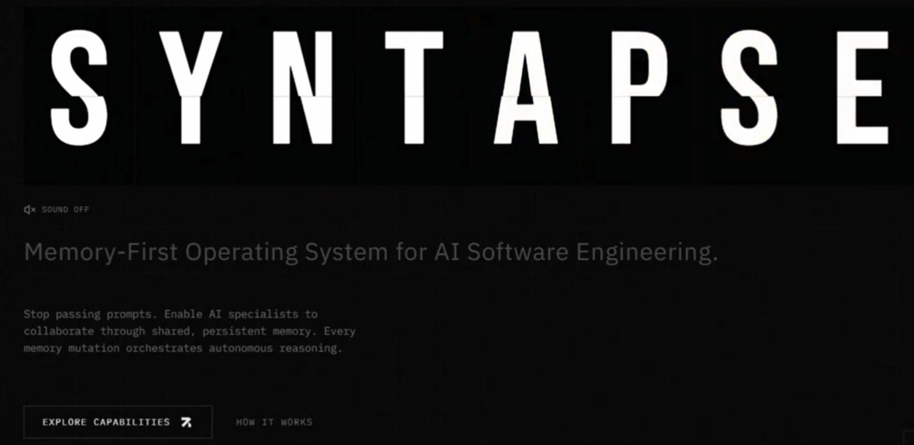
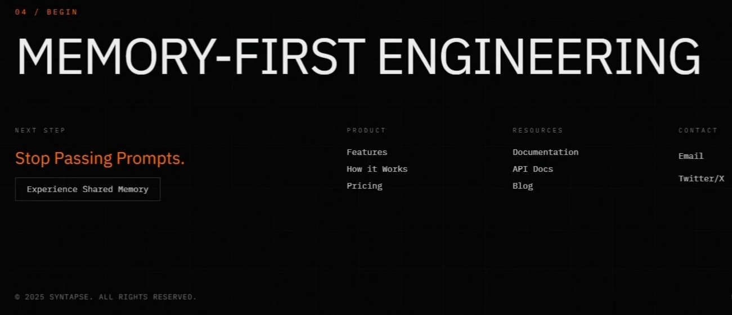
Platform Interface
A glimpse of the Syntapse landing experience that introduces the memory-first engineering concept to users.
Landing hero
Call to action
The homepage leads with the platform name and its core promise: a memory-first operating system for AI software engineering, built so specialists collaborate through shared, persistent memory instead of passed prompts.
The closing section reinforces the same idea, "Stop Passing Prompts," and invites users to experience shared memory directly, alongside links to product, docs and contact information.
Syntapse
8

Slide 9
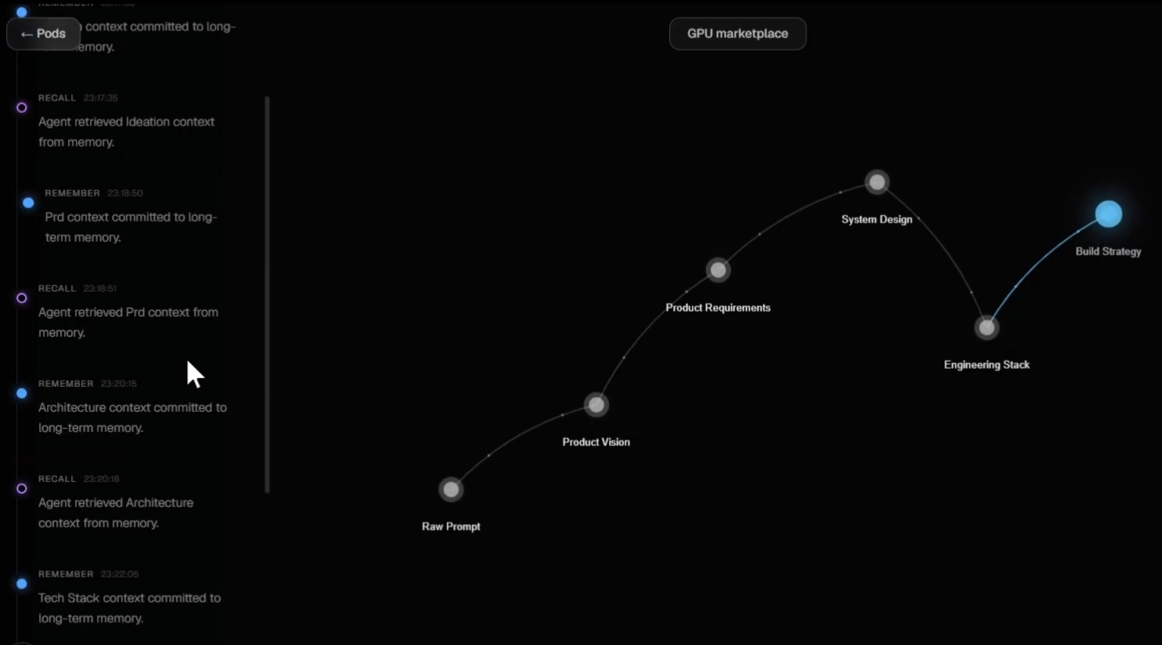
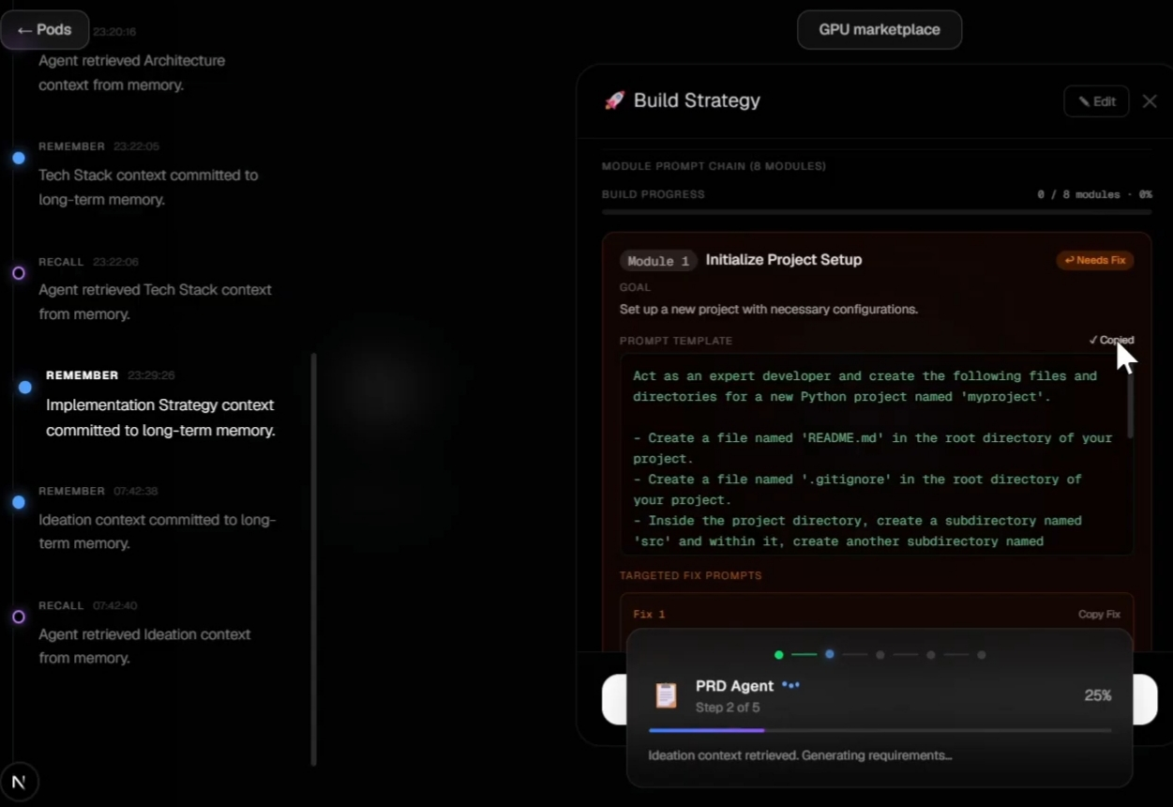
Agent Interaction and Memory Activity
The frontend visualizes every memory event live, turning backend agent activity into a readable timeline.
Thread of Consciousness
Live agent progress
A left-hand event log streams Remember and Recall events with timestamps, while the graph view on the right traces the plan from Raw Prompt through Product Vision, Requirements and System Design to the completed Build Strategy.
Opening a node such as Build Strategy shows its generated module prompt chain and fix suggestions, while a floating status card reports the active PRD Agent's step and progress as it retrieves context and generates requirements.
Syntapse
9

Slide 10






Advantages
Persistent context
Autonomous self-healing
Decoupled agents
Memory is a permanent state of truth, so no context is lost between agents or steps.
Editing a memory node triggers stale plans to be discarded and regenerated without a restart.
Agents run as independent background daemons, so each one can be added, replaced or scaled separately.
Relational and semantic
Human in the loop
Transparent process
Cognee stores relationships and semantic meaning, giving agents precise, hierarchical context.
Users can inject new truth into any memory node at any time and the system adapts.
The Thread of Consciousness UI shows every remember, recall, improve and forget event.
Syntapse
10

Slide 11



Future Scope
Multi-Player Memory
Allow entire engineering teams to connect their IDEs directly into the Syntapse memory graph.
IMPACT
Humans and agents work from one live, shared source of truth.
Code Generation Agents
Add terminal-enabled daemons that execute the implementation plans generated by the current strategy agents.
IMPACT
Moves the platform from planning to running, verified code.
Memory Snapshots
Version control for the digital brain, letting users branch, fork and revert entire project cognitive states.
IMPACT
Safe experimentation and easy rollback of project decisions.
Syntapse
11

Slide 12





Commercialization
Tiered SaaS subscription
Usage-based API access
Enterprise licensing
Marketplace revenue share
Free tier for individual developers, with Pro and Team tiers unlocking more agents, larger memory graphs and priority compute.
Charge per memory mutation and per agent invocation, so integrators and platforms pay in proportion to the work Syntapse does for them.
On-premise or private-cloud deployment for organizations with strict data and IP requirements, with dedicated support and custom agent daemons.
Let teams publish custom agent daemons or memory templates and take a share of the transactions on that marketplace.
Target customers: AI-native startups, software consultancies and enterprise engineering teams that run agentic development pipelines.
Syntapse
12

Slide 13
Conclusion
Memory as the source of truth
Key takeaway
Five specialist daemons read from and write to one persistent Cognee graph instead of passing prompts.
Syntapse replaces fragile prompt chains with a shared, evolving memory that every agent can trust.
Self-healing by design
A human edit to any memory node makes downstream agents discard stale plans and regenerate them.
Software is planned, adapted, verified and evolved without losing context.
Ready to grow
Multi-player memory, code generation agents and memory snapshots extend it toward full software delivery.
Thank You
Syntapse
13

