Slide 1


15 September 2026
Project Phase-I Review-II
28 October 2026
Paper Title: Design and Development of a Full-Stack Online Learning Platform Using Spring Boot, Docker and Kubernetes
Presented by:
Mr. Syed Riyan Mohiuddin (160923737156)
Mr. Mohammed Ajmal Shaik (160923737132)
Mr. Shaikh Faizan Ahmed (160923737130)
Under the Guidance of
Ms. Khutaija Abid
Department of IT, Lords Institute of Engineering and Technology, (Autonomous), Hyderabad –Telangana -India

Slide 2
OUTLINES
15 September 2026
Introduction
Problem Statement
Literature Review
Research Methodology
Expected Result And Evaluation
Conclusion
References (Base Papers)
Department of IT, Lords Institute of Engineering and Technology, (Autonomous), Hyderabad –Telangana -India

Slide 3
15 September 2026
Introduction
Online learning provides flexible access to educational content independent of time and location.
Modern learning platforms support course management, learning materials, assessments, and progress tracking.
Existing studies show that flexibility and accessibility can benefit learners, while engagement and interaction remain important challenges.
This project proposes a full-stack online learning platform connecting students, instructors, and administrators.
Spring Boot is used for backend services, while Docker and Kubernetes support containerized deployment and scalability.
Department of IT, Lords Institute of Engineering and Technology, (Autonomous), Hyderabad –Telangana -India

Slide 4
Problem Statement
15 September 2026
Fragmented access to courses, learning materials, and assessments.
Limited interaction and engagement between students and instructors.
Difficulty in monitoring student progress and performance.
Scalability and deployment challenges as the number of users increases.
Need for a centralized platform supporting different user roles.
Department of IT, Lords Institute of Engineering and Technology, (Autonomous), Hyderabad –Telangana -India

Slide 5
15 September 2026
Literature Review
Study | Key Findings
Akpen et al. (2024) | Online learning can improve flexibility and accessibility, but engagement, isolation and interaction remain challenges. (Springer)
Ahmadi et al. (2023) | LMS engagement can be evaluated using activity indicators such as login/usage, course-material access, assessments and communication. (ERIC)
Bulsara & Bagdi (2024) | System quality, active learning, instructor interaction and student readiness influence online-learning engagement. (InderScience)
Aeiad & Meziane (2019) | Adaptable e-learning architectures can organize learning resources according to learner requirements. (Springer)
Zhang et al. / Cloud-native research | Container-based technologies such as Docker and Kubernetes provide a foundation for cloud-native application deployment. (IEEE Xplore)
Department of IT, Lords Institute of Engineering and Technology, (Autonomous), Hyderabad –Telangana -India

Slide 6
Methodology
15 September 2026
1. Requirement Analysis
    Identify student, instructor and administrator requirements.
Define functional and non-functional requirements.
2. System Design
Design full-stack architecture and database.
Define REST APIs and role-based access.
3. Development
Frontend: Web-based user interface
Backend: Spring Boot REST APIs
Database: PostgreSQL/MySQL
Authentication: Role-based authentication
4. Containerization & Deployment
Package application components using Docker.
Deploy and manage containers using Kubernetes.
5. Testing & Evaluation
Functional testing
API testing
Performance/load testing
Deployment and scalability testing
Department of IT, Lords Institute of Engineering and Technology, (Autonomous), Hyderabad –Telangana -India

Slide 7
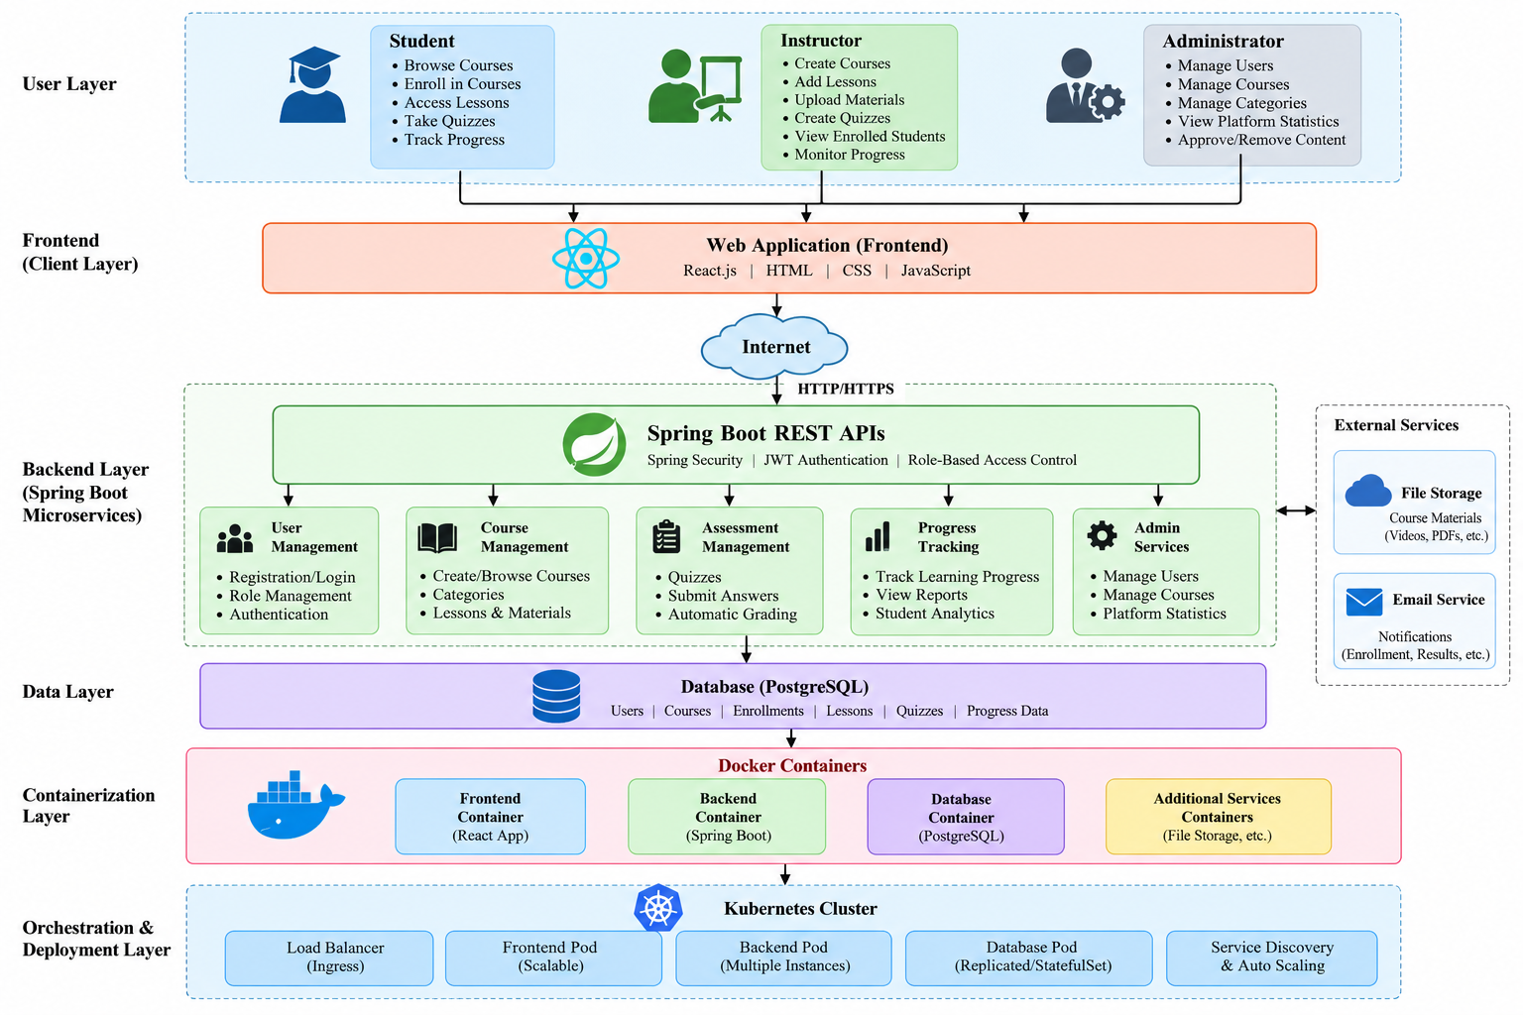
15 September 2026
Proposed System Architecture
Department of IT, Lords Institute of Engineering and Technology, (Autonomous), Hyderabad –Telangana -India

Slide 8
Expected Results
15 September 2026
A centralized platform for students, instructors and administrators.
Secure role-based access to platform functionality.
Efficient course enrollment and learning-material management.
Automated quiz/assessment handling and progress tracking.
Portable deployment through Docker containers.
Scalable application management through Kubernetes.
Evaluation Metrics
Area | Metric
Functionality | Successful completion of required use cases
Performance | Response time / throughput
Scalability | Behaviour under increasing concurrent users
Reliability | Service availability and recovery
Usability | User feedback and task completion
Deployment | Successful containerized deployment
Department of IT, Lords Institute of Engineering and Technology, (Autonomous), Hyderabad –Telangana -India

Slide 9
Conclusion
15 September 2026
The project aims to develop a full-stack and scalable online learning platform.
It integrates essential e-learning functions such as course management, enrollment, assessments and progress tracking.
Spring Boot provides a modular backend through RESTful APIs.
Docker enables portable and consistent application deployment.
Kubernetes provides container orchestration and supports scalable deployment.
The proposed architecture provides a foundation for future enhancements such as personalized learning, recommendations, analytics and AI-assisted education.
Department of IT, Lords Institute of Engineering and Technology, (Autonomous), Hyderabad –Telangana -India

Slide 10
15 September 2026
Thank You…
Department of IT, Lords Institute of Engineering and Technology, (Autonomous), Hyderabad –Telangana -India

Slide 11
References
15 September 2026
[1] C. N. Akpen, S. Asaolu, S. Atobatele, H. Okagbue and S. Sampson,
"Impact of Online Learning on Student's Performance and Engagement: A Systematic Review," Discover Education, Vol. 3, Article 205, 2024.
[2] G. Ahmadi, A. Mohammadi, S. Asadzandi, M. Shah and R. Mojtahedzadeh,
"What Are the Indicators of Student Engagement in Learning Management Systems? A Systematized Review of the Literature," International Review of Research in Open and Distributed Learning, Vol. 24, No. 1, pp. 117–136, 2023.
[3] H. P. Bulsara and H. Bagdi,
"Students' Engagement for Online Learning in Higher Education Institutions: A Literature Review," International Journal of Indian Culture and Business Management, Vol. 32, No. 4, pp. 441–468, 2024.
[4] E. Aeiad and F. Meziane,
"An Adaptable and Personalised E-learning System Applied to Computer Science Programmes Design," Education and Information Technologies, Vol. 24, pp. 1485–1509, 2019.
[5] "Performance Evaluation of Resource Management Schemes for Cloud Native Platforms with Computing Containers," IEEE International Performance, Computing, and Communications Conference (IPCCC), 2022.
Department of IT, Lords Institute of Engineering and Technology, (Autonomous), Hyderabad –Telangana -India

