Slide 1
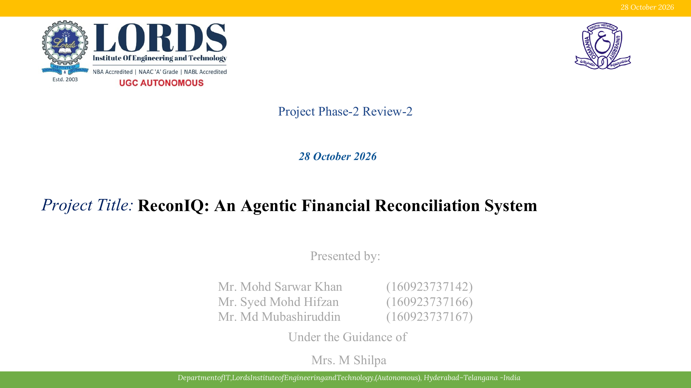
5 November 2026
Project Phase-I Review
5 November 2026
Project Title: Event-Driven E-Commerce Platform Using Cloud-Native Services
Presented by:
Mr. Mohammed Umar Farooq
(160923737145)
Mr. Fayez Mohammed Abdul Samad
(160923737155)
Under the Guidance of
Mrs. M. Neelima
Batch Number: C4

Slide 2
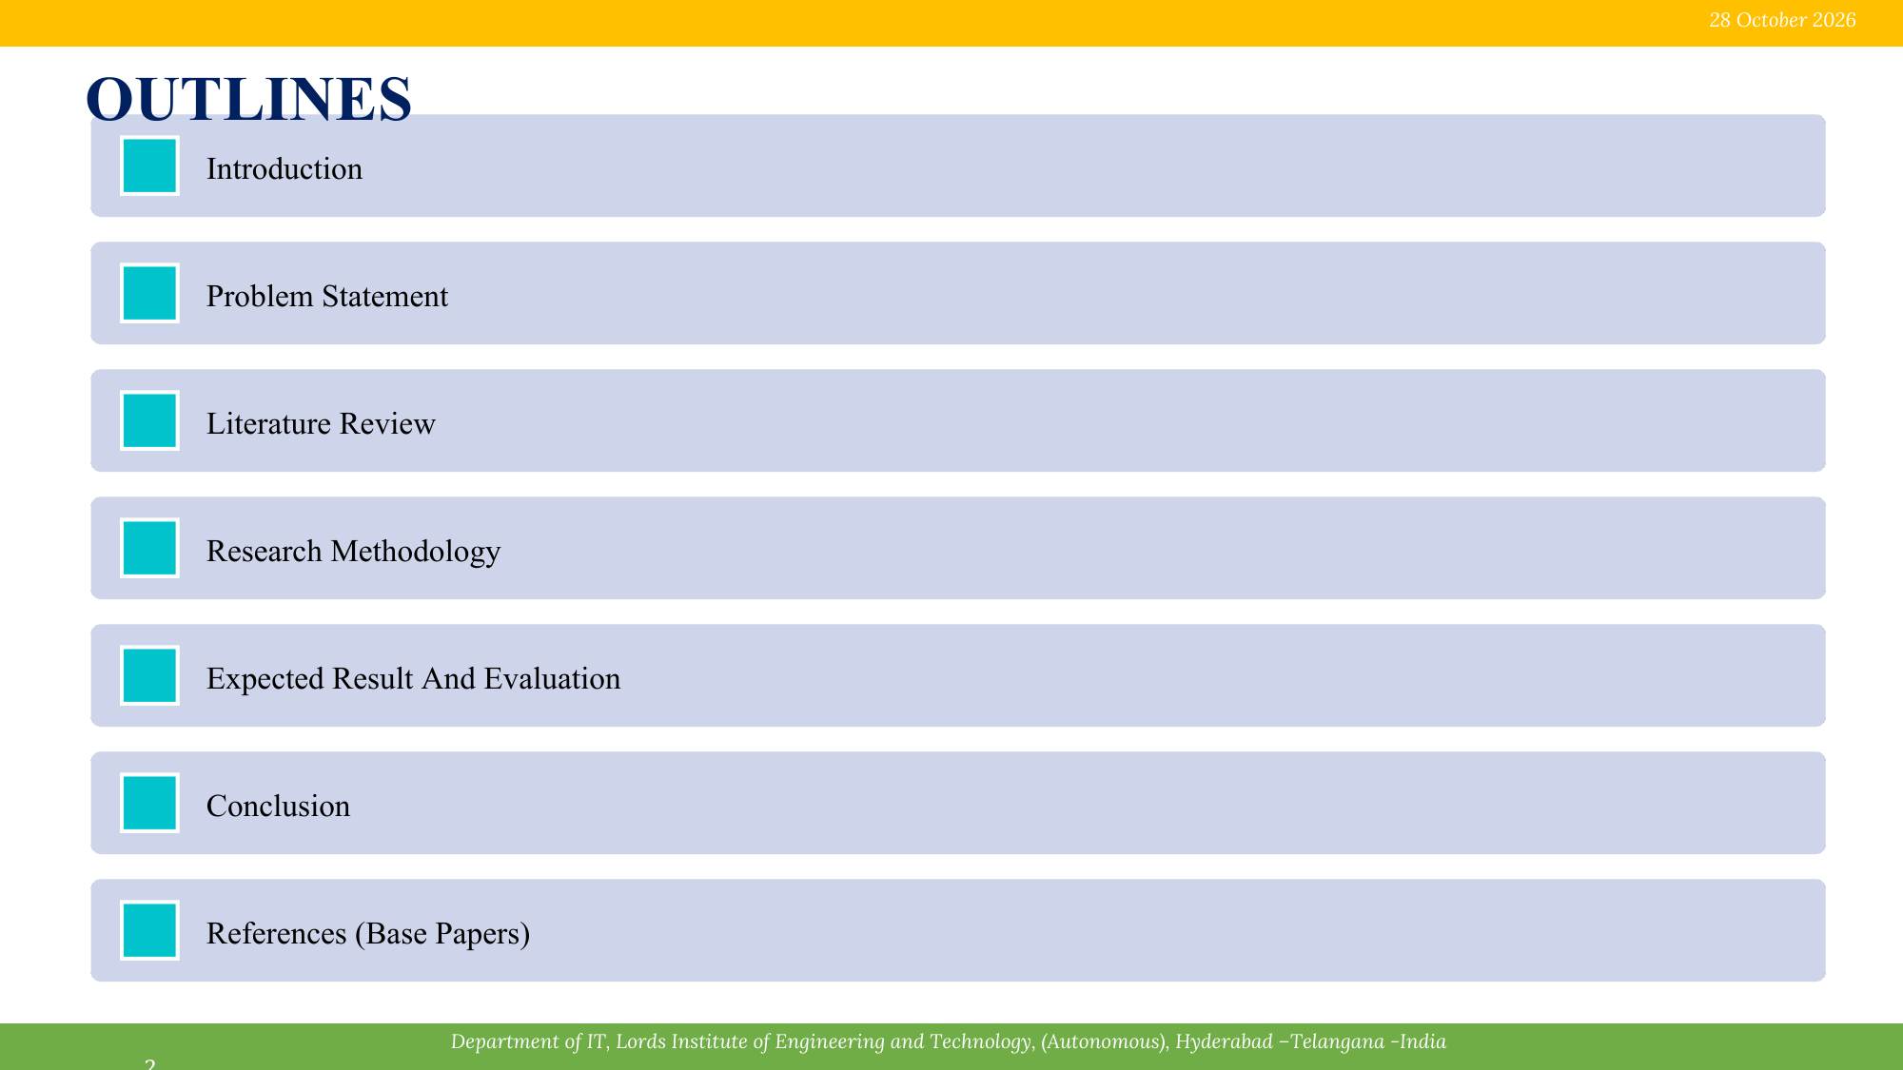
5 November 2026
Introduction
Problem Statement
Literature Review
Research Methodology
System Architecture
Expected Results and Evaluation
Conclusion and References

Slide 3
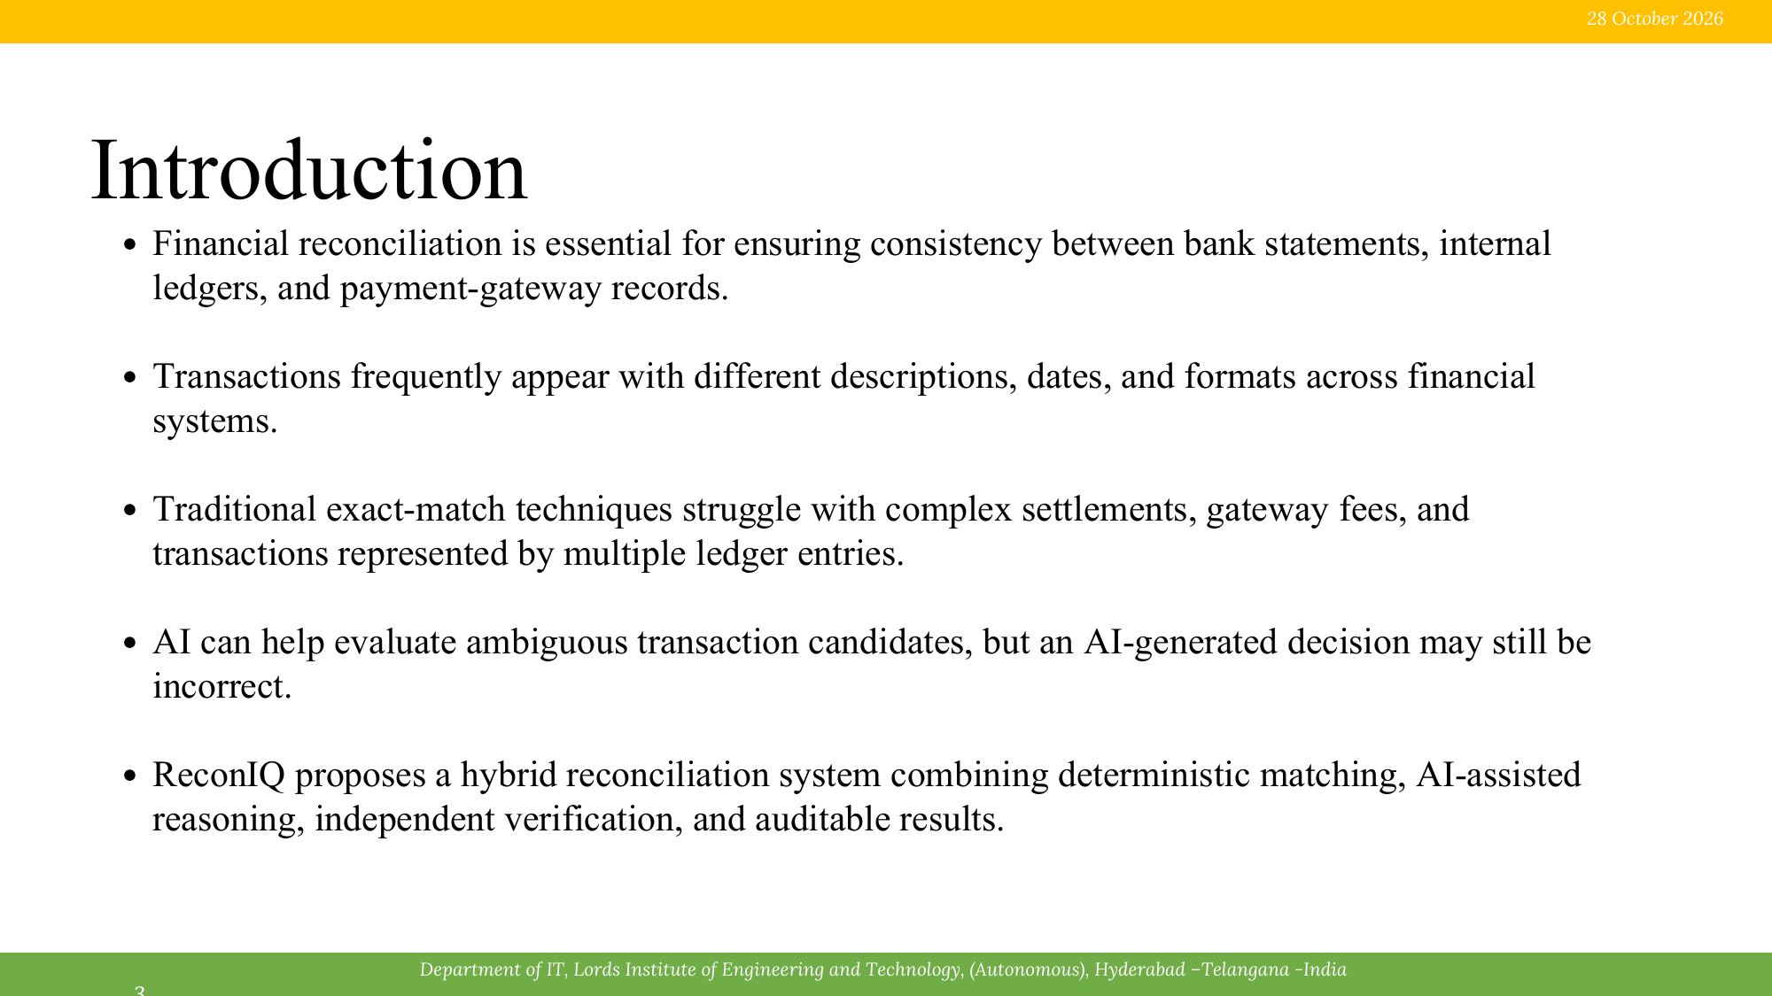
5 November 2026
• E-commerce platforms coordinate product discovery, carts, inventory, orders, payments, fulfilment, and notifications.
• Traditional designs often connect these capabilities through long synchronous service calls.
• A delay in inventory or payment can increase checkout latency and disrupt the purchase workflow.
• Event-driven architecture lets a service publish a business event while independent consumers process it asynchronously.
• Cloud-native services support independent deployment, autoscaling, monitoring, and fault isolation.

Slide 4
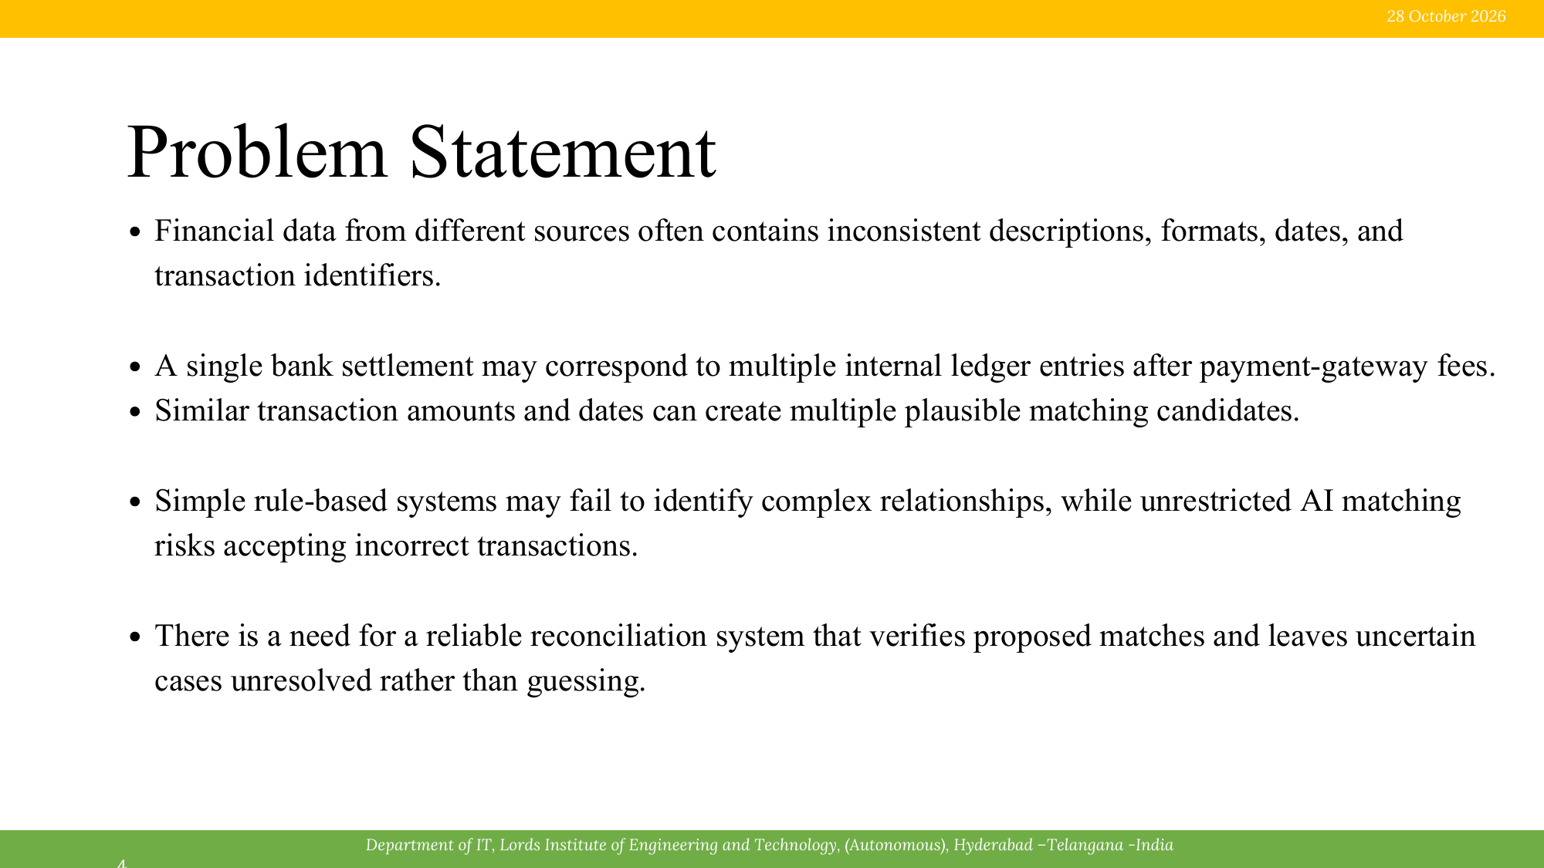
5 November 2026
• A single purchase spans multiple services that own separate data and business responsibilities.
• Direct synchronous dependencies can make checkout fragile. A slowdown or outage in one service can block the full request chain.
• Asynchronous workflows must handle repeated or delayed events, failed publication, out-of-order processing, and eventual consistency.
• The platform needs reliable coordination through a saga, transactional outbox, idempotent consumers, bounded retries, and dead-letter handling.

Slide 5
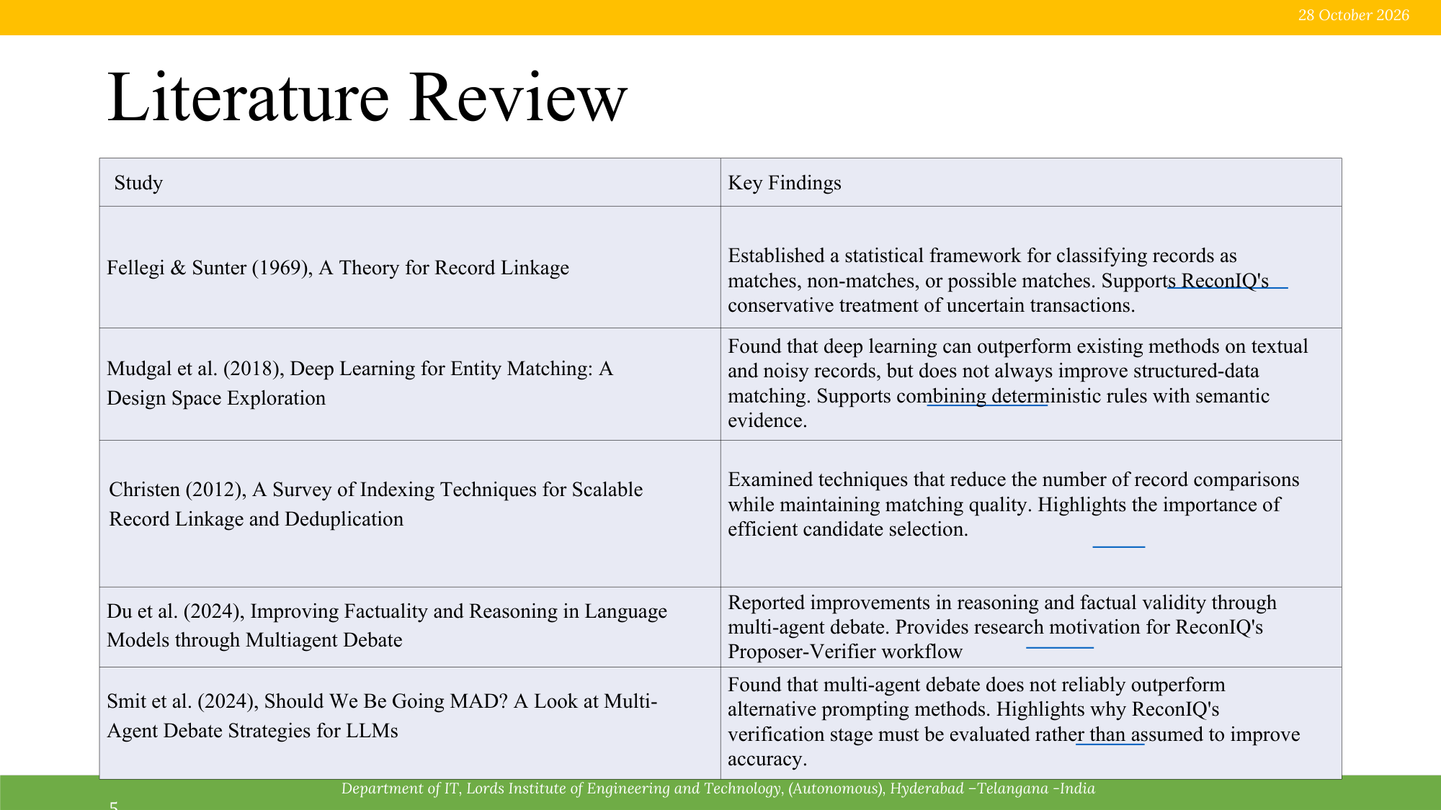
5 November 2026
Study
Key Findings
CNCF (2025), Cloud Native Definition v1.0
Highlights scalability, loose coupling, resilience, manageability, and observability as core cloud-native characteristics.
Lewis & Fowler (2014); Newman (2021), Microservices
Organizes systems around independently deployable business capabilities. Services own their data, with additional distributed-system overhead.
Microsoft Azure; Google Cloud, Event-Driven Architecture
Describes producers, event channels or brokers, and consumers. Events decouple services and support asynchronous processing.
AWS Prescriptive Guidance, Saga and Transactional Outbox
Saga coordinates local transactions and compensating actions. The outbox closes the database/event dual-write gap; idempotency handles redelivery.
CloudEvents; NIST SP 800-204; OWASP API Security Top 10
Standard event metadata supports interoperability and tracing. Security guidance emphasizes authentication, authorization, TLS, webhook validation, and safe logging.

Slide 6
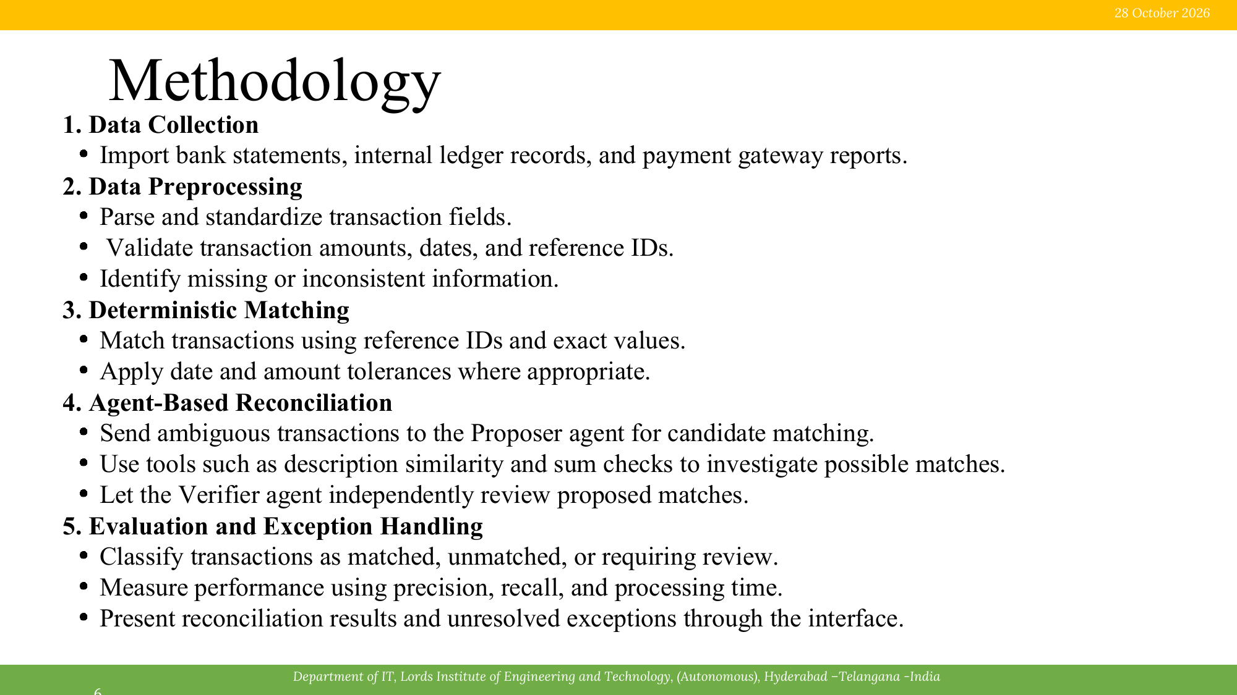
5 November 2026
1. Requirements and Service Boundaries
• Identify customer, administrator, fulfilment, and platform roles; assign business data to its owning service.
2. Interface and Event Contracts
• Define REST endpoints and versioned event envelopes with event ID, source, type, timestamp, schema version, and correlation ID.
3. Order Workflow and Saga
• Coordinate pending order, stock reservation, payment authorization, confirmation, and shipment request.
4. Reliability and Security Controls
• Use transactional outbox, idempotent consumers, bounded retries, dead-letter queues, role-based access, and verified provider callbacks.
5. Validation and Observability
• Test success and failure paths, duplicate events, broker recovery, latency, consumer lag, workflow timeouts, logs, metrics, and traces.

Slide 7
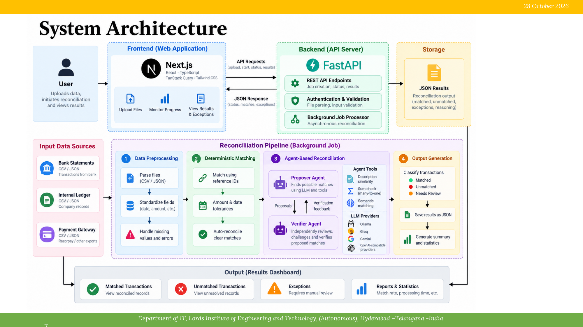
5 November 2026
System Architecture
CUSTOMER WEB / MOBILE
React / TypeScript
→
EDGE / API GATEWAY
HTTPS • TLS • Auth • Rate limits
→
IDENTITY PROVIDER
Users • Roles • Sessions
CLOUD-NATIVE RUNTIME
Containers or serverless • Autoscaling • Managed services
DOMAIN SERVICES | Each service owns its data and publishes events after local commit
IDENTITY
Registration, login, roles
CATALOGUE
Products, categories, search
CART
Cart lines, pricing, checkout
ORDER
Order state, workflow coordinator
INVENTORY
Stock balances, reservations
PAYMENT ADAPTER
Authorize, capture, void, refund
FULFILMENT
Shipment tasks, delivery status
NOTIFICATION
Email / SMS delivery and retries
EVENT BROKER / EVENT BUS
Domain topics • routing • durable queues • consumer groups • bounded retries • dead-letter queue
OrderCreated → InventoryReserved → PaymentAuthorized → OrderConfirmed → ShipmentRequested
DATA SERVICES
Service-owned SQL stores
Redis cache • Object storage
RELIABILITY CONTROLS
Transactional outbox • Idempotency
Saga compensation • Backoff
OPERATIONS & OBSERVABILITY
Secrets • Logs • Metrics • Traces
CI/CD • Health checks

Slide 8
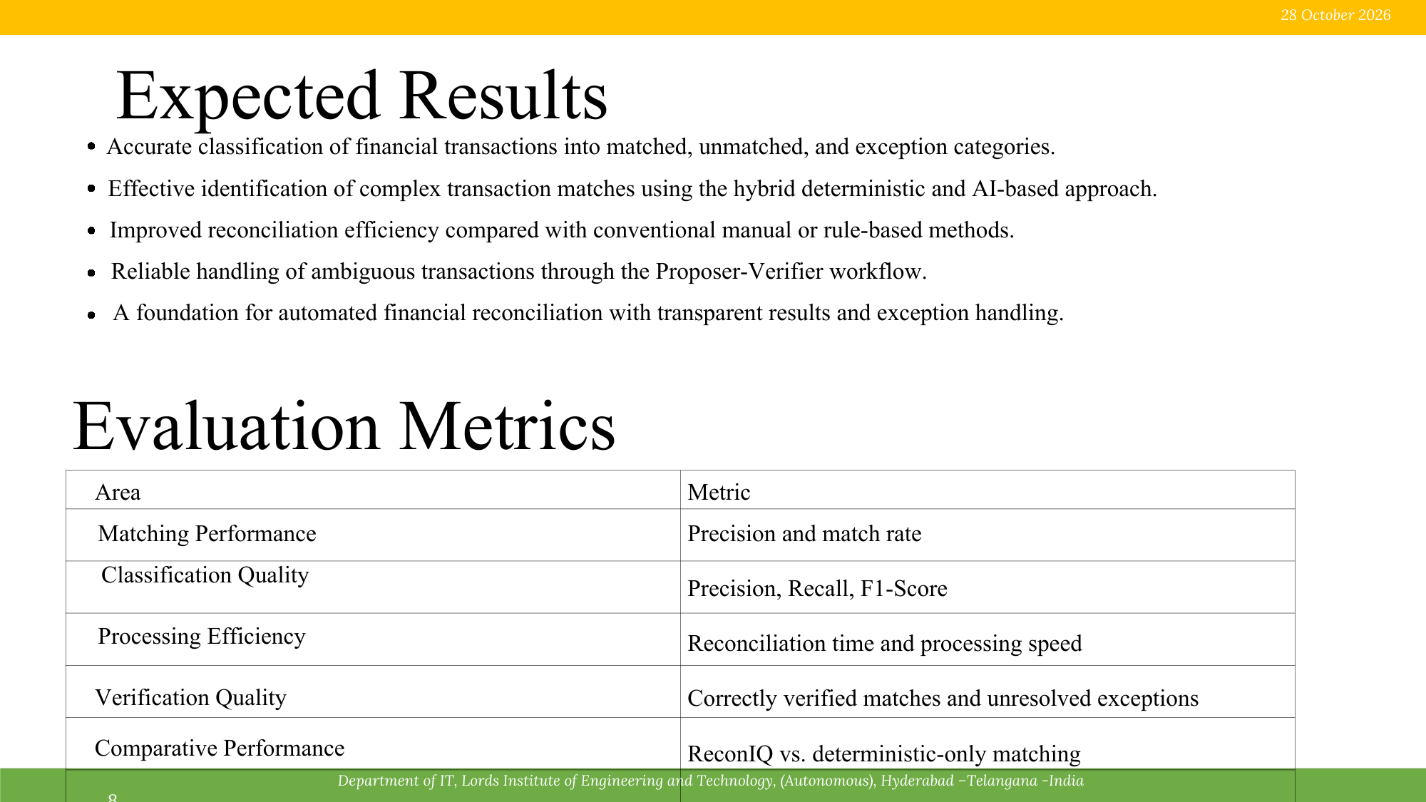
5 November 2026
• Independent service ownership for catalogue, cart, order, inventory, payment, fulfilment, and notifications.
• Checkout can return a pending order while downstream tasks continue asynchronously.
• A saga preserves a clear purchase state and compensates failed inventory or payment steps.
• Outbox publishing, idempotency, retries, and dead-letter queues target message-loss and duplicate-effect risks.
• Distributed traces and structured telemetry support diagnosis across service boundaries.
Area
Metric
Customer API responsiveness
P95 catalogue latency; checkout acceptance time
Order workflow
Time to confirmed / cancelled state; completion rate
Event processing
Publish-to-consumer delay; consumer lag
Reliability
Duplicate business effects; dead-letter rate; recovery time
Resource and cost behaviour
CPU, memory, database, broker, storage, and egress usage
Initial targets are proposed for later testing, not measured results: catalogue P95 < 500 ms; checkout acceptance P95 < 1 s; zero duplicate business effects on replay.

Slide 9
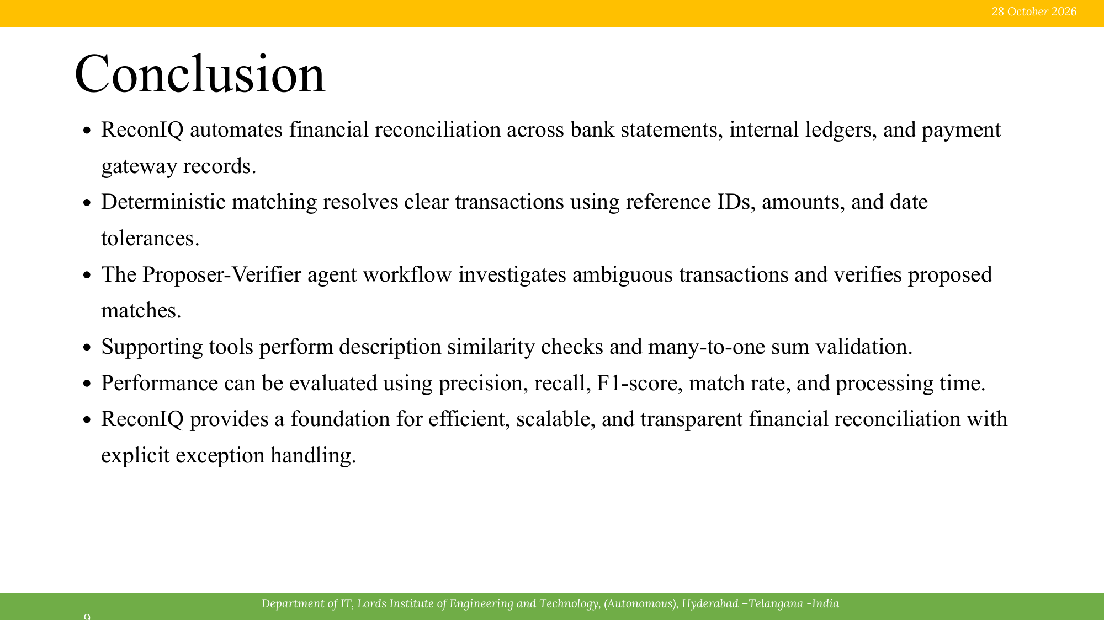
5 November 2026
• The proposed platform separates catalogue, cart, order, inventory, payment, fulfilment, and notification capabilities into independent services.
• A managed event broker coordinates asynchronous business events and reduces direct runtime dependencies between services.
• A saga coordinates stock reservation, payment authorization, order confirmation, and fulfilment, with compensation when a step fails.
• Transactional outbox publishing, idempotent consumers, bounded retries, and dead-letter queues address common event-delivery failures.
• Role-based access, secure provider callbacks, structured logs, metrics, and distributed tracing support security and operations.
• Phase-I defines the architecture and validation plan. Deployment, executed tests, and benchmark results remain future work.

Slide 10
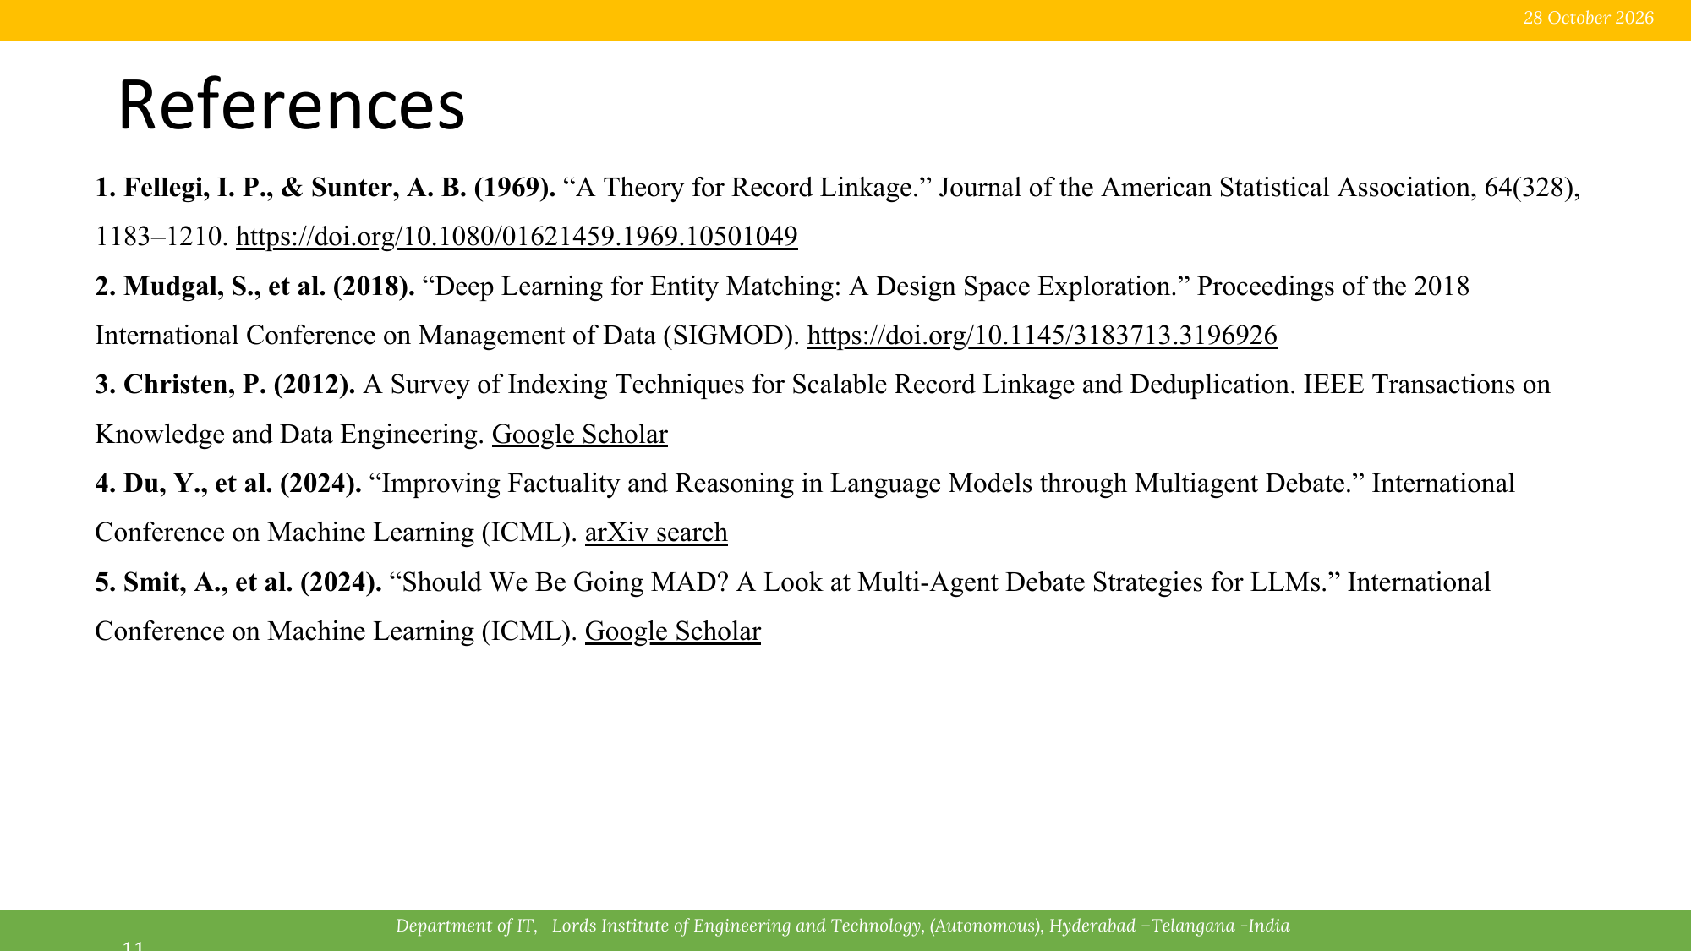
5 November 2026
1. Cloud Native Computing Foundation. “Cloud Native Definition v1.0,” CNCF Charter, 2025.
2. J. Lewis and M. Fowler. “Microservices: a definition of this new architectural term,” 25 March 2014.
3. S. Newman. Building Microservices, 2nd ed. O’Reilly Media, 2021.
4. Microsoft. “Event-driven architecture style,” Azure Architecture Center.
5. Google Cloud. “Event-driven architectures,” Eventarc Standard Documentation.
6. Amazon Web Services. “Saga patterns,” AWS Prescriptive Guidance.
7. Amazon Web Services. “Transactional outbox pattern,” AWS Prescriptive Guidance.
8. Cloud Native Computing Foundation. “CloudEvents Specification,” CloudEvents Project.
9. R. Chandramouli. Security Strategies for Microservices-based Application Systems, NIST SP 800-204, 2019.
10. OWASP Foundation. “OWASP API Security Top 10 - 2023,” OWASP API Security Project.

