Slide 1
Day 8: Workflow Orchestration with Apache Airflow
Medallion Pipeline Training - Week 2
DAG files
Scheduler
Workers
Kafka
Hop
PostgreSQL
The control room for dependable data workflows
Classroom promise
Define workflows as Python code
Schedule, monitor, retry and debug tasks
Coordinate Kafka events, Hop transformations and warehouse tables
By the end, learners can read a DAG, explain Airflow architecture and run the Day 8 lab stack.
1

Slide 2
Day 8 - Apache Airflow | 2
OPENING
Learning arc for the day
The sequence is problem first, then Airflow, then real lab orchestration.
Pain
Airflow mental model
DAGs and tasks
Scheduling and failure
Kafka + Hop
Labs + recap
Beginner outcome
Engineer outcome
Trainer rhythm
Students can explain why Airflow exists before they see syntax.
Students can read the Day 8 DAGs and reason about dependencies, retries, logs and data movement.
Teach each concept with a short story, a diagram and a quick check.
Takeaway: Airflow is not another processing engine. It is the workflow control layer.
2

Slide 3
Day 8 - Apache Airflow | 3
OPENING
Full-day agenda
Designed for a slow beginner-friendly Airflow ramp.
Time | Block | Duration
09:00 | Opening, motivation and mental model | 30 min
09:30 | Architecture and components | 75 min
10:45 | DAGs, tasks, operators and sensors | 90 min
12:15 | Lunch break | 60 min
13:15 | Scheduling, TaskFlow, XCom and connections | 75 min
14:30 | Day 8 lab stack: Airflow, Kafka, Hop, PostgreSQL | 120 min
16:30 | Production patterns, quizzes and recap | 60 min
3

Slide 4
Day 8 - Apache Airflow | 4
OPENING
Before Airflow: the business pain
A late-night report is empty, and nobody knows which script broke.
download.sh
clean.py
load.sql
report.py
email.sh
2 AM failure
What is missing?
Airflow answer
Dependencies Retries Logs Ownership A single control room
Model the workflow, schedule it, monitor each task, retry safe work and alert when it fails.
Takeaway: The failure is bad. Not knowing it failed is worse.
4

Slide 5
Day 8 - Apache Airflow | 5
OPENING
Guess one word
TRY IT
Airflow mainly helps us ______ workflows.
Answer on next slide
5

Slide 6
Day 8 - Apache Airflow | 6
OPENING
Guess one word - answer
ANSWER
orchestrate
Why
It coordinates specialized systems instead of replacing them.
Takeaway: Say the answer in one sentence before moving on.
6

Slide 7
MODULE 1
Airflow Mental Model
What Airflow is, what it is not, and where it fits.
Concept
Visual
Practice
Check
7

Slide 8
Day 8 - Apache Airflow | 8
CONCEPTS
What is workflow orchestration?
Manual or cron-only chain
Orchestrated workflow
Time-based starts Weak dependency visibility Custom retry logic Logs scattered in many places
Steps arranged as a graph Dependencies visible Retries and timeouts UI, logs and run history
Takeaway: Orchestration means right step, right time, right order, visible recovery.
8

Slide 9
Day 8 - Apache Airflow | 9
CONCEPTS
Airflow in one sentence
The simplest definition to remember.
Apache Airflow lets teams define, schedule and monitor workflows as Python code.
Define
Schedule
Monitor
Recover
Why Python?
Version control, code review, reuse, tests and clear ownership.
9

Slide 10
Day 8 - Apache Airflow | 10
CONCEPTS
Airflow is not a data processing engine
Keep each tool in its lane.
Airflow
Spark / SQL
Kafka
Heavy transformations and distributed compute
Event streaming and durable topics
Schedules Coordinates Monitors Retries Alerts
Apache Hop
PostgreSQL
Visual ETL pipelines and workflows
State, warehouse tables and SQL checks
Takeaway: Do not process huge data inside Airflow task memory.
10

Slide 11
Day 8 - Apache Airflow | 11
CONCEPTS
Where Airflow fits in data engineering
Airflow sits above the systems and controls repeatable work.
AIRFLOW CONTROL ROOM
Sources
Files, APIs, databases, CDC
Transport
Kafka topics, queues, landing zones
Transform
Hop, Spark, SQL, dbt, Python
Store
Bronze, Silver, Gold, marts
Consume
BI, reports, ML, alerts
Takeaway: Airflow tells the full pipeline when to move and what to do next.
11

Slide 12
Day 8 - Apache Airflow | 12
CONCEPTS
The day story: railway analogy
Use this to make the vocabulary stick.
DAG
Task
Operator
Route map
Station
Type of worker
Scheduler
Worker
Metadata DB
Station master
Person or machine doing work
Control register
Web UI
Kafka
Hop
Control room screen
Live event highway
Visual ETL workshop
Takeaway: A beginner can explain Airflow if they can explain the analogy.
12

Slide 13
Day 8 - Apache Airflow | 13
CONCEPTS
MCQ: What is Airflow's main job?
TRY IT
Which sentence best explains Airflow?
A
B
Airflow stores big data
Airflow orchestrates workflows as code
C
D
Airflow is a Kafka broker
Airflow replaces all databases
Answer on next slide
13

Slide 14
Day 8 - Apache Airflow | 14
CONCEPTS
MCQ answer
ANSWER
B) Airflow orchestrates workflows as code
Why
It schedules and monitors work that other systems execute.
Takeaway: Say the answer in one sentence before moving on.
14

Slide 15
MODULE 2
Airflow Architecture
Components, control flow, deployment shapes and UI.
Concept
Visual
Practice
Check
15

Slide 16
Day 8 - Apache Airflow | 16
ARCHITECTURE
Simple Airflow control room
A teaching diagram before the official architecture diagram.
DAG files
DAG processor
Metadata DB
Scheduler
Executor
State lives here
Worker runtime
Web UI
Logs
Takeaway: The metadata database is Airflow's memory.
16

Slide 17
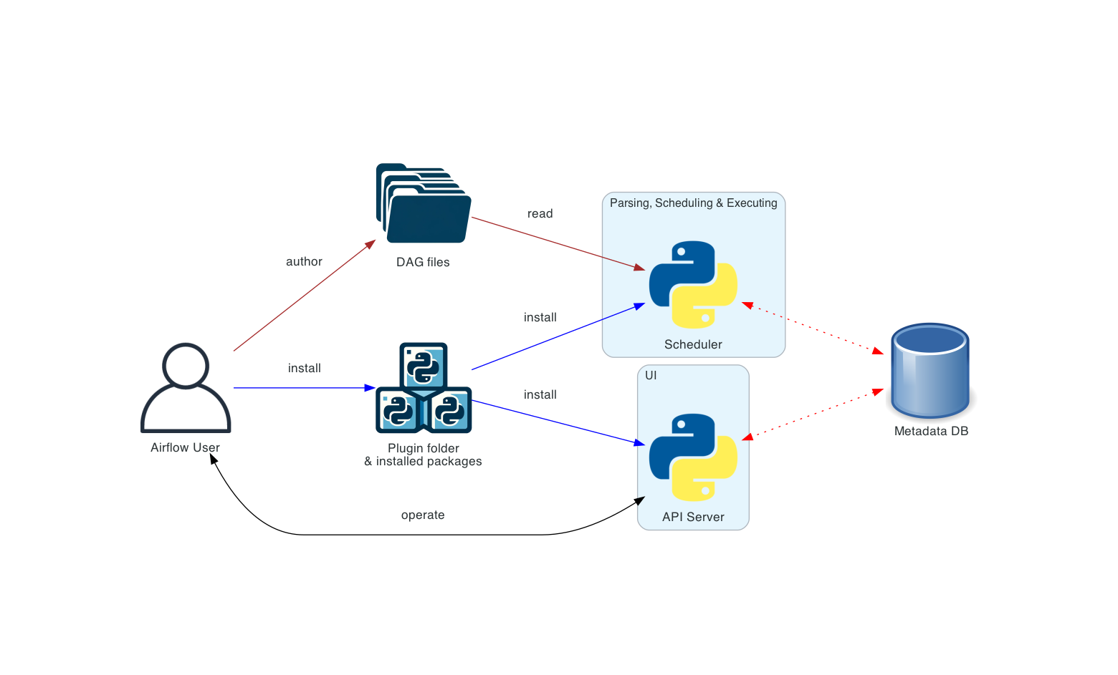
Day 8 - Apache Airflow | 17
ARCHITECTURE
Official: basic Airflow deployment
Use this to connect the simplified teaching diagram to real Airflow terminology.
17
Source: Airflow architecture overview
17

Slide 18
Day 8 - Apache Airflow | 18
ARCHITECTURE
Required components
A minimum Airflow deployment needs these pieces.
Scheduler
DAG processor
Webserver
Triggers scheduled workflows and submits tasks to the executor.
Parses DAG files and serializes them to the metadata database.
Provides the UI to inspect, trigger and debug DAGs.
DAG folder
Metadata DB
Executor
Python files that define workflows and dependencies.
Stores state for DAGs, tasks, variables and run history.
Chooses how task work is run.
Takeaway: If students can name these, they can debug the lab stack.
18

Slide 19
Day 8 - Apache Airflow | 19
ARCHITECTURE
Optional components and why they exist
Workers
Triggerer
Plugins
Separate long-running processes or pods that execute tasks in distributed setups.
Runs deferred tasks asynchronously so sensors do not waste worker slots.
Extend Airflow with custom operators, hooks, UI pieces and shared helpers.
Simple lab
More load
Distributed executors
Better isolation
Takeaway: Components are separated to scale and isolate responsibilities.
19

Slide 20
Day 8 - Apache Airflow | 20
ARCHITECTURE
Scheduler loop: what happens repeatedly?
The scheduler is boring on purpose: parse, decide, submit, record.
Read serialized DAGs
Find due DAG runs
Check task dependencies
Queue runnable tasks
Record state
Important detail
The scheduler does not magically know business correctness. It only knows states, dependencies, schedules and configuration.
Takeaway: A bad SQL transform can still finish successfully; test data quality separately.
20

Slide 21
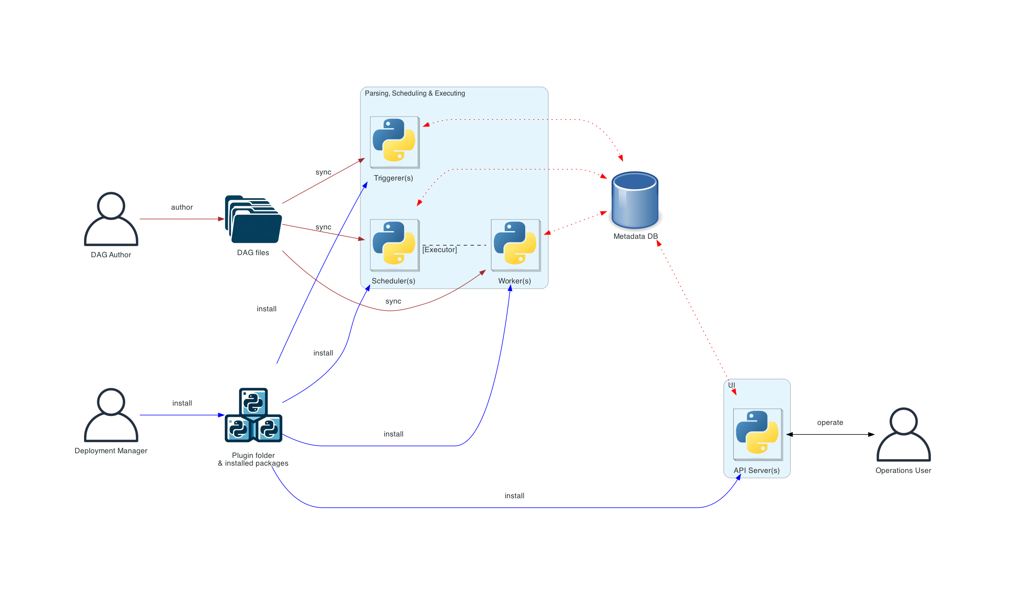
Day 8 - Apache Airflow | 21
ARCHITECTURE
Official: distributed Airflow architecture
Show this after students understand the simple control-room version.
21
Source: Airflow architecture overview
21

Slide 22
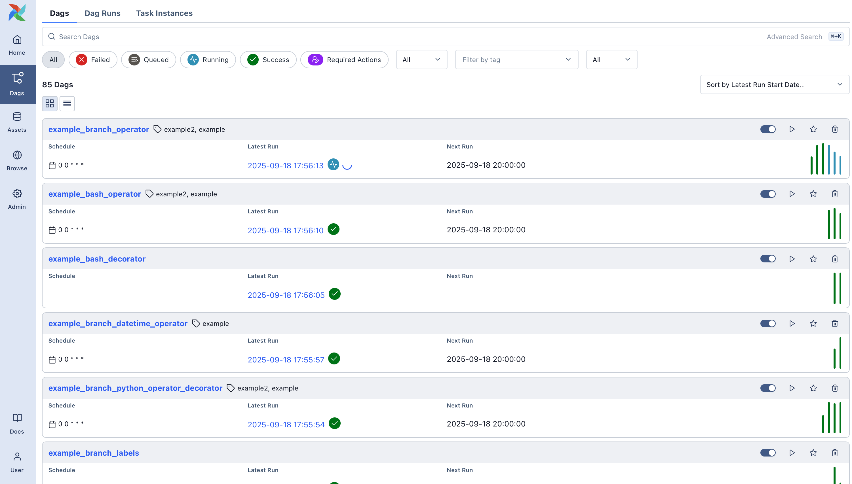
Day 8 - Apache Airflow | 22
ARCHITECTURE
Airflow UI: operational control room
The UI is where learners see run state, graph, logs and debugging clues.
Use the UI for
DAG list Graph and Grid views Manual trigger Task logs Import errors XCom inspection
First failure question
Which task failed, and what does its log say?
22
Source: Airflow UI overview image
22

Slide 23
Day 8 - Apache Airflow | 23
ARCHITECTURE
Fill in the blanks: architecture
TRY IT
The ______ decides when work should run. The ______ stores task state.
Answer on next slide
23

Slide 24
Day 8 - Apache Airflow | 24
ARCHITECTURE
Fill in the blanks - answer
ANSWER
Scheduler; Metadata DB
Why
The scheduler makes run decisions. The database remembers the state and history.
Takeaway: Say the answer in one sentence before moving on.
24

Slide 25
MODULE 3
DAGs, Tasks and Operators
How workflow ideas become Python code and visible graphs.
Concept
Visual
Practice
Check
25

Slide 26
Day 8 - Apache Airflow | 26
DAGS
DAG = Directed Acyclic Graph
The workflow map: tasks plus directional dependencies, with no loops.
extract
validate
transform
load
report
Directed
Acyclic
Graph
Arrows show order.
No circular dependency.
Nodes and edges.
Takeaway: If there is a loop, Airflow cannot decide a valid order.
26

Slide 27
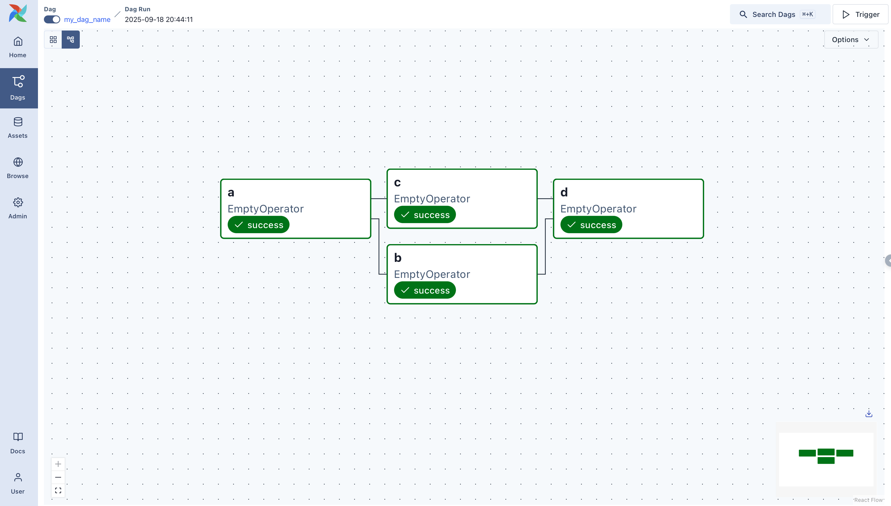
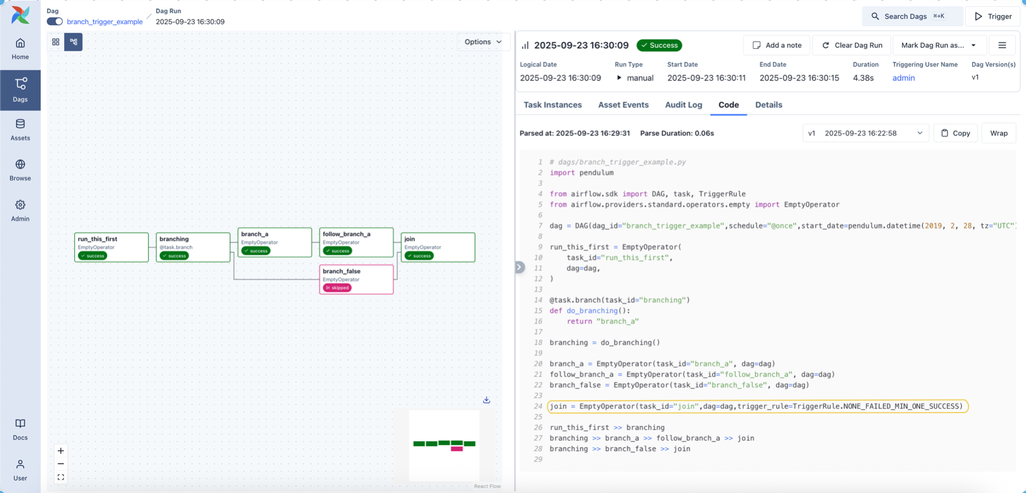
Day 8 - Apache Airflow | 27
DAGS
Official: DAG graph examples
Trainer prompt
Ask learners to point at nodes, edges, branches and join points.
27
Source: Airflow DAG documentation
27

Slide 28
Day 8 - Apache Airflow | 28
DAGS
Task, operator and task instance
Three terms that beginners often mix up.
Operator
Task
Task instance
Reusable template for work. Example: BashOperator
Operator configured inside a DAG. Example: task_id='extract'
A task for one DAG run and logical date. Example: extract on today's run
Template
Configured node
Actual run record
Takeaway: The UI mostly shows task instances: task + run + state.
28

Slide 29
Day 8 - Apache Airflow | 29
DAGS
Common task states
Students should learn the colors before the labs.
queued
running
success
Waiting for executor capacity
Currently executing
Finished successfully
failed
upstream_failed
skipped
Finished with error
Blocked by earlier failure
Intentionally not run
Takeaway: A production incident starts by reading task state and task logs.
29

Slide 30
Day 8 - Apache Airflow | 30
DAGS
Choose the right operator
Right tool for the unit of work.
Need | Good Airflow choice | Example
Run shell or CLI | BashOperator | hop-run, dbt, shell script
Run Python function | PythonOperator or @task | validate rows, call API
Run SQL | SQL/Postgres operator | create table, transform rows
Wait for condition | Sensor or deferrable operator | file exists, row count ready
Trigger another DAG | TriggerDagRunOperator | cross-DAG dependency
30

Slide 31
Day 8 - Apache Airflow | 31
DAGS
Sensors: poke vs reschedule
Both wait. One occupies a worker; the other gives the slot back.
poke mode
reschedule mode
Keeps checking and holds the worker slot while waiting. Use for short waits.
Checks, then frees the worker slot until the next poke interval. Use for longer waits.
wait_for_file
load_bronze
transform_silver
Takeaway: Long waits should not block worker capacity.
31

Slide 32
Day 8 - Apache Airflow | 32
DAGS
TaskFlow API: Python functions become tasks
TaskFlow pattern
@task def extract_orders(): return {"rows": 120} @task def validate(batch): return batch["rows"] > 0 ok = validate(extract_orders())
What learners should see
Function return values become XComs. Function arguments imply dependencies. Use it for lightweight Python logic.
Takeaway: TaskFlow is easiest when the data passed is small metadata, not big datasets.
32

Slide 33
Day 8 - Apache Airflow | 33
DAGS
XCom: useful, but not for big data
XCom means cross-communication.
Good XCom
Bad XCom
row counts file path status flag small JSON business date
large DataFrame full CSV millions of rows binary files warehouse extracts
Task A
Metadata DB
Task B
Takeaway: Move big data through storage systems; pass only pointers or counts through XCom.
33

Slide 34
Day 8 - Apache Airflow | 34
DAGS
Connections, hooks and external systems
Task
Operator
Hook
Connection ID
External system
Why this matters
Credentials stay out of DAG code. Operators can reuse provider hooks. Security and rotation become manageable.
Takeaway: Use conn_id, not hardcoded passwords.
34

Slide 35
Day 8 - Apache Airflow | 35
DAGS
Minimal DAG code: read the shape
day8_simple_etl.py
from datetime import datetime from airflow import DAG from airflow.operators.bash import BashOperator with DAG( dag_id="day8_simple_etl", start_date=datetime(2026, 6, 1), schedule="@daily", catchup=False, ) as dag: extract = BashOperator(task_id="extract", bash_command="echo extract") transform = BashOperator(task_id="transform", bash_command="echo transform") load = BashOperator(task_id="load", bash_command="echo load") extract >> transform >> load
35

Slide 36
Day 8 - Apache Airflow | 36
DAGS
Dependency patterns students will see
Linear
Fan-out / fan-in
Branch
extract -> transform -> load
one task splits into parallel work, then joins
a decision chooses one downstream path
A
B
C
start
load 1
join
check
A/B
join
Trigger rules
all_success, one_failed, all_done, none_failed_min_one_success
36

Slide 37
Day 8 - Apache Airflow | 37
DAGS
Catchup explosion
A scheduling setting that surprises beginners.
start_date: Jan 1
today: Apr 1
catchup=True?
many historical runs
Default classroom advice
Use catchup=False for new learning pipelines unless you intentionally teach backfill.
Takeaway: Backfills are powerful. Unplanned catchup can overwhelm systems.
37

Slide 38
Day 8 - Apache Airflow | 38
DAGS
Mini exercise: draw the DAG
TRY IT
download file -> validate file -> load table -> send report
Answer on next slide
38

Slide 39
Day 8 - Apache Airflow | 39
DAGS
Mini exercise answer
ANSWER
download >> validate >> load >> report
Why
This is a simple linear DAG. load waits for validate; report waits for load.
Takeaway: Say the answer in one sentence before moving on.
39

Slide 40
MODULE 4
Day 8 Lab Stack
The real files: Airflow, Kafka, Hop, PostgreSQL and ten DAGs.
Concept
Visual
Practice
Check
40

Slide 41
Day 8 - Apache Airflow | 41
LAB
Docker Compose stack for Day 8
What runs when students start Lab_Files/docker-compose.yml.
Airflow web
Scheduler + triggerer
PostgreSQL
Kafka
UI :8080 admin/admin
parses and runs DAGs
metadata + warehouse :5432
orders.raw :9092
Kafka UI
Hop Web
Lab files
:8081
:8082
dags, data, scripts, hop, sql
Takeaway: The lab is reproducible because every learner runs the same Compose stack.
41

Slide 42
Day 8 - Apache Airflow | 42
LAB
Start and verify the environment
PowerShell or terminal
Service | URL / Port | Credential
Airflow UI | localhost:8080 | admin / admin
Kafka UI | localhost:8081 | -
Hop Web | localhost:8082 | -
PostgreSQL | localhost:5432 | airflow / airflow
cd Week_02\Day_08\Lab_Files docker compose up -d --build docker compose ps docker compose exec airflow-web python /opt/airflow/scripts/verify_setup.py
Takeaway: Always verify services before debugging DAG code.
42

Slide 43
Day 8 - Apache Airflow | 43
LAB
Lab_Files map
Where students should look when something breaks.
Folder/file | Purpose
dags/ | Airflow DAGs for Labs 1-10
dags/helpers/ | Kafka and Hop helper utilities
data/ | CSV files mounted to /opt/airflow/data
hop/ | Hop project, pipelines and workflows
sql/init_warehouse.sql | Bronze/Silver/Gold schema
scripts/ | Kafka producer and setup verifier
43

Slide 44
Day 8 - Apache Airflow | 44
LAB
Ten DAGs, one learning ladder
DAG | Main idea
01_hello_airflow | UI, logs, Bash/Python basics
02_operators_showcase | templating, SQL, branching
03_medallion_pipeline | CSV Bronze -> Silver -> Gold
04_sensor_patterns | FileSensor, SQL checks, schedules
05_xcom_and_taskflow | XCom vs TaskFlow API
06_dynamic_dags | dynamic mapping and TaskGroups
07_hop_integration | Airflow triggers Hop patterns
08_kafka_consumer_pipeline | Kafka micro-batch into Bronze
09_full_orchestration | capstone CSV + Kafka + Hop + Gold
10_advanced_patterns | callbacks, idempotency, monitoring
44

Slide 45
Day 8 - Apache Airflow | 45
LAB
Lab 3: medallion pipeline shape
orders.csv
bronze_orders
silver_orders
gold_daily_sales
customers.csv
bronze_customers
silver_customers
gold_customer_360
What to observe
FileSensors wait, Bronze appends, Silver cleans/deduplicates, Gold aggregates, XCom stores counts.
45

Slide 46
Day 8 - Apache Airflow | 46
LAB
Validation SQL students should run
Evidence, not hope
docker compose exec postgres psql -U airflow -d airflow -c "SELECT COUNT(*) FROM bronze_orders;" docker compose exec postgres psql -U airflow -d airflow -c "SELECT COUNT(*) FROM silver_orders;" docker compose exec postgres psql -U airflow -d airflow -c "SELECT * FROM gold_customer_360;" docker compose exec postgres psql -U airflow -d airflow -c "SELECT * FROM data_quality_results ORDER BY checked_at DESC LIMIT 10;"
Takeaway: A green DAG is not enough; validate the tables.
46

Slide 47
Day 8 - Apache Airflow | 47
LAB
Labs 4-6: waiting, passing, mapping
Lab 4 Sensors
Lab 5 XCom + TaskFlow
Lab 6 Dynamic DAGs
poke vs reschedule TimeDeltaSensor SQL readiness checks
traditional XCom @task return values BI report pipeline
expand() TaskGroups category analysis
wait
pass metadata
fan out dynamically
47

Slide 48
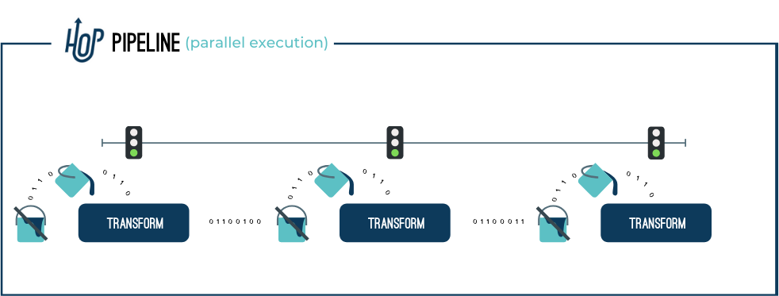
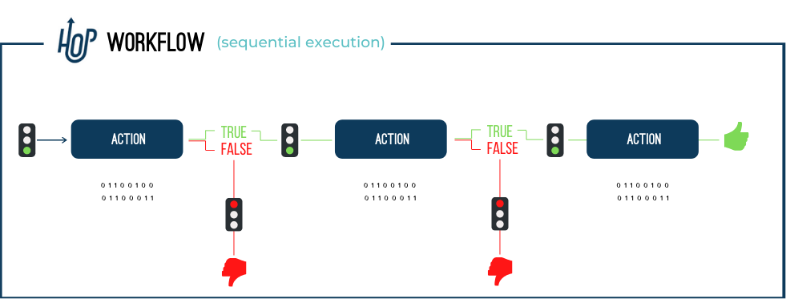
Day 8 - Apache Airflow | 48
LAB
Lab 7: Apache Hop integration
Airflow schedules; Hop transforms visually.
Integration patterns
BashOperator + docker exec Python helper wrapper Hybrid Airflow checks + Hop workflow
48
Source: Apache Hop concepts
48

Slide 49

Day 8 - Apache Airflow | 49
LAB
Lab 8: Kafka micro-batch pattern
Producer
orders.raw
Airflow consumer task
bronze_kafka_events
silver_orders
Run
docker compose exec airflow-web python /opt/airflow/scripts/kafka_producer.py --count 20 docker compose exec airflow-web airflow dags trigger 08_kafka_consumer_pipeline
Takeaway: Airflow consumes a batch; Kafka remains the streaming platform.
49

Slide 50
Day 8 - Apache Airflow | 50
LAB
Lab 9: full orchestration capstone
CSV via Hop
Kafka events
Quality gate
Silver transforms
Gold tables
Executive summary
What makes it capstone?
Multiple sources run in parallel, quality gates protect layers, Gold tables are built, and the final task prints business-facing counts.
50

Slide 51
Day 8 - Apache Airflow | 51
LAB
Lab 10: advanced production patterns
Variables
Idempotency
Callbacks
Branching
Runtime configuration
Safe reruns with upsert
success, failure, retry hooks
data-driven path
TriggerDagRun
Monitoring
cross-DAG handoff
freshness, counts, quality pass rate
Takeaway: Production is mostly about predictable recovery and visibility.
51

Slide 52
Day 8 - Apache Airflow | 52
LAB
Lab check: first debugging move
TRY IT
Your DAG file is saved but not visible in the UI. What are two first checks?
Answer on next slide
52

Slide 53
Day 8 - Apache Airflow | 53
LAB
Lab check answer
ANSWER
DAG folder path and import errors
Why
Check that the file is in mounted dags/ and then open Airflow import errors or scheduler logs.
Takeaway: Say the answer in one sentence before moving on.
53

Slide 54
MODULE 5
Integration and Production Thinking
How Airflow coordinates Kafka, Hop and medallion tables.
Concept
Visual
Practice
Check
54

Slide 55
Day 8 - Apache Airflow | 55
INTEGRATION
Airflow + Kafka + Hop: one clean story
Source DB
CDC / events
Kafka topic
Bronze landing
Hop transform
Silver / Gold
BI report
Airflow DAG watches, triggers, retries and records each step
Takeaway: Kafka streams, Hop transforms, Airflow orchestrates.
55

Slide 56
Day 8 - Apache Airflow | 56
INTEGRATION
Kafka responsibilities
Where Kafka starts and where Airflow should take over.
Kafka does
Airflow does around Kafka
Accept events from producers Store topics and partitions Serve consumers Handle high-throughput streams
Produce test events in lab Consume bounded micro-batches Check readiness Trigger downstream jobs Alert and log failures
Takeaway: Airflow is not a per-event real-time processor.
56

Slide 57
Day 8 - Apache Airflow | 57
INTEGRATION
Hop responsibilities
Hop is a visual workshop for ETL logic.
Hop pipeline
Hop workflow
Row-by-row transformations: input, validate, filter, enrich, output.
Orchestrates Hop actions: run pipeline, branch, wait, handle success/failure.
Airflow can call hop-run
docker exec day8-hop-cli /opt/hop/hop-run.sh --file /project/workflows/day8_medallion_batch.hwf --project day8_airflow_hop
Takeaway: Airflow schedules and monitors Hop, but Hop owns visual ETL design.
57

Slide 58
Day 8 - Apache Airflow | 58
INTEGRATION
Data quality gates between layers
Bronze raw
Quality checks
Silver clean
Quality checks
Gold aggregate
Typical checks
Why before Gold?
not empty no null key positive amount valid status freshness within SLA
Bad Silver data creates convincing but wrong business metrics.
58

Slide 59
Day 8 - Apache Airflow | 59
INTEGRATION
Retries are only safe when tasks are idempotent
Unsafe rerun
Safer rerun
INSERT same rows again send duplicate emails charge payment twice
UPSERT by business key write to run-specific path check before sending replace partition
retry
Takeaway: Retries are a recovery tool, not a substitute for idempotent design.
59

Slide 60
Day 8 - Apache Airflow | 60
INTEGRATION
Monitoring questions for production DAGs
Q1
Q2
Is the scheduler alive?
Which tasks failed in the last hour?
Q3
Q4
Are source files or Kafka events fresh?
Are row counts within expected range?
Q5
Q6
Did quality checks pass?
Who gets alerted when the DAG fails?
Takeaway: A DAG that ran once is a demo. A monitored DAG is a production candidate.
60

Slide 61
Day 8 - Apache Airflow | 61
INTEGRATION
Do and don't: beginner Airflow design
Do
Don't
Use small tasks Use clear task IDs Use connections Validate data Make retries safe Read logs first
Pass DataFrames in XCom Hardcode passwords Use one giant task Ignore catchup Use Airflow as Kafka Trust green runs blindly
61

Slide 62
MODULE 6
Active Learning
Fast checks, answer reveals and class discussion prompts.
Concept
Visual
Practice
Check
62

Slide 63
Day 8 - Apache Airflow | 63
ACTIVITY
Guess the word round
TRY IT
A Sensor waits for a ______.
Answer on next slide
63

Slide 64
Day 8 - Apache Airflow | 64
ACTIVITY
Guess the word answer
ANSWER
condition
Why
Examples: file exists, SQL row count is ready, API is reachable.
Takeaway: Say the answer in one sentence before moving on.
64

Slide 65
Day 8 - Apache Airflow | 65
ACTIVITY
Guess the word round
TRY IT
A retry helps recover from temporary ______.
Answer on next slide
65

Slide 66
Day 8 - Apache Airflow | 66
ACTIVITY
Guess the word answer
ANSWER
failures
Why
Retries help transient issues, such as a short network timeout. They do not fix bad code.
Takeaway: Say the answer in one sentence before moving on.
66

Slide 67
Day 8 - Apache Airflow | 67
ACTIVITY
Fill in the blank
TRY IT
DAG stands for Directed ______ Graph.
Answer on next slide
67

Slide 68
Day 8 - Apache Airflow | 68
ACTIVITY
Fill in the blank answer
ANSWER
Acyclic
Why
Acyclic means no cycles. Every workflow needs a valid direction.
Takeaway: Say the answer in one sentence before moving on.
68

Slide 69
Day 8 - Apache Airflow | 69
ACTIVITY
MCQ: XCom
TRY IT
What should XCom be used for?
A
B
Passing small values
Moving terabytes
C
D
Replacing databases
Running Docker
Answer on next slide
69

Slide 70
Day 8 - Apache Airflow | 70
ACTIVITY
MCQ answer
ANSWER
A) Passing small values
Why
XCom records live in Airflow metadata storage, so use it for metadata, not bulk data.
Takeaway: Say the answer in one sentence before moving on.
70

Slide 71
Day 8 - Apache Airflow | 71
ACTIVITY
MCQ: catchup
TRY IT
What can catchup=True do when start_date is months ago?
A
B
Stop all schedules
Create missed historical runs
C
D
Delete logs
Disable retries
Answer on next slide
71

Slide 72
Day 8 - Apache Airflow | 72
ACTIVITY
MCQ answer
ANSWER
B) Create missed historical runs
Why
This is useful for planned backfills and risky when enabled accidentally.
Takeaway: Say the answer in one sentence before moving on.
72

Slide 73
Day 8 - Apache Airflow | 73
ACTIVITY
MCQ: Kafka and Airflow
TRY IT
Which sentence is best?
A
B
Airflow replaces Kafka
Kafka streams; Airflow orchestrates around it
C
D
Kafka schedules DAGs
Airflow stores Kafka partitions
Answer on next slide
73

Slide 74
Day 8 - Apache Airflow | 74
ACTIVITY
MCQ answer
ANSWER
B) Kafka streams; Airflow orchestrates around it
Why
Keep streaming and orchestration responsibilities separate.
Takeaway: Say the answer in one sentence before moving on.
74

Slide 75
Day 8 - Apache Airflow | 75
ACTIVITY
Match the following
Ask students to match Column A to Column B before revealing the answer.
Column A | Column B
Scheduler | A. Passes small metadata
Webserver | B. Visual ETL / data integration
XCom | C. Decides when work should run
Kafka | D. UI for monitoring and logs
Hop | E. Event streaming platform
Answer on next slide
75

Slide 76
Day 8 - Apache Airflow | 76
ACTIVITY
Match the following - answer
Term | Correct match
Scheduler | C. Decides when work should run
Webserver | D. UI for monitoring and logs
XCom | A. Passes small metadata
Kafka | E. Event streaming platform
Hop | B. Visual ETL / data integration
76

Slide 77
Day 8 - Apache Airflow | 77
ACTIVITY
Scenario: external API timeout
Scenario
A task calls an external API. Sometimes the API times out for one minute and then works again.
1. Which Airflow feature helps?
2. Should retry delay be zero seconds?
3. Is this temporary or permanent failure?
Answer on next slide
77

Slide 78
Day 8 - Apache Airflow | 78
ACTIVITY
Scenario answer
ANSWER
Retries, with delay/backoff
Why
This is a transient failure. Use retries with a reasonable retry_delay or exponential backoff.
Takeaway: Say the answer in one sentence before moving on.
78

Slide 79
Day 8 - Apache Airflow | 79
ACTIVITY
Debugging game: task is red
Ask in order
1. Which task failed? 2. What does the log say? 3. Did upstream tasks succeed? 4. Is it data, code, connection or environment? 5. Is rerun safe?
Trainer move
Make students open the log before guessing.
79

Slide 80
Day 8 - Apache Airflow | 80
ACTIVITY
Mini lab challenge menu
Easy
Add a BashOperator that counts files in /opt/airflow/dags.
Medium
Add a TaskFlow KPI task to Lab 5.
Medium
Add a product performance Gold task to Lab 3.
Hard
Add a priority field to Kafka producer and filter high-priority events.
Hard
Add a sixth export phase to Lab 9.
80

Slide 81
MODULE 7
Recap and Close
Make the mental model durable before students leave.
Concept
Visual
Practice
Check
81

Slide 82
Day 8 - Apache Airflow | 82
SUMMARY
One-page mental map
Defines
Schedules
DAGs as Python code
time, manual and data-aware runs
AIRFLOW
Runs
Observes
tasks through executors/workers
logs, states, XCom and metadata
Integrates
Kafka, Hop, SQL and external systems
Takeaway: Airflow makes workflow state visible.
82

Slide 83
Day 8 - Apache Airflow | 83
SUMMARY
Exit checklist
1. What problem does Airflow solve?
2. What is a DAG, and why can it not have a cycle?
3. What is the difference between an operator, task and task instance?
4. What does the scheduler do?
5. Why is XCom not for large data?
6. What does catchup do?
7. Why does Airflow not replace Kafka?
8. How can Airflow trigger Apache Hop?
9. Where do you check task failure logs?
83

Slide 84
Day 8 - Apache Airflow | 84
SUMMARY
Homework / practice
1. Create a DAG with four tasks: extract, validate, transform, load.
2. Add one intentional failure with two retries and a retry delay.
3. Add one notification placeholder task that echoes an alert.
4. Draw Airflow + Kafka + Hop in your own words.
5. Write five cron expressions: daily, hourly, Monday 9 AM, every 15 min, first of month.
6. Explain in five lines why Airflow is not a streaming engine.
84

Slide 85
Day 8 - Apache Airflow | 85
SUMMARY
Official references used
Topic | Reference
Airflow architecture | airflow.apache.org/docs/apache-airflow/stable/core-concepts/overview.html
Airflow DAGs | airflow.apache.org/docs/apache-airflow/stable/core-concepts/dags.html
Airflow scheduler | airflow.apache.org/docs/apache-airflow/stable/administration-and-deployment/scheduler.html
TaskFlow API | airflow.apache.org/docs/apache-airflow/stable/tutorial/taskflow.html
Airflow Docker Compose | airflow.apache.org/docs/apache-airflow/stable/howto/docker-compose/index.html
Kafka docs | kafka.apache.org/documentation/
Apache Hop hop-run | hop.apache.org/manual/latest/hop-run/index.html
Apache Hop concepts | hop.apache.org/manual/latest/concepts.html
85

Slide 86
Day 8 complete
You now have the Airflow control-room mental model.
Define
Schedule
Monitor
Recover
Integrate
Next: wire these workflows into richer production patterns.
86

