Slide 1
Day 2
Apache Kafka Fundamentals on Ubuntu + Windows
Events, Topics, Partitions, Brokers and Hands-on Labs
Data Engineering Workshop
Week 1 | Eight-hour instructor-led day

Slide 2






Learning Objectives
Explain event streaming in plain language and identify a useful event.
Trace a record from producer to topic, partition, broker and consumer.
Predict ordering and parallelism when keys and partitions change.
Run a single-broker Kafka KRaft environment on an Ubuntu host.
Create topics and prove message flow with CLI and Python clients.
Compare batch collection with real-time ingestion before Day 3.
[1] Course roadmap; Apache Kafka documentation

Slide 3
Agenda | Eight-Hour Teaching Plan
09:00
Recap + events
Why Kafka exists
10:00
Architecture
Topics and partitions
11:30
Deployment
Broker + KRaft lab
13:30
CLI labs
Produce and consume
15:00
Python labs
Keys and JSON
16:30
Challenge + recap
Evidence and handoff
[1] Includes short breaks and guided mini exercises

Slide 4
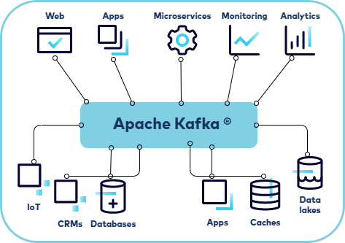
Kafka in One Picture
Start with a visual system before definitions.
Important points to note
- Producers publish records
- Kafka stores streams durably
- Many apps can consume independently
- Kafka can sit between apps, databases and data lakes
[1] Confluent documentation

Slide 5
Quick Recap: What Changed Since Day 1?
Day 1 batch file
Day 2 event stream
- A saved file captures a completed set.
- The reader waits for the next file.
- Good for scheduled movement.
- A new record can arrive now.
- Readers can react continuously.
- Good for changing operational facts.
[1] Apache Kafka documentation

Slide 6
Events Begin With a Human Question
A fact that changed
An event record
order-104 was paid
shipment-88 departed
sensor-17 exceeded threshold
what happened + when + business key + values needed by a reader
[1] Apache Kafka documentation

Slide 7
Tightly Coupled vs Loosely Coupled
Direct call
Event handoff
Checkout calls inventory now.
If inventory is down, checkout waits or fails.
Checkout publishes OrderPaid.
Inventory reacts when ready; Kafka holds the fact.
[1] Apache Kafka documentation

Slide 8
Producer to Consumer: End-to-End Flow
Use this as the main architecture picture before touching code.
1. Checkout service
creates event
2. Producer API
serializes + sends
3. Broker stores
record in partition
4. Consumer API
fetches records
5. Notification service
reacts
Key teaching sentence
Kafka is not the business application. It is the event bus between applications: it accepts records, stores them durably, and lets consumers read independently.
[1] Apache Kafka documentation; Confluent Developer; kafka-python docs

Slide 9
Queue vs Event Bus
This distinction is the first freshers need.
Queue mental model
- one worker usually takes a message
- message often disappears after processing
- good for distributing work
Kafka event bus mental model
- events are retained for a period
- multiple services can read same event
- late consumers can replay retained records
[1] Apache Kafka documentation; Confluent Developer; kafka-python docs

Slide 10
Mini Exercise 1: Is It an Event?
In pairs, classify each item:
1. Daily customer.csv export
2. PaymentReceived at 10:03:04
3. Weekly report PDF
4. TruckArrived at gate 2
Then write one event name of your own.
Quick Check:
Which two items deserve immediate consumers?
What business key would you put on each event?
[1] Apache Kafka documentation

Slide 11
Solution: Is It an Event?
Use this immediately after the activity so the class closes the loop.
Answer
- Daily customer.csv export: batch file, not an immediate event.
- PaymentReceived at 10:03:04: event; key could be payment_id or order_id.
- Weekly report PDF: report artifact, not a stream event.
- TruckArrived at gate 2: event; key could be truck_id or shipment_id.
Remember
Rule: use an event when something happened and another system may need to react quickly.
[1] Apache Kafka documentation; Confluent Developer; kafka-python docs

Slide 12
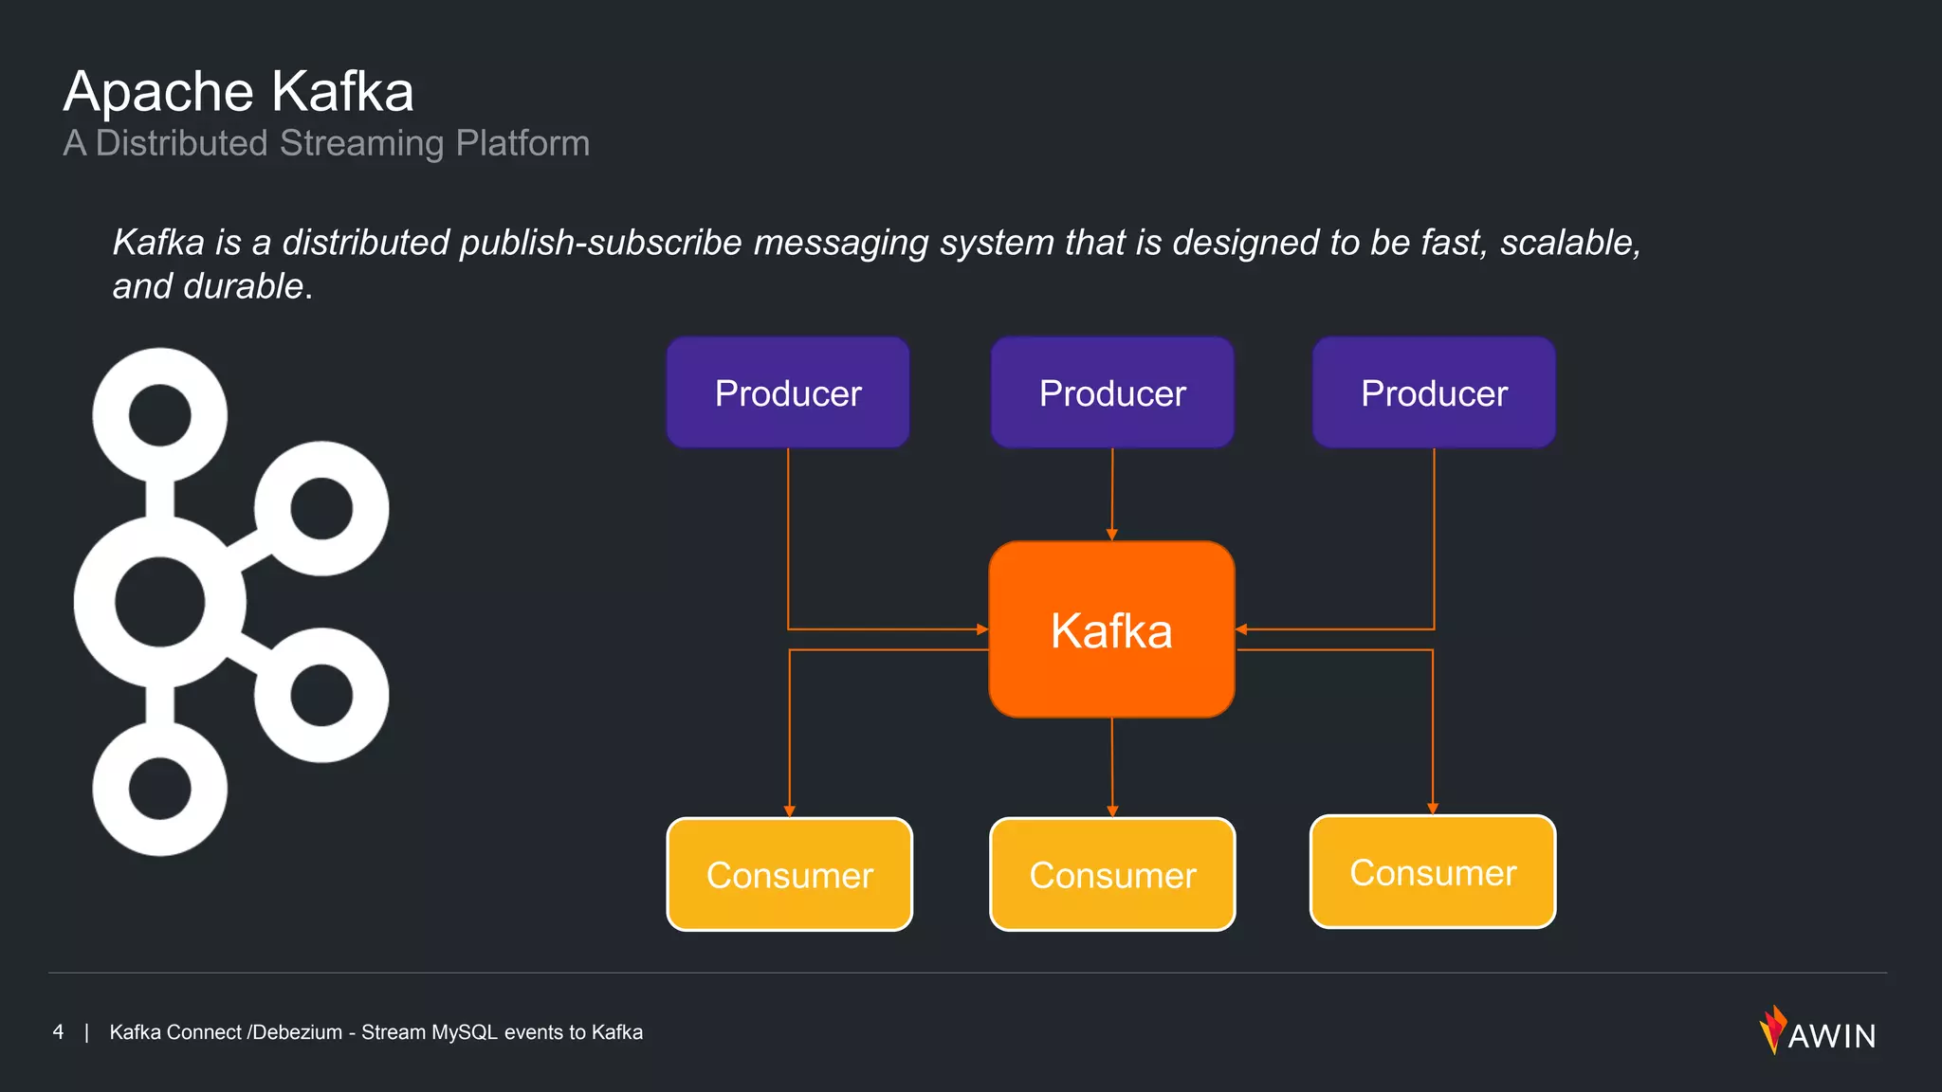
Pub Sub Architecture
Producers
Applications that send records to Kafka topics. Producers serialise data, choose partitions, batch records and specify delivery guarantees.
Consumers
Applications that read records from topics. Consumers maintain offsets, support manual or automatic commits, and coordinate within consumer groups for parallelism.
[1] [2]

Slide 13
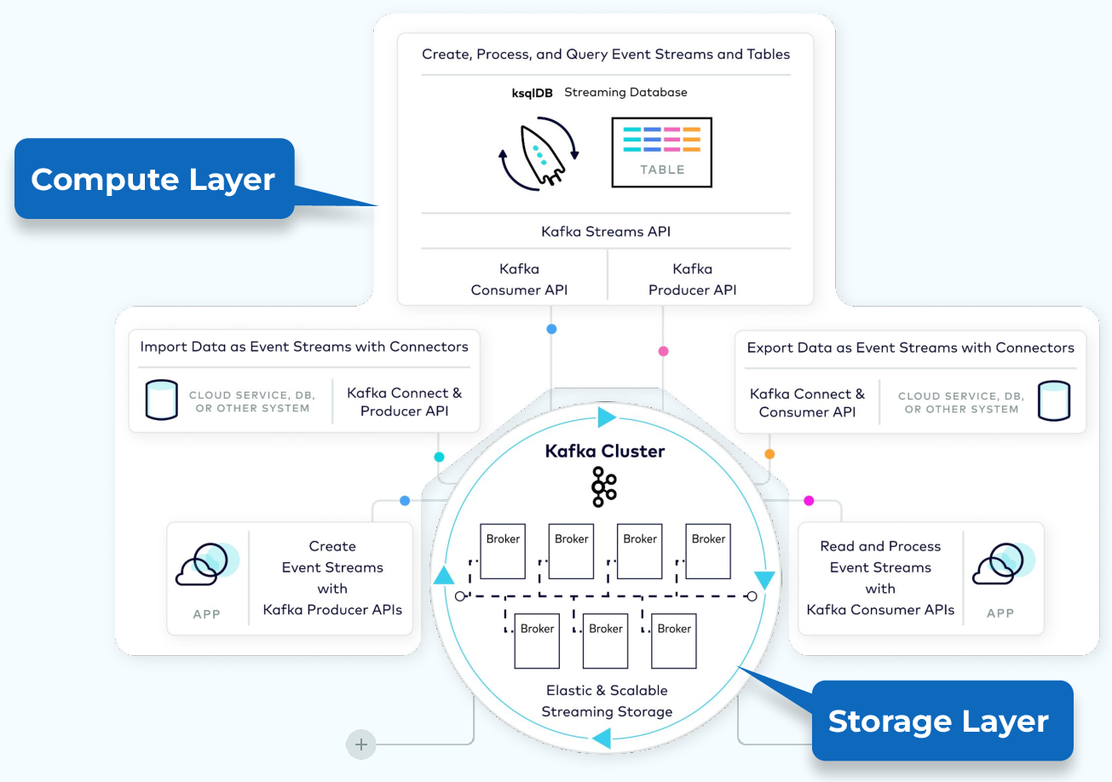
Architecture Deep Dive: Storage + APIs
This is the map for the rest of Day 2.
Important points to note
- Storage layer keeps event logs
- Producer API writes events
- Consumer API reads events
- Higher APIs build on the basics
[1] Confluent Developer architecture course

Slide 14
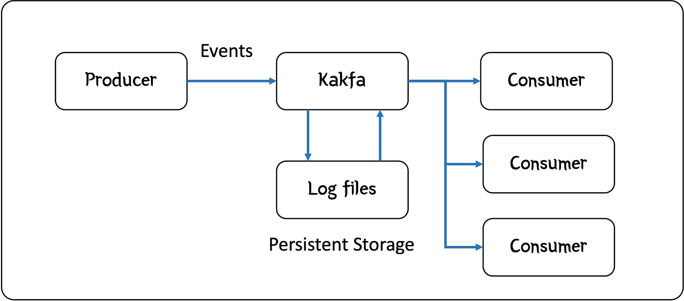
Read Kafka From the Message Perspective
A producer publishes a record. Kafka stores it in a durable log. A consumer reads it later or continuously.
Beginner rule: Kafka is not a phone call; the stored event remains available according to retention.
[1] Hodges, Medium, 1 Apr 2024; verified with Apache Kafka documentation

Slide 15
A Kafka Record Has Data and Delivery Metadata
Payload
Metadata
{"order_id": 104,
"status": "PAID",
"total": 850.00}
topic | partition | offset
key | timestamp | headers
The broker assigns position in a partition.
[1] Apache Kafka documentation

Slide 16
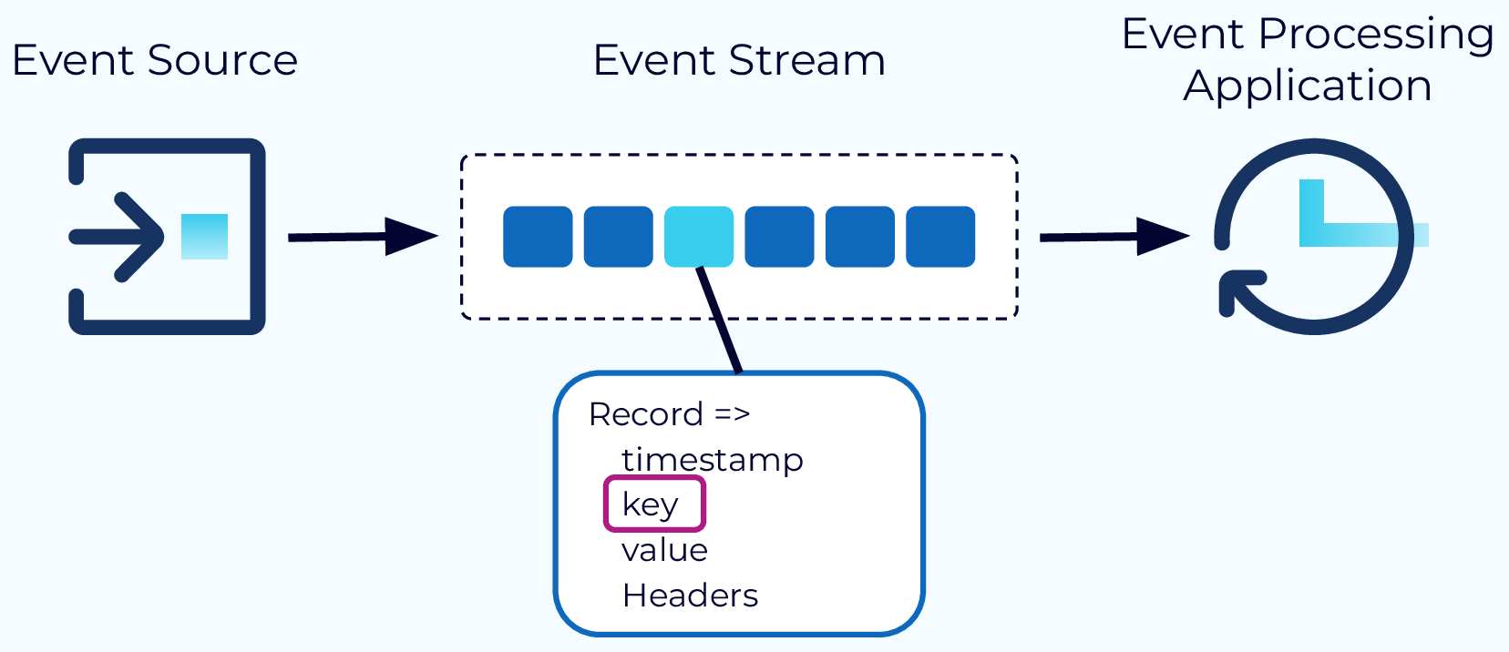
Record Deep Dive: Timestamp, Key, Value, Headers
A Kafka message is more than JSON text.
Important points to note
- timestamp says when
- key helps ordering and placement
- value is the business payload
- headers carry small metadata
[1] Confluent Developer architecture course

Slide 17


Serialization Fundamentals
Why serialise?
Kafka transports records as bytes. Producers must convert objects (e.g. JSON, Avro) into bytes, and consumers must interpret them. The choice of format impacts performance, compatibility and evolvability.
Schema registry
A schema registry stores versioned schemas centrally. Producers embed a schema ID in each message; consumers fetch the correct schema to deserialise data. Compatibility modes (backward, forward, full) govern how schemas evolve.
Record
Schema Registry
[1] [2] [3]

Slide 18
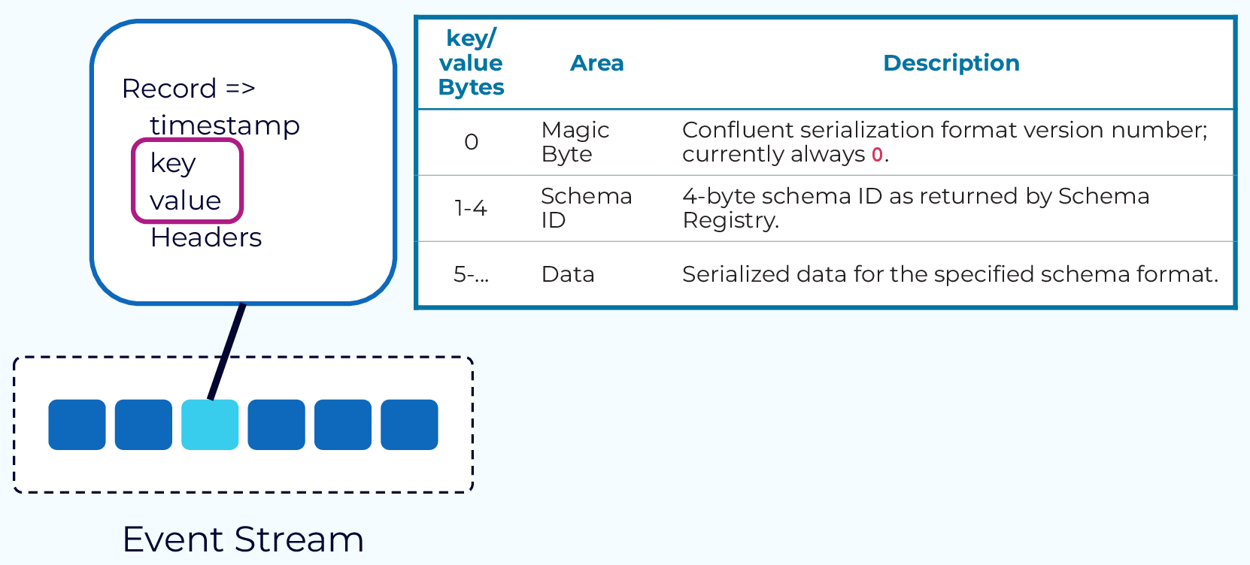
Serialization: Kafka Stores Bytes
This explains why serializers exist in producer.py.
Important points to note
- producer serializes key and value
- broker stores bytes
- consumer deserializes bytes
- JSON is readable for this lab
[1] Confluent Developer architecture course

Slide 19
Comparing Serialization Formats
Avro
Protobuf
JSON Schema
• Binary encoding; small messages
• Compact binary encoding with field numbers
• Human‑readable data and schema
• Schema stored separately; dynamic typing
• Code generation provides strong typing
• Rich validation capabilities
• Excellent schema evolution support
• Schema evolution via reserved field numbers
• Less efficient; larger messages
• Popular in analytical lakes & Kafka
• Great for microservices and multi‑language
• Useful for APIs and configuration
[1] [2] [3]

Slide 20
Schema Evolution & Compatibility
Backward compatibility
Consumers using new schema can read data produced with an older schema. Typically upgrade consumers first.
Forward compatibility
Consumers using old schema can read data produced with a newer schema. Producers upgrade first.
Full compatibility
Both backward and forward compatible. Adds restrictions to ensure both directions work.
Producer v1
Schema change
Producer v2
Consumer v1
Upgrade
Consumer v2
[1]

Slide 21
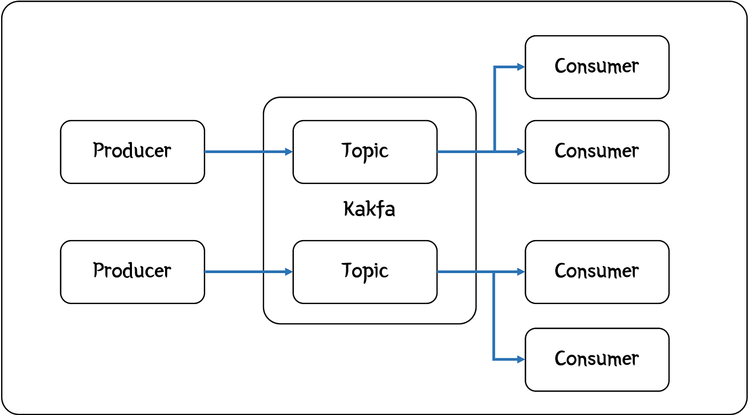
Topic = A Named Stream of Related Events
A topic lets a consumer subscribe to useful events rather than inspect everything.
Examples: order-paid, shipment-status, inventory-adjusted.
[1] Hodges, Medium, 1 Apr 2024; verified with Apache Kafka documentation

Slide 22
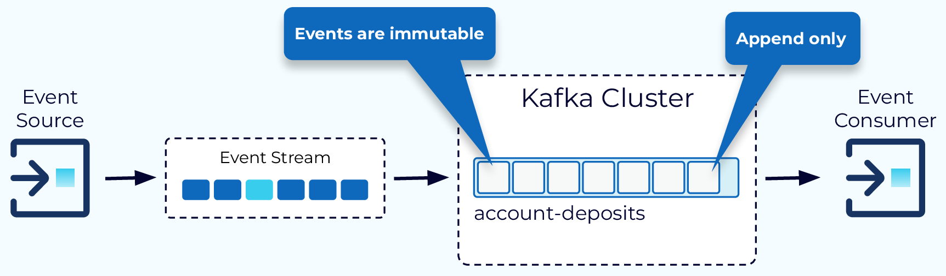
Topic Deep Dive: Append-Only Event Log
This makes --from-beginning understandable.
Important points to note
- topic groups related events
- new records append to the end
- offset identifies position
- consumer can read old retained records
[1] Confluent Developer architecture course

Slide 23
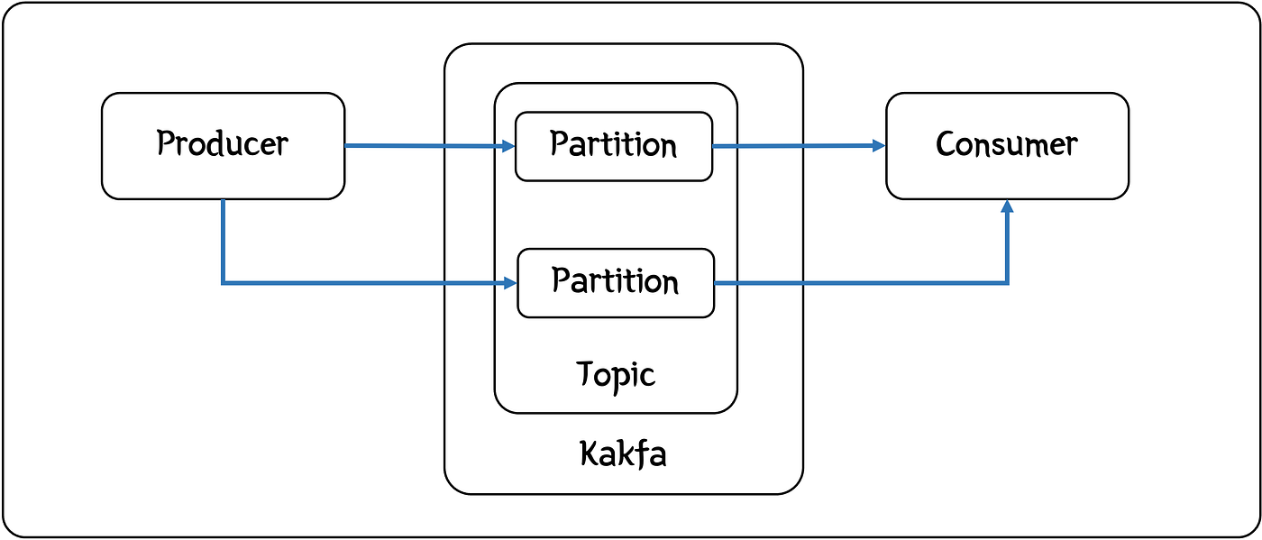
Partition = One Ordered Lane Inside a Topic
Partitions increase parallel throughput. Records are ordered inside one partition, not globally across every partition.
That single sentence prevents many design mistakes.
[1] Hodges, Medium, 1 Apr 2024; verified with Apache Kafka documentation

Slide 24
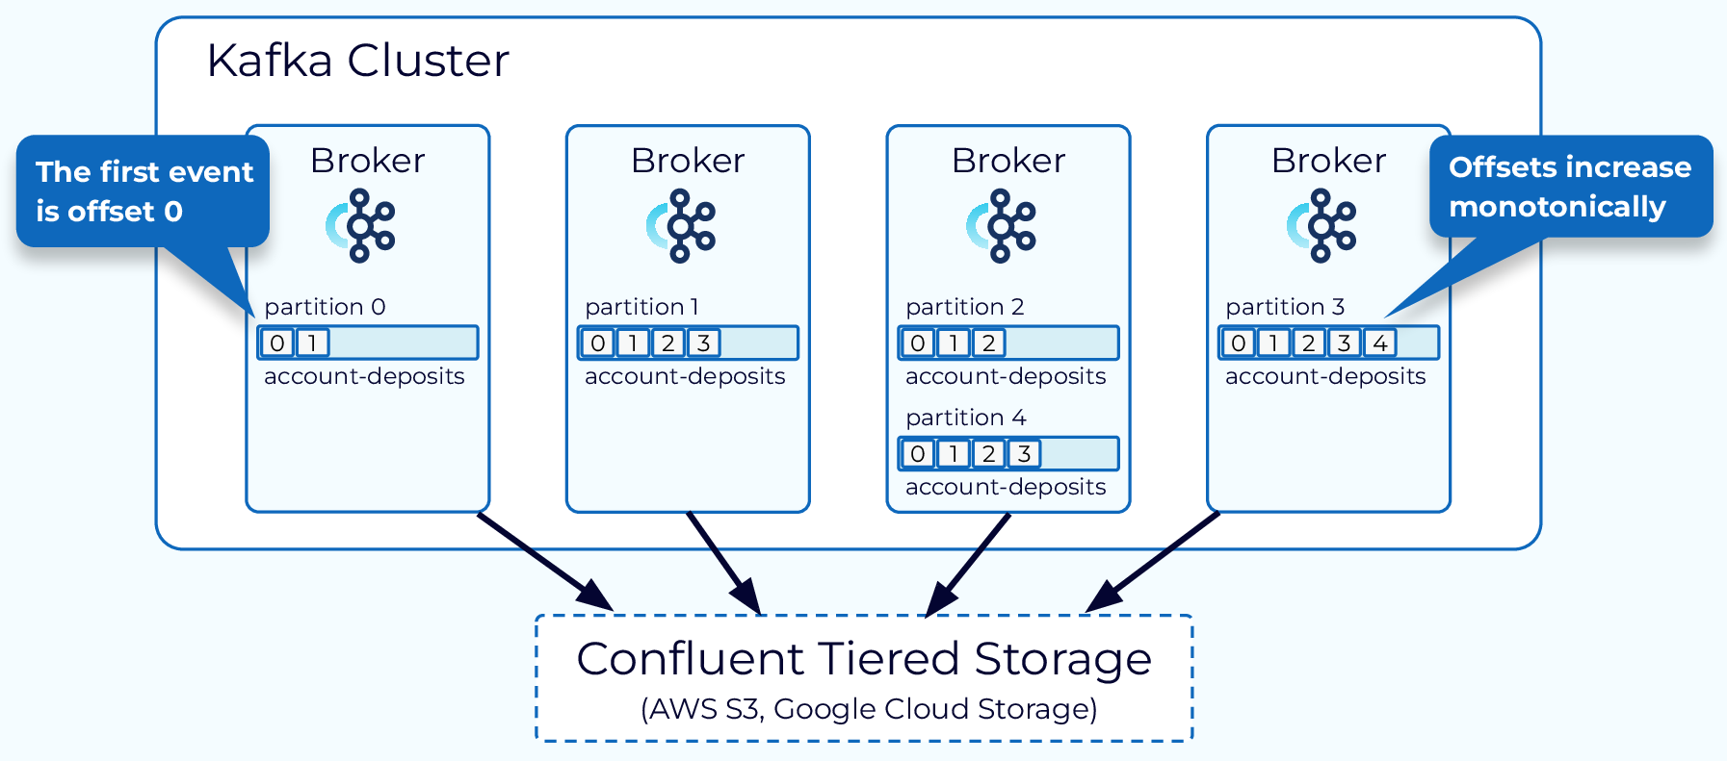
Partition Deep Dive: Storage and Parallelism
This makes key selection matter.
Important points to note
- topic is split into partitions
- partitions can live on brokers
- partition is the ordering lane
- partition is also a parallelism unit
[1] Confluent Developer architecture course

Slide 25
Ordering: What Kafka Guarantees
Guaranteed
Not guaranteed
Within partition 0:
offset 0 -> offset 1 -> offset 2
Consumers read that lane in order.
Partition 0 and partition 1 may be processed at different speeds.
No global event order across lanes.
[1] Apache Kafka documentation

Slide 26
Partitions Are Lanes, Offsets Are Positions
This picture helps beginners separate topic, partition, key and offset.
Topic: order-events
Partition 0
offset 0
offset 1
offset 2
offset 3
Partition 1
offset 0
offset 1
offset 2
offset 3
Partition 2
offset 0
offset 1
offset 2
offset 3
Ordering is guaranteed inside one lane. Kafka does not promise one global order across all lanes.
[1] Apache Kafka documentation; Confluent Developer; kafka-python docs

Slide 27
Keys Keep Related Changes in One Lane
Key = order_id
No useful key
All updates for order-104 hash to the same partition.
PAID -> PACKED -> SHIPPED stays ordered.
Records can spread for throughput.
Updates for one entity may be observed in different lanes.
[1] Apache Kafka documentation

Slide 28
Mini Exercise 2: Predict the Partition Decision
Topic shipment-status has 3 partitions.
Events carry keys: SHIP-01, SHIP-02, SHIP-01, SHIP-03.
Sketch three lanes and place the events conceptually.
Quick Check:
Must both SHIP-01 records share a partition?
Can you claim SHIP-02 happened before SHIP-03 globally?
Explain in one sentence.
[1] Apache Kafka documentation

Slide 29
Solution: Partition Prediction
Use this immediately after the activity so the class closes the loop.
Answer
- Both SHIP-01 records must map to the same partition when the same key is used.
- SHIP-02 and SHIP-03 may map to different partitions.
- You cannot claim one global order across different partitions.
- You can only trust order inside one partition lane.
Remember
Rule: key choice protects ordering for one business entity.
[1] Apache Kafka documentation; Confluent Developer; kafka-python docs

Slide 30
Kafka Deployment View: From Clients to a Broker
The message view explains records. The deployment view explains where records live.
In today's lab, one broker is enough to observe mechanics.
Producer
Broker :9092
Topic partitions
Consumer
[1] Apache Kafka documentation; Day 3 continues availability

Slide 31
Broker Deep Dive
A broker is the Kafka server; producers and consumers are application clients.
Broker responsibilities
- accept produce requests
- store partition log segments
- serve fetch requests
- return metadata to clients
Client responsibilities
- serialize data
- choose key/partition behavior
- retry or fail sends
- deserialize and process events
[1] Apache Kafka documentation; Confluent Developer; kafka-python docs

Slide 32
A Broker Is the Kafka Server Students Touch
Broker responsibility
Client responsibility
- Accept producer records.
- Store topic partition log segments.
- Serve consumer fetch requests.
- Producer serializes and sends.
- Consumer deserializes and reads.
- Clients use bootstrap address localhost:9092.
[1] Apache Kafka documentation

Slide 33
KRaft: Cluster Metadata Without ZooKeeper
In this Ubuntu lab
Why only one broker?
One container acts as broker and controller.
KRaft maintains Kafka metadata.
Client listener: 9092.
It exposes concepts with less setup.
It is not a resilience design.
Replication and failure tests are Day 3.
[1] Supplied KRaft lab files

Slide 34
KRaft in the Day 2 Lab
Important points to note why the compose file has broker and controller settings.
What KRaft does
- stores Kafka metadata without ZooKeeper
- controller manages cluster metadata
- broker handles client reads/writes
- single container can run both roles for training
What our lab is not
- not highly available
- not a production cluster
- not a replication/failure exercise
[1] Apache Kafka documentation; Confluent Developer; kafka-python docs

Slide 35
Lab Topology: Ubuntu Host to Kafka and Back
You will start one KRaft broker with Docker Compose, create order-events, produce records, and consume them.
Then Python scripts add JSON values and keys.
Ubuntu terminal
day2_kafka
order-events
CLI / Python reader
[1] Supplied KRaft lab files

Slide 36
Lab Architecture on Windows or Ubuntu
No separate Windows lab track is needed.
Same lab flow
- PowerShell or Bash
- Docker Compose starts day2_kafka
- clients connect to localhost:9092
- topic is order-events
Only shell syntax changes
- Windows uses py -3 and .venv\Scripts
- Ubuntu uses python3 and source .venv/bin/activate
- Kafka commands inside container are the same
[1] Apache Kafka documentation; Confluent Developer; kafka-python docs

Slide 37
Kafka UI Demo: See Topics and Messages
Use Kafka UI when the class needs a visual checkpoint.
Open
- Start Docker Compose.
- Open http://localhost:8080.
- Select cluster day2-local.
- Open Topics -> order-events.
- View messages after producer.py runs.
docker compose up -d
docker ps --filter name=day2_
# Browser:
http://localhost:8080
Demo talking points
- Topics tab shows streams.
- Messages view shows key and value.
- Partitions make lanes visible.
- This is for learning visibility, not a replacement for CLI evidence.
[1] Apache Kafka documentation; Confluent Developer; kafka-python docs

Slide 38
Mini Exercise 3: Label the Architecture
Draw the lab route on paper before typing commands:
Host terminal -> container -> broker -> topic -> partition -> consumer.
Mark where the record is durable.
Quick Check:
What runs on port 9092?
Where does a topic live?
Which component prints the record?
[1] Supplied KRaft lab files

Slide 39
Solution: Label the Architecture
Use this immediately after the activity so the class closes the loop.
Answer
- Host terminal runs Docker and Kafka CLI/Python commands.
- day2_kafka container runs the Kafka broker.
- order-events is stored as topic partition logs inside Kafka.
- Consumer or Python code prints the record after reading it.
Remember
Rule: clients send and read; the broker stores.
[1] Apache Kafka documentation; Confluent Developer; kafka-python docs

Slide 40
Checkpoint Before the Lab
Know before you run
Evidence to capture
topic: order-events
partitions: 3
broker endpoint: localhost:9092
container: day2_kafka
running container
topic description
produced records
consumed records with metadata
[1] Supplied KRaft lab files

Slide 41
CLI Flags Students Must Recognize
Important points to note what each command flag means, not just copy commands.
kafka-topics --bootstrap-server localhost:9092 \
--create --if-not-exists \
--topic order-events \
--partitions 3 --replication-factor 1
Topic flags
- --bootstrap-server: broker to contact
- --create: create topic
- --if-not-exists: safe rerun
- --partitions: number of lanes
- --replication-factor: copies per partition
kafka-console-consumer --topic order-events \
--from-beginning --max-messages 5 \
--property print.key=true
Consumer flags
- --from-beginning: read old retained events
- --max-messages: stop after N messages
- print.key=true: show business key
[1] Apache Kafka documentation; Confluent Developer; kafka-python docs

Slide 42
Lab 1: Verify the Lab Host
Run in the supplied lab-code folder:
1. docker --version
2. docker compose version
3. dir / ls
4. Confirm docker-compose.yml, producer.py and consumer.py exist.
Success Evidence:
Record the Docker versions and the visible three supplied files.
Do not start Kafka until this check passes.
[1] Supplied KRaft lab files

Slide 43
Lab 2: Understand the Compose File Before Starting
This supplied configuration starts one Kafka node in KRaft mode. Read the listener and role settings first.
services:
kafka:
container_name: day2_kafka
environment:
KAFKA_PROCESS_ROLES: 'broker,controller'
KAFKA_LISTENERS: 'PLAINTEXT://0.0.0.0:9092,CONTROLLER://0.0.0.0:9093'
KAFKA_ADVERTISED_LISTENERS: 'PLAINTEXT://localhost:9092'
[1] Supplied KRaft lab files

Slide 44
Read docker-compose.yml Like an Engineer
This is the first architecture lab, not just a startup command.
Kafka listener settings
- KAFKA_LISTENERS binds inside container
- KAFKA_ADVERTISED_LISTENERS tells clients how to connect
- ports maps host 9092 to container 9092
KRaft settings
- KAFKA_PROCESS_ROLES broker,controller
- KAFKA_NODE_ID identifies the node
- KAFKA_CONTROLLER_QUORUM_VOTERS defines controller quorum
[1] Apache Kafka documentation; Confluent Developer; kafka-python docs

Slide 45
Lab 3: Start One Kafka Broker
Start the service and prove the container is running before creating a topic.
cd "Week1/Day 2/lab-code"
docker compose up -d
docker ps --filter name=day2_kafka
docker logs day2_kafka --tail 30
[1] Supplied KRaft lab files

Slide 46
Lab 4: Create a Topic With Three Ordered Lanes
The three partitions give us visible parallel lanes while keeping the lab small.
docker exec day2_kafka kafka-topics \
--bootstrap-server localhost:9092 \
--create --if-not-exists \
--topic order-events --partitions 3 \
--replication-factor 1
[1] Supplied KRaft lab files

Slide 47
Topic Creation Flags: Why Each One Exists
Students should not copy commands blindly.
Command
- --bootstrap-server localhost:9092
- --create --if-not-exists
- --topic order-events
- --partitions 3
- --replication-factor 1
Meaning
- which broker to ask
- safe create operation
- named event stream
- three ordering lanes
- one copy because lab has one broker
[1] Apache Kafka documentation; Confluent Developer; kafka-python docs

Slide 48
Lab 5: Ask Kafka What Was Created
Topic description turns configuration into observable evidence. Read partition count before continuing.
docker exec day2_kafka kafka-topics \
--bootstrap-server localhost:9092 \
--describe --topic order-events
Expected observation: PartitionCount: 3, ReplicationFactor: 1
[1] Supplied KRaft lab files

Slide 49
Mini Exercise 4: Read a Topic Description
Circle the evidence in your terminal output:
1. Topic name
2. Partition count
3. Replication factor
4. One line per partition
Quick Check:
Why is replication factor 1 acceptable for this learning lab but not a production availability pattern?
Production clusters use more brokers and separate failure testing.
[1] Supplied KRaft lab files

Slide 50
Solution: Topic Description
Use this immediately after the activity so the class closes the loop.
Answer
- Topic name proves the stream exists.
- Partition count proves the number of ordered lanes.
- Replication factor 1 is acceptable only because this is a one-broker learning setup.
- One line per partition shows Kafka created separate lanes.
Remember
Rule: topic description is configuration evidence.
[1] Apache Kafka documentation; Confluent Developer; kafka-python docs

Slide 51
Lab 6: Produce Human-Readable Records
Open a terminal producer, type these records, then press Ctrl+C when complete.
docker exec -it day2_kafka kafka-console-producer \
--bootstrap-server localhost:9092 \
--topic order-events
{"order_id":104,"status":"PAID"}
{"order_id":105,"status":"PAID"}
{"order_id":104,"status":"PACKED"}
[1] Supplied KRaft lab files

Slide 52
Console Producer and Consumer: The Fastest Proof
This is why we do CLI before Python.
Producer proves
- a record can be sent to Kafka
- topic accepts business JSON
- broker stores the event
Consumer proves
- a separate client can read later
- --from-beginning replays retained records
- Kafka decouples sender and reader
[1] Apache Kafka documentation; Confluent Developer; kafka-python docs

Slide 53
Lab 7: Consume From the Beginning
Read the records stored in the topic. A consumer can arrive after the producer has finished.
docker exec day2_kafka kafka-console-consumer \
--bootstrap-server localhost:9092 \
--topic order-events --from-beginning \
--max-messages 3
[1] Supplied KRaft lab files

Slide 54
Evidence Check: Prove Kafka Stored the Events
Collect evidence in this order:
1. Running broker container
2. Topic description
3. Three producer inputs
4. Three consumer outputs
5. A sentence explaining why late reading worked
Explain Before Moving On:
The consumer could read after production because Kafka retains records in a log.
A screenshot of commands alone is not evidence of message movement.
[1] Supplied KRaft lab files

Slide 55
Mini Exercise 5: Observe Parallel Lanes
Create a second topic named keyed-orders with three partitions. Produce a few keyed records using the console producer key options or the Python lab later.
Predict First:
If every record uses key order-104, should the lane stay stable?
Write your prediction before observing output.
[1] Supplied KRaft lab files

Slide 56
Solution: Parallel Lanes
Use this immediately after the activity so the class closes the loop.
Answer
- If every record uses key order-104, the lane should stay stable.
- Stable key placement protects order for that order_id.
- A constant key for every record is a bad design because it overloads one lane.
- Different keys can spread records across partitions.
Remember
Rule: keys trade off ordering and distribution.
[1] Apache Kafka documentation; Confluent Developer; kafka-python docs

Slide 57
Concept Check: Topic, Partition or Broker?
Match each definition:
A. Named stream a reader subscribes to.
B. Ordered lane with offsets.
C. Server storing log segments.
D. Application sending records.
Quick Check:
Answers: A topic; B partition; C broker; D producer.
Then explain why increasing partitions can increase concurrent work.
[1] Apache Kafka documentation

Slide 58
Serialization: Kafka Moves Bytes, Applications Supply Meaning
Text or JSON
Schema preview
Readable in beginner labs.
A JSON record exposes fields such as order_id and status.
As teams evolve fields, contracts matter.
Formal schema evolution is taught later, not in today's lab.
[1] Apache Kafka documentation

Slide 59
Feature Deep Dive: Kafka Fundamentals
Day 2 names the features; later days operate them deeply.
Core features
- durable event log
- publish/subscribe
- retention and replay
- partition parallelism
- ordering within partition
Operational features to name
- acknowledgements
- batching
- compression
- client retries
- metadata discovery
[1] Apache Kafka documentation; Confluent Developer; kafka-python docs

Slide 60
JSON Event Anatomy
A useful event is explicit enough that another team can interpret it without asking the producer.
{
"event_type": "OrderPaid",
"event_time": "2026-05-26T10:03:04Z",
"order_id": 104,
"customer_id": 38,
"amount": 850.00,
"currency": "INR"
}
[1] Apache Kafka documentation

Slide 61
Producer Flags in This Lab
These settings make the Python producer easier to reason about.
bootstrap_servers
Where the producer first connects: localhost:9092
linger_ms
Small wait to form batches
client_id
Human-readable producer name in logs and metrics
batch_size
Maximum bytes to collect per partition batch
key_serializer
Converts order_id string to bytes
compression_type
Compresses records before sending
value_serializer
Converts event dict to JSON bytes
retries
Retries transient send failures
acks='all'
Waits for broker acknowledgement; safest setting in this one-broker lab
request_timeout_ms
How long to wait for broker response
[1] Apache Kafka documentation; Confluent Developer; kafka-python docs

Slide 62
Consumer Flags in This Lab
The consumer shows how applications read from the event bus.
bootstrap_servers
Broker endpoint the consumer uses
enable_auto_commit=True
Let client periodically store progress
client_id
Readable client name
key_deserializer
Turns key bytes back into string
group_id
Logical subscriber name
value_deserializer
Turns JSON bytes back into dict
auto_offset_reset='earliest'
Begin at old records when no previous position exists
consumer_timeout_ms
Stops the beginner lab after quiet time
[1] Apache Kafka documentation; Confluent Developer; kafka-python docs

Slide 63
Mini Exercise 6: Improve a Weak Event
Weak record: {"id":104,"done":true}
Rewrite it so a fulfilment consumer understands what changed, when it changed and which entity changed.
Quick Check:
Minimum fields:
event_type, event_time, entity key and useful business value.
Which field should become the Kafka key?
[1] Apache Kafka documentation

Slide 64
Solution: Improve a Weak Event
Use this immediately after the activity so the class closes the loop.
Answer
- Better event: {"event_type":"OrderStatusChanged","event_time":"2026-06-01T10:03:04Z","order_id":104,"status":"PAID"}
- Use order_id as the Kafka key if order lifecycle ordering matters.
- event_type tells what happened.
- event_time tells when it happened.
Remember
Rule: a useful event can be understood by another team without asking the producer.
[1] Apache Kafka documentation; Confluent Developer; kafka-python docs

Slide 65
Lab 8: The Supplied Python Producer
The producer serializes business order events as JSON and sends keyed records to order-events.
producer = KafkaProducer(
bootstrap_servers=["localhost:9092"],
value_serializer=json_serializer,
key_serializer=lambda k: k.encode("utf-8"),
acks="all")
key = order_id
producer.send("order-events", key=key, value=value)
[1] Supplied KRaft lab files

Slide 66
Producer Code: Create a Business Event
The slide uses the actual Day 2 lab code.
def build_order_event(order_id: str, status: str, amount: float) -> dict[str, Any]:
"""Create one event-bus message payload."""
return {
"event_type": "OrderStatusChanged",
"event_time": utc_now(),
"order_id": order_id,
"status": status,
"amount": amount,
"currency": "INR",
"source_system": "checkout-service",
}
Instructor explanation
- event_type names the fact
- event_time makes timing explicit
- order_id is the key
- source_system helps lineage
[1] Apache Kafka documentation; Confluent Developer; kafka-python docs

Slide 67
Producer Code: Configure KafkaProducer
The slide uses the actual Day 2 lab code.
producer = KafkaProducer(
bootstrap_servers=["localhost:9092"],
client_id="checkout-service-producer",
key_serializer=key_serializer,
value_serializer=json_serializer,
acks="all",
linger_ms=10,
batch_size=32_768,
compression_type="gzip",
retries=5,
retry_backoff_ms=200,
request_timeout_ms=30_000,
Instructor explanation
- bootstrap_servers finds broker
- serializers convert to bytes
- acks and retries affect reliability
- batching and compression affect throughput
[1] Apache Kafka documentation; Confluent Developer; kafka-python docs

Slide 68
Producer Code: send() and Delivery Metadata
The slide uses the actual Day 2 lab code.
future = producer.send(
TOPIC_NAME,
key=order_id,
value=event,
headers=[("event_type", event["event_type"].encode("utf-8"))],
)
report_delivery(future, order_id)
Instructor explanation
- topic is order-events
- key controls partition lane
- value is JSON event payload
- future.get reveals partition and offset
[1] Apache Kafka documentation; Confluent Developer; kafka-python docs

Slide 69
Lab 9: The Supplied Python Consumer
The reader prints partition and offset so students can observe where records landed. Offset management remains Day 3.
consumer = KafkaConsumer(
"order-events",
bootstrap_servers=["localhost:9092"],
group_id="demo-group",
auto_offset_reset="earliest")
print(message.partition, message.offset, message.value)
[1] Supplied KRaft lab files

Slide 70
Consumer Code: Configure KafkaConsumer
The slide uses the actual Day 2 lab code.
consumer = KafkaConsumer(
TOPIC_NAME,
bootstrap_servers=["localhost:9092"],
client_id="order-notification-client",
group_id="order-notification-service",
auto_offset_reset="earliest",
enable_auto_commit=True,
key_deserializer=key_deserializer,
value_deserializer=json_deserializer,
consumer_timeout_ms=15_000,
Instructor explanation
- subscribes to order-events
- group_id names logical subscriber
- deserializers turn bytes back into data
- timeout lets the lab finish cleanly
[1] Apache Kafka documentation; Confluent Developer; kafka-python docs

Slide 71
Consumer Code: Read Business Data and Metadata
The slide uses the actual Day 2 lab code.
for message in consumer:
event = message.value
print(
"received",
f"event_type={event['event_type']}",
f"order_id={event['order_id']}",
f"status={event['status']}",
f"key={message.key}",
f"topic={message.topic}",
f"partition={message.partition}",
f"offset={message.offset}",
)
Instructor explanation
- message.value is the event
- message.key is the business key
- topic/partition/offset are Kafka metadata
- service reacts without calling checkout
[1] Apache Kafka documentation; Confluent Developer; kafka-python docs

Slide 72
Lab 10: Run the Python Round Trip
In the lab-code folder:
1. python -m pip install kafka-python
2. Run python consumer.py in terminal A.
3. Run python producer.py in terminal B.
4. Capture records printed by the consumer.
Evidence Required:
Order events printed with partition and offset.
Annotate which fields came from the app and which came from Kafka.
[1] Supplied KRaft lab files

Slide 73
Python Round Trip: What Students Should See
This connects code to architecture.
Producer terminal
- published order_id=ORD-1001
- topic=order-events
- partition=N
- offset=N
Consumer terminal
- received event_type=OrderStatusChanged
- order_id and status
- key=ORD-1001
- same topic/partition/offset metadata
[1] Apache Kafka documentation; Confluent Developer; kafka-python docs

Slide 74
Lab 11: Change Keys and Observe Placement
Run A: keep key = order_id.
Run B: add different order_id values.
Compare observed partition values after each producer run.
Reasoning Check:
A stable key keeps related changes together.
Multiple keys may spread work, but ordering is only within each key's partition lane.
[1] Supplied KRaft lab files

Slide 75
Key Experiment: Make Ordering Visible
This is the cleanest beginner partition exercise.
Same order_id
- ORD-1001 PAID
- ORD-1001 PACKED
- ORD-1001 SHIPPED
- should stay in one partition
Different order_id
- ORD-1002
- ORD-1003
- can be placed in other partitions
- gives parallel lanes
[1] Apache Kafka documentation; Confluent Developer; kafka-python docs

Slide 76
Mini Exercise 7: Explain the Output
Your consumer output contains value, key, partition and offset. In pairs, label which items are business payload and which are Kafka delivery metadata.
Quick Check:
Why is an offset not an order number?
Why should a consumer not assume two partitions are globally ordered?
[1] Apache Kafka documentation

Slide 77
Solution: Explain the Output
Use this immediately after the activity so the class closes the loop.
Answer
- Business payload: event_type, order_id, status, amount, currency.
- Kafka key: the routing/business key used for partition choice.
- Kafka metadata: topic, partition, offset and timestamp.
- Offset is a log position, not an order number.
Remember
Rule: separate business facts from transport metadata.
[1] Apache Kafka documentation; Confluent Developer; kafka-python docs

Slide 78
Batch Path vs Streaming Path
Batch reads a completed collection on a schedule. Streaming responds as events arrive.
Both paths can end in medallion layers; the difference is arrival and processing rhythm.
Saved file
Scheduled ingest
Bronze table
Downstream use
[1] Course medallion pipeline; Apache Kafka documentation

Slide 79
Where Kafka Fits in a Medallion Pipeline
Kafka transports raw event records. Bronze persists received facts; Silver cleans and validates; Gold answers analytical questions.
Kafka is transport and retention, not the entire lakehouse.
Kafka topic
Bronze raw
Silver clean
Gold metric
[1] Medallion pipeline curriculum; Apache Kafka documentation

Slide 80
Kafka to Medallion Pipeline
Explain the handoff without building the whole pipeline today.
Today
- Kafka transports order events
- topic retains raw facts
- partition/offset identify location
- consumer proves data can be read
Later pipeline
- Bronze stores raw events
- Silver validates and cleans
- Gold aggregates for BI
- same event can feed many downstream systems
[1] Apache Kafka documentation; Confluent Developer; kafka-python docs

Slide 81
Troubleshooting From the First Broken Boundary
Diagnostic route:
1. docker ps: broker running?
2. docker logs day2_kafka: startup error?
3. kafka-topics --describe: topic present?
4. Producer output: send succeeds?
5. Consumer output: records visible?
Incident Check:
Broker is running, but no consumer records appear.
First confirm the topic name and run a from-beginning consumer before changing code.
[1] Supplied KRaft lab files

Slide 82
Mini Challenge: Design order-events
In pairs:
1. Choose a topic name.
2. Choose number of partitions for the lab.
3. Choose a key and defend ordering.
4. Produce three JSON events.
5. Consume and capture evidence.
Submission Rubric:
Topic described; records readable; key rationale stated; consumed output visible; one batch-versus-stream sentence.
[1] Supplied KRaft lab files

Slide 83
Client Story Exercise: Design payment-events
This becomes a human story, not a dry definition.
Event contract
- event_type: PaymentCaptured
- key: payment_id or order_id
- value: amount, currency, event_time
- headers: source or event type
Kafka decision
- topic name
- partition count
- key choice
- evidence command
[1] Apache Kafka documentation; Confluent Developer; kafka-python docs

Slide 84
Challenge Debrief: Evidence Beats Definitions
Share in two minutes:
- Your topic and key.
- The partition observation.
- One event payload.
- One command that proves movement.
Instructor Listen-For:
Students distinguish topic from partition; payload from metadata; a learning broker from production availability.
[1] Supplied KRaft lab files

Slide 85
Knowledge Check 1: The Message View
Answer without notes:
1. What does a producer do?
2. Why create topics?
3. Where is ordering guaranteed?
4. What purpose does a key serve?
Quick Check:
Model answers:
Publish; select relevant stream; within one partition; keep related records in a stable lane.
[1] Apache Kafka documentation

Slide 86
Solution: Message View
Use this immediately after the activity so the class closes the loop.
Answer
- Producer publishes records to a topic.
- Topics group related events so consumers can subscribe to the right stream.
- Ordering is guaranteed within one partition.
- A key keeps related records in a stable partition lane.
Remember
Rule: the message view follows producer -> topic -> partition -> consumer.
[1] Apache Kafka documentation; Confluent Developer; kafka-python docs

Slide 87
Knowledge Check 2: The Deployment View
Answer on paper:
1. What does the broker store?
2. What endpoint did clients use today?
3. Why use KRaft in the Ubuntu lab?
4. Why is replication factor 1 only a learning setup?
Answers:
Partition logs; localhost:9092; metadata without ZooKeeper; one broker cannot demonstrate fault tolerance.
Replication and recovery testing require a multi-broker production-style setup.
[1] Apache Kafka documentation

Slide 88
Solution: Deployment View
Use this immediately after the activity so the class closes the loop.
Answer
- The broker stores partition logs.
- Clients used localhost:9092 from the host machine.
- KRaft manages Kafka metadata without ZooKeeper.
- Replication factor 1 is only a learning setup because one broker cannot tolerate broker failure.
Remember
Rule: the deployment view explains where records live and how clients connect.
[1] Apache Kafka documentation; Confluent Developer; kafka-python docs

Slide 89
Day 3 Preview: What We Deliberately Did Not Teach Yet
Today: fundamentals
Tomorrow: operations
Events, topics, partitions, broker, KRaft start-up, producing, consuming, JSON and keys.
Consumer groups, committed offsets, lag, replication, failure tolerance and Kafka Connect.
[1] Apache Kafka documentation

Slide 90
Quick Recap: Five Sentences to Carry Forward
Today you learned:
- Kafka stores event records so producers and consumers do not need to operate in lockstep.
- A topic is a named stream; a partition is an ordered lane.
- A useful key keeps related changes in the same lane.
- A broker stores partition logs; our Ubuntu lab uses one KRaft broker.
- CLI and Python evidence proved produce -> store -> consume flow.
Tomorrow (Day 3): groups, offsets, replicas, recovery and Connect.
[1] Apache Kafka documentation; supplied Ubuntu lab

Slide 91
Exit Ticket and Lab Evidence Pack
Submit before leaving:
1. Topic description for order-events.
2. CLI consumed JSON output.
3. Python output showing partition and offset.
4. Key experiment observation.
5. A four-sentence batch-versus-stream comparison.
Final Question:
Your consumer is restarted tomorrow. What state might matter for resuming work?
Do not solve it today; bring the question to Day 3 when we learn offsets.
[1] Supplied KRaft lab files

