Slide 1
DAY 6
Data Transformation with Apache Hop
Architecture, first pipeline, CSV batch, PostgreSQL, Kafka streaming and workflow orchestration
Raw CSV
Hop pipeline
PostgreSQL
Kafka topics
Workflow
Sources: Apache Hop docs and Samuel Second Medium walkthrough
01

Slide 2
OUTCOME
What students will be able to do
Explain Apache Hop architecture: engine, project, metadata, pipeline, workflow, run configuration and environment.
Choose the right official Docker image for the lab objective.
Build a first CSV-to-CSV pipeline using Hop Web.
Create batch transformations with filtering, standardization, lookup, math and deduplication.
Write to and read from PostgreSQL, then process Kafka streams in Hop.
Lab shape
00 first pipeline -> 01 clean customers -> 02 enrich orders -> 03 write DB -> 04 read DB -> 05 Kafka stream -> workflow
Evidence
Saved HPL/HWF files, CSV outputs, PostgreSQL rows, Kafka topic messages, workflow run result
What is excluded
Dataflow/Beam deployment images, Schema Registry, ZooKeeper and pgAdmin for this beginner Day 6 lab
02

Slide 3
DOCKER CHOICE
Use only the official Hop images that match the lab
Image
Purpose
Day 6 decision
apache/hop-web
Browser Hop GUI on Tomcat
Required
apache/hop
CLI/client/server image
Optional hop-cli profile
apache/hop-web-beam
Hop Web plus Beam fat jar
Skip unless teaching Dataflow
apache/hop-dataflow-template
Dataflow Flex Template image
Skip for this lab
For this lab, Hop Web is the required visual interface. The plain hop image is useful as an optional CLI runner, but adding it as a required service would make the classroom stack heavier without improving the visual build.
Source: Apache Hop Docker and Hop Web documentation
03
03

Slide 4
LAB TOPOLOGY
The Compose stack stays small and purposeful
Kafka UI 8080
Hop Web 8082
PostgreSQL 5432
Optional hop-cli profile: cli
Kafka 9092 / 29092
No Schema Registry: messages are JSON, not Avro/Protobuf. No ZooKeeper: Kafka runs in KRaft mode. No pgAdmin: Hop already proves database write/read.
04

Slide 5
ARCHITECTURE
Apache Hop architecture is layered around metadata
Apache Hop Engine
Apache Hop
Hop GUI
Hop Run
Hop Server
Project
Metadata
JDBC
NoSQL
Probe
Test
...
Workflow
Pipeline
Action
Transform
Run Configuration: native local, remote, Spark/Flink/Dataflow through Beam
Environment
05

Slide 6
ENGINE LAYER
Hop GUI, Hop Run and Hop Server are different surfaces on the same engine
Hop GUI / Hop Web
Hop Run
Hop Server
Visual design surface. Use it to create pipelines, workflows and metadata. Day 6 uses Hop Web at :8082.
CLI execution. Useful for automated validation and production-style runs after the visual design is stable.
Remote execution/status endpoint. Useful for services, web APIs or distributed runtime patterns.
Teaching decision: use Hop Web first. Add Hop Run later when students understand what the pipeline/workflow files mean.
06

Slide 7
PROJECTS
Projects are required because Hop treats metadata like code
One folder holds the solution: pipelines, workflows, metadata, data files and reference artifacts.
Project files can be versioned in Git and moved across laptops or containers.
Environment variables keep dev/test/prod differences out of pipeline logic.
In this lab, Lab_Files is mounted as /project inside Hop Web.
day6_hop_lab project
pipelines/*.hpl
workflows/*.hwf
metadata/*.json
data/*.csv
output/*.csv
07

Slide 8
METADATA
Reusable metadata keeps the visual design clean
Database connection
Run configuration
Pipeline probe
PostgreSQL_Medallion.json
local / Beam / remote
stream rows for inspection
Pipeline unit test
Logs and execution info
Static schema definition
compare output to data set
audit and troubleshoot runs
reuse field layout
08

Slide 9
PIPELINES
Transforms process rows; hops pass row streams between transforms
Input
Transform
Transform
Output
Pipeline examples in this lab: CSV file input -> text output, customer cleaning, order enrichment, PostgreSQL IO, Kafka consumer parent and Kafka batch sub-pipeline.
09

Slide 10
WORKFLOWS
Actions orchestrate work and react to success or failure
Success
Start
Run first pipeline
Clean + enrich
Write/read DB
Failure
Workflow actions do not normally transform row data. They run tasks and return true/false so the workflow can choose the next path.
10

Slide 11
RUN CONFIGURATION AND ENVIRONMENT
The same design can run in different places
Run configuration
Environment
Project variables
Chooses engine/runtime: native local today, Beam options later.
Stores lifecycle-specific variables like DB host, credentials, and file paths.
Useful for stable project-level values such as project home or standard folders.
Design once. Move by changing metadata and variables, not by editing every transform.
11

Slide 12
TRANSFORM CATALOG
What transformations are present in Apache Hop?
Input/output
Row shaping
CSV, Text, Excel, JSON, XML, Avro, Parquet, Table Input/Output, Kafka Consumer/Producer
Select Values, Add Constants, Formula, Calculator, JavaScript, String Operations
Quality
Join/lookup
Filter Rows, Data Validator, If Null, Null If, XSD Validator, error handling
Merge Join, Stream Lookup, Database Lookup, Database Join, Append Streams
Aggregation/dedup
Integration/cloud
Sort Rows, Unique Rows, Group By, Memory Group By, analytic query
HTTP, REST, MongoDB, Neo4j, Salesforce, Beam, AWS/Azure/GCP connectors
Source: Apache Hop Transform Plugins manual
12
12

Slide 13
ACTION CATALOG
What actions are present in Apache Hop workflows?
Control
Run work
Start, Success, Abort, Simple evaluation, Wait for, Wait for file, Wait for SQL
Pipeline, Workflow, SQL, Shell, XSL pipeline
Files
Messaging
Copy files, Move files, Delete files, Create folder, Zip, Unzip, file exists
Mail, Write to Log, HTTP, Web service-oriented actions
Database checks
Validation/security
Table exists, Truncate tables, SQL, Wait for SQL
XSD validator, PGP signature verification, mail validator
Source: Apache Hop Action Plugins manual
13
13

Slide 14
METADATA CATALOG
What metadata activities are present in Apache Hop?
Connections
Execution
Relational DB, REST, Salesforce, MongoDB, Neo4j, MinIO/S3, WebDAV
Pipeline Run Configuration, Workflow Run Configuration, Hop Server
Observability
Testing
Pipeline Log, Workflow Log, Pipeline Probe, Execution Information Location
Pipeline Unit Test, Data Set, Execution Data Profile
Schemas
Secrets/variables
Static Schema Definition, Beam File Definition, Partition Schema
Variable Resolver, Azure/GCP/Vault resolvers, authentication metadata
Source: Apache Hop Metadata Types manual
14
14

Slide 15
PIPELINES VS WORKFLOWS
Use pipelines for data flow; workflows for control flow
Pipeline
Workflow
Rows move through transforms. Transforms can run in parallel. Use for reading, cleaning, joining, validating, aggregating and writing data.
Actions run tasks and return success/failure. Use for ordering pipelines, file handling, SQL setup, notifications and operational control.
Day 6 pattern: workflow orchestrates; pipelines transform.
15

Slide 16
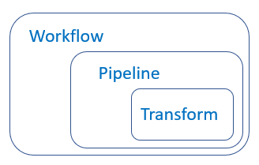
FIRST PIPELINE ARTICLE FLOW
The beginner walkthrough becomes Exercise 0
1
Create a project
2
Create and save a pipeline
3
Add CSV File Input
4
Get fields and preview
5
Fix encoding if needed
6
Add Text File Output
7
Create the hop
8
Run and verify the output file
Source: Samuel Second Medium article
16
16

Slide 17
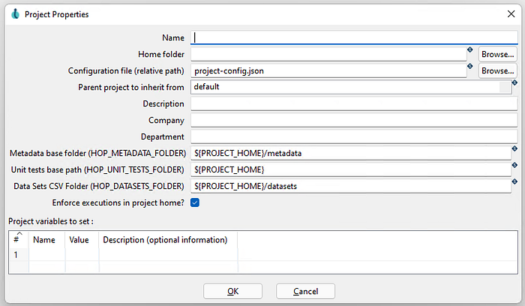
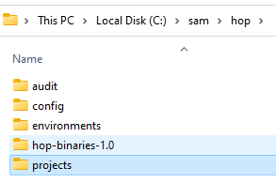

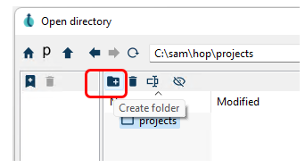
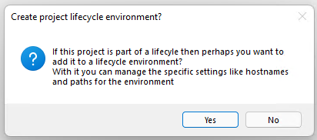
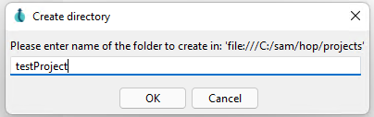
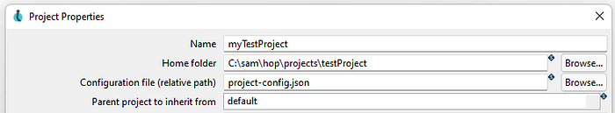
ARTICLE WALKTHROUGH
Project setup
Create a project, project folder, and project properties
3
4
5
6
7
8
9
10
Images: Samuel Second Medium article
17

Slide 18
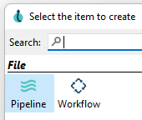
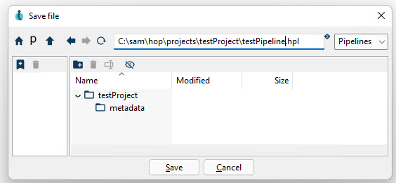
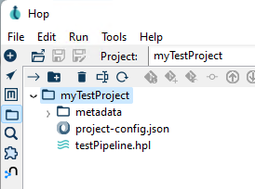
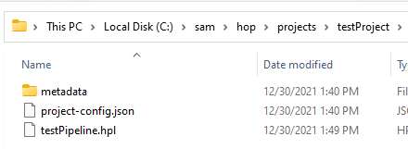
ARTICLE WALKTHROUGH
Create pipeline
New pipeline, save it, and find it in the file explorer
11
12
13
14
Images: Samuel Second Medium article
18

Slide 19
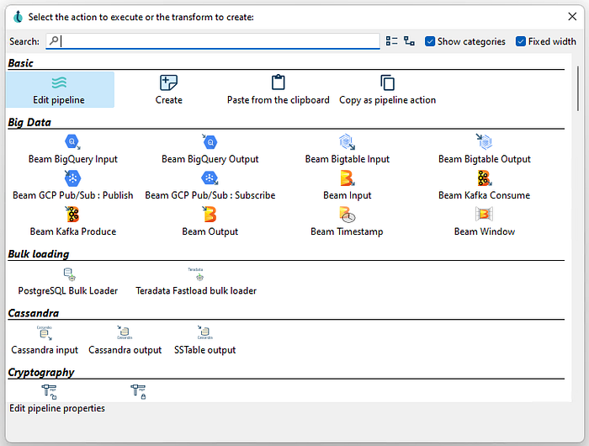
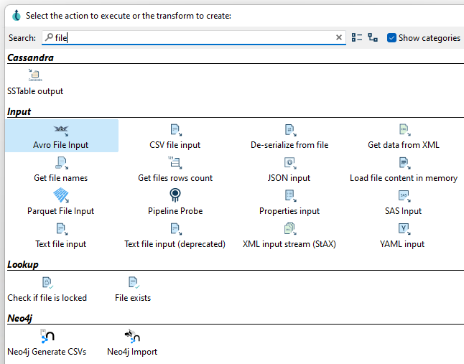
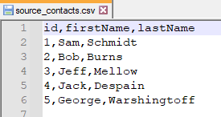

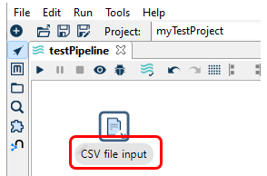
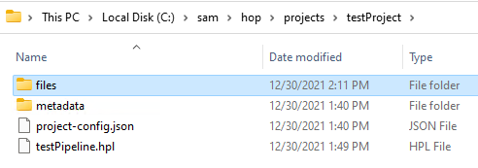
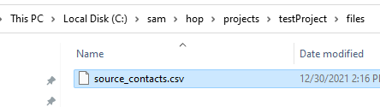
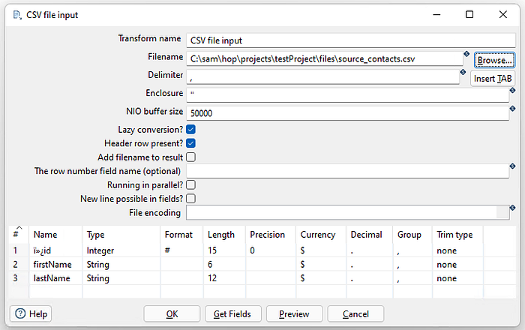
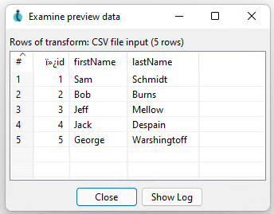
ARTICLE WALKTHROUGH
CSV input
Search transforms, add CSV File Input, browse source file, get fields
15
16
17
18
19
20
21
22
23
24
Images: Samuel Second Medium article
19

Slide 20
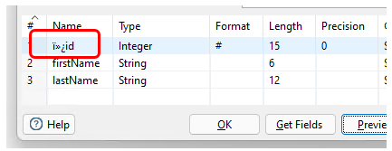
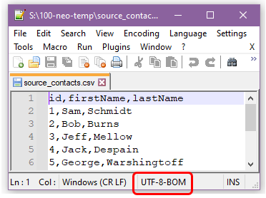
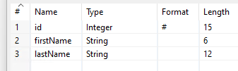
ARTICLE WALKTHROUGH
Preview and encoding
Preview the file, recognize encoding issues, then set the encoding field
25
26
27
28
Images: Samuel Second Medium article
20

Slide 21
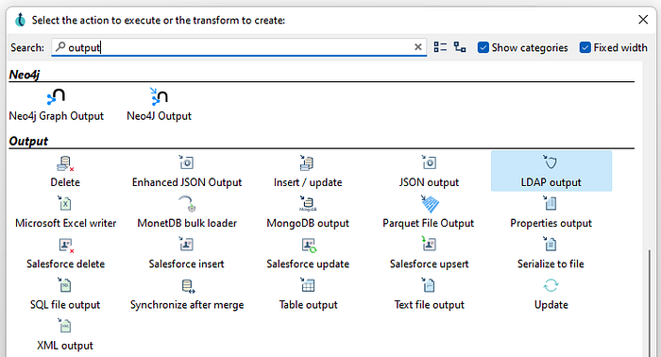
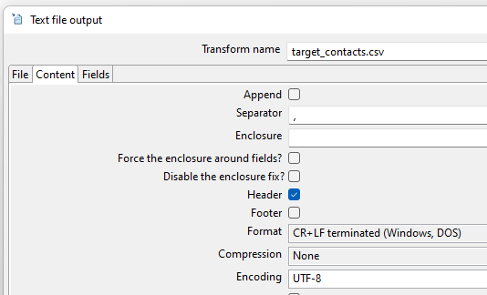
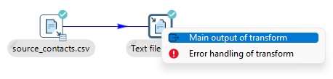
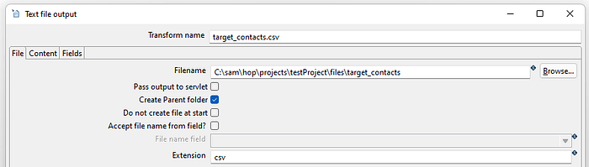
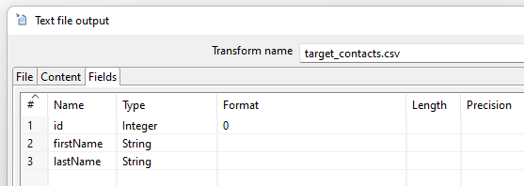
ARTICLE WALKTHROUGH
Text output and hop
Add Text File Output, connect the transforms, configure file/content/fields
29
30
31
32
33
Images: Samuel Second Medium article
21

Slide 22
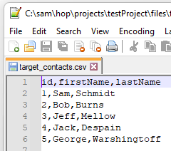
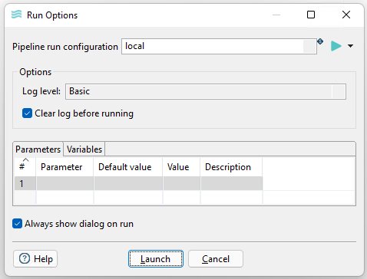
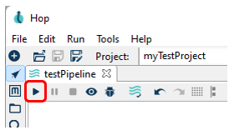
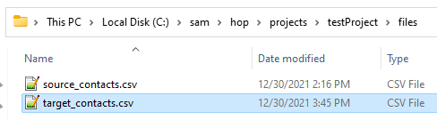

ARTICLE WALKTHROUGH
Run and verify
Run the pipeline and open the output file
34
35
36
37
38
Images: Samuel Second Medium article
22

Slide 23
LAB 0
Build a first CSV-to-CSV pipeline
first_pipeline_source.csv
CSV File Input
Text File Output
first_pipeline_result.csv
Open 00_first_pipeline_csv_to_csv.hpl or build it manually.
Use Get Fields and Preview before running.
Verify output/first_pipeline_result.csv.
23

Slide 24
LAB 1
Batch CSV cleaning pipeline
customers.csv
Normalize fields
Filter valid
Sort + unique
clean/reject CSV
Concepts
Pipeline
Outputs
String normalization, email validation, de-duplication, reject path
01_clean_customers.hpl
customers_cleaned.csv and customers_rejected.csv
24

Slide 25
LAB 2
Lookup, string and math operations
orders.csv
Stream Lookup
Calculate metrics
orders_enriched.csv
products.csv
Product lookup enriches orders by product_id.
JavaScript transform uppercases category and calculates tax, discount and net amount.
25

Slide 26
LAB 3
Real database write and read
customers_cleaned.csv
Table Output
PostgreSQL
Table Input
postgres_customers_de.csv
Metadata
Evidence
PostgreSQL_Medallion.json keeps connection details reusable.
Rows exist in customers_cleaned and verification CSV is written.
26

Slide 27
LAB 4
Kafka streaming in Hop uses a parent pipeline and sub-pipeline
orders.cleaned
orders_producer.py
orders.cdc
Kafka Consumer
Injector sub-pipeline
orders.customer_totals
05_consume_orders_kafka.hpl consumes batches.
06_kafka_order_batch_subpipeline.hpl parses JSON, filters NEW, deduplicates and aggregates.
27

Slide 28
LAB 5
Workflow orchestration ties the batch labs together
Start
First pipeline
Clean
Enrich
DB write/read
Success
Failure
Workflow file: workflows/01_day6_batch_orchestration.hwf
28

Slide 29
MEDALLION PATH
Day 6 transforms Bronze-like raw inputs into Silver-ready outputs
Raw files / CDC
Bronze Kafka / CSV
Hop transforms
Silver clean
Gold analytics-ready
Cleaning, standardization, validation, deduplication and enrichment are Silver responsibilities.
Workflow evidence proves the lab is repeatable, not just a one-off demo.
29

Slide 30
RUN CHECKS
What learners should submit
Hop files
00-06 .hpl files and 01_day6_batch_orchestration.hwf
CSV evidence
first_pipeline_result, customers_cleaned/rejected, orders_enriched
PostgreSQL evidence
customers_cleaned rows and postgres_customers_de.csv
Kafka evidence
orders.cdc, orders.cleaned, orders.customer_totals in Kafka UI
Troubleshooting note
What failed, what was fixed, and which log proved it
30

Slide 31

APPENDIX
Medium article screenshots 1/5
All article images are embedded for classroom reference.
1
2
3
4
5
6
7
8
Images: Samuel Second Medium article
31

Slide 32
APPENDIX
Medium article screenshots 2/5
All article images are embedded for classroom reference.
9
10
11
12
13
14
15
16
Images: Samuel Second Medium article
32

Slide 33
APPENDIX
Medium article screenshots 3/5
All article images are embedded for classroom reference.
17
18
19
20
21
22
23
24
Images: Samuel Second Medium article
33

Slide 34
APPENDIX
Medium article screenshots 4/5
All article images are embedded for classroom reference.
25
26
27
28
29
30
31
32
Images: Samuel Second Medium article
34

Slide 35
APPENDIX
Medium article screenshots 5/5
All article images are embedded for classroom reference.
33
34
35
36
37
38
Images: Samuel Second Medium article
35

Slide 36
SOURCES
Source trail for this recap
Apache Hop User Manual: Hop Web, Docker container, projects/environments, transform plugins, action plugins, metadata types, Kafka Consumer, Kafka Producer and PostgreSQL support.
Samuel Second, Apache Hop, build and run your first pipeline, Medium, Dec 30, 2021: https://medium.com/@samuel.second/apache-hop-build-your-first-pipeline-6ee918ce5092
Lab files in Week_02/Day_06/Lab_Files: docker-compose.yml, pipelines/*.hpl, workflows/*.hwf, metadata/rdbms/PostgreSQL_Medallion.json.
36

Slide 37
PDF ADD-ON
Hop is a modern, plugin-based successor to PDI/Kettle
Low-code design, reusable metadata and execution portability are the core thesis.
Pentaho Kettle / PDI
Apache Hop rebuild
Plugin architecture
Portable pipelines
Focus
Modularity
Portability
Low-code/no-code pipeline design; separation of pipelines, workflows and metadata.
Input/output steps, transforms, actions, metadata objects and engines are extensible plugins.
Develop locally, then move toward cloud, containers or distributed engines.
Source: Apache Hop ILIDE.INFO PDF content reviewed from Slides folder
37

Slide 38
FEATURES
Apache Hop feature map
The PDF emphasizes visual building, metadata-driven development, multi-engine execution, monitoring and extensibility.
Visual builder
Metadata-driven
ETL transforms, CDC, file ingestion, API-to-database, data quality, orchestration
Reusable, Git-friendly, parameter-driven execution
Multi-engine
Integration
Local, Spark, Flink, Dataflow/Beam, Kubernetes
JDBC/NoSQL, CSV/JSON/Avro/Parquet/ORC, S3/GCS/Azure Blob, Kafka/MQTT, REST/SOAP, HDFS/Hive/HBase
Reusable components
Monitoring
Sub-pipelines, workflow actions, DB connections, schemas, parameterized pipelines
Execution logs, statistics, retries, audit trails
Source: Apache Hop ILIDE.INFO PDF content reviewed from Slides folder
38

Slide 39
ECOSYSTEM
Where Hop integrates
Think of Hop as orchestration plus connectors, not only a file transformation tool.
Big data Hadoop Spark Flink Beam
Cloud AWS Azure GCP
Streaming Kafka MQTT CDC
DevOps Git Jenkins GitLab Airflow K8s
Pipeline-as-code means versioning and automation are natural: files can be reviewed, promoted and run through CI/CD.
Source: Apache Hop ILIDE.INFO PDF content reviewed from Slides folder
39

Slide 40
USE CASES
Where Apache Hop fits in a data platform
ETL/ELT pipelines
Data lake ingestion
Real-time processing
Extract operational data, transform/standardize, load warehouses and lakes
Cloud object storage, Parquet/ORC, metadata-driven ingestion
Kafka streaming, CDC ingestion, operational analytics
Quality & governance
Orchestration
ML support
Validation, profiling, matching and standardization
External jobs, scripts/notebooks, multi-step workflows, alerts
Data prep, feature engineering, Python/Spark ML integration
Source: Apache Hop ILIDE.INFO PDF content reviewed from Slides folder
40

Slide 41
ADVANTAGES AND LIMITS
Use Hop deliberately
Advantages
Limitations
Modern successor to PDI/Kettle More modular architecture Multi-environment support Cloud-native adaptability Low-code productivity Reusable/debuggable/version-controlled assets Extensible plugin-driven design
Not a full processing engine by itself Requires familiarity with visual ETL tools Heavy custom code may belong outside Hop Built-in ML is limited and usually depends on external engines
Best fit: visual, metadata-driven, portable ETL/ELT and orchestration.
Source: Apache Hop ILIDE.INFO PDF content reviewed from Slides folder
41

Slide 42
HPL ANATOMY
A Hop pipeline is XML metadata that describes transforms and hops
<pipeline> <transform name="CSV file input" type="CsvInput"> <filename>${PROJECT_HOME}/data/customers.csv</filename> </transform> <transform name="Keep Valid" type="FilterRows"> <condition>email <> ""</condition> </transform> <transform name="Write to PostgreSQL" type="TableOutput"> <connection>PostgreSQL_Medallion</connection> </transform> <hop from="CSV file input" to="Keep Valid"/> </pipeline>
Why this matters
The visual canvas is backed by portable XML files that can be stored in Git.
Lab link
00-06 .hpl files are the real definitions students open and run.
Review tip
Inspect transform names, plugin types, file paths, connections and hop routes.
Source: Apache Hop ILIDE.INFO PDF content reviewed from Slides folder
42

Slide 43
WHEN TO USE HOP
Summary from the PDF
Visual, metadata-driven, low-code ETL/ELT
Portable pipelines across local, cloud and distributed engines
Integration with Hadoop, Spark, Beam and Kafka
Easy orchestration of complex workflows
Reusable components and multi-environment support
Extensible, open-source, no vendor lock-in
Source: Apache Hop ILIDE.INFO PDF content reviewed from Slides folder
43

