Slide 1


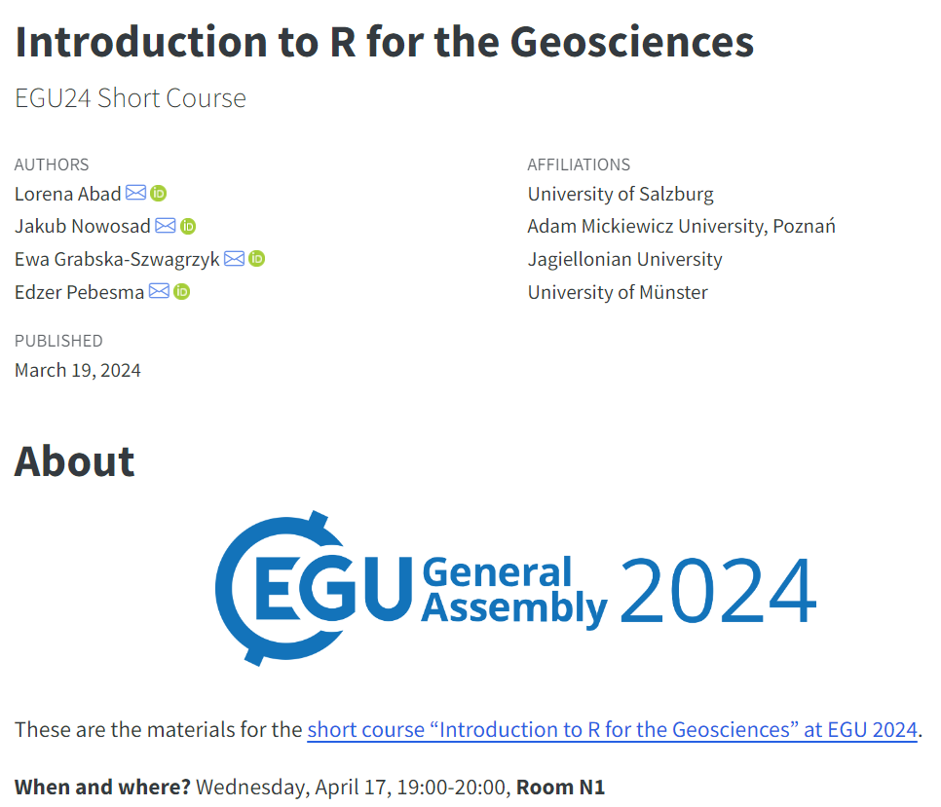
meetingorganizer.copernicus.org/EGU24/session/49442
Artwork by @allison_horst

