Slide 1

Development of an integrated respiratory rate monitoring system using STM32 microcontroller
Lorenzo Bartolucci – Luca De Bartolo – Simone Pasquariello – Marco Corrado – Francesco Ronchi
Luca De Bartolo
Simone..
Lorenzo ..
Francesco..
Macro..
Hardware & Software Co-Design of Electronic Systems
A.Y. 2023-2024

Slide 2
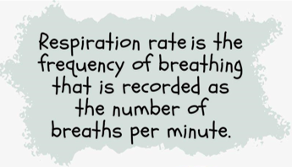


Respiratory Rate
Definition
Why is it important?
It is a fundamental vital sign sensitive to various pathological conditions:
Adverse cardiac events
Clinical deterioration
Pneumonia
Stress factors
Low body oxigenation
Normal Range
(12 – 30) breaths/min
(0.2 – 0.5) Hz

Slide 3
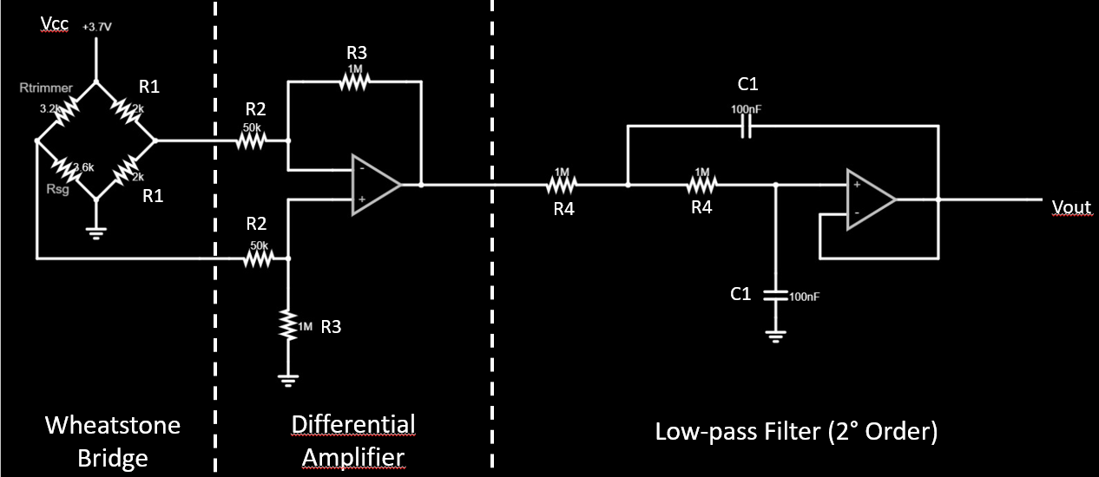
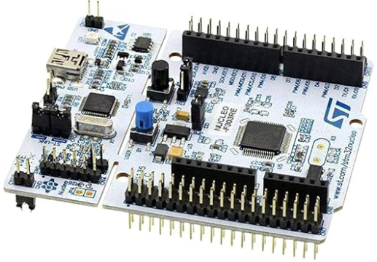
How do we measure it?
Strain Gauge Sensor
Wearable band that transforms the strain into a resistance variation
Conditioning Circuit
It converts the resistance variation into a voltage one, which is also amplified and filtered
STM32 Microcontroller
It elaborates the voltage signal and it retrieves the respiratory rate through the FFT

Slide 4
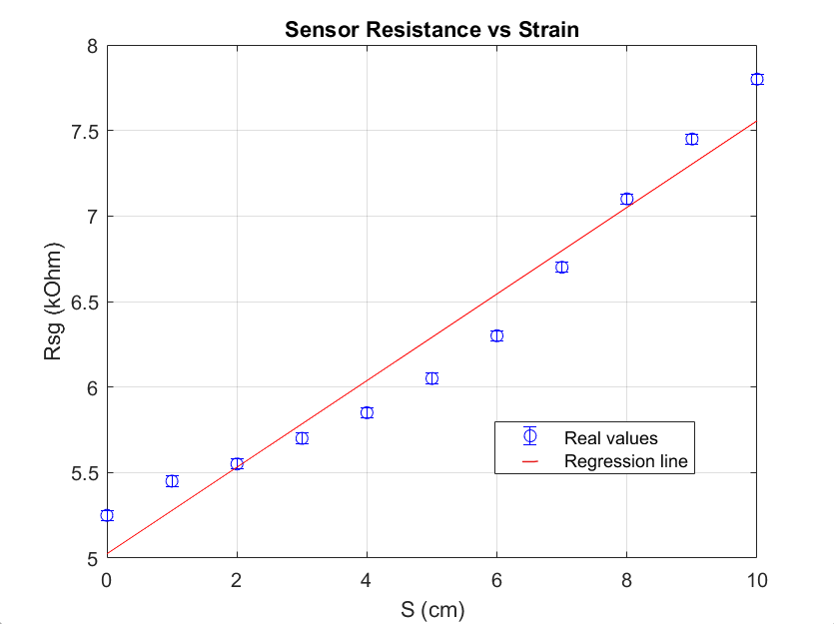
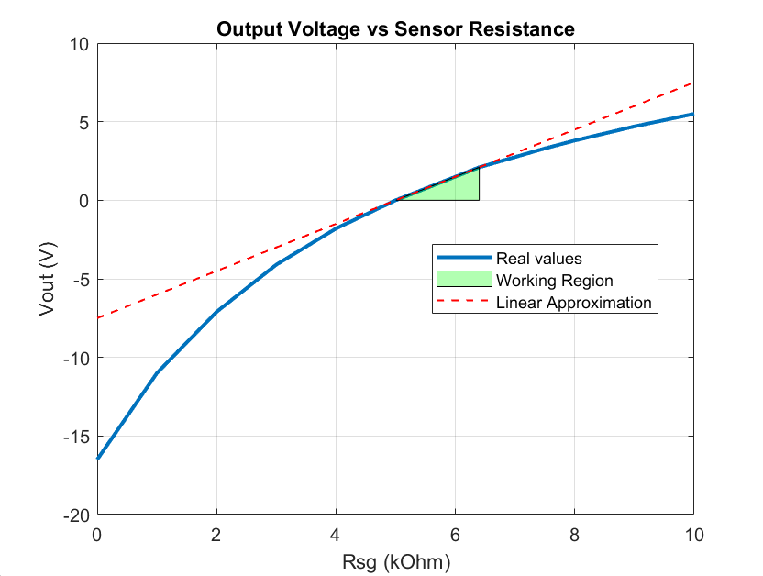


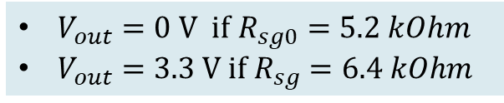
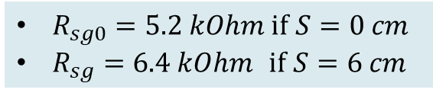
Strain Gauge Sensor
Silicon fabric that responds to strain with a change in resistance: $∆R_{sg}=R_{sg0}∙S∙G$
From conditioning circuit we get the output voltage as function of sensor resistance
$R_{sg0}=5.2 kOhm if$ $S=0 cm$
$R_{sg}=6.4 kOhm$ if $S=6 cm$
Working region
$V_{out}=0 V if$ $R_{sg0}=5.2 kOhm$
$V_{out}=3.3 V if{ R}_{sg}=6.4 kOhm$
High sensitivity of $\frac{3.3 V}{6 cm}=0.55 V/cm$

Slide 5
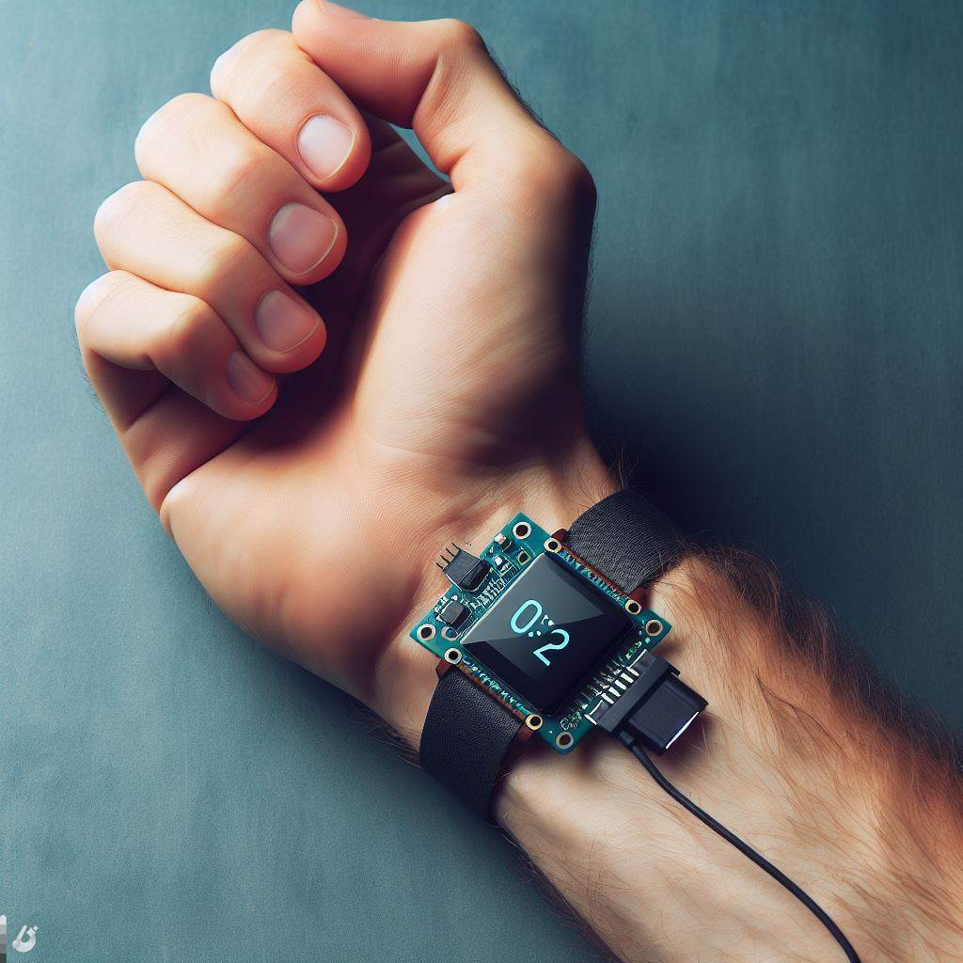
Project Overview and Divisions
Studio della benda resistiva a disposizione
Circuito di Condizionamento (Hardware)
Codice (Software)
PCB

Slide 6
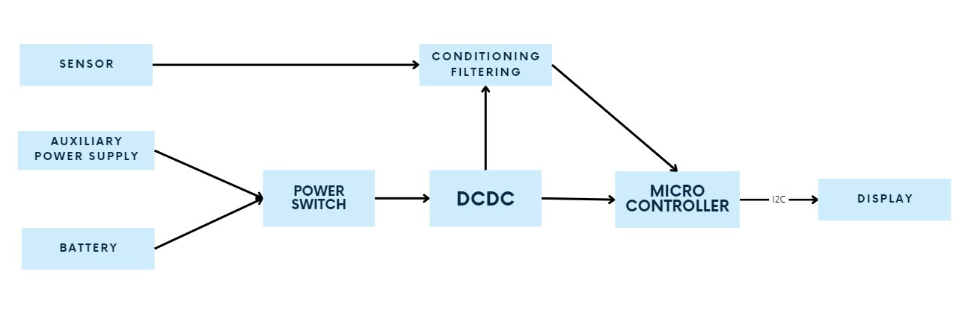
Overall Electronics Architecture

Slide 7
Battery powered circuit requirements
Battery charging circuit
Battery Protection circuit (Undervoltage and Overvoltage)
Battery Charging IC with embedded overvoltage protection
DCDC converter with an enable pin that has an embedded comparator

Slide 8
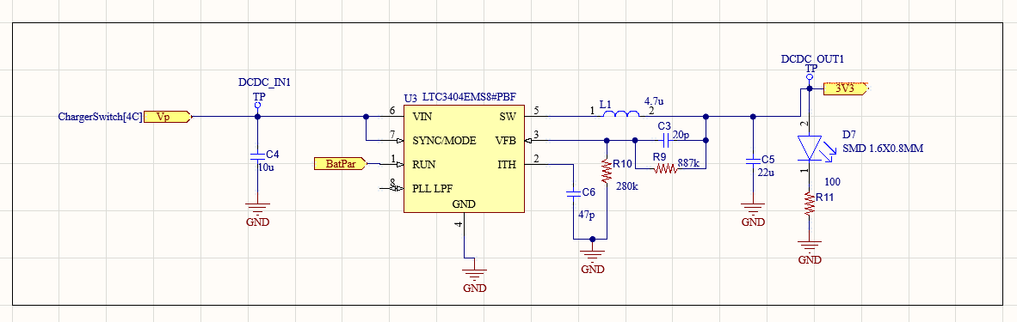
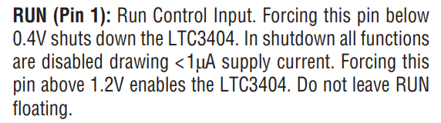
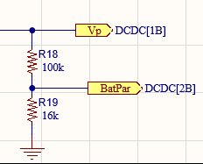
DCDC Converter

Slide 9
Power Switch
Enable the continuous operation while changing the power supply without losing data coming from the sensor
3 different circuits:
Programmable power switch: overkill for our purposes
Low cost analog circuit: our choice
High cost Integrated circuit

Slide 10
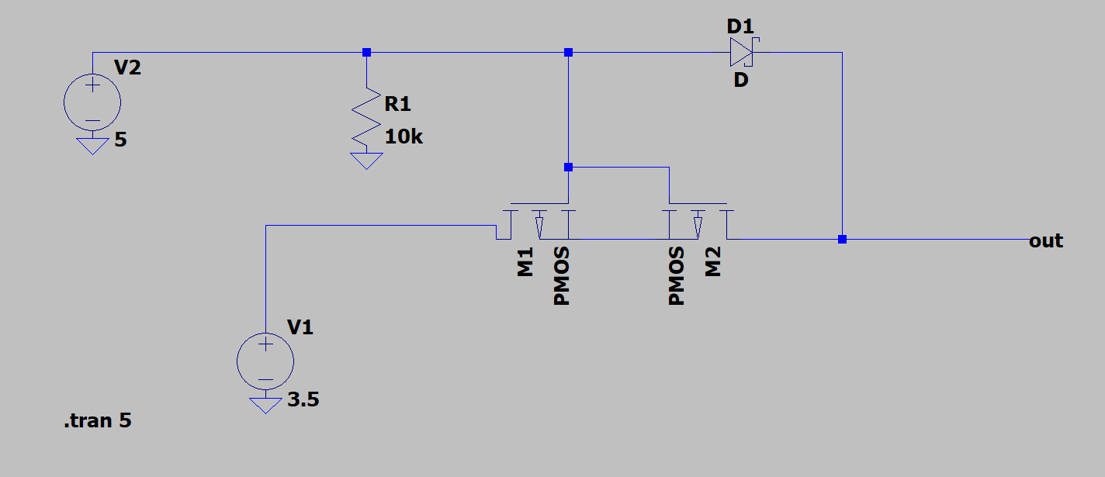
Low cost analog configuration

Slide 11
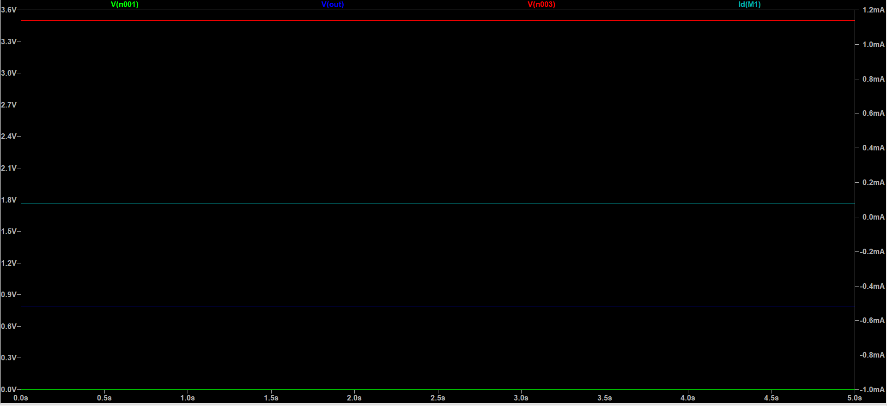
Simulation results: Switch ON

Slide 12
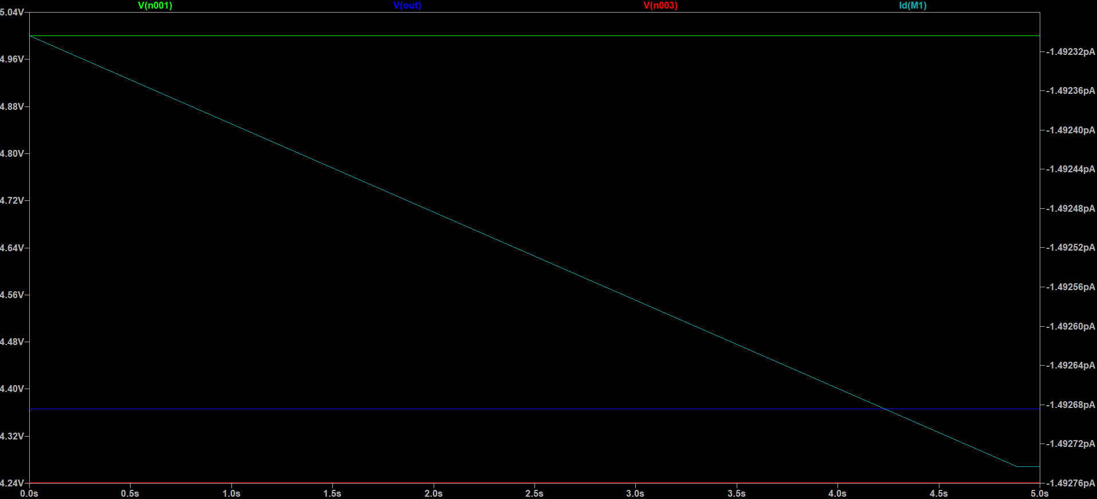
Simulation results: Switch OFF

Slide 13
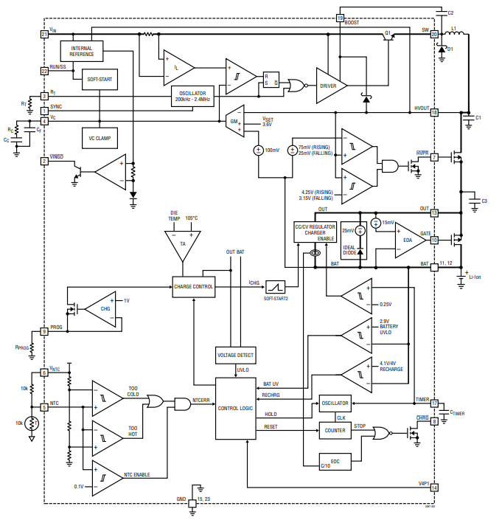
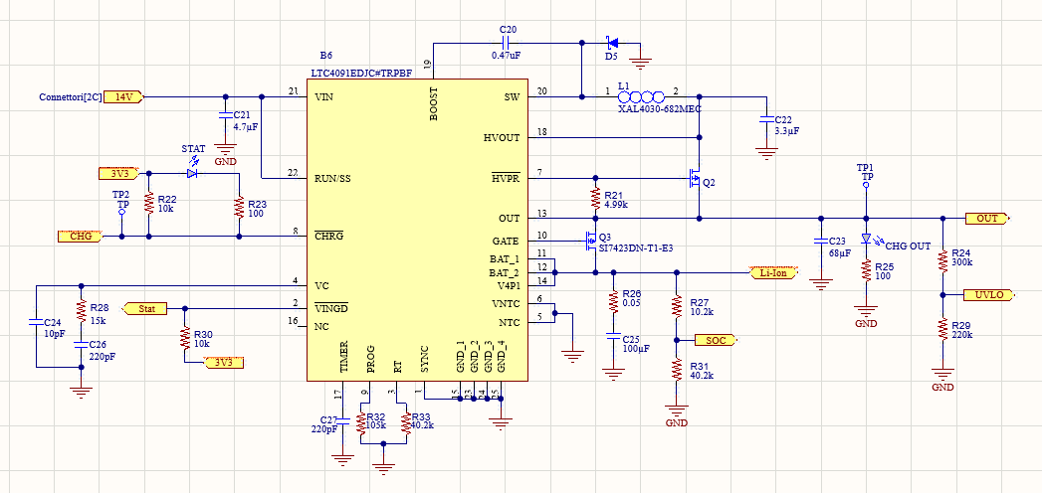
High cost Integrated IC for further improvements

Slide 14
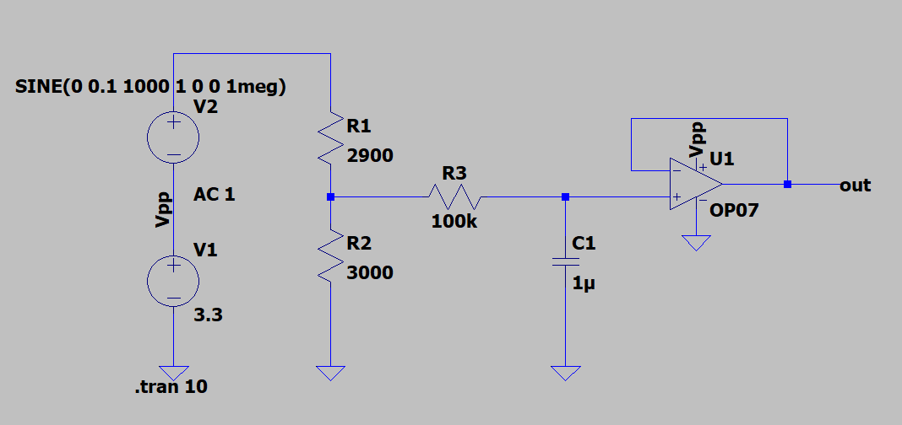
Conditioning Filtering circuit
Voltage Divider: low accuracy

Slide 15
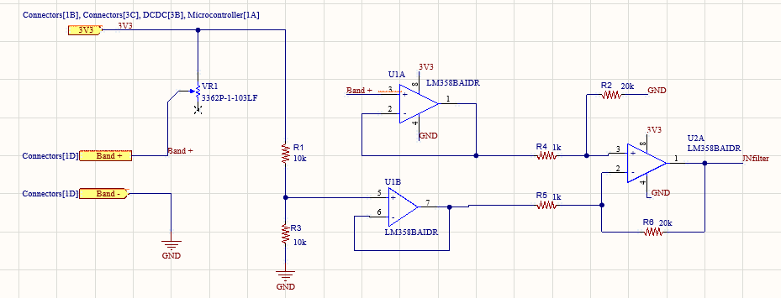
Wheaston Bridge + Differential Amplifier

Slide 16
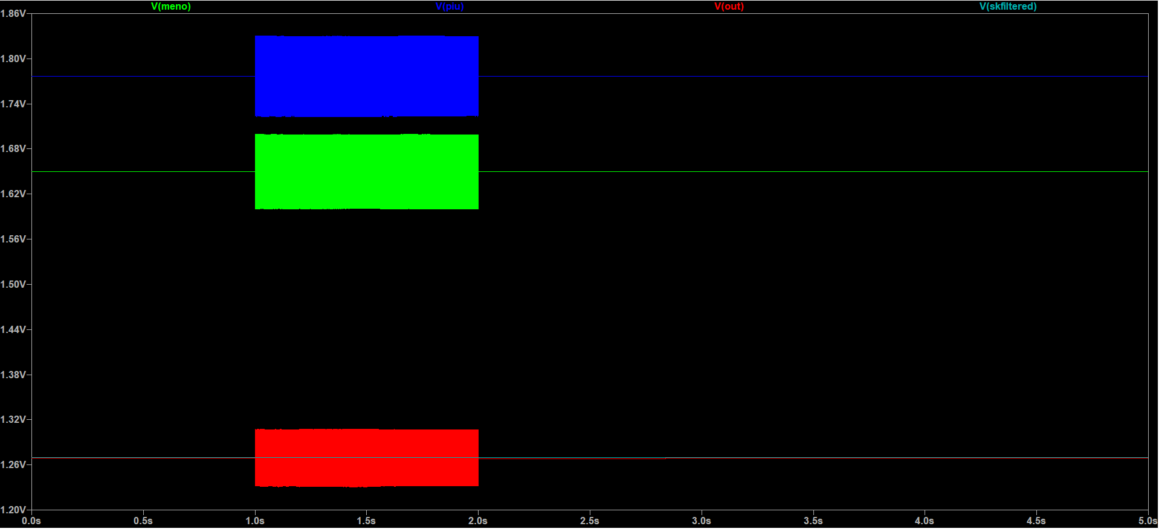
Conditioning simulations

Slide 17
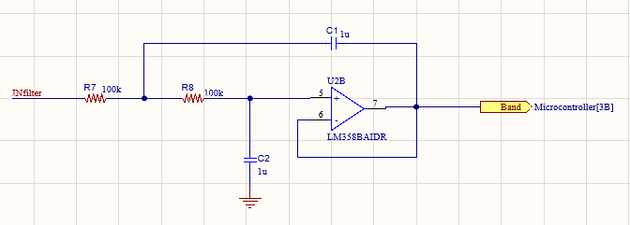
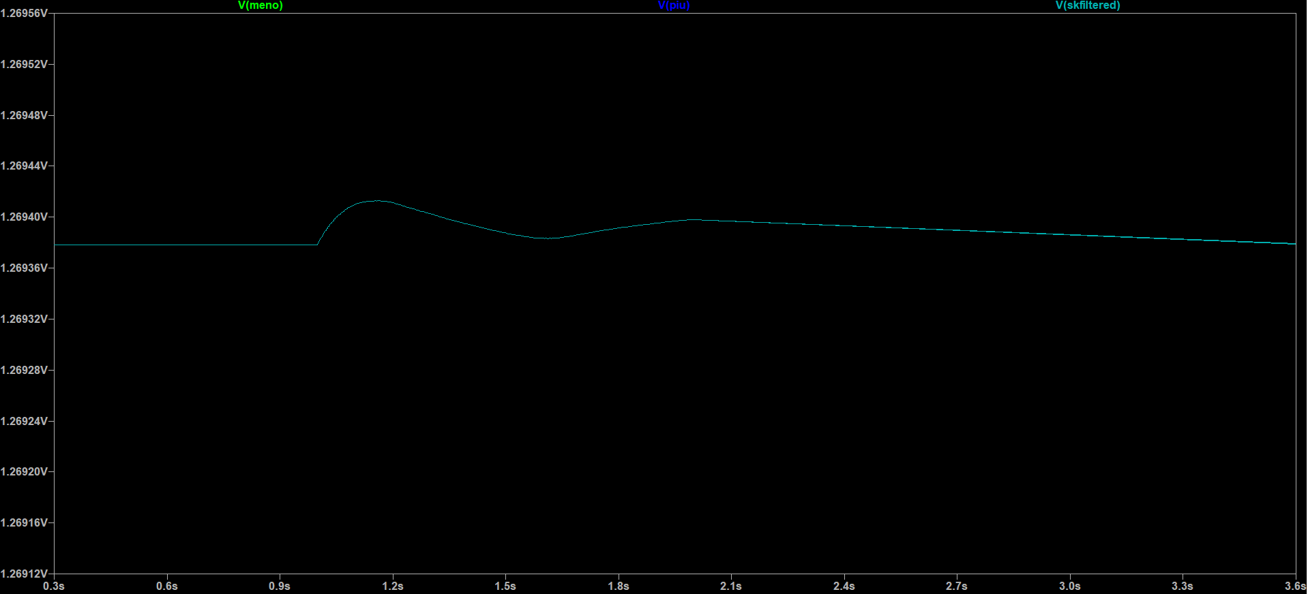
Using a Sallen Key filter

Slide 18
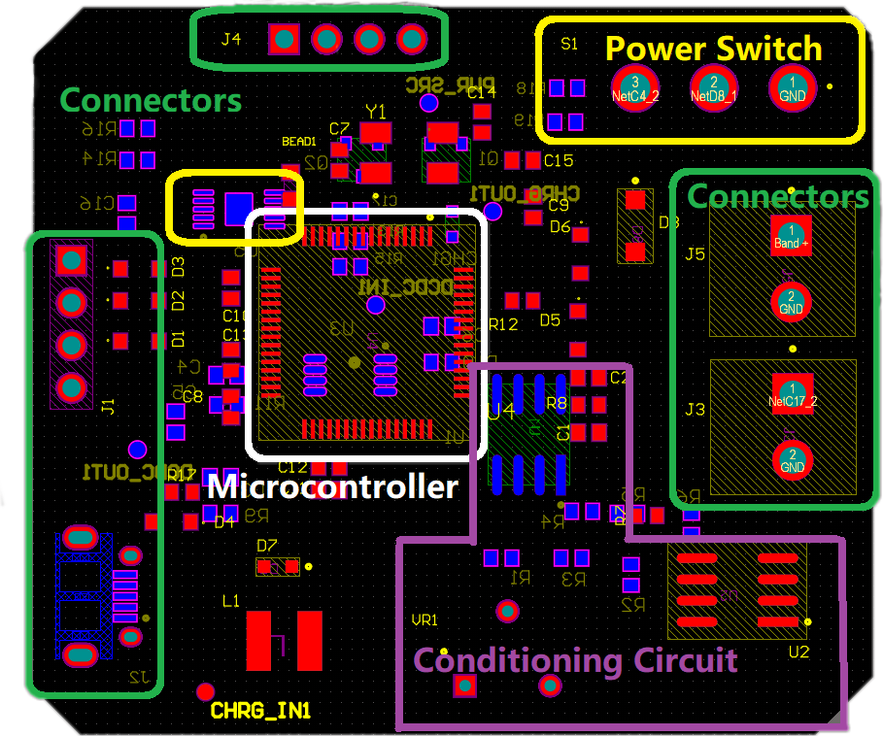
PCB Design and Component Layout
Centralized STM32 microcontroller: Optimal signal path and integrity
Edge-placed SWD connector: Facilitates programming access
Micro USB connector: Unrestricted cable access, minimized board stress
I2C interface for LCD: Considered spatial requirements, no component interference
Polygon pours: used to create a solid or shaded area in the PCB layers

Slide 19
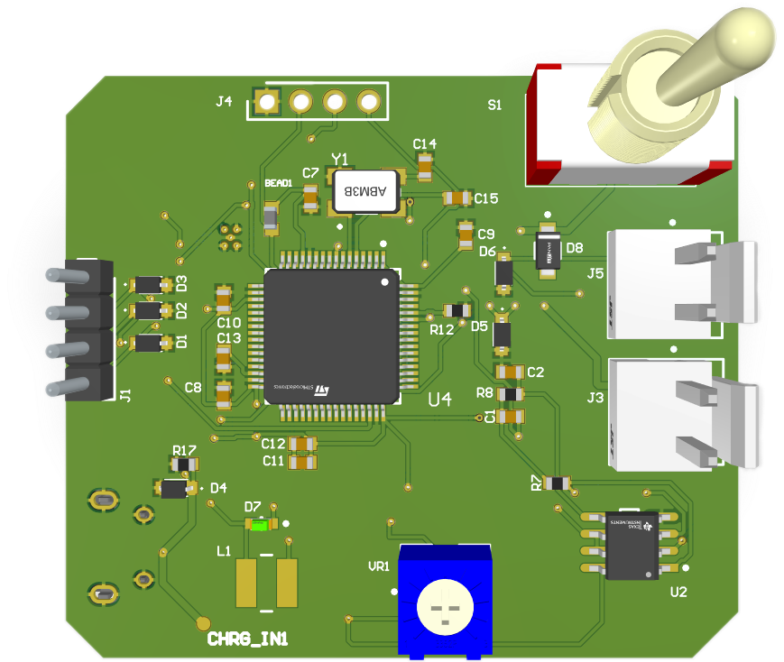
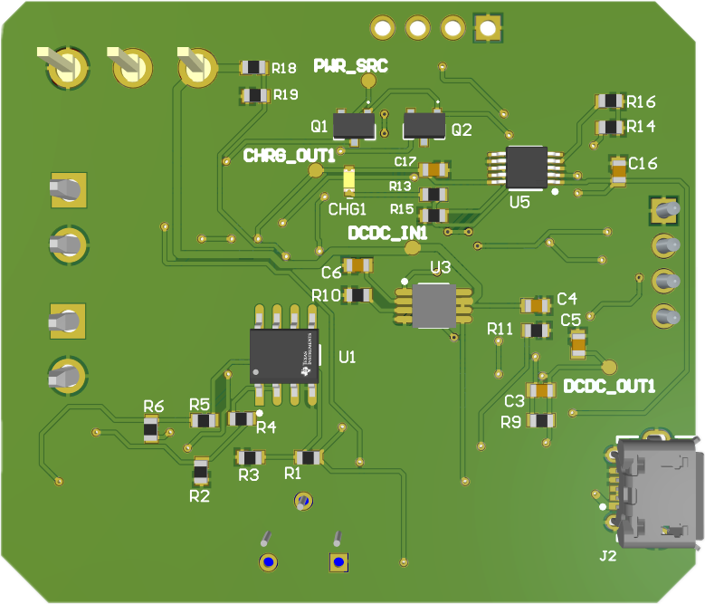
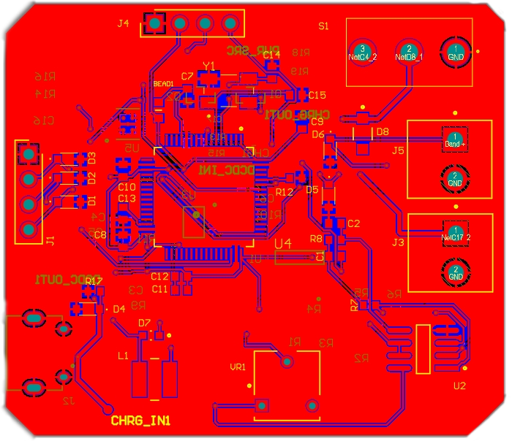
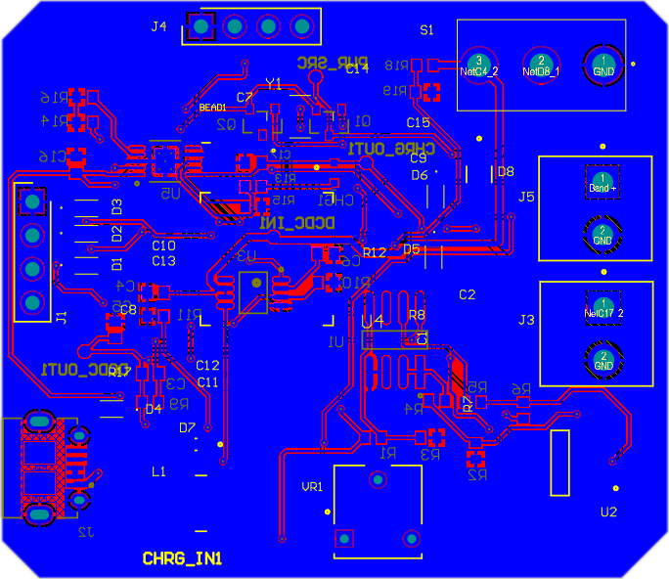
3d view
2d view

Slide 20


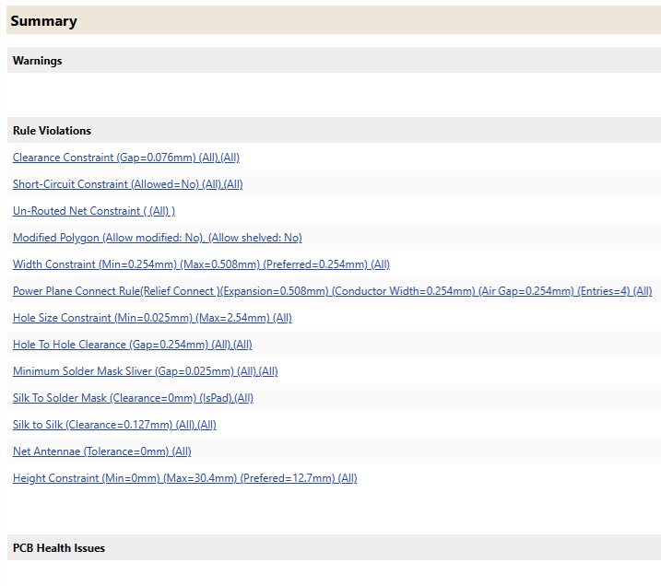

Design Rule Check (DRC) and Manufacturing Compliance

Slide 21

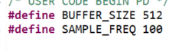
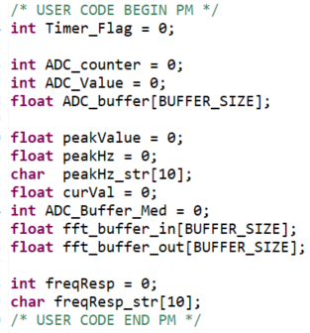
Software

Slide 22
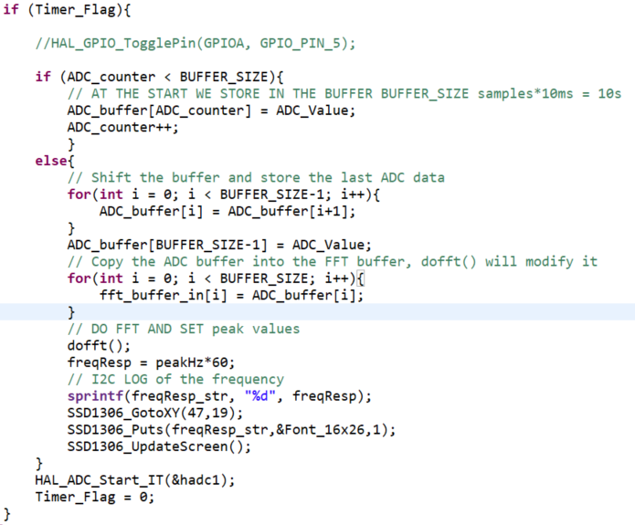
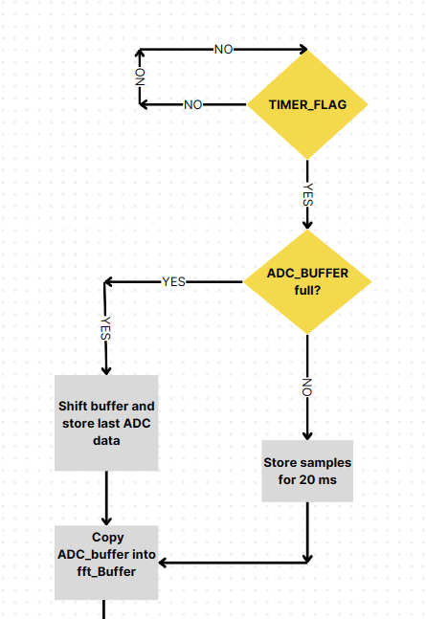
Software (2)

Slide 23
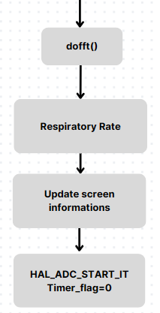
Software (2)

Slide 24
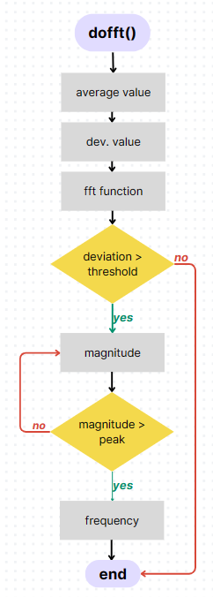
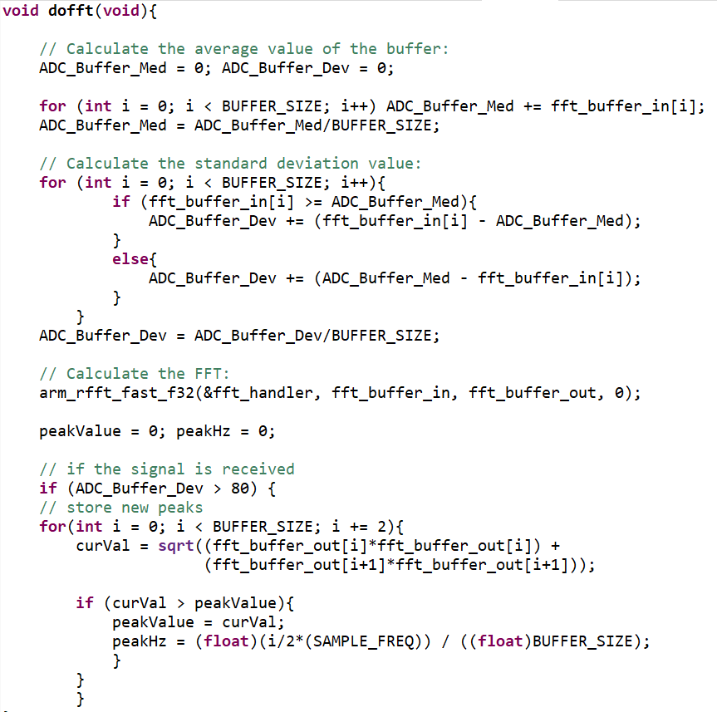
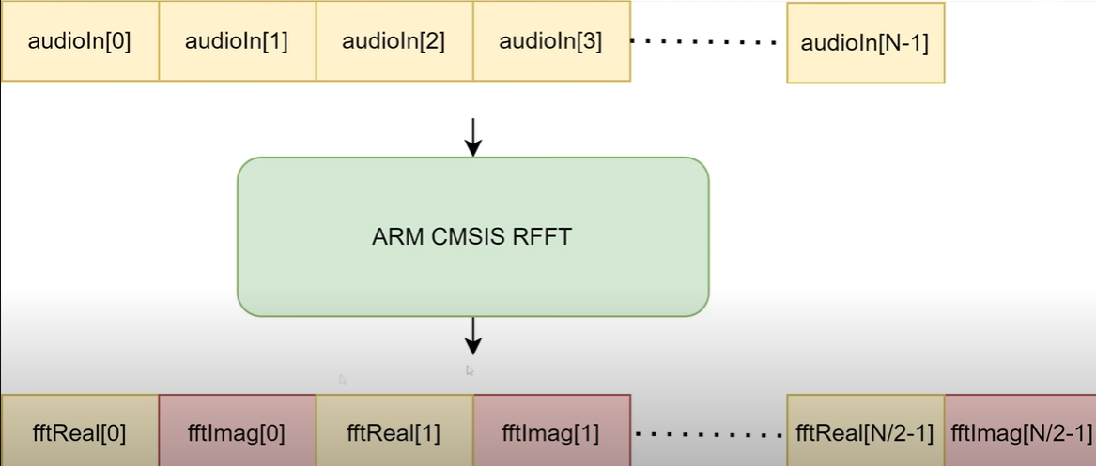
Software (3)

Slide 25
Software (3)

Slide 26
Video

Slide 27
Conclusions
Initial time to fill the buffer
Manual potentiometer adjustment
Changing the buffer size or sampling time
Implement a self-adjusting potentiometer
Trade off tra tempo e prestazioni (sensibilità)
Notes:
Grazie al trimmer abbiamo più Flessibilità (modulability/modularity o modularity) del codice .. Nel servomotor implemneta una formula che per qualsiasi grado calcoli il movimento.
Robustezza: metti funzione che ti fa uscire dal programma se succede una cosa indesiderata!

