Slide 1

Development of an integrated respiratory rate monitoring system using STM32 microcontroller
Lorenzo Bartolucci – Luca De Bartolo – Simone Pasquariello – Marco Corrado – Francesco Ronchi
Luca De Bartolo
Simone..
Lorenzo ..
Francesco..
Macro..
Hardware & Software Co-Design of Electronic Systems
A.Y. 2023-2024

Slide 2
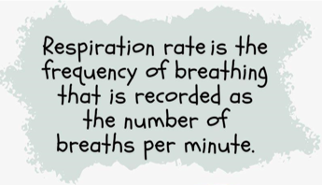
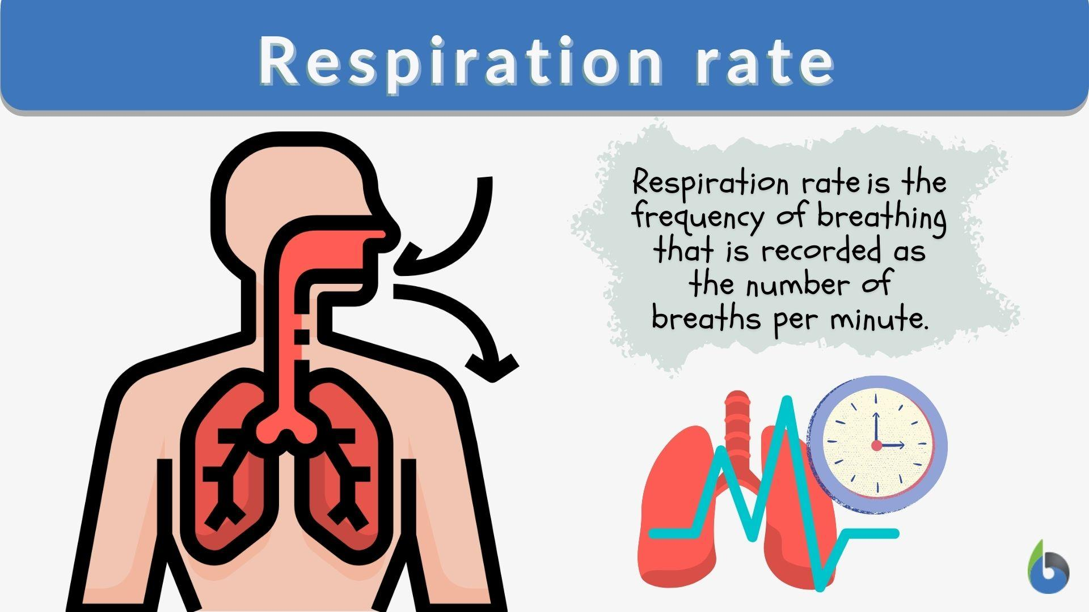

Respiratory Rate
Definition
Why is it important?
It is a fundamental vital sign sensitive to various pathological conditions:
Adverse cardiac events
Clinical deterioration
Pneumonia
Stress factors
Low body oxigenation
Normal Range
(12 – 30) breaths/min
(0.2 – 0.5) Hz

Slide 3
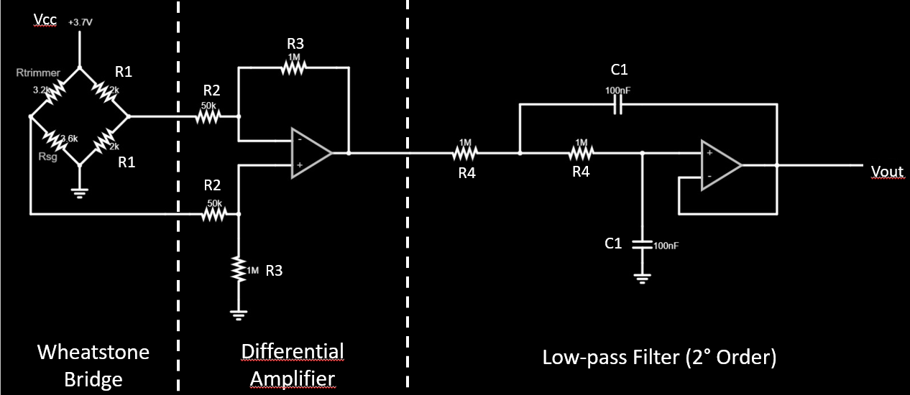
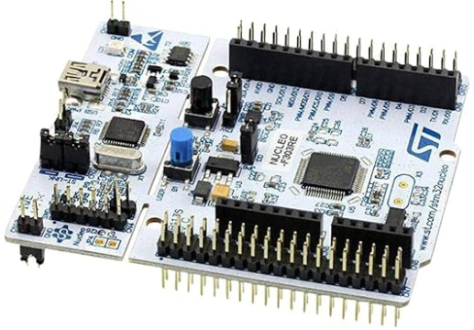
How do we measure it?
Strain Gauge Sensor
Wearable band that transforms the strain into a resistance variation
Conditioning Circuit
It converts the resistance variation into a voltage one, which is also amplified and filtered
STM32 Microcontroller
It elaborates the voltage signal and it retrieves the respiratory rate through the FFT

Slide 4
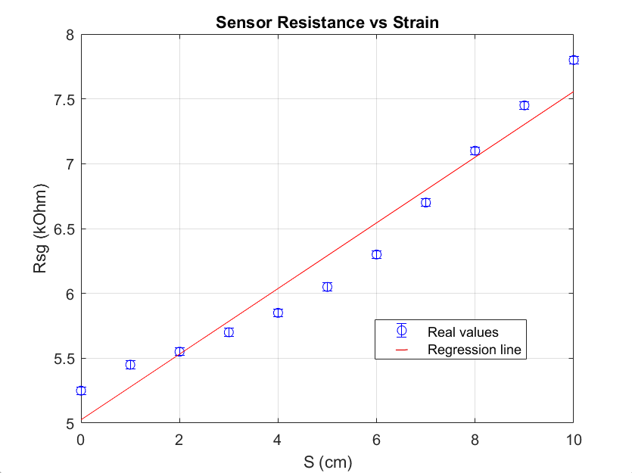
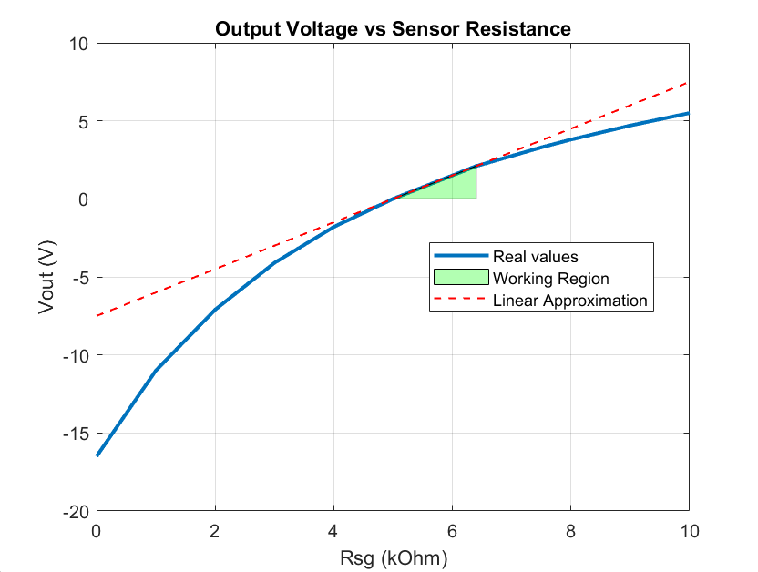


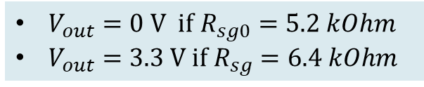
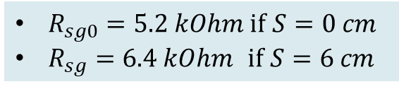
Strain Gauge Sensor
Silicon fabric that responds to strain with a change in resistance: $∆R_{sg}=R_{sg0}∙S∙G$
From conditioning circuit we get the output voltage as function of sensor resistance
$R_{sg0}=5.2 kOhm if$ $S=0 cm$
$R_{sg}=6.4 kOhm$ if $S=6 cm$
Working region
$V_{out}=0 V if$ $R_{sg0}=5.2 kOhm$
$V_{out}=3.3 V if{ R}_{sg}=6.4 kOhm$
High sensitivity of $\frac{3.3 V}{6 cm}=0.55 V/cm$

Slide 5
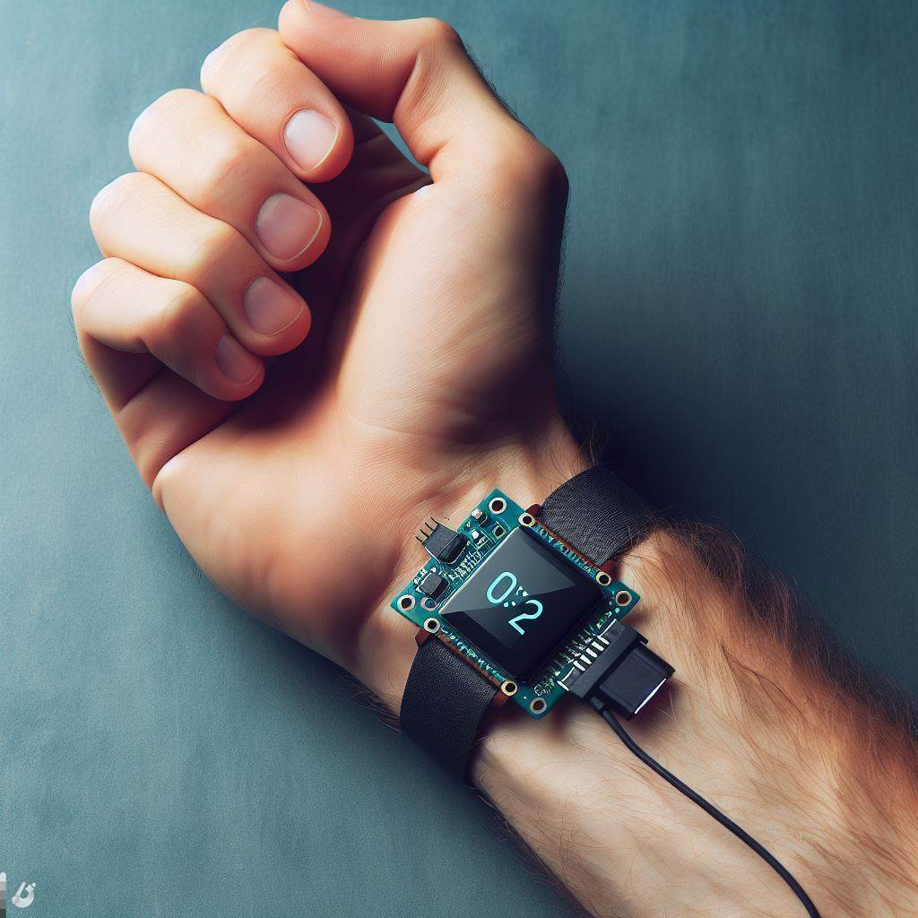
Project Overview and Divisions
Studio della benda resistiva a disposizione
Circuito di Condizionamento (Hardware)
Codice (Software)
PCB

Slide 6
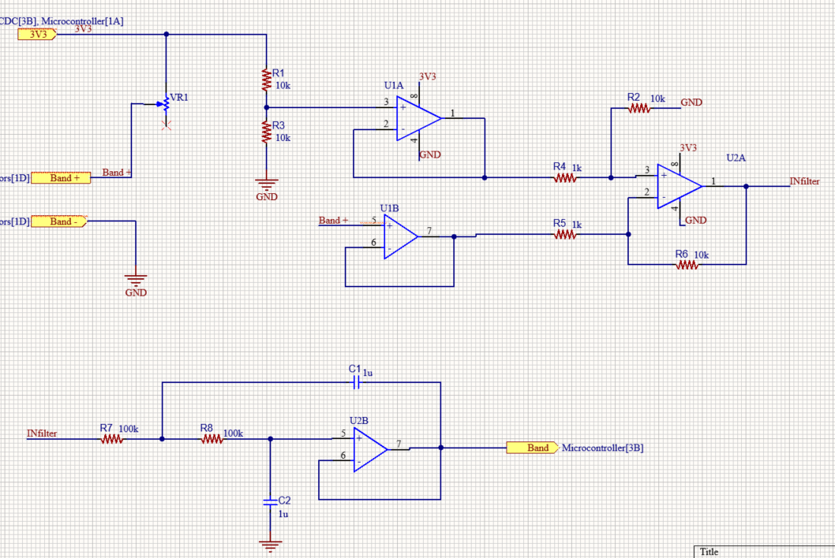
Hardware

Slide 7
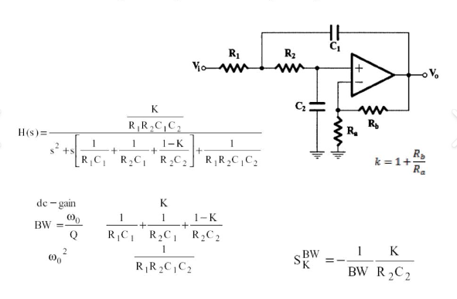
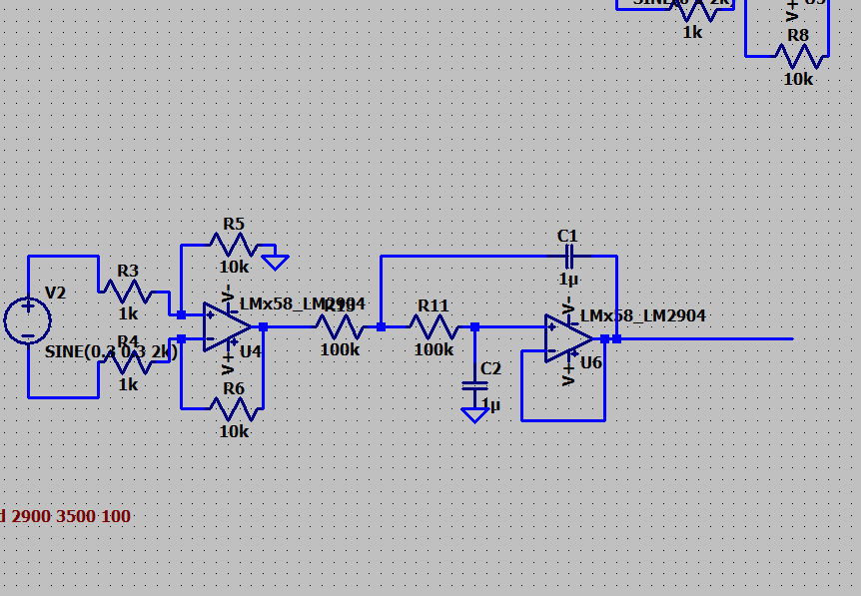
Hardware (2)

Slide 8
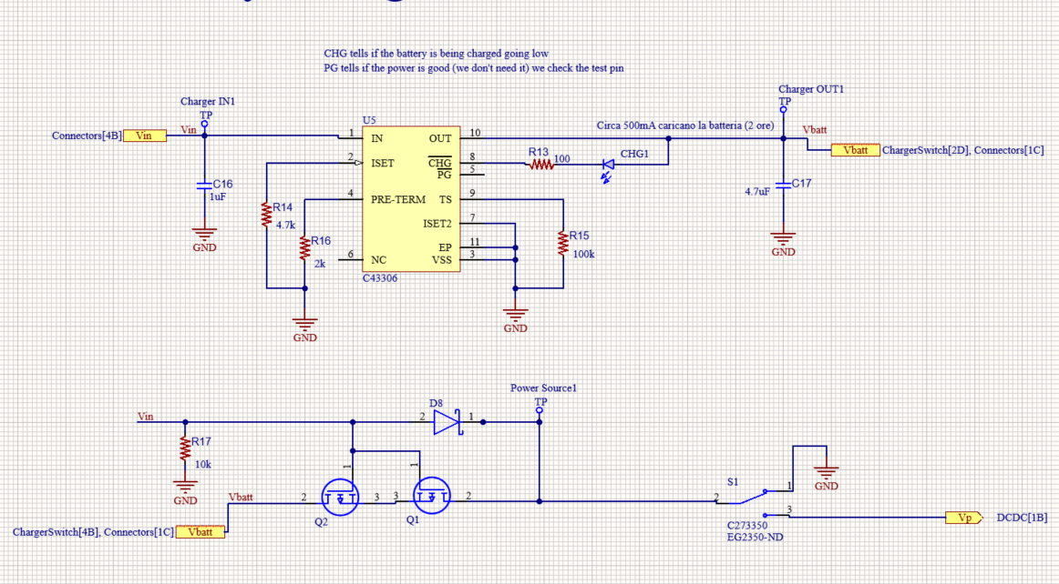
Hardware (3)

Slide 9
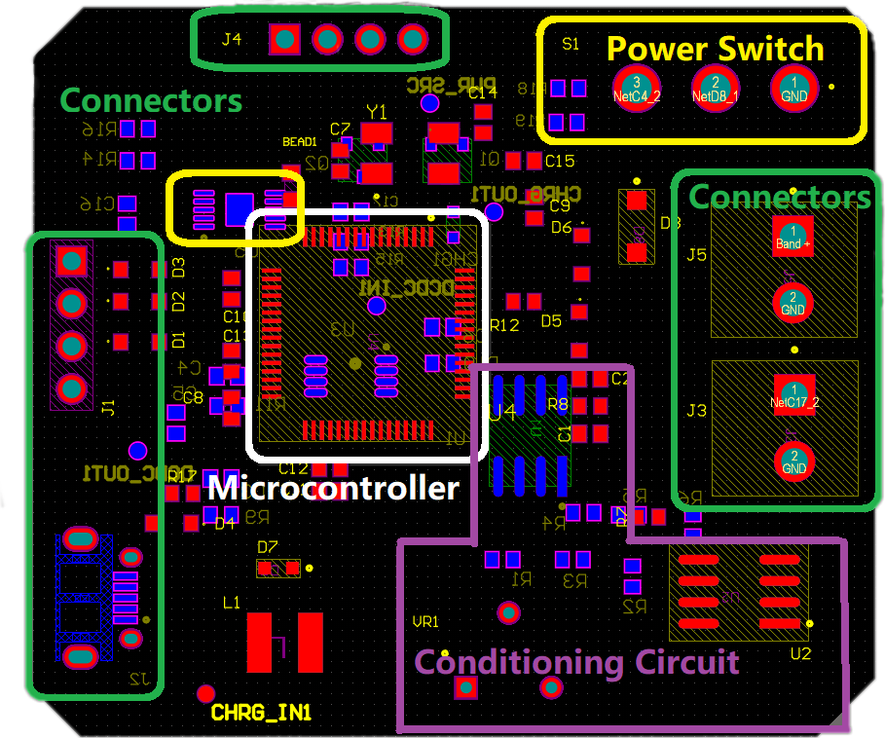
PCB Design and Component Layout
Centralized STM32 microcontroller: Optimal signal path and integrity
Edge-placed SWD connector: Facilitates programming access
Micro USB connector: Unrestricted cable access, minimized board stress
I2C interface for LCD: Considered spatial requirements, no component interference
Polygon pours: used to create a solid or shaded area in the PCB layers

Slide 10
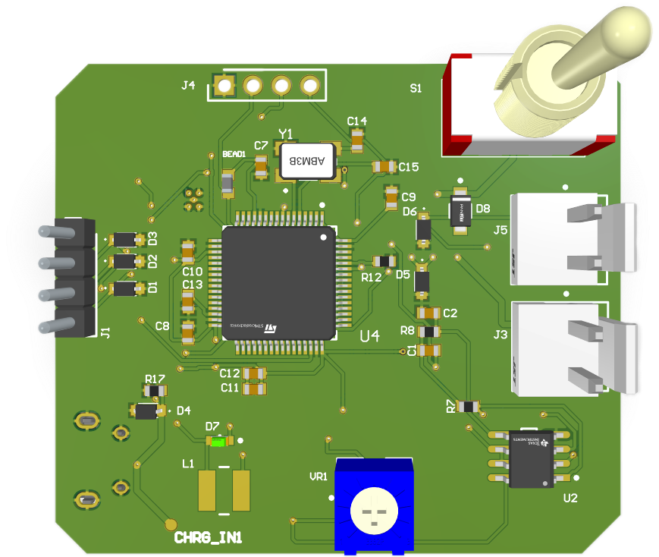
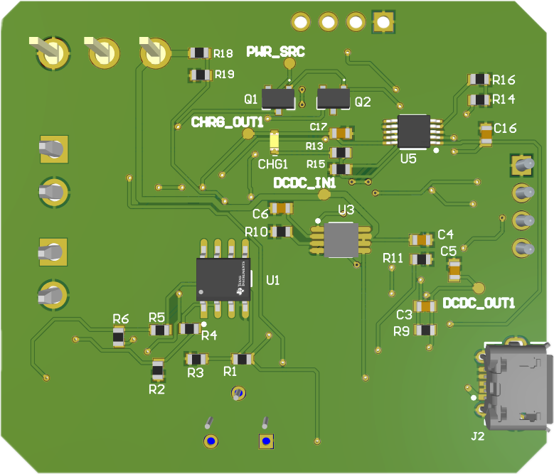
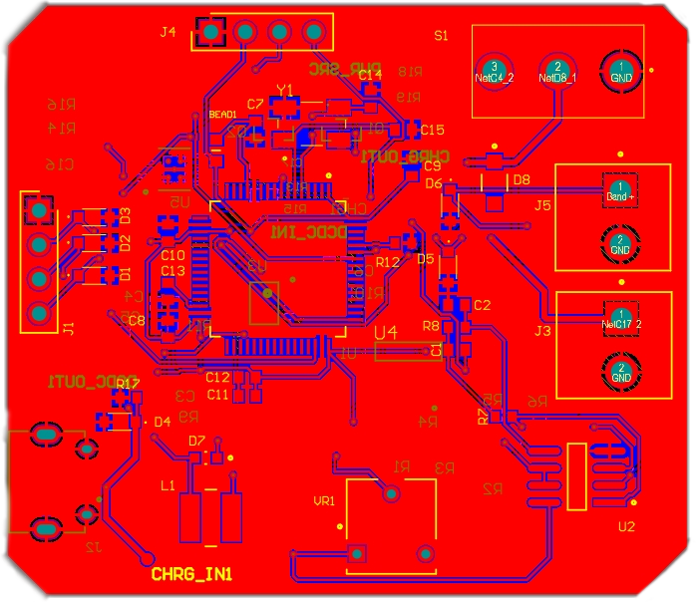
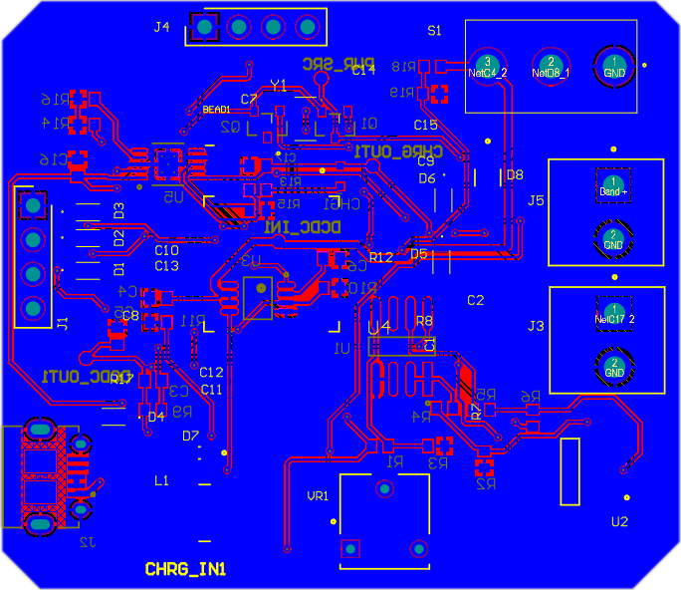
3d view
2d view

Slide 11


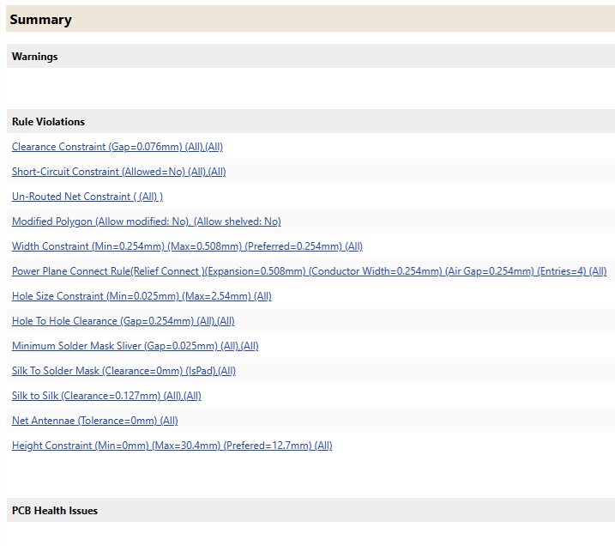
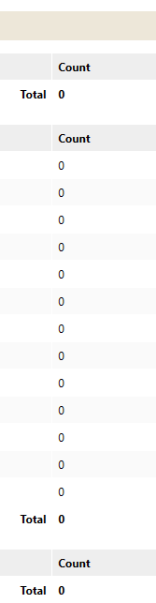
Design Rule Check (DRC) and Manufacturing Compliance

Slide 12
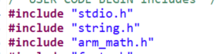
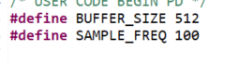
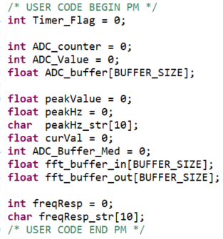
Software

Slide 13
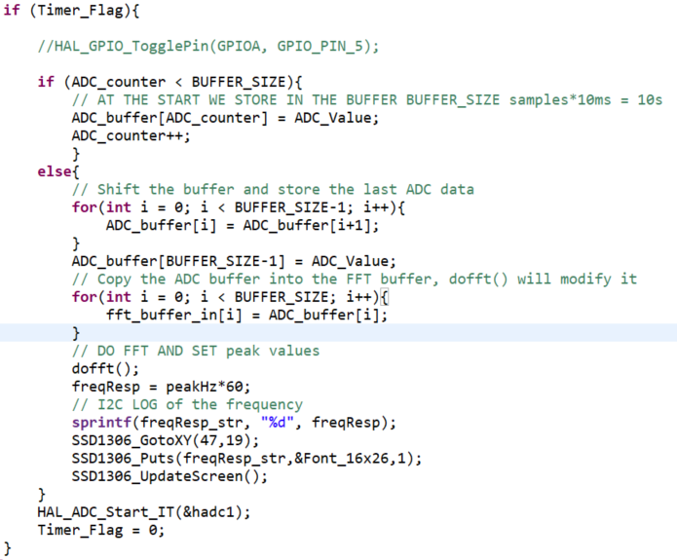
Software (2)

Slide 14
Software (3)

Slide 15
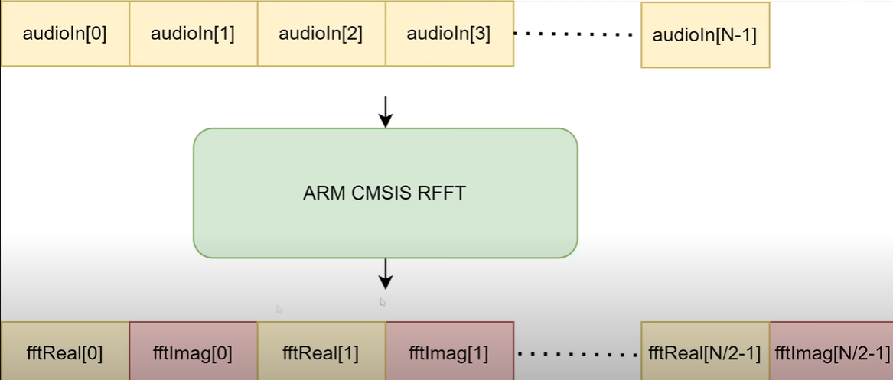
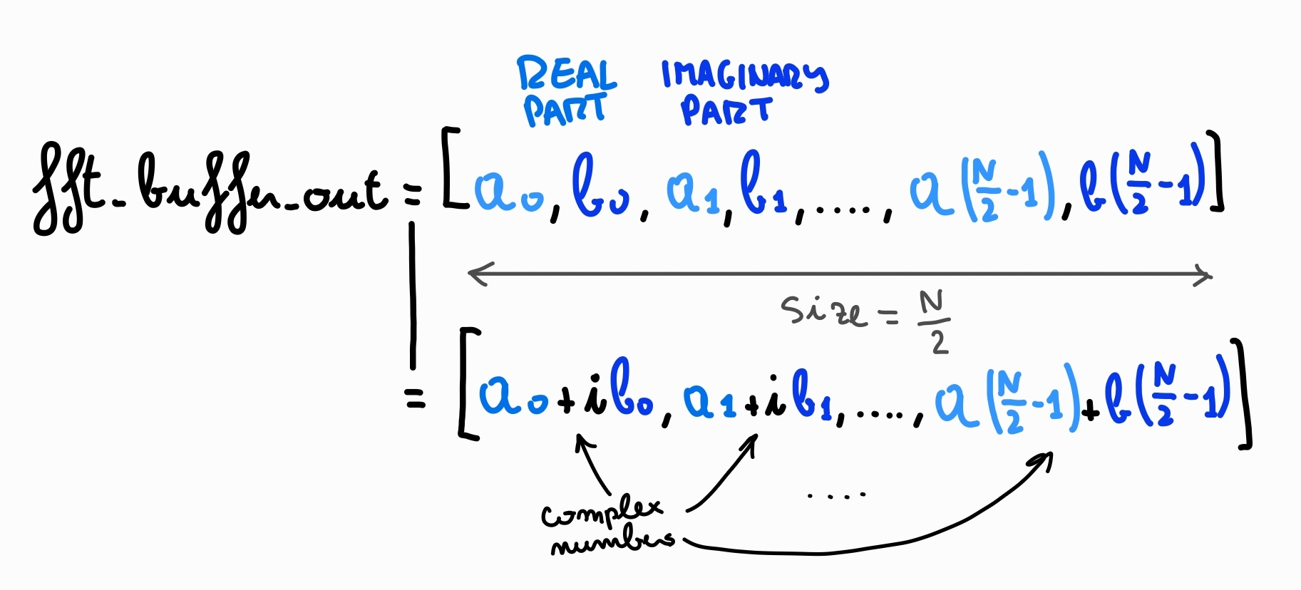
Software (3)

Slide 16
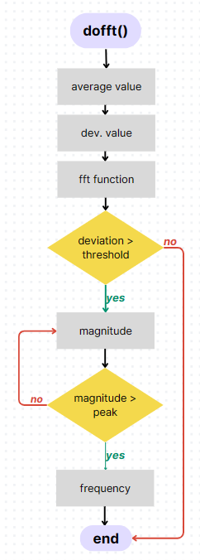
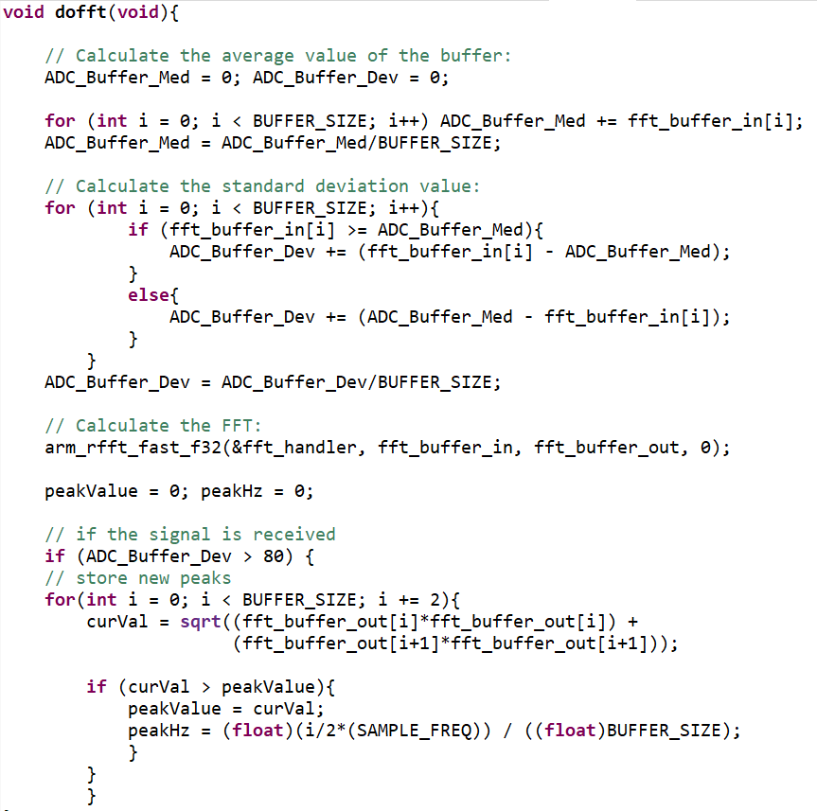
Software (4)

Slide 17
Video

Slide 18
Conclusions
Initial time to fill the buffer
Manual potentiometer adjustment
Changing the buffer size or sampling time
Implement a self-adjusting potentiometer
Trade off tra tempo e prestazioni (sensibilità)
Notes:
Grazie al trimmer abbiamo più Flessibilità (modulability/modularity o modularity) del codice .. Nel servomotor implemneta una formula che per qualsiasi grado calcoli il movimento.
Robustezza: metti funzione che ti fa uscire dal programma se succede una cosa indesiderata!

