Slide 1

DGN & DDQN Agent
toxicity counterfactual explainability
Lorenzo Benucci - 2219690
Emilio Leo - 1966813

Slide 2

Our Pipeline
Deep Graph Network
Double
Deep
Q-net
TOX21
EDA
RESULTS
GOAL: flipping toxicity, maximizing similarity

Slide 3
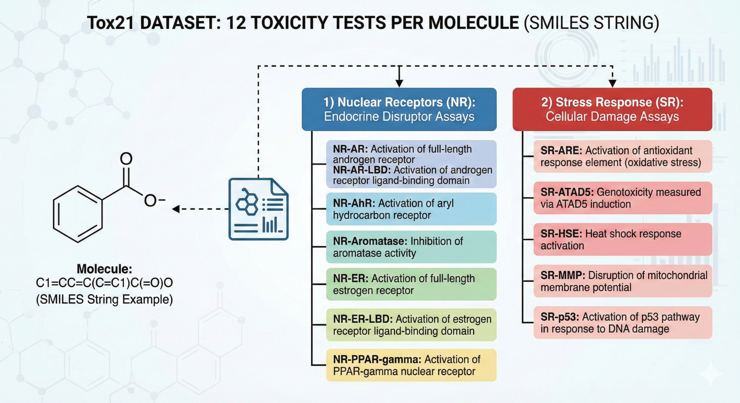
Dataset - TOX21
Nuclear Receptors (NR)
Toxicity Test
Stress Response (SR)
TOX21
Molecular Formula
[SMILE] format
Molecule Structure
Molecule ID

Slide 4
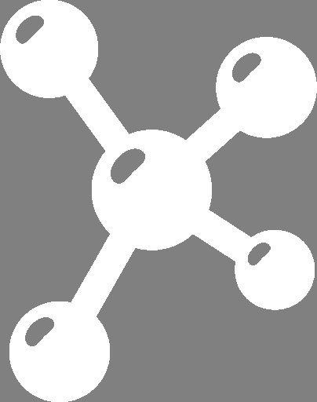
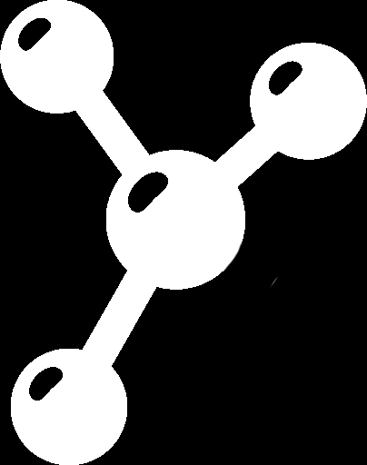
DGN & DDQN - workflow
TOX probabilities
INPUT MOLECULE
OUTPUT MOLECULE
0.74
…
0.13
…
0.92
DGN
predictor
DDQN
RL agent
DGN embedding
SIMILARITY - TOXICITY

Slide 5


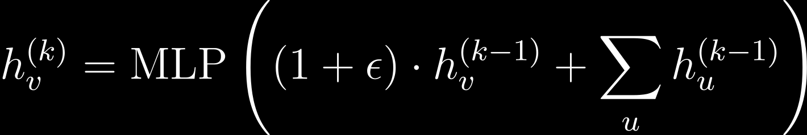
DGN - Predictor
The Oracle: predicting toxicity
our choice: GINEConv
Why DGN?
Native non-euclidean form
MLP
+
Weisfeiler Lehman
including
edges
“Agent Friendly”
Learns high-D representations
Outputs continuous distribution

Slide 6
DGN - Reading TOX21
RDKit
Nodes
88 features
Graph
DATA
SMILES
[c1ccccc1]
Edges
11 features
INPUTS
Adjacency matrix
Topology
Additional
MW
LogP
Standard Scaler

Slide 7
DGN - Architecture
INPUTS
TOX21-GNN
Output [0,1]
nodes
nodes
Encoders
0.12
Test 1
GINEConv
CONCATENATE
edge attributes
0.62
Test 2
GINEConv
edge index
max/addPooling
edges
GINEConv
SOFTMAX
Batch
GINEConv
0.35
Test 12
MW + LogP
CLASSIFIER
GINEConv

Slide 8
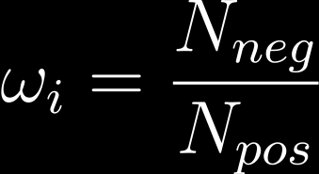

DGN - Training
TOOLS
Dynamic Class Weighting
Hybrid LR Scheduler
ROC - AUC
Masked backpropagation
here more reliable than accuracy
class-independent computed
continuous Spectrum reliability
Linear Warmup
Cosine Decay
PARAMETERS
Adam Optimizer
LR ≈ 6.1e-3
Epochs = 200
Batch Size = 64
Dropout ≈ 0.41
W. Decay ≈ 2.6e-4
Hidden Ch. = 128
[T|T|V] = [0.7|0.15|0.15]

Slide 9
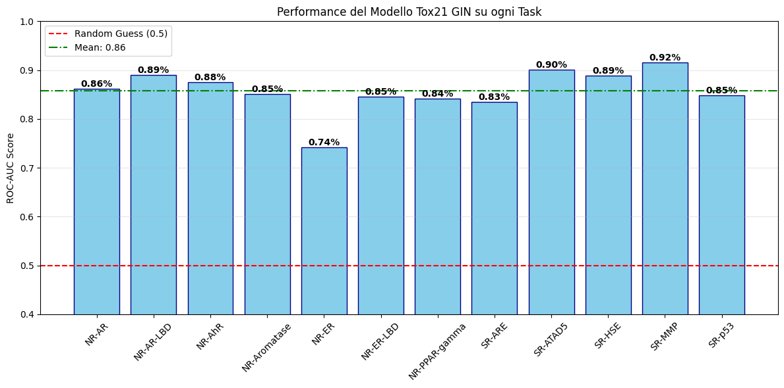
DGN - Results
*
*
performances on test set (15% , N. molecules = 1174)

Slide 10





MEG - Environment
STATE SPACE
X1
X5
Max
Sum
LogP
MW
Global Properties
GiNEConv output concatenation
Global Pooling
ACTION SPACE
H
I⁻
H
H
F⁻
H
H
C
H
Cl⁻
Cl⁻
0⁻²
C
C
H
H
C
ADD-atom
SUB-atom
ADD-bond
RM-Bond

Slide 11

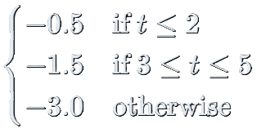

DDQN - Reward
Invalid action [P]
-2.0
Similarity [P]
Flip success [B] (Best case)
=
+
+
+
+
+
R_{t}
R_{step}
R_{invalid}
R_{ring}
R_{sim}
R_{tox}
R_{flip}
Similarity [P]
Step [P]
Structural [P]
Flip success [B] (unlucky case):
+ 5.0

Slide 12








DDQN - Agent
DDQN
FEAT LAYERS
VALUE STREAM
INPUTS
OUTPUT
GNN embedding
Estimated Q-value
ADVANTAGE STREAM

Slide 13

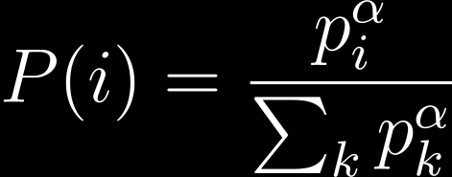
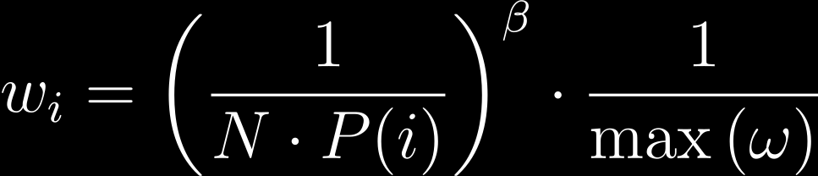

DDQN - Weighted replay buffer
UNIFORM
WEIGHTED
PRIORITY
SAMPLING PROB.
IMPORTANCE SAMPLING
Correction:
α = 0.6
ε = 1e-5
β - annealing: 0.4→1.0
success-failure symmetry

Slide 14

DDQN - Optimization
SAMPLE STATE
COLLECT EXPERIENCES
if BUFFER > BATCH
POLICY NET
NEXT A
TARGET NET
IMPORTANCE SAMPLING
CURRENT Q
TARGET Q
LOSS & SOFT UPDATE

Slide 15



DDQN - Evaluation
FOR each input test
FOR n-attempts
TEST INPUT
[SMILES]
State (embedded)
Loose success
Agent
Final SMILE
CH3Cl
Graph Embedding
Origin toxicity
Q-value
Best action
Hybrid
Sym
Strict success

Slide 16
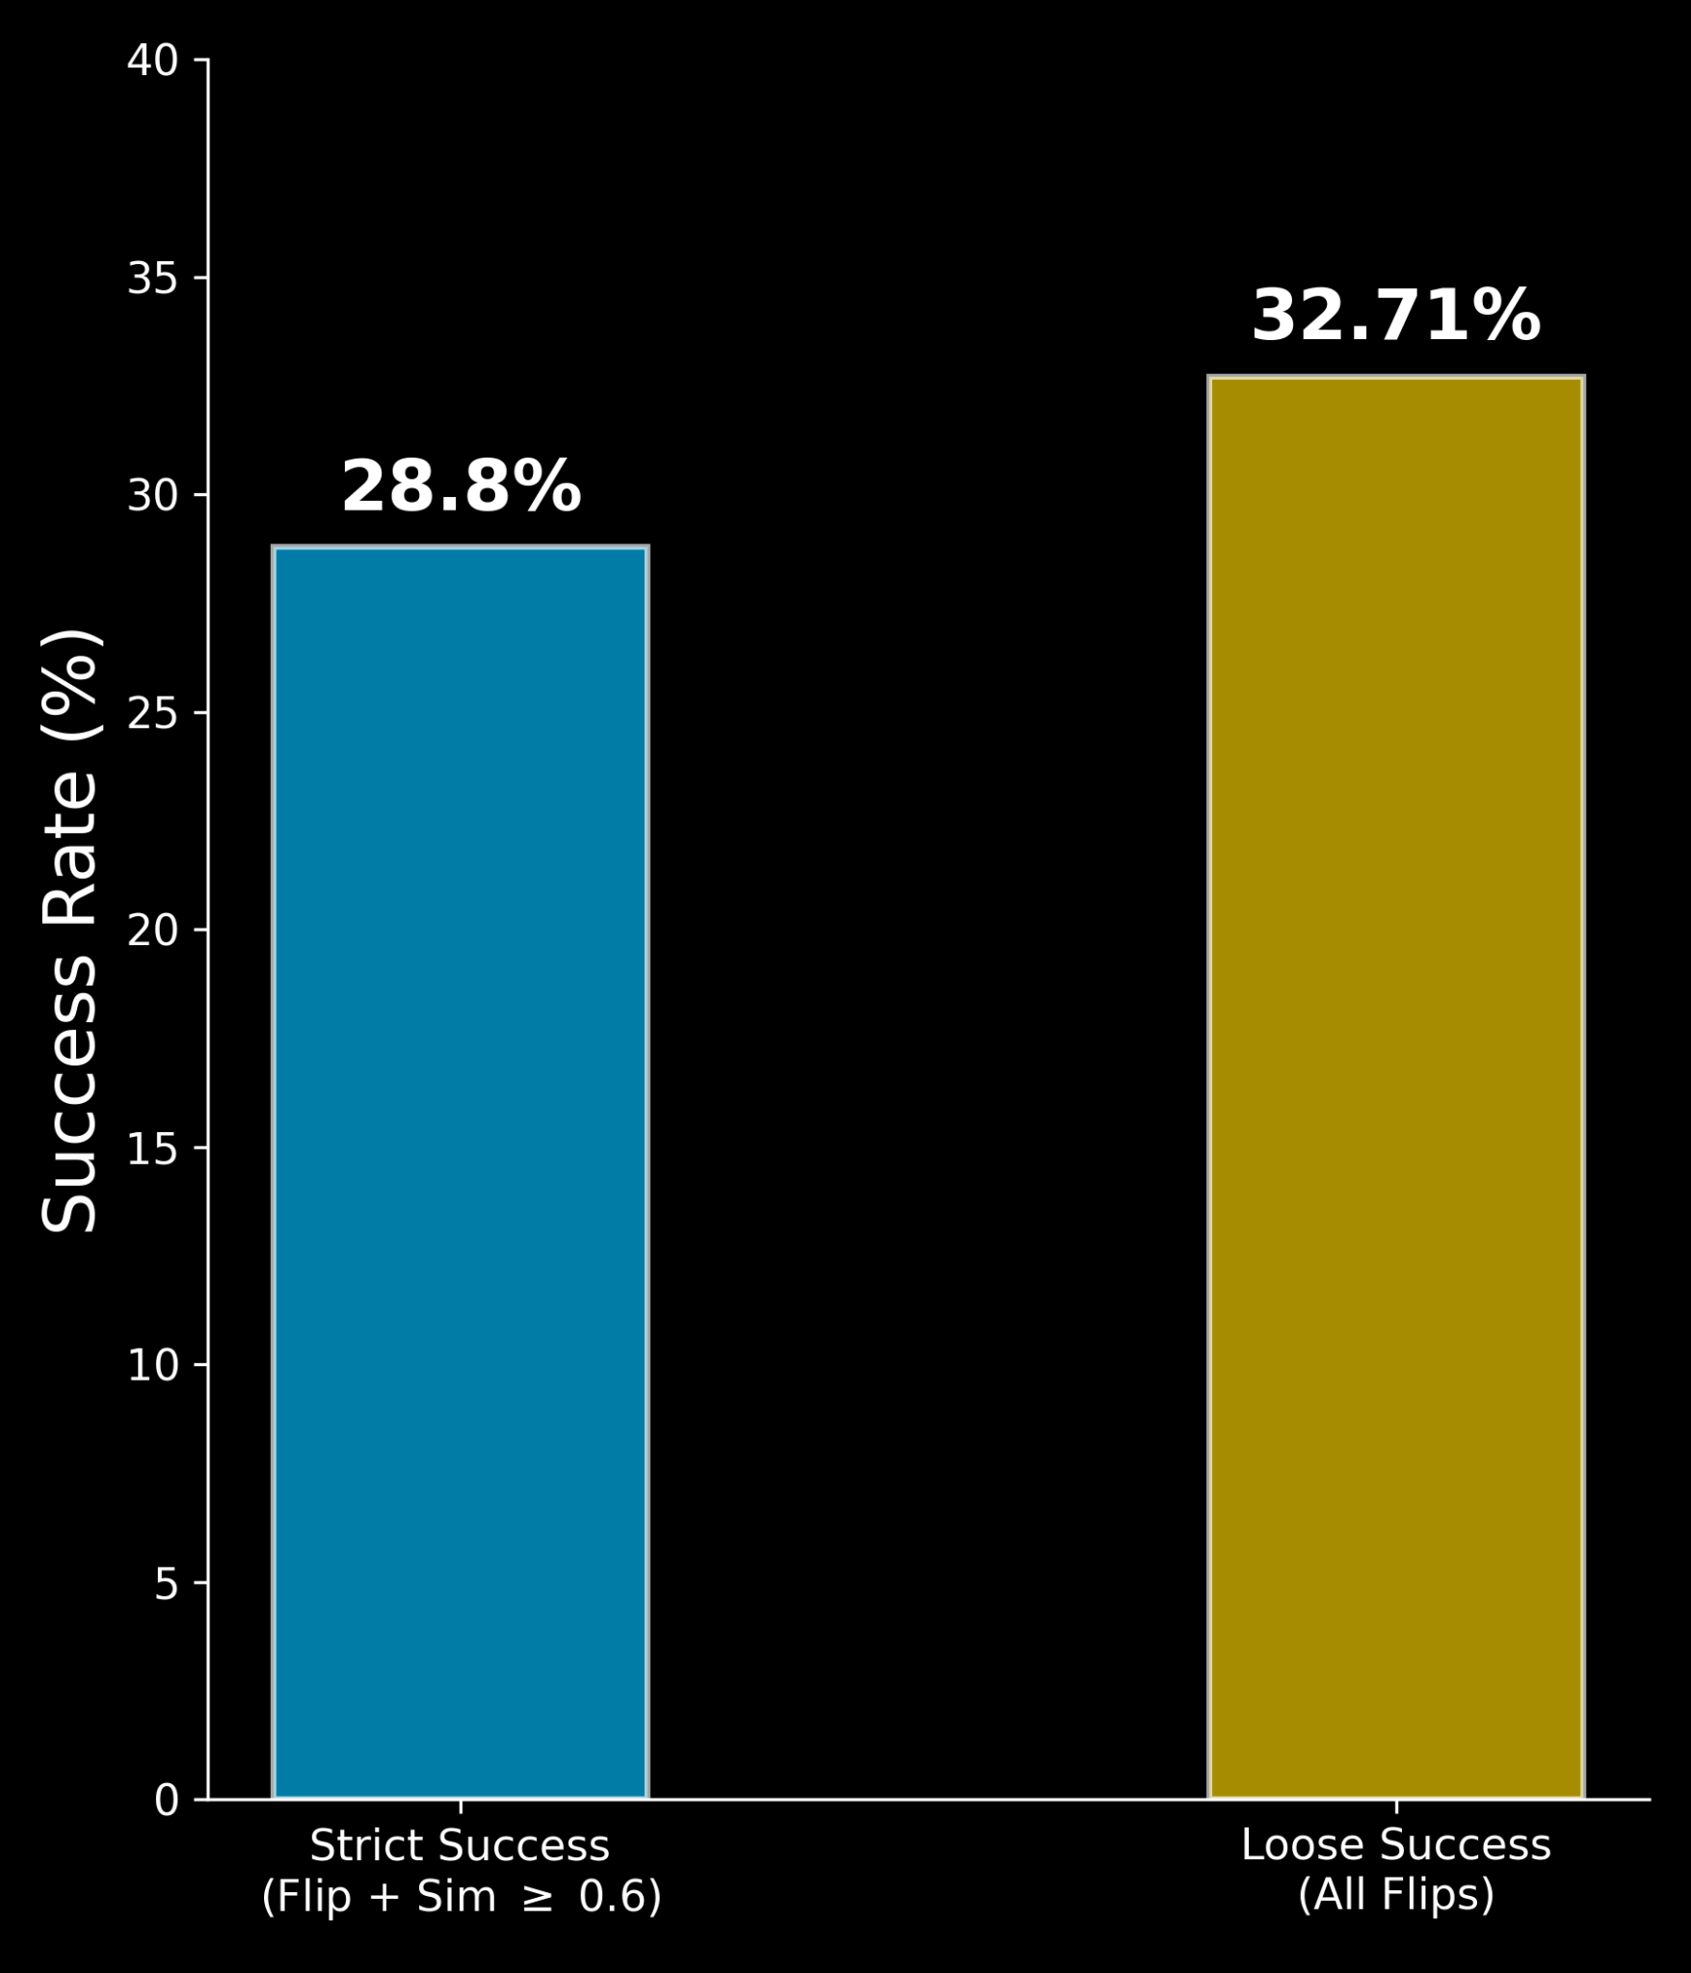
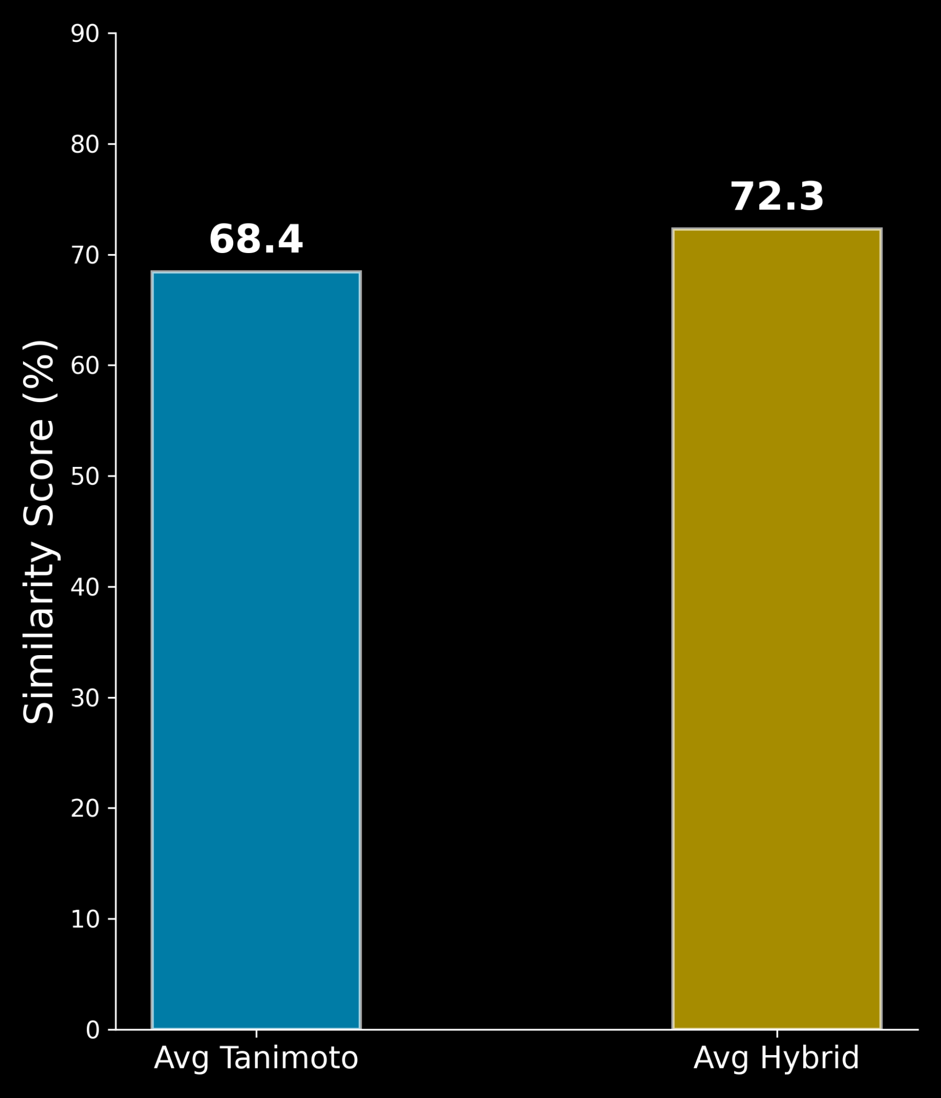
Results - success
!
Average Steps = 1

Slide 17
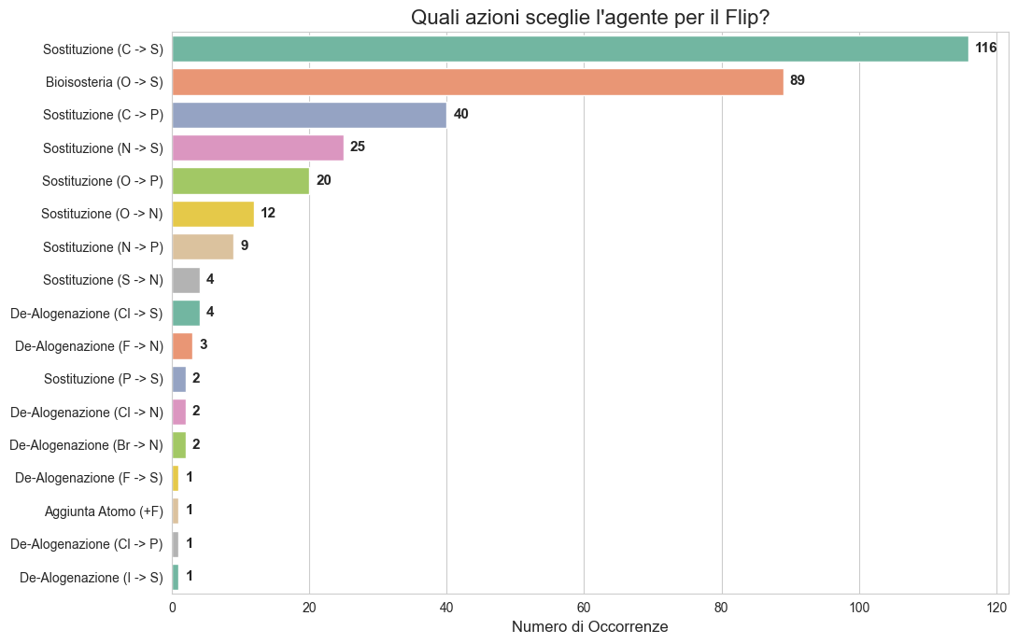
Results - best actions

Slide 18
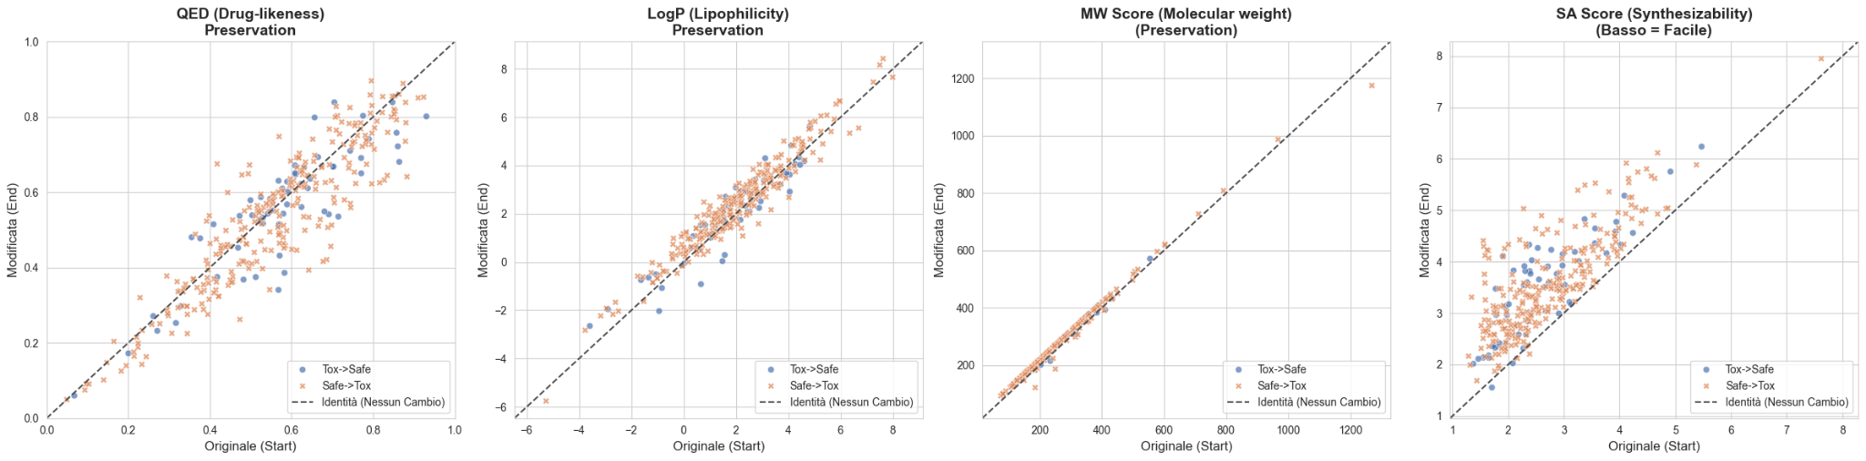
Results - chemical properties

Slide 19
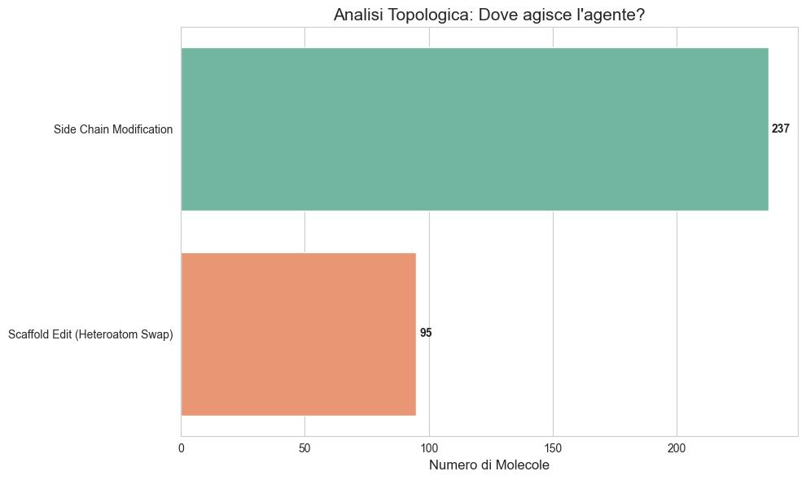
Results - topology

Slide 20
Thank you

Slide 21
References
Molecular Generation with RL:
D. Numeroso and D. Bacciu, "MEG: Generating Molecular Counterfactual Explanations for Deep Graph Networks," in 2021 International Joint Conference on Neural Networks (IJCNN), Shenzhen, China, 2021, pp. 1-8.
M. Goel, S. Raghunathan, S. Laghuvarapu, and U. D. Priyakumar, "MoleGuLAR: Molecule Generation Using Reinforcement Learning with Alternating Rewards," J. Chem. Inf. Model., vol. 61, no. 12, pp. 5815–5826, Dec. 2021.
Z. Zhou, S. Kearnes, L. Li, R. N. Zare, and P. Riley, "Optimization of Molecules via Deep Reinforcement Learning," Sci. Rep., vol. 9, no. 1, Art. no. 10752, 2019.
Explainable AI and CounterFactual theory:
RexYing, Dylan Bourgeois, Jiaxuan You, Marinka Zitnik, and Jure Leskovec. Gnnexplainer: Generating explanations for graph neural networks, 2019.
Sandra Wachter, Brent Mittelstadt, and Chris Russell. Counterfactual explanations without opening the black box: Automated decisions and the gdpr, 2018.
Deep Graph Networks:
A. Micheli. Neural network for graphs: A contextual constructive approach. IEEE Transactions on Neural Networks, 20(3):498–511, 2009.
Justin Gilmer, Samuel S. Schoenholz, Patrick F. Riley, Oriol Vinyals, and George E. Dahl. Neural message passing for quantum chemistry. volume 70 of Proceedings of Machine Learning Research, pages 1263– 1272, International Convention Centre, Sydney, Australia, 06–11 Aug 2017. PMLR.

