Slide 1

EDA#BOT2
Studenti
Lorenzo Morlacco
Francesco Santarelli
Data Analytics 21/22
Prof.
Massimo Callisto De Donato

Slide 2


Objective
The aim of the project is to create a question answering system capable of answering questions regarding the information contained on the Filippetti Group website.
Objective

Slide 3

DeepPavlov
DeepPavlov is an open-source framework for chatbots and virtual assistants' development.
In the first approach it seems to guarantee us the tools to realize the goal of the project but, moving forward, we discovered that to create our QA with wasn't possible due to the fact that the pre-configured use case was based only on wikipedia document.
DeepPavlov

Slide 4

MindMeld
MindMeld is a Conversational AI platform and Python-based machine learning framework .
MindMeld is the only Conversational AI platform available that provides tools and capabilities for every step in the workflow for a state-of-the-art conversational application and this is the solution against the problem of DeepPavlov.
Build from zero a Question Answering system is complex.
MindMeld

Slide 5

Milvus
Milvus is used to store, index, and manage massive embedding vectors generated by deep neural networks and other machine learning (ML) models.
An embedding vector is an abstraction of unstructured data, such as emails, IoT sensor data... and is an array of floating-point numbers or binaries. Embedding techniques are used to convert unstructured data to embedding vectors.
Milvus

Slide 6
Vector similarity search is the process of comparing a vector to a database to find vectors that are most similar to the query vector.
To create a QA system with Milvus is very easy because it provide us a pre-trained model and we can just insert our csv file with questions and answers. Its simplicity solve the problem of MindMeld regarding the complexity to create the system.
Milvus

Slide 7
Question Answering
BERT
Question answering system is a common real world application that belongs to the field of natural language processing.
The ML model and third-party software used include:
BERT;
MySQL
Question Answering

Slide 8
BERT
BERT
Bert is a framework that provides machine learning experts a base to build their own Bert-like versions through which a wide range of tasks can be fulfilled.
Bert aims to learn a representation of the input text.
Question Answering

Slide 9
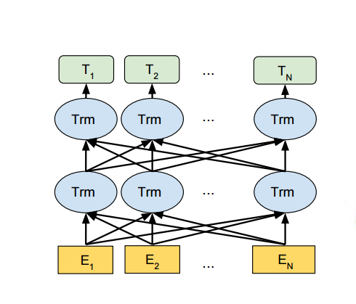
BERT
E: acquired word with its own representation
Trm: are the intermediate representations of the same word. On each level is calculated the attention
T: is the final output
Question Answering

Slide 10
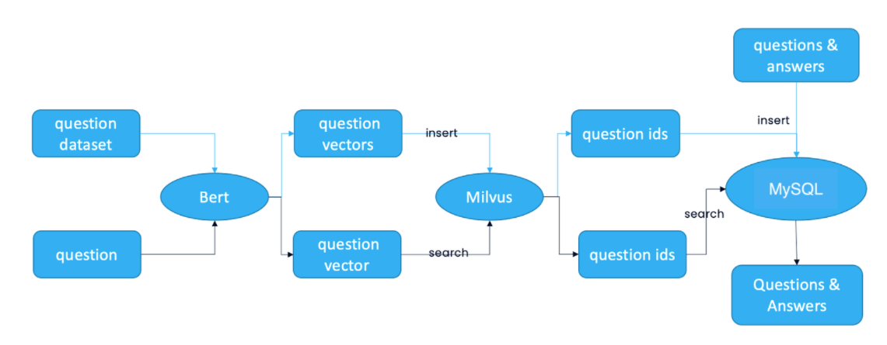
QA-Implementation
BERT
Question Answering

Slide 11
Technical implementation
BERT
SERVER
Clone the repository from github
https://github.com/loremorla/EDA-BOT2.git
Install Docker
Install Milvus 2.0 standalone and Start
Start MySQL
$ docker run -p 3306:3306 -e MYSQL_ROOT_PASSWORD=123456 -d mysql:5.7
Question Answering-Server

Slide 12
BERT
Export IP & Port
$ export Milvus_HOST='127.0.0.1' $ export Milvus_PORT='19530' $ export Mysql_HOST='127.0.0.1'
Run docker
$ docker run -d \ -p 8000:8000 \ -e "MILVUS_HOST=${Milvus_HOST}" \ -e "MILVUS_PORT=${Milvus_PORT}" \ -e "MYSQL_HOST=${Mysql_HOST}" \ milvusbootcamp/qa-chatbot-server:v2
Question Answering- Server

Slide 13
BERT
Get the models
$ apt-get update && apt-get install python3-pip python3 -y && apt-get install wget -y && apt-get install zip –y
$ mkdir -p /src/models
$ wget https://public.ukp.informatik.tu-darmstadt.de/reimers/sentence-transformers/v0.2/paraphrase-mpnet-base-v2.zip
$ unzip paraphrase-mpnet-base-v2.zip -d /src/models/paraphrase-mpnet-base-v2/
Install requirements
$ cd server
$ mkdir app
$ cd app
$ pip3 install -r /requirements.txt -i https://mirrors.aliyun.com/pypi/simple --trusted-host mirrors.aliyun.com
Question Answering-Server

Slide 14
BERT
Modify config.py
Run main.py
$ cd src
$ sudo python3 main.py
Parameter | Description | Default setting
MILVUS_HOST | The IP address of Milvus, you can get it by ifconfig. | 127.0.0.1
MILVUS_PORT | Port of Milvus. | 19530
VECTOR_DIMENSION | Dimension of the vectors. | 768
MYSQL_HOST | The IP address of Mysql. | 127.0.0.1
MYSQL_PORT | Port of Milvus. | 3306
DEFAULT_TABLE | The milvus and mysql default collection name. | milvus_qa
MODEL_PATH | The path of the model paraphrase-mpnet-base-v2
Question Answering-Server

Slide 15
BERT
CLIENT
Start the front-end
$ export API_URL='http://127.0.0.1:8000' *insert IP in according to config.py* $ docker run -d -p 80:80 \ -e API_URL=${API_URL} \ milvusbootcamp/qa-chatbot-client:v1
Enter WEBCLIENT_IP:80 in the browser to open the interface for reverse image search.
Question Answering-Client

Slide 16
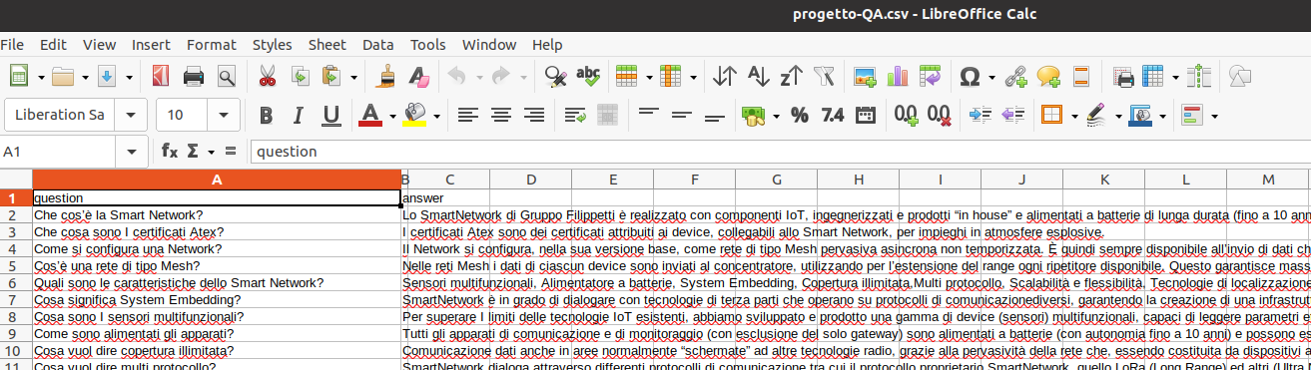
BERT
DATA DESCRIPTION
The dataset needed for this system is a CSV format file which needs to contain a column of questions and a column of answers.
Question Answering-Data Description

Slide 17
Text Search Engine
BERT
It is a tool that compare the keywords or semantics users input against a database of texts, and then return the results that meet certain criteria.
The ML model and third-party software used include:
BERT;
MySQL
Text Search Engine

Slide 18
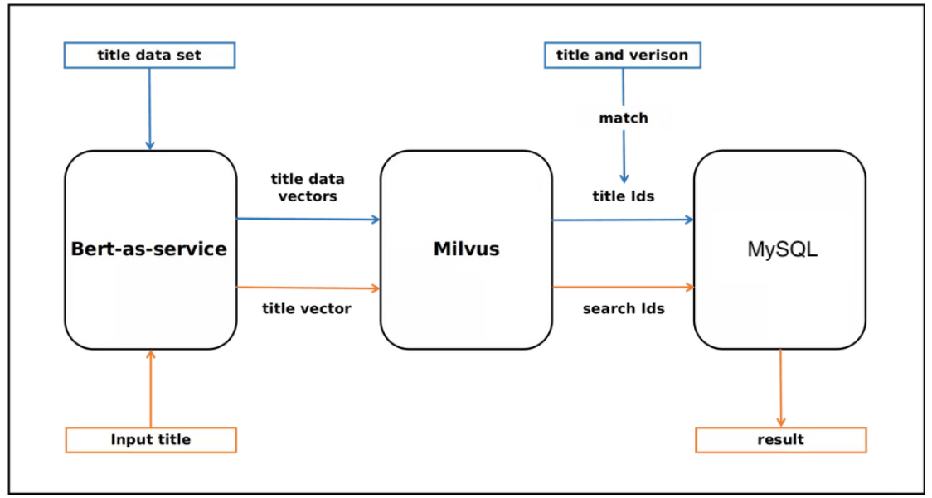
TSE-Implementation
BERT
Text Search Engine

Slide 19
Technical implementation
BERT
SERVER
Clone the repository from github
https://github.com/loremorla/EDA-BOT2.git
Install Docker
Install Milvus 2.0 standalone and Start
Start MySQL
$ docker run -p 3306:3306 -e MYSQL_ROOT_PASSWORD=123456 -d mysql:5.7
Text Search Engine-Server

Slide 20
BERT
Install requirements
$ apt-get update && apt-get install python3-pip python3 -y && apt-get install wget -y && apt-get install zip –y
$ cd server
$ cd src
$ pip3 --default-timeout=1000 install -r /requirements.txt
Get the models
$ cd src
$ mkdir models
$ cd models
$ wget https://public.ukp.informatik.tu-darmstadt.de/reimers/sentence-transformers/v0.2/paraphrase-mpnet-base-v2.zip
$ unzip paraphrase-mpnet-base-v2.zip -d paraphrase-mpnet-base-v2/
Export IP & Port
$ export Milvus_HOST='127.0.0.1' $ export Milvus_PORT='19530' $ export Mysql_HOST='127.0.0.1'
Text Search Engine-Server

Slide 21
BERT
Modify config.py
Run main.py
$ cd src
$ sudo python3 main.py
Parameter | Description | Default setting
MILVUS_HOST | The IP address of Milvus, you can get it by ifconfig. | 127.0.0.1
MILVUS_PORT | Port of Milvus. | 19530
VECTOR_DIMENSION | Dimension of the vectors. | 2048
MYSQL_HOST | The IP address of Mysql. | 127.0.0.1
MYSQL_PORT | Port of Milvus. | 3306
DEFAULT_TABLE | The milvus and mysql default collection name. | text_search
Text Search Engine-Server

Slide 22
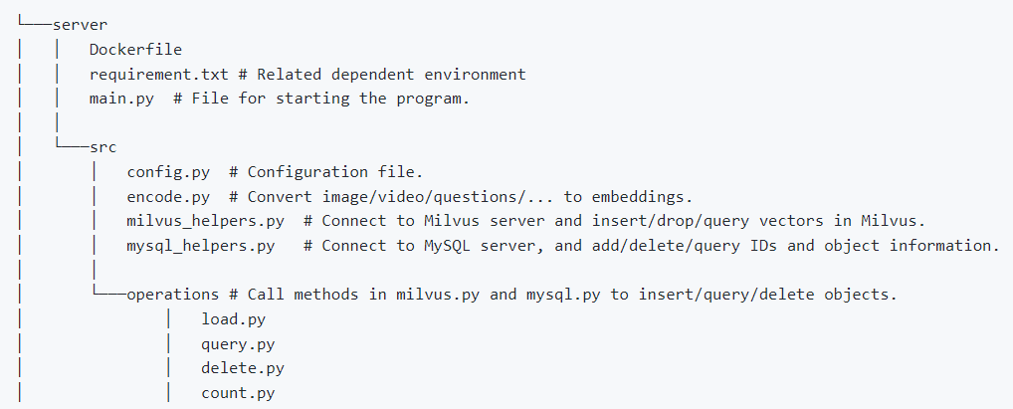
BERT
Code structure
Text Search Engine-Server

Slide 23
BERT
CLIENT
Install Node.js
Install Yarn
$ cd client
$ sudo apt remove cmdtest sudo apt remove yarn curl $ https://dl.yarnpkg.com/debian/pubkey.gpg | sudo apt-key add - echo "deb $ https://dl.yarnpkg.com/debian/ stable main" | sudo tee /etc/apt/sources.list.d/yarn.list
$ sudo apt-get update
$ sudo apt-get install yarn -y
Check Constants.ts and make sure that let endpoint points to the correct Milvus server endpoint.
The UI client will be available at http://localhost:3000.
Text Search Engine-Client

Slide 24
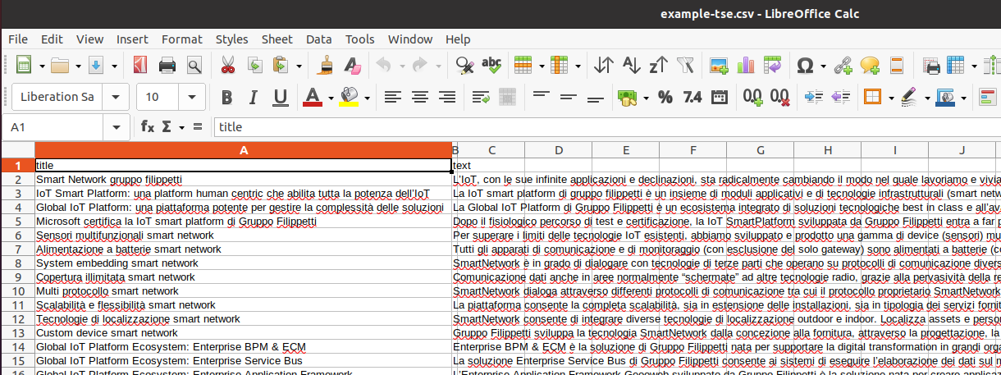
BERT
DATA DESCRIPTION
The dataset needed for this system is a CSV format file which needs to contain a column of title and a column of text.
Text Search Engine-Data Description

Slide 25
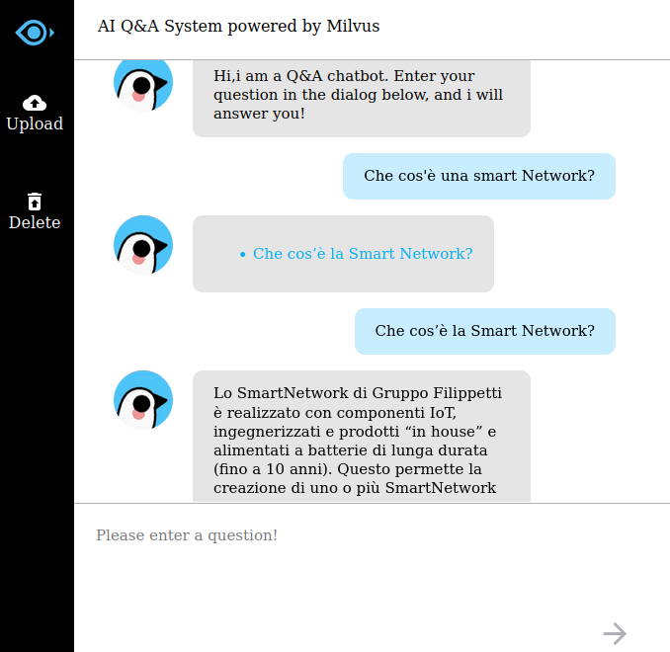
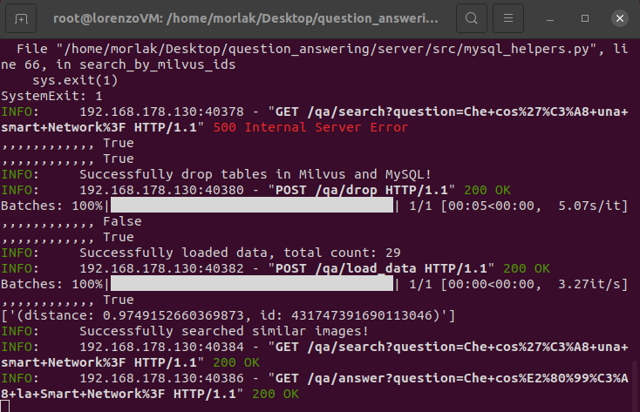
Achieved results (QA)

Slide 26
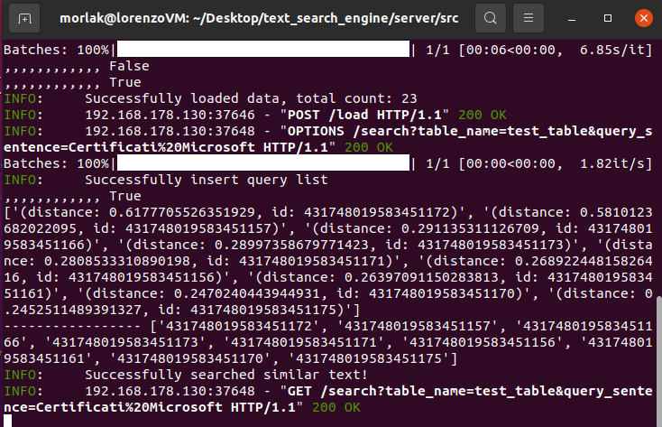
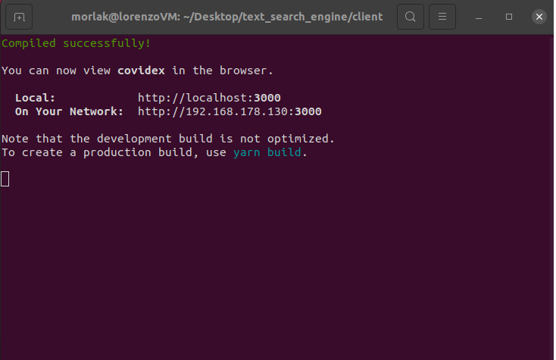
Achieved results (TSE)

Slide 27

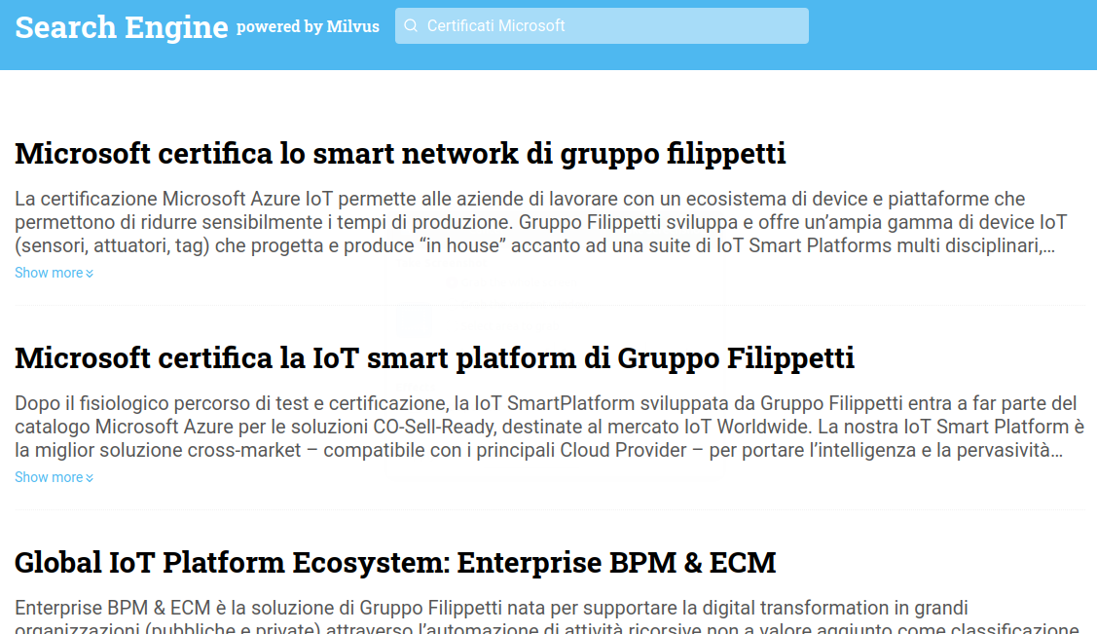
Achieved results (TSE)

Slide 28
Future implementations
QA: add the immediate answer mode instead of letting the user choose one of the questions proposed.
TSE: add the ability to analyze the text and not just the title.

Slide 29
THANKS FOR YOUR ATTENTION

