Slide 1

Lab Book 1.0. Waveguides
Student:

Slide 2
Instructions
General
SCRIPTS
From GitHub →
  Fork the repo: https://github.com/cccanvas-upv/cifoin-lab1.git
  Clone the repo using VSCode
Run the Jupyter Notebook:
  WAVEGUIDES_Student.ipynb
W (width)
W (width)
Core
Core
h_core
h
(height)
Cladding
Cladding
Slab
h_slab
deep waveguide
shallow waveguide

Slide 3
Learning outcome #1 – Effective index of a waveguide
INSTRUCTOR:
Present Python and GDSFactory: materials, output, results.
Explain how to run a simulation for a particular cross-section.
Showcase how to change between shallow and deep waveguide.
Describe how to change the wavelength and width for the waveguide analysis.
Describe the outputs.
ALL EXAMPLE #1: waveguide width 1.2 µm, deep wvg, wavelength start and end same 1.55 µm → all ”Run”
ALL: Follow instructor, that will show how to 1) plot mode, 2) explore the results (neff …)
Document all your results (neff, plot fields of different modes, comparison between different polarizations…)

Slide 4
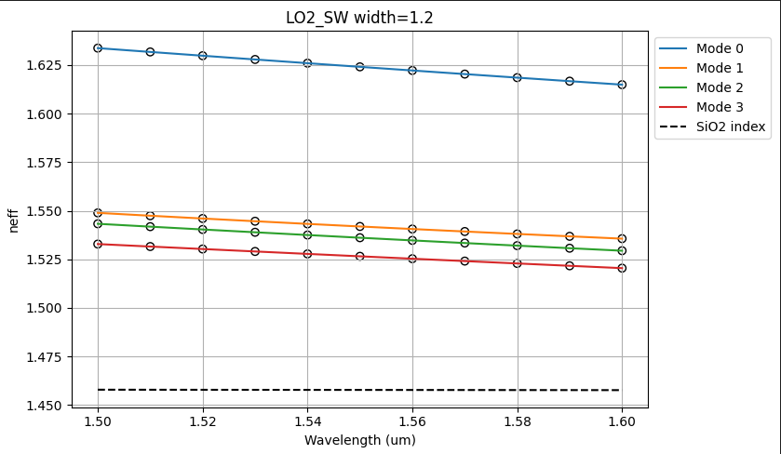
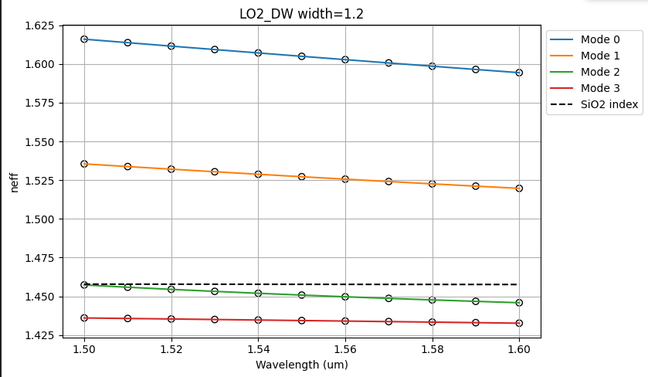
Learning outcome #2 – Wavelength behavior
Wavelength 1.5-1.6 µm (step 0.01 µm) – width 1.2 µm
shallow waveguide
Paste plot here
deep waveguide
Paste plot here
slab = 150nm
Comment results (neff changes this way with wavelength, comparison between different waveguide cross-sections …etc)
In both waveguides, neff decreases monotonically with wavelength due to normal dispersion. The shallow waveguide shows higher neff for all modes and keeps them guided across the full range, while the deep waveguide fall bellow the SIO2 index and become unguided above ~ 1,54 um.

Slide 5
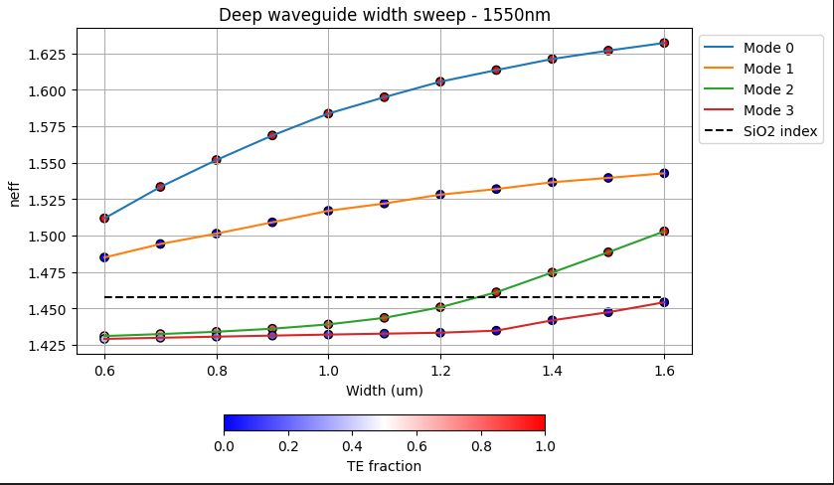
Learning outcome #3 – Width dependence
Width 0.6 - 1.6 µm (step 0.1 µm) – Wavelength 1.55 µm
deep waveguide
Paste plot here
Comment results (neff changes this way with width, polarization behavior, etc…)
As the waveguide width increases, the effective index of each mode rises smoothly, indicating stronger confinement in the high‑index core.
Polarization:We have pure TE0 and pure TM1, but modes 2 and 3 have not a polarized mode when they are unguided, but become more TE and TM polarized across the width range, which means a dependence between waveguude confine

Slide 6
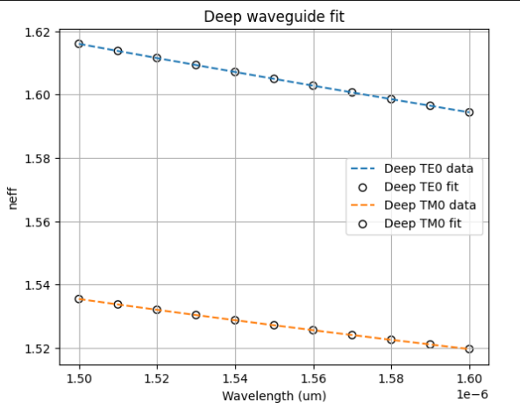
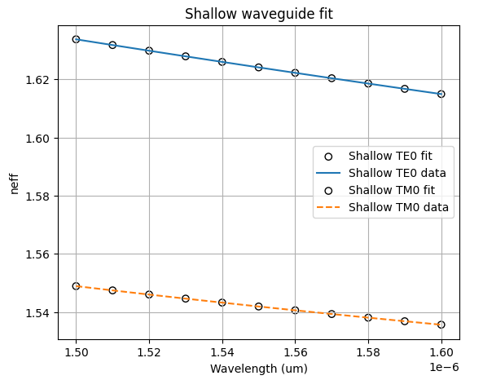
Learning outcome #4 – Waveguide compact model
- Find the compact models of the following waveguides:
Deep waveguide, h=300nm, w=1.2um - Shallow waveguide, core h=300nm, slab h=150 nm, w = 1.2um
slab: 150nm
Polynomial Coefficients:n1 represents the baseline effective refractive index, neff(lambda0), n2 represents the slope of the curve, n3 represents the second derivative, the curvature.
Deep comparisson:The TE0 mode travels "slower" through the material, exhibiting both a higher effective index (1.605 compared to 1.527) and a higher group index (1.940 compared to 1.772). TM0 is more disperssive, 1.59e-09 s²/m compared to 1.07e-09s²/m for TE0, because the neff is smaller for TM.
Shallow Comparisson: Similar as the comments of deep comparisson, but with a significative difference of the disperssion(~4e-10 less) because of the slab introduced.
Every D obtained are negative which means anomalous dispersion in the range of transmission.

Slide 7
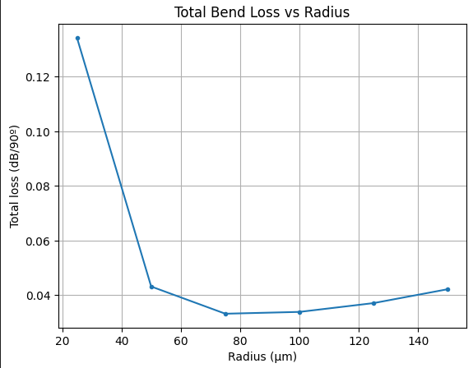
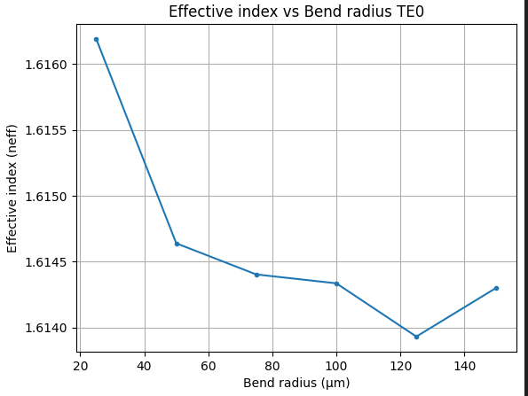
Learning outcome #5 – Bend waveguide radius vs. loss – deep
Find neff_TE0 for wvl 1.55 µm, width 1.2 µm for R=25,50,75,100, 125,150 µm
deep waveguide
Paste Total Loss (dB/90º) vs R & neff_TE0 vs R
Safe Radius: R>=50, because in that point total loss became less than 0.1dB/90º.
Bend effective index became smaller as we make radius bigger because of the shift movement that produces the shape of the curve.
s

Slide 8

Thank you

