Slide 1

Lab Book 1.0. Waveguides
Student: Lorena Gómez Diego & Marta Orient Cabañas

Slide 2
Instructions General
SCRIPTS
From GitHub →
Fork the repo: https://github.com/cccanvas-upv/cifoin-lab1.git
Clone the repo using VSCode
Run the Jupyter Notebook:
WAVEGUIDES_Student.ipynb
W (width)
W (width)
Core
Core
h_core
h
(height)
Cladding
Cladding
Slab
h_slab
deep waveguide
shallow waveguide

Slide 3
Learning outcome #1 – Effective index of a waveguide
INSTRUCTOR:
Present Python and GDSFactory: materials, output, results.
Explain how to run a simulation for a particular cross-section.
Showcase how to change between shallow and deep waveguide.
Describe how to change the wavelength and width for the waveguide analysis.
Describe the outputs.
ALL EXAMPLE #1: waveguide width 1.2 µm, deep wvg, wavelength start and end same 1.55 µm → all ”Run”
ALL: Follow instructor, that will show how to 1) plot mode, 2) explore the results (neff …)
The first steps were to compare the refractive index of each material studied: silicon (Si), silicon nitride (SiNx) and silicon dioxide (SiO2). Results were clear, as the silicon nitride resulted being less dispersive than silicon, having also lower refraction index (3.47 for Si vs 2 for SiNx). Furthermore, the SiO2 has the lowest dispersion and refractive index (1.457, varying the fifth decimal).
Refractive index represents how much the speed of light is reduced in a material (the speed of light in the material), and so, if we want modes to be guided inside a waveguide, the refraction index of the cladding must be lower than the refraction index of the core, to ensure that the refraction angle is not reached, and the power is confined inside the waveguide.
This way, we arrive to the section definition, where a shallow waveguide will be defined with a SiO2 cladding (n_clad=1.457) and a SiNx core (n_core=2 > n_clad). The modes that will be propagated inside this waveguide are those that have a n_eff inside the range → n_clad < n_eff < n_core. The closer the effective index is to the core index, the more confined the mode is in the core (and the same works for the cladding analogously).

Slide 4
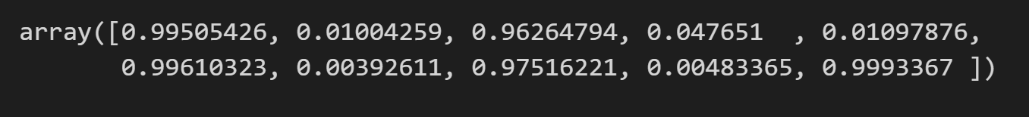
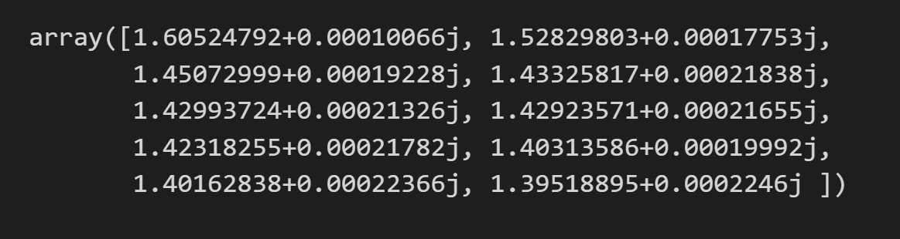
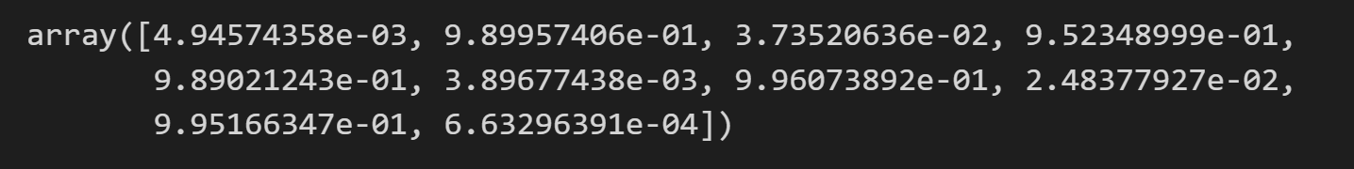
Learning outcome #1 – Effective index of a waveguide
n_clad<n_eff<n_core
fraction_te:
n_eff:
fraction_tm:
Once we define the waveguide, we must study the results. As we determined, only those modes which n_eff is inside the range defined by the refractive indexes of the cladding and the core will be guided. In this case, as we can see, the two first modes are the only guided ones, because in all the rest the n_eff is lower than the n of the cladding. Also, as we commented in the previous slide, as for the first mode the n_eff is closest to the n_core than the second mode, the deduction is that this first mode will be more confined in the core than the second mode, confined mostly in the cladding.
The imaginary part represents the losses of each mode, in this case, in every mode it’s almost 0, which means that there are no significant losses in th waveguide.
By representing the fraction_te and fraction_tm, we can see how the electric/magnetic fields are distributed in the waveguide. As we can see, for the first mode, fraction_te is almost 1, while fraction_tm is almost 0, representing a clear TE0 mode. Analogously, for the second mode, fraction_te is almost 0 and fraction_tm is almost 1, representing the TM0 mode.

Slide 5
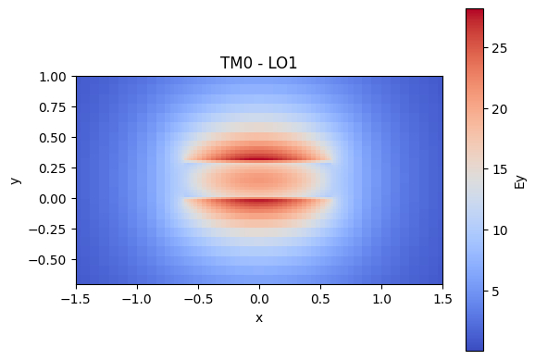
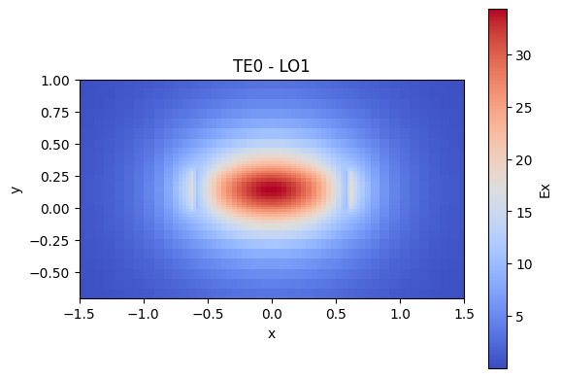
Learning outcome #1 – Effective index of a waveguide
In TE0 mode, we observe discontinuities at the walls along the x-axis, corresponding to the side walls, this leads to a conclusion that in TE mode, the construction of this side walls is critic, if we want to avoid field leakage.
We see that the field is confined within the core, as predicted.
In TM0 mode, we observe discontinuities at the walls along the y-axis, corresponding to the top-low walls, this leads to a conclusion that in TM mode, the construction of these walls is critic, if we want to avoid field leakage.
We see that TM0 mode is guided, but less confined than TE0 — its field extends further into the cladding due to the boundary conditions imposed by its perpendicular electric field orientation, resulting in a lower effective index.

Slide 6
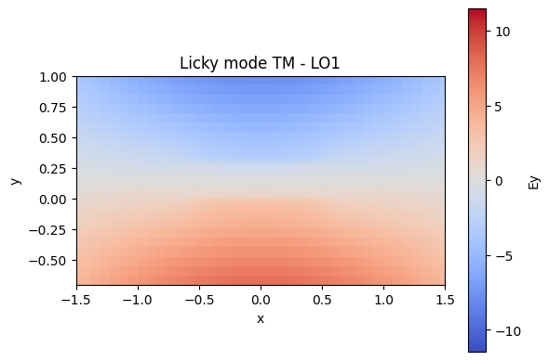
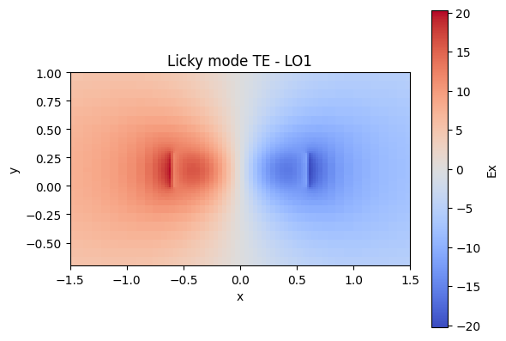
Learning outcome #1 – Effective index of a waveguide
These two modes were represented just for as to confirm that the mode isn’t guided for the modes 2 and above. They all represent licky modes, were the fields are not confined in the waveguide, nor the electric and neither the magnetic.
We see the difference in polarities, which gives a 0 in the field propagation at the center of the x-axis for licky mode TE and in the y-axis for licky mode TM, and we see that the field extends more outside the core, which is typical of higher-order modes.

Slide 7
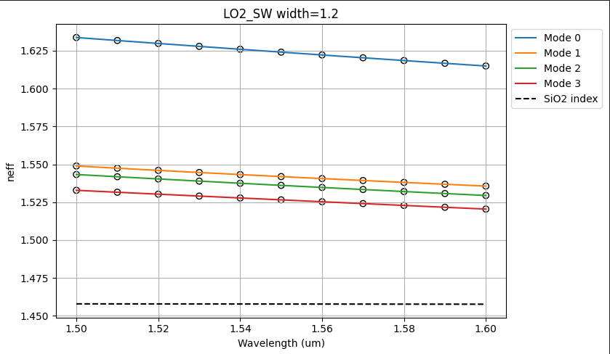
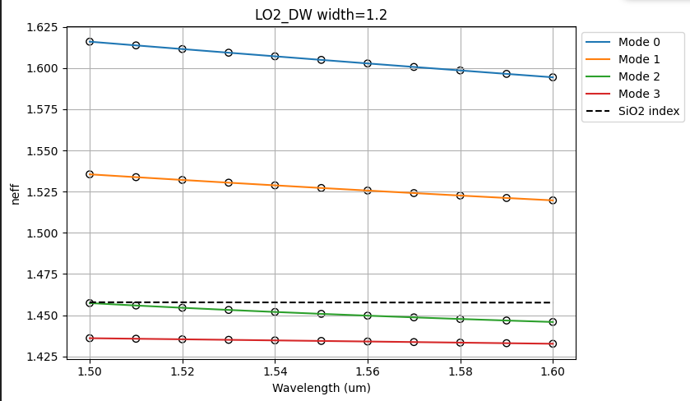
Learning outcome #2 – Wavelength behavior Wavelength 1.5-1.6 µm (step 0.01 µm) – width 1.2 µm
shallow waveguide
Paste plot here
deep waveguide
Paste plot here
slab = 150nm
Comment results (neff changes this way with wavelength, comparison between different waveguide cross-sections …etc)
The graphs show how the effective refractive index (neff) of optical waveguides varies with wavelength over the 1.5–1.6 µm range for a fixed width of 1.2 µm. In both structures, neff decreases monotonically with wavelength, consistent with normal dispersion: as wavelength increases, the mode becomes less confined and interacts more with the lower-index SiO₂ cladding (n ≈ 1.457), reducing the effective index.
The shallow waveguide maintains all four modes guided across because the slab provides additional lateral confinement, keeping the modes bound to the core even at longer wavelengths.
The deep waveguide is more sensitive to wavelength, with fewer guided modes at longer wavelengths compared to the shallow structure

Slide 8
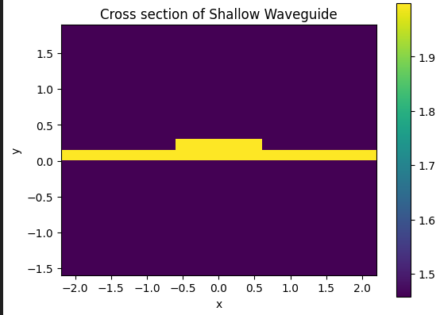
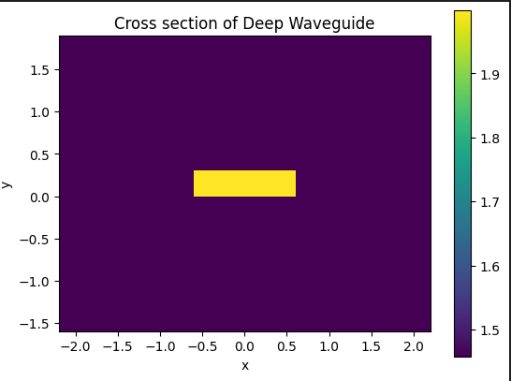
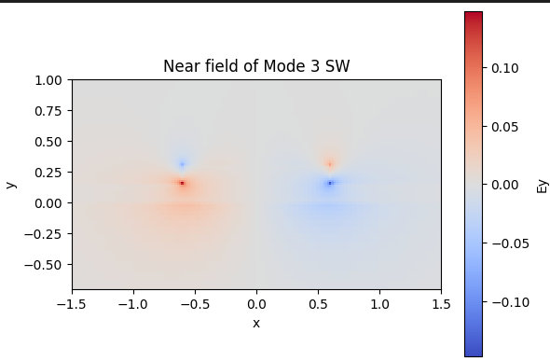
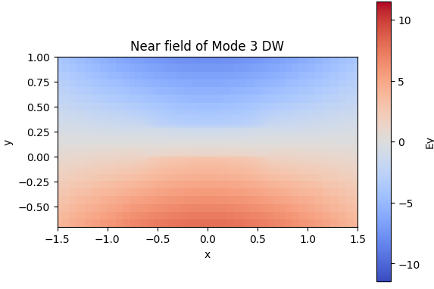
Learning outcome #2 bis– Effect of slab section Cross section Wavelength 1.550 µm – width 1.2 µm
shallow waveguide
Paste plot here
deep waveguide
Paste plot here
slab = 150nm
The cross-sections reveal the fundamental structural difference: the shallow waveguide (slab = 150 nm) presents a wider effective guiding region than the isolated rectangular core of the deep waveguide, giving higher-order modes more material to propagate in.
At λ = 1550 nm this translates into higher neff values for all modes in the shallow structure.Mode 3 at of the shallow waveguide shows a spatially extended but still bound field distribution with clear lateral lobes sustained by the slab, whereas the equivalent mode in the deep waveguide either disappears or presents a leaky, delocalized field with no defined confinement.

Slide 9
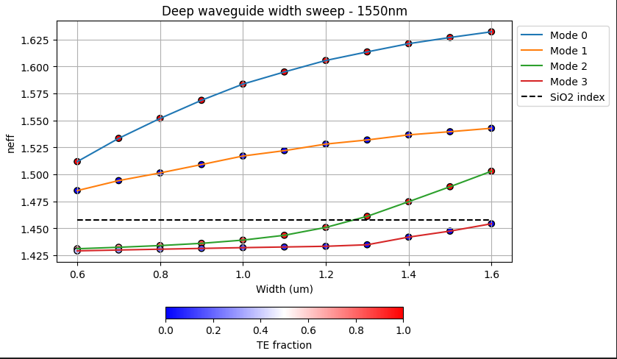
Learning outcome #3 – Width dependence Width 0.6 - 1.6 µm (step 0.1 µm) – Wavelength 1.55 µm
deep waveguide
Paste plot here
Comment results (neff changes this way with width, polarization behavior, etc…)
As the waveguide width increases, the effective index of each mode rises smoothly, indicating stronger confinement in the high‑index core.
Polarization:We have pure TE0 and pure TM1, but modes 2 and 3 have not a polarized mode when they are unguided, but become more TE and TM polarized across the width range, which means a dependence between waveguude confine

Slide 10

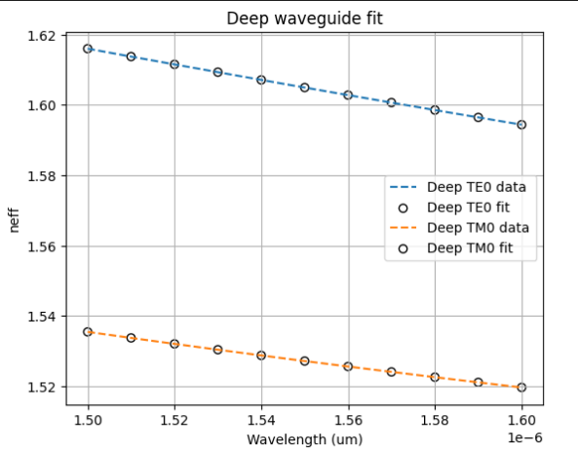
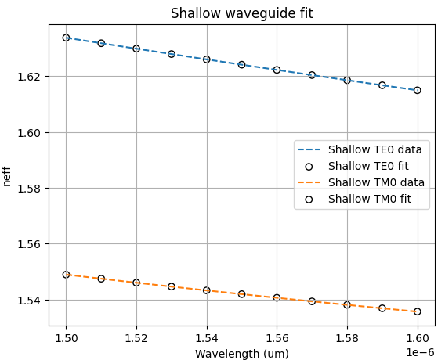
Learning outcome #4 – Waveguide compact model - Find the compact models of the following waveguides: Deep waveguide, h=300nm, w=1.2um - Shallow waveguide, core h=300nm, slab h=150 nm, w = 1.2um
(1)
slab: 150nm
Polynomial Coefficients:n1 represents the baseline effective refractive index, neff(λ0), n2 represents the slope of the curve, n3 represents the second derivative, the curvature.
Deep comparisson: neff decreases monotonically with wavelength for all modes. This is the signature of waveguide dispersion: as λ increases, the mode becomes less confined and "sees" more of the lower-index cladding, reducing its effective index.
If we see (1) it has two contributions: the baseline value neff(λ0)(n1 of the polynomial fit), and a correction term related to the slope (n2). A steeper negative slope pushes ng above neff, meaning the mode's group velocity is slower. Visually, the TE0 curve in both plots is steeper than TM0, pointing to a larger ng for TE.
Shallow Comparisson: Similar as the comments of deep comparisson, but shows a subtly flatter TM0 curve introduced, which means reduced dispersion because of the slab

Slide 11
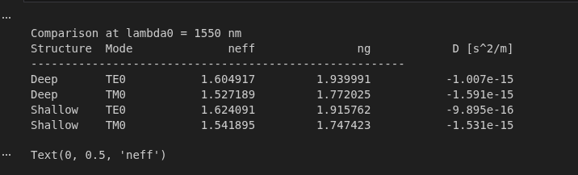
Learning outcome #4 – Waveguide compact model bis - Find the compact models of the following waveguides: Deep waveguide, h=300nm, w=1.2um - Shallow waveguide, core h=300nm, slab h=150 nm, w = 1.2um
slab: 150nm
Comparison on a same mode of WV, both deeper and shallor, TM0 is more dispersive (larger |D|) in both structures: its weaker confinement makes neff more sensitive to wavelength changes in curvature (n3), not just in slope (n2).
Comparing between shallow and deep waveguide:
The 150 nm slab raises neff for both modes (TE0: +0.019, TM0: +0.015) by providing an additional lateral guiding region, while ng slightly decreases (TE0: −0.024, TM0: −0.025), meaning the slab flattens the slope n2, meaning the field become less sensitive to λ.
We see also, negative values for D which means a normal dispersion, and the effects of strong confinement is translated into less dispersion value(TE0 of shallow waveguide has the least dispersive configuration(whith the smallest D value).

Slide 12
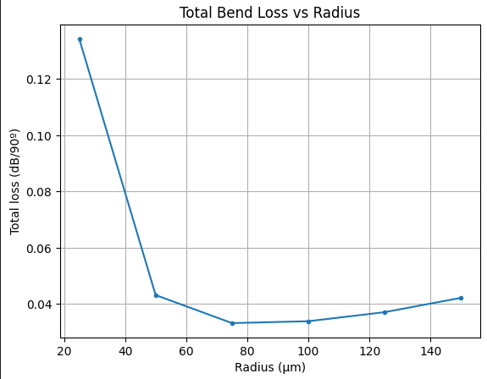
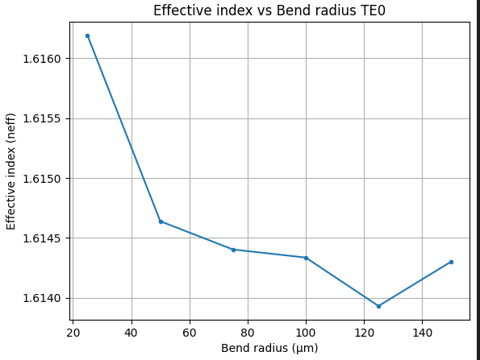
Learning outcome #5 – Bend waveguide radius vs. loss – deep Find neff_TE0 for wvl 1.55 µm, width 1.2 µm for R=25,50,75,100, 125,150 µm
deep waveguide
Paste Total Loss (dB/90º) vs R & neff_TE0 vs R
Bend curves are essential for routing light inside a chip; without them, circuits could only be linear. The chosen radius directly affects: the area occupied on the chip (footprint), radiation losses, and mode displacement. In this slide we measure the total bend loss. By definition, the criterion for a safe radius is a loss < 0.1 dB/90°, meaning the signal cannot lose more than 0.1 dB per quarter circle at a given radius. On the left graph, we observe that total losses drop below 0.1 dB/90° from R = 50 µm onwards and remain low for larger radii; therefore, R ≥ 50 µm is sufficient to meet the requirement. On the right graph, we observe that the real part of n_eff decreases as the radius increases. This is because, at larger radii, the mode becomes less confined towards the outer edge of the curve, lowering the effective index. It is important to note that n_eff is complex in a bent waveguide: its imaginary part encodes the radiation loss, while the real part reflects the phase propagation

Slide 13
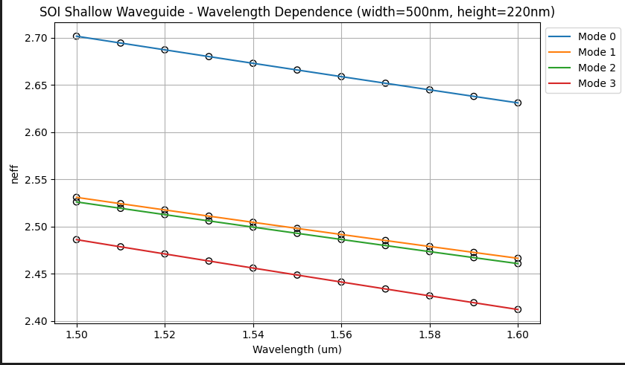
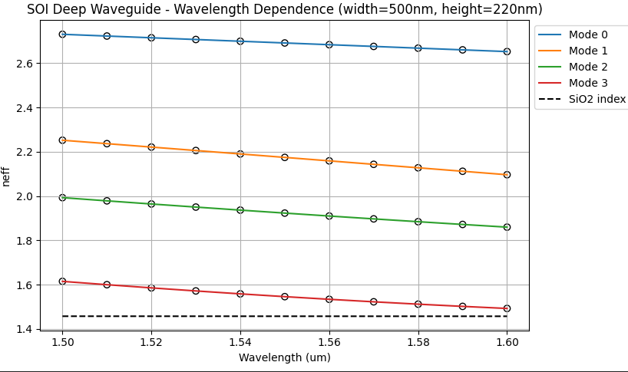
#6 Learning outcome #2 – Wavelength behavior with Silicon Wavelength 1.5-1.6 µm (step 0.01 µm) – h=220nm, w=500nm
shallow waveguide
Paste plot here
deep waveguide
Paste plot here
slab = 150nm
In this case, the core material is silicon (Si), which has a refractive index of approximately n_core ≈ 3.475 at λ = 1.55 µm, while the cladding is silicon dioxide (SiO₂) with n_clad ≈ 1.457. This results in a very high index contrast (Δn ≈ 2.014), which creates a strong numerical aperture (NA) and tight light confinement within the core. Because the index contrast is so large, the condition for Total Internal Reflection (TIR) is easily satisfied for multiple modes, meaning both the shallow and deep waveguide configurations support all 4 guided modes found in the simulation. High index contrast materials like silicon allow for tighter bend radii and stronger mode confinement, which is why silicon photonics is widely used for compact integrated circuits

Slide 14
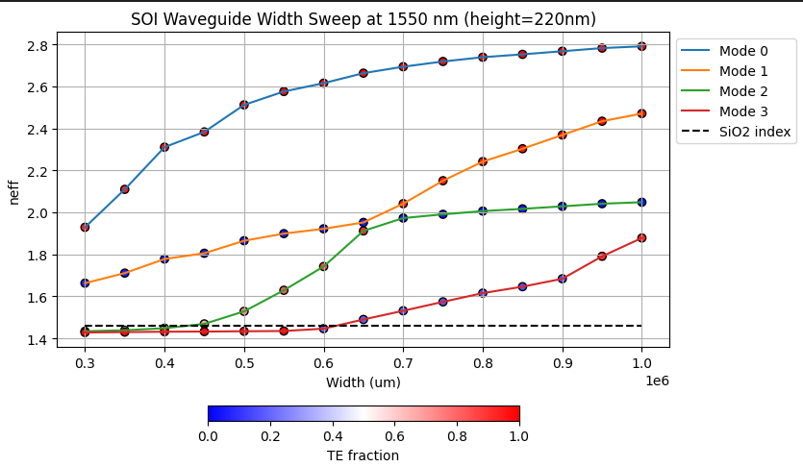
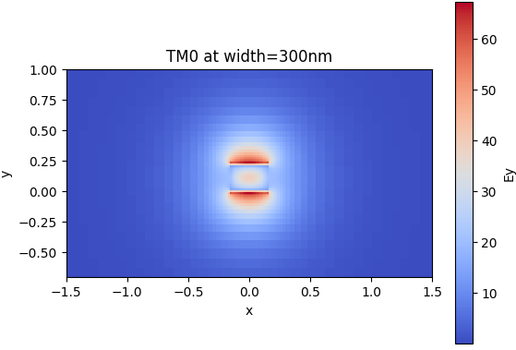
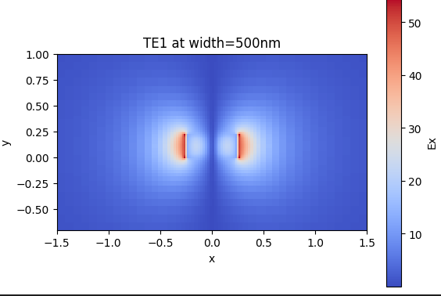
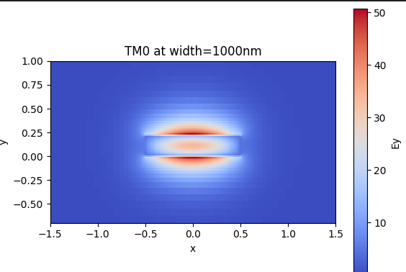
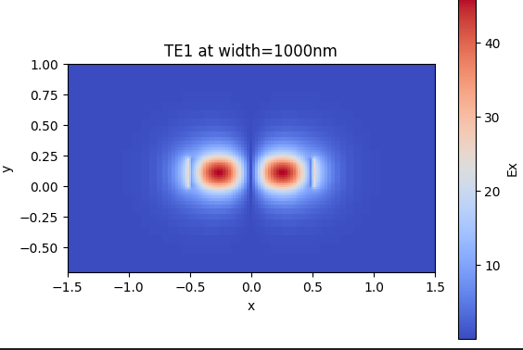
#6 Learning outcome #3 – Width dependence Width 0.3- 1 µm (step 0.1 µm) – Wavelength 1.55 µm
The simulation library (tidy3d) orders modes by descending n_eff, not by polarization label. This means that as the waveguide width increases, modes can swap positions in the ordering, what appears as Mode 1 and 2 in our case at narrow widths may not correspond to the same physical mode at wider widths. However, the plot avoids crossing lines precisely because of this reordering, so these both curves have half of it with green and half of the other with green.
We see this on the near field representation:
TM0 (left column) The shape barely changes because TM0 confinement is height-dominated — width has little influence on it, which is exactly why its n_eff remains flat in the sweep
TE1(right column) a completely change on its shape, The wider the waveguide, the more lateral space TE1 has to confine its two-lobe profile inside the high-index silicon core — pulling n_eff up rapidly.

Slide 15
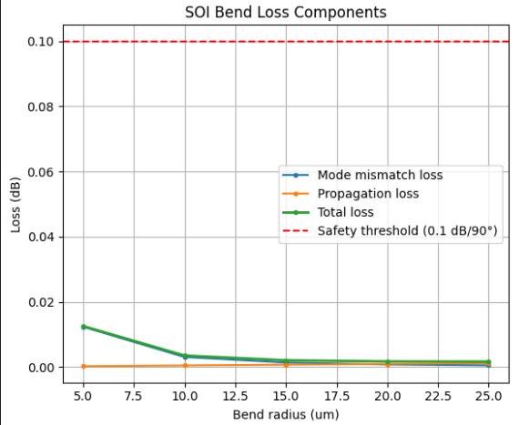
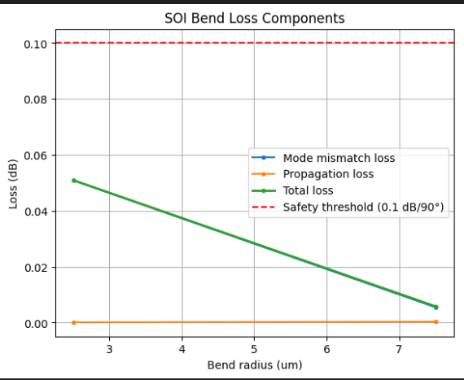
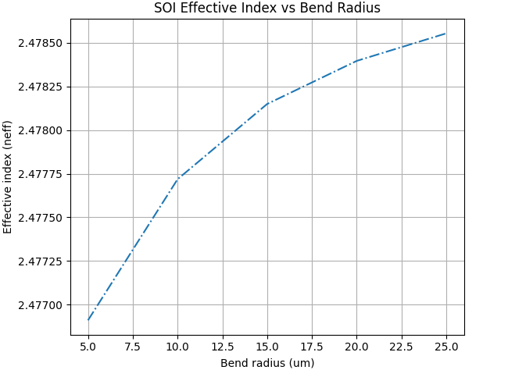
#6 Learning outcome #5 –Finding the safe radius for this tecnology Find neff_TE0 for wvl 1.55 µm, h=220nm, w=500nm for R=5,10,15,20,25,30 µm
In the left graph (R = 5–25 µm), we observed that total loss drops well below the 0.1 dB/90° safety threshold across the entire range, confirming that SOI safely operates at these radii. Since the condition was comfortably satisfied, we decided to push the radius to smaller values to find the actual limit — this is shown in the centre graph (R = 2.5–7.5 µm), where total loss increases steeply as R decreases, approaching the 0.1 dB/90° threshold. However, we observed that below R ≈ 2.5 µm the modesolver diverges, returning unphysically large loss values. This is a known numerical artefact at extreme radii where the bent waveguide mode is no longer well-defined, so we established R = 2.5 µm as the lower simulation boundary.
In the right graph, we observed that neff increases as R decreases. This is expected: at tighter bends, the mode shifts towards the outer edge of the curve and overlaps more with the core, so it experiences a slightly higher average index.

Slide 16
#6 Learning outcome #Conclusion –Comparison of material use Silicon vs Silicon Nitride for the Core
Index contrast drives confinement: SOI has Δn ≈ 2.05 vs. SiNx Δn ≈ 0.55, so TIR is satisfied over a wider angle range in SOI, confining the mode in a much smaller cross-section (500 nm × 220 nm vs. 1.2 µm × 300 nm).
Confinement enables tighter bends: The evanescent field decays faster in high-contrast waveguides, allowing SOI to use bend radii of ~5–10 µm vs. ~25 µm for SiNx — directly reducing circuit footprint.
Confinement increases dispersion: In SOI, the mode field distribution changes more with λ, making neff more wavelength-sensitive and increasing |D|. SiNx's moderate confinement yields a flatter neff(λ), as confirmed by the simulated D values around −1×10⁻¹⁵ s²/m .
Losses involve a trade-off: SiNx has higher propagation loss (~1.5 dB/cm) because its larger mode overlaps more with rough sidewalls. SOI reaches ~0.3 dB/cm thanks to mature CMOS lithography, but bend losses increase sharply below ~5 µm radius.
CMOS compatibility reduces cost: SOI reuses standard electronic IC fabrication flows, giving access to high-volume foundries (IMEC, CEA-LETI). SiNx needs LPCVD steps outside CMOS, limiting foundry access but remaining the platform of choice for passive, low-loss broadband circuits.
Core material | Silicon Nitride | Silicon
Core refractive index @ 1550 nm | ~2.0 | ~3.5
Cladding material | SiO₂ | SiO₂
Index contrast Δn | ~0.55 | ~2.05
Core dimensions | 1.2 µm × 300 nm | 500 nm × 220 nm
Mode confinement | Moderate | Very high
Dispersion | Low → filters, broadband | High → modulators, high-speed
Safe bend radius | ~25 µm | ~5–10 µm
Propagation loss | ~1.5 dB/cm | ~0.3 dB/cm
CMOS compatible | No | Yes
Cost | Medium | Low

Slide 17

Thank you

