Slide 1

Agent Spend Control
Clear spending limits for AI agents that pay for APIs in USDC
Let your agents bee autonomous. Bee in control.
Notes:
Nectrae gives paid agent workflows clear financial boundaries: one budget per API, checked before the agent pays, and verified on-chain afterward.

Slide 2



Every API call is a spending decision
THE PROBLEM
Agents buy data
Agent stuck in a loop, no limits
When an AI agent pays for APIs, every call spends money.
Daily budget: 1.00 USDC
Call #98
+0.01
total 0.98
Loops keep spending
A stuck loop can keep calls going past the intended budget.
Call #99
+0.01
total 0.99
Call #100
+0.01
total 1.00
No clear view
Call #101
+0.01
total 1.01
Developers need limits and visibility into where the money goes.
Call #102
+0.01
total 1.02
Notes:
When an AI agent buys data, every API call becomes a spending decision, and a loop can keep those calls going beyond the intended budget. Nectrae gives developers clear limits and visibility into where the money goes.

Slide 3
Agents are already paying for services
WHY NOW
57.3%
109.6M
$985B
of respondents have agents in production
adjusted x402 transactions through Apr 21, 2026
agentic AI software spending forecast by 2030
LangChain, State of Agent Engineering
Visa and Artemis, Agentic Payments from the Ground Up
Gartner, Feb 17, 2026
The Gartner forecast covers the broad agentic AI software market, not the market directly addressable by Nectrae.
Notes:
LangChain found agents in production among 57.3 percent of respondents, while Visa and Artemis counted 109.6 million adjusted x402 transactions through April 21, 2026. Agents are already working, and software is already paying for services. Nectrae brings spending boundaries to those paid workflows. Gartner forecasts 985 billion dollars in agentic AI software spending by 2030.
Sources: Gartner, Forecast Analysis: Agentic AI Spending in Software Markets, 17 Feb 2026, gartner.com/en/documents/7455226; LangChain, State of Agent Engineering; Visa and Artemis, Agentic Payments from the Ground Up, data through 21 Apr 2026.

Slide 4
Teams paying for APIs in USDC
OUR FOCUS
Agentic AI software
$985B forecast by 2030 (Gartner). The broad market context.
Paid agent workflows
USDC API teams
Software already pays for services: 109.6M adjusted x402 transactions.
Our focus
Teams whose agents pay for APIs in USDC, on Solana and Base.
Notes:
Gartner's forecast is the broad agentic AI software market. Our focus within that broader market is teams paying for APIs in USDC.

Slide 5



One budget per API, across Solana and Base
THE SOLUTION
Daily budget
Solana
Solana and Base requests count toward the same budget.
Example API
Per-call limit
1 USDC / day
A 20-cent call is blocked when the limit is 5 cents.
max $0.05 per call
Base
Allowed recipients
Payments to recipients outside the list are blocked.
Checked before signing, in SDK-connected workflows.
Notes:
Nectrae brings Solana and Base activity into one budget per API. Within SDK-connected workflows, it checks the budget, per-call limit, and recipient before signing. Example from the demo: a daily budget of one USDC and a five-cent limit per call; a twenty-cent request and a request to a recipient that isn't allowed are both blocked.

Slide 6

Checked before signing, verified on-chain
HOW IT WORKS
1
2
3
4
Agent asks to pay
Rules are checked
Your wallet signs
Verified on-chain
The agent calls a paid API through the Nectrae SDK.
Budget, per-call limit and recipient, before signing.
Signing happens outside Nectrae, with your keys.
Amount, recipient and status are checked on the network.
Recent wallet outflows that skip the SDK are flagged in the record afterward. They can be flagged, not stopped.
Notes:
Within SDK-connected workflows, Nectrae checks the budget, per-call limit, and recipient before signing, then verifies the payment against blockchain activity: amount, recipient, and status on the network. It also scans for recent wallet outflows that skipped the SDK. Those can be flagged afterward, but not stopped.

Slide 7
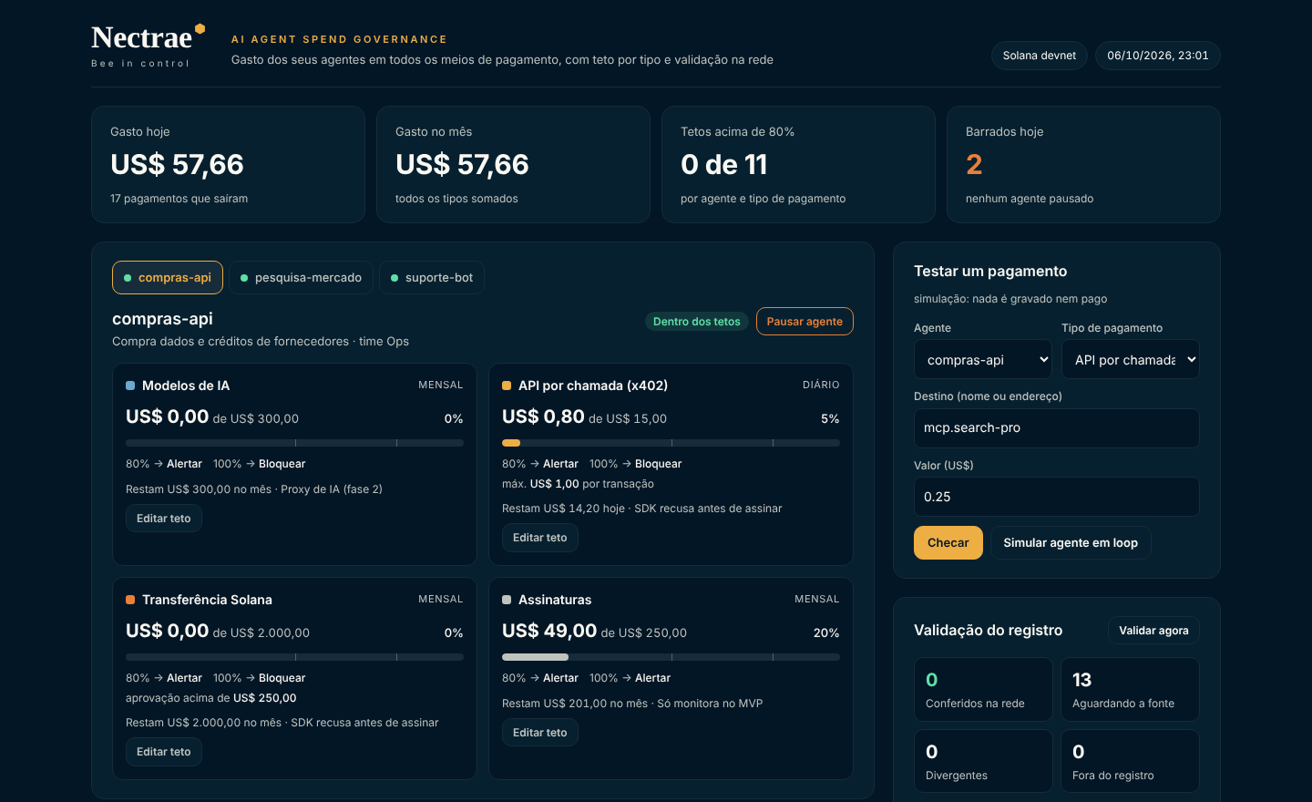



Activity, rules and evidence in one place
THE PRODUCT
Activity per API
Spend, limits and blocked calls at a glance.
Rules
Budget, per-call limit and allowed recipients.
Transaction evidence
Every attempt in one record, checked on-chain.
Local MVP on Solana devnet and Base Sepolia, test USDC. Example data.
Notes:
The payer sees each API's activity, rules, and transaction evidence together. Our local MVP runs on Solana devnet and Base Sepolia with test USDC. The API names shown are examples, not real customers or purchases.

Slide 8



Funds and keys stay in your own hive
NON-CUSTODIAL
Your keys, your funds
Funds and private keys stay with you. Nectrae never holds them.
Your wallet signs
Signing happens outside Nectrae.
You set the boundaries
Your agent checks them before paying through the integration.
Notes:
Your wallet signs outside Nectrae, and your funds and private keys stay with you. You set the boundaries, and your agent checks them before paying through the integration. Funds and private keys stay in your own hive.

Slide 9




A developer-first route to customers
GO-TO-MARKET
Developer communities
BUSINESS MODEL
Reach teams building paid agent workflows.
Team subscriptions
SDK examples on GitHub
Ready-to-run integrations developers can copy.
Shared controls and spending records for teams running paid agent workflows.
Assisted integrations
Hands-on setup with paid API workflows.
Planned commercial strategy, not current revenue.
Notes:
Our route to customers combines developer communities, SDK examples on GitHub, and assisted integrations with paid API workflows. Team subscriptions form the basis of our commercial strategy for shared controls and spending records. This is a commercial strategy, not revenue already obtained.

Slide 10

Team
THE HIVE
[Name]
[Name]
[Name]
[Role]
[Role]
[Role]
[Background and relevant experience]
[Background and relevant experience]
[Background and relevant experience]
Notes:
Fill in each team member's name, role, and the background that makes them right for this problem.

Slide 11
Next steps
[The ask: funding, pilots or partners]
[Milestone 1: e.g. first SDK integrations]
[Milestone 2: e.g. mainnet launch]
[Contact: email or handle]
Let your agents bee autonomous.
Bee in control.
Demo: [demo video link]
GitHub: [repository link]
Notes:
Nectrae gives paid agent workflows clear financial boundaries. Let your agents bee autonomous. Bee in control.

