Slide 1
Comparative Gene Expression Analysis of African and European-ancestry women by subtype
Lorena Sandoval

Slide 2
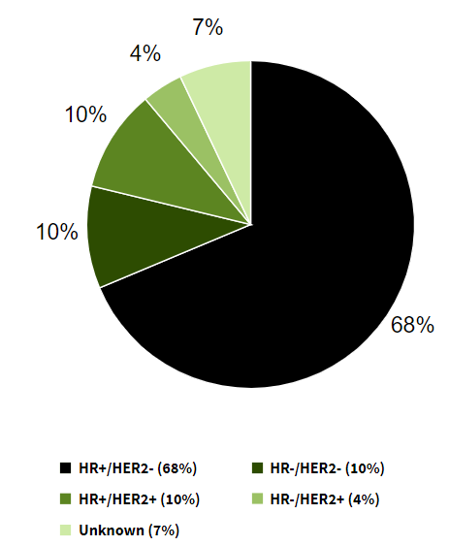
Breast Cancer Subtypes
Four main subtypes, including the following in order of prevalence:
HR+/HER2- ( “Luminal A”)
HR-/HER2- (“Triple Negative”)
HR+/HER2+ (“Luminal B”)
HR-/HER2+ (“HER2 Enriched)
Classified by IHC, ISH and PAM50
PAM50 classification problems
31%–59% of cases with HER2 positivity as defined by IHC and/or ISH are classified as an ‘intrinsic’ subtype other than HER2 enriched
Notes:
https://seer.cancer.gov/statfacts/html/breast-subtypes.html
HR stands for hormone receptor. HR+ means that tumor cells have receptors for the hormones estrogen or progesterone, which can promote the growth of HR+ tumors. HER2 stands for human epidermal growth factor receptor 2. HER2+ means that tumor cells make high levels of a protein called HER2/neu, which has been shown to be associated with certain aggressive types of breast cancer.

Slide 3
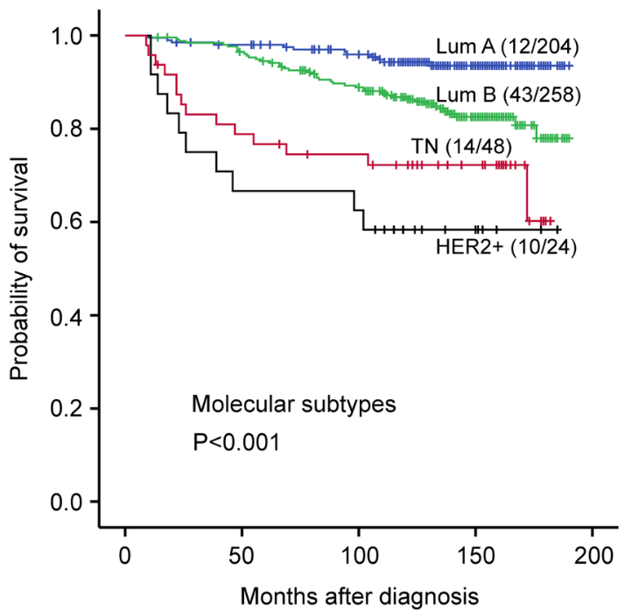
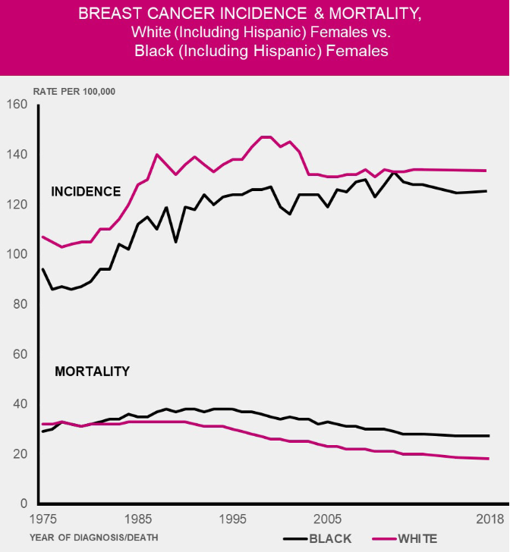
BC Disparities by race and subtype
AA worse prognosis, shorter survival time and higher mortality rates, despite higher incidence in EA.
death hazard in ER/PR (+) tumor 4 times higher in AA women compared to EA
ER/PR (-) more likely to be missed by screening
Basal subtype
most fatal and has the worst prognosis overall.
more common in AA than EA.
five-year survival rate was 92% in EA women, but 82% in AA women
disparities are independent of socioeconomic status, access to healthcare or age, or even the stage of BC (Gupta 2018)
Her2+ metastatic BC has high risk of relapse
Treated with Her2 inhibitors and chemotherapy
AA treated with trastuzumab showed significantly lower overall median survival compared to EA patients receiving the same therapy (Rugo et al. 2013)
Notes:
Gupta 2018
https://www.ncbi.nlm.nih.gov/pmc/articles/PMC5842180/

Slide 4
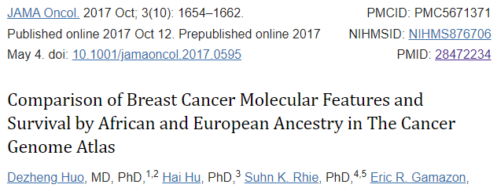
major genes that various investigators found to be differentially expressed in AA women with BC. Compared to EA
modest molecular differences in gene expression, protein expression, somatic mutations, and DNA methylation patterns and higher genetic contribution to ER- breast cancer was seen in black patients than in white patients
Biological differences may be linked to differences in the distribution of germline genetic variants
New findings can lead to improved risk assessment more targeted therapies
The top 2 differentially expressed genes were LOC90784 and CRYBB2
Gene symbol | Gene name | Regulation
CDKN2A | Cyclin Dependent Kinase Inhibitor 2A | Up
CCNA2 | Cyclin-A2 | Up
CCNB1 | Cyclin-B1 | Up
CRYBB2 | β-crystallin B2 | Up
TMPO | Thymopoietin | Up
AMFR | Autocrine Motility Factor Receptor | Up
GATA-3 | GATA Binding Protein 3 | Up
BRCA1 | Breast cancer gene 1 | Up
Notes:
Gupta 2018 table (left)
https://www.ncbi.nlm.nih.gov/pmc/articles/PMC5842180/table/Tab4/?report=objectonly
Biological importance of differentially expressed genes
Ping et al 2020
https://academic.oup.com/carcin/article/41/7/887/5817819

Slide 5
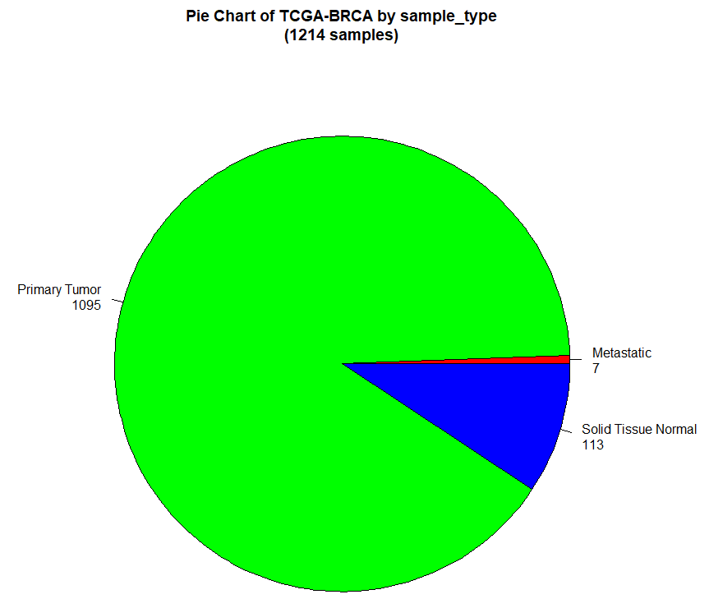
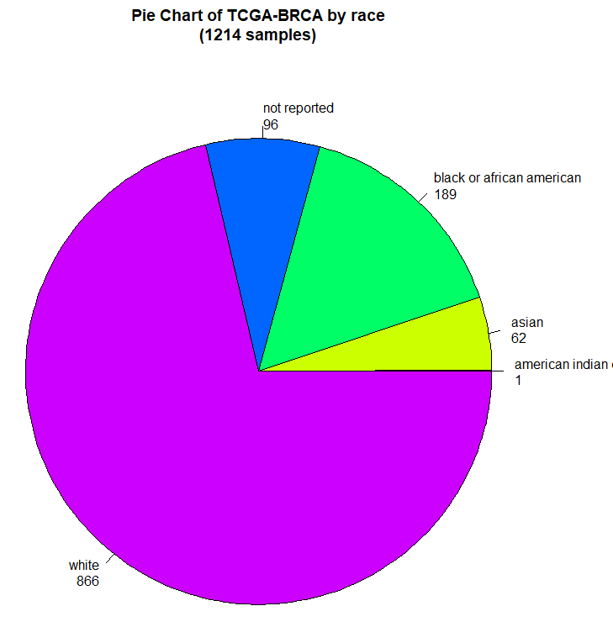
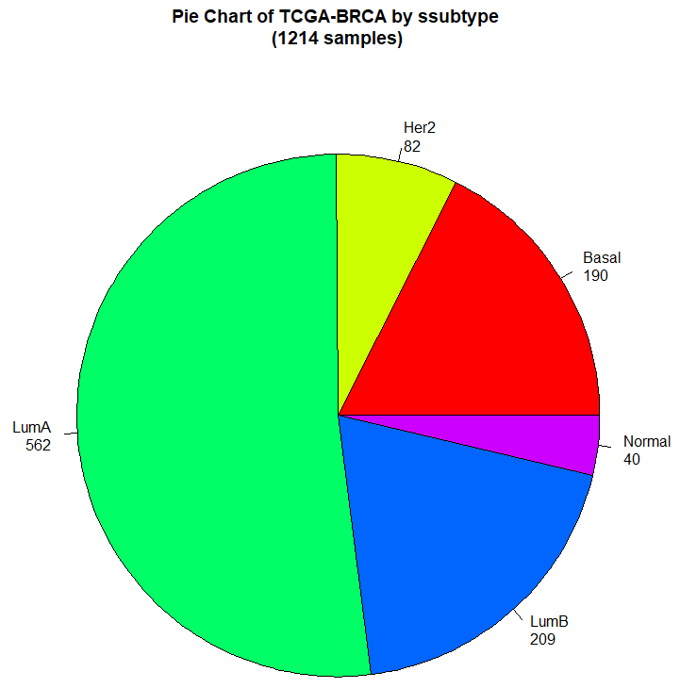
BRCA TCGA Project (1215 samples, 19,947 7genes)
Notes:
Gupta 2018 table (left)
https://www.ncbi.nlm.nih.gov/pmc/articles/PMC5842180/table/Tab4/?report=objectonly
Biological importance of differentially expressed genes
Ping et al 2020
https://academic.oup.com/carcin/article/41/7/887/5817819

Slide 6
Dataset
 | White | Black or African American
PAM50 Class
LumA | 46 | 24
LumB | 17 | 17
Her2 | 3 | 7
Basal | 13 | 26
Normal
Sample Types
Solid Tissue Normal | 80 | 80
Metastatic | 0 | 0
Primary Tumor | 0 | 0
160 samples
1900 genes
RNAseq
Gene expression quantification
illuminA platform
Notes:
Gupta 2018 table (left)
https://www.ncbi.nlm.nih.gov/pmc/articles/PMC5842180/table/Tab4/?report=objectonly
Biological importance of differentially expressed genes
Ping et al 2020
https://academic.oup.com/carcin/article/41/7/887/5817819

Slide 7
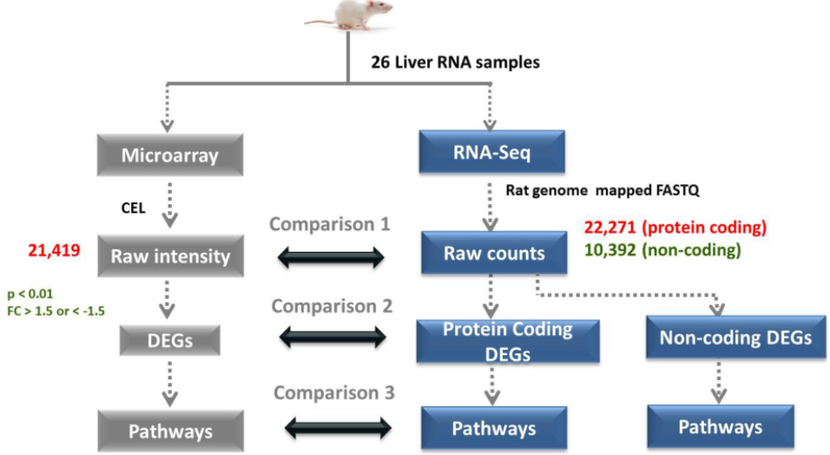
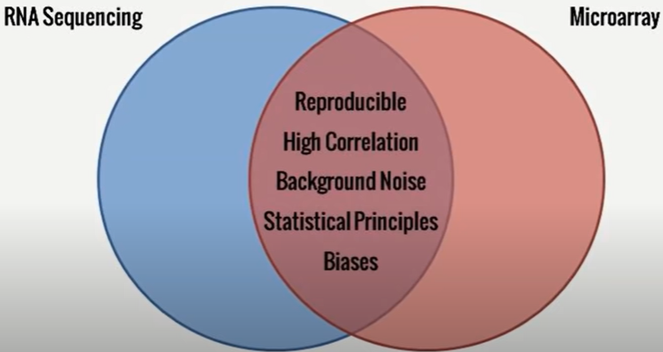
RNAseq vs. microarray
RNAseq
Includes full sequencing of the whole transcriptome
Quantifies discrete digital read counts aligned to a particular sequence
Can find gene fusion, alternative splicing events, and novel genes
Microarray
Only profiles predefined transcripts/genes through hybridization on a chip
Can’t detect isoforms or structural variations
More affordable
Not an absolute quantification method, only relative expression levels
Notes:
Gupta 2018 table (left)
https://www.ncbi.nlm.nih.gov/pmc/articles/PMC5842180/table/Tab4/?report=objectonly
Biological importance of differentially expressed genes
Ping et al 2020
https://academic.oup.com/carcin/article/41/7/887/5817819

Slide 8
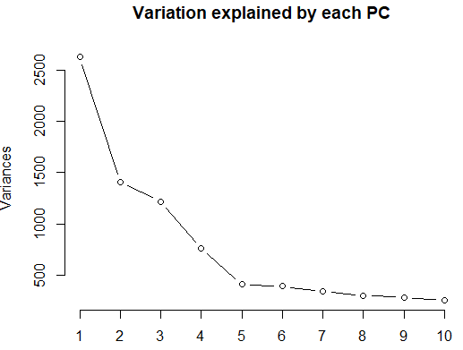
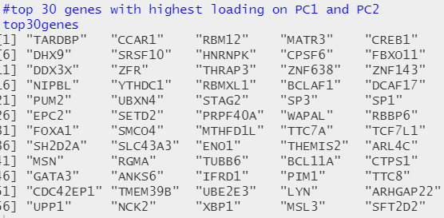
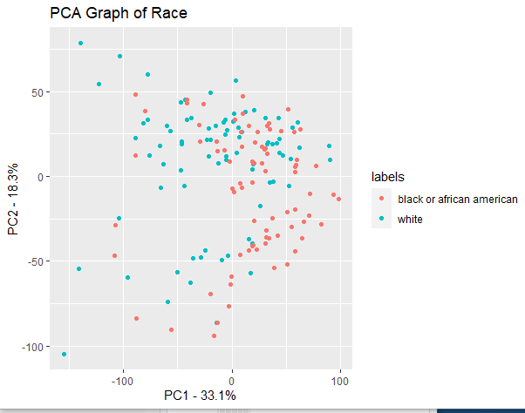
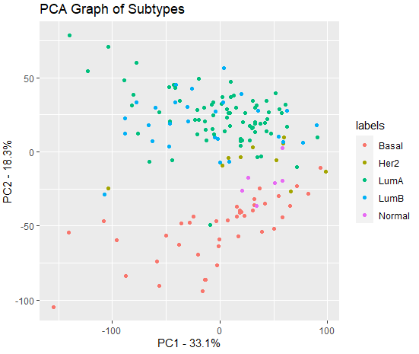
PCA by race and subtype (80 samples)
pc <- prcomp(d , scale=TRUE, center=TRUE)
Cols=function (vec ){cols=rainbow (length (unique (vec )))
return (cols[as.numeric (as.factor (vec))])}
plot(pc$x[,1:2], col = Cols(labs), pch =19, xlab ="PC1",ylab="PC2")
Notes:
Gupta 2018 table (left)
https://www.ncbi.nlm.nih.gov/pmc/articles/PMC5842180/table/Tab4/?report=objectonly
Biological importance of differentially expressed genes
Ping et al 2020
https://academic.oup.com/carcin/article/41/7/887/5817819

Slide 9
Differential expression in R
Limma, DESeq and edgeR are three methods and R packages for analyzing quantitative readouts from high-throughput experiments such as RNA-seq
Methods used to analyze array-based data assume a normally distributed, continuous response variable.
However, response variables for digital methods like RNA-seq are discrete counts. Thus, both DESeq and edgeR transformation methods are based on the negative binomial distribution whereas Limma uses a linear model.
DESeq and EdgeR assume that no genes are differentially expressed. DESeq uses a "geometric" normalisation strategy, whereas EdgeR is a weighted mean of log ratios-based method. Both normalise data initially via the calculation of size / normalisation factors.
Limma /is different in that it normalises via the very successful (for microarrays) quantile nomalisation, where an attempt is made to match gene count distributions across samples in your dataset. It can somewhat loosely be viewed as scaling each sample's values to be between the min and max values (across all samples). Thus, the final distributions will be similar.
Notes:
Gupta 2018 table (left)
https://www.ncbi.nlm.nih.gov/pmc/articles/PMC5842180/table/Tab4/?report=objectonly
Biological importance of differentially expressed genes
Ping et al 2020
https://academic.oup.com/carcin/article/41/7/887/5817819

Slide 10
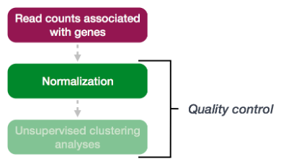
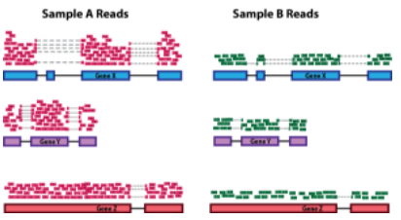
Normalization in Deseq
First step: Count normalization
Counts are proportional to the expression of RNA (“interesting”) in addition to many other factors (“uninteresting”) such as:
Sequencing depth
Gene length (not accounted for)
RNA composition
Normalization scales the raw count values to account for the “uninteresting” factors, so the expression levels are more comparable between and/or within samples.
Notes:
Gupta 2018 table (left)
https://www.ncbi.nlm.nih.gov/pmc/articles/PMC5842180/table/Tab4/?report=objectonly
Biological importance of differentially expressed genes
Ping et al 2020
https://academic.oup.com/carcin/article/41/7/887/5817819

Slide 11
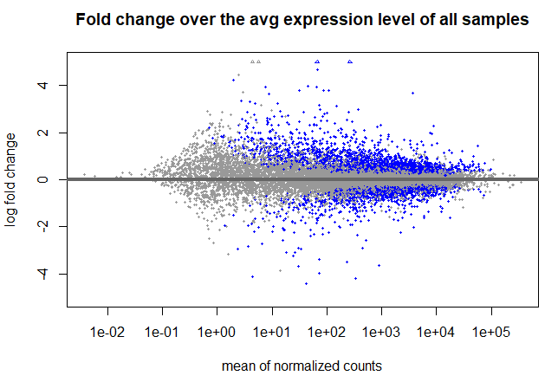
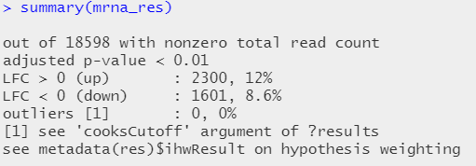
DE by Race
Shows the log2 Fold Change with shrinkage over the mean of normalized counts for all samples. Shrinkage on an MAplot helps reduce the effect of lowly expressed genes with high variability.
dds <- DESeqDataSetFromMatrix(countData = cts, colData = coldata, design= ~ batch + condition) dds <- DESeq(dds) resultsNames(dds)
# lists the coefficients res <- results(dds, name="condition_white_v_black")
# or to shrink log fold changes association with condition: res <- lfcShrink(dds, coef="condition_trt_vs_untrt", type="apeglm")
Highlighted in blue are genes which has an adjusted p-values less than 0.1
Notes:
Gupta 2018 table (left)
https://www.ncbi.nlm.nih.gov/pmc/articles/PMC5842180/table/Tab4/?report=objectonly
Biological importance of differentially expressed genes
Ping et al 2020
https://academic.oup.com/carcin/article/41/7/887/5817819

Slide 12
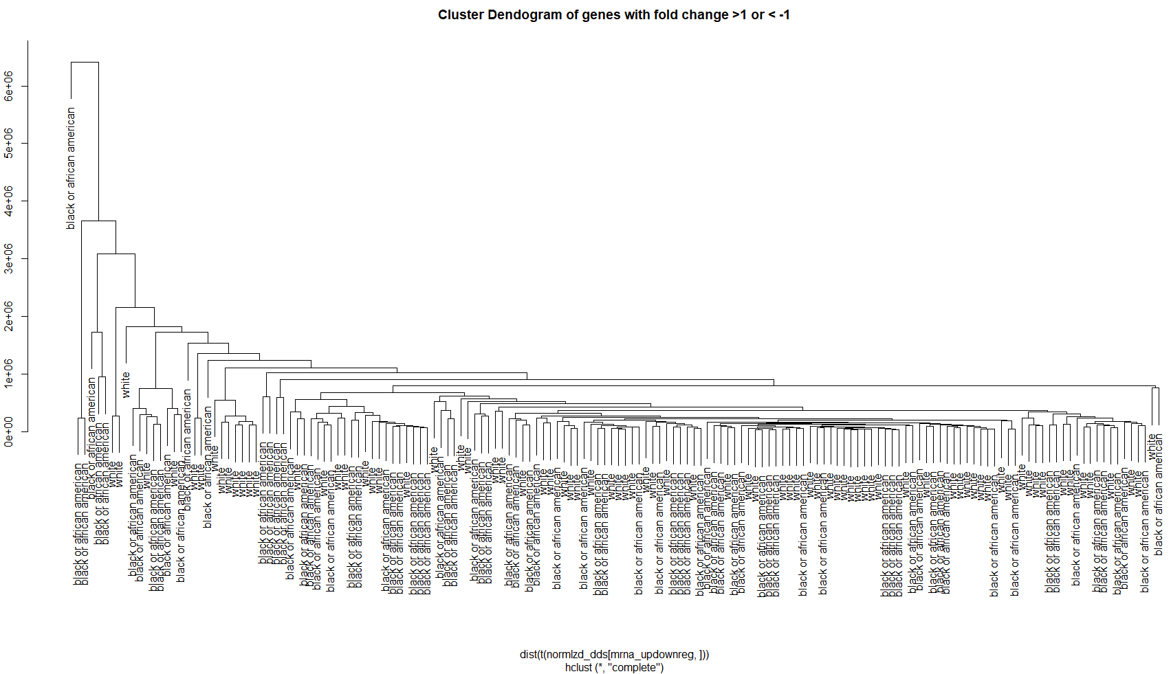
DE Clustering by Race
Complete linkage clustering based on Euclidean distances of 700 upregulated and 200 downregulated genes
Notes:
Gupta 2018 table (left)
https://www.ncbi.nlm.nih.gov/pmc/articles/PMC5842180/table/Tab4/?report=objectonly
Biological importance of differentially expressed genes
Ping et al 2020
https://academic.oup.com/carcin/article/41/7/887/5817819

Slide 13
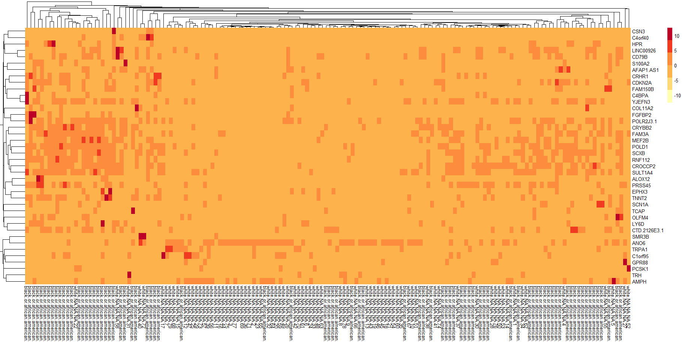
DE Heatmap by Race
Heatmap of 30 genes sorted by lowest pvalues
Notes:
Gupta 2018 table (left)
https://www.ncbi.nlm.nih.gov/pmc/articles/PMC5842180/table/Tab4/?report=objectonly
Biological importance of differentially expressed genes
Ping et al 2020
https://academic.oup.com/carcin/article/41/7/887/5817819

Slide 14
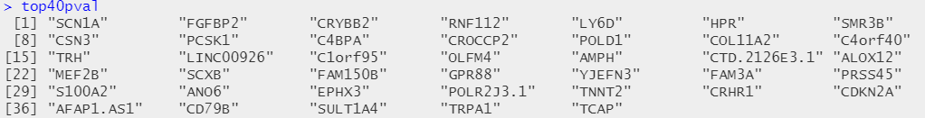
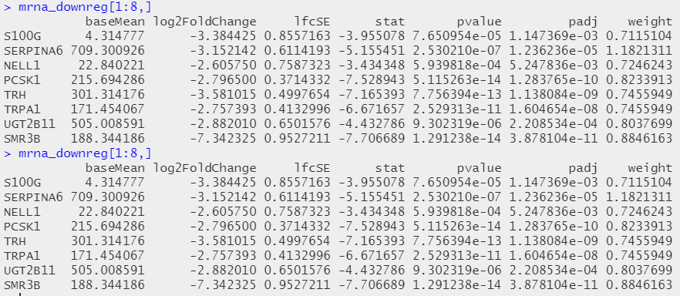
Significant Genes from DE
40 genes with the lowest pvalues:
resSort <- mrna_res[order(mrna_res$pvalue),]
16 genes with fold change > 2.5 or < -2.5 and adjusted pvalue of 0.01
rownames(df)[which(df$log2FoldChange>=2.5)],rownames(df)[which(df$padj<=0.01)]
Notes:
Gupta 2018 table (left)
https://www.ncbi.nlm.nih.gov/pmc/articles/PMC5842180/table/Tab4/?report=objectonly
Biological importance of differentially expressed genes
Ping et al 2020
https://academic.oup.com/carcin/article/41/7/887/5817819

Slide 15
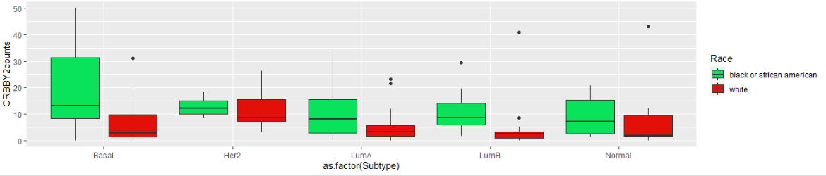
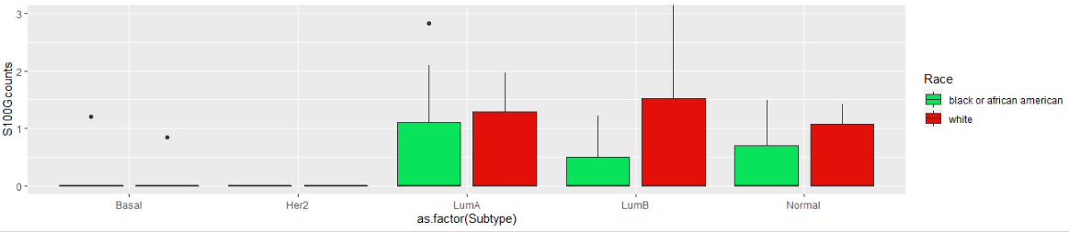
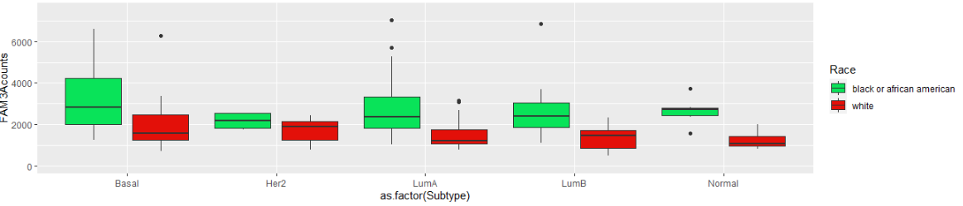
Possible biomarkers to differentiate race by subtype: CRYBB2, S100G, AND FAM3A

Slide 16
Next steps..
Subset data to include metastatic cancers
Run clustering using the PAM50 gene list to confirm subtypes
Normalize data in a different way to better visualize heatmap and boxplot
Adjust for age subtype and pre/post menopausal status

Slide 17
references..
Gupta, Vijayalaxmi et al. “Racial disparity in breast cancer: can it be mattered for prognosis and therapy.” Journal of cell communication and signaling vol. 12,1 (2018): 119-132. PMID: 29188479
Jie Ping, Xingyi Guo, Fei Ye, Jirong Long, Loren Lipworth, Qiuyin Cai, William Blot, Xiao-Ou Shu, Wei Zheng, Differences in gene-expression profiles in breast cancer between African and European-ancestry women, Carcinogenesis, Volume 41, Issue 7, July 2020
Deseq package: https://avikarn.com/2020-07-02-RNAseq_DeSeq2/
Huo, Dezheng et al. “Comparison of Breast Cancer Molecular Features and Survival by African and European Ancestry in The Cancer Genome Atlas.” JAMA oncology vol. 3,12 (2017): 1654-1662. doi:10.1001/jamaoncol.2017.0595

