Slide 1
RCA Signal Detection
Early Detection Through Multiple Customer Signals
RCA Overview

Slide 2
RCA Overview
A multi-signal framework for proactive issue identification
OBJECTIVE
Develop a multi-signal detection framework to proactively identify emerging customer issues before they develop into broader concerns.
Combine multiple independent signals to provide stronger evidence for further investigation.
FRAMEWORK
01
02
03
04
Customer Signals
Historical Baseline
Outlier Detection
LLM Topic Analysis
Derive multiple signals from customer interactions.
Establish a 13-month baseline for each signal.
Identify unusual and sustained changes.
Identify detailed topics and themes for investigation.
Multiple signals provide stronger evidence for investigation than any single indicator.
02

Slide 3
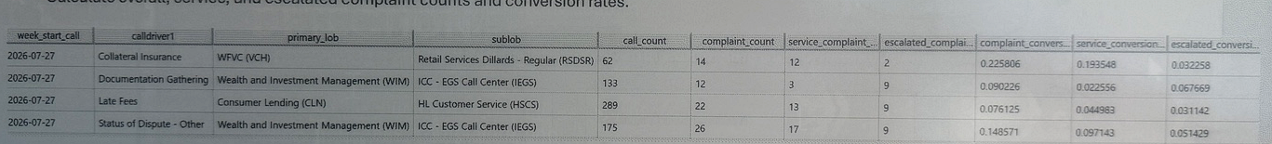
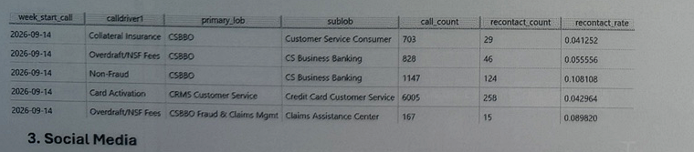
Key Signals
Three complementary views of customer friction and emerging issues
01 Call-to-Complaint Conversion Rate
Measures how frequently calls result in complaints; tracks overall, service, and escalated complaint counts and conversion rates.
02 Recontact Rate
Measures repeat contacts following an initial interaction. Recontact Rate = Recontact Calls / Total Calls
03 Social Media
Sprinklr data across X, Facebook, Instagram, TikTok and Bluesky. Highly noisy and subjective, with limited actionable issue information; best suited as a corroborating signal rather than a standalone signal.
03

Slide 4
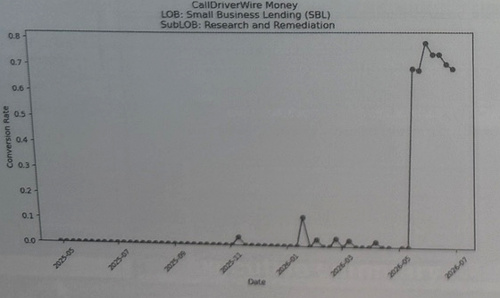
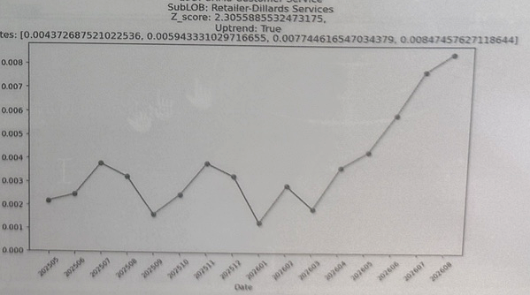
Outlier Detection
Establish a 13-month baseline for each signal and compare current performance against historical patterns.
01 Z-Score · Point Anomaly Detection
02 Upward Trend · Sustained Change Detection
Compares current conversion rate with historical mean and variability.
Useful for detecting sudden spikes or abrupt changes.
Evaluates whether rates show a consistent upward pattern.
Complements Z-score by identifying gradual but persistent increases.
Z-score: Is the current rate unusual? | Trend: Is the issue consistently worsening?
04

Slide 5
Data Challenges
Key considerations for consistent measurement across data sources
01 LOB Mapping
Call and complaint data use different business taxonomies.
Call-side Virtual Queues require mapping to standardized LOB / Sub-LOB classifications.
02 Interaction ID Standardization
Interaction identifiers changed during migration from the legacy call platform to the new system.
Historical calls primarily use CONNID, while newer interactions may use Global ID.
A hierarchical matching approach maintains consistent historical coverage across the migration period.
Impact: consistent historical baselines and more reliable cross-signal comparisons.
05

