Slide 1
PAYDAY
Andrew Rutherford
Sheehan Toufiq
Ben Byrd
Justin Patel
Suraj Sequira

Slide 2
Updates
We removed multiple redundant RTM entries and simplified the program requirements.
We developed user interaction diagrams that show a conceptual/graphical representation of the use case flow chart.
Removed Employee view function of their clock-in/out times.
Technical Writer: Produces technical documents for the project.

Slide 3
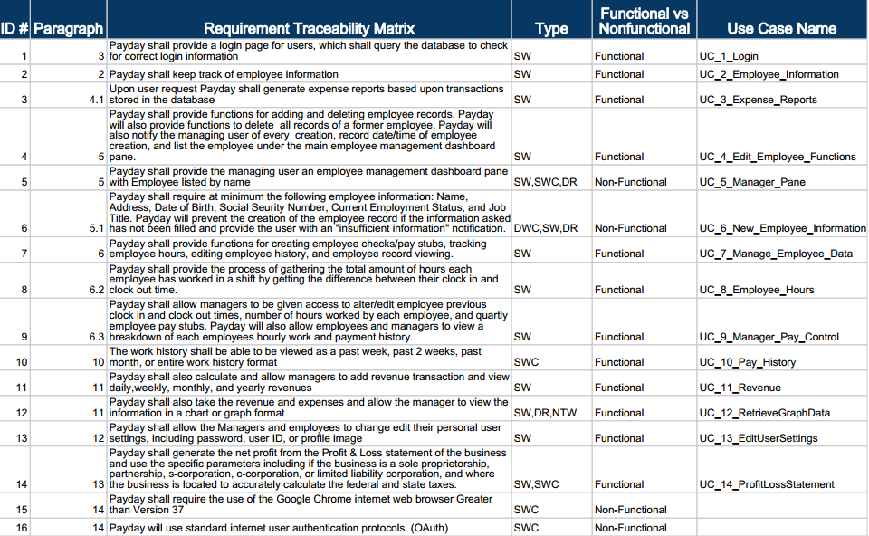

Slide 4
Use Cases
UC_1_Login
UC_4_Edit_Employee_Functions
UC_7_Manage_Employee_Data
UC_11_Revenue
UC_13_Edit_User_Settings

Slide 5
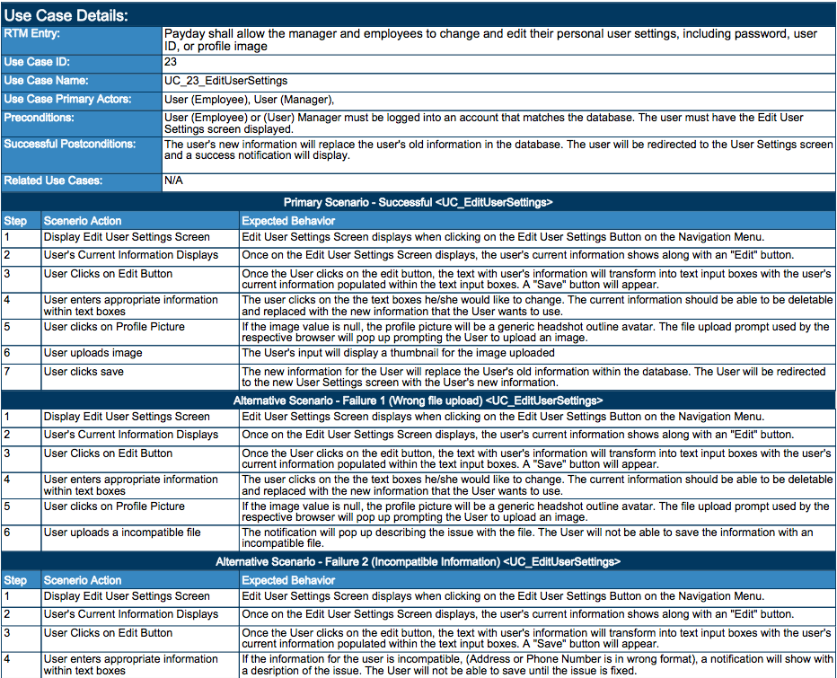

Slide 7
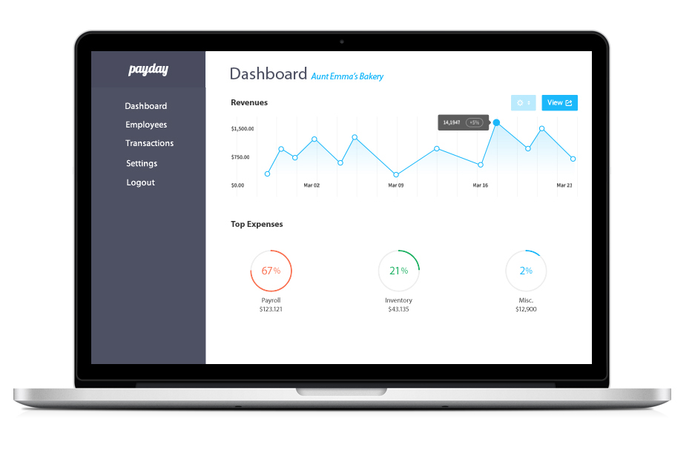

Slide 8
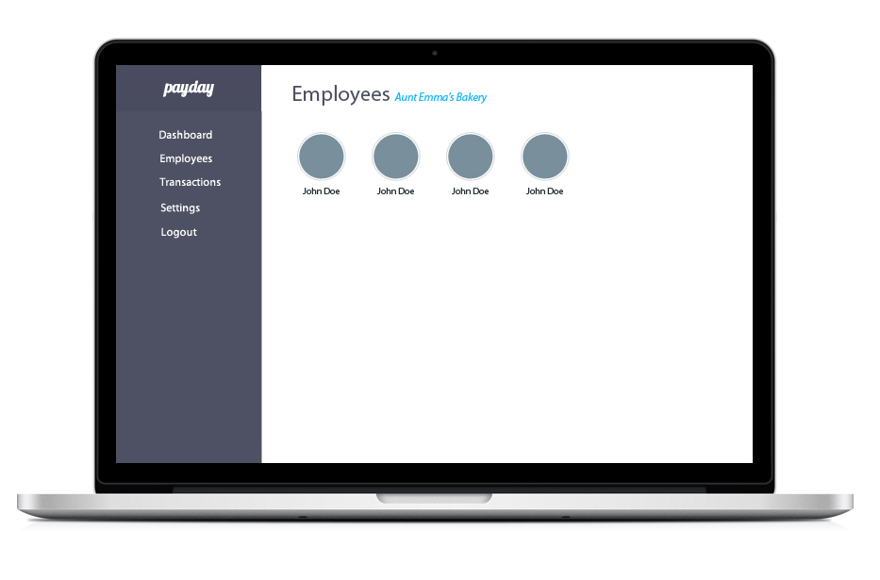

Slide 9
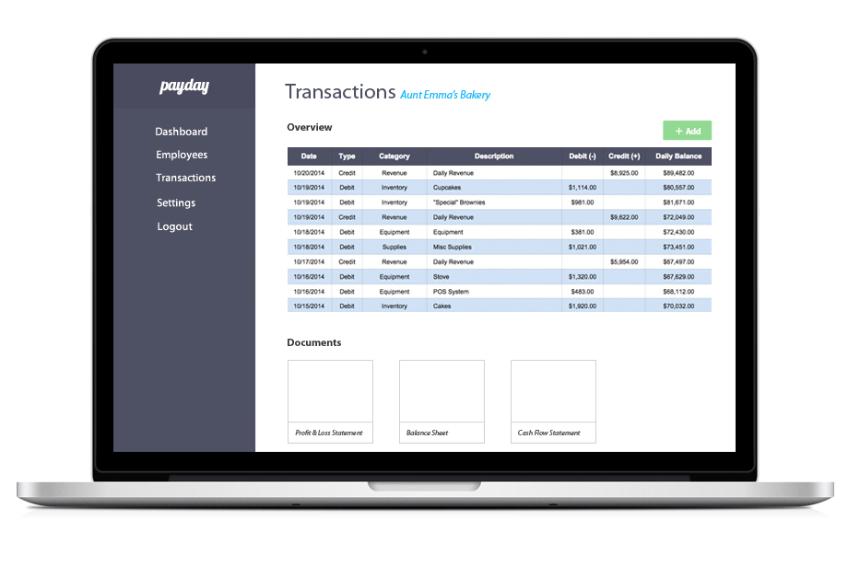

Slide 10
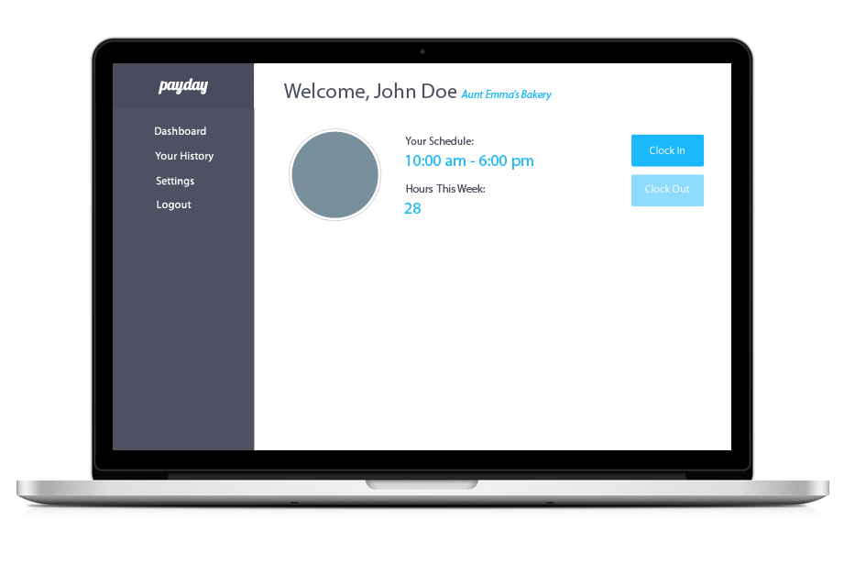

Slide 11
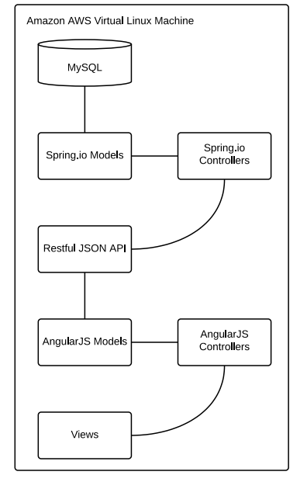
Tech Stack

Slide 12
